Slide 1
Developing SharePoint Workflows
Notes:
SharePoint 2013 dramatically changes the workflow architecture in the latest release. SharePoint 2013 Workflow is now handled by Workflow Managers, both in on-premises and hosted deployments. In this module students will learn how to create custom workflows using SharePoint Designer 2013 and Visual Studio 2013 as well as some of the new capabilities introduced in SharePoint 2013 workflows: dynamic values, stages and remote web service calls.

Slide 2
Agenda
Introduction to SharePoint Workflow
Creating Custom Workflows
Workflow Template Types
Developing Workflows with Visual Studio
Programming Workflows using CSOM

Slide 3
Motivation for SharePoint Workflow
Automate business processes (e.g. document approval)
Initiate and monitor long running processes
Apps can leverage using SharePoint UX concepts in custom solutions such as history lists, task lists & forms
Notes:
Most businesses have repeatable processes they use in their organization
Many of these processes can automate these using a customizable workflow engine
Developers can leverage this same platform in custom applications
Client-side apps can use this to
Protect business logic & IP
Execute long running processes
Automate processes that are well integrated with SharePoint’s UX
History list
Task list
Forms

Slide 4
What is SharePoint Workflow?
Strategy used to automate business process
  Introduced in SharePoint 2007
  Changed slightly in SharePoint 2010
  Completely redesigned in SharePoint 2013
SharePoint 2013 supports two workflow platforms
  SharePoint 2010 Workflow
  SharePoint 2013 Workflow
Notes:
Workflow is used to automate business process that typically involve some sort of human or external system interaction
Workflow was introduced in SharePoint 2007 and updated in 2010
In SharePoint 2013 Microsoft made significant changes to the Workflow story
.NET WF engine used in SharePoint 2010 still present for backcompat
SP 2013 “outsourced” WF processing & management to new product: workflow manager
Workflow works same way, with full parity between on-prem & office 365

Slide 5
Understanding Workflow Manager
Workflow Manager runs outside of SharePoint
  You need workflow farm in addition to SharePoint farm
  Loose connection created between farms
  Communications based on REST calls between farms
  SharePoint calls Workflow Manager to start workflow
  Workflow Manager handles all workflow processing
SharePoint 2013 Farm
Workflow Manager Farm
REST Calls
REST Calls
Workflow processing

Slide 6
Agenda
Introduction to SharePoint Workflow
Creating Custom Workflows
Workflow Template Types
Developing Workflows with Visual Studio
Programming Workflows using CSOM

Slide 7
SharePoint Workflow Actors
Workflow Template
  WF Program and optionally workflow input forms
  A feature to install it inside WSS farm
Workflow Association
  Binding of workflow template to list or content type
  A named instance containing parameterized data
Workflow Instance
  A running instance of a WF program
  Attached to an item
Notes:
A workflow template defines the workflow stages, activities and forms. Once the template is bound to a list, library or content type it is named and can be parameterized based on the columns in the list or content type. When a user starts a workflow the workflow instance is created, a single running “version” of the associated workflow. It is important to understand the distinction between these different concepts.

Slide 8
SharePoint Designer 2013
Improved visual designer
  Integrated the Visio designer into SharePoint Designer
    Visio installation required for visual designer
  Can switch between visual designer & text-style
  Activity properties editable in visual designer
Support for Stages & Loops
Support for calling Web Services
Workflow designer supports Office operations:
  cut / copy / paste / undo / redo / select-all
Improved email editor (rich formatting)

Slide 9
Creating Custom SharePoint 2013 Workflows

Slide 10
SharePoint Designer Limitations
Audience: power users / end users
Real-time workflow dev in production (yikes)
Developers should keep in mind…
  No debugging
  Can’t connect to AppWeb’s
  Can’t package workflows
  Can’t create apps
  Can’t create state machine workflows
  Limited support for workflow forms

Slide 11
Visual Studio
Supports packaging workflows into:
  Farm solutions
  Sandboxed solutions
  SharePoint apps
Rich debugging support
Full support for creating custom workflow forms

Slide 12
Activities versus Actions
Perspective when using SharePoint Designer
  Workflow is created by adding actions and conditions
Perspective when using Visual Studio
  Workflow is created by adding activities
Activity is a reusable single unit of work
  Some activities can contain child activities
  Developers use activities from Workflow Foundation, Workflow Manager & SharePoint

Slide 13
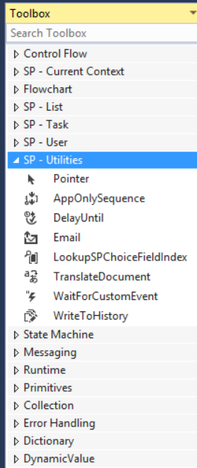
Workflow Activities in Visual Studio
SharePoint 2013 Specific Activities
  List Activities
  Task Activities
  User Activities
  Utility Activities
More activities available from…
  Workflow Foundation 4.5 Activities
  Workflow Manager 1.0 Activities

Slide 14
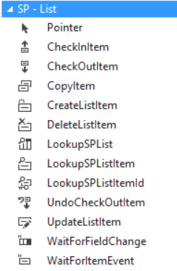
SharePoint List Activities

Slide 15
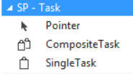
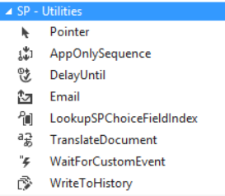
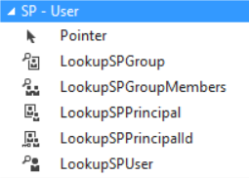
More SharePoint Activities

Slide 16
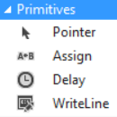
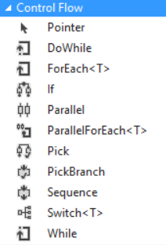
Workflow Foundation 4.5 Activities

Slide 17
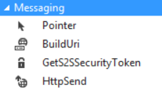
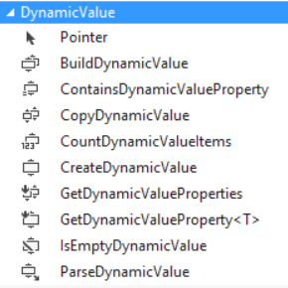
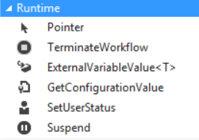
Workflow Manager Activities

Slide 18
Agenda
Introduction to SharePoint Workflow
Creating Custom Workflows
Workflow Template Types
Developing Workflows with Visual Studio
Programming Workflows using CSOM

Slide 19
Three Types of Workflow Supported
Sequential
  Workflows have a prescribed linear path to follow
  May or may not have loops & branches
Flowchart
  Container activity for FlowDecision and FlowSwitch
State machine
  Define different states of the business process
  Define how you transition between states

Slide 20
Sequential Workflow Pros & Cons
Pros (advantages)
  Simple to create
  Easily modeled using Visio
  Ideal for predetermined, ordered tasks that have a more systematic behavior
Cons (disadvantages)
  Limited in how complex they can get
  Not ideal for event driven, flexible or reactive processes

Slide 21
Flowchart Workflows
Flowchart
  Container activity for FlowDecision & FlowSwitch activities
FlowDecision
  Similar to a “If” statement – condition evaluates to TRUE or FALSE
FlowSwitch
  Similar to a nested “If” or a “switch” statement in C#
  Multiple options based on a condition
Keep in mind that Flowchart workflows can live within sequential or state machine workflows… and even other flowchart workflows!

Slide 22
Flowchart Workflow Pros & Cons
Pros (advantages)
  Adds flexibility for modeling decision processes
  Adds decision making modeling of a process without using loops of loops
Cons (disadvantages)
  Not ideal for event driven, flexible or more reactive behaviors

Slide 23
State Machine Workflow Components
State Machine Activity
  Top-level activity
State Activity
  With entry activity and exit activity
Final State Activity
  With exit activity
Transition
  Includes Trigger, Condition and Action

Slide 24
State Machine Workflow Pros & Cons
Pros (advantages)
  Much more flexible than other models
  Allows modeling real world business process
  Ideal when there’s human interaction
Cons (disadvantages)
  Can get complex quickly
  Can be tedious to troubleshooting and debug
  Not ideal for ordered steps

Slide 25
Agenda
Introduction to SharePoint Workflow
Creating Custom Workflows
Workflow Template Types
Developing Workflows with Visual Studio
Programming Workflows using CSOM

Slide 26
Workflows & Web Services
Use to replace custom business logic within workflows
Request or post data to web service
Processing of complex JSON responses
DynamicValue: New Object Type
  Supports hierarchical structures
  Supports child objects
  Extract to another dynamic value variable
Most SharePoint activities leverage this capability

Slide 27
Custom Web Services for Workflows
Recommended: Create OData Services
  WCF Data Services 5.*+
  OData services
  REST service
Securing Options
  Basic Authentication
  OAuth2

Slide 28
Sequential Workflows & Updating List Data With Web Services
demo

Slide 29
Creating Custom Tasks
All OOTB tasks based on the content type - Workflow Task (SharePoint 2013)
Custom Tasks in SharePoint 2013
  Create custom content type
  Don’t create custom form
  In task activities, specify your content type

Slide 30
Task Content Type
Name:
  Workflow Task (SharePoint 2013)
ID:
  0x0108003365C4474CAE8C42BCE396314E88E51F
Adds two fields:
  Task Outcome – Approve / Reject
  Workflow instance ID

Slide 31
Workflow Services CSOM / JSOM
Available in both CSOM & JSOM
Comprised of 5 components / services
  Workflow Service Manager
  Deployment Service
  Subscription Service
  Instance Service
  Interop Service
Makes association & initiation forms possible

Slide 32
Workflow Forms in SharePoint 2013
All forms are ASP.NET / HTML pages
Deployed using SharePoint solutions or SharePoint apps
Forms communicate with SharePoint via CSOM
Visual Studio includes templates for association
and initiation forms
No custom task forms – use custom task content types & CSR for customized presentation

Slide 33
Association Forms
Shown after the SharePoint association form
Responsible for creating workflow history & task list (if indicated) & the workflow association
Common Uses:
  Collecting configuration information
  Collecting default values in initiation forms

Slide 34
Initiation Forms
Shown when a workflow is manually started
Auto-start workflows skip the initiation form
Common uses:
  Collect workflow instance-specific configuration data
  Collect special messages to Include in tasks / email notifications

Slide 35
State Machines, Forms & Tasks

Slide 36
Summary
Introduction to SharePoint Workflow
Creating Custom Workflows
Workflow Template Types
Developing Workflows with Visual Studio

