Slide 1
Working with Access Services 2013
Notes:
In this module you will learn about the features of Access Services in SharePoint 2013. Access Services in SharePoint 2013 is very different from the 2010 version. In this module you will learn what is new and how you can use Access Services in SharePoint 2013 to create business applications that are hosted by SharePoint 2013 and use the power of SQL Server for managing the data.

Slide 2
Agenda
A Brief History of Access
Access Services 2013 Architecture
Designing Access Apps
Packaging Apps for Redistribution

Slide 3
Where is Your Data?
On paper
MS Word documents
MS Excel spreadsheets
RDMS systems
Mainframes
Cloud
All of the above
Laptops
Thumb drives
Servers
Whiteboards

Slide 4
Access Desktop vs. Access Services
Classic Access – a desktop applications
20 years old – industry has a wealth of Access talent
Must be deployed to a client computer
Access Services 2010
Introduced in SharePoint 2010
Support in SharePoint 2013
Content stored using SharePoint lists
Access Services 2013
Completely different than Access Services 2010
Content stored using SQL Server tables
Notes:
Access on the desktop has been around for many years. In SharePoint 2010 Microsoft introduced Access Services which enable the publication of Access Services databases to SharePoint. This process essentially converted an Access Database to a series to SharePoint lists. Access Services (2010) is still supported in SharePoint 2013 for legacy applications, but the new Access Services in SharePoint 2013 is significantly different than the 2010 version.
Access Services in SharePoint 2013 creates a Access App that is bound to a SharePoint Site. The app creates a SQL database specifically for the App that houses all of the tables, views and macros created by the app author (you). The result is a more robust application that can be managed by your IT department and backed up and restored with standard SQL tools. Apps can even be packaged for redistribution as SharePoint Apps.

Slide 5
Access client vs. collaboration via the web
Desktop Client
Rich functionality
VBA
Ecosystem
Supported 2013
Web
Easy sharing
No code
Latest technology
New functionality
Notes:
The Access Desktop application offers rich functionality that you will not find on the web. Being a client application designed for the desktop it supports extensibility through Visual Basic for Applications (VBA) and has a vast community following with knowledge experts (sound like SharePoint?). The current release of Access is 2013 and connections to SharePoint are supported.
Access Services Web Applications offer the ability to host an Access Services App associated with a SharePoint Team Site. This model supports simplified sharing of data. Apps are enhanced without the use of traditional coding techniques like VBA. You can connect to SharePoint list data and import data from other SQL sources.

Slide 6
What are the problems we are solving?
Unknown/uncontrolled data applications
Bad/broken end-user applications
Inefficient business processes
Backlog of IT requests
No data access control/backup
Difficult application sharing
Lack of upgrade path
Notes:
The whole point of Access Services is to centralize islands of data. Make them more stable and improve the sharing of the data, while decreasing the overhead for IT. By managing these databases in Access Services IT can manage the backend operation ensuring that data is recoverable while decreasing the work for traditional development staff for standard patterns of applications.

Slide 7
Advantages of Access Services
Centralize data/administration/security
End-user created
Professional interface
Usage monitoring
App Store
Upgrade path
Notes:
Not only does Access Services empower the end user and make IT’s job easier for these simple applications, but Access Services produces very attractive “modern” looking apps that are cross-browser capable. The rich controls are fun to use and promote productivity. Apps can be packaged and added to the App Store (even for corporations looking to manage the app centrally). Apps can even be upgraded when the time comes to add fields and views.

Slide 8
Agenda
A Brief History of Access
Access Services 2013 Architecture
Designing Access Apps
Packaging Apps for Redistribution

Slide 9
Access Services Architecture
SharePoint 2013
SQL Server 2012
Browser
Browser
Web app 1
Browser
runtime
Web app 2
design
Access IDE
Web app 3
…
Notes:
Access Apps are created with the Access 2013 client. They are used in a browser.
In an on-premise environment, Access 2013 apps are hosted by SharePoint 2013 while the data is stored in SQL Server 2012. SharePoint 2013 the security for Access 2013 apps. The SQL tables, views, macros, and queries are stored in a SQL Server 2012 database. In SharePoint Online all of the setup and configuration for the storage of your Access Apps is handled for you by Office 365. The Database Tables are stored in SQL Azure and connected to your Access App with your Tennant ID.

Slide 10
Access Services uses New App Model
App Model created for SharePoint developers
Access Services does developer work behind scenes
Simplified design experience
Pre-defined schema templates (nouns)
Automatic generation of navigation, forms and buttons
Simplified, code-free configuration and customization
Polished, professional results
Apps created with attractive, easy-to-use interface
Consistent user experience across all apps
Notes:
When a new Access application is created, Access Services in SharePoint Server 2013 creates a new Application database that stores the data, view, queries and macros contained in the app. The Access Services 2013 System database can be configured to create new Application databases on a separate SQL Server 2012 server. That is handled for you by IT on premise and by Microsoft in Office 365.
Using SQL Server 2012 to store data provides manageability and scalability previously unknown to Access applications. Now when you need to make you Access App available to many users you don’t need to redesigned and implement it in a more powerful environment.
Remember: An Access 2013 app is online the moment it’s created. You can decide to share the app with other users, deploy to the private corporate catalog, or deploy to the Office Store.

Slide 11




Access App Data Stored in SQL Server
Data stored in a real backend DBMS
Transparent to end user
Use common tools for reports and integration
Developers can use existing skills to customize
Future upgrade path
View and Edit Data
SharePoint
Advanced Reporting & Integration
Desktop Access Reports
Excel
Power View
Crystal Reports
Custom Websites (.NET, PHP, etc.)
Access Services
SQL Server
Database Design
Notes:
Unlike Access on the desktop, Access Apps are stored in a SQL database. The entire process is transparent to the end user. This means that you can now use reporting tools like Access, SSRS, and Excel to write reports against your Access App data.

Slide 12
Security Model
SharePoint
NT Auth
SQL server hosting Access apps
Access Data Services
Access App 1
SQL Auth 1
Access App 2
SQL Auth 2
Access App 3
SQL Auth 3
Access IDE
Access App 4
SQL Auth 4
Notes:
SharePoint handles the security for your app through the host site. Once the app is published you can invite users to participate by sharing the host site with them. Readers can view the data, Editors can change thee data, and Full Control empowers them to edit the Application in Access.

Slide 13
Agenda
A Brief History of Access
Access Services 2013 Architecture
Setup and Configuration
Designing Access Apps

Slide 14
Software Requirement
SharePoint 2013
SQL Server 2012
SQL Server
2008 R2 SP1
or 2012

Slide 15
Install Access pre-req components (cont.)
Microsoft SQL Server 2012 Transact-SQL ScriptDom (sqldom.msi)
Microsoft System CLR Types for Microsoft SQL Server 2012 (SQLSysClrTypes.msi)
Microsoft SQL Server 2012 Data-Tier Application Framework (DACFramework.msi)
Microsoft SQL Server 2012 Local DB (SQLLocalDB.msi)
Microsoft SQL Server 2012 Native Client (sqlncli.msi)

Slide 16
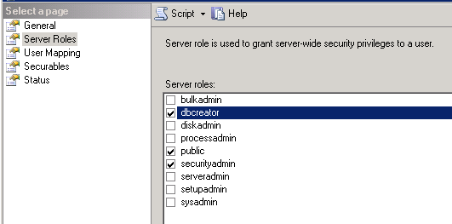
Install & Configure SQL Server 2012 (1)
Security Mode = Mixed Mode
Security uses SQL Server auth and Windows auth

Slide 17
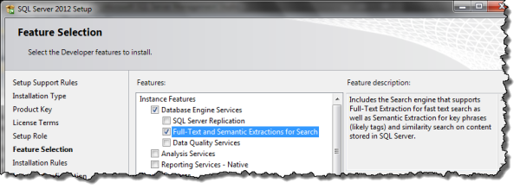
Configure SQL Server 2012 (2)
Turn on Full-text search

Slide 18
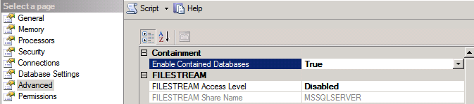
Install & Configure SQL Server 2012 (3)
Enable Contained Databases property

Slide 19
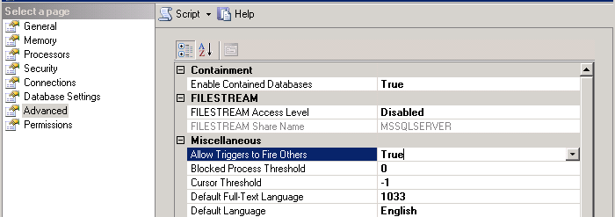
Install & Configure SQL Server 2012 (4)
Allow Triggers to Fire Others property

Slide 20
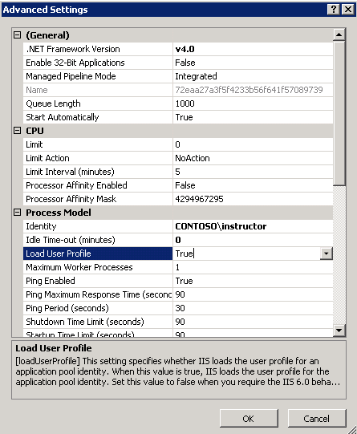
IIS Application Pool Load User Profile

Slide 21
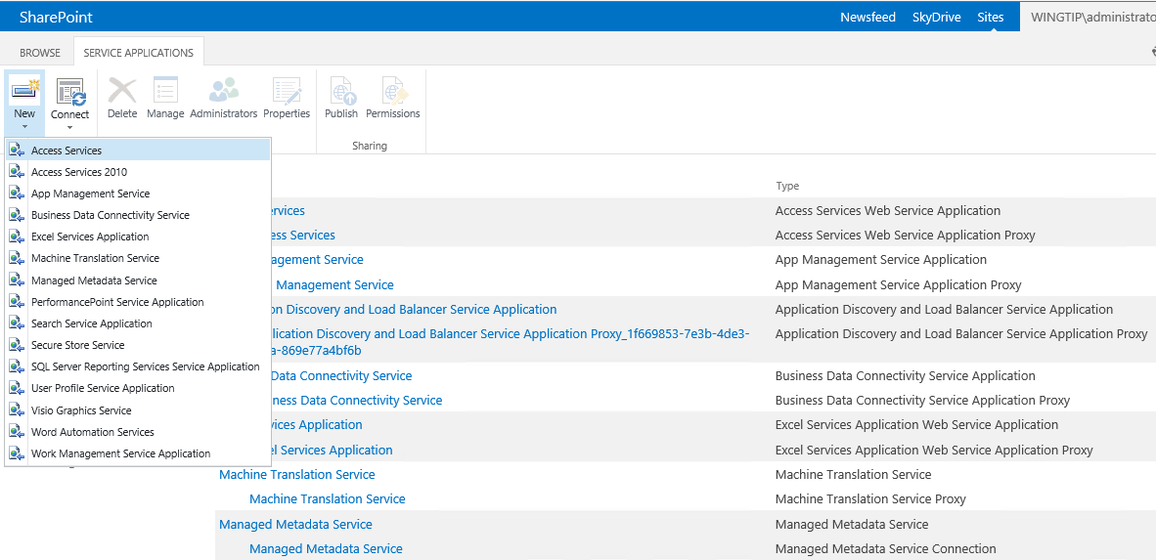
Enable Access Services on SharePoint

Slide 22
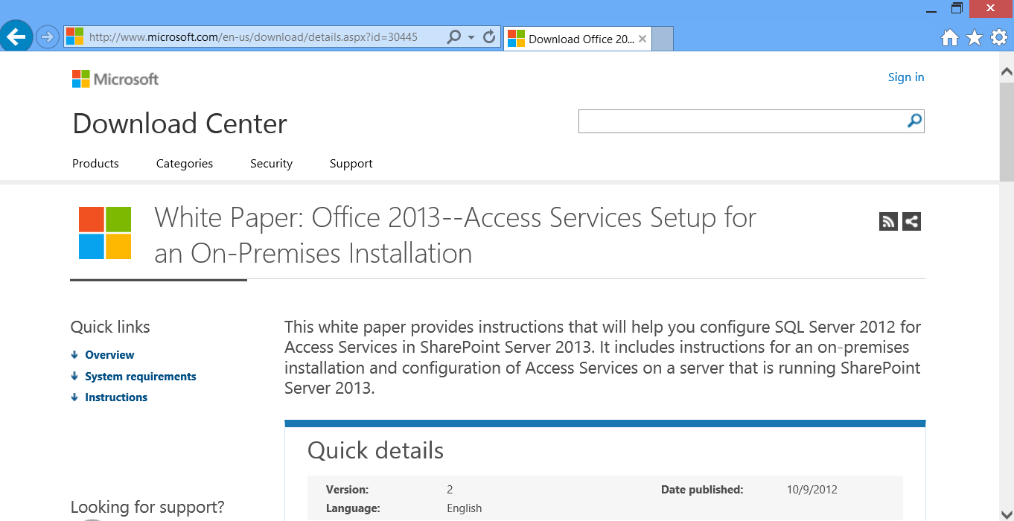
Resources for Setup/Configuration
Kirk Evans Blog
http://blogs.msdn.com/b/kaevans/archive/2012/08/30/configuring-access-services-2013-on-premises.aspx
Microsoft White Paper
http://www.microsoft.com/en-us/download/details.aspx?id=30445

Slide 23
Agenda
A Brief History of Access
Access Services 2013 Architecture
Designing Access Apps
Packaging Apps for Redistribution

Slide 24
Components of an Access App
Tables
Create New from Scratch or Templates
Import from external data (Access, Excel, SQL, etc.)
Link to SharePoint Lists
Views (“Forms” on Desktop)
Table Selector
View Selector
Macros
Data Macros (triggers)
UI Macros
Notes:
For tables, you can start from scratch or import tables from other data sources. You can also use one or more of our built in table templates and template groups. On the web we call “forms” Views. We use the term Views whenever we are talking about Access web apps. (They are forms in a sense, but we use the term views in this context.)
In the UI your users will learn to use the Table and View Selector to move between data entry and filtered views, much like moving from Lists and Libraries in SharePoint and their associated views.
Macros are split into two categories, data and UI. The UI macros run in the browser and can change the look and values on the user interface. Data macros run in SQL and are a very powerful way to manipulate data in your App. For example a data macro can be used to check values, update additional tables and maintain data integrity.

Slide 25
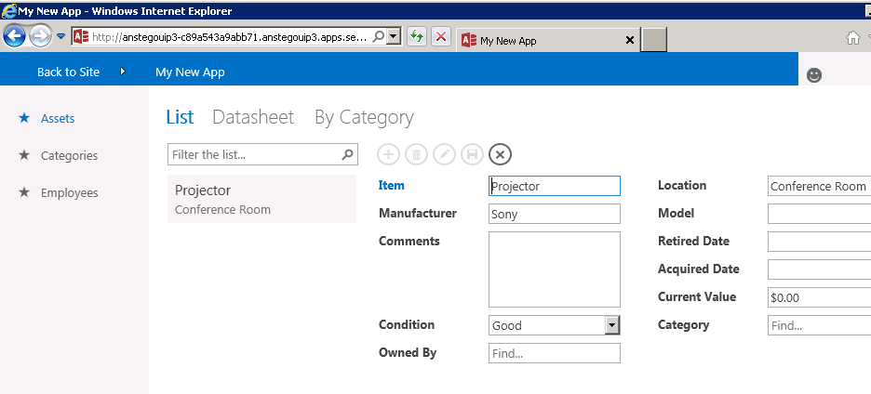
Polished, Professional User Interface
2. Choose view
1. Choose table
3. Search and filter
4. Add and edit items
Notes:
This screenshot show the different components of an Access App. Your users will choose a Table to work with, then the desired view of the data. Using the built in controls they can search and filter the data and then view, add, update and delete the data based on their permission level.

Slide 26
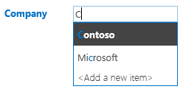
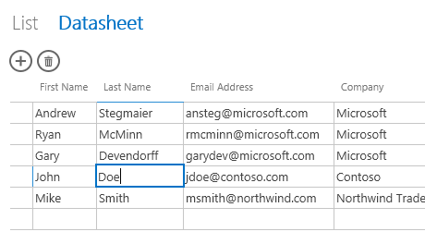

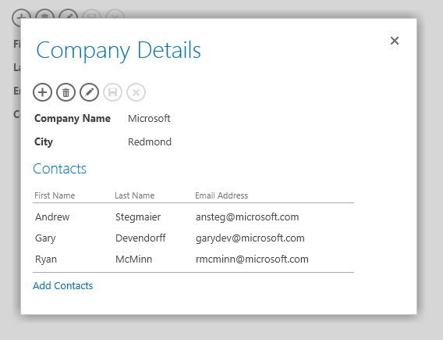
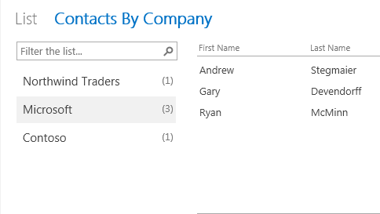
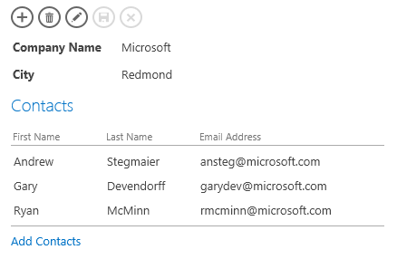

Access Services User Interface Elements
Autocomplete Control
Datasheet
Drill-Through Popups
Summary View
Related Items Control
Action Bar
Notes:
Out of the box, Access offer a wealth of controls for interacting with the data in your App.
Autocomplete
The autocomplete control performs a lookup on linked data. It also supports adding new items if the permissions allow.
Datasheet
The datasheet view in Access Services enables your users to work with data in a table like Excel, rather than one record at a time. The tabular format can be far more effective at handling large changes to data.
Drill-Through Popups
This popup control enables your users to edit records in context within a modal dialog.
Summary View
Displays a configurable view of summary data related to the currently selected record.
Related Items
Displays items related to the currently selected item in a table view. For example, Items for an order, or Contacts at a Company. You can also interact directly with the items from the control.
Action Bar
A configurable tool bar of actions that are bound to common commands but can also be modified to run Macros.

Slide 27
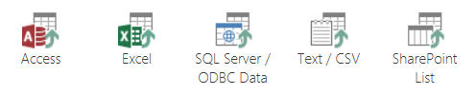
Importing Data
Import data from earlier version of Access
Just the data or the whole applications
Import data from Excel spreadsheets
Import data from Other sources
CSV files
ODBC Data
Import/Link Data from SharePoint lists
Notes:
Generally, data is imported into your Access App from other sources. Sources that can be imported include Access desktop databases, Excel, SQL and Text files. SharePoint lists can also be imported or linked. A linked list can be maintained in SharePoint and then linked (one way only) from SharePoint to Access. Linked lists are read only.
Once the data is imported into the App it resides in the App Database. You can open up the database to external access for Reporting and other data connections. With the database so opened you can create hybrid applications.

Slide 28
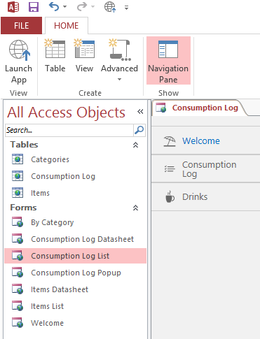
Navigation Pane
List objects in your Web App
Tables
Queries
Views (Forms)
Named Macros
Notes:
The navigation pane displays all of the objects in your Access App. This is not something your end users will ever see, but is a handy tool for managing your App.

Slide 29
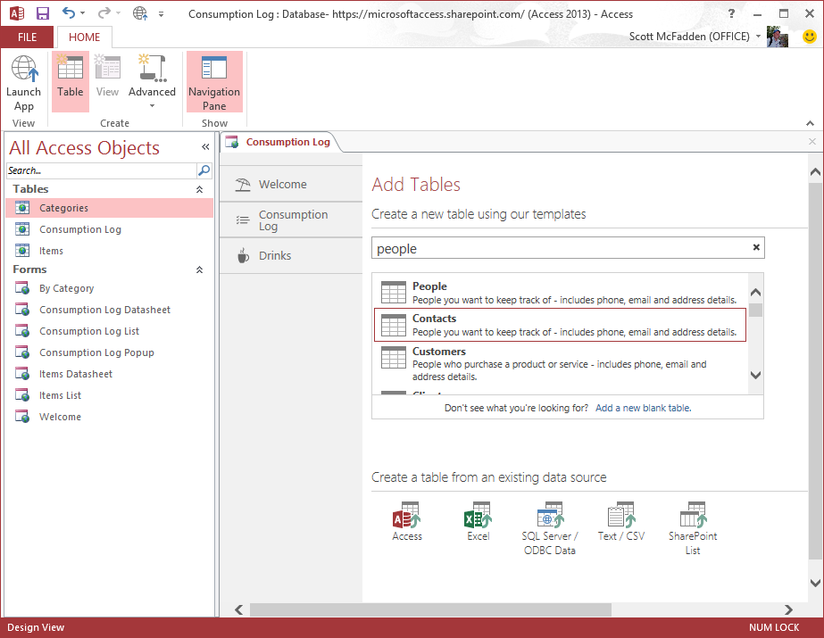
Creating Tables
Home→ Create→ Table
From templates
Blank table (from scratch)
From data source
Notes:
Access Services supports a wide variety of table templates. There is also an online gallery of applications for you to try different approaches of using Access Services. Using the wizard you can select the table or group of tables to build your App. The tables are created immediately and available for you to change and redesign as needed.

Slide 30
Creating an Access App

Slide 31
Linking to SharePoint Lists
What can you create?
Forms with lookups to SharePoint Lists
Limitations in the 2013 Release…
Read-Only
No Data Macro support
List must be in the same site collection
SharePoint Lists is the only supported data-linking source
Notes:
SharePoint lists can be imported or linked to your App. The data in a Linked List is read only and limited in this release to the same site collection as your App.

Slide 32
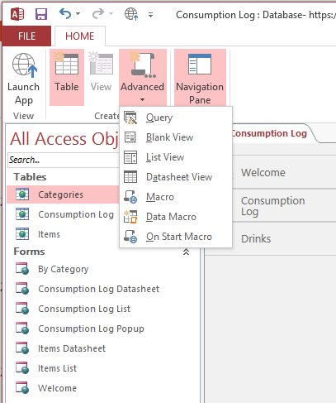
Creating Access App Design Elements
Query
Blank View
List View
Datasheet View
Macro
Data Macro
On Start Macro
Notes:
Once you begin creating your App the ribbon commands for creating new objects will be available to you. You can also rename, edit and delete the default tables and views to suit your needs. All changes are applied as soon as you save your app. For this reason it is important to have a good idea of what you are building wen you start your Access Services App project. An App is just a collection of Tables and Views stitched together by the Table Selector and View Selector. UI Macros and Data Macros run on changes that the user makes to the data.

Slide 33
UI Macros
Used for…
App Navigation
Controls: filling in defaults, validation
Calls to Data Macros
Cannot Directly Manipulate Data
Can manipulate data bound controls
Cannot Iterate a Recordset
Notes about creating UI Macros
Debugging: MessageBox and Exceptions
UI Macros are converted to JavaScript
Notes:
User Interface Macros run in the user’s browser and can perform “front end” actions like data validation, default value handling. They can only effect the controls and their values and properties, they do not impact the data directly (data macros do that). They can be tricky to debug, but you can use the Message Box object and throw Exceptions to figure out what is happening.

Slide 34
Data Macros
Used for…
Iterating Recordsets
Bulk data operations
Complex data validation
Notes on Data Macros
Cannot Interact with UI
Debugging: Tracing and Exceptions
Hint: RaiseError = MessageBox
Data Macros are converted to SQL triggers and stored procedures
All Data Macros run in a Transaction
Notes:
Data Macros are very powerful companion to UI Macros. They run “behind the scenes” and can handle the heavy data lifting that UI Macros cannot. If you are familiar with SQL you know that triggers are bound to data tables and can run on different events, data macros are the same idea. Write a data macro to ensure that your data is validated.

Slide 35
Data and UI Macros

Slide 36
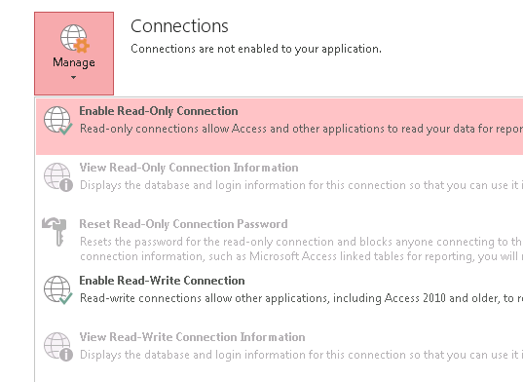
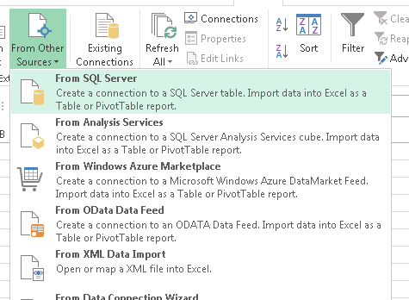
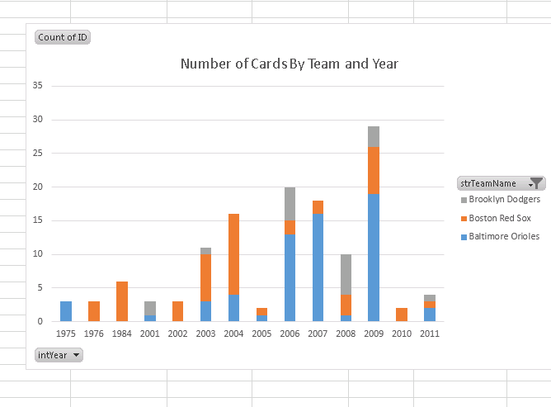
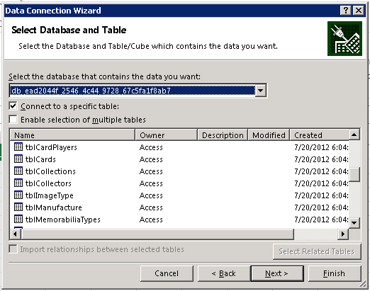
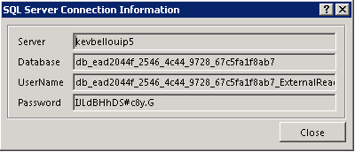
Visualize Access App Data in Excel
Authorize in Access
Allow other programs to connect to the SQL Server database that powers your access app. You’ll find all the necessary credentials in one place.
Connect from Anywhere
Enter the SQL Server connection information from Access into your analysis program, and you’ll find all your database’s queries and tables available. SQL Server is an industry standard, so you have a choice of tools, from Excel to Crystal Reports.
Analyze and Report
Take advantage of the powerful charting and analysis tools that Excel already provides. Or crunch your data in a program of your choice.
Notes:
Apps can be configured for external connection (think inbound connections to your app data). This means that the data in the app can be used in reports by other tools beyond Access.

Slide 37
Agenda
A Brief History of Access
Access Services 2013 Architecture
Designing Access Apps
Packaging Apps for Redistribution

Slide 38
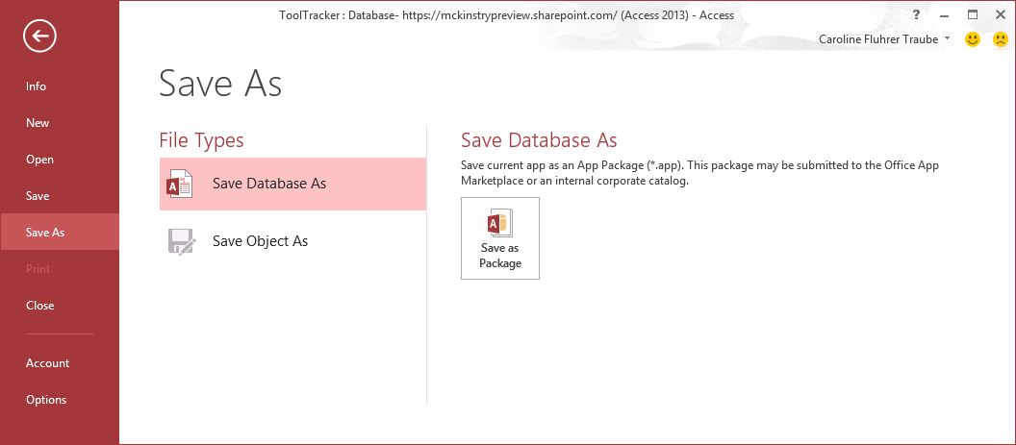
Backup, Packaging, and Publishing
Export data through Access Client
Save as Package
Install App in other SharePoint sites
Publish to the SharePoint Marketplace
Notes:
Apps can be packaged for redistribution to other SharePoint sites, farms or even sold in the SharePoint App Store. The process is to Save the Database As an App Package. Once packaged you can publish the app thorough the corporate catalog or just upload it to another site in your enterprise.

Slide 39
Packaging an App
Notes:
Make sure to also cover packaging up your web app as an app package.

Slide 40
Summary
A Brief History of Access
Access Services 2013 Architecture
Designing Access Apps
Packaging Apps for Redistribution

