Slide 1
Document Libraries and Document Sets
Notes:
This module examines how SharePoint 2013 manages files, documents and pages within the context of a SharePoint site. You will learn how to create and configure document libraries and picture libraries. The module will also discuss how to configure a document library with a custom document template and explain why it is often better to configure document templates in terms of custom content types. The module introduces Document Sets and explains how to use them to automate business processes in scenarios where a set of files needs to be managed, versioned and disposed of as an atomic unit.

Slide 2
Agenda
Sites, Files, Folders and Pages
Document Libraries
Document Templates
Wiki Page Libraries
Document Sets

Slide 3
Site Root Folder
Each site has a root folder
Root folder contains child folders and files
Child folders can contain child folders and files
Each document library contains a root folder
Root folder can contain child folders and files
Child folders can contain child folders and files
Notes:
Each site in a SharePoint site collection contains a root folder. The folder can contain files and sub-folders. Likewise, each library has a root folder as well. This folder can also contain files and folders. The difference is the ability to configure the settings for the Document Library.

Slide 4
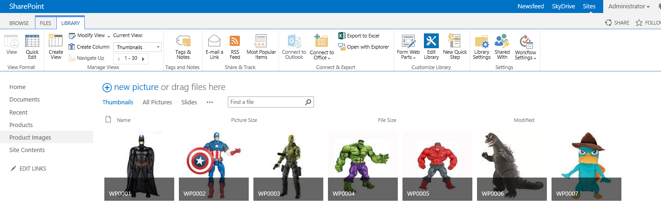
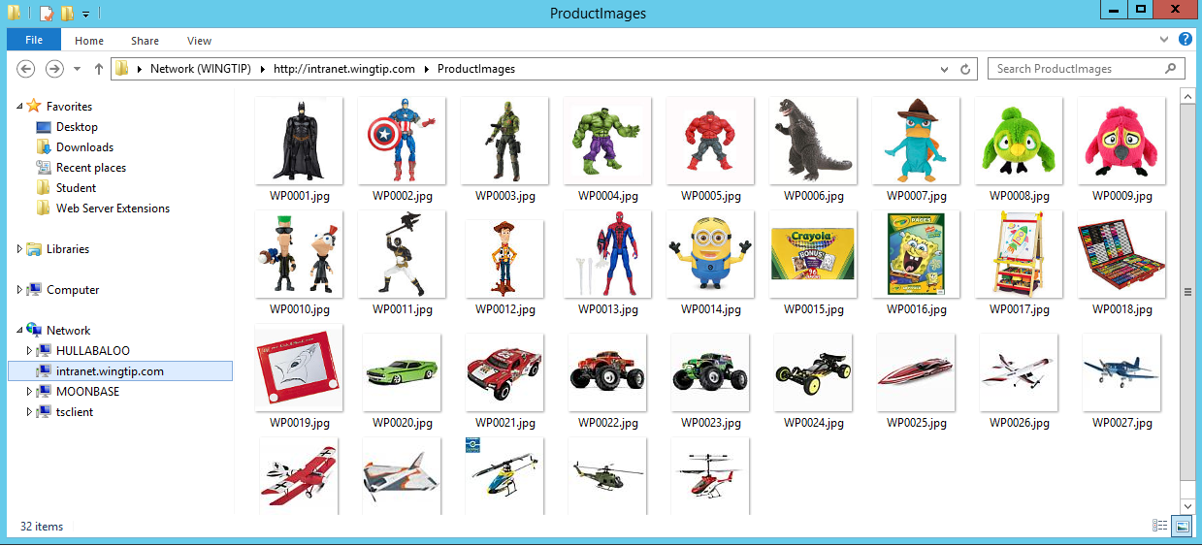
Accessing Documents with Windows Explorer
Notes:
Windows Explorer is still available and, depending on your network settings, can be accessed through a button on the ribbon. The new drag and drop features of the document libraries reduces the need for Windows Explorer. Now in SharePoint 2013 you can drag files directly into the library view in the browser.

Slide 5
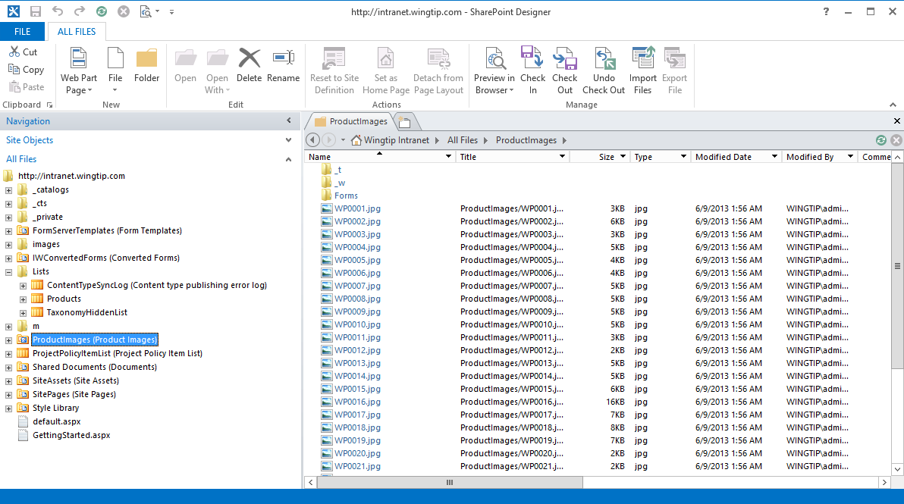
All Files View in SharePoint Designer
Notes:
In SharePoint Designer there is also an “All Files View” available to users with Administrative rights on the site. This view makes it easier to navigate the site as a set of files and folders, but you have to be very careful as it is also possible to do great damage to a site in this view. For example, deleting certain folders will cause issues on your site.

Slide 6
Examining a Site using SharePoint Designer 2013 All Files View

Slide 7
Agenda
Sites, Files, Folders and Pages
Document Libraries
Document Templates
Wiki Page Libraries
Document Sets

Slide 8
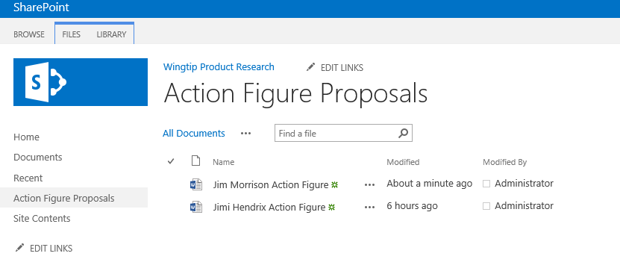
Document Libraries
A document library is a hybrid list type
Same features as a list plus more
Support for uploading and storing documents
Support for major and minor versioning
Notes:
All SharePoint content is based on Content Types. The Document Library is a “special” list that knows how to manage documents (or files) in a SharePoint team site. The Document Library is the default location on your team site for files and there are several “flavors” of Document Libraries that can be used for Forms and Pictures.
Document Libraries support advanced features that are not present in a traditional file share. These features, like versioning, check-in/check-out, and others make the storage and management of files in document libraries much better than on file shares.

Slide 9
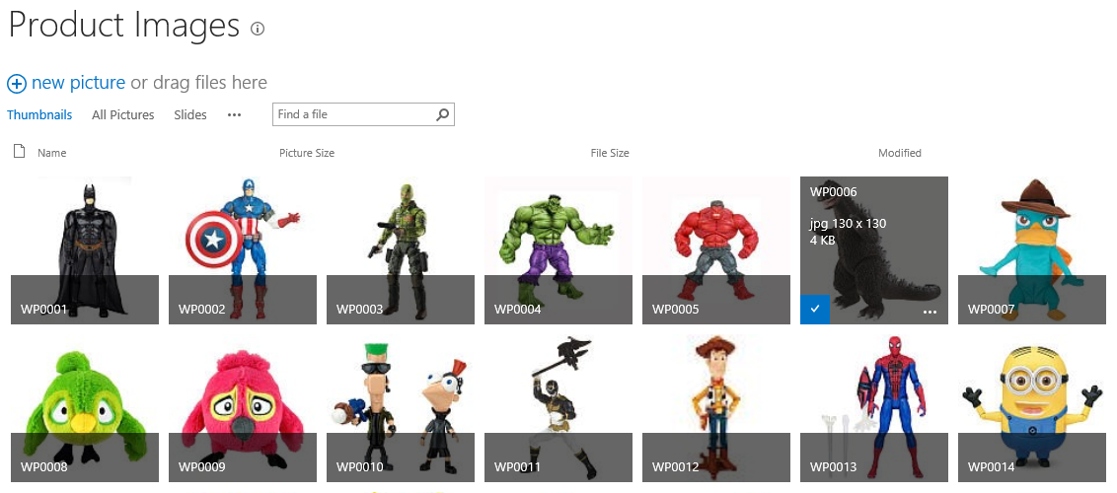
Picture Libraries
Picture library is a hybrid document library
Provides support to render image files in default view
Notes:
Picture Libraries are a special Document Library designed for storing images. The library will automatically generate a thumbnail of the image and grab additional metadata from then image. Search results from Picture Libraries will show the thumbnail. If you store images in Document Libraries, they will not.

Slide 10
Agenda
Sites, Files, Folders and Pages
Document Libraries
Document Templates
Wiki Page Libraries
Document Sets

Slide 11
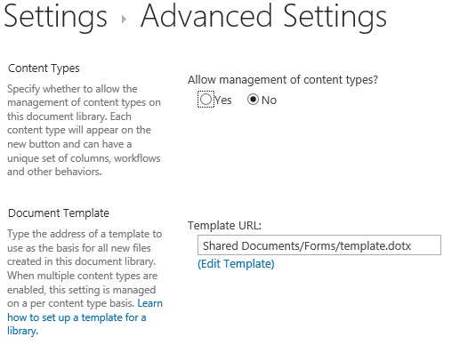
Document Libraries and Document Templates
Document library can be configured document template
Standard Document Library uses vanilla Word document template
You can edit the template in Word and save it back to SharePoint
Notes:
Document Libraries support many features for document management. The Document Template feature is used to create a template for the default New document for a library. Once configured you can show your users that they just need to click the New Document button and the template will be loaded from SharePoint. When they click Save, the default save location will be the Library that they started from.

Slide 12
Content Types and Document Templates
Content type can have a document template
Supported for Document content type
Supported for Document-derived content types
Not supported in other content types
What scenarios should this be used?
When multiple document libraries use single template
When document templates need to be reused across site collections
Notes:
Document Libraries also support more than one Content Type (as long as they are descended from Document). This means that you can configure a library to store more than one content type each having their own document template. Since the Content Type is a Site or Site Collection scoped resource, you can use them on many Libraries all using the same template.

Slide 13
Configuring a Document Library with a Custom Document Template

Slide 14
Agenda
Sites, Files, Folders and Pages
Document Libraries
Document Templates
Wiki Page Libraries
Document Sets

Slide 15
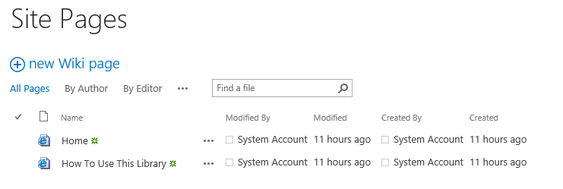
Wiki Page Libraries
Wiki page libraries provide wiki-style editing
Site Pages wiki page library create in a Team sites
Users can easily add and link pages
Read How To Use This Library page to get started
Notes:
SharePoint 2010 introduced us to Wiki pages and wiki editing. This simple page editing mode enables us to easily create a multi page web site for our users with content, images and links to content in and outside of SharePoint. Each team site contains a Site Pages library specifically for this purpose.

Slide 16
Adding Content and Hyperlinks to a Wiki Page Library

Slide 17
Agenda
Sites, Files, Folders and Pages
Document Libraries
Document Templates
Wiki Page Libraries
Document Sets

Slide 18
Understanding Document Sets
A collection of files and folders
documents, spreadsheets, presentations, etc.
Whatever makes up a single work product
Think “Super Folder”
Metadata can be shared across all items in the Document Set
Content Type Handling
Default Content Types are included…by default
Optional Content Types may be added
This enforces the rules set by the Doc Set Creator
Notes:
A document set is a special content type that behaves like a folder, but offers very powerful features specifically intended for managing groups of related documents, called document sets. The process is to create the related content types and then create the Document Set content type, associating the related content types to the Document Set. You can event specify templates (or default documents) for each content type.

Slide 19
The Power of Document Sets
Welcome page for status of the whole doc set
Shared Columns
Default Templates for each Content Type
Document Set Versioning
Captures State and key intervals
Review points in time
Set owner can restore version to point in time
Special Out of the Box Workflow
Treat the whole document set as an atomic item
Notes:
Each Document Set displays a Welcome Page of summary information (think folder properties) but the real power is in the shared properties, properties that span all documents in the document set. Change the property on the document set and all descendant documents will receive the updated property. When a Document Set is versioned, it grabs the version at that point in time for all documents. There is also a special out of the box workflow activity that treats all documents in the set as an atomic unit (rather than separate items).

Slide 20

Using Document Sets
Document Set introduced in SharePoint 2010
Implementing using Document Set content type
Enabled by activating feature from SharePoint Server
Feature automatically activated in Team sites
Document set can contain many documents
Documents can be nested in folder structure
Document set can have custom document templates
Notes:
Document Sets were introduced in SharePoint 2010. They are enabled through a Feature that is activated by default on the Team Site template. Document Sets behave like folders in some ways and like documents in others, for example they can be nested and contain templates. They can share properties, or have unique properties.

Slide 21
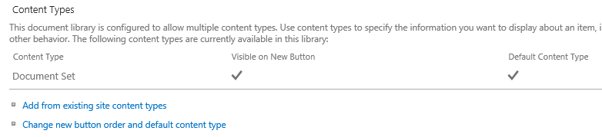
Configuring Document Sets
Create a new document library
Configure support for the Document Set content type
Configure the Document Set content type
Add site columns to Document Set
Choose which site columns are shared with inner documents
Configure document templates for Document Set
Configure default documents for Document Set
Notes:
The process of configuring a Document Set takes a little planning (or a lot). You have to initially configure the content types that the Document Set will contain, which means planning the Site Columns and Content Types. Once the content types are assigned to the Document Set you can define default and optional content types.

Slide 22
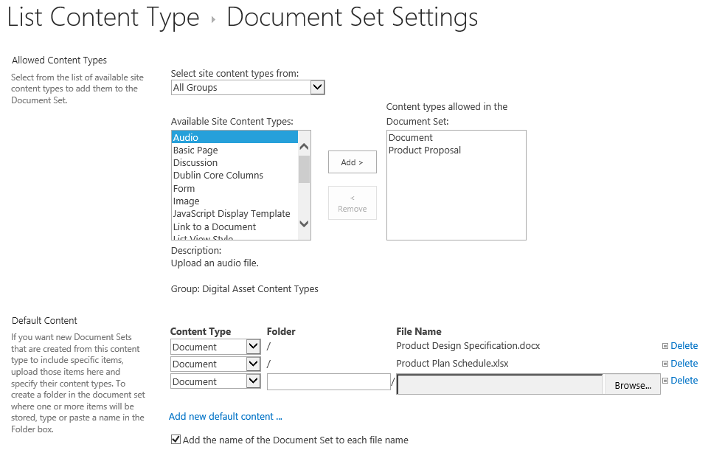
Adding Templates and Default Documents
Notes:
This screen shows the Document Set configuration screen and the process for configuring document templates (which is different from the Content Type template).

Slide 23
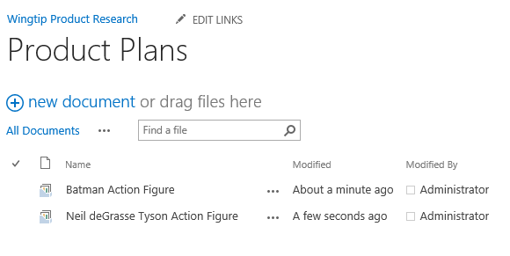
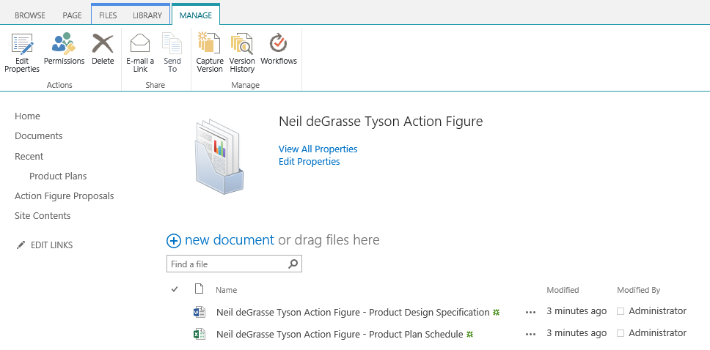
Outside View versus Inside View
Notes:
At the top level of the Document Library you will see the list of Document Sets (notice the special icon that looks like a folder with different files). Clicking on a single Document Set takes you to the Welcome Page of the Document Set. From the Welcome Page you can begin working with the files, or change the properties from the top of the Welcome Page.

Slide 24
Configuring a Document Library to Support Document Sets

Slide 25
Summary
Sites, Files, Folders and Pages
Document Libraries
Document Templates
Wiki Page Libraries
Document Sets

