Slide 1
Using Excel Services in SharePoint 2013
Notes:
This module examines the architecture of Excel Services and teaches you how to use Microsoft Excel to publish Excel workbooks which are accessible to users through the browser. You will also learn about the benefits and techniques involved with finer-grained publishing of Excel items such as worksheets, charts and tables. This module will teach you how to publish Excel workbooks with Pivot Charts and Pivot reports which rely on server-side connections to external data sources such cubes in SQL Server Analysis Services (SSAS). You will also learn how to take advantage of the new features in SharePoint 2013 that allow you to publish a workbook with an Excel table that is exposed as an OData data source.

Slide 2
Agenda
Excel Services Architecture
Excel Services REST API
Data Models
Publishing Workbooks

Slide 3
Excel Services Overview
What is Excel Services?
Service application
Enables Excel workbooks to load, calculate, and display in SharePoint through the browser
Excel Services Components
Excel Calculation Services
Excel Web Access
Excel Web Services
Notes:
Excel Services is a shared service used to publish Excel 2013 workbooks which enables the ability to load, calculate, and display Excel workbooks in SharePoint Server 2013. The published workbooks can be managed and secured according to your organization’s needs. They can be shared among SharePoint 2013 users so they can render the workbook through the browser. By using Excel Services, you can reuse and share Excel workbooks on SharePoint 2013 portals and dashboards. Excel Services was first introduced in MOSS 2007 and is only available in the Enterprise edition of SharePoint Server 2013 and the E3 plan for O365.
Excel Services is designed as a web-based, data exploration and reporting system used primarily for Business Intelligence (BI) solutions. Excel workbooks can connect to external data sources, reports are created, and then the workbook is published to a SharePoint document library.
Excel Services includes three core components:
Excel Calculation Services – Main Excel Services component that loads the Excel workbook, calculates the spreadsheet, refreshes external data, and maintains the session state.
Excel Web Access – Web Part that displays the Excel workbooks data and charts.
Excel Web Services – Web Service hosted in SharePoint that provides various methods for developers to calculate, set, extract values from workbooks, and refresh external data connections.

Slide 4
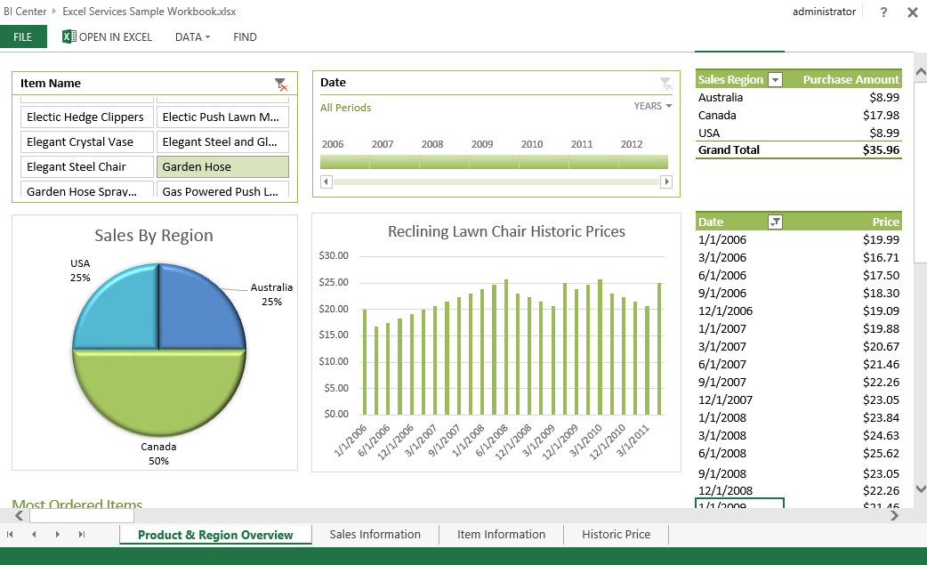
Excel Services Overview
Notes:
In this sample Excel spreadsheet you can see how the rendering of spreadsheets in Excel Services is amazingly accurate. You can still choose to open the spreadsheet in the Excel Client, but if all you need is a dashboard view Excel Services is much more efficient.

Slide 5
Excel Services Benefits
Secure sharing of workbooks
Share workbooks w/o exposing proprietary business logic
Prevent users from editing workbooks when required
Business Intelligence
Workbooks connected to enterprise data sources
Workbooks can contain dashboards and scorecards
Workbooks can be published to SharePoint
Extensibility
Create reusable logic that is contained inside workbooks
Reliability and availability
Calculations performed on server instead of client machines
Notes:
Offloading calculations to servers frees the users’ computers and takes advantage of the server’s additional computing power.

Slide 6
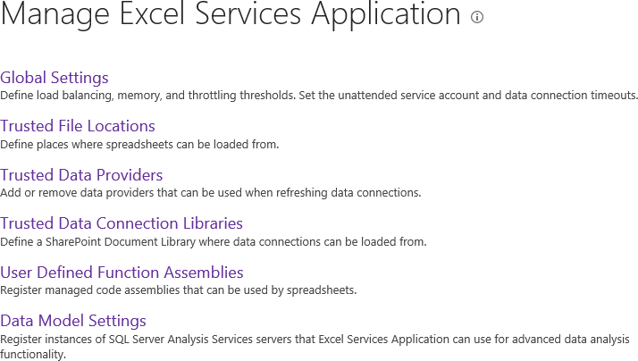
Configuring Excel Services
Notes:
The settings for managing Excel Services include the following:
Global Settings - settings for security, load balancing, session management, memory utilization, workbook, caches, and external data connections.
Trusted File Locations - Allows you to define which document libraries are trusted by Excel Services. Settings also include session management, workbook size, calculation behavior, and external data settings of workbooks stored in the defined locations.
Trusted Data Providers - Contains a predefined list of trust data providers for connecting to your external data. Also provides the ability to add your own trusted data provider.
Trusted Data Connection Libraries - Allows you to define which data connection libraries in your farm are trusted by Excel Services. Data Connection libraries are used to store the shared data connection files.
User-defined Function Assemblies - Provides the ability to add your own custom user-defined assemblies.
Data Model Settings – Registers instances of SSAS for Excel Services.

Slide 7
Excel Services Architecture
External data connections
There is support for SQL Server, SQL Server Analysis Services (SSAS), OLE DB, and ODBC
Data models
Supported if SSAS is registered in Excel Services
Reports and scorecards
Reports, dashboards, and scorecards are supported in Excel Services. PivotTable reports are also supported.
Notes:
Excel business intelligence provides the capability to explore and analyze data of any size, and integrate and show interactive solutions of the data. In SharePoint 2013, Excel BI offers the following new features:
External data connections. As mentioned in the previous chapter, most external data connections are supported in Excel Services. This includes SQL Server Analysis Services (SSAS), SQL Server databases, OLE DB, and ODBC data sources.
Data models. Data models are supported as long as an instance of SSAS is registered in Excel Services.
Reports and scorecards. Reports, dashboards, and scorecards created in Excel are supported in Excel Services. PivotTable reports can be viewed, sorted, filtered, and interacted with in the browser through SharePoint. This includes views created by Power View.

Slide 8
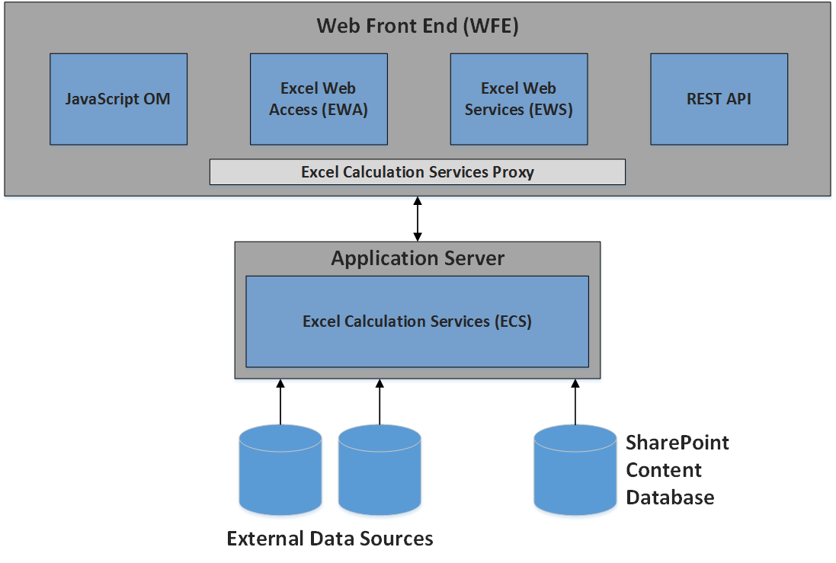
Excel Services Architecture
Notes:
The figure above shows an example of an on-premises SharePoint 2013 Excel Services environment. The Excel Services components can be divided between the Web Front End (WFE) and the Application Server. The WFE includes JavaScript, Excel Web Access, Excel Web Services, and the REST API. Excel Calculation Services component resides on the Application Server along with any UDF assemblies that an administrator has added.
Developers can access the Excel Services REST API on SharePoint Online for O365. The REST API enables developers to access workbook parts manually or programmatically. A subset of .NET SharePoint web services REST API is available and for on-premises all .NET SharePoint web services REST API is available.

Slide 9
Excel Services Architecture
JavaScript UDFs
Similar to user-defined functions (UDFs)
Store in SharePoint
Insert Web Part on a SharePoint page that contains a workbook stored in a trusted location
Include the code in the SharePoint
Store on SkyDrive
Embed a workbook stored on SkyDrive into the host web page using an HTML <div> element
Notes:
JavaScript UDFs are similar to user-defined functions (UDFs) that can be created in the Excel client. UDFs can be added to the list of available functions in Excel when Excel doesn’t provide the necessary function out-of-the-box. The difference with JavaScript UDFs are they are only used in the embedded workbooks and only exist in page rendering the Excel workbook. When the page rendering the workbook is closed, the JavaScript UDF is no longer available.
JavaScript UDFs on workbooks can either be rendered in SharePoint through the Excel Web Access Web part or hosted on a page that has the embedded workbook stored on SkyDrive.

Slide 10
Publishing an Excel Workbook to a SharePoint Document Library

Slide 11
Agenda
Excel Services Architecture
Excel Services REST API
Data Models
Publishing Workbooks

Slide 12
Excel Services REST API
REST API was introduced in SharePoint 2010
Allows the access of workbook parts or elements directly through a URL
REST Services based on two requirements:
An addressing scheme used to locate networked resources
Methodology for returning representations of the resources
REST Sample
http://intranet.wingtip.com/_vti_bin/ExcelRest.aspx/Documents/MyWorkbook.xlsx/Model/Charts('Chart1')
Notes:
The REST API for Excel Services enables operations against Excel workbooks using operations specified in the HTTP standard. This allows for a flexible, secure, and a simple way to access and manipulate Excel Services content. The REST Sample in the slide shows the URL for retrieving a chart named Chart7 from the ExcelFileName.xlsx file on the Contoso site which resides in the Documents library. This URL can be placed inside an Image Viewer web part to display the chart through the web part.

Slide 13
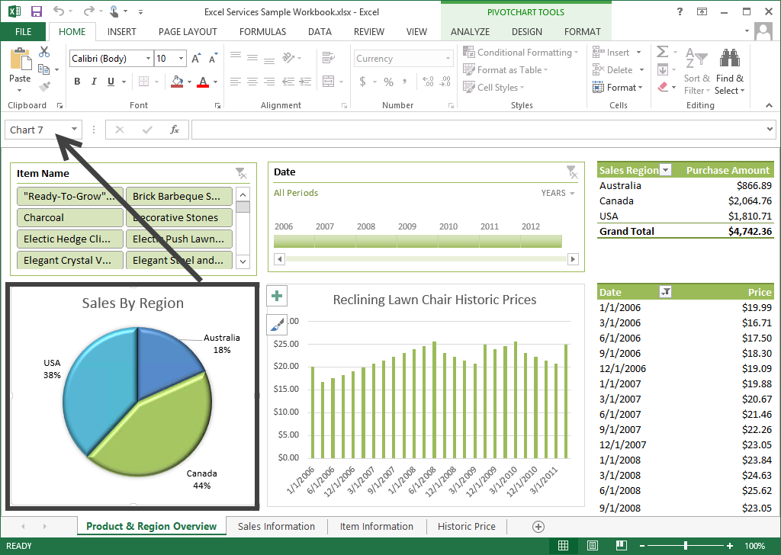
Excel Services REST API
Notes:
Through Excel Services REST API you can expose named items from the spreadsheet. In this example the chart is “Chart 7” so the request would be: http://intranet.wingtip.com/_vti_bin/ExcelRest.aspx/Documents/Excel Services Sample Workbook.xlsx/Model/Charts('Chart 7')

Slide 14
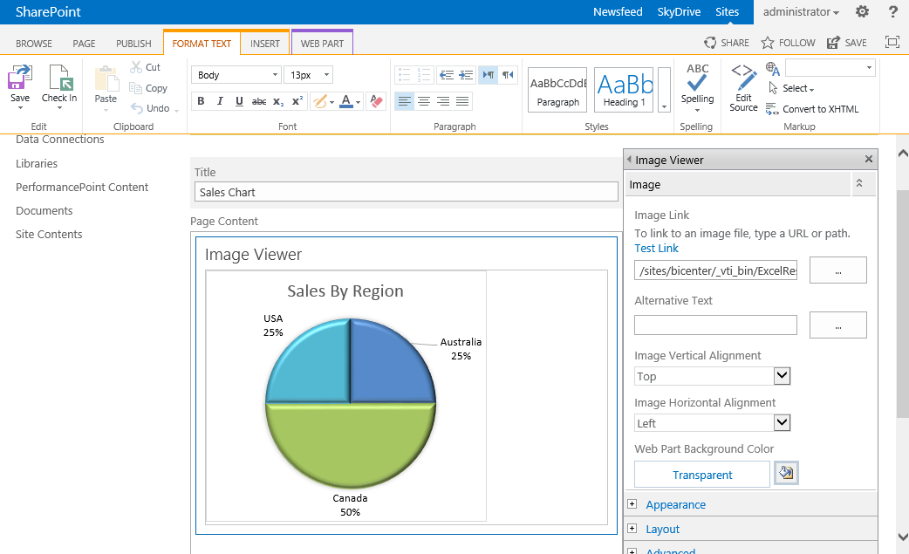
Excel Services REST API
Notes:
Then you can add an image web part to the page and reference the REST URL and Excel Services will return an image.

Slide 15
Calling the Excel Services REST API

Slide 16
Agenda
Excel Services Architecture
Excel Services REST API
Data Models
Publishing Workbooks

Slide 17
Data Models Overview
What is a Data Model?
A dataset consisting of one or more tables of data
Use to bring together data from different database
Create relationships between tables of data
Created and organized through PowerPivot
Provide tabular data used in PivotTables, PivotCharts, and Power View reports
Used as a source for reports, scorecards, and dashboards
PowerPivot add-in must be enabled in Excel client
Users can view and interact with items in workbooks that contain data models
Notes:
A Data Model is a dataset consisting of one or more tables of data from different databases. You can create relationships between the tables of data and some of the various sources you can connect to are Microsoft Access, SQL Server, OData data feeds, Azure, XML, and Oracle. Data models are created and organized through PowerPivot using the Excel client. They can be used as the data source for providing tabular data for PivotTables, PivotCharts, and Power View reports to create various reports, scorecards, and dashboards. In order to create data models from the Excel client, the PowerPivot add-in must be enabled. Users who have the appropriate access can view and interact with the items in the workbook that contain the data models.

Slide 18
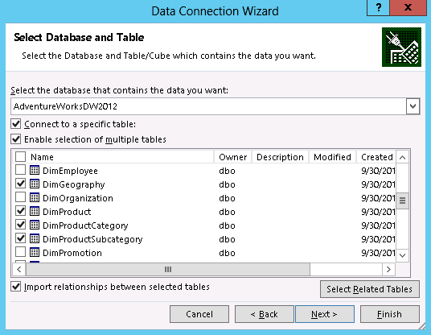
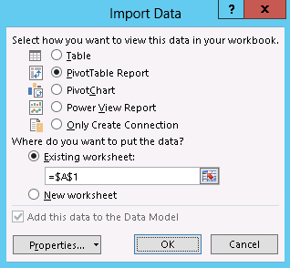
Data Models Creation in Excel
Creating a Data Model automatically occurs when you select multiple tables in Excel
Notes:
Like other data connection wizards, you can connect from Excel to Databases, SharePoint Lists and Data Warehouses. Then decide how you wish to use the imported data.

Slide 19
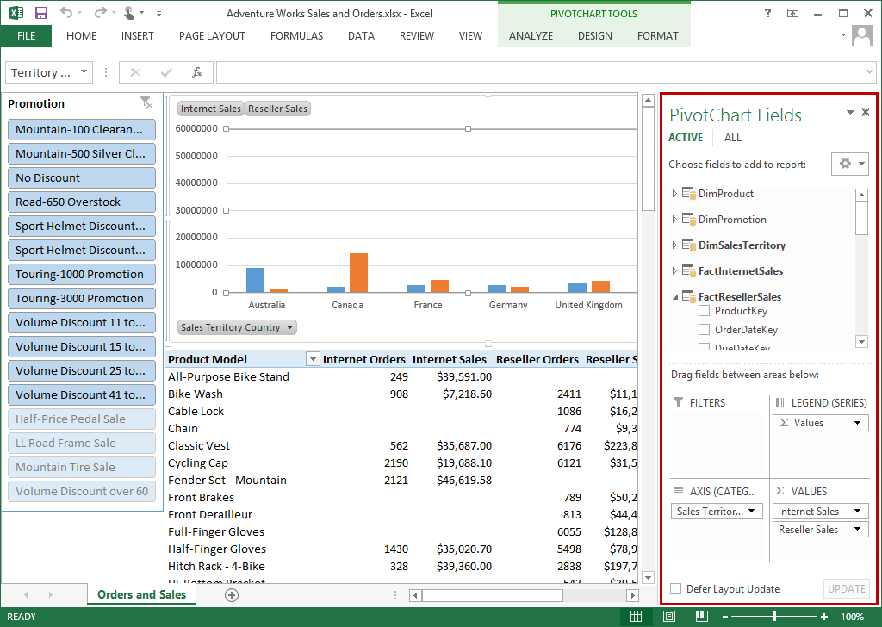
Data Models Visualization
A Data Model is visualized as a collection of tables in a Field List
Notes:
Excel and Excel Services support the creation and use of Pivot Charts and Pivot Tables.

Slide 20
Data Models Creation in Excel
Created implicitly when importing two or more tables
Created explicitly when using the PowerPivot add-in to import data
Models are represented in a tabbed layout in PowerPivot
A model can contain a single table
In PowerPivot, select one table and click Add to Data Model
Use when you want to use PowerPivot features such as filtered datasets, calculated columns, calculated fields, KPIs, and hierarchies
Notes:
In Excel Data Models are create for you when you import data. You can also create a data model for a specific purpose to support other features of the Business Intelligence suite of tools.

Slide 21
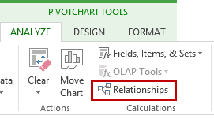
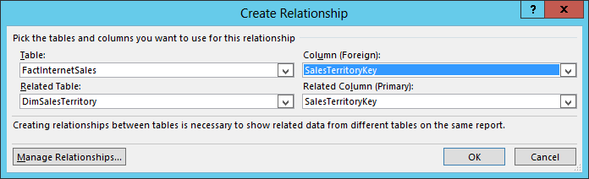
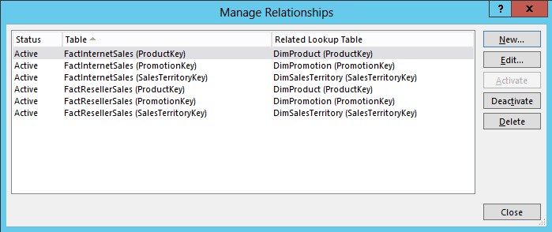
Data Models Table Relationships
Table relationships can be created automatically
If imported related tables have primary and foreign key
Table relationships can be created manually
Notes:
If the data source (like SQL) already has defined relationships Excel will create the relationship for you when you import the tables.

Slide 22
Agenda
Excel Services Architecture
Excel Services REST API
Data Models
Publishing Workbooks

Slide 23
Publishing Workbooks
Before you can publish a workbook the following is required:
Trusted data connections library and trusted document library must be configured
Administrator has provided the data authentication information
Contribute permissions are required on the SharePoint library you are publishing to
If you are publishing Data Models, data models must be configured in Excel Services
If using Power View, SSRS must be configured in SharePoint integrated mode
Notes:
Before you can publish Excel 2013 workbooks to your SharePoint Server, the prerequisites must be addressed first based on your requirements.

Slide 24


Publishing Workbooks
An Excel workbook must be created
Workbook must contain at least one item
Chart, table, PivotChart report, PivotTable report, or a range of data
When publishing to a document library
The location used must be specified as a trusted location for Excel Services
Notes:
In order to publish an Excel workbook, a workbook must be created and contain at least one item such as a chart, table, Pivot chart report, PivotTable report, or a range of data. The document library you are publishing to must have the location added to the trusted location in Excel Services.

Slide 25
Summary
Excel Services Architecture
Excel Services REST API
Data Models
Publishing Workbooks

