Slide 1
Getting Started with SharePoint 2013
Notes:
This module explains the new features and architectural changes that have been introduced to the platform with SharePoint 2013. You will learn about the difference between using SharePoint 2013 in an Office 365 environment versus using SharePoint 2013 in an on-premises environment. The module also explains why building business solutions with a no-code approach works equally well across both environments. The module concludes with an exploration of the new SharePoint 2013 team site and demonstrates new ways in which to change a site's appearance.

Slide 2
Agenda
SharePoint 2013 Overview
Office 365 versus SharePoint On-premises
Strategies for Building No Code Solutions
Working with Team Sites in SharePoint 2013
Working with Composed Looks

Slide 3
SharePoint 2013 Architecture
SharePoint 2013 runs on Windows Server
SharePoint Server 2013 provides services
SharePoint Foundation 2013 provides platform
Runs on top of IIS, the .NET Framework and ASP.NET
SharePoint Server 2013
SharePoint Foundation 2013
.NET Framework 4.5 and ASP.NET 4.5
Internet Information Services 8.0 (IIS)
Windows Server 2012 (64-bit only)
Notes:
SharePoint Foundation 2013 is the free version of SharePoint 2013. SharePoint Server 2013 is the new version of the SharePoint technology stack. There are different SKUs for SharePoint Server 2013 which includes (1) SharePoint Foundation 2013, (2) SharePoint Server 2013 Standard and (3) SharePoint Server 2013 Enterprise.
Like SharePoint Server 2010, SharePoint Server 2013 requires both server-side licenses and client access licenses (CAL). A server-side license is required for each server computer on which SharePoint is installed. A Standard Edition CAL is required for each authenticated user that uses SharePoint Server 2013. An additional Enterprise Edition CAL is required for users that utilize features that are part of the Enterprise SKU.
Note that with SharePoint 2013, Microsoft has discontinued the two “for Internet Sites” SKUs that were introduced with SharePoint 2010. A significant change here is that with SharePoint 2013, anonymous users are covered under the server-side license.
SharePoint 2013 only runs on 64-bit operating systems. No version of SharePoint 2013 supports installation on a client OS. However, you can run a 64-bit version of Windows 8 with Hyper-V which allows you to run 64-bit virtual machine’s with SharePoint 2013.

Slide 4
SharePoint Farms
Farm contains SQL Server database server
Farm contains web server(s) running SharePoint
Production farms contains many servers
Simple farm can be built on a single server or VM
SharePoint Farm
web servers
database server
Config DB
Notes:
A SharePoint Farm is simply a collection of servers that have SharePoint installed on them and are all connected to the same configuration database (aka: the config DB).
A SharePoint farm typically consists of one or more web servers and a database server. The number of web servers required in the farm largely depends upon the number of users and other factors such as the processing requirements of the services being utilized. Each farm must run SQL Server on at least one server to run the databases required in a SharePoint environment. The first database that is created is called the configuration database.
In a development or testing environment, a SharePoint 2013 farm can be built entirely on a single server. This is the type of farm you will create and configure in the labs for this course. However, a single-server farm is not something which should be used in a production environment. For starters, a SharePoint 2013 farm in a production environment should always have a database server that is separate from the web server or web servers.

Slide 5
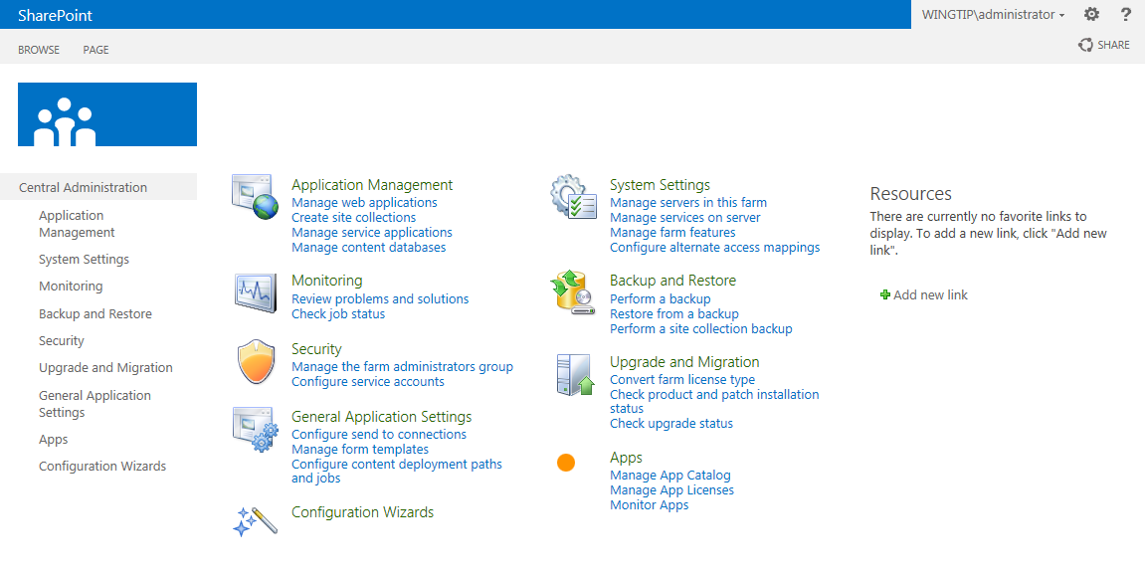
Central Administration
Central Administration is for farm administrators
Can be used to create and configure service applications
Can be used to create and configure web applications
Can be used to create and managed site collections
Notes:
This is the new layout of the SharePoint 2013 Central Administration. The home page displays a better overview of the different management tasks. Each hyperlink brings you to a page where you can configure details of your SharePoint farm.

Slide 6
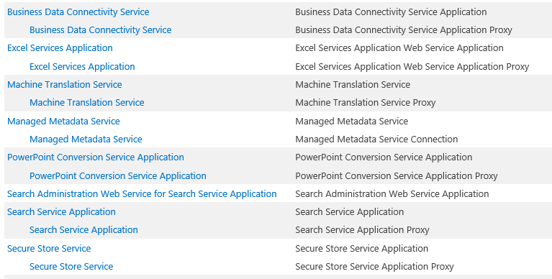
SharePoint Service Applications
SharePoint support service application model
Service applications supply essential functionality
Farm administrator creates service applications
Notes:
Starting in SharePoint 2010, Microsoft introduced a new model based on Service Applications for sharing resources across sites and web applications. The service application model continues to be a central figure in the architecture for SharePoint 2013. Furthermore, the service applications model facilitates multitenant deployment in SharePoint 2013 which provides more flexibility in SharePoint farm topologies.

Slide 7
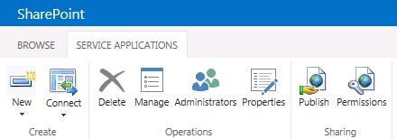
Service Application Management
Use ribbon buttons to configure service applications
Manage - navigate to main administrative page for service application
Administrators - set who can administrate/configure this service application
Properties - view and modify properties such as database location
Publish - configure service application for access by other farms
Permissions - configure which users can use this service application
Administrator
Permissions
User
Permissions
Notes:
The Service Applications page is accessible from SharePoint Central Administration > Application Management > Manage service applications. This page lists all service applications instances. Clicking the hyperlinked name of the service application brings you to a page where you can manage the service application instance. You can highlight the service application instance by clicking on the row of the service application instance. Once the instance is hightlighted, you can use the buttons on the ribbon to configure additional settings like administrators and permissions.

Slide 8
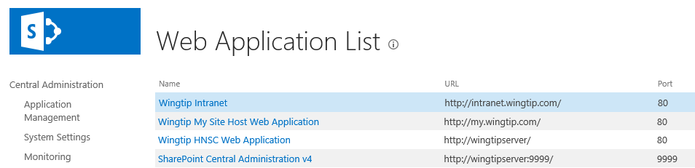
Web Applications
Web applications created to host SharePoint sites
Web application is SharePoint object built on top of IIS Web sites
Web application stores site data in content database(s)
Web application is scope for configuring service applications this is the way it's usually done in on-premises SharePoint farms
SharePoint Farm
Web Applications
Content DB
Wingtip Intranet
http:/intranet.wingtip.com
Wingtip My Site Host Web Application
http://my.wingtip.com
Content DB
Wingtip HNSC Web Application
http://wingtipserver
Content DB
SharePoint Central Administration
https://wingtipserver:9999
Content DB
Notes:
SharePoint 2013 is primarily a web-based application which means it must provide HTTP entry points to its clients. SharePoint 2013 leverages the web server infrastructure of Internet Information Services (IIS) and IIS website to listen for incoming HTTP requests and to process them inside server-side processes that are launched on demand. SharePoint 2013 creates an abstraction on top of an IIS websites known as a web application. Therefore, a SharePoint web application provides an HTTP entry point into a SharePoint farm for browser-based clients as well as other types of clients such as Office application that communicate with a SharePoint farm using HTTP requests.
A web application provides a scope for creating sites which are accessible to business users. In fact, every SharePoint site must be created within the scope of a particular web application.
The content within a SharePoint site is stored within a SQL Server database known as a content database. Therefore, every web application must have at least one content database associated with it. However, there will often be more than one content database associated with a specific web application. In this training course, you will learn how to manage the association between web applications, content databases and sites.
A web application defines a scope for configuring user authentication. For example, one web application might require integrated windows authentication and disable anonymous access. A second web application within the same farm could be configured to support other types of user authentication such as forms-based authentication (FBA) and/or to permit anonymous access.

Slide 9
Site Collections and Sites
Sites always created in scope of a site collection
Site collections created in scope of a web application
Web applications can scale to1000s of site collections
Site collection has site collection administrator(s)
SharePoint Web Application Host Header Path: http://intranet.wingtip.com
site collection (root)
site collection /sites/operations
site collection /sites/sales
site collection /sites/finance
top-level site
(root)
top-level site
(root)
top-level site
(root)
top-level site
(root)
child site
/WestDivision
child site
/EastDivision
child site
/FY2012
child site
/FY2013
child site
/Reports
child site
/Dashboards
Notes:
All user-generated content resides in SharePoint sites. The primary types of content include items within lists and documents inside document libraries. However, there are other forms of user-generated content as well such as customization data and personalization data tracked by server-side web parts as well.
Sites are grouped into site collections. Whenever a site is created, it is always created within a scope of a specific site collection. Furthermore, each site collection is associated with exactly one content database which is used to store the content of all the sites inside.
Each site collection must have exactly one site referred to as the “top-level” or “root” site. The URL of the top-level site is always the same as the URL of the site collection. A site collection may additionally contain child sites below the root site. Child sites can be nested within other child sites within a site collection resulting in the creation of a site hierarchy. While SharePoint supports nested child sites more than 10 levels in depth, experience has taught the SharePoint community that creating deep site hierarchies can be very hard to manage and to scale.
A key reason why the SharePoint architecture requires that sites are always partitioned into site collections has to do with security. More specifically, site collections provide a scope for administrative privileges. If you are configured as the site collection administrator (aka site collection owner), you are guaranteed to have full administrative control over all the sites inside. Web application can support thousands of site collections.

Slide 10
Host-named Site Collections (HNSC)
SharePoint 2013 supports HNSC
Supported in web applications without host header path
Each site collection can be created in unique domain
Creating a HNSC only possible using PowerShell
SharePoint Web Application Host Header Path: (blank)
site collection operations.wingtip.com
site collection sales.wingtip.com
site collection finance.wingtip.com
top-level site
(root)
top-level site
(root)
top-level site
(root)
child site
/WestDivision
child site
/EastDivision
child site
/FY2012
child site
/FY2013
child site
/Reports
child site
/Dashboards
Notes:
SharePoint 2013 supports a special type of site collection known as a host-named site collection (HNSC). The key difference between a path-based site collections and a HNSC is that a HNSC does not need to be created within the context of a DNS domain (e.g. intranet.wingtip.com) that is defined by the hosting web application. Instead, HNSCs are created in a web application that has no path, which means you can create the HNSC using any DNS domain you would like.

Slide 11
Creating a new site collection using Central Administration

Slide 12
Agenda
SharePoint 2013 Overview
Office 365 versus SharePoint On-premises
Strategies for Building No Code Solutions
Working with Team Sites in SharePoint 2013
Working with Composed Looks

Slide 13
Office 365 and SharePoint Online
SharePoint 2013 was designed for Office 365
Architectural changes made to improve hosting support
SharePoint Online now runs SharePoint 2013 upgrade from SharePoint 2010 to SharePoint 2013 occurred in Q1 of 2013
Microsoft pushing hard to get customers into the cloud
Office 365
Exchange
Lync
SharePoint Online
Notes:
SharePoint 2013 marked the first version of the product in which Microsoft shifted its focus to support hosting SharePoint in the cloud. Much of this has to do with Microsoft’s recent investments in Office 365 (aka SharePoint Online). A significant percentage of the investment that Microsoft has made to make SharePoint 2013 better than SharePoint 2010 resolves around making things work in cloud-based hosting scenarios.
With the SharePoint 2013 environment hosted within Office 365, Microsoft assumes the role of SharePoint administrator. One important factor to note is that companies don't require hardware or as much SharePoint expertise to leverage SharePoint in their business.
In this training course, the focus will be on installing and configuring SharePoint 2013 in an on-premises environment as opposed to learning how to use SharePoint 2013 in Office 365.

Slide 14
SharePoint Online versus On-premises
Using SharePoint Server 2013 On-Premises
SharePoint farm must be created/configured
Runs within the context of local Active Directory domain
Services configured at web application scope
Using SharePoint Online in Office 365
New tenancy is provisioned for each new customer
Tenancy defines a scope for creating user accounts
Active Directory accounts can be imported
Notes:
There are two primary ways in which a company can use SharePoint 2013. A company can install SharePoint 2013 on server computers which it controls. This type of SharePoint 2013 installation is known as an on-premises farm. Alternately, a company can establish an account in Office 365 which makes it possible to create and utilize SharePoint sites which make use of SharePoint services. Furthermore, there is nothing that prevents a company from using both approaches at the same time which involves one or more on-premises farms used in conjunction with a SharePoint presence in Office 365.
With an on-premises farm deployment, a company must acquire its own hardware and purchase licenses from Microsoft. The company must also maintain expertise within its IT staff to install SharePoint 2013 on servers running on premises. This is largely the focus of this training class.
When establishing a company account in Office 365, a company must purchase an Office 365 plan for hosting SharePoint sites which typically involves monthly per-user charges but eliminates the need to purchase SharePoint 2013 licenses. Microsoft provides the hardware and manages the SharePoint farm behind the scenes. A company will administrate its account at a higher level which is known as “tenancy level”. Therefore, the company will have one or more users who will play the role of tenancy administrator.

Slide 15
A SharePoint Online Tenancy
Tenancy provides top-level administrative scope
Customer has no visibility to farm or web application
Special site collection created for tenant administration
SharePoint Online Tenancy
site collection wingtip-admin.sharepoint.com
site collection wingtip.sharepoint.com
site collection wingtip.sharepoint.com/sites/sales
top-level site
(root)
top-level site
(root)
top-level site
(root)
child site
/Reports
child site
/Operations
child site
/WestDivision
child site
/EastDivision
Notes:
In the Office 365 environment, customers are never permitted to perform administrative work at the farm level or the web application level. Instead, Office 365 customers using SharePoint Online create and manage site collections with the scope of a tenancy.
SharePoint Online provides each customers with a Tenant Admin site collection that is accessible to users who have been granted Tenant Admin permissions. If you have been granted the required permissions, you can use the Tenant Admin site collection to create and manage site collections with your tenancy and to configure the tenancy's service applications.

Slide 16
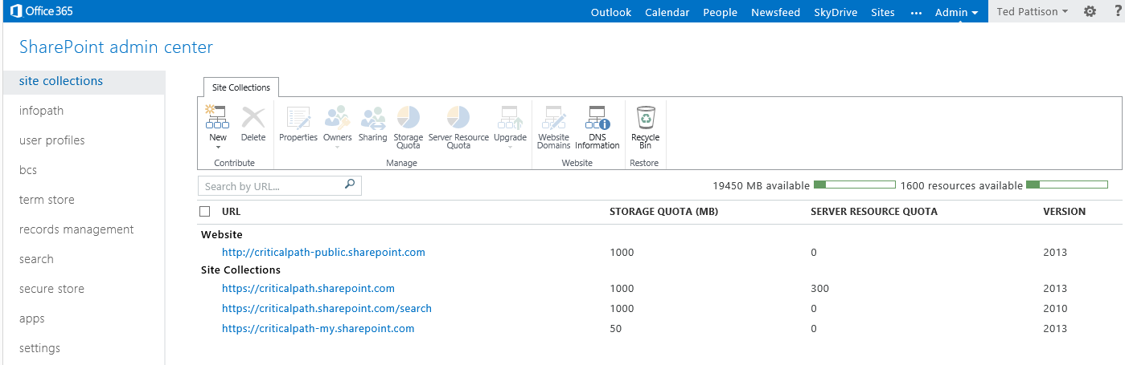
Tenant Admin Site Collection
Tenant Admin Site Collection used to…
Create and manage site collections
Configure SharePoint Services
Notes:
If you are working in a multi-tenant site like Office 365, your Administration Pages will appear a little differently that the way they look on-premises.

Slide 17
Agenda
SharePoint 2013 Overview
Office 365 versus SharePoint On-premises
Strategies for Building No Code Solutions
Working with Team Sites in SharePoint 2013
Working with Composed Looks

Slide 18
Building "No Code" Solutions
What do you need to get started?
An out-of-the-box SharePoint environment
A browser (IE10, FireFox, Chrome, Safari, etc.)
SharePoint Designer 2013
Modest ability to read/write PowerShell scripts
Modest coding skills with HTML, CSS and JavaScript
What will be avoided?
Use of Visual Studio is explicitly prohibited
No custom development of SharePoint solutions
No custom development of SharePoint apps
Notes:
When building No-Code solutions you will be using all of the tools available to you that do not require you to deploy code. For example, the browser, SharePoint Designer, InfoPath. You will also run a few scripts and use editors like Notepad to create visuals in SharePoint with HTML and CSS.

Slide 19
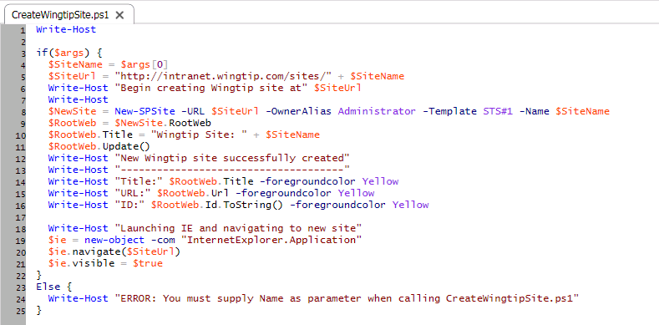
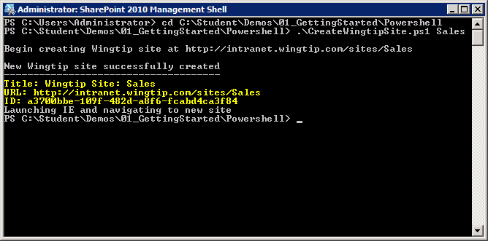
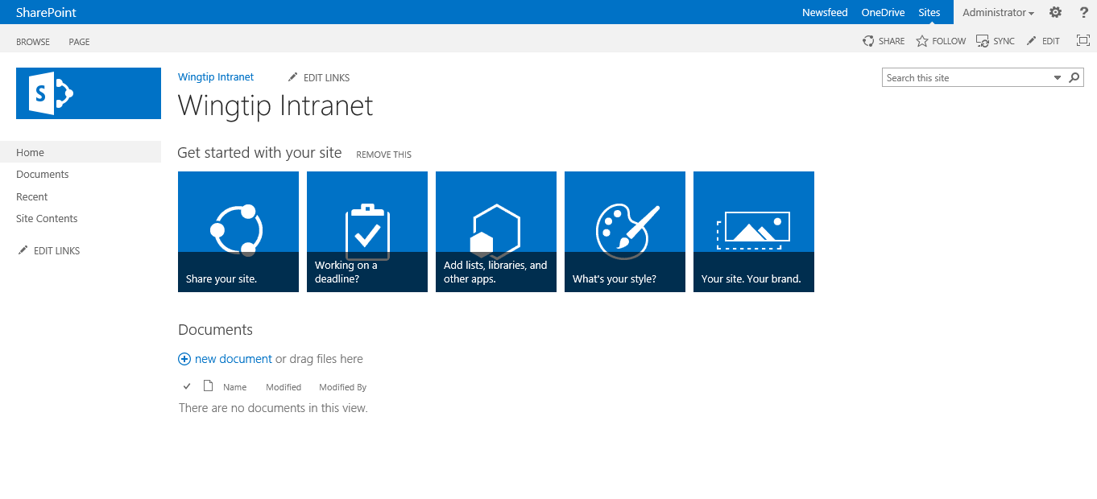
PowerShell Scripting for SharePoint 2013
Notes:
The example shows a PowerShell script which uses the New-SPSite cmdlet to create a new site. You should observe that the New-SPSite cmdlet returns a SPSite object which is then used to access the SPWeb object for the top-level site.

Slide 20
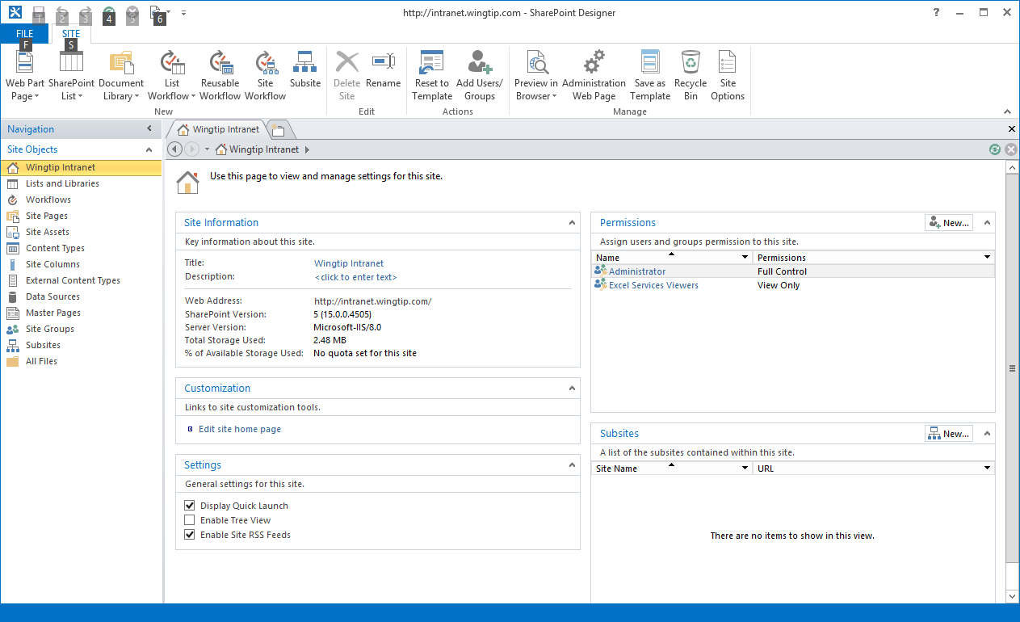
SharePoint Designer 2013
A Valuable SharePoint Utility Tool
Inspect and update site properties
Create and manage lists and document libraries
Many other things as well (e.g. create custom workflows)
Notes:
SharePoint Designer 2013 is the go to tool for Site management and workflow creation. If you are a visual designer, you may use SharePoint Designer, but you don’t have to. New features of SharePoint enable you to use any text editor you like for creating Master Pages and Page Layouts.

Slide 21
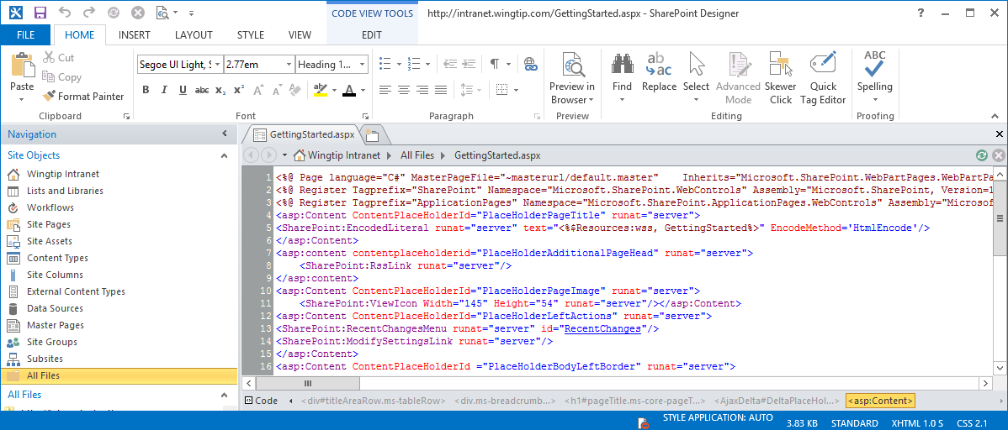
What’s New in SharePoint Designer 2013?
The Good News
Significantly improved support for creating workflows
The Bad News
No more Design View for editing HTML in web pages
Site pages must be edited in Code View
Notes:
SharePoint Designer 2013 is now used mainly for building workflows in SharePoint 2013. You don’t need it for visual design, but if you decide to use it you should know in advance that it no longer has any preview capability. It only has code view. Use a browser for previews.

Slide 22
Customizing a SharePoint 2013 Site using SharePoint Designer 2013

Slide 23
Agenda
SharePoint 2013 Overview
Office 365 versus SharePoint On-premises
Strategies for Building No Code Solutions
Working with Team Sites in SharePoint 2013
Working with Composed Looks

Slide 24
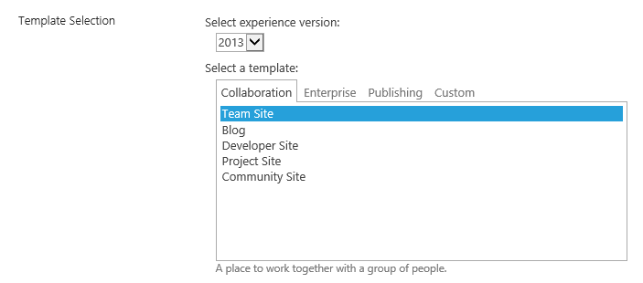
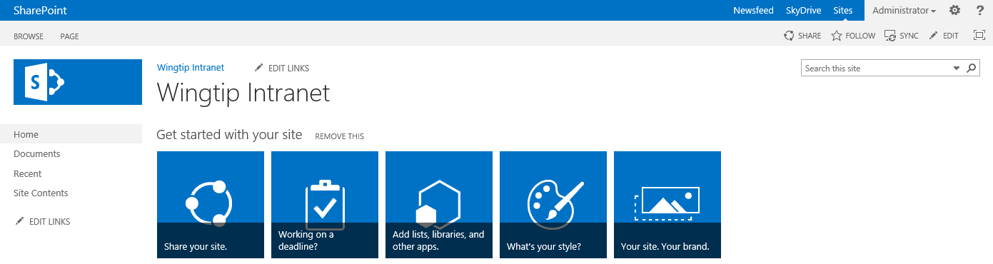
SharePoint 2013 Team Sites
Team sites provide support for collaboration
Same functionality as in earlier versions
SharePoint 2013 introduces new UI experiences
Notes:
SharePoint 2013 is the fifth major version of the SharePoint technology stack. Each version has enhanced the product and made significant changes to account for changes in the IT industry. However, a few things have remained consistent across versions. One example of this is the site template for creating Team Sites which has been available since the very first version of SharePoint technologies released in 2001. Team sites are the most commonly-created type of site in all versions of SharePoint.
The new team site in SharePoint 2013 looks quite a bit different from SharePoint 2010. The master page has changed. The Site Actions menu has been moved from the left to the right. Much of the user interface has been redesigned around the new app model.

Slide 25
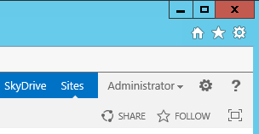
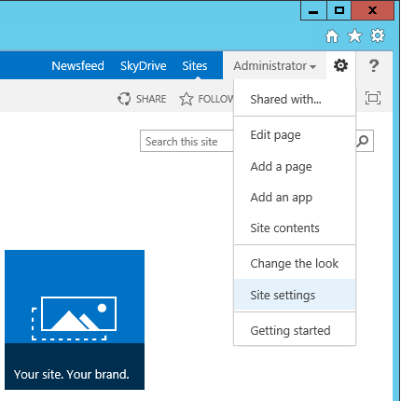
Site Actions Menu
Site Actions menu displayed in top right corner
Provides commands for actions and navigation
Internet Explorer Settings menu
SharePoint Site Actions menu
Configure permissions to this site
Edit the current page (applies to web part pages or wiki pages)
Add a new wiki page to the SitePages wiki page library
(Create new list or document library) OR (Install a new SharePoint app)
Navigate to Site Contents page
Navigate to the Change the Look page
Navigate to the Site Settings page
Navigate to the Getting Started page
Notes:
The Site Actions menu by default is now a Gear icon. It supports most of the necessary functions for managing your site and getting you to the site settings page.

Slide 26
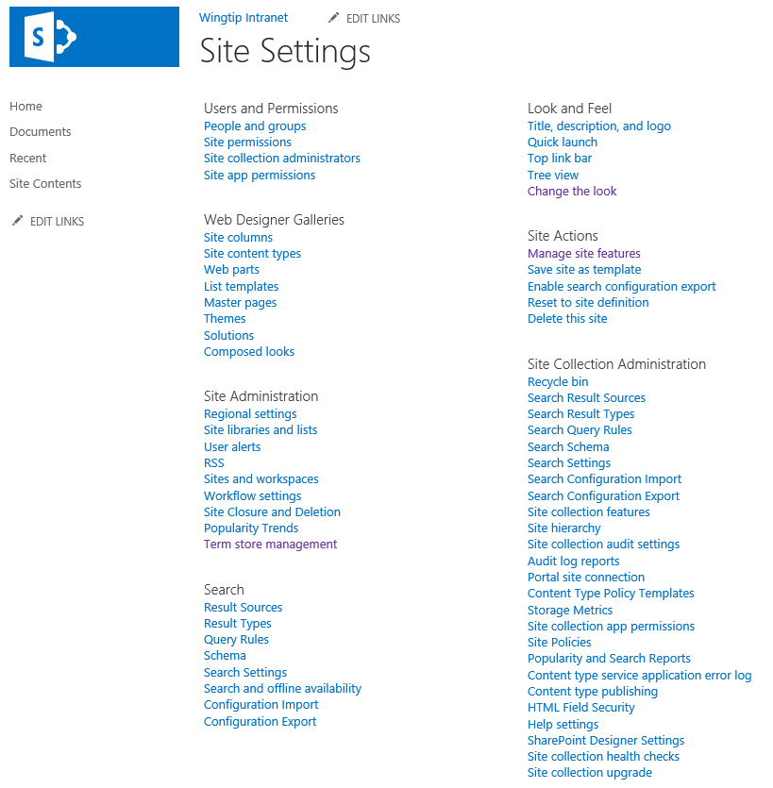
Site Settings
Notes:
Certain users are given the role as “site administrator”. Quite often this means that the user has been assigned the permissions of a site collection administrator. In some scenarios, the IT staff within a company may elect to use a more elaborate security configuration where business users are never configured as site collection administrators, but instead they are assigned less-powerful administrative permissions on one or more sites within a site collection. In either case, these users will be responsible for certain administrative duties at the site level.
Each site contains a site settings page ([site_url]_layouts/settings.aspx) which provides links to administrative pages which make it possible to perform common administrative tasks at the site level. The site settings page of the top-level site also contains links to pages which are used to perform administrative tasks on the site collection as a whole.

Slide 27
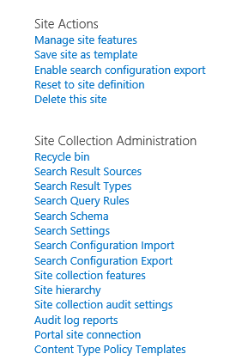
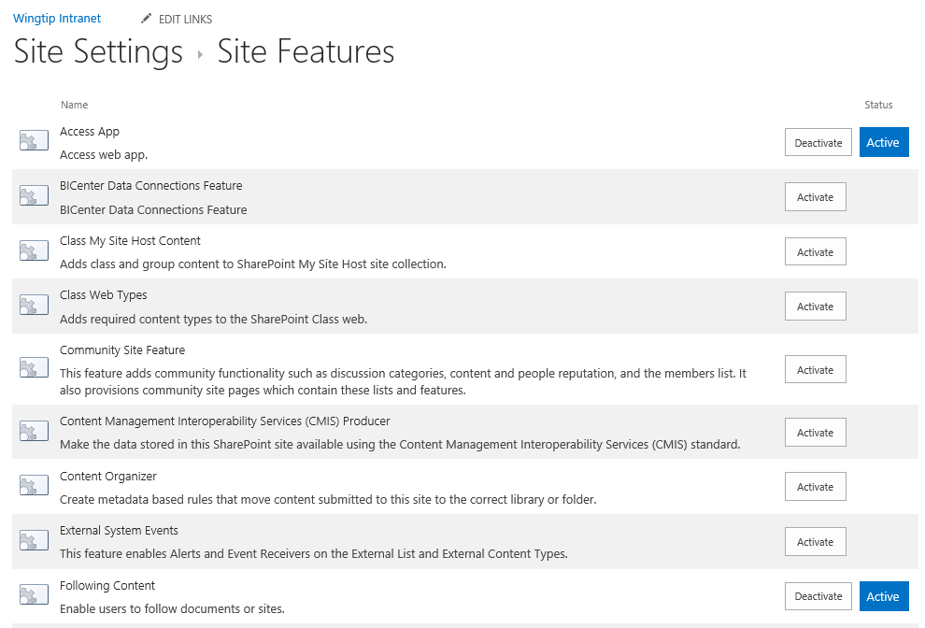
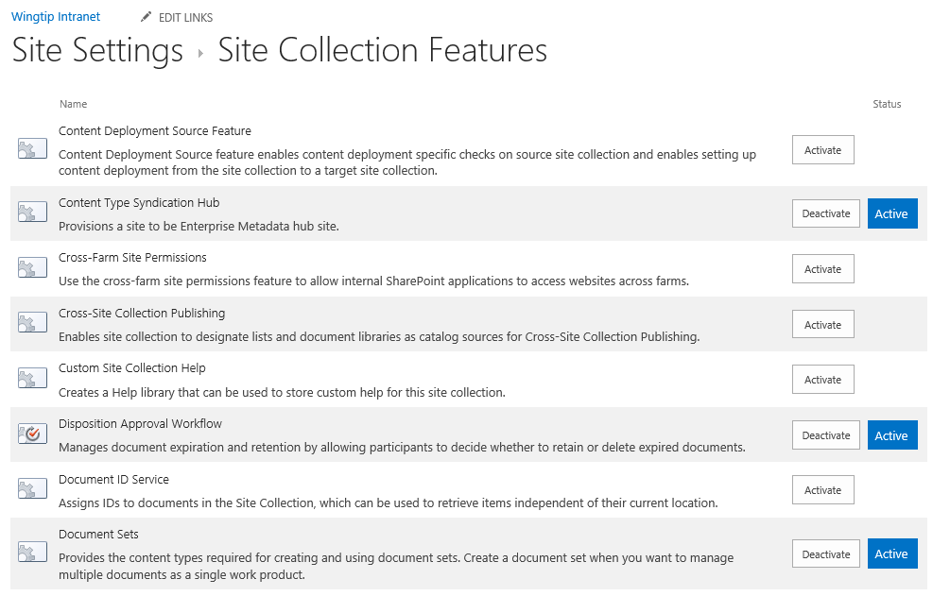
Managing Features
Site collection administrator can activate features
Some features activate at site (aka web) level
Other features activate at site collection level
Notes:
SharePoint adds functionality to sites through “Features”. If a desired behavior is not present you can Activate the associated feature and add that feature to your site. Features are scoped to the Site or Site Collection and may also have dependencies that must also be activated.

Slide 28
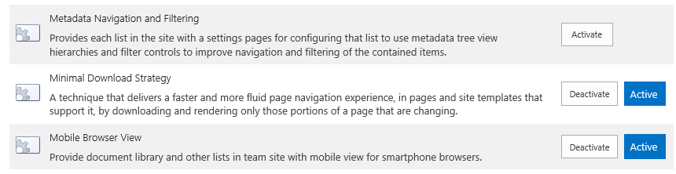
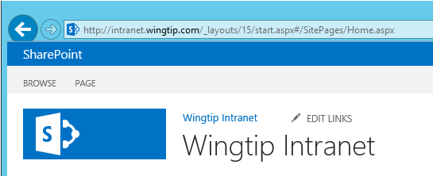
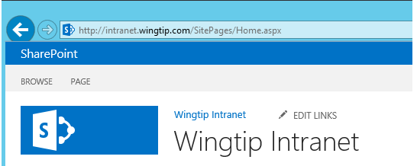
Minimal Download Strategy (MDS) Feature
MDS features used to smooth page transitions
Implemented with site-scoped feature that's
MDS features is activated in Team Site by default
Feature can be deactivated if change to URLs is undesirable
URL structure to site page with MDS feature activated
URL structure to site page with MDS feature deactivated
Notes:
The new feature Minimal Download Strategy uses an optimization that only sends the part of the page that has changed from view to view. This optimization does cause the URLs to get “funny looking” if you deactivate the MDS feature it will result in longer page load times and more predictable URLs.

Slide 29
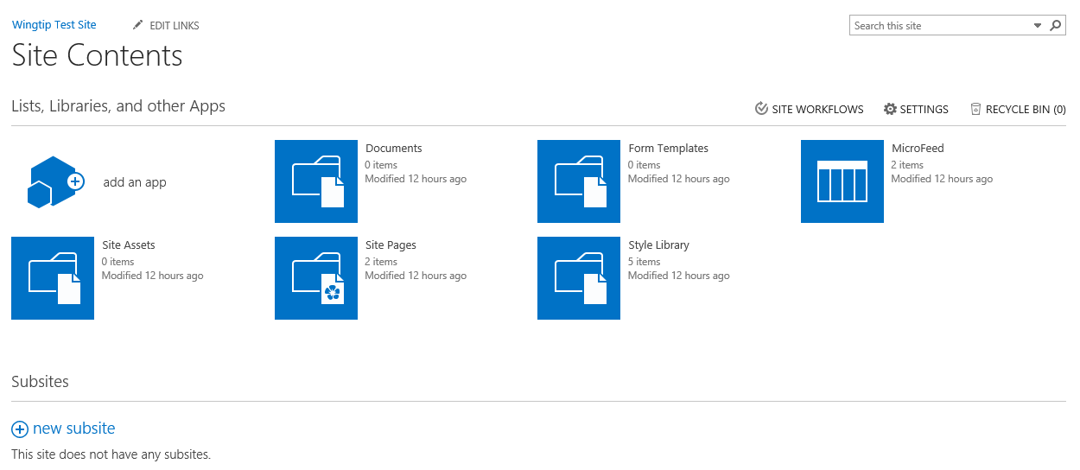
Site Contents
Site Contents page shows…
Lists in current site
Document libraries in current site
Apps available in current site
Add an app icon
Notes:
The Site Contents page shows the Apps (aka, lists and libraries) for the current site and a list of sub sites. From this page you can navigate to lists or directly to their settings and permissions pages.

Slide 30
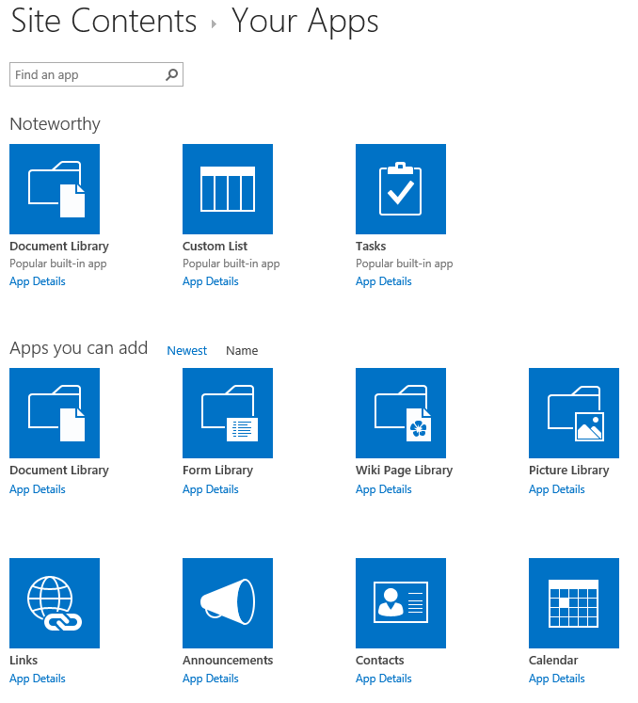
Your Apps
Steps to create a new list
Go to the Your Apps page
Click on desired list type
Provide title for new list
Configure list as required
Begin using list
Notes:
Creating a list or library (App) involves the following steps:
Navigate to the Site Contents page, this displays “Your Apps”.
Choose the list or library (or App).
Provide a name and other optional information,
Configure additional settings after the App is created.
Use the list.

Slide 31
Agenda
SharePoint 2013 Overview
Office 365 versus SharePoint On-premises
Strategies for Building No Code Solutions
Working with Team Sites in SharePoint 2013
Working with Composed Looks

Slide 32
SharePoint Integration with Master Pages
Each site has master page gallery
Contains a set of master pages
MasterUrl property of site points to current master page
Standard SharePoint 2013 master pages
Seattle.master - default used in SharePoint 2013
Oslo.master - alternate master page
V4.master - used for SharePoint 2010 UI mode
Notes:
In SharePoint 2010:
When a site is created, a Master Page Gallery is created and SharePoint provisions an instance of the following master pages.
v4.master
minimal.master
In SharePoint 2013:
When a site is created, a Master Page Gallery is created and SharePoint provisions an instance of the following master pages.
Seattle.master - used in SharePoint 2013 UI mode (15)
Oslo.master - used in SharePoint 2013 UI mode (15)
v4.master - used in SharePoint 2010 UI mode (4)
minimal.master - used in SharePoint 2010 UI mode (4)

Slide 33
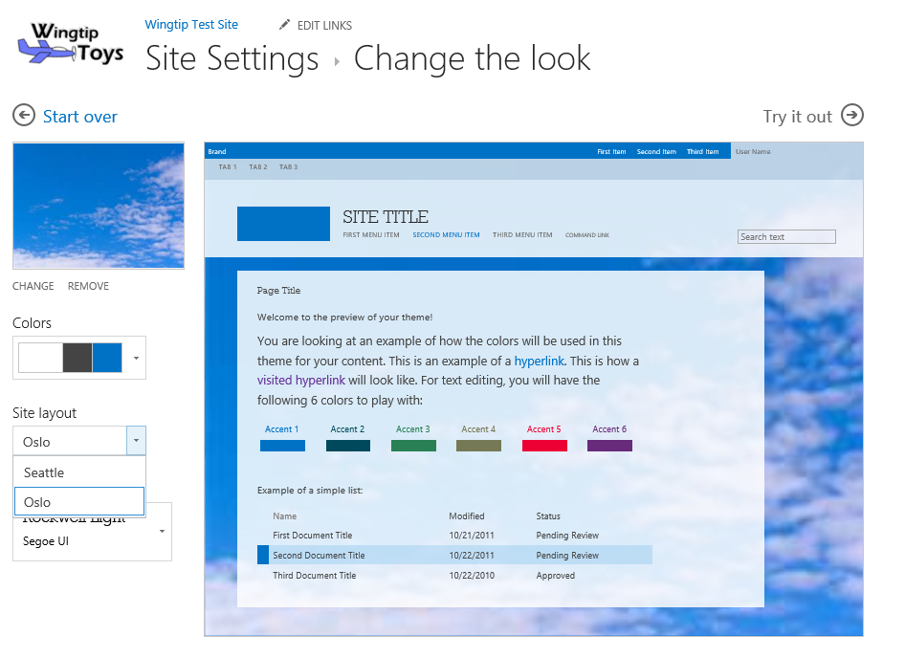
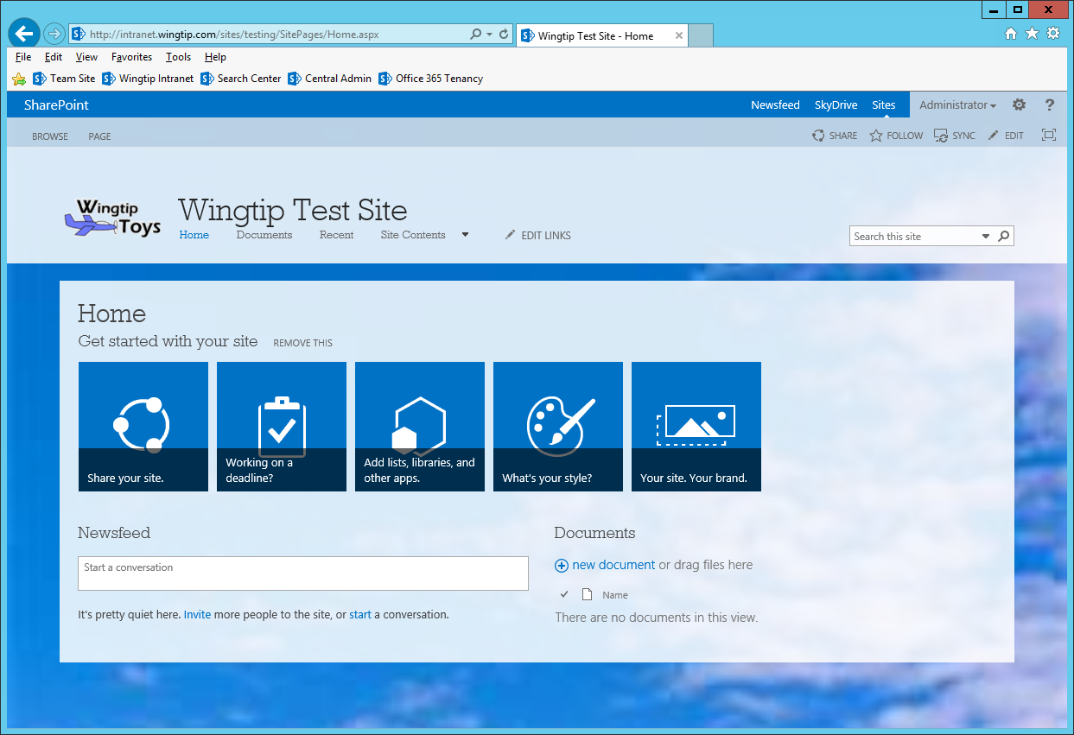
Changing the Look of a Site
Notes:
SharePoint 2013 introduces a new way to theme sites called Composed looks. These consist of a color pallet and fonts you can use to change the way a site looks.

Slide 34
Customizing the Look and Feel of a Team Site in SharePoint 2013

Slide 35
Summary
SharePoint 2013 Overview
Office 365 versus SharePoint On-premises
Strategies for Building No Code Solutions
Working with Team Sites in SharePoint 2013
Working with Composed Looks

