Slide 1
Creating Custom Forms using InfoPath 2013
Notes:
This module focuses on InfoPath 2013 and its integration with SharePoint 2013. You will learn how InfoPath 2013 can be used to replace the standard edit form for a SharePoint list with a custom InfoPath form designed to improve the user experience. You will also learn about the possibilities and techniques for creating custom InfoPath forms based on hierarchical data which can be published to a site in SharePoint 2013 using a Forms library.

Slide 2
Agenda
InfoPath 2013 Overview
Customizing Lists using InfoPath Forms
Working with Secondary Connections
Publishing InfoPath Forms to a Forms Library

Slide 3


What is InfoPath?
A Form Designer for Business Users
Visual Layout
Form Logic
Data Connections
Filling out InfoPath forms
InfoPath Designer 2013/2010
InfoPath Filler
Browser (thin client forms)
Notes:
Microsoft InfoPath 2013 is a powerful electronic form generation tool. InfoPath 2013 is the fourth iteration of this software, the first one coming out in 2003 (InfoPath 2003). InfoPath uses an XML format to standardize your form information. Because it follows a standard, it’s easy to write computer programs to interact with the form data to control the business process. In fact, InfoPath can often control the entire business process itself.
InfoPath 2013 is deeply integrated in designing list and library forms for SharePoint 2013 in both on-premises farms and in SharePoint Online. In addition to designing SharePoint list and library forms, you can design InfoPath form templates that can be published and hosted in a Form Library within SharePoint. Later in this module the differences between the two are compared.
InfoPath 2013 is actually a set of two applications:
InfoPath Designer: The tool that’s necessary to create/design forms.
InfoPath Filler: The tool for users to fill in the pre-designed forms (if you are running Forms Services then forms can be filled using the browser as well).
InfoPath gives the non-developer user a lot of power with a minimal amount of effort. The layout of forms is created using tables to align the labels and controls in the form. An extensive collection of controls (text boxes, drop-down lists, checkboxes etc.) is available at the form creator’s disposal. Form designers can easily and quickly configure form logic by clicking around in the interface. Data connections can be created also to a variety of data sources. And best of all, none of this requires any coding at all. These concepts are further discussed in later slides.

Slide 4
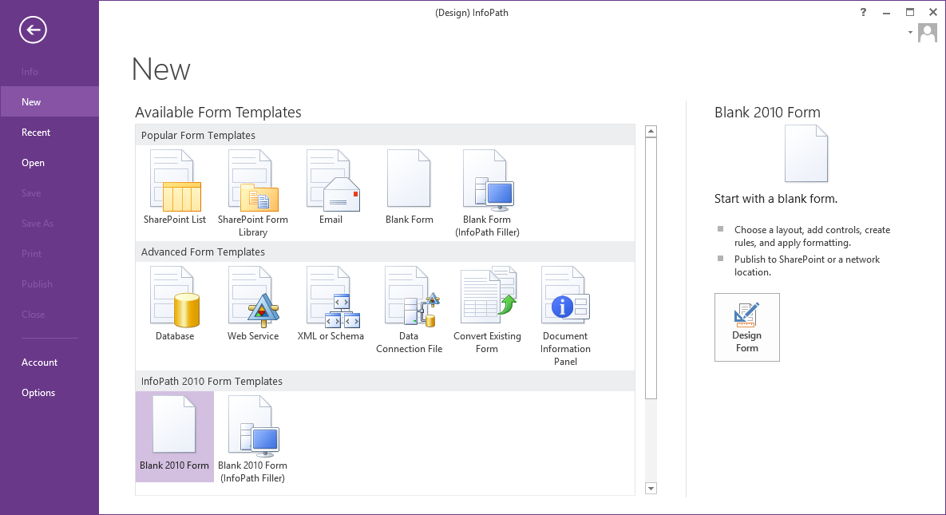
InfoPath Backstage
Pick a template to get started
Notes:
The InfoPath Backstage shows all of the different types of form solutions you can create. You can start with a Blank form and later decide where you want to publish it or start with a template that will guide you towards publishing your forms solution to a specific type of location.

Slide 5
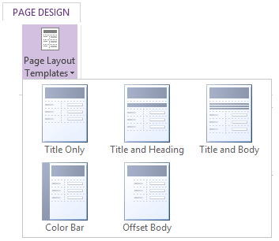
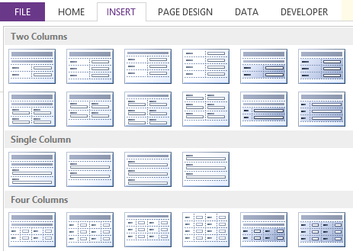
Using Page and Table Layouts
Page Layouts
Table Layouts
Notes:
To get started with form design, you can use the easy to use form development tools provided in the ribbon.
Start with using an existing pre-defined page Layout that comes close to what you envision the final form to be. Then use the Table Layouts within sections of the page to create various parts of the form. Finally, choose from a myriad of provided Themes to change the colors of your form.

Slide 6
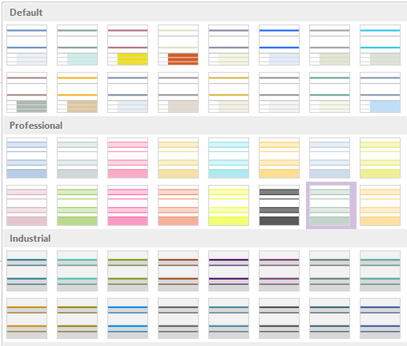
Using Themes
Themes provide pre-designed color combinations
Notes:
InfoPath provides a useful number of themes. This makes it much easier to add a stylish color scheme to the form instead of having it produce a bland visual experience lacking in personality.

Slide 7
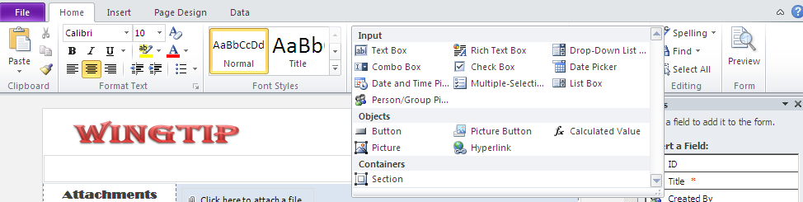
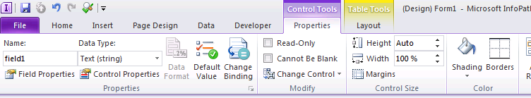
Working with Controls and Formatting
A rich set of design tools:
MS Word like formatting
Variety of Form Controls
Notes:
Formatting of text in InfoPath is just like within Microsoft Word. Form designers will realize that their knowledge of text formatting in Word transfers over very well to InfoPath.
A large set of input controls are available for the designer. Controls such as text box, check box, date picker and more which are usually used by developers to create forms are available to create robust and interactive applications.

Slide 8
A Lap Around InfoPath 2013

Slide 9
Agenda
InfoPath 2013 Overview
Customizing Lists using InfoPath Forms
Working with Secondary Connections
Publishing InfoPath Forms to a Forms Library

Slide 10
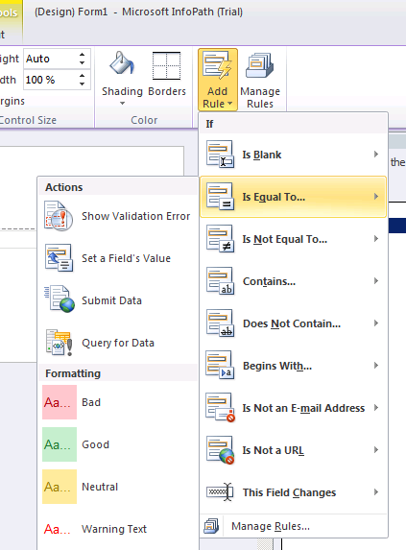
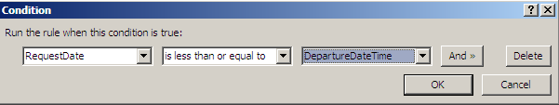
Creating Rules Which Contain Form Logic
Create Rules in Forms for:
Validation – Data Validation within controls
Formatting – Formatting of information displayed in controls
Action – Usually used on Buttons and Picture Buttons to execute an action
Notes:
Rules in InfoPath are like mini workflows. They can be attached to and executed on any control within the form. A rule is usually configured with certain conditions and multiple subsequent actions.
An Add Rule wizard exists in the ribbon to quickly create the most popular types of rules (shown in image on slide). If none of these will suffice for your need then clicking on Manage Rules button brings up the rules configuration task pane.
Three types of rules can be configured here:
Validation: Data validation is a necessity for many scenarios. An example of a validation rule would be to check if a field’s value is not equal to another field’s value and display an error if that’s the case.
Formatting: Formatting of control usually deals with changing the font or colors of a control based on certain criteria.
Action: Setting a field’s value, querying for data and submitting data are all different types of actions you can take when, for example, a button is clicked.

Slide 11
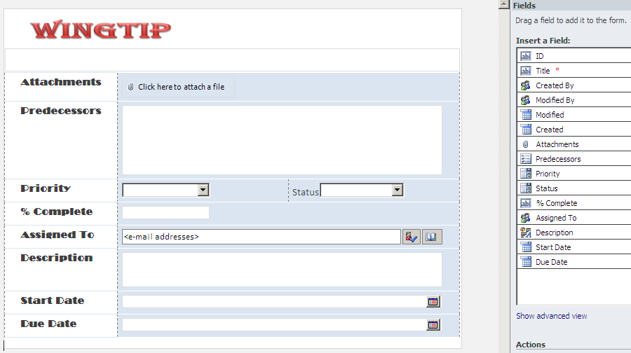
InfoPath List Form
Use the power of InfoPath to manage List Forms
Notes:
Work has been done in the InfoPath team to ensure that Information Workers get the experience they expect when editing forms using InfoPath. The InfoPath data source is hidden behind a ‘advanced view’ to hide the hierarchical nature of InfoPath data. The controls that you can use in InfoPath now also have parity with SharePoint.

Slide 12
Customizing the New and Edit Forms for a SharePoint List

Slide 13
Agenda
InfoPath 2013 Overview
Customizing Lists using InfoPath Forms
Working with Secondary Connections
Publishing InfoPath Forms to a Forms Library

Slide 14
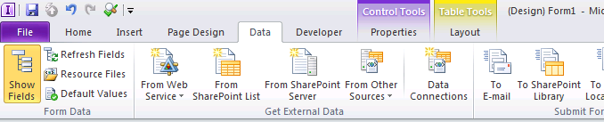
Data Connections to External Sources
Bring in data from a variety of sources:
Web Services
SharePoint List and Libraries
Databases
XML Files
Notes:
InfoPath excels in its capability to fetch data from external sources. Information can be fetched from a variety of places and incorporated within the form’s controls. Data can be gathered when the form is loaded or it can be queried based upon an event or action taken by the user.

Slide 15
Performing a Column Lookup using a Secondary Connection

Slide 16
Agenda
InfoPath 2013 Overview
Customizing Lists using InfoPath Forms
Working with Secondary Connections
Publishing InfoPath Forms to a Forms Library

Slide 17
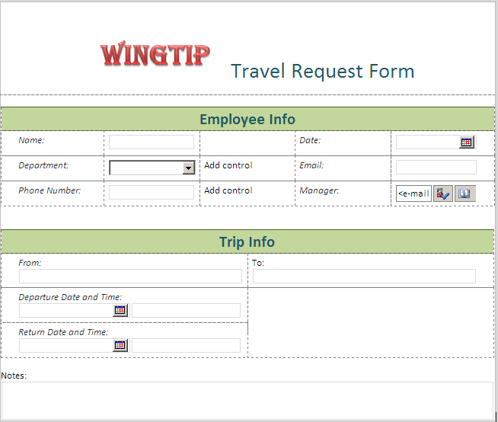
Form Library Forms
InfoPath Forms published to Form Library in SharePoint
Forms can be filled using InfoPath Filler or the browser
Notes:
The Form Library in SharePoint is enabled to host forms created in InfoPath. InfoPath publishes a form template, with a *.XSN extension, to a specified form library. End users can then visit this library and fill out forms using this template. The forms can get served either in the InfoPath client or the browser (this functionality requires SharePoint Enterprise CAL) depending on the settings set at the form library level. The resulting forms get saved with a *.XML extension.

Slide 18
Publishing a Custom InfoPath Form to a Forms Library

Slide 19
Summary
InfoPath 2013 Overview
Customizing Lists using InfoPath Forms
Working with Secondary Connections
Publishing InfoPath Forms to a Forms Library

