Slide 1
Working with ECM and Managed Metadata
Notes:
This module will cover all the Enterprise Content Management (ECM) capabilities in SharePoint 2013 in the areas of document management, records management and eDiscovery. Microsoft invested a considerable amount of effort in eDiscovery in SharePoint 2013 and this module will cover what students need to know. In addition students will also learn how to work with Managed Metadata, what’s new in SharePoint 2013 and how to leverage new functionality.

Slide 2
Agenda
Managed Metadata
Enterprise Content Types
Managing Large Content Sets
Metadata-driven Navigation
Records Management and eDiscovery

Slide 3
Managed Metadata Service
Term Store Management
Default Keyword Store
Shared Enterprise Term Store
User Profile Service Term Store
Enterprise Content Types
Syndication of Content Types
Content Type Publishing (Push Down)
Notes:
The Managed Metadata Service Application is responsible for maintaining the Enterprise Term Store. The term store is the location where the terms from Managed Metadata fields are stored. This is also the default location for the Enterprise Keywords, a special open term set used by the tagging and keyword fields in SharePoint. The Managed Metadata Service is also responsible for publishing Enterprise Content Types from a Content Type Hub site to all participating Site Collections.

Slide 4
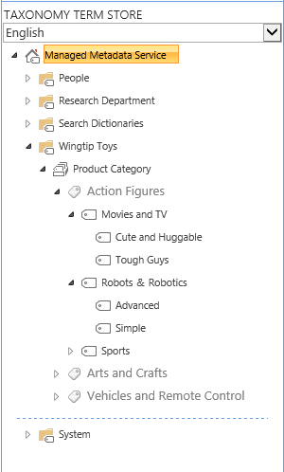
Understanding Terms and Term Sets
Term Store
Term Group
Term Set
Term
Term
Term
Notes:
The term store is hierarchical. Create a term group for a specific use and then create Term Sets that contain terms and sub terms.

Slide 5
Term Sets
Flat
Red
Blue
Hierarchical
North America>USA>Texas>Paris
Europe>France>Paris
Taxonomy
Structured Controlled
Generally Closed
Folksonomy
Unstructured
Generally Open
Notes:
Term sets can be flat like a list of colors or hierarchical like a list of Continents > Countries > States > Cities. Generally curated term sets are “closed” and managed centrally, but you can also create them “open” and let users add to them.

Slide 6
Working with Managed Metadata
Managed Metadata Column for Lists
Link to Term Set
Supports Open and Closed Term Sets
Enterprise Keywords Column
Specifically for Enterprise Keywords
Optionally Shared as Social Tags
Stored with the List data
Tags
Stored in the Social Database
Tag with URL (does not have to be SharePoint content)
Notes:
When using managed metadata you can use a special field that is linked to a term set. Alternatively you can add an Enterprise Keyword column and it automatically connects to the term store and exposes all terms. Both of these approaches store the taxonomy information with the list. If you rather use the tagging features of SharePoint the information is stored in the Social Database.

Slide 7
Working with Managed Metadata
Notes:
Managed Metadata Administration
Managed Metadata Fields

Slide 8
Agenda
Managed Metadata
Enterprise Content Types
Managing Large Content Sets
Metadata-driven Navigation
Records Management and eDiscovery

Slide 9
Enterprise Content Types
Central Store of Content Types
Published to Subscribed Site Collections
Republished when Source is Updated
In Subscriber Site
Cannot Edit Source Content Type
Create New Content Types that Inherit
Notes:
In early versions of SharePoint it was a challenge to keep content types synchronized across Site Collections. In 2010 the Managed Metadata Service was enhanced to Publish certain Content Types to all site collections as Enterprise Content Types. They are read only in the subscribing site collection, but can be inherited from.

Slide 10
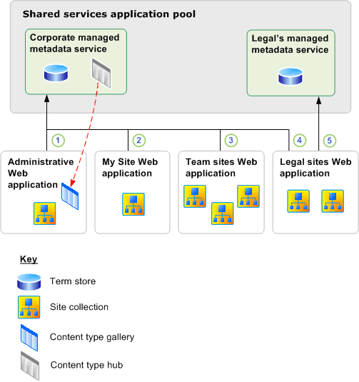
Enterprise Content Types
Notes:
In this diagram the Managed Metadata Service has a designated Content Type Hub that pushes it’s content types to the subscribed Web Applications and Site Collections.

Slide 11
Enterprise Content Type Publishing
Notes:
Configure Enterprise Content Types
Publishing and Republishing Content Types

Slide 12
Agenda
Managed Metadata
Enterprise Content Types
Managing Large Content Sets
Metadata-driven Navigation
Records Management and eDiscovery

Slide 13
Managing Large Content Sets
Metadata Navigation and Filtering Feature
Configure Navigation based on Hierarchies
Content Type
Choice Field
Managed Metadata
Configure Key Filters
Content Type
Choice
Managed Metadata
Person
Date
Number
Notes:
There are feature of SharePoint designed to present large lists and libraries more efficiently. Metadata Navigation enables you to create a navigational structure based on the contents Metadata rather than a standard folder structure. SharePoint creates indexes behind the scenes that make this approach very fast. Alternatively you can also create key filters to further refine you views of large data sets.

Slide 14
Agenda
Managed Metadata
Enterprise Content Types
Managing Large Content Sets
Metadata-driven Navigation
Records Management and eDiscovery

Slide 15
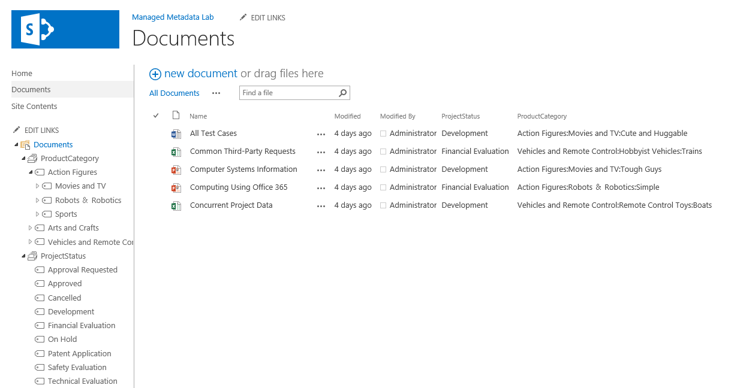
Metadata Navigation
Notes:
This figure depicts metadata navigation of a Document Library. The navigation looks like folders, but it is actually the hierarchical navigation of the associated term set.

Slide 16
Metadata Content Assistance
Content Organizer
Create metadata based rules that move content submitted to this site to the correct library or folder.
Column Default Value Settings
Configure Metadata Default values based on the location of data in the list and library.
Unique Document ID Service
Generate unique ID for each document
Site Collection Specific
Enable the Document ID Service Feature
Wait about 24 hours
Notes:
Other features empower users to organize their content in a SharePoint library. One great feature is the Content Organizer. You create organizer rules based on the submitted content and then the organizer can automatically create folders and manage the destination of the content from a central “drop folder”. You may also choose to set up Default values, so that documents that are dropped in certain folders will receive default metadata based on the folder. The unique document ID Service applies a Site Collection wide ID that works like a Perma-Link for the document.

Slide 17
Metadata Navigation
Notes:
Configure Enterprise Content Types
Publishing and Republishing Content Types

Slide 18
Agenda
Managed Metadata
Enterprise Content Types
Managing Large Content Sets
Metadata-driven Navigation
Records Management and eDiscovery

Slide 19
Records Management
In Place Records Management
Records Management of all content in SharePoint
Integrated with Exchange 2013 to place email holds
Security defines who can and cannot declare a record
Supported by Records Center
Though not required, Consider
Content Types
Retention Policies
Holds
eDiscovery
Notes:
In place Records Management means that users do not need to move their documents to declare them as records. You can use security to define who can and cannot declare records. Records Management takes some planning so consider that you will have to plan for Content Types and associated Retention Policies and then act on Holds and eDiscovery.

Slide 20
eDiscovery
Legal Action Requires Disclosure of Information
eDiscovery covers all electronic content
If SharePoint can crawl it, it can be discovered
SharePoint
File Shares
Exchange Public Folders
Exchange Mail Boxes*
Line of Business Systems
Facilitated by eDiscovery Center site
Notes:
SharePoint 2013 introduces new features for supporting eDiscovery efforts. This extends to any content that SharePoint can crawl. It included Mailboxes in Exchange 2013.

Slide 21
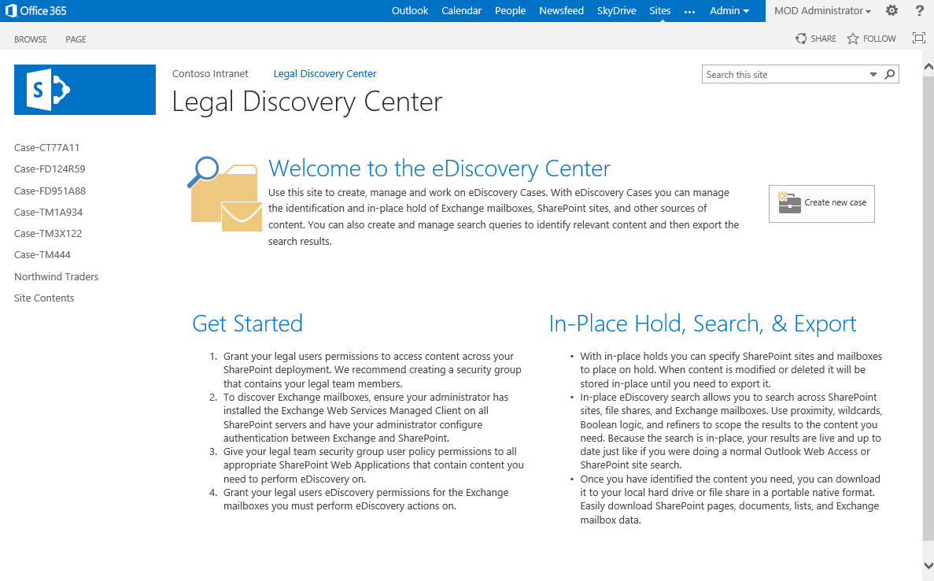
eDiscovery Center
Notes:
The eDiscovery Center uses a central site for creating new “Cases”. Each new case creates a Case Site.

Slide 22
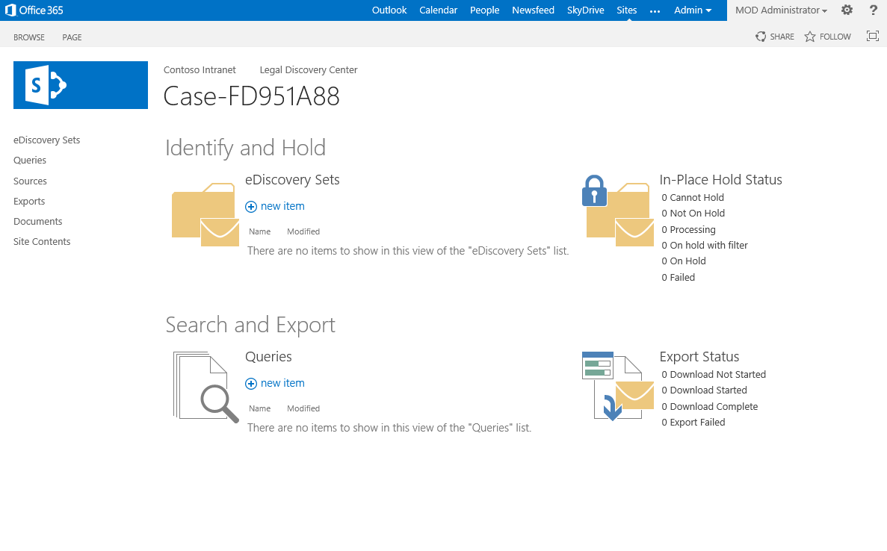
Case Site
Notes:
Case site is where the eDiscovery Team can create Queries for eDiscovery content and then place holds and export the content. This powerful feature of exporting content means that content from SharePoint can be discovered and exported to deliver to the litigation team.

Slide 23
eDiscovery and Case Sites
Notes:
Configure Enterprise Content Types
Publishing and Republishing Content Types

Slide 24
Summary
Managed Metadata
Enterprise Content Types
Managing Large Content Sets
Metadata-driven Navigation
Records Management and eDiscovery

