Slide 1
SQL Reporting Services in SharePoint 2013
Notes:
This module examines SQL Reporting Services (SSRS) in SharePoint 2013 and teaches you how to integrate SSRS with SharePoint. You will learn how to use the SQL Server 2012 Report Builder as well as how to build various different types of reports.

Slide 2
Agenda
SQL Reporting Services Overview
SharePoint Integration
Data Sources
Report Builder

Slide 3
SQL Reporting Services Overview
What is SQL Reporting Services (SSRS)?
Server-based reporting platform
Provides ready-to-use tools to create, prepare, deliver interactive and printed reports
Create interactive, tabular, graphical, free-form reports
Use relational, multidimensional, or XML-based data sources
Publish reports, schedule report processing, access on-demand (ad-hoc) reports
View reports via browser with SharePoint Integration
Notes:
SQL Reporting Services (SSRS) is a comprehensive, highly scalable, server-based platform that empowers real-time reporting. SSRS provides a full range of ready-to-use tools and services that provide the ability to create interactive and print-ready reports for your organization. With SSRS you can create interactive, tabular, graphical, or free-form reports using relational, multidimensional, or XML-based data sources.
You can publish reports, schedule report processing, or access reports on-demand (ad-hoc). Ad-hoc reporting gives users the flexibility to create dynamic reports based on their input. You can select from a variety of viewing formats, export reports to other applications such as Excel or PDF, and subscribe to published reports. The reports can be viewed via the browser in SharePoint with SSRS SharePoint integration.

Slide 4
Agenda
SQL Reporting Services Overview
SharePoint Integration
Data Sources
Report Builder

Slide 5
SharePoint Integration
SharePoint Integrated Mode provides the following features:
Alerts and version control ability on reports
Set permissions on reports and models
Publish or upload reports to SharePoint libraries
Use Report Designer, Model Designer, and Report Builder to create reports and data sources
Use Report View Web Part on SharePoint pages
Notes:
SQL Server Reporting Services can be installed in SharePoint Integrated mode. When the integration is enabled you gain a more tightly integrated reporting experience than in stand alone mode.

Slide 6

SSRS & Power View Integration Features
Activated by default after SSRS add-in for SharePoint is installed
Sometimes needs to be manually activated
Report Server integration and Power View integration features only active on root site collection
If SSRS add-in installed after SharePoint installation
Notes:
There are features in SharePoint that can be activated to integrate SQL Server Reporting Services and Power View. This integration supports a better end user experience for workers creating Business Intelligence solutions.

Slide 7

Report Server File Sync Feature
Optional SharePoint Site Feature
Synchronizes report server catalog with items in SharePoint document libraries
If deactivated, content will still sync just not as frequently if active
Site settings > Site features
Notes:
SharePoint supports report delivery and synchronization to document libraries. There is a feature that helps drive this synchronization, if enabled.

Slide 8
Power View
Interactive data exploration and visualization experience for SSRS
Browser-based Silverlight application launched from SharePoint
Great for ad-hoc reporting
Provides access to data represented by tabular models based on PowerPivot workbooks
Notes:
Power View is an interactive data exploration, visualization, and presentation experience for SQL Reporting Services that was introduced in SQL Server 2012. This Reporting Services Add-on for SharePoint is a browser-based Silverlight application launched from SharePoint. It provides access to data represented by tabular models based on PowerPivot workbooks either published in a PowerPivot Gallery or tabular models deployed to SQL Server 2012 Analysis Services (SSAS) instances.

Slide 9
Agenda
SQL Reporting Services Overview
SharePoint Integration
Data Sources
Report Builder

Slide 10
Data Sources
Before creating reports you must first create a data connection (aka data sources)
Data Sources include:
Data source type, connection information, type of credentials to use
Two types of data sources:
Embedded
Defined in report and used only by the report
Shared
Defined independently
Can be used by multiple reports
Notes:
Data Connections in SharePoint are created to access external data. When you create a data source you can optionally create a shared source outside of the report. The data source can be secured separately.

Slide 11
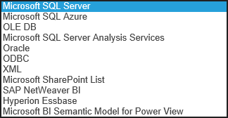

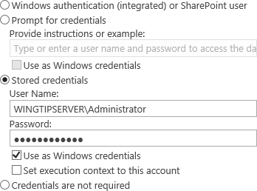
Creating a Data Source
To create a data source you must have the following information:
Data source type
Connection information
Credentials
Notes:
Like other data connections, you need to know the location and other connection information. If your report designer does not have this information the data source can be created separately by someone who does.

Slide 12
Creating Data Sources to SQL Server Tables and SharePoint Sites

Slide 13
Agenda
SQL Reporting Services Overview
SharePoint Integration
Data Sources
Report Builder

Slide 14
Report Builder
Reporting authoring tool for business users
Benefits of Report Builder:
Quickly add items to reports, launch table, chart, map wizards, and format report data
Add data using query designers to specify data to include in report
Create/use report parameters and other features
Preview reports that use shared data sources and shared datasets
Preview reports in HTML or print format
Notes:
The Report Builder installs from the report site. This enables users to create reports without having to install software beforehand. The click once installation is installed on demand. And provides the necessary features for creating the reports.

Slide 15
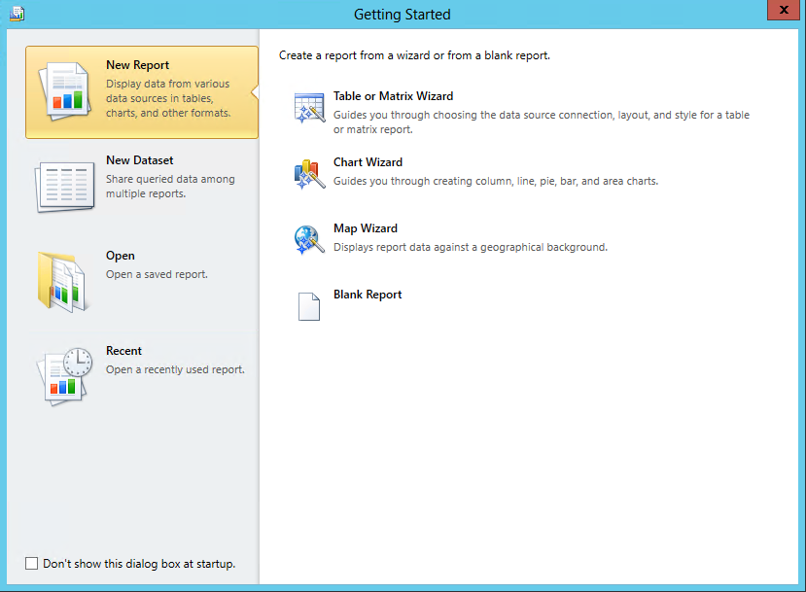
Report Builder
Notes:
The report builder in action. Create new reports with or without a wizard.

Slide 16
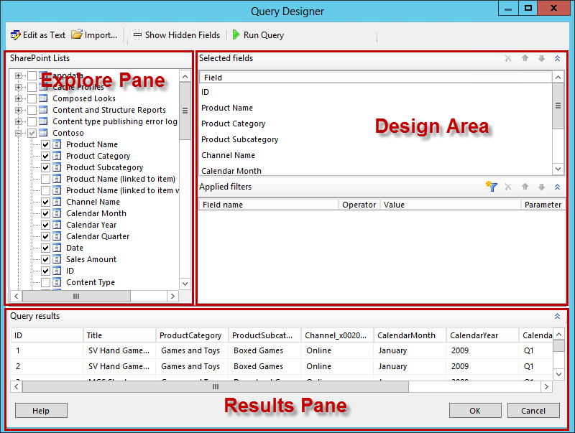
Graphical Design Query
Notes:
The graphical query designer makes it very easy to create and test complex queries.

Slide 17
Creating an SSRS Report based on content from a SQL Server Table

Slide 18
Graphical Design Query
SharePoint Lists
Displays SharePoint lists and fields within each item in the list
Selected Fields
Displays SharePoint field names of items selected in the SharePoint Lists pane
Applied Filters
Displays list of fields and filter criteria for tables or views
Query results
Displays data result set
Notes:
Data sources can include SharePoint lists as well as data from external databases. The Query Designer helps you craft the query and test the results.

Slide 19
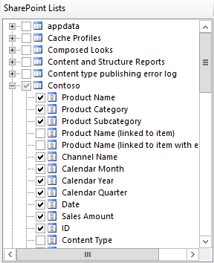
SharePoint Lists Pane
Displays metadata for database objects
Based on permissions to view
Determined by data source connection and credentials
Hierarchical view
Displays database objects organized by database schema
Expand node for each schema to view tables, views, stored procedures, table-valued functions
Expand table or view to display columns
Notes:
In the query designer you can select the table or list you wish to report and then choose the specific fields that you want to display in your reports. The hierarchical view is based on the schema of the lists (or tables) and columns (or fields) in the data source. If the data source is SQL, you can also target Stored Procedures and Views.

Slide 20
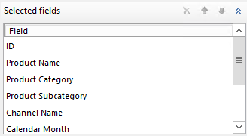
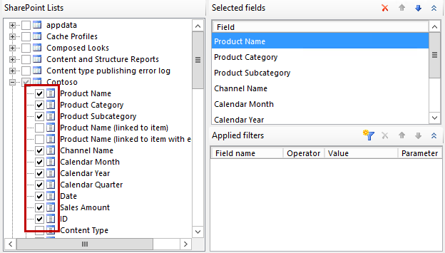
Selected Fields Pane
Displays list item fields of items selected in SharePoint Lists pane
These fields become the field collection for report dataset
To add or remove fields to this pane
Select or clear check boxes for table or view fields in SharePoint Lists pane
Notes:
The fields list helps you select the fields to return in your query for inclusion in your report. As you design the query use the checkboxes to select the fields for inclusion.

Slide 21
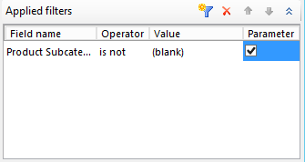
Applied Filters Pane
Use to filter data retrieved at run-time
The following columns are displayed:
Field Name
Displays name of field to apply criteria to
Operator
Displays operation to use in filter expression
Value
Displays value to use in filter expression
Parameter
Displays option to add a query parameter to query
Use Dataset properties to view relationship between query parameter and report parameter
Notes:
The filters pane creates a where clause for the query. Select the field and operator, for static filters you can specify a value. For dynamic filters you can specify that the filter accepts a parameter that can later be passed to the report.

Slide 22
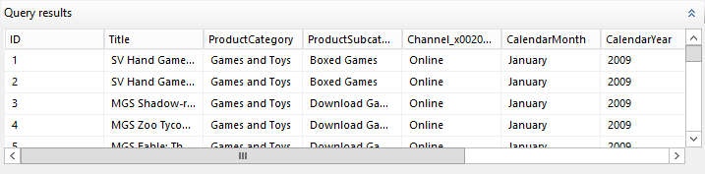
Query Results Pane
Click Run Query to execute query
Query results pane displays results for automatically generated query
Columns in result set:
Are fields specified in Selected Fields pane
Row data limited by filters set in Applied Filters pane
Notes:
The Query Result Pane shows a live interactive view of the results of your query. This is very helpful in determining if the query you are writing is working the way you want.

Slide 23
Graphical Query Designer Toolbar
Edit As Text
Toggle to text-based query designer
Import
Import existing query from file or report.
Supported file types (.sql & .rdl)
Run Query
Query results pane displays the result set
Show Hidden Fields
Toggle to show or hide fields automatically generated by SharePoint (ie. ProgId & Level for link items)
Typically not used in reports
Notes:
Tools in the Query Designer Toolbar help you fine tune your query. You can also import a query from other working reports.

Slide 24
Creating an SSRS Report based on content from a SharePoint List

Slide 25
Report Viewer Web Part
Installed by the Reporting Services Add-in for SharePoint Products
ReportViewer.dwp
Use to view, navigate, print, and export reports
Associated with report definition (.rdl) files
Can only link to a single report
Includes view area, toolbar, collapsible area for setting credentials/parameters, and properties
Notes:
You can add the report viewer web part to a page to show an associated report (by targeting the *.rdl file) or allow users to navigate the report collection.

Slide 26
Displaying SSRS Reports using the Report Viewer Web Part

Slide 27
Summary
SQL Reporting Services Overview
SharePoint Integration
Data Sources
Report Builder

