Slide 1
The SharePoint 2013 Search Service​
Notes:
Previous versions of SharePoint included various search implementations between SharePoint search and FAST search. In SharePoint 2013 Microsoft merged their search implementations into a single, unified search architecture with a powerful and robust search API that is accessible both in server-side and client-side solutions. In this module students will learn about the search architecture as well as how to leverage it in custom solutions.

Slide 2
Agenda
SharePoint 2013 Search Architecture
Managed Properties
Query Execution using KQL
Understanding Result Sources and Result Types
Creating Display Templates and Result Types
Creating Custom Query Rules

Slide 3
SharePoint 2013 Search Architecture
Public API
Unit of scale/role boundary
Content Processing
Search Index
Crawl
Index
Query Processing
WFE
API
Content
UX
Analytics
Processing
Search
Admin
Notes:
The crawl component crawls content sources to collect crawled properties and metadata from crawled items. It sends this information to the content processing component.
The content processing component transforms the crawled items so that they can be included in the search index. The component also maps crawled properties to managed properties. In addition, the content processing component interacts with the analytics processing component.
The analytics processing component analyzes the crawled items and how users interact with their search results. The information is used to improve the search relevance, and to create search reports and recommendations.
The index component receives the processed items from the content processing component and writes them to the search index. The component also handles incoming queries, retrieves information from the search index and sends the results back to the query processing component.
The query processing component analyzes incoming queries to help optimize precision, recall (which items are returned in the results) and ranking (the order of those items). The query is then sent to the index component which returns a set of search results for the query. The results can then be further processed before they are presented to the user as the search results for his/her query.
The search administration component runs the required search processes and adds and initializes new instances of search components.
The crawl database contains detailed tracking and historical information about crawled items such as documents and links. The database holds information such as the last crawl time, the last crawl ID and the type of update during the last crawl (add, update, delete).
The link database stores the information extracted by the content processing component and click-through information.
The analytics reporting database stores the results of search and usage analysis, such as the number of times an item has been viewed.
The search administration database stores settings for the Search service application, such as the topology, crawl rules, query rules and the mappings between crawled and managed properties.

Slide 4
Configuring the SharePoint Search Service
Central Administration (SSA)
Content Sources
Result Sources
Query Rules
New Managed Properties
Site Collection and Site
Result Sources
Result Types
Query Rules
Reassign Managed Properties
Notes:
Search can be configured at the Farm level for all major areas of Search Configuration. A subset of configuration items are available now in the Site Collection and the Site.

Slide 5
Search Administration
Notes:
Search Administration
Contrast with Site Administration

Slide 6
Agenda
SharePoint 2013 Search Architecture
Managed Properties
Query Execution using KQL
Understanding Result Sources and Result Types
Creating Display Templates and Result Types
Creating Custom Query Rules

Slide 7
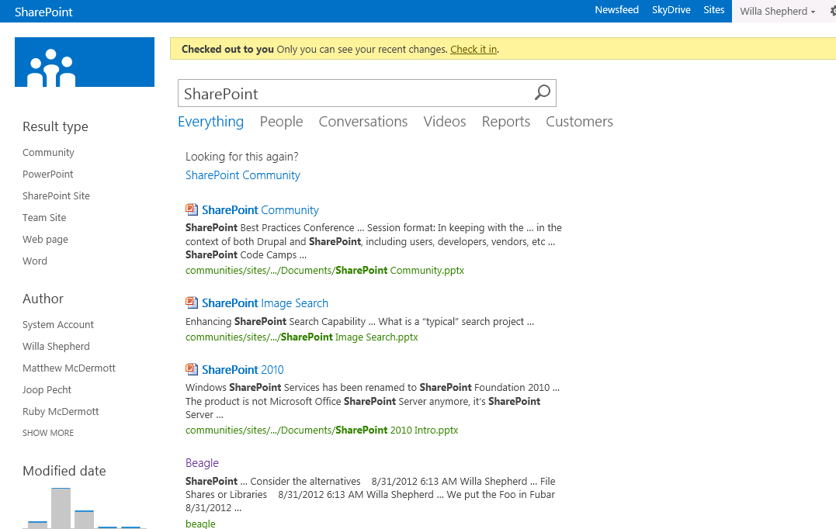
How do Queries get processed?
Index
Result
Types
Display
Templates
?
Query
Rules
Notes:
When an end user executes a query the query is processed and Query Rules are applied. The results are evaluated against Result Type Rules and matched to Display Templates. The final combination of Results are presented in the Search Results.

Slide 8
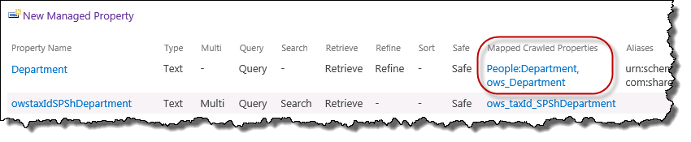
The Name Game
Field Names <> Managed Property Names
Profile Property Names<>Managed Property Names
Managed Properties 1:Many Crawled Properties
Notes:
In SharePoint Search Managed Properties must be created for any crawled data to be available for viewing, filtering or refinement. The process is generally to map a crawled property to a managed property. This process enables you to change the names of columns and also create aliases for properties. In the example above the Department managed property is mapped to both the People Department attribute as well as the Department column.

Slide 9
Managed Properties
Not only for Administrators anymore
Farm
Site Collection
Site
Managed Property Controls
Type & Multivalue
Query, Search, Retrieve, Refine, Sort, Safe
Notes:
Managed Properties used to be only available at the Farm level. Now in SharePoint 2013 site and site collection administrators can manage some settings for search. They can create and assign Managed Properties for creating search solutions for their sites.

Slide 10
Managed Properties
Notes:
Create and Map Managed Properties
Discuss Managed Property Attributes

Slide 11
Agenda
SharePoint 2013 Search Architecture
Managed Properties
Query Execution using KQL
Understanding Result Sources and Result Types
Creating Display Templates and Result Types
Creating Custom Query Rules

Slide 12
Query Language Options
Keyword Query Language (KQL)
Default query language
FAST Query Language (FQL)
Available, though disabled by default
SQL Query Language
Removed from SharePoint 2013
Notes:
SharePoint uses Keyword Query Language for requesting search results. You can also use the predecessor, FAST Query Language if you need to, but the SQL Query Language is no longer available.
More info: http://msdn.microsoft.com/en-us/library/jj163973.aspx

Slide 13
KQL
Free text
SharePoint
Wildcard
Share*
Property
Author:McD*, ContentType:Image
NEAR, ONEAR
SharePoint NEAR Social
Notes:
Keyword Query Language is pretty easy to understand. At it’s core is just a word or phrase that you are looking for, but it can be so much more. You can request a value of a specific property, like author, or content type. You can also use special operators like NEAR and ONEAR to find words in relation to one another.

Slide 14
Search Queries
Notes:
Free text Queries
Managed Property Queries
People Queries (Phonetic Name Search)
MacDermot
Theodore
Kenneth

Slide 15
Agenda
SharePoint 2013 Search Architecture
Managed Properties
Query Execution using KQL
Understanding Result Sources and Result Types
Creating Display Templates and Result Types
Creating Custom Query Rules

Slide 16
Search Result Sources
Think “Scopes”
…then forget everything you know about scopes
Consider them…
…a way to help the user find content
…a way to improve the users query
…a way to discover popular content
…or just call them new and improved scopes!
Notes:
Search Result Sources are “slices” or sub sections of the Index. They are based on rules. One you have crawled content and you decide you need to run a query against a specific kind of content you can create a result source to make that process easier.

Slide 17
Result Types
Result Types are Applied with Rules
Result Types Act on Search Results
Result Types are tied to a Display Template
Notes:
Result Types run when results are returned from a Query. The result Type rules run to determine what Display Template should be applied to the results.

Slide 18
Agenda
SharePoint 2013 Search Architecture
Managed Properties
Query Execution using KQL
Understanding Result Sources and Result Types
Creating Display Templates and Result Types
Creating Custom Query Rules

Slide 19
Display Templates
HTML Template for
Search Result
Refiner
Content By Search
Controls
Containers
Etc…
Upload HTML and SharePoint Converts it to *.JS
Use any editor
NotePad++, Dreamweaver…
even SharePoint Designer!
Notes:
Display Templates determine how a specific result should look. Out of the box you get a bunch of templates, and you can easily create more for your specific needs. They consist of a HTML file with specific markup that SharePoint understands. You don’t need SharePoint Designer for this either.

Slide 20
Display Templates and Result Types
Notes:
Create a Display Template for the new Managed Properties
Create a Result Type
Discuss Refiners too.

Slide 21
Agenda
SharePoint 2013 Search Architecture
Managed Properties
Query Execution using KQL
Understanding Result Sources and Result Types
Creating Display Templates and Result Types
Creating Custom Query Rules

Slide 22
Query Rules
Intercept and change a users query
Promote Special Content
Best Bets
Detect the User
Act on user “intent”
Perform another query
Create banner ads
Change the rank of results
So much more…
Notes:
Query Rules allow you to promote content (we used to call these Best Bets), but they do so much more thanks to the powerful rules we can run on the query submitted by the user. For example, you can detect who the user is or what department they are in and use that in your rule to promote content.

Slide 23
Query Rules
Notes:
Query Rules for:
Banner
Experts
My Documents

Slide 24
Summary
SharePoint 2013 Search Architecture
Managed Properties
Query Execution using KQL
Understanding Result Sources and Result Types
Creating Display Templates and Result Types
Creating Custom Query Rules

