Slide 1
Workflow in SharePoint 2013
Notes:
This module begins by explaining the drastic differences between the new SharePoint 2013 workflow architecture compared to what existed in SharePoint 2010. The good news is that all these underlying changes to the workflow architecture have also brought about dramatic improvements to the design process of creating custom workflows in SharePoint Designer 2013. You will learn about the new support for stages, looping, assigning tasks and calling up web services across the network. The module will also explain the backwards compatibility support which allows you to integrate new SharePoint 2013 workflows together with older custom workflows which have been migrated from SharePoint 2010.

Slide 2
Agenda
SharePoint Workflow Overview
SharePoint Workflow Fundamentals
Creating SharePoint 2010 Workflows
Creating SharePoint 2013 Workflows

Slide 3
Scenario – Product Approval
Write
Product
Proposal
Submit
Proposal
For
Approval
Approve
Or
Reject
If approved,
Create New
Product Plan
Notes:
When defining a workflow it is important to focus on the different stages that the workflow item will pass through as it goes, for example, from draft through to approved status. These stages can then be broken down into actual workflow Stages in the final workflow design in Visio or SharePoint Designer.

Slide 4
SharePoint 2010 vs. 2013 Workflows
SharePoint 2013 support two workflow platforms
SharePoint 2010 workflows (older format)
SharePoint 2013 workflows (newer format)
Benefits to using SharePoint 2010 workflows
Migrate existing workflows from SharePoint 2010
Support out-of-box with no additional configuration
Benefits to using SharePoint 2013
More scalable - especially in SharePoint Online
Improved design experience in SharePoint Designer
Notes:
Customers creating new workflows in SharePoint 2013 are presented with two options in SharePoint Designer 2013:
SharePoint 2010 Workflow: Workflows based on the same SharePoint 2010 model using .NET Framework 3.5 SP1 WF. These execute the same way they did in SharePoint 2010 (they run within the same SharePoint processes) and cannot leverage any of the improvements outlined in the remainder of this module.
SharePoint 2013 Workflow: This option is available when SharePoint 2013 is connected to a configured instance of Workflow Manager. These workflows execute within Workflow Manager and not within the SharePoint process. They can leverage all the improvements outlined in the remainder of this module.
If the SharePoint farm has not been connected to a Workflow Manager farm, SharePoint Designer 2013 will allow the creation of SharePoint Server 2010 style workflows. These workflows will not have any of the new capabilities offered in SharePoint 2013 or Workflow Manager and will be executed within the SharePoint workflow host which was carried forward from SharePoint 2010.
When building workflows with Visual Studio 2012, developers can create SharePoint 2010 style workflows that are coded and must be deployed using farm solutions. These workflows will run within the same workflow host that was included in SharePoint 2010 and are only available for on-premises SharePoint deployments. Visual Studio 2012 also supports creating SharePoint 2013 style workflows which will be covered later in the module.

Slide 5
Agenda
SharePoint Workflow Overview
SharePoint Workflow Fundamentals
Creating SharePoint 2010 Workflows
Creating SharePoint 2013 Workflows

Slide 6
SharePoint Workflow Actors
Workflow Template
WF Program and optionally workflow input forms
A feature to install it inside WSS farm
Workflow Association
Binding of workflow template to list or content type
A named instance containing parameterized data
Workflow Instance
A running instance of a WF program
Attached to an item
Notes:
A workflow template defines the workflow stages, activities and forms. Once the template is bound to a list, library or content type it is named and can be parameterized based on the columns in the list or content type. When a user starts a workflow the workflow instance is created, a single running “version” of the associated workflow. It is important to understand the distinction between these different concepts.

Slide 7
Configuring a Workflow Association using a Built-in Workflow Template

Slide 8
Agenda
SharePoint Workflow Overview
SharePoint Workflow Fundamentals
Creating SharePoint 2010 Workflows
Creating SharePoint 2013 Workflows

Slide 9
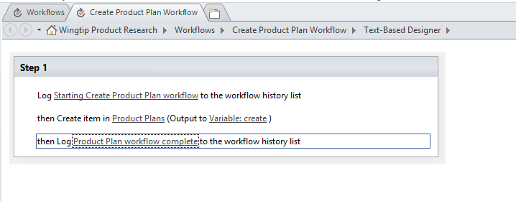
Creating SharePoint 2010 Workflows
Works just like it does in SharePoint 2010
Very few changes in what is possible
SPD improvements only for SharePoint 2013 workflows
Notes:
SharePoint 2013 supports both SharePoint 2010 style workflows and 2013 style workflows. The activities for 2010 have not changed or been improved much, most of the new features of workflow are introduced in the 2013 style workflows. You will benefit from an improved design experience in SharePoint Designer.

Slide 10
Creating Custom SharePoint 2010 Workflows

Slide 11
Agenda
SharePoint Workflow Overview
SharePoint Workflow Fundamentals
Creating SharePoint 2010 Workflows
Creating SharePoint 2013 Workflows

Slide 12
Workflow in SharePoint 2013
Workflow processing moved to Workflow Manager (WM)
No longer runs in the SharePoint content farm / servers
SharePoint farm & WM farm can be on same / different servers
Improves stability, scalability & transparency
SharePoint 2013 leverages WM
WM hosts Workflow Foundation v4 (WF4)
Notes:
SharePoint 2013 takes a very different approach to workflow. Existing SharePoint 2010 workflows will still run using the same legacy SharePoint 2010 / .NET Framework 3.5 architecture and developers/users are free to continue creating workflows using this approach although it is not recommended.
SharePoint 2013 workflows are based on Windows Workflow Foundation 4.0 (WF), which has been substantially redesigned from earlier versions. WF, in turn, is built on the messaging functionality provided by WCF. The workflow story in SharePoint 2013 now treats workflow as a separate service and leverages Workflow Manager which includes the WF included in .NET Framework 4.0. The workflow service provided by Workflow Manager is decoupled from SharePoint and no longer runs in the content farm. Rather it runs on it’s own servers. Workflow Manager also leverages the latest and greatest advancements in workflow capabilities, performance and scalability from Microsoft.
Workflow Manager is very much a customer and leverages the new SharePoint App Model architecture in that workflow (like apps) are treated as a “service”. SharePoint instructs Workflow Manager to execute a workflow and the two products communicate with each other over a service model infrastructure (WCF).

Slide 13
SharePoint Designer 2013
Improved visual designer
Integrated the Visio designer into SharePoint Designer
Visio installation required for visual designer
Can switch between visual designer & text-style
Activity properties editable in visual designer
Support for Stages & Loops
Support for calling Web Services
Workflow designer supports Office operations:
cut / copy / paste / undo / redo / select-all
Improved email editor (rich formatting)
Notes:
SharePoint Designer 2013 now provides a visual workflow designer. The previous version, SharePoint Designer 2010, offered integration with Microsoft Visio 2010 so that you could design workflows visually in Visio and then import them into SharePoint Designer. Now, you can visually design your workflows by dragging, dropping, and connecting shapes directly within SharePoint Designer 2013. You can set all the properties of a workflow action in the new visual workflow designer — just select the shape and then click the action tag. Also, if you click Properties on the action tag, the property grids for conditions and actions appear in the visual designer, just as they do in the declarative workflow designer.
Loops: SharePoint Designer 2013 now provides looping. A loop is a container that you can use to group conditions and actions that you want the workflow to process repeatedly.

Slide 14
SharePoint 2010 Workflow Challenges
Designed for on-premises deployments
Didn’t scale well in the cloud (Office 365)
In SharePoint, extending WF meant you had to be a box admin
Only possible via farm solutions
Analytics on current / previous workflow instances hard to acquire
Buried within the SharePoint content databases
Workflows were executed in the context of SharePoint as super user
Notes:
Workflows built for SharePoint were tightly coupled with SharePoint, ran at a very low level and were designed primarily for on-premises deployments.
This meant that coded workflows could not run within the sandbox or in a hosted environment.
All workflow data was also retained within the site collection’s content database where the workflow ran.

Slide 15
SharePoint Deployments & Workflow
Office 365 / SharePoint Online
Workflow Manager hosted version already deployed & managed by Microsoft
No custom setup / configuration actions necessary
SharePoint On-Prem Deployment
Customer must install a Workflow Manager farm
After Workflow Manager farm installed, must connect SharePoint 2013 farm to Workflow Manager farm
Notes:
This new architecture is available both in the on-premises model using Workflow Manager as well as in a hosted model. By moving to this new architecture, SharePoint benefits from improvements in stability and scalability in the workflow platform. In addition, Workflow Manager is much more transparent where developers can use a service-based API to gain insight into metrics and analytics of WF.
Regardless of how you are using SharePoint, either in a hosted deployment such as SharePoint Online in Office 365, or on-premises (where you install SharePoint on your own corporate servers), workflows are created and are processed the same way.
Microsoft has already installed and configured Workflow Manager and connected it to SharePoint Online in Office 365 so there is no extra work for you to do; you can create and deploy workflows right away in this scenario.
If you are running SharePoint on-premises, as in the case where you install it on your own servers, you need to install and configure a Workflow Manager farm. After installing and configuring it, you will need to then connect your on-prem SharePoint farm to the Workflow Manager farm. Once this is done you’ll be in the same state as SharePoint Online and can then create and deploy workflows on-prem.

Slide 16
SharePoint 2013 Workflow Changes
Ability to call Web Services
Workflows on WF4 are fully declarative
No more custom code within workflows
When you would have needed custom code, now build a Web Service & call it from the workflow
Full parity between deployment types
SharePoint 2013–style workflows based on WM will work the same way regardless of the deployment type
Tooling improvements:
SharePoint Designer 2013
Visual Studio 2012
Notes:
You can now call web services from within declarative workflows. Data returned by those Web services is stored in workflow variables and can then be used by the workflow in any number of scenarios. These actions provide tremendous flexibility in integrating data external to SharePoint into your workflows. The recommended approach to embedding custom logic implemented with custom code in SharePoint 2013 workflows is to create a custom service and use the new service actions so all can consume these from your declarative workflow.
In addition, all workflows now in SharePoint 2013 executed by Workflow Manager are fully declarative. This means custom managed code within a workflow project is no longer possible. When you would have written custom code, the guidance is now to build a custom web service, ideally an OData service with WCF Data Services (Microsoft’s implementation of the OData protocol) and call these services using the new activities provided.
Both SharePoint Designer 2013 and Visual Studio 2012 have also received significant improvements as covered later in the module. Finally, Microsoft also included quite a few new actions and activities for use in creating workflows.

Slide 17
SharePoint Designer Workflow Stages
Each stage has an entry point & gate
Gate: conditional transition point where workflow exits
Underlying core in WF4 flow step in a flowchart
Can contain multiple steps
Mitigates SharePoint Designer loop limitations
Notes:
Microsoft has introduced the concept of stages to workflows in SharePoint 2013. Stages, founded on the flowchart workflow type in WF 4.0, mitigate a lot of the challenges people had creating workflows with SharePoint Designer in previous versions of SharePoint, specifically the loop limitations. Each stage has an entry point and gate. All workflows start by entering the first stage. At the end of a stage the workflow author dictates the next stage (optionally using a conditional IF statement) the workflow should proceed to. Further, each workflow stage can contain multiple steps and actions within it.
Stages: In the past, declarative workflows have been strictly serial: They start at the beginning and progress to the end. Now, SharePoint Designer 2013 introduces an important new building block—the stage. Stages are a top-level container that you use to group together conditions, actions, or steps. The conditions, actions, or steps in one stage are processed in the listed order before the workflow transitions to the next specified stage. But here’s the important part: The transition means that the next stage can be any stage in the workflow—not necessarily the next stage serially.
Stages, not steps, are the new top-level containers.
Stages cannot be nested in any other building block; a stage must be at the top level.
Only stages can have Go To actions, and the target of a Go To action must be another stage.
Steps can be nested in stages and other steps.
A stage can be connected only to another stage. (In the visual workflow designer only, a stage can also be connected to a condition shape.)

Slide 18
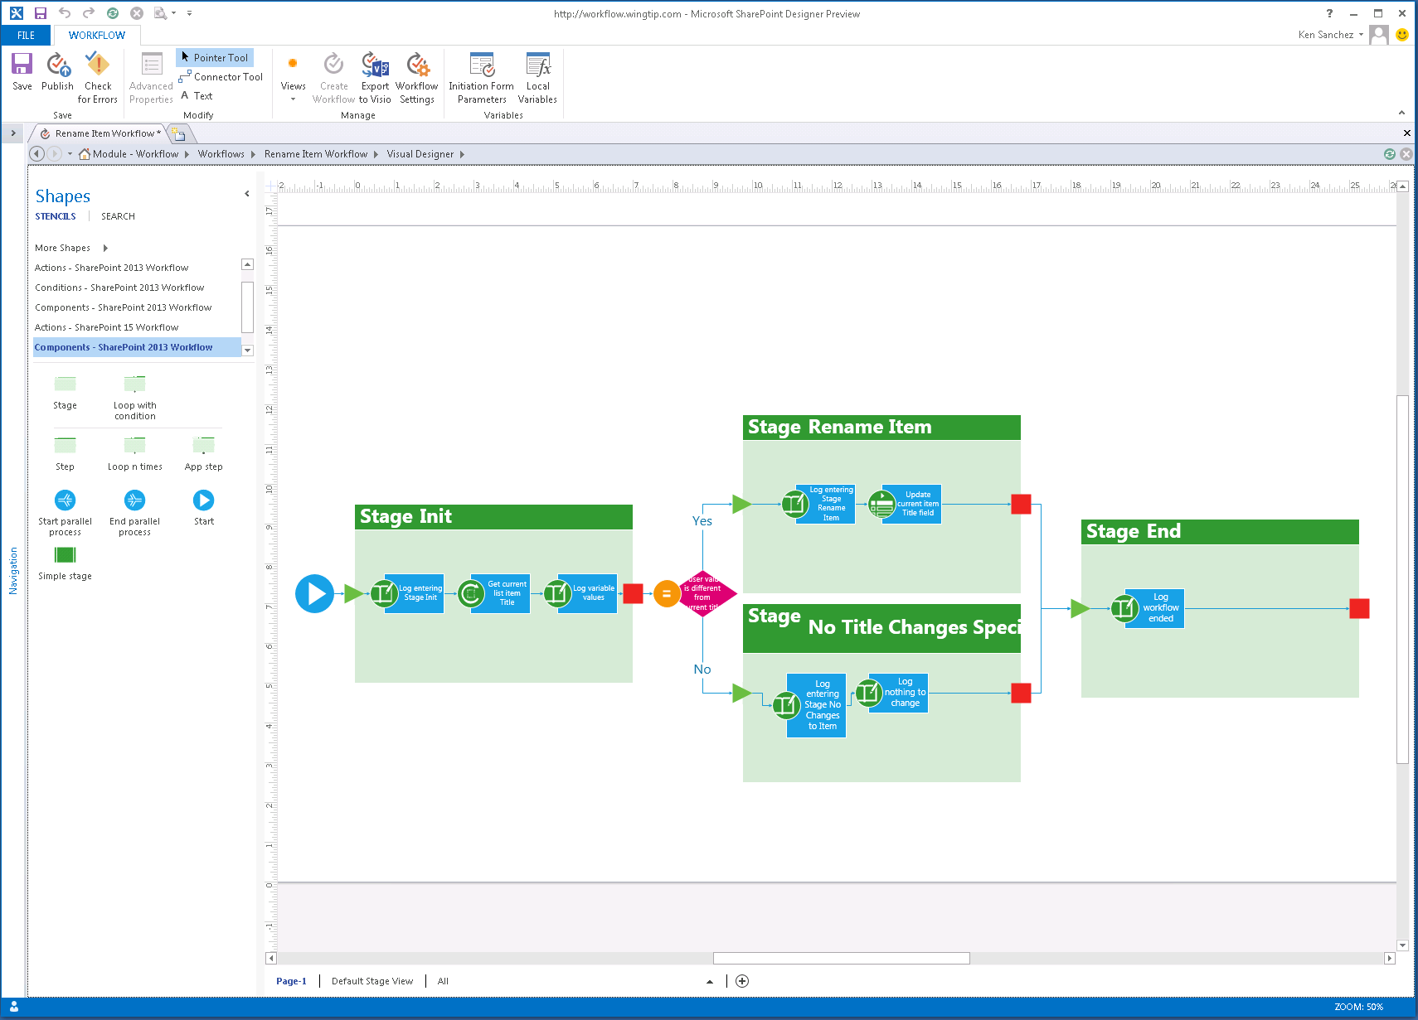
SharePoint Designer – Visual Designer
Notes:
In addition to the existing Test-Based Designer, SharePoint Designer has been improved to include a visual designer for authoring and customizing workflow, similar to how Visio allowed you to create workflows in previous versions of SharePoint. This new designer in SharePoint Designer, available when Visio is installed, allows you to not only customize the workflow actions and stages but you can modify the properties of the actions directly in the Visual Designer.

Slide 19
New Workflow Activities & Actions
New Actions & Activities |  | Microsoft Project Specific Actions
Assign a Task | Get Property from [Dictionary/DynamicValue] | Create a Project from Current Item
Start a Task Process | Count Items in [Dictionary/DynamicValue] | Set the current project stage status to this value
Go to This Stage | Trim String | Set the status field in the idea list item to this value
Call HTTP Web Service | Find Substring in String | Wait for Project Event
Start a List Workflow | Replace Substring in String | Set this field in the project to this value
Start a Site Workflow | Translate Document
Build [Dictionary/DynamicValue] | Set Workflow Status
Notes:
SharePoint 2013 workflows are built using a series of activities that are arranged in stages and steps as well as conditions and loops. There are multiple types of activities:
Core Actions: Actions for adding comments, adding time to date, calling services, performing calculations, sending emails, etc.
List Actions: Check In/Out items, copy items, updating items, etc.
Conditional Actions: If statements, checking if something was created or modified by a specific person or in a time span, etc.
Utility Actions: String manipulation functions.
Task Actions: Assigning tasks or starting a task process.
In SharePoint 2013, Microsoft added a series of new activities, including:
Assign a Task: Assigns a single workflow task to a user or group.
Start a Task Process: Initiates execution of a task process.
Go to This Stage: Specifies the next stage in a workflow to which flow control should be handed.
Call HTTP Web Service: Functions as a method call to a Representational State Transfer (REST) endpoint.
Start a List Workflow: Starts a list-scoped workflow.
Start a Site Workflow: Starts a site-scoped workflow.
Build [Dictionary/DynamicValue]: Creates a new variable of type [Dictionary/DynamicValue].
Get Property from [Dictionary/DynamicValue]: Retrieves a property value from a specified variable of type [Dictionary/DynamicValue].
Count Items in [Dictionary/DynamicValue]: Returns the number of rows in a variable of type [Dictionary/DynamicValue].
Trim String: Removes all leading and trailing white-space characters from the current string.
Find Substring in String: Returns 1-based index of the first occurrence of one or more characters, or the first occurrence of a string, within a string.
Replace Substring in String: Returns a new string in which all occurrences of a specified character or string are replaced with another specified character or string.
Translate Document: Functions as a wrapper around the HTTP activity that calls the synchronous translation API. You must configure a Machine Translation Service Application for the SharePoint site on which you run the workflow.
Set Workflow Status: Updates workflow status as specified in message string.
The activities that contain Dictionary / Dynamic Value are handled differently depending on the tool. For instance, only Visual Studio understands the new DynamicValue types and therefore, SharePoint Designer only uses a Dictionary type.
Some new activities are specific to Microsoft Project:
Create a Project from Current Item: Creates a Project Server project based on the current item.
Set the current project stage status to this value: Sets the two status fields within the current stage of the project.
Set the status field in the idea list item to this value: Updates the status field of the original SharePoint list item.
Wait for Project Event: Pauses the current instance of the workflow to await a specified Project event: Project checked in, Project committed, Project submitted.
Set this field in the project to this value: Sets the value.

Slide 20
Workflow Authoring Tools Compared
 | SharePoint Designer 2013 | Visual Studio 2012
Declarative
Custom Code
Reusability | Reusable / Content Type based workflows | Workflow templates, include workflows in apps
Include in Apps
Visio Integration
Custom Actions | Consume, not create | Create & consume
Debugging
Supported Versions | 2010 & 2013 | 2010 & 2013
Target Audiences | Power Users, End Users, Developers | Developers
Notes:
The two primary tools, SharePoint Designer 2013 and Visual Studio 2012, used to create custom workflows in SharePoint 2013 are similar but have some distinct differences from their previous versions:
Declarative vs. Custom Code: Both SharePoint Designer and Visual Studio can create declarative workflows. In fact, Visual Studio can *only* create declarative workflows for SharePoint 2013… a significant change from previous versions. Custom code is only possible when creating SharePoint 2010 workflows using farm solutions which is still support but not recommended as you cannot leverage any of the new capabilities in Workflow Manager or SharePoint 2013.
Reusability: Similar to previous versions, SharePoint Designer can create reusable workflows that can be used multiple times within the same site or exported for deployment to other sites. Visual Studio workflows are created as templates which can be deployed and associated with any list or library.
Include in Apps: One benefit Visual Studio has over SharePoint Designer is that developers can include workflows within SharePoint Apps; SharePoint Designer has no support for apps.
Visio Integration: Only SharePoint Designer supports Visio integration in that workflows can be modeled using Visio and imported into SharePoint Designer. Only SharePoint Designer authored workflows will have a user-friendly visualization for executing workflows.
Custom Actions: Both SharePoint Designer and Visual Studio can consume and use custom actions in authored workflows. However Visual Studio will use the underlying action’s activity and not the action in its workflow. Further custom activities/actions can be created using Visual Studio.

Slide 21
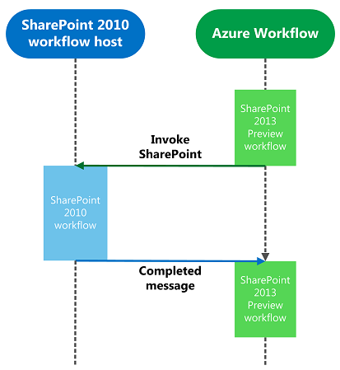
Workflow Interop Bridge
Enables SharePoint 2010 workflows to work in 2013
Execution engine hosted in SharePoint 2013
Negotiates between the two execution engines
WF in SharePoint 2010
WM in SharePoint 2013
InvokeSharePointWorkflow activity sends a start message to SharePoint’s workflow web service control endpoint
Notes:
Existing SharePoint 2010 workflows will continue to run within the context of SharePoint within SharePoint 2013 and cannot leverage new additions to the workflow story in SharePoint 2013. However at times a SharePoint 2010 workflow may need to communicate with a SharePoint 2013 workflow. The Workflow Interop Bridge is a tool to connect SharePoint Workflow to Workflow Manager workflow. The bridge exists to allow customers to reuse existing workflow assets available in SharePoint and provide a smooth transition path to Workflow Manager. It allows Workflow Manager workflows to delegate part of the process to SharePoint, enabling reuse of existing workflow assets that may not be available in Workflow Manager. It removes the complexity of creating workflows that span the SharePoint workflow host and the Workflow Manager workflow host. Customers will not have to write any service gateways, solve distributed security models, and cross-product integration challenges.
Essentially, the Interop Bridge allows SharePoint workflows based on Workflow Foundation 3 to run. Workflow Manager simply calls back into SharePoint which hosts the Workflow Foundation 3 runtime and receives a message when the process has completed.
The message flow documented on this slide is kicked off when the Workflow Manager workflow encounters a branch of the workflow that calls the interop bridge by invoking the activity InvokeSharePointWorkflow. From there, the following happens:
The InvokeSharePointWorkflow activity tells the Workflow 3 engine in SharePoint to start (by calling a Web service). This message includes the workflow instance ID which acts as a correlation ID when SharePoint sends a completed message back to Workflow Manager (#4).
The SharePoint workflow Web service authorizes the request and then starts the workflow.
When finished, workflow events are used to publish a message through the SharePoint event publisher. This message includes the workflow instance ID.
The SharePoint event publisher notifies Workflow Manager using the same pipeline that is used to notify Workflow Manager of list events (for instance: item updated/added).
Workflow Manager dispatches a Completed message to the instance within Workflow Manager using the instance ID as the correlation ID.

Slide 22
Creating Custom SharePoint 2013 Workflows

Slide 23
Summary
SharePoint Workflow Overview
SharePoint Workflow Fundamentals
Creating SharePoint 2010 Workflows
Creating SharePoint 2013 Workflows

