Slide 1
Branding and Web Site Design
Notes:
This module begins with an overview of branding, website design, and usability best practices. It poses essential questions that should be asked at the start of any SharePoint 2013 branding project, such as who is the intended audience and which browsers and devices should be supported. The module introduces the developer tools built into Chrome and the Internet Explorer as well as Firebug in FireFox. The module will also discuss which aspects of HTML5 should be used in a modern website design.

Slide 2
Agenda
Branding and Website Design
Determining the target audiences
Cross-browser compatibility
Web designer tools for HTML and CSS
Tablets and mobile devices
What do you need to know about HTML5?
Notes:
This module begins with an overview of branding, website design, and usability best practices. It poses essential questions that should be asked at the start of any SharePoint 2013 branding project, such as who is the intended audience and which browsers and devices should be supported. The module introduces the developer tools built into Chrome and the Internet Explorer as well as Firebug in Firefox. The module will also discuss which aspects of HTML5 should be used in a modern website design.

Slide 3


What’s Your Role?
Not just brand SharePoint
Design the best branded experience for your users
Know your brand and it’s voice
What the brand is
What the brand isn’t
Notes:
You’re job isn’t just to put your brand on SharePoint. Your role as a web designer is to give your viewers the best user experience you can that adheres to the brand standard of your company or client. The first step to do this is truly knowing your brand. Knowing a brand means knowing it’s voice and tone regarding both messaging and visuals. Part of this is knowing not only what your brand is, but what it isn’t. For example, your brand may be strong, but not aggressive. Playful, but not childish. Proud, but not arrogant. Expressive, but not outspoken. Unique, but not weird. All this needs to be apparent to visitors of your web site. As web designers and developers, you are a huge part of making this happen.

Slide 4
What is Good Design?
Good Design
Enhances content, does not harm it
Engages the viewer
Is well organized
Has personality
Has focus
Has intent
.
Good design is a beautiful group of elements, not a group of beautiful elements
Notes:
What exactly is good design? In the end, good design supports the function or the purpose of the product.

Slide 5
Good Design Makes a Difference
ROI on Aesthetic Design
Every dollar spent on advertising yields $7.21 in increased sales.
Every dollar spent on aesthetic design, yields $415.17 in increased sales.
Why is that?
“Proving Our Value: Measuring Package Design’s Return on Investment”
Rob Wallace, 2001 DMI Journal Vol. 12, No. 3
Notes:
Spending time and money can be difficult for some people to understand and agree with. On this slide is one of many examples of the direct ROI on good design. That is not an insubstantial difference.
Why is good design so important? As much as we all hate to admit it, EVERYONE is impacted by the way things look. It’s not vain or a character flaw, it’s human nature, and has been since the development of humankind.

Slide 6
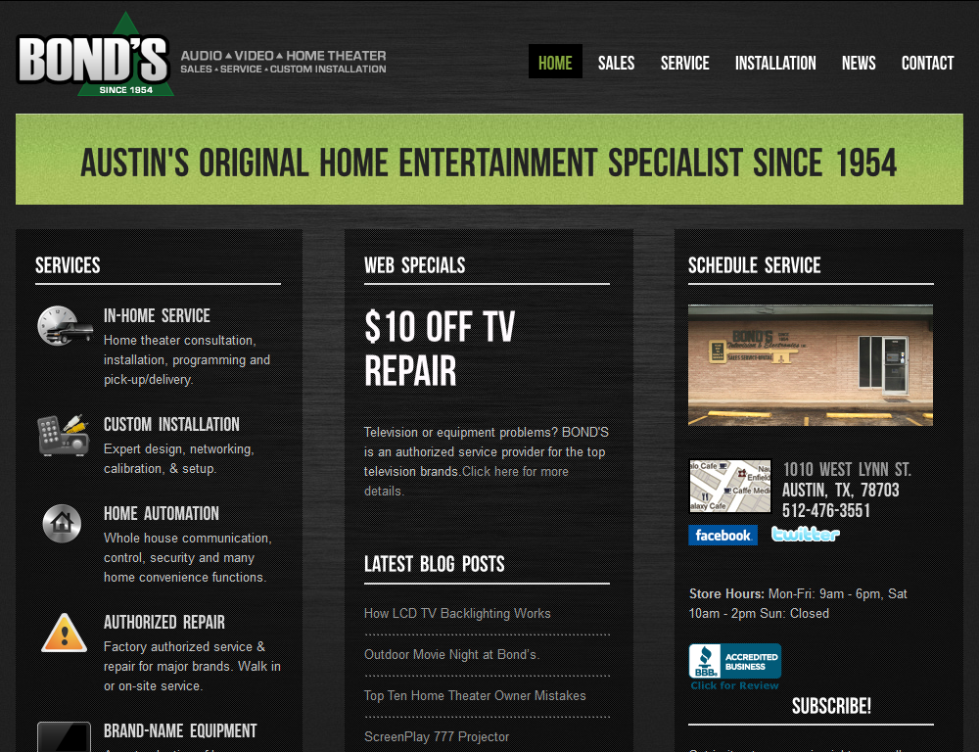
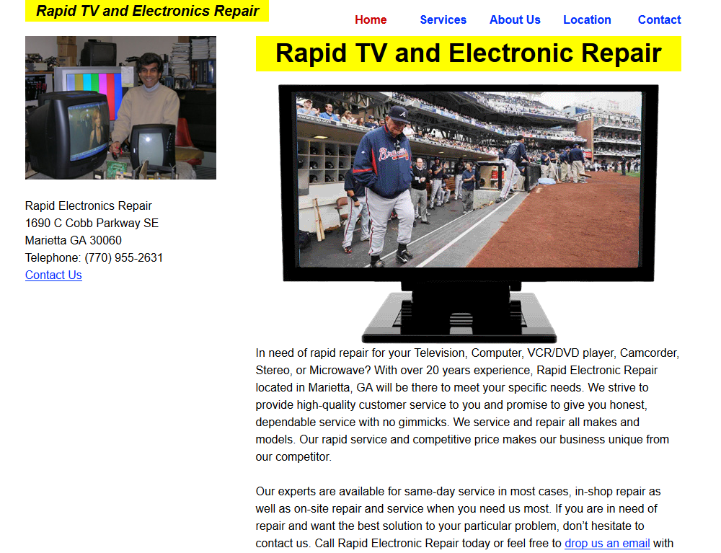
Good Design = Trust and Engagement
Who is going to repair your TV?
Notes:
More than likely, you’ll call the TV Repair company on the left. You can thank or blame your cavemen ancestors for that. Primitive people were concerned with one thing: survival. This meant staying away from harm, staying fed and procreation. When sizing up something new, the cave man had to decide to flee, eat, or have sex. These situations came up multiple time a day, and a decision had to made instantly, as their life frequently depended on it. These split second judgments became part of the subconscious brain. The brain learned what to be “attracted” to: things that meant continued survival.
This decision making process is still with us today in what scientists call the “old brain.” In the end, we have the luxury of letting our conscious mind weigh in on the decision, but everyone is effected by aesthetics. Visual appeal impacts decision making. As humans, we associate attractiveness with intelligence, capability, wealth and fortitude.
While beauty is in the eye of the beholder, there are things that are generally thought of as “attractive” to humans. Balance, color harmony, radiance and strength are all things that we generally find attractive. If you put time and effort in to making your web site attractive, people will also associate that with you putting time and effort into the goods and services you are selling.
Source: Dr. Susan M. Weinschenk, Neuro Web Design

Slide 7
Design for Content
People visit a web site to accomplish something
4 main reasons people visit web sites
Information
Communication
Transaction
Entertainment
Context imperative to engage users
Design with data/content first
Notes:
It is important to know why people are coming to your web site, so you can design an environment that best suits that needs. IN general, people go to web sites to:
Gather information
Communicate with others (email, social media, forums, etc)
Buy stuff
Entertainment - because they’re board
Knowing the main reason and adding context to this is essential to engage your users. The best way to do this is to make a design based on the content. The design should fit the content, not the content fit the design.

Slide 8
More Than Just a Task
Activity vs Experience
Activity – one task
Experience – event as a whole
Designing activities vs experiences: Theme parks
Activity: Six Flags
Experience: Disneyworld
Notes:
A web browsing even is made up of two things: activities and experience. An activity is a task a person does, i.e., read an article, send an email, upload a document, etc. An experience is how the user is the cumulated activities, the event as a whole. Usability expert Jared Spool uses theme parks to demonstrate this. Six Flags is an activity based. You want to ride roller coasters. A number of them happen to be conveniently located next to each other. Disneyworld is all about experience. Disneyworld has roller coasters, but that’s not why people go there. People go to Disneyworld for everything that happens in between roller coasters.
People go to whichever Six Flags is closest because it’s convenient to accomplish their task. People from all over the globe go to Disneyworld because it is Disneyworld.
http://www.uie.com/articles/gap_between_activities/

Slide 9

Activity
Notes:
Waiting in line at Six Flags…

Slide 10

Experience
Experience is what keeps people coming back
Notes:
Waiting in line at Disneyworld...Oh, and at the end of this line is a roller coaster that is run off of randomized drop sequences, so you never know what ride you’re going to get.

Slide 11
Guiding Design Reviews/Critiques
People are good at saying what they don’t like
They Say… | You ask…
The page is too busy. | What do you want people to focus on first?
Make this thing pink. | What do you want to accomplish by changing colors?
Let’s make this thing bigger. | Is it difficult to read? Or is that important content that needs more prominent?
All of these things are very important and need to be above the fold. | What is the one thing you want users to accomplish on this page?
This isn’t what I had in mind… | Let’s start with this element: what about it would you like to change?
Notes:
Most web designers need approval on their designs for people who aren’t usability/design savvy. It’s very easy for reviewers to point out things they don’t like. Use guiding questions to find out what the real issue is, what problem needs to be solved. Once you know what they actually want to accomplish, you can design a solution that enhances the page and stays true to the users task.

Slide 12
Keep Value in Mind
Value of the page, as well as it’s elements
Ask if an element adds value before you add it
What is “value”?
Add relevance
Add emotional attachment
Decrease energy needed to accomplish something?
Unique isn’t always good
Notes:
All the elements on your page should add value to the purpose of the page in some way. They could enhance the experience, represent your brand, ease functionality for users, etc. Whatever it is, before you add it to your web page, ask yourself if it adds value.

Slide 13
Usability
Ease of which visitors can access and use a site
Load time
Appropriate content
Readability
Useful navigation
Clear CTAs
Consistency
SEO
What do users expect from your site?
Notes:
Usability is becoming a bigger and bigger topic for the web, and it should be. When this concept first started, it was a way to measure whether or not users could get to you site and use it. Usability now has become so much more. As technology grows, so do users expectations.

Slide 14
UX and UI - The Next Level of Usability
Usability is the measurement of UX and UI
User Experience (UX)
What you want users to do/see/feel/accomplish
User Interface
Context to accomplish your UX goals
Notes:
A big part of usability now is User Experience and User Interface standards. UX represents the intangible side of the web: what your users feel, accomplish, experience on your web sites. UI is what you make to support that experience, what you present your users to interact with to meet your UX goals.

Slide 15
Agenda
Branding and Website Design
Determining the target audiences
Cross-browser compatibility
Web designer tools for HTML and CSS
Tablets and mobile devices
What do you need to know about HTML5?

Slide 16
Who is Your Web Site For?
Web site is NOT for
You
Your client
Your boss
Site build is for them
Site itself is for their audience
Notes:
Before you can even start thinking about building and designing a web site, you need to determine who the web site is for. The web site is not for your boss, your client, etc. You are building a web site for these people, but the site itself is for their audience. Those people may be members of your target audience, but it’s essential to keep in mind the needs of the audience, and not the needs of one person.

Slide 17
Find “Who” by Asking “Why?”
Why is this website being built?
So X can Y
Determine the Who and What associated with the Why
X = Who
Y = What
Dig deeper into Who
Is it really everybody?
Notes:
To find your audience, ask why the web site is being built. Generally, the answer will come in the format, “So X can Y.” X is the who, your audience. Y is what they’re there to do. “So gamers can find out more about our latest game.” “So bank customers can see their financial information from their home computers.” “So people can buy our album online.” “So our team can have all their documents stored in one place.”
This statement will be very broad at first, but once you have it you can dig deeper into what those things actually mean.

Slide 18
Get to Know Your Most Important Users
The world can access your site
That doesn’t make them your audience
The main “who” not 100% of your audience
The most important part of your audience
Design for your most important users
Where are these people?
What are their interests?
What other web sites do the go to?
What devices do they use?
Be culturally sensitive
Notes:
Everyone can access your web page, but that doesn’t make everyone your audience. And more than likely, you’ll have multiple audience segments. But there is almost one group that is the true focus of your web site. The site needs to be usable for everyone, but it needs to be comfortable and intuitive for your main audience.
If you have a global site or a global audience, be aware of cultural nuances.

Slide 19
All Audiences Have 1 Thing In Common…
…they’re human
Humans are selfish
Make it personal
Like choices, but not too many
Humans are lazy
Finite amount of attention
Do their work for them
People don’t read, they scan
Frustration = Abandonment
Notes:
We humans are far from perfect, although we seem to expect that from other people and things. Accept this, don’t fight it. Humans are selfish – we want to feel special. We have a need to connect with people and things that we’re interested in. People like choices because it gives them a sense of control. But too many choices can lead to frustration. Take this into consideration when designing your site. What can you do to connect with your target audience? Most of all, humans are lazy (some people prefer to use the term “efficient”). People have a finite amount of attention. If they can’t find what they’re looking for quickly, they’ll leave. Web sites should do the majority of the work for them. This means putting specific elements like navigation and search boxes where people expect to find them. Keep content on higher level pages concise and organized. Online, people scan much more than they read. They want to find the information they’re looking for quickly. If they can’t find what they want, they’ll leave and go find it somewhere else.

Slide 20
Agenda
Branding and Website Design
Determining the target audiences
Cross-browser compatibility
Web designer tools for HTML and CSS
Tablets and mobile devices
What do you need to know about HTML5?

Slide 21
Ok, All Audiences have 2 Things in Common
Device, browser, network
The only thing you have control over is your code
Can’t control
Device
Browser
Network speed
Notes:
Alright, all audiences have 2 things in common: they’re all viewing your site on a device from a browser that is connected somehow to the internet. And you all have something in common: you can’t control what devices and browsers you users choose to view your site.

Slide 22
Cross Browser Compatibility
No such thing as “no styling”
Browsers have native CSS
Each browser has different standards
Goal
Work in every browser
NOT look the same in every browser
Strive for consistency
Content readability is the most important
Notes:
Cross browser compatibility is important to make sure that users get a branded, consistent and user friendly experience no matter what browser they use. It’s impractical to believe that you can make a design look the same in every browser on every device in all the browsers out there and all the browsers to come. Having all your content present and readable on all browsers is the most important part.

Slide 23
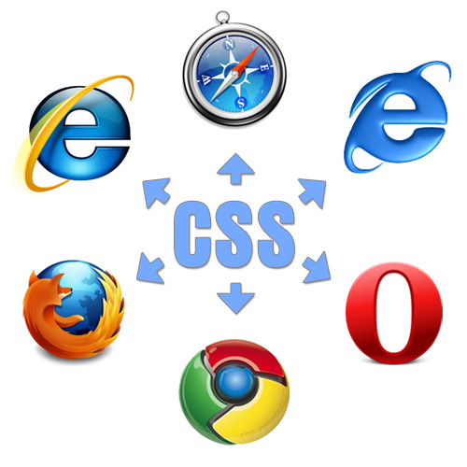
CSS is the Key
CSS Reset
Overrides majority of native browser styles
Which browser to start in?
Most used browser for your audience
Addressed further in Module 6
Image by Louis Lazaris
Notes:
When dealing with cross browser compatibility, using CSS reset styles can be very helpful. This targets the styles placed on native HTML elements by each browser and basically sets them all to zero. As to which browser to start with, to make look the best, it all depends on your audience. We’ll get into all this more in Module 6.

Slide 24
Agenda
Branding and Website Design
Determining the target audiences
Cross-browser compatibility
Web designer tools for HTML and CSS
Tablets and mobile devices
What do you need to know about HTML5?

Slide 25
Furthering Cross Browser Compatibility
Browser developer tools
In-browser debugging tools
Available in
Internet Explorer (IE)
Firefox
Chrome
View HTML, CSS, loaded resources
Target elements to see associated styles
More detail in Module 6
Notes:
Browser debugging tools are vital for optimizing cross browser compatibility. These in-browser tools allow you to see what styles are being used on individual elements, and allow you to test modifications in the browser before you go and change your code.

Slide 26
Agenda
Branding and Website Design
Determining the target audiences
Cross-browser compatibility
Web designer tools for HTML and CSS
Tablets and mobile devices
What do you need to know about HTML5?

Slide 27
Browsers Everywhere!
Mobile data traffic is outpacing broadband traffic
By 2015 mobile phones will be the most common device for accessing the internet in US
84% use mobile device at home
62% use mobile devices while watching TV (refer back to slide 17 where we told you humans are lazy)
Fun Fact
Globally, there are more iPhones sold than babies born daily Stats Gathered by Luke Wroblewski
Notes:
All the browsers and browser versions for you desktop or laptop is just the beginning of true browser compatibility. Enter the smart phone – soon to be the source of the majority of visits to the web. Browsing the web from a mobile device has grown exponentially over the past few years and will continue to do so. Having your content viewable on a mobile device is a must.

Slide 28
Responsive Web Design
Web site built to adapt to user environment
One web site, many devices
No more m.website.com
It’s all about the experience
Deliver optimized content not matter what the device
Responsive design elements
Media queries
CSS
Flexible layout
Scalable Imagery
Will be discussed in detail in Module 10
Notes:
Responsive design is the best thing to happen to the web since CSS. Responsive design uses media queries and CSS to adapt your web site to the viewers screen size, allowing us to deliver optimized content no matter what device the site is being viewed on.

Slide 29
Agenda
Branding and Website Design
Determining the target audiences
Cross-browser compatibility
Web designer tools for HTML and CSS
Tablets and mobile devices
What do you need to know about HTML5?

Slide 30
HTML5
Make your web pages HTML5 compatible
<!DOCTYPE html>
Does HTML5 work with SharePoint?
YES
HTML5 is HTML
http://caniuse.com
HTML5 and CSS3 browser compatibility chart
Notes:
Ready to wow your company or client by making their web site HTML5 compatible? This is done with one easy step: set your doctype to html.
You may get a lot of questions about whether or not SharePoint works with HTML5. The short answer is yes. The long answer is that HTML5 has nothing at all to do with SharePoint, or what version of SharePoint, or whatever CMS you may be using. HTML5 is still just HTML. A version of HTML that has some amazing native elements, but HTML none the less. HTML is about browser compatibility, not CMS. Think about it like CSS3. CSS3 is CSS. It’s new elements can be used to enhance content, but it’s styles won’t show in every browser. It’s the same way with HTML5. However, you need to be more careful with your use of HTML5. CSS3 is for presentation. If you use CSS3 to put a drop shadow on your text and your user have an older browser, the text still shows. You don’t loose any content, just display enhancements. If you place content on a page using the audio, video, or canvas HTML5 tags and your users have an older browser, the content will not display.
http://caniuse.com/ is a great resource for checking what CSS3 and HTML5 are accepted by different browsers.

Slide 31
Final Thoughts
You get one first impression
Features vs expected behavior
People will remember their experience
Not the font, colors, layout, etc
Opinion formed on how your site made them feel
Notes:
Just a couple final thoughts. You’ve heard it before, but it’s true. You get one first impression. Make sure your web site gives the impression you want, regardless of device.
Pay attention to features that have become expected behavior, and be sure to incorporate them where appropriate. Touch screens are a great example. When the iPhone was released in 2007, the touch screen was AMAZING. It was a feature that differentiated Apple from the competition and was a huge selling point for the phone. Fast-forward to today – what do you think about mobile devices that don’t have a touch screen? It’s not a feature anymore. People expect their phone to have a touch screen.
And again, it’s all about the experience.

Slide 32
Summary
Branding and Website Design
Determining the target audiences
Cross-browser compatibility
Web designer tools for HTML and CSS
Tablets and mobile devices
What do you need to know about HTML5?

