Slide 1
Composed Looks
Notes:
This module covers creating and applying a customized composed look to a team site. The module begins by reviewing the OOB look, and how to make simple modifications to them. Next you will learn to create custom font and color files that can be used to create a composed look. The last section addresses when and how to create a custom master page and CSS to add to the font and color files to create a fully branded team site.

Slide 2
Agenda
Anatomy of a Composed Look
Modifying a Composed Look
Creating an .spcolor file using the Color Palette Tool
Creating an .spfont file for a custom Composed Look
Creating and Configuring Custom Composed Looks
Packaging and Distribution

Slide 3
Team Site Design – Composed Looks
More robust version of a “theme”
17 OOB Composed Looks
Color & font easy to customize on OOB Composed Looks
Creating a Custom Composed Look
Low Level of effort: (custom color) + (font) + (background image)
High Level of effort: (all the above) + (master page) + (CSS)
Notes:
Here’s a quick review from Module 3 of what a Composed Look is. Branding Team Sites in SharePoint 2013 is done with Composed Looks. Composed Looks is Microsoft’s solution that allows users to build themes as simple or complex as they wish, depending on their desired level of effort and time available.
The main difference between Themes and Composed Looks is easily updatable files associated with each.
Theme: color and font
Composed Look: color, font, background image, master pages (potential to add css here)

Slide 4
Anatomy of a Composed Look
Group of files combined to create one theme
Composed Looks contain
Master page: wrapper, holds SharePoint controls
Theme file: xml, contains color palette information
Background image: site background image
Font scheme: xml, contains font information
Notes:
Master page we’ve talked about quite a bit through this course. We’ll get into the details of the theme file, background image, and font scheme later on in the module.

Slide 5
Customize a Composed Look
Elements that can be changed
Select a different color scheme
Select different fonts
Background image
Master page
Notes:
There are 4 main elements that can be customized in a Composed Look. A custom CSS can be added as part of the custom master page. The site logo can be changed as well, but this is done in the site settings, not the Composed Look.

Slide 6
Agenda
Anatomy of a Composed Look
Modifying a Composed Look
Creating an .spcolor file using the Color Palette Tool
Creating an .spfont file for a custom Composed Look
Creating and Configuring Custom Composed Looks
Packaging and Distribution

Slide 7
2 Levels of Composed Look Branding
Easy – low level of effort
Modification
Predetermined selections
No code
Moderate – higher level of effort
Fully custom
Create and upload xml files
Option for custom master
Minimal code
Notes:
There are 2 ways to brand a Composed Look:
Easy - modify an OOB Composed Look
Moderate - create a custom Composed Look
With both option, the designer can change the logo, master page, color scheme, font selection and background image. The difference is in the level of control and change over these elements.

Slide 8
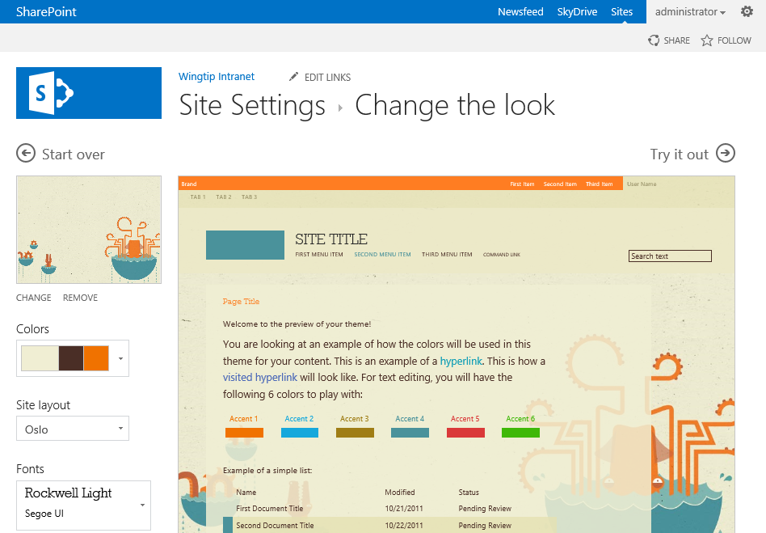
Modifying Composed Looks
Items that can be modified in the left panel

Slide 9
Options
Limited selection for color and font
32 OOB color palette options
7 OOB font options
Drag-and-drop background image upload
2 OOB master page options (listed under site layout)
"Try it Out"
Preview look with modification before applying
"Start Over"
Lose all modifications and go back to gallery
Notes:
Along with the 17 OOB Composed Looks, SharePoint has 32 color schemes and 7 fonts schemes to choose from. A different background image can easily be added by simply dragging and dropping it into the image box on the left under the logo. You also have the option to preview what your modifications will look like on your home page before you apply the look with the, “Try it Out” option.

Slide 10
Modifying a Composed Look

Slide 11
Agenda
Anatomy of a Composed Look
Modifying a Composed Look
Creating and Configuring Custom Composed Looks
Creating an .spfont file for a custom Composed Look
Creating an .spcolor file using the Color Palette Tool
Packaging and Distribution

Slide 12
Theme (Color) File – .spcolor
Color palette information stored in an xml
Uses .spcolor file extension
.spcolor file accepts hex, hex with transparency
Be aware of browser compatibility
Two ways to create custom .spcolor file
XML editor
SharePoint Color Palette Tool
Notes:
The theme file is an xml file that holds the color information for the 90 elements that call color in a Composed Look. The file accepts hex with transparency, but be aware of what browsers the site will be used in. There are 2 different ways to create a custom theme file. One is by manually modifying the XML. The second is through software called the SharePoint Color Palette Tool.

Slide 13
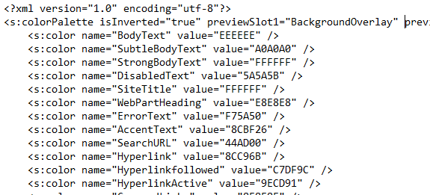
.spcolor with XML editor
Start with an OOB .spcolor file
Modify values
90 items
Notes:
To create a custom theme file using an XML editor, start with an OOB .spcolor file and edit as needed. This is a good option if you want to do a find and replace for your colors.

Slide 14
.spcolor with SharePoint Color Palette Tool
Free software from Microsoft
http://www.microsoft.com/en-us/download/details.aspx?id=38182
Default .spcolor file with software is Office
Can open and modify any .spcolor file
Select custom color
Entering in the color code
Using color picker
A color slot mapping list is available in the student resources folder.
Notes:
The SharePoint Color Palette Tool is great if you want full control over your color scheme and are not sure what colors you want or aren’t comfortable modifying the XML.

Slide 15
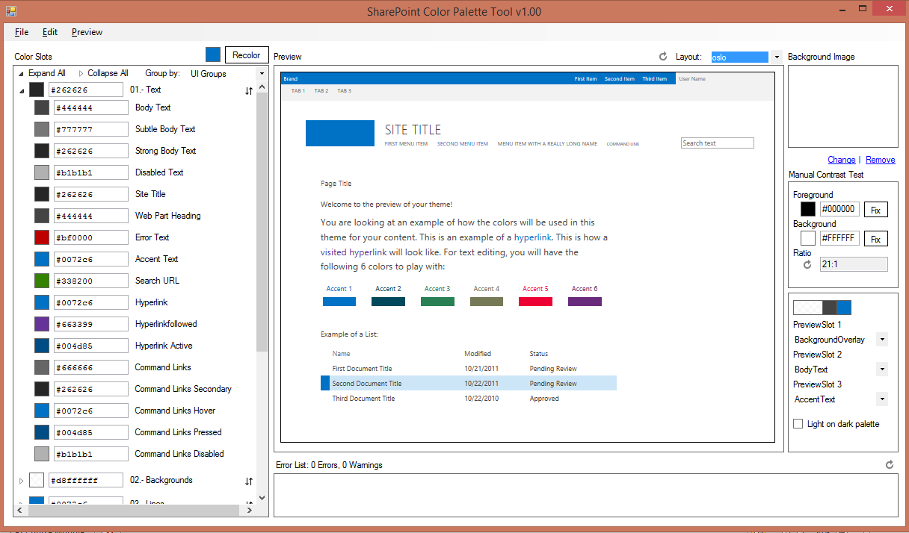
SharePoint Color Palette Tool
Preview pane
Colors, background image, master page
Notes:
The tool has a simple interface, with multiple ways to group the color slots on the left, and a big preview pane to view the changes as you make them.

Slide 16
Create a Custom .spcolor File

Slide 17
Agenda
Anatomy of a Composed Look
Modifying a Composed Look
Creating an .spcolor file using the Color Palette Tool
Creating an .spfont file for a custom Composed Look
Creating and Configuring Custom Composed Looks
Packaging and Distribution

Slide 18
Font File – .spfont
Font information stored in an xml
Uses .spfont file extension
Font settings structured into four main areas
Title
Navigation
Heading
Body
.spfont file accepts hex, RGBA
Be aware of browser compatibility
A font slot mapping list is available in the student resources folder
Notes:
To create a custom file file using an XML editor, start with an OOB .spfile file and edit as needed.

Slide 19
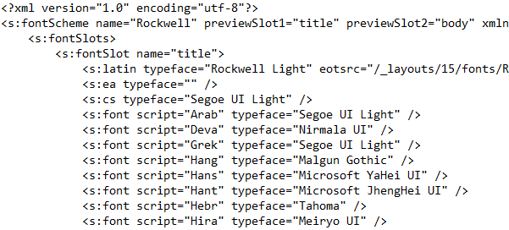
.spfont with XML editor
Start with an OOB .spfont file
Modify values
32 items
Notes:
Easy if you want to do a find and replace.

Slide 20
Font Types
Web safe font and web font accepted
Markup required for web font
<s:latin typeface="FontName" eotsrc="EotFile" woffsrc="WoffFile" ttfsrc="TtfFile" svgsrc="SvgFile" largeimgsrc="LargeImgFile" smallimgsrc="SmallImgFile" />
Attributes shown in red optional
Used for thumbnail image in font scheme picker
Notes:
.spfont file accepts both web safe fonts and web fonts. Use the markup provided if you’d like to use a web font.

Slide 21
Create a Custom .spfont file

Slide 22
Agenda
Anatomy of a Composed Look
Modifying a Composed Look
Creating an .spcolor file using the Color Palette Tool
Creating an .spfont file for a custom Composed Look
Creating and Configuring Custom Composed Looks
Packaging and Distribution

Slide 23
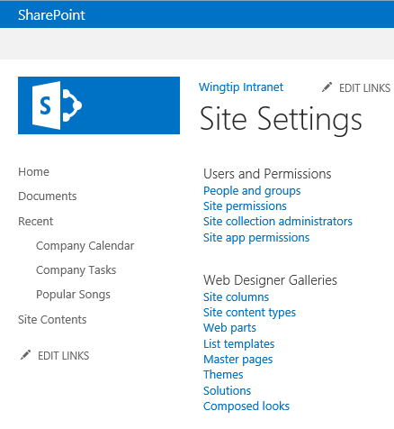
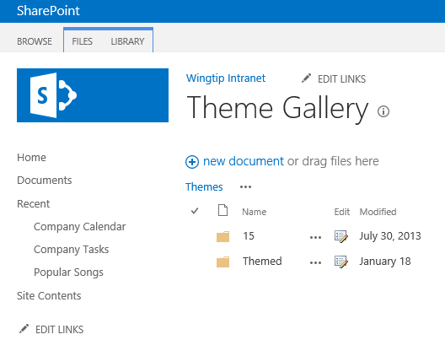
Putting it All Together
Upload Composed Look files to SharePoint
.spfont and .spcolor files go in15 folder in Theme gallery
Upload background image to Theme gallery
Notes:
The background image can really be loaded anywhere in the site. But since it’s part of the Composed Look, and not a content image, it’s helpful to put it in a location where other users can access it and accidentally modify or delete it.

Slide 24
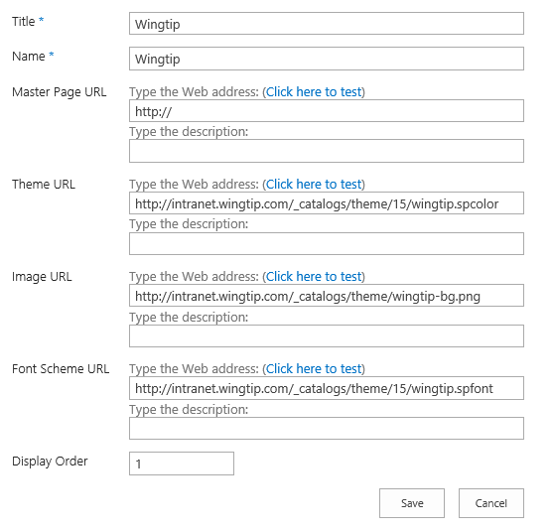
Create a Custom Composed Look
In Composed Looks Gallery, Create New
Link to uploaded files and save
Notes:
Now that all your files have been uploaded you can create your custom Composed Look. In the Composed Looks Gallery, select “Create New.” Here you can link to the .spcolor, background image and .spfont file you created and uploaded. If you don’t select a master page, the default master page will be used. The Display Order dictates what order the looks are in the Composed Look Gallery. Once you hit “Save,” you’ll see your custom composed look available in the gallery.

Slide 25
Create a Custom Composed Look

Slide 26
Summary
Anatomy of a Composed Look
Modifying a Composed Look
Creating an .spcolor file using the Color Palette Tool
Creating an .spfont file for a custom Composed Look
Creating and Configuring Custom Composed Looks
Packaging and Distribution

