Slide 1
Introduction to Design Manager
Notes:
This module provides an in depth look at what the Design Manager is and its role in branding SharePoint Publishing sites. You will learn how to create a branded SharePoint site from an HTML and CSS prototype. This module will introduce the Snippet Gallery and Device Manager, which will both be discussed greater detail in later modules of this course. The final section of this module will cover creating, exporting, and importing Design Packages.

Slide 2
Agenda
Introduction to Design Manager
Mapping a drive to a Publishing site
Converting HTML pages into Master Pages
Working with Design Manager Snippets
Other Design Manager Features
Design Packages
Notes:
This module provides an in depth look at what the Design Manager is and its role in branding SharePoint Publishing sites. You will learn how to create a branded SharePoint site from an HTML and CSS prototype. This module will introduce the Snippet Gallery, which will be discussed in further detail in Modules 5 and 7, and Device Channels, which will be addressed in detail in Module 10. The final section of this module will cover creating, exporting, and importing Design Packages.

Slide 3
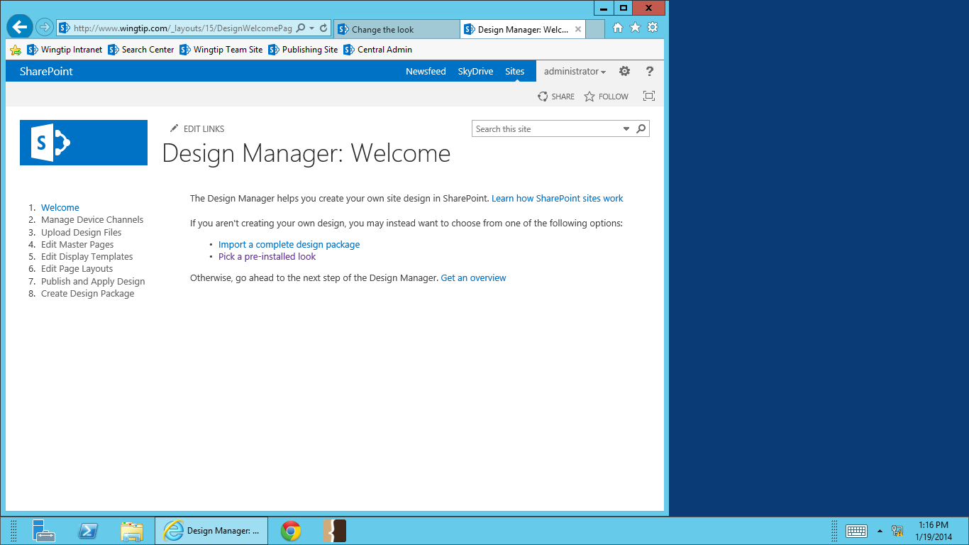
What is Design Manager?
Tool for implementing and maintaining branding, design, and user experience on publishing sites *
*ONLY available with publishing feature enabled
Notes:
Design Manager is new feature in SharePoint 2013. Through Design Manger, web designers more easily create and manage their brand and desired user experience. Designers can use html and their preferred html editor to create their brand on SharePoint without having to any modify asp.net files.

Slide 4
What Design Manager Does
Converts html to master page
Edits done in .html files instead of .aspx or .master files
Edits can be done using just about any html editor
Preview for master page and page layouts
Device channels
User experience tailored for specific browsers and devices
Design package
Exported file containing all published design assets
Can be applied to another site collection
Notes:
Design Manager was developed so web designers could create a fully branded SharePoint experience using tools and languages they know and are comfortable with. Edits to master pages, page layouts and display templates can all be done in HTML. Device channels can be configured to create optimized experience for specific devices or browsers. Your work can all be packaged and applied to another site collection with a design package.

Slide 5
Agenda
Introduction to Design Manager
Mapping a drive to a Publishing site
Converting HTML pages into Master Pages
Working with Design Manager Snippets
Other Design Manager Features
Design Packages

Slide 6
Getting Started
Design Manager has 8 steps
Welcome
Can upload design package
Manage Device Channels
Set master for specific Device Channels
Addressed further in Module 10
Notes:
Design manager has 8 steps. In the first step you can upload a design package if you have one. Otherwise, it’s not really a step. The second step is for setting up and managing Device Channels. Device Channels allow you to set master page and specific site columns inside page layouts to display for targeted browser or user device. We’ll get into this in detail in Module 11.

Slide 7
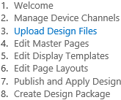
Mapping a Drive to SharePoint
Upload Design Files
First real step to get started in Design Manger
Necessary step for editing html in a program other than SharePoint Designer
Easy way to upload your html and other branding assets to the master page gallery without SharePoint Designer
Check Out, Check In, Publish, and Approve can NOT be done from the mapped drive
Notes:
Be careful when working in your mapped drive – you are working on the SharePoint Server site collection.
Pros and Cons of copying all your assets in one folder into the master page gallery:
Pro: Only the assets you need to work with are in this folder – no searching through all the OOB files to find yours
Con: When you create a new page layout, you will need to drag it from the main master page gallery into your folder

Slide 8
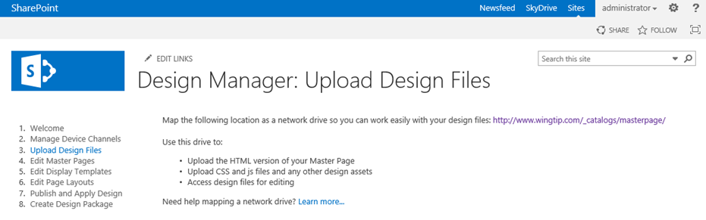
Steps for Mapping a Drive to SharePoint
Copy the supplied url
On your PC, right click on “Computer”
Select “Map Network Drive
Select drive letter and paste in url
Enter in credentials when prompted

Slide 9
Mapping a Drive to the Master Page Gallery

Slide 10
Agenda
Introduction to Design Manager
Mapping a drive to a Publishing site
Converting HTML pages into Master Pages
Working with Design Manager Snippets
Other Design Manager Features
Design Packages

Slide 11
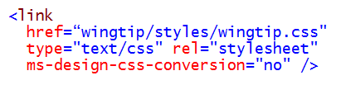
Design Manager Requirements for HTML
The HTML file you feed to design manager…
Must be XML compliant
DOCTYPE declaration should be HTML
<!DOCTYPE html>
No <form> anywhere in your HTML
Inline JavaScript in <script> element must be on it’s own line
No <style> elements allowed in the <head>
Add ms-design-css-conversion="no" in the css <link>
Notes:
No <style> in the <head> is best practice anyway, but SharePoint will skip <style> in the <head> on conversion.
Adding ms-design-css-conversion=“no” tells the conversion service that there is no need to do any conversion on this tag.
Inline JavaScript won’t render unless the <script> declaration is on it’s own line.
ASP.Net only allows on <form> on a page. There is already a <form> on the page tag put there by SharePoint.

Slide 12
Conversion – What happens to the HTML?
Conversion results in 2 files:
wingtip.html
wingtip.master
Modifications made to the original HTML
SharePoint master page code added
Added code clearly commented
Syncing master pages only goes one direction
.html -> .master
Edits to .html will be reflected in .master.
Editing .master breaks that relationship
Notes:
Converting HTML to a master page results in 2 files: a .html file and a .master file. The .html file will be a modification of the .html you uploaded, so make sure you have a backup before you convert. All your modifications will be done in the .html file. Edits you make will be pushed to the .master file.

Slide 13
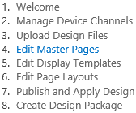
Converting HTML to a Master Page
Edit Master Pages
Only html files in the master page gallery can be converted to a master page
Simple conversion process
Notification of conversion status
Notes:
Converting HTML to a master is simple. Select the .html file you uploaded to the _catalogs library. Only files inside the site can be converted. SharePoint will let you know whether or not your conversion was successful

Slide 14
Converting HTML to a Master Page

Slide 15
Agenda
Introduction to Design Manager
Mapping a drive to a Publishing site
Converting HTML pages into Master Pages
Working with Design Manager Snippets
Other Design Manager Features
Design Packages

Slide 16
The Snippet Gallery
List of available code snippets
SharePoint fields and functions
For master pages and page layouts
Accessible from preview mode
Contains
SharePoint Content Placeholders
Site columns
Web parts
Addressed further in Modules 5 and 7
Notes:
The Snippet Gallery is a list of available code snippets for SharePoint fields and functions that can be placed in a master page or page layout. The gallery is accessible from master page or page layout preview mode. It contains some available SharePoint Content Placeholders, site columns, and web parts.

Slide 17
The Snippet Gallery

Slide 18
Agenda
Introduction to Design Manager
Mapping a drive to a Publishing site
Converting HTML pages into Master Pages
Working with Design Manager Snippets
Other Design Manager Features
Design Packages

Slide 19
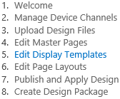
Display Templates and Page Layouts
Edit Display Templates
Render Content by Search results
Addressed further in Module 9
Edit Page Layouts
Modified using HTML
Will be addressed in the Page Layouts module
Notes:
Step 5 is editing Display Templates. Display Templates are used to render results from the Content by Search web parts. They are also kept in _catalogs. They are edited using HTML. They will be discussed in detail in Module 9.
Step 6 is editing page layouts. Like master pages, page layouts can also be modified using HTML. They will be discussed in detail in Module 7.

Slide 20
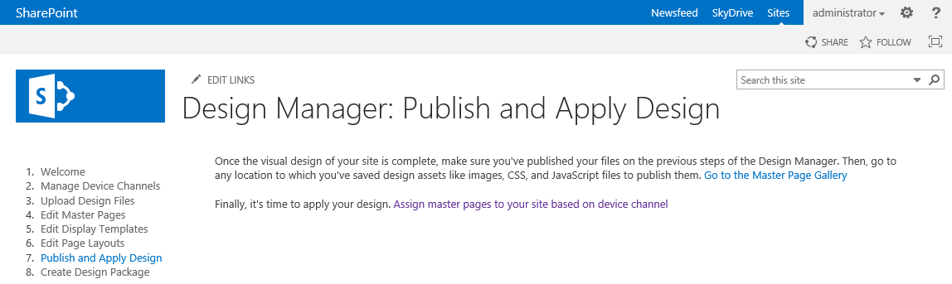
Applying a Master Page
Publish and Apply Design
“Reminder” Step
Supplies links to publish and apply a master page
Notes:
Step 7 is more of a reminder step. A master page must be published before it can be applied to a site. It also supplies a link to the master pages settings where the master pages can be applied.

Slide 21
Agenda
Introduction to Design Manager
Mapping a drive to a Publishing site
Converting HTML pages into Master Pages
Working with Design Manager Snippets
Configuring Device Channels
Design Packages

Slide 22
Design Packages
Design Package is set of SharePoint brand-related assets
Master page
Page Layouts
Site Columns/Content Types
Display Templates
CSS
XSLT
Designer Package is exported to .wsp file
.wsp file can be imported and applied to other SharePoint sites
Target import site must have publishing features enabled

Slide 23
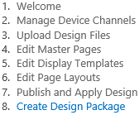
Create and Export a Design Package
Create Design Package
Option to include customized search
Search Configuration only optional item
No way of selecting what items are or aren’t included in a Design Package
Notes:
Step 8 is creating and exporting a Design Package. A Design Package is a SharePoint solutions file (.wsp) that contains all the design elements you’ve created, modified, and published. This file can then be uploaded to another site collection (remember Step 1…?) and applied. This makes it easy to move your SharePoint site collection to site collection in one easy step instead of having to recreate and manually upload design files. If custom search queries and results have been created, option to include custom Search Configuration at export.

Slide 24
Create a Design Package

Slide 25
Keep in Mind…
Master page needs to be solid before page layouts are created using that master
<head> and other master page text in top of layout code
Some updates to master don’t show in these pages layouts
Design Packages
Takes major and minor versions of EVERYTHING
Overwrites EVERYTHING
If uninstalled, uninstalls EVERYTHING
XSLT & Dreamweaver = 0.1
Notes:
A few things to keep in mind:
Make sure your master page has all the controls in it that you’ll want to use BEFORE you make any page layouts. A lot of code from the master page is placed in the layouts, and if some controls are missing you may have to manually go and update all the master page code in the page layouts.
Design Packages have some issues.
It gathers both published and unpublished versions.
It takes both custom and OOB site columns, content types, display templates, XSLT, CSS, master pages, page layouts.
It overwrites everything on your current site collection with everything in your Design Package.
If you uninstall the Design Package, it uninstalls everything. Since it contains both custom and OOB elements, it virtually wipes out publishing site columns, content types, display templates, XSLT, CSS, master pages, page layouts.
When applying a Design Package to a site, it automatically applies the master page in the package to your site.
Dreamweaver is fine to edit any files except XSLT. As soon as you save an XSLT that you’ve been modifying in Dreamweaver, it automatically deletes all previous versions of the file and resets the file to be version 0.1.

Slide 26
Summary
Introduction to Design Manager
Mapping a drive to a Publishing site
Converting HTML pages into Master Pages
Working with Design Manager Snippets
Configuring Device Channels
Design Packages

