Slide 1
Display Templates in SharePoint 2013
Notes:
This module covers the fundamentals customizing the display of content in SharePoint 2013 using display templates. The module begins with a quick primer on JavaScript programming fundamentals focusing on the aspects of the JavaScript language which are required when designing and writing display templates. Next, you will learn how to create and configure a simple display template for a standard SharePoint list to customize the display of items on a page. Next, you will learn more advanced techniques for creating and configuring a custom search result type along with an associated display templates which make it possible to customize the appearance of search results using the Content by Search web part.

Slide 2
Agenda
World's Fastest JavaScript Primer
Creating a Display Template for a Standard List
Display Templates used in SharePoint 2013
Using Display Templates with Search Results
Using the Content Web Search (CBS) Web Part
Notes:
Display Templates are used throughout SharePoint for presenting content. There are still a few Web parts that rely on XSL, but most have been replaced with display templates. Display templates are used for the visual and functional aspects of many common controls like the Search Box, Content By Search, Search Results, Refiners and others.

Slide 3
JavaScript
Client Language
Variables
var x;
var y = 2;
Notes:
JavaScript is a client language. It does not run on the server. It runs in the browser. When you are writing JavaScript you have access to the Document Object Model (or DOM) of the current page. Using JavaScript you can create variables and take action on the users interaction with the page for links and buttons.

Slide 4
JavaScript vs. jQuery
JavaScript is a Language
jQuery is written in JavaScript and expands the language.
jQuery relies on Selectors to associate code with HTML elements
$("p")
$("#test")
$(".test")
Notes:
JavaScript is a language. jQuery is a popular enhancement library that uses JavaScript and enables developers to be more productive with JavaScript. The “Query” in jQuery is based on how the syntax of jQuery enables developers to attach to DOM elements. A developer creates a query statement that associates the code to specific elements on the page, usually by ID, but the query can be based on any attribute.

Slide 5
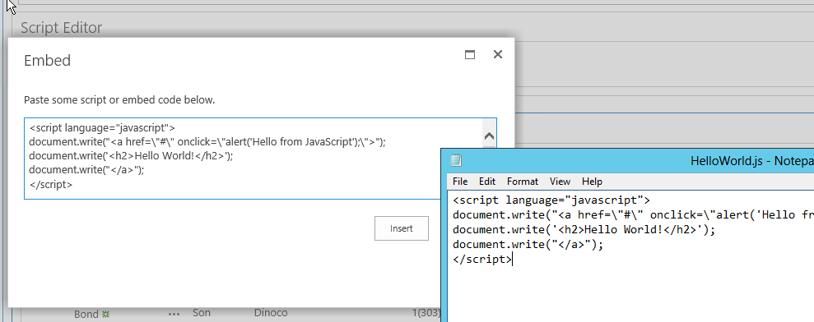
Adding JavaScript to SharePoint
Master Page Reference
<script type="text/javascript" src=“mjcode.js"></script>
Use the Script Editor Web Part
Notes:
Adding a JavaScript file reference to SharePoint can be done in many ways. Most commonly you will add a reference to the Master Page or Page Layout using a <script> tag. There are other options for adding script references that delay the loading of scripts until they are needed by the page. These optimizations are generally employed by developers. There is also a Script Editor We part that will enable scripting on a single page.

Slide 6
Client Development Options
JavaScript
REST
CSOM (JSOM)
Notes:
When developing more extensive solutions with SharePoint and JavaScript you can use the SharePoint JavaScript Object Model (JSOM). You can also reference the SharePoint REST endpoints and request items from SharePoint directly. These options enable developers to build SharePoint integration without deploying any code to the server. This is the preferred technique for customizing SharePoint.

Slide 7
Agenda
World's Fastest JavaScript Primer
Creating a Display Template for a Standard List
Display Templates used in SharePoint 2013
Using Display Templates with Search Results
Using the Content Web Search (CBS) Web Part
Notes:
Lists and Libraries in SharePoint 2013 can be customized with JavaScript to enhance the end user experience. For example if you would like to render a list in a different way that the default view, you can make those changes with JavaScript.

Slide 8
List Views
SharePoint List Views use “Render Templates”
Render templates can be overridden with code
Notes:
Using JavaScript you can override the client rendering. List views use built in Render Templates to present list data. These Render Templates are simply JavaScript and HTML that is pushed down to the client browser and then “assembled” with the list data to present a view of the list. You can change the way a view looks by altering the Render Template in custom JavaScript.

Slide 9
Changing the Default Render Template
// create and intialize object to override context
var overrideCtx = {};
overrideCtx.BaseViewID = 1;
overrideCtx.ListTemplateType = 105;
// initialize template
overrideCtx.Templates = {};
overrideCtx.Templates.Header = "<ol>";
overrideCtx.Templates.Item = customItem;
overrideCtx.Templates.Footer = "</ol>";
// register with page template manager
SPClientTemplates.TemplateManager.RegisterTemplateOverrides(overrideCtx);
Notes:
In this sample we create a sample override with a header and footer. In between the header and footer we call a customItem function for each item in the list view. The custom item formats each line in the render template.

Slide 10
Item Template
function customItem(ctx) {
// create item style
var itemStyle = "color:blue;";
//create & return HTML for each item
return "<li style='" + itemStyle + "' >" +
ctx.CurrentItem.FirstName + " " + ctx.CurrentItem.Title +
"</li>";
}
Notes:
I this customItem template we create a template for rendering each individual field returned by the list. For each item in the list a new <li> tag is created including the fields for FirstName and Title and the font is colored blue.

Slide 11
Agenda
World's Fastest JavaScript Primer
Creating a Display Template for a Standard List
Display Templates used in SharePoint 2013
Using Display Templates with Search Results
Using the Content Web Search (CBS) Web Part
Notes:
Beyond list rendering, controls and item results use Display Templates for creating the visual look and feel for many parts of SharePoint 2013. In this section we will discuss how Display Templates are used.

Slide 12
Display Templates in Use
Control Template
Refinement Item
Search Results
Group Template
Item Template
Hover Template
Notes:
Display Templates come in several varieties based on where they are used in SharePoint. Control Templates are used to create the bounding box around a control, for example the Search Box, Refiner and Search Results controls us a single Control Template. Inside the control, individual items are presented with Item Templates, in the Refiner Control a refinement item is used, in the Search Results and Content By Search controls an Item Template is used and sometimes bound by a group control or associated with a Hover Template.

Slide 13
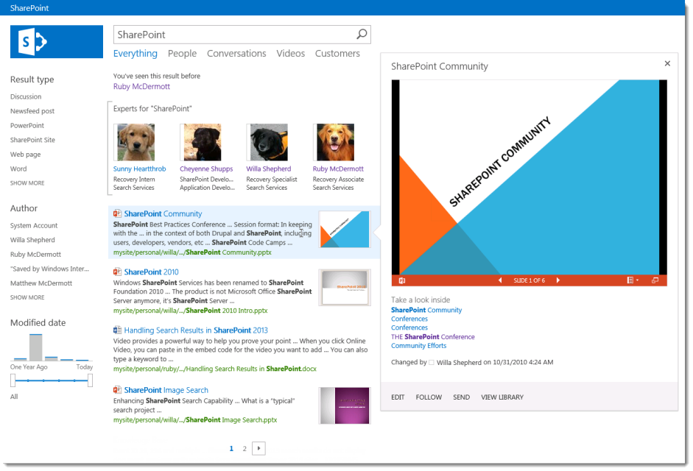
Anatomy of Search Results
Notes:
The Search results page demonstrates the different types of display templates in use. The search results page is composed of several web parts that make use of Control, Group, Item and Hover templates.

Slide 14
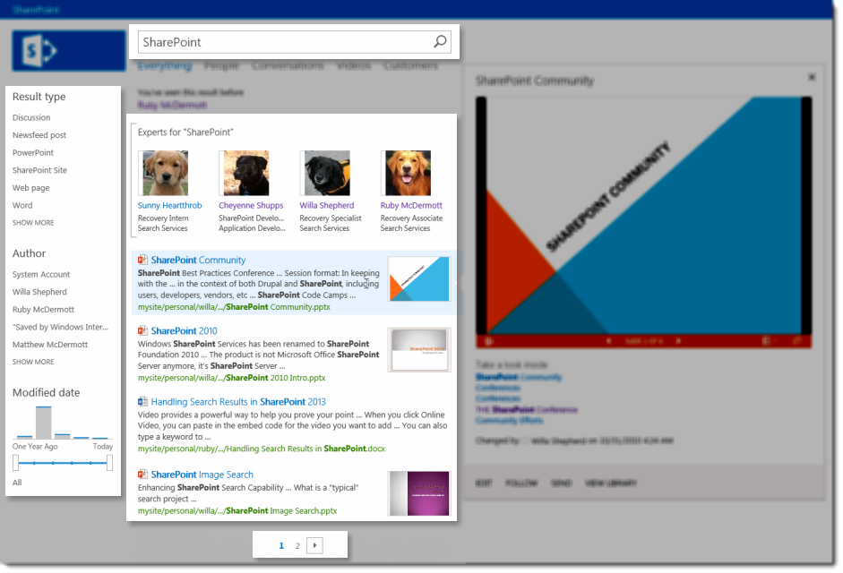
Control Template
Notes:
Control templates define the outermost container. In this case we are highlighting the Search, Refinement, Search Results, and Paging controls. Each of these controls uses an associated Control Template for function and rendering.

Slide 15
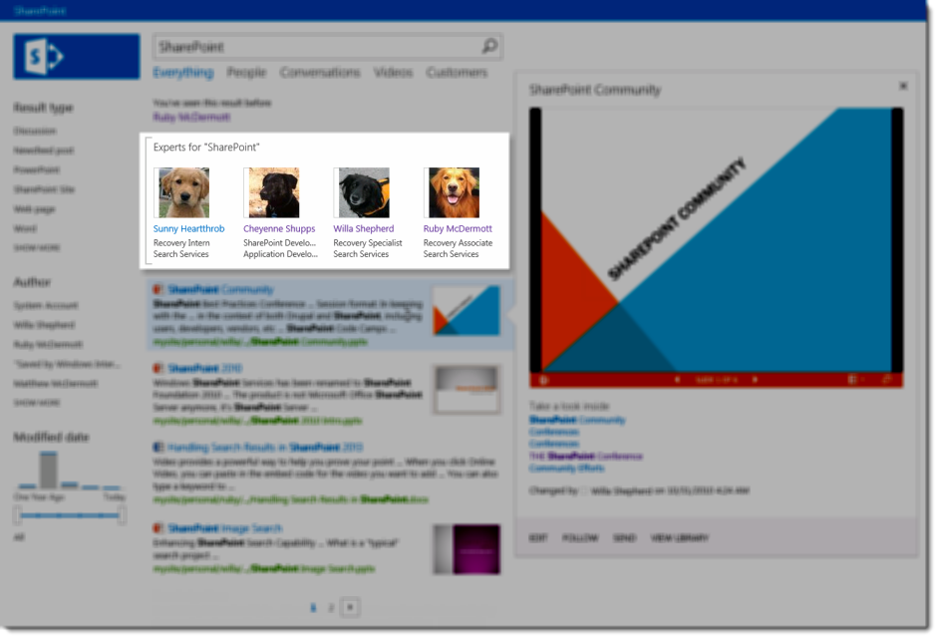
Group Display Template
Notes:
Group display templates define how sets of results are displayed within a Control. In this case the People Results are displayed in a group template that renders a small person item template in a horizontal format. Changing the Group Template will change the way the items within the result are rendered.

Slide 16
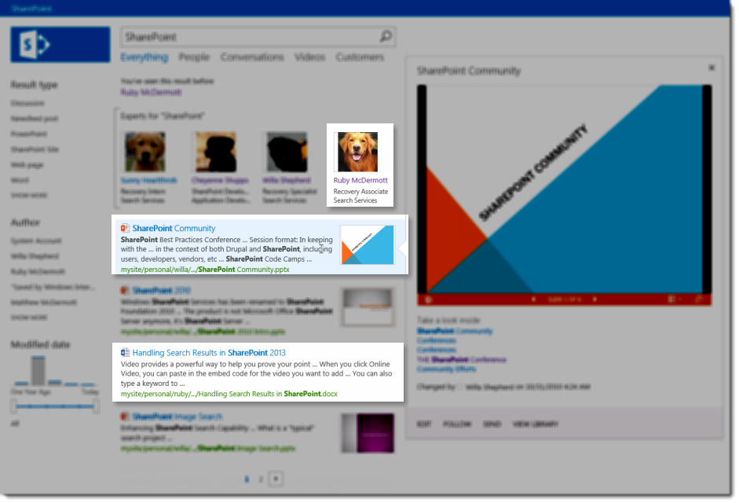
Item Display Template
Notes:
Item templates define the display of individual items. In this case the Person Item and the Search result Items are highlighted. Later in this section we will look at how these individual items can be changed to look the way we want.

Slide 17
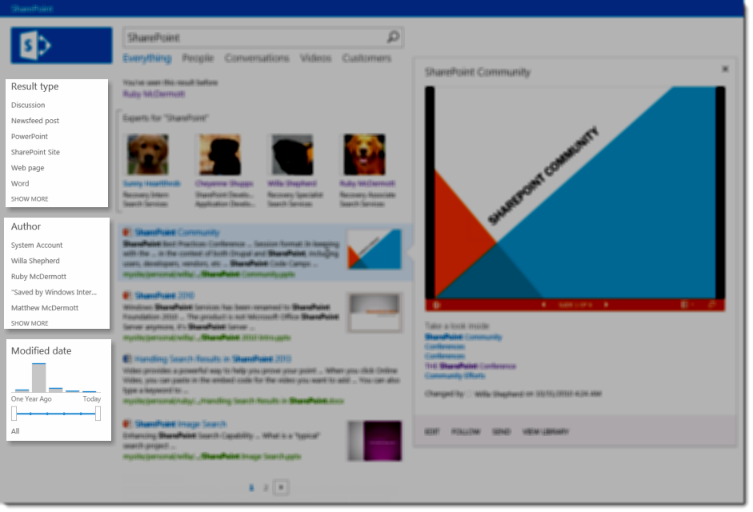
Refinement Item
Notes:
Refiners are Display Templates too! Each refinement item can be customized in the same way. Out of the box you get text and a graphical bar graph refiner. You can use jQuery to customize these refiners to add graphics and imagery to improve the user interface.

Slide 18
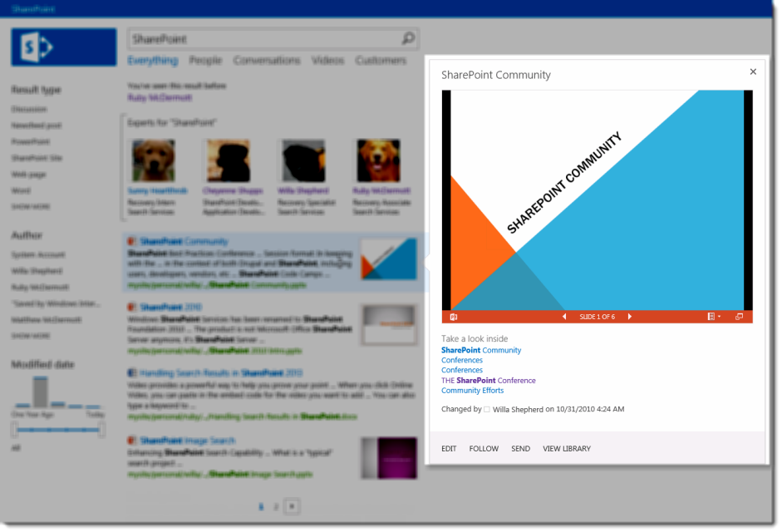
Hover Panel
Notes:
Hover Panels are too, they are referenced by the Item Display template. With hover panels you can increase the amount of information you present in your search results. This enables designers to create graphically rich user interfaces that are responsive to the users’ hover and mouse actions.

Slide 19
Search Control Rendering
Control
<property name="RenderTemplateId"
Group
<property name="GroupTemplateId"
Item
<property name="ItemTemplateId"
Item
Item
Notes:
The control renders the referenced Control, then group, then each item. In the UI for the web parts, generally you will not be able to change the Group Template (it depends on the web part). In any case, if you need to change the group template you can export the web part and edit the GroupTemplateID in the web part file. Then upload the web part file to incorporate your changes.

Slide 20
Creating Search Display Templates
Copy an Existing Display Template
Rename It Internally and Externally
Copy the New File back to Master Page Gallery
\Display Templates\Search
Create a Result Type related to your Template
Test the Rule
Notes:
The easies way to create a display template is to start with one that already works. Copy it out and rename the file (you don’t want to overwrite the out of the box templates.) Copy it back to the appropriate directory and then for Search create a Result Type Rule. For Content By Search you make the association in the Web part.

Slide 21
Other Uses
Refinement
\Display Templates\Filters
Content By Search
\Display Templates\Content Web Parts
Notes:
Each type of Display Template has a unique directory. Refiners are stored in the Filters directory and Content By Search Web parts are stored in the Content Web Parts directory.

Slide 22
Agenda
World's Fastest JavaScript Primer
Creating a Display Template for a Standard List
Display Templates used in SharePoint 2013
Using Display Templates with Search Results
Using the Content Web Search (CBS) Web Part
Notes:
Display templates are commonly used in creating unique and useful user interfaces in the Search center. It is through display templates that users interact with search results and gain value from the search center. As a designer it is your job to envision these interfaces and create the interface that your users will see and use.

Slide 23
Search Results
Search Service Crawls Content
Content Processing extracts Properties
Column Values extracted as Crawled Properties
Site Column Values
Extracted as Site Columns
Automatically Creates Managed Properties
Managed Properties can be displayed in Search
Managed Properties are referenced in the context of the current result
Notes:
In order for crawled properties to be displayed in Search Results and Content By Search you have to create Managed Properties. SharePoint will do this automatically for Site Columns in your site collection. Other Managed properties need to be created in Central Administration, like those from BCS properties. Only managed properties can be displayed in Search Results. Once registered in your display template Managed Properties are referenced in the context of the current result like this: ctx.CurrentItem.MyManagedProperty.

Slide 24
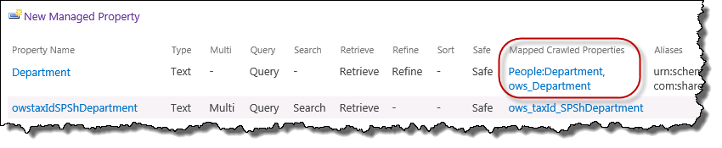
Understanding Managed Properties
Managed Properties are created from crawled properties
Create a Managed Property to use it in Search
Field Names <> Managed Property Names
Profile Property Names<>Managed Property Names
There MAY be a 1:Many relationship of Managed to Crawled Props
Notes:
Managed properties are part of the Search Schema and created from Crawled Properties. In order to display a value from search it must be a managed property. Field Names and Profile Property names are not the same as managed property names (though they may be). For example if you have a column named Color the crawled property will be named ows_Color. You then create a Managed Property that you may call Color, or ShirtColor or any name you choose. You can also map several different crawled properties to the same Managed Property to account for different names used in SharePoint.

Slide 25
Automatic Managed Properties
Site column type | Site column name | Crawled property name | Managed property name
Single line of text | Site Column Name | ows_q_TEXT_SiteColumnName | SiteColumnNameOWSTEXT
Multiple lines of text | Site Column Name | ows_r_MTXT_SiteColumnName | SiteColumnNameOWSMTXT
Choice | Site Column Name | ows_q_CHCS_SiteColumnName | SiteColumnNameOWSCHCS
Choice (allow multiple) | Site Column Name | ows_q_CHCM_SiteColumnName | SiteColumnNameOWSCHCM
Number | Site Column Name | ows_q_NMBR_SiteColumnName | SiteColumnNameOWSNMBR
Notes:
Automatic Managed Properties is new in SharePoint 2013. This solves a big issue we had in the Cloud. Now you can use custom properties in SharePoint Online 2013. (Previously you could not.) What you have to be aware of both on-prem and in the cloud, is that Site Columns are automatically converted to Managed Properties, not regular list columns. The columns are converted in a specific way based on their data type.

Slide 26
Token Substitution
For the Site Column “Product”
<div id="Header">
_#= ctx.CurrentItem.ProductOWSTEXT =#_
</div>
Notes:
In this sample the goal is to display the column Product in the display template. The column is called Product and it is of type Text. Thus SharePoint creates a Managed Property called ProductOWSTEXT that we can use in our search display template. In this sample the “_#=“ and “=#_” are in the template to tell SharePoint when to stat processing the field variables. You will explore this in your lab.

Slide 27
Agenda
World's Fastest JavaScript Primer
Creating a Display Template for a Standard List
Display Templates used in SharePoint 2013
Using Display Templates with Search Results
Using the Content Web Search (CBS) Web Part
Notes:
Content By Search was introduced in SharePoint 2013 as an alternative to Content By Query. The goal of the web part is to provide results from the Search Service rather than a direct query from the site. This has two benefits, first, performance. The second is that results can come from the entire farm if you wish rather than being bound to a site collection. Content By Search uses display templates as well, so as a designer, you can use the same tools to make the needed UI changes.

Slide 28
Content Rollup
Content by Search vs. Content by Query
Feature | CBS | CBQ
Results Display | Display Template | XSLT
Query/Filter | KQL Query | CAML Filter
Scope | Results from Index | Site Collection
Versions | Major Versions | Major and Minor
Freshness | Based on Index | Always Current
Notes:
Content By Search differs from Content Query in a few notable ways, there are still times when you may choose to use CBQ rather than CBS, this table details a few differences.

Slide 29
Content by Query
Available in 2010
Simple to Configure Query
Harder to Configure the Look and Feel
Requires XSLT
Notes:
The Content Query Web part was first introduced in SharePoint 2010. It is very simple to configure initially, though the look and feel can be challenging unless you know XSL. You also need to make changes to a single file that can impact (break) every other Content Query Web part in the site collection. This posed a risk to many folks who were unfamiliar with how Content Query worked.

Slide 30
Content By Search
Released in 2013
Depends on Search Service Application
Cross Farm
Easily Configured using Display Templates
Notes:
Content By Search was introduced in SharePoint 2013. Since it uses Search queries, it depends on the scope of search crawled by the Search Service Application. The real benefit of the web part is that it is not bound to the Site Collection (but can be configured to be limited if you desire.) The look and Feel is FAR easier to change as you can use Display Templates to make UI changes for the items in your result set one file at a time rather than the sweeping changes you make in the CBQ XSL file.

Slide 31
Managing the Content Search Part
Add the Content Search Web part to a page
Configure the Query for your Results
Configure the Display
Create a Custom Display Template
Notes:
The process of using the Content By Search Web part is similar to other web parts. Add the Web part to a page. Configure the Query using the Query Builder to return the result set you seek. Change the Display attributes to use a defined Display Template (or copy an existing Display Template and make it your own.) This process will become familiar to you as you proceed through the lab.

Slide 32
Summary
World's Fastest JavaScript Primer
Creating a Display Template for a Standard List
Display Templates used in SharePoint 2013
Using Display Templates with Search Results
Using the Content Web Search (CBS) Web Part
Notes:
Display Templates can have a profound impact on your end users enjoyment of your site. They add the visual queues that empower your users to get their jobs done. Properly employed they will be the icing on the cake for your project.

