Slide 1
Master Pages in SharePoint 2013
Notes:
This module is dedicated to understanding and customizing master pages in a SharePoint 2013 environment. The first section provides a thorough walk through of seattle.master, reviewing necessary placeholders, server controls, and their location within the master page. You will also learn about the additional placeholders and server controls available in the Snippet Gallery, and their uses. This module also covers configuring the Ribbon, as well as changing the location and appearance of the standard SharePoint navigation controls.

Slide 2
Agenda
Master Pages in SharePoint 2013
Walkthrough of seatle.master
Creating Custom Master Pages
Designing your own Starter Master Page

Slide 3
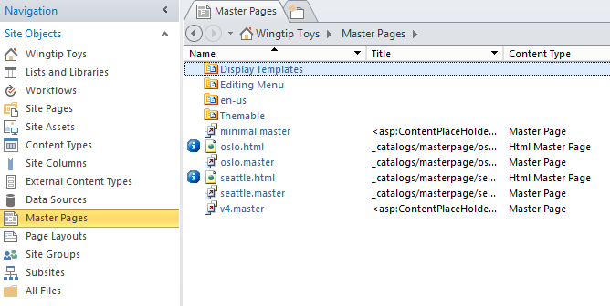
The Master Page Gallery
Each site has a Master Page Gallery
seattle.master default master page in SharePoint 2013
oslo.master alternative master page in SharePoint 2013
v4.master default master page in SharePoint 2010
minimal.master another master page used in SharePoint 2010
Notes:
SharePoint 2013 is designed around the concept of master pages. The obvious benefit of this is that all the pages in a SharePoint site can link to a single master page to achieve a consistent look and feel. Whenever SharePoint creates a new site, it creates a special hidden document library known as the Master Page Gallery. In addition to creating the Master Page Gallery in each new site, SharePoint automatically adds the following four master page instances:
seattle.master
olso.master
v4.master
minimal.master
The master page named seatle.master is the primary master page used in SharePoint 2013 sites. For example, seattle.master is what gives Team sites in SharePoint 2013 a common page layout across all the pages within a site. This common layout is what some designers and developers refer to as the "chrome" of the page because it includes familiar elements such as the Site Actions menu, the breadcrumb trail, the Ribbon, the Welcome menu, the Site Icon, the TopNav bar, and the Quick Launch.

Slide 4
Content Placeholders used in SharePoint
PlaceHolderMain
PlaceHolderAdditionalPageHead
PlaceHolderPageTitle
PlaceHolderPageTitleInTitleArea
PlaceHolderPageDescription
PlaceHolderGlobalNavigation
PlaceHolderTitleBreadcrumb
PlaceHolderGlobalNavigationSiteMap
SPNavigation
PlaceHolderSiteName
PlaceHolderSearchArea
PlaceHolderTopNavBar
PlaceHolderHorizontalNav
PlaceHolderFormDigest
PlaceHolderLeftNavBarDataSource
PlaceHolderCalendarNavigator
PlaceHolderLeftActions
PlaceHolderLeftNavBarTop
PlaceHolderLeftNavBar
PlaceHolderQuickLaunchTop
PlaceHolderQuickLaunchBottom
PlaceHolderPageImage
PlaceHolderLeftNavBarBorder
PlaceHolderMiniConsole
PlaceHolderNavSpacer
PlaceHolderTitleAreaClass
PlaceHolderBodyAreaClass
PlaceHolderBodyLeftBorder
PlaceHolderBodyRightMargin
PlaceHolderTitleAreaSeparator
PlaceHolderTitleLeftBorder
PlaceHolderTitleRightMargin
WSSDesignConsole
Notes:
Learning about the ContentPlaceHolder controls that exist in seattle.master is important because they provide the extensibility mechanism used to add unique content to site page. There are 34 named placeholders in all. Here is a brief listing of the ones that are most frequently used in SharePoint 2013.
PlaceHolderMain: Main content of the page.
PlaceHolderAdditionalPageHead: Used to add CSS and JavaScript to head section of page.
PlaceHolderSiteName: Name of the site where the current page resides.
PlaceHolderPageTitle: The title of the site shown in top title bar browser.
PlaceHolderPageTitleInTitleArea: The title of the page appearing in title area of page.
PlaceHolderPageDescription: Description of the current page.
PlaceHolderSearchArea: Section of the page for the search box and controls.
PlaceHolderTopNavBar: Container used to hold the top navigation bar.
PlaceHolderHorizontalNav: Navigation menu that is inside the top navigation bar.
PlaceHolderTitleBreadcrumb Breadcrumb text for the breadcrumb control.
PlaceHolderGlobalNavigation Global navigation (aka Top Link Bar)
PlaceHolderGlobalNavigationSiteMap: Control for getting list of child sites.
PlaceHolderLeftNavBar: Quick Launch navigation bar.
PlaceHolderLeftNavBarDataSource: Data source for Quick Launch
PlaceHolderFormDigest: Container where the page form digest control is stored.
PlaceHolderUtilityContent: Additional content at bottom of page outside the form tag.

Slide 5
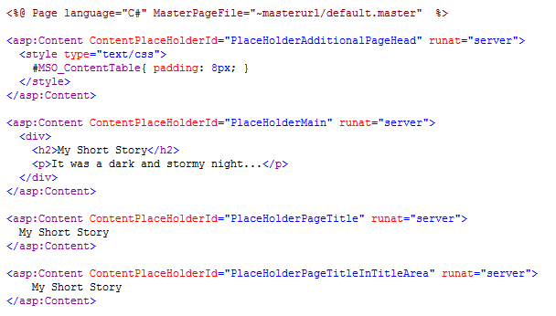
A Sample Content Page
~masterurl/default.master is a dynamic token
Replaced with master page for current site
Has a default value of seattle.master
Can be modify to point to another master page
Notes:
When you examine the site pages supplied by SharePoint, you will discover that they use the standard MasterPageFile attribute, which is understood and interpreted by the ASP.NET runtime. However, these site page templates use a dynamic token value of ~masterurl/default.master.
<%@ Page MasterPageFile="~masterurl/default.master" %>
The obvious question now becomes what the meaning of ~masterurl/default.master is. This dynamic token is a key part of the strategy that SharePoint employs to swap out the master page used by all the pages in a site. Each SharePoint site (i. e. SPWeb object) has a property named MasterUrl, which is initialized to reference the instance of seattle.master in the current site. When SharePoint processes a site page, it inspects the page’s MasterPageFile attribute. If the MasterPageFile attribute has a token value of ~masterurl/default.master, SharePoint replaces it with the MasterUrl property value of the current site. After SharePoint performs this substitution, it passes the site page over to ASP.NET for parsing and execution.
What is important to see is that all the pages in a site initially link to seattle.master. However, you can modify the value of the MasterUrl property for a SharePoint site to redirect all the pages in the current site to use a different master page. This has the effect of swapping out one master page for another.

Slide 6
Creating a Content Page with Named Placeholders

Slide 7
Agenda
Master Pages in SharePoint 2013
Walkthrough of seatle.master
Creating Custom Master Pages
Designing your own Starter Master Page

Slide 8
Understanding seattle.master
By default, all pages in site link to seattle.master
seattle.master links to CSS files including core15.css
seattle.master links to rich client-side library of *.js files
What you need to know about seattle.master
General HMTL layout of important <div> elements
Named placeholders and their locations
Delegate controls and when you need to use them
AjaxDelta controls and when you need to use them
How to extend core15.css with additional formatting

Slide 9
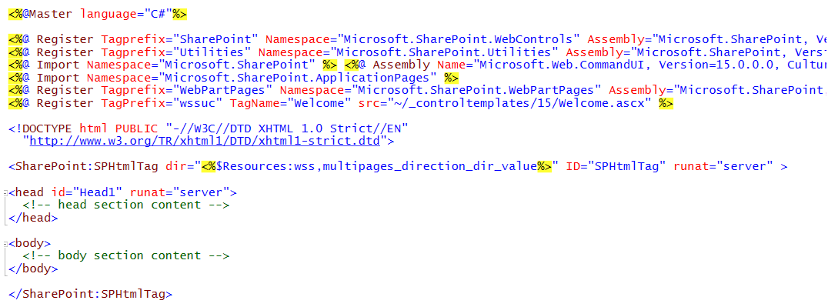
Top-level Structure of seattle.master
Seattle.master contains these top level page element
Master directive to indicate that it’s a master page
Register and Import directives
DOCTYPE tag for XHTML 1.0
SPHtmlTag element which generates the page's html element
head element
body element

Slide 10
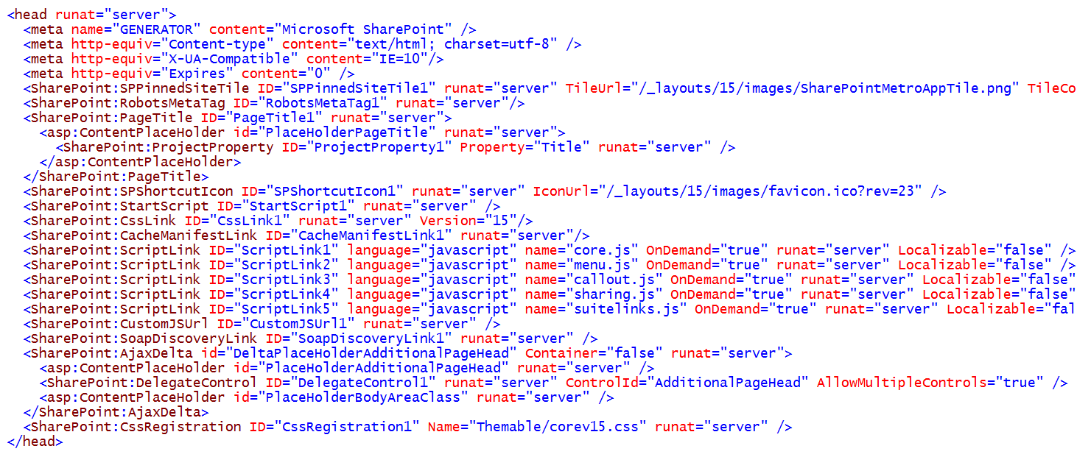
The head element in seattle.master

Slide 11
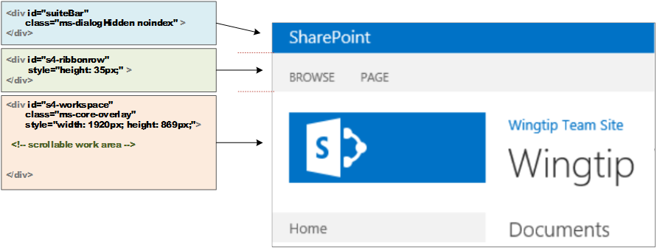
Top-level DIV Elements in seattle.master
Seattle.master has 3 important div elements
suiteBar
s4-ribbonrow
s4-workspace

Slide 12
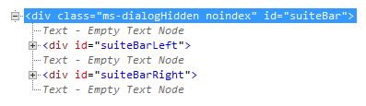
The Suite Bar
Suite Bar row serves as top visual row in page
Suite bar contains two inner div elements
suiteBarLeft
suiteBarRight

Slide 13
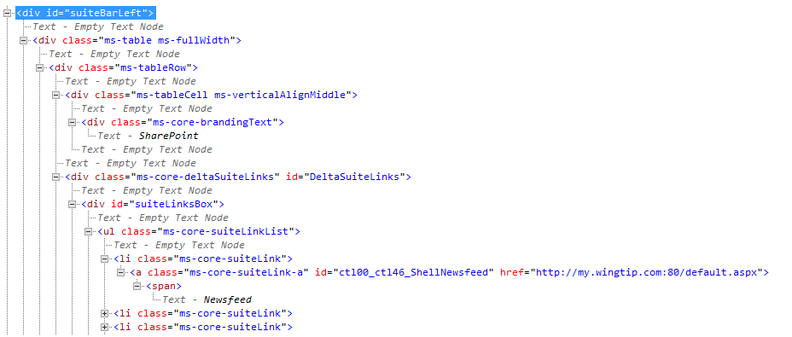
Suite Bar Left
Suite bar left contains
Branding text (SharePoint)
Suite Link List (Newsfeed, SkyDrive and Sites)

Slide 14
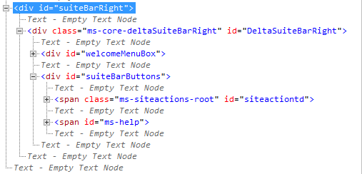
Suite Bar Right
Suite Bar Right contains
Welcome menu
Site Actions menu
Help link

Slide 15
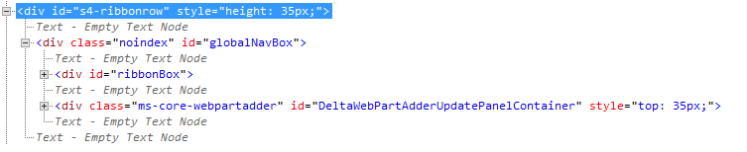
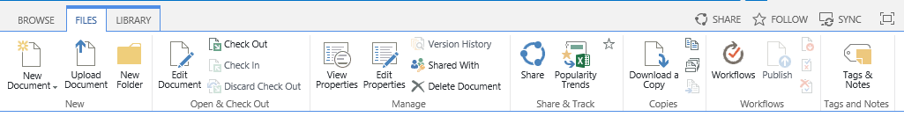
The Ribbon Row

Slide 16
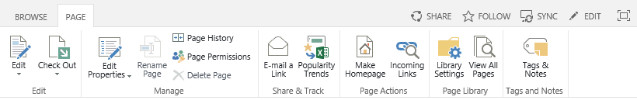
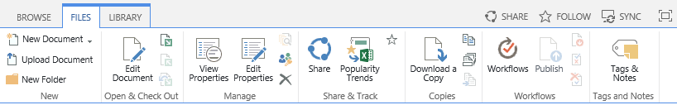
Contextual Rendering in the Ribbon
Ribbon displays tabs and actions for page context
Click a tab drops down

Slide 17
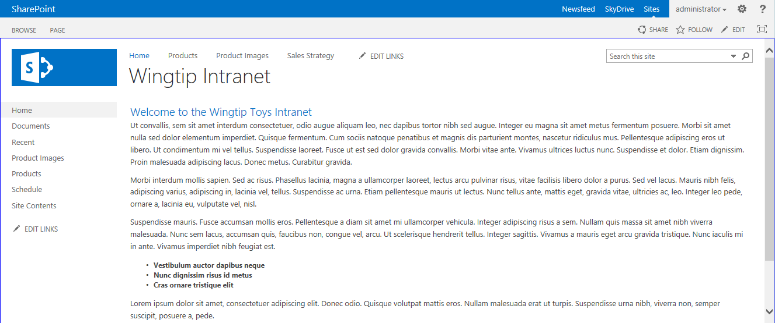
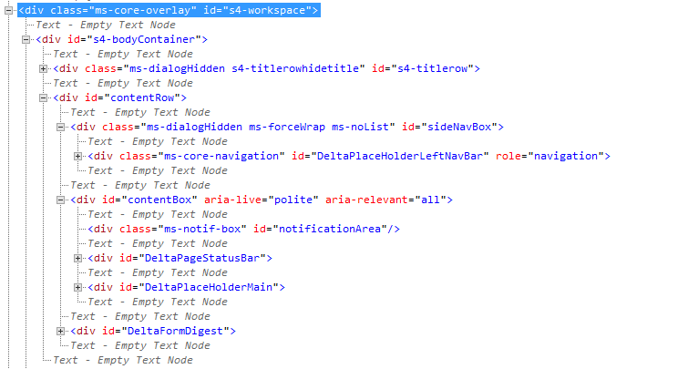
The s4-workspace Row

Slide 18
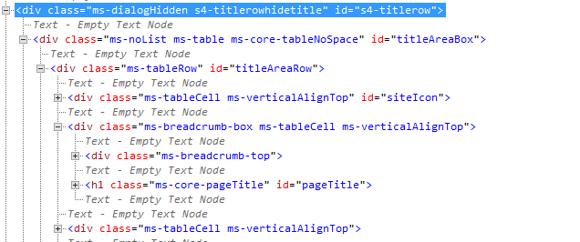
The s4-titlerow Element

Slide 19
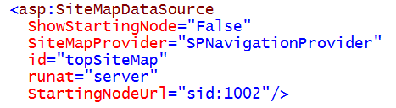
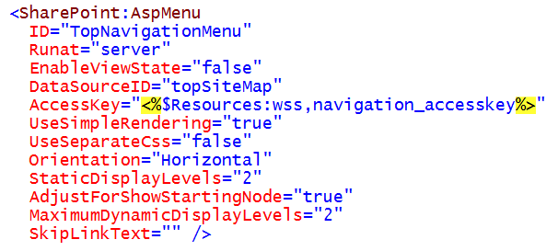
Top Link Bar

Slide 20
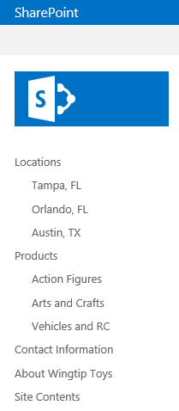
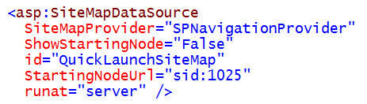
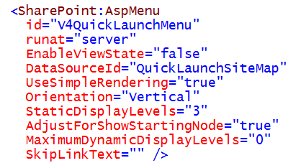
Quick Launch

Slide 21
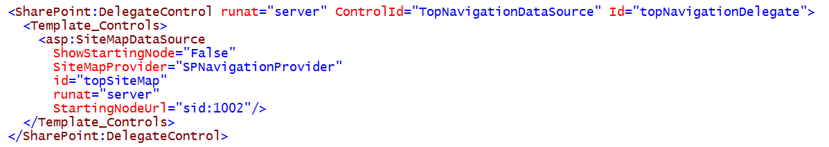
Delegate Controls used in seattle.master
seattle.master contains delegate controls
Used to substitute content into content pages
Content substitution driven by feature activation
Complete list of delegates found in seattle.master
AdditionalPageHead
GlobalNavigation
GlobalSiteLink3
GlobalSiteLink0
SuiteBarBrandingDelegate
SuiteLinksDelegate
PromotedActions
PublishingConsole
TopNavigationDataSource
SmallSearchInputBox
QuickLaunchDataSource
TreeViewAndDataSource

Slide 22
AJaxDelta Usage Seattle.master
These are the AjaxDelta placeholder in seattle.master
DeltaPlaceHolderAdditionalPageHead Container="false"
DeltaSuiteLinks <span>
DeltaSuiteBarRight <div>
DeltaSPRibbon <div>
DeltaSPNavigation <span>
DeltaSiteLogo <div>
DeltaBreadcrumbDropdown <span>
DeltaTopNavigation <div>
DeltaPlaceHolderPageTitleInTitleArea <span>
DeltaPlaceHolderSearchArea <div>
DeltaPlaceHolderLeftNavBar <div>
DeltaPlaceHolderMain <div> IsMainContent=true
Notes:
This is the complete list of AjaxDelta controls in seattle.master
DeltaPlaceHolderAdditionalPageHead" Container="false"
DeltaSuiteLinks BlockElement
DeltaSuiteBarRight BlockElement
DeltaSPRibbon BlockElement
DeltaSPNavigation
DeltaSiteLogo BlockElement
DeltaBreadcrumbDropdown
DeltaTopNavigation BlockElement role="navigation"
DeltaPlaceHolderPageTitleInTitleArea
DeltaPlaceHolderSearchArea BlockElement
DeltaPlaceHolderLeftNavBar BlockElement role="navigation"
DeltaPlaceHolderMain BlockElement IsMainContent
DeltaPlaceHolderPageDescription
DeltaPageStatusBar BlockElement
DeltaSPWebPartManager
DeltaDelegateControls
DeltaWebPartAdderUpdatePanelContainer BlockElement
DeltaFormDigest
DeltaPlaceHolderUtilityContent

Slide 23
Agenda
Master Pages in SharePoint 2013
Walkthrough of seatle.master
Creating Custom Master Pages
Designing your own Starter Master Page

Slide 24
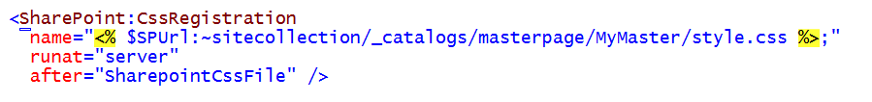
Linking to a Custom CSS File
CSS links can be created using CssRegistration control
Control should be added to head section
$SPUrl expression required for sites not at root of Web Application
You should add a link to corev15.css
You should also add link to your custom CSS file(s)
Notes:
In some cases such as when linking a single page to a CSS file you can use a simple
<asp:Content ContentPlaceHolderId="PlaceHolderAdditionalPageHead" runat="server">
<link rel="stylesheet" type="text/css" href="styles.css" />
</asp:Content>
However, there is a problem when creating master pages because you have to deal with pages at the root of the site as well as pages inside folders. Therefore, you cannot hardcode a path to the CSS file. You can use the CssRegistration control together with an $SPUrl expression to solve this problem. This makes it possible to calculate the path from a specific page to a CSS file at runtime.
CAVEAT: The $SPUrl expression is included as part of SharePoint Server 2013 and is not part of SharePoint Foundation. When using the $SPUrl expression you should always be able to make the assumption that your code will run exclusively in SharePoint Server farms and will never have to run in a farm running on only SharePoint Foundation.

Slide 25
Creating a Custom Master Page with SharePoint Designer 2013

Slide 26
Agenda
Master Pages in SharePoint 2013
Walkthrough of seatle.master
Creating Custom Master Pages
Designing your own Starter Master Page

Slide 27
Working with a Starter Master Page

Slide 28
Summary
Master Pages in SharePoint 2013
Walkthrough of seatle.master
Creating Custom Master Pages
Designing your own Starter Master Page

