Slide 1
Responsive Design and Device Channels
Notes:
This module discusses how to implement a responsive design to optimize a SharePoint site for access by mobile devices as well as how a responsive design can be complimented through the use of device channels. Students will learn about the motivation, concepts and terminology involved with a responsive design and will also learn how to implement a responsive design using pure HTML, CSS, JavaScript and media queries. After introducing responsive design, the module then explains how device channels can be used as a tool to compliment or replace a responsive design created with pure HTML approach. The module concludes by explaining how page layouts can created which target specific device channels when outputting HTML, CSS and JavaScript which can add a powerful dimension when targeting modern types of devices such as tablets and mobile devices.

Slide 2
Agenda
Introduction to Responsive Design
Understanding Media Queries
Device Channel Configuration for Mobile
Customizing Page Layouts with Device Channels

Slide 3
Responsive Design
Web site built to adapt to user environment
One web site, many devices
No more m.website.com
It’s all about the experience
Deliver optimized content not matter what the device
Notes:
Responsive design adapts your web site to the viewers screen size, allowing us to deliver optimized content no matter what device the site is being viewed on. This means you have only one web site to manage (no more m.website.com)!

Slide 4
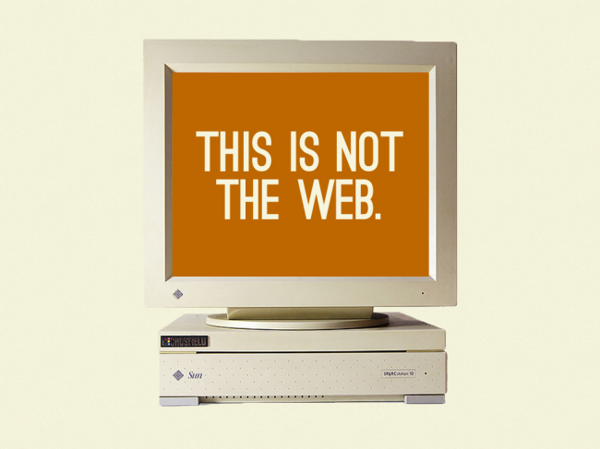
Yesterday
Image by Brad Frost

Slide 5
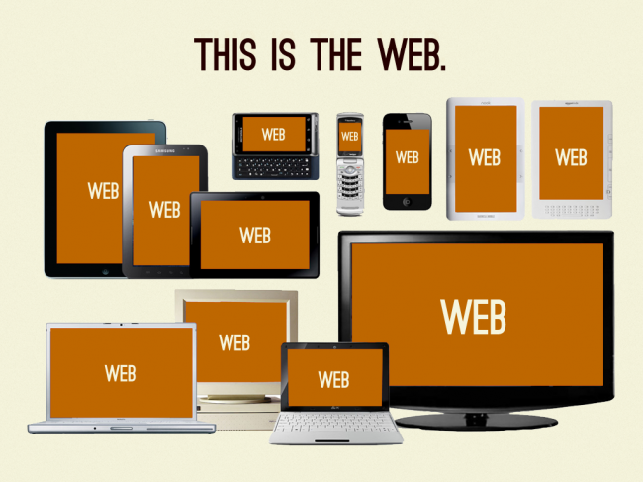
Today
Image by Brad Frost

Slide 6
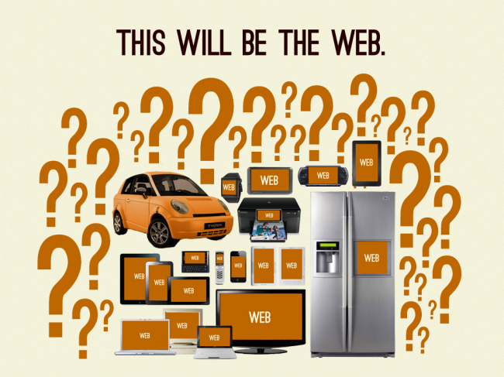
Tomorrow
Image by Brad Frost

Slide 7
How Responsive Design Works
Media queries send targeted CSS
Based on viewport size
Recipe for a responsive site
Media queries
CSS
Flexible layout
Scalable Imagery
Notes:
Responsive design uses media queries and CSS to target screen sizes and call different CSSs to arrange, hide and display content that is best for that particular screen size. This requires using flexible layouts (no using tables to layout content!) and scalable imagery.

Slide 8
Changing the Way We Think About the Web
The web is not a tangible medium
Embrace it’s flexibility
The web isn’t print
Print lingo used in web
Canvas
Layout
Masthead
Whitespace
Fold
None of those elements physically exist online
Notes:
You know the web isn’t a physical medium, but do you treat it as such? How often do you design just for your monitor?
It’s natural that many of the terms used in graphic design would lend to web design. The same scenario has happened with many physical items that develop digital counterparts, such as Photoshop. While it’s valuable to know the history of these terms, it’s time to accept the intangible aspect of the web and change the way you think about it. How big is the canvas for your web page? It’s however big or small you tell it to be. How it is perceived depends completely on the viewer’s device and browser.

Slide 9
Flexibility – A Blessing and a Curse
No control over how people view the web
Any device
Any browser
Any user settings
Any where
Any time
The only thing you can control is your code
Notes:
As mentioned in Module 1, the only thing you can control is your code.

Slide 10
What Content to Display on Mobile
“Hiding” content on mobile devices
Don’t remove content to make your page look better
Desktop content should be available on mobile
Mobile First
Forces focus on content and design
Design can be enhanced for larger screens
If content isn’t important enough to be viewed on your mobile site, is it really important?
Notes:
How do you determine what content to display on your mobile device? The bottom line is to make sure you don’t remove content to make the page look better. The most important thing is getting the content your users want. Consistency is very important. If important content is available on the desktop site and a user goes to the site on their mobile device, the content needs to still be accessible. It may look different, but it needs to be there.
Luke Wroblewski has developed a concept he calls “Mobile First.” He urges designers to design and build their mobile site first. This forces focus on what is really most important to the user. Design enhancements can be added for larger screens if it adds value. His main point is if content isn’t important enough to be viewed on your mobile site, is it really important?

Slide 11
Responsive Design

Slide 12
A Few Responsive Web Resources
Ethan Marcotte
http://ethanmarcotte.com/
Luke Wroblewski
http://www.lukew.com/
Brad Frost – Responsive Resources
http://bradfrost.github.io/this-is-responsive/resources.html
A List Apart
http://alistapart.com/topic/responsive-design
Smashing Magazine
http://coding.smashingmagazine.com/tag/responsive-web-design/
Notes:
Here are a few helpful resources if you’d like to learn more about responsive design.
Ethan Marcotte coined the term, “responsive design.” He knows what he’s talking about.
Luke Wroblewski is responsible for the concept, “mobile first.” Great reading for shifting the way you think about web content and mobile design.
Brad Frost has done us all a favor by collecting the best resources out there for responsive design, and putting them all in one place. Yeah!
A List Apart is famous for attracting the best in the industry. Their publications and conferences are always informative.
Smashing Magazine is a great source for solid publications and out-of-the-box, forward-looking articles.

Slide 13
Agenda
Introduction to Responsive Design
Understanding Media Queries
Device Channel Configuration for Mobile
Customizing Page Layouts with Device Channels
Notes:
This module covers responsive design and implementing it using device channels. We will review responsive design and its use for optimizing websites for mobile devices. The next section will cover implementing responsive design online using media queries. Then you will learn about device channels, a tool provided by SharePoint to implement responsive design on your SharePoint site. We will set up custom device channels with custom master pages and CSSs. The last section covers modifying layouts for use in multiple device channels.

Slide 14
Viewport Meta Tag
Used to improve web page presentation
Specify
Initial Scale
Scalability
Width
Height
Best viewport settings for responsive design
Use caution when limiting scalability
Often poor user experience
Notes:
Height not necessary to set.
Scalable options:
maximum-scale=X
minimum-scale=X
user-scalable=no/yes

Slide 15
Media Queries
Media-dependent style sheet
Based on media types
Query includes
Media type
Expression(s) that check for a specific media feature(s)
Style(s) applied when both conditions are met
One media type per query
Can have multiple feature expressions per query
Notes:
You may have used media queries before when setting up optimizing printed web pages. Media queries require a media type and at least one expression (technically, it can have zero expressions, but that doesn’t do much good).

Slide 16
Applying Media Queries
Three ways to use media queries
Page-level style element
In an external CSS
Linking to an external CSS
Case-insensitive
Type used for responsive
screen
Features used for responsive
min-width
max-width
*See the slides at the end of this presentation for a full list of media query types, features, and applications
Notes:
There are three ways to add a media query. It can be added in a <style> as a page level element. It can be added with the @media call in an external CSS. Or it can be added to the link to the external CSS. This last method is the one we’ll be using. Media queries are case sensitive.

Slide 17
Fluid Layout
Fixed-width is not the enemy
Readability is the priority
Keep consistency across devices
Don’t redesign layouts for smaller devices – adapt it
Build a layout to support fixed and flexible
What makes a layout flexible?
Built with divs and floats
Grids, grids, grids
Not a must, but can be a good place to start
Notes:
A fluid or flexible layout is a layout that is built with divs. It uses floats to position the content on the page. Because the floats are called in the CSS, they can be changed in the responsive CSSs to accommodate layout shifts for different device screens. This doesn’t mean that a site can’t have a fixed width for desktop display. Depending on the content and the layout, a fixed width can often deliver the best desktop experience for your users. Content that spreads across the entire screen is difficult to read. Having multiple columns or a fixed width makes the page more readable and organized.

Slide 18
Font Sizes With ems
Why should I use ems for font sizes?
It keeps your font styles to a minimum
How do I use ems?
Set body to 100%
Target size / 100% size (16px) = ems
I want my h1 to be 32px
32 / 16 = 2ems
Too many nested ems = lots of math
Notes:
ems are useful for font sizing when using responsive web standards. It allows the font to shift as the screen size and the rest of your layout does. Just remember what you’ve set your ems to in a specific style if you’re modifying nested elements.

Slide 19
Break Points
Where the design breaks in different screen sizes
Used to be focused on screen size
Too many devices to have a “common” screen size
Target CSS and media queries for content
Where does your design need to shift?
Think fluid more than flexible
Notes:
Logical point where you design “breaks.” This used to be focused on specific browser dimensions, but there are too many now for this to be useful. Look at your design and decide when and how your layout needs to shift. Be aware of the most used browser dimensions of your audience, but don’t let it dictate your break points.

Slide 20
Images
Retina Display
Hiding image client side – data still loads
Optimize images for web
Displaying images on mobile
Scale
Crop with content
Notes:
When creating your images, keep in mind retina display and other double-density devices. iPhones and many other new phones have upped the ppi on their devices. This means that standard 72dpi images will looked pixelated and blurry. This can be accommodated two ways: upping the dpi, or doubling the image size. Either way, you’ll have to set the image dimensions for your desktop images so they’re not too big (in CSS, of course).
When dealing with images and layout on mobile devices there are two methods. The first is you can scale the image by setting the image width to 100% (in CSS, of course). The second is keeping the image the same size, but floating content over the image, essentially “cropping” it.

Slide 21
Setting Up Media Queries

Slide 22
Media Query Reference for Media Types
all: suitable for all devices
braille: for braille tactile feedback devices
embossed: for paged braille printers
handheld: for handheld devices (typically small screen, limited bandwidth)
print: for paged material and for documents viewed in print preview mode
projection: for projected presentations, for example projectors
screen: primarily for color computer screens
speech: for speech synthesizers
tty: media using a fixed-pitch character grid (such as teletypes, terminals, or portable devices with limited display capabilities). Authors should not use pixel units with the "tty" media type.
tv: for television-type devices (low resolution, color, limited-scrollability screens, sound available)
Source: W3C (w3c.org)

Slide 23
Media Query – Media Features
Feature | Description | Value | Min/Max
aspect-ratio | Ratio of width to height of the media feature | Ratio | Yes
color | Number of bits per color component of the output device | Integer | Yes
color-index | Number of entries in the color lookup table of the output device | Integer | Yes
device-aspect-ratio | Ratio of device width to device height of the media feature | Ratio | Yes
device-height | Height of the rendering surface of output device | Length | Yes
device-width | Width of the rendering surface of output device | Length | Yes
grid | query whether the output device is grid or bitmap | Integer | No

Slide 24
Media Query – Media Features (cont.)
Feature | Description | Value | Min/Max
height | height of targeted display area of output device | Length | Yes
monochrome | Number of bits per pixel in a monochrome frame buffer | Integer | Yes
orientation | portrait, height equal to or greater than width; or landscape, width equal to or greater than height | Portrait/ Landscape | No
resolution | resolution (density of the pixels) of the output device. Can be specified used min or max values | Resolution | Yes
scan | Height of the rendering surface of output device | Progressive/Interlace | No
width | Width of targeted display area of output device | Length | Yes

Slide 25
3 Ways to Apply Media Queries
Page-level style element
<style type="text/css">
@media (max-width: 640px) {
h1 { font-size: 1.5ems; }
}
</style>
Inside a CSS
@media (min-width: 960px) {
.content { background-color: blue; }
}
Linking to an external CSS
<link href=“styles.css" rel="stylesheet" type="text/css" media="screen and (max-width:640px)" >

Slide 26
Agenda
Introduction to Responsive Design
Understanding Media Queries
Device Channel Configuration for Mobile
Customizing Page Layouts with Device Channels
Notes:
This module covers responsive design and implementing it using device channels. We will review responsive design and its use for optimizing websites for mobile devices. The next section will cover implementing responsive design online using media queries. Then you will learn about device channels, a tool provided by SharePoint to implement responsive design on your SharePoint site. We will set up custom device channels with custom master pages and CSSs. The last section covers modifying layouts for use in multiple device channels.

Slide 27
Device Channels
New feature in SP2013
Create a “channel” based on device or browser
Defined by user agent substrings
Customized experience
Separate master page
Specific site columns in layout
Image renditions
Notes:
Device Channels are a new feature in the Design Manager. They allow designer to create different channels based on defined user agent screens. This allows for a design to be applied for specific devices, OSs and browsers.

Slide 28
Device Channels + Responsive Design
Why not just device channels?
Too many devices to manage device channels for each
Lots of device channels = lots of masters
No common browser and viewport size
Why not just responsive?
LOTS of display = none
No good client side solution for hi-res images
No common browser and viewport size
Used together
More control
Lighter pages
Notes:
Device Channels and responsive design work very well together. It is possible to use just one or the other, but used together you can develop a powerful, manageable solution to deliver optimized content to all you users.

Slide 29
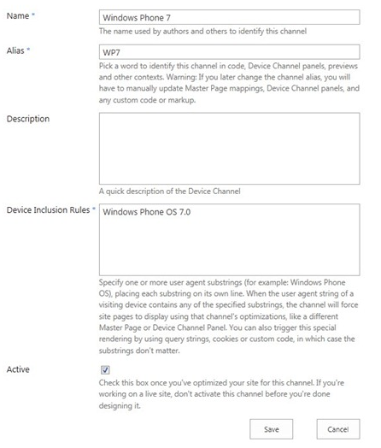
Creating Device Channel
Step 2 in Design Manager
New device channel requires…
Title
Alias
Device Inclusion Rule
User agent substring
Identification information
Browser
OS
Platform
Language Tag
Notes:
Creating a Device Channel is Step 2 in the Design Manager. It must include a standard user agent string.

Slide 30
Device Targeted Master Page
Lighter pages
Add or remove items for device channels
Focus design for a specific device or browser
Notes:
Creating a master page for a specific Device Channel gives the designer complete control over what content should be displayed for that channel and how it should be displayed. Controls can be added or removed from the master as the design dictates. This leads to lighter pages.

Slide 31
Creating a Device Channel with its own Custom Master Page

Slide 32
Agenda
Introduction to Responsive Design
Understanding Media Queries
Device Channel Configuration for Mobile
Customizing Page Layouts with Device Channels
Notes:
This module covers responsive design and implementing it using device channels. We will review responsive design and its use for optimizing websites for mobile devices. The next section will cover implementing responsive design online using media queries. Then you will learn about device channels, a tool provided by SharePoint to implement responsive design on your SharePoint site. We will set up custom device channels with custom master pages and CSSs. The last section covers modifying layouts for use in multiple device channels.

Slide 33
Device Channels and Content
Device Channel Panel
Content fields for individual device channels
Specified in layout
Pros
Lighter pages
More control over content experience
Cons
More maintenance
Available in Snippet Gallery
Notes:
The Device Channel Panels are available in the Snippet Gallery. They can be added to page layouts to specify which content fields display in which channels.
Device Channel Panel – helpful and fun to say!

Slide 34
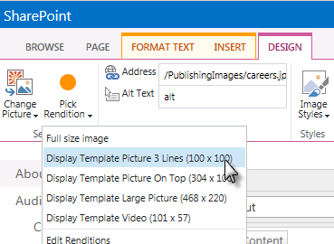
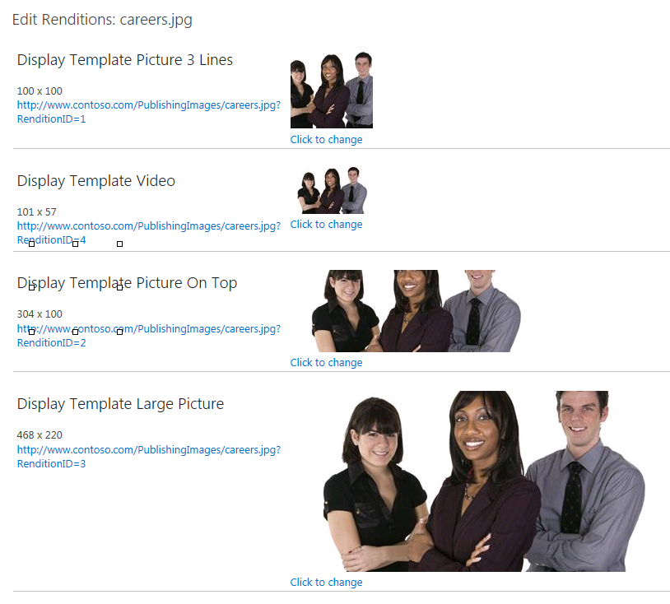
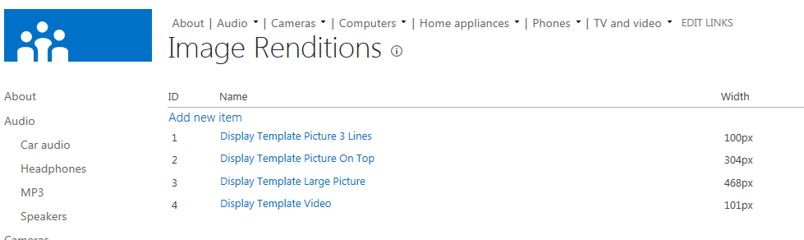
Image Renditions
Image transformation on demand
Thumbnails are actual thumbnails
Consistency sized images
Cropping for targetting areas of pictures
Notes:
Many times the same image needs to be used across a site in standard formats. What SharePoint now offers is something called Image Renditions. Site owners can create multiple renditions of an image and when content owners want to use an image on a page, they select the image and then the rendition they want. SharePoint then, when first requested, generates the image according to the rendition and saves it to the WFE disk for future requests.

Slide 35
Customizing Layouts for Device Channel Specific Content

Slide 36
Summary
Introduction to Responsive Design
Understanding Media Queries
Device Channel Configuration for Mobile
Customizing Page Layouts with Device Channels

