Slide 1
SharePoint and Branding Assets Overview
Notes:
This module explains how SharePoint 2013 processes pages in a SharePoint site by integrating .aspx pages together with master pages and CSS. You will learn about the standard SharePoint branding elements added to every sites such as the Master Page Gallery and the master pages included out of the box. The module also explains the difference between site pages and application pages from the perspective of a web designer. The final section of this module introduces the new Composed Looks feature of SharePoint 2013 and shows how it can be used to change the look and feel of the current site.

Slide 2
Agenda
Branding in SharePoint
Team Site Design Assets
Applying a Composed Look
Publishing Site Design Assets
Applying a new Master
Notes:
This module gives a high-level overview of branding in SharePoint. You will learn about the standard SharePoint branding elements added to every site such as the Master Page Gallery and the master pages included out of the box. The final section of this module introduces the new Composed Looks feature of SharePoint 2013 and shows how it can be used to change the look and feel of the current site. At the end of this module, you will be able to apply a new design to both a publishing and a team site.

Slide 3
Branding in SharePoint
Branding SharePoint isn’t about it “not looking like SharePoint” any more
University of Northampton
Marshfield Clinic
Woox Innovations
SharePoint 2013 offers a new branding experience
Team Sites – Composed Looks
Publishing Sites – Design Manager
Notes:
With SharePoint 2013, Microsoft has changed their approach to how SharePoint sites get branded. Having your SharePoint sites simply, “not look like SharePoint” isn’t enough. Instead of SharePoint being able to be rebranded, SharePoint was built to be rebranded. As discussed in Module 1, branding and website design isn’t just about what the site looks like, but how’s it’s organized, what content is displayed, and how that content is presented to the user. SharePoint now offers more OOB feature and functionality based options that allow for a more customized experience, without custom development, such as different navigation options, cross-site publishing, and content by search.
Branding isn’t just done by developers anymore. Different levels of branding can be done according to time, experience, and level of effort.

Slide 4
Agenda
Branding in SharePoint
Team Site Design Assets
Applying a Composed Look
Publishing Site Design Assets
Applying a new Master
Notes:
This module gives a high-level overview of branding in SharePoint. You will learn about the standard SharePoint branding elements added to every site such as the Master Page Gallery and the master pages included out of the box. The final section of this module introduces the new Composed Looks feature of SharePoint 2013 and shows how it can be used to change the look and feel of the current site. At the end of this module, you will be able to apply a new design to both a publishing and a team site.

Slide 5
Team Sites - What Happened to Themes?
SharePoint 2003 and 2007
Level of effort was high
Access to themeable files required access to server files
Designs could be complex, but require a developer
SharePoint 2010
Themes created with .thmx files
Could be uploaded through the user interface
Designs were very limited
Notes:
How theming has been handled in the different versions of SharePoint has been inconsistent. In SharePoint 2003, theming was primitive at best, and required a developer with access to the file system. SharePoint 2007 made little improvement on this, but customizing items inside the theme file was a bit more efficient. With SharePoint 2010, SharePoint was added to the products that could be themed with the Office theming tools. While this allowed users to create and upload themes to SharePoint without needing a developer, the themes that could be created were too simple. Theming in SharePoint 2013 aims to create a balance between these two extremes.

Slide 6
Team Site Design – Composed Looks
More robust version of a “theme”
Group of files combined to create one theme
Composed Looks contain
Master Page
Theme (color palette) file
Background Image
Font Scheme
Notes:
Branding Team Sites in SharePoint 2013 is done with Composed Looks. Composed Looks is Microsoft’s solution that allows users to build themes as simple or complex as they wish, depending on their desired level of effort and time available.
The main difference between Themes and Composed Looks is easily updatable files associated with each.
Theme: color and font
Composed Look: color, font, background image, master pages (potential to add css here)

Slide 7
Composed Looks are Flexible
Color and font easy to customize
Custom Composed Look
Low Level of effort: color, font, background image
High Level of effort: color, font, background image, master page, css
Addressed further in Module 11
Notes:
Composed Looks are easy to apply and customize. They can be easily modified by changing the color, font and background image for an OOB look. Or with a bit more time and effort, a completely custom composed look can be made by creating custom font and color files. We’ll get into this in detail in Module 11.

Slide 8
Agenda
Branding in SharePoint
Team Site Design Assets
Applying a Composed Look
Publishing Site Design Assets
Applying a new Master

Slide 9
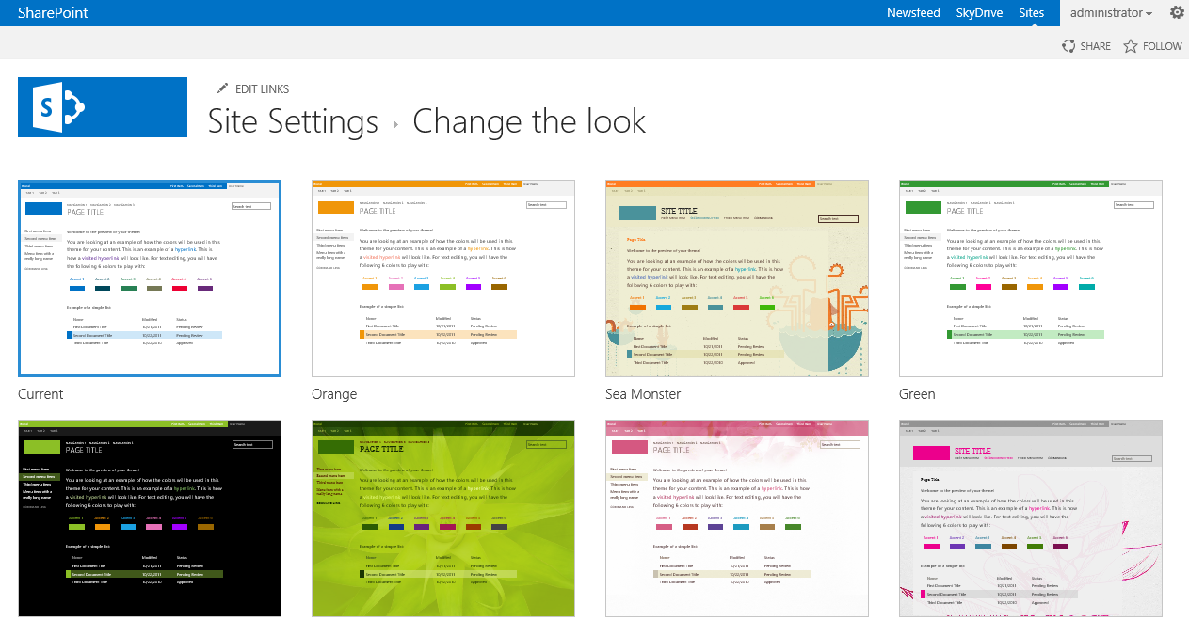
Applying a Composed Look
Designer Level or greater permissions need to be able to change Composed Look
Themes can be applied at the subsite level
Notes:
SharePoint 2013 comes with 13 OOB Composed Looks.

Slide 10
Applying a Composed Look

Slide 11
Agenda
Branding in SharePoint
Team Site Design Assets
Applying a Composed Look
Publishing Site Design Assets
Applying a new Master

Slide 12
Publishing Site Design Assets
Master Pages
Wrapper
CSS
Manage styles
Page Layouts
Content placement
XSLT
Web part styling
Display Templates
Content by search styling
Notes:
These are the items involved in branding a Publishing SharePoint site. We’ll get into these in much more detail in the next days of the course.

Slide 13
Location of Design Assets
SharePoint 2007 and 2010 asset locations
Master page and page layouts: _catalogs
CSS and imagery: style library
SharePoint 2013 with Design Manager
Every in _catalogs
Notes:
In previous versions of SharePoint, the master page and page layouts were kept in the catalogs folder, and the CSS and imagery were kept in the style library. The Design Manager in SharePoint 2013 makes it easy to keep all your assets in one place – the catalogs folder. l

Slide 14
Master Pages
Wrapper or Chrome
Changing the look of a Publishing site done by changing the site’s master page
Link to css in the master
Unlike Composed Looks, Publishing sites come with two master pages OOTB
oslo.master
seattle.master
Stylistically the same, difference in navigation and they way the handle anonymous users
Notes:
As discussed in Module 2, all SharePoint pages use a master page. The master page controls is the site’s wrapper or chrome. It contains the opening and closing page elements (html, head, body), as well as the SharePoint controls such as navigation. The master page also contains the links to the JavaScript and CSS files.
Olso: focus on intranet
Seattle: focus on internet

Slide 15
Site Master vs System Master
Site Master Page
Used by publishing pages
System Master Page
Used by forms, view, and settings pages
_layouts/
Forms, libraries, lists,
Notes:
Site master: publishing pages
System master: pretty much everything but publishing pages
No need to change system master

Slide 16
Agenda
Branding in SharePoint
Team Site Design Assets
Applying a Composed Look
Publishing Site Design Assets
Applying a new Master

Slide 17
Applying a Different Master
Master page has to be published to be applied
Can be applied at subsite level
Can be forced on children sites
Changing master effects styles and controls
Changing master doesn’t effect
Content
Page Layout
XSLT
Display Templates
Notes:
If versioning is turned on, a master page must be published before it can be applied to a site. The master page is applied at the site level, so subsites can use different master pages if desired. Changing the master page won’t change the content on the page, the page layout, display templates or XSLT. It can however change the styles that are applied if the master page uses a different CSS.

Slide 18
Apply a Master Page

Slide 19
Summary
Branding in SharePoint
Team Site Design Assets
Applying a Composed Look
Publishing Site Design Assets
Applying a new Master

