Slide 1
Team Sites Versus Publishing Sites
Notes:
This module discusses essential similarities and differences between Team sites and Publishing sites. You will learn how to create and utilize site columns and content types to track content in a SharePoint list. You will also be given an overview of the Publishing features in SharePoint 2013 and learn how the SharePoint publishing scheme is based on publishing pages and page layouts. The module will also discusses the differences between how navigation is configured in a Team site versus a Publishing site.

Slide 2
Agenda
SharePoint Site Fundamentals
Understanding Team Sites
Site Columns and Content Types
Understanding Publishing Sites
Navigation in a Publishing Site

Slide 3
What is a SharePoint Site?
A SharePoint site is…
A securable website on the network or Internet
A collection of pages accessible through a root URL
A place to store files and collaborate on documents
A place to publish content and all kinds of information
A platform for building business applications

Slide 4
Site Collections and Sites
Sites always created in scope of a site collection
Site collections created at web application scope in on-prem farm
Site collections created at tenancy scope in SharePoint on-line
User can be configured to be site collection administrator
SharePoint Web Application Host Header Path: http://intranet.wingtip.com
site collection (root)
site collection /sites/operations
site collection /sites/sales
site collection /sites/finance
top-level site
(root)
top-level site
(root)
top-level site
(root)
top-level site
(root)
child site
/WestDivision
child site
/EastDivision
child site
/FY2012
child site
/FY2013
child site
/Reports
child site
/Dashboards
Notes:
All user-generated content resides in SharePoint sites. The primary types of content include items within lists and documents inside document libraries. However, there are other forms of user-generated content as well such as customization data and personalization data tracked by server-side web parts as well.
Sites are grouped into site collections. Whenever a site is created, it is always created within a scope of a specific site collection. Furthermore, each site collection is associated with exactly one content database which is used to store the content of all the sites inside.
Each site collection must have exactly one site referred to as the “top-level” or “root” site. The URL of the top-level site is always the same as the URL of the site collection. A site collection may additionally contain child sites below the root site. Child sites can be nested within other child sites within a site collection resulting in the creation of a site hierarchy. While SharePoint supports nested child sites more than 10 levels in depth, experience has taught the SharePoint community that creating deep site hierarchies can be very hard to manage and to scale.
A key reason why the SharePoint architecture requires that sites are always partitioned into site collections has to do with security. More specifically, site collections provide a scope for administrative privileges. If you are configured as the site collection administrator (aka site collection owner), you are guaranteed to have full administrative control over all the sites inside.

Slide 5
Team Sites Versus Publishing Sites
Team Sites
Focused on collaboration between team members
Used to store, edit and review business documents
Facilitates communication between team members
Content typically added to site using wiki pages
Publishing Sites
Used to publish content to a specific audience
Provides extra support to content approval processes
Provides extra support for web design and branding
Content typically added to site using publishing pages

Slide 6
Agenda
SharePoint Site Fundamentals
Understanding Team Sites
Site Columns and Content Types
Understanding Publishing Sites
Navigation in a Publishing Site

Slide 7
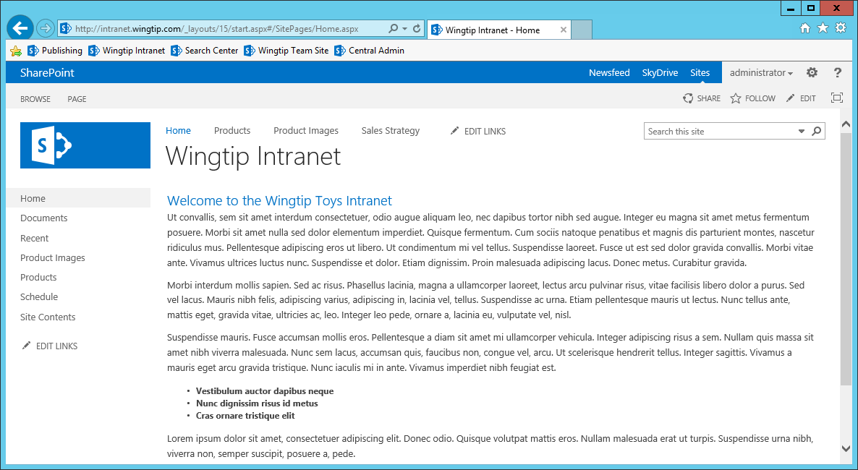
The New Team Sites UI in SharePoint 2013

Slide 8
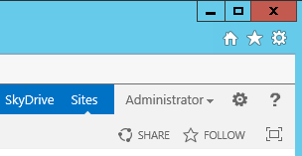
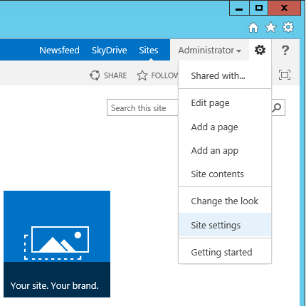
Site Actions Menu
Site Actions menu displayed in top right corner
Provides commands for actions and navigation
Internet Explorer Settings menu
SharePoint Site Actions menu
Configure permissions to this site
Edit the current page (applies to web part pages or wiki pages)
Add a new wiki page to the SitePages wiki page library
(Create new list or document library) OR (Install a new SharePoint app)
Navigate to Site Contents page
Navigate to the Change the Look page
Navigate to the Site Settings page
Navigate to the Getting Started page

Slide 9
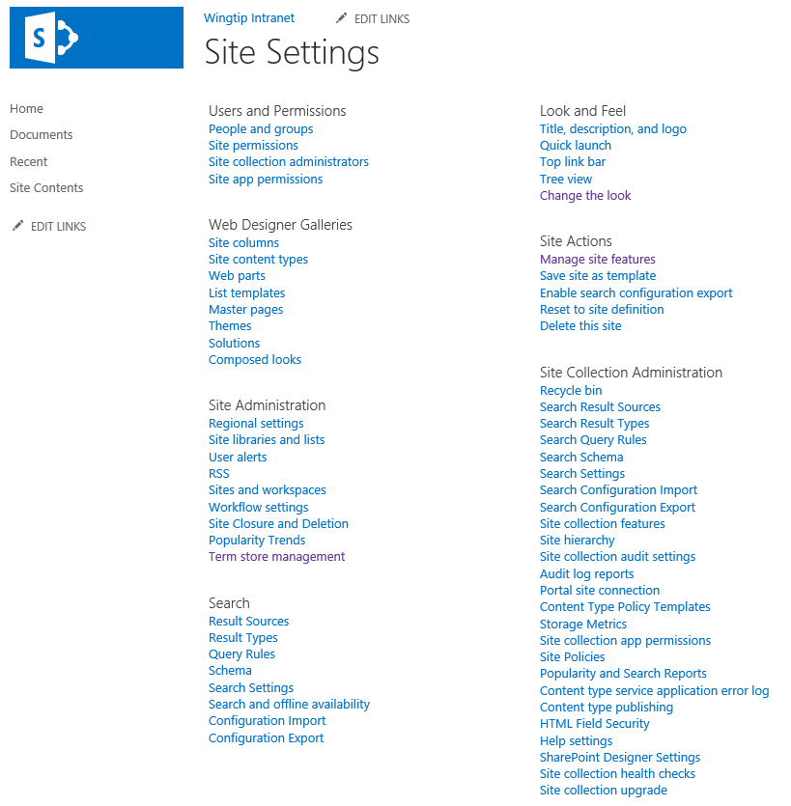
Site Settings
Notes:
Certain users are given the role as “site administrator”. Quite often this means that the user has been assigned the permissions of a site collection administrator. In some scenarios, the IT staff within a company may elect to use a more elaborate security configuration where business users are never configured as site collection administrators, but instead they are assigned less-powerful administrative permissions on one or more sites within a site collection. In either case, these users will be responsible for certain administrative duties at the site level.
Each site contains a site settings page ([site_url]_layouts/settings.aspx) which provides links to administrative pages which make it possible to perform common administrative tasks at the site level. The site settings page of the top-level site also contains links to pages which are used to perform administrative tasks on the site collection as a whole.

Slide 10
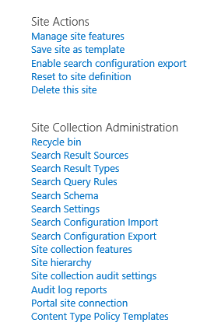
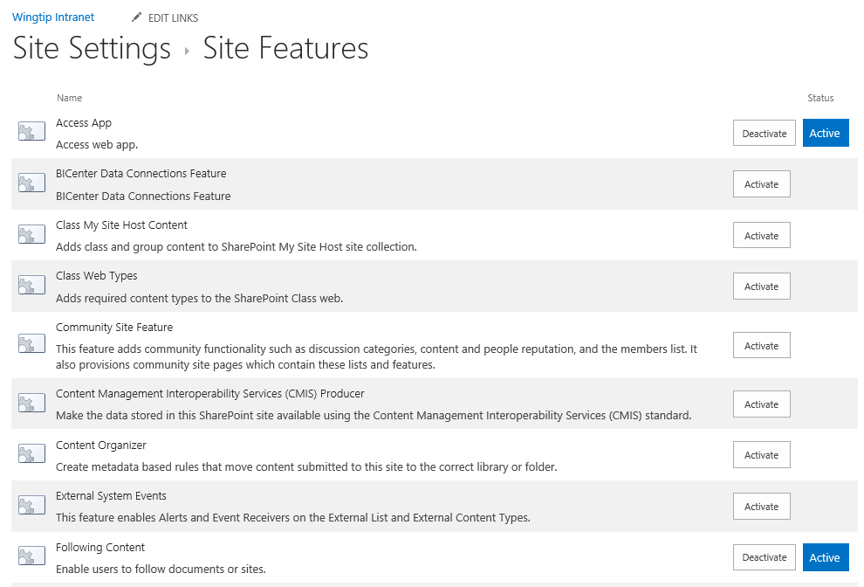
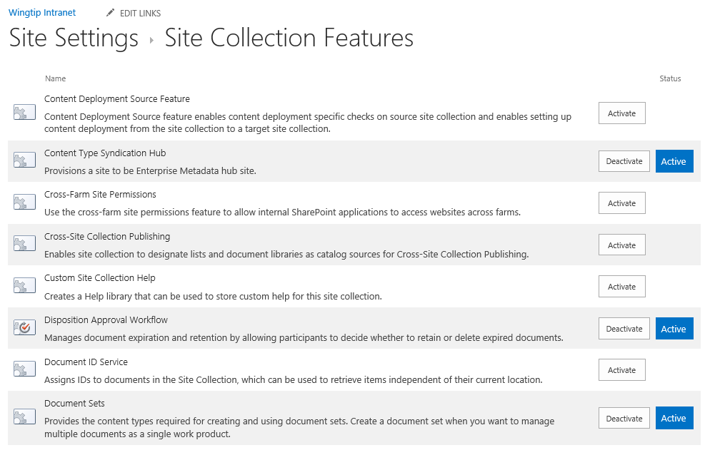
Managing Features
Site collection administrator can activate features
Some features activate at site (aka web) level
Other features activate at site collection level

Slide 11
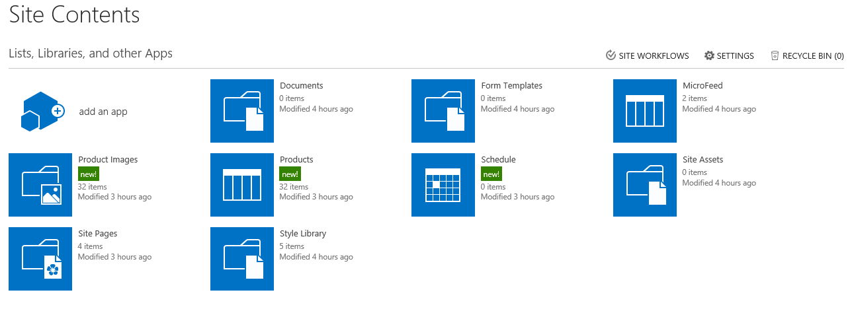
Site Contents of a Team Site
Team site contains standard set of document libraries
Documents is a library for storing business documents
Site Pages is a wiki page library for adding site content
Site Assets is a library for storing files (e.g. images) uploaded by users
Team site that is top-level site has a few more libraries
Style Library - used to store files like images, CSS files and XSLT files
Form Templates - used by InfoPath Services to store form templates

Slide 12
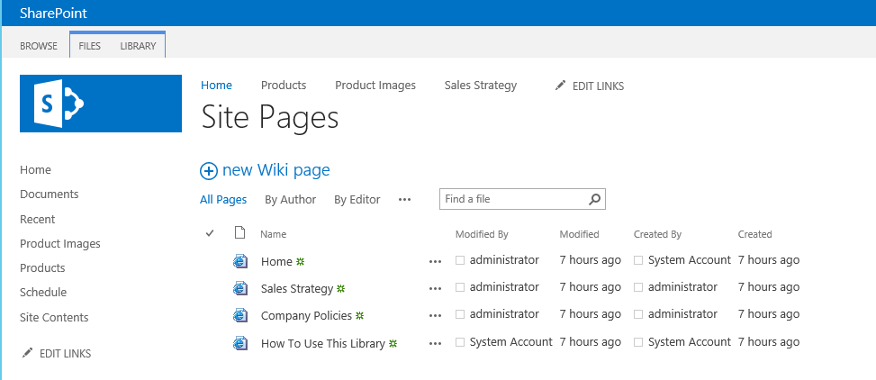
The Site Pages Library
New pages usually added to Site Page Library
Home.aspx wiki page automatically added as welcome page
How To User This Library.aspx page provides wiki syntax
Other pages can be created in ad hoc manner

Slide 13
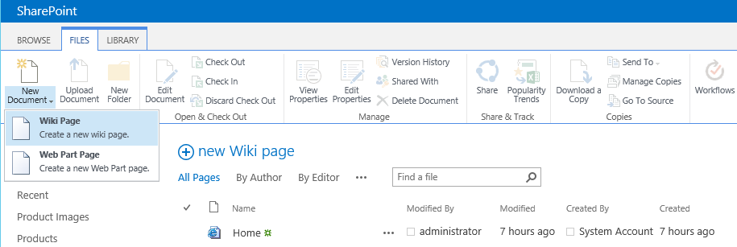
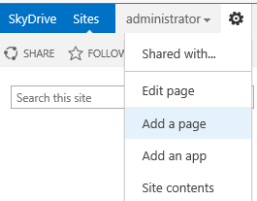
Adding Pages to the Site Pages Library
Site Pages library support creating two types of pages
Wiki Pages
Web Part Pages
Add a page command in Site Actions creates new new wiki page

Slide 14
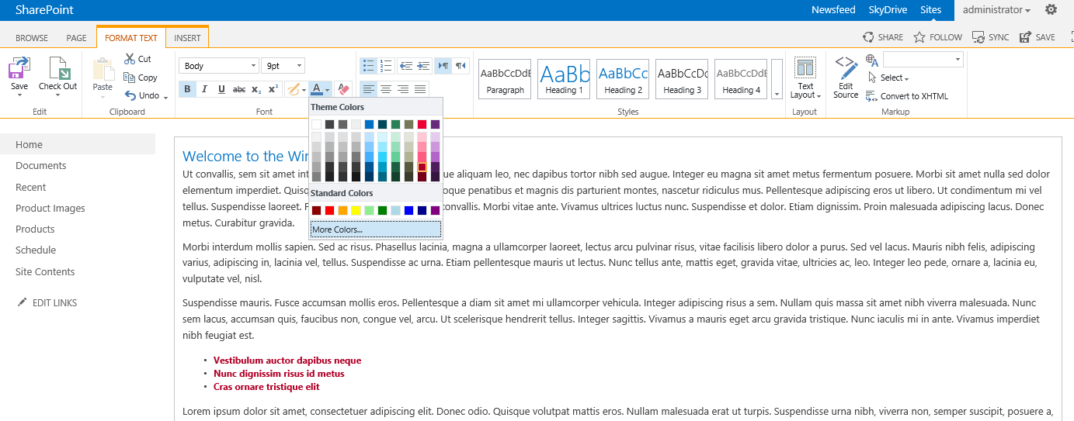
Editing a Wiki Page
Wiki page provides simple editing experience
Users can type and edit text just like in Microsoft Word
Contextual ribbon provides familiar editing tools
Not too hard for most users to add images and video files
Wiki page syntax provides linking to pages, lists and items

Slide 15
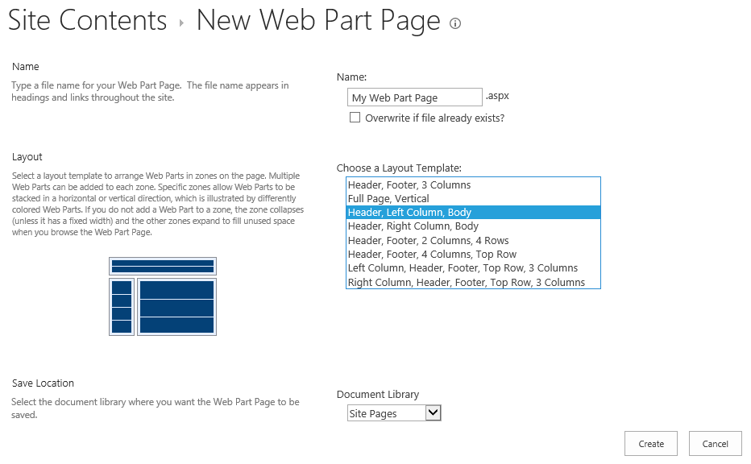
Creating Web Part Pages
Web Part Pages can be added to Site Pages
Added with New Document > Web Part Page command in ribbon
Give the page a name and select a Web Part Page layout template

Slide 16
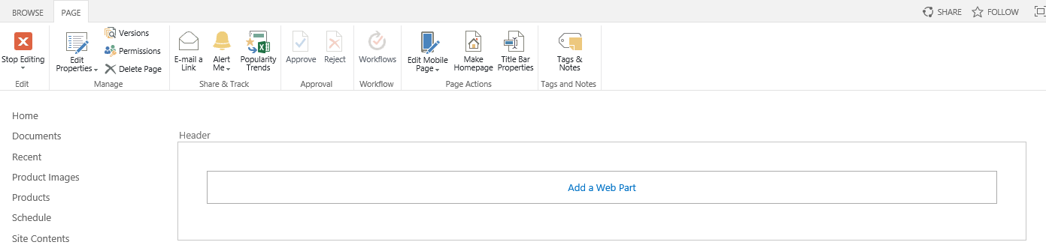
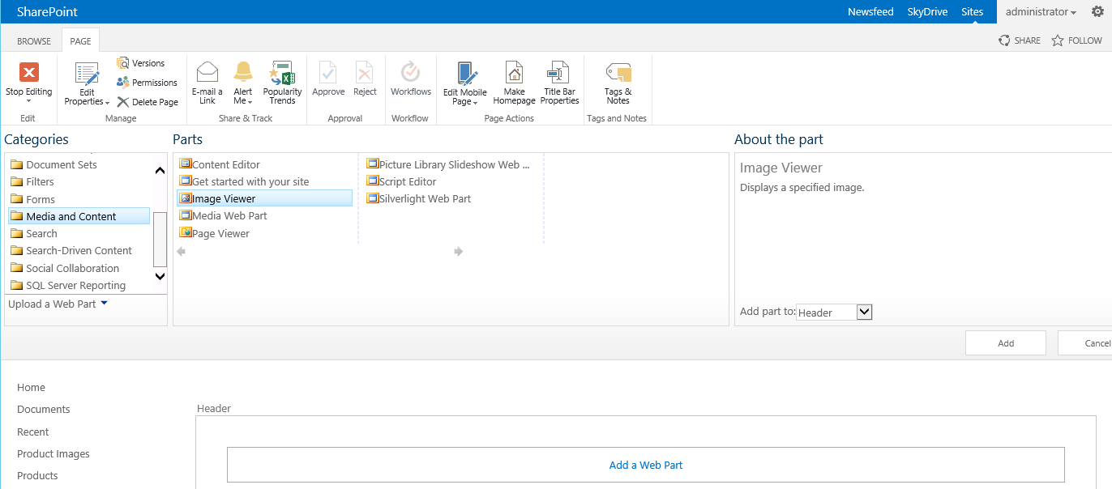
Editing Web Part Pages
Click on Add a Web Part link in a Web Part Zone
Select Web Part from Web Part Adder panel

Slide 17
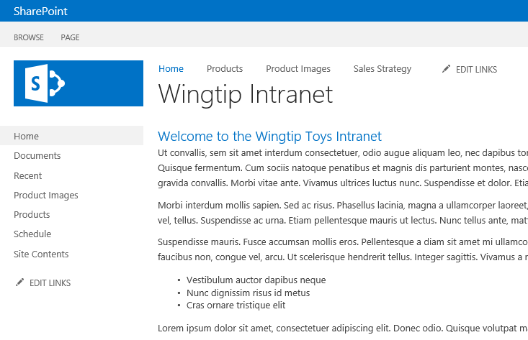
Team Site Navigation Elements
Top Link Bar (aka Global Navigation)
Remains constant from site to site within site collection
Quick Launch (aka Current Navigation)
Changes when crossing site boundaries
Top Link Bar
Quick Launch

Slide 18
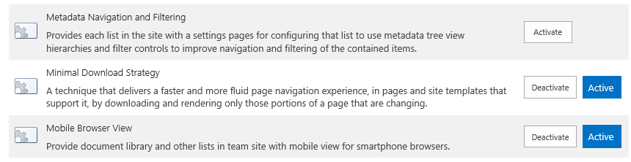
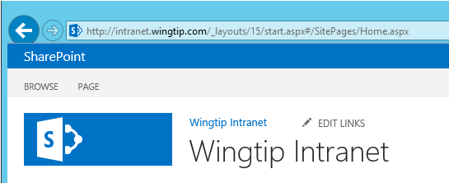
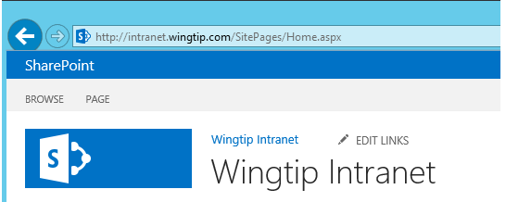
Minimal Download Strategy (MDS) Feature
MDS features used to smooth page transitions
Implemented with site-scoped feature
MDS features is activated in Team Site by default
MDS feature is disabled (and not supported) in Publishing Sites
URL structure to site page with MDS feature activated
URL structure to site page with MDS feature deactivated

Slide 19
Agenda
SharePoint Site Fundamentals
Understanding Team Sites
Site Columns and Content Types
Understanding Publishing Sites
Navigation in a Publishing Site

Slide 20
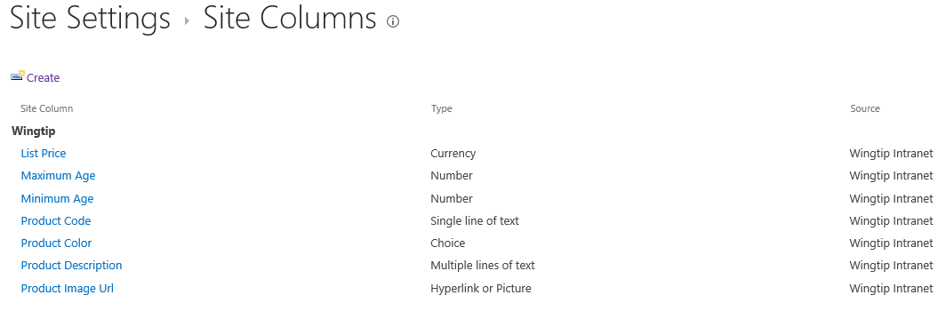
Site Columns
Reusable column templates that define…
The underlying field type for column value
The default value
Rendering characteristics
Each site has its own Site Column Gallery
Site columns available in current site and sites below
Site columns in top site available to site collection
Notes:
A site column represents the definition for a reusable column templates. Each site column defines an underlying field type for column value, a default value and the rendering characteristics for that field type. For example, a site column based on the underlying field type of Currency can define the formatting in terms of US Dollars.
Each site has its own Site Column Gallery. This is true of both top level sites as well as child sites. A site column in the site column gallery is available for use in the current site and in child sites below in the site hierarchy. A site column in the site column gallery of the top-level site is available for use throughout the entire site collection.

Slide 21
Content Types
Reusable item/document templates that define…
A parent content type
A collection of site columns
Each site has its own Content Type Gallery
Content types available in current site and sites below
Content types in top site available to site collection
Notes:
A content type is a reusable template of site columns used for an item or document. Since we are concentrating on publishing sites in this course, we are interested in content types that are used behind the Pages document library.
Each content type lives in a large hierarchy of content types and therefore must be defined with a parent content type. The content type inherits a set of site columns from its parent content type and can add more of its own.
Just like site columns, content types are tracked in a content type gallery. Each site within a site collection has its own Content Type Gallery. Content types in a content type gallery are available in the current site as well as in child sites below in the sire hierarchy. Content types that have been added to the content type gallery of the top-level site are available for use throughout the current site collection.

Slide 22
Content Type Hierarchy
Content types designed in hierarchy
All content types inherit (aka derive) from Item
Child content type inherits site columns from parent
Child content type can add new site columns
Child content type can remove site columns inherited from parent
SharePoint content type hierarchy
Item
Announcement
Contact
Task
Document
Form
Picture

Slide 23
Creating Custom Content Types
Creating a custom content type
Select a content type name
Select a parent content type to inherit from
Add whatever site columns are required
Configure content type settings
SharePoint-supplied content types
Item
Document
Custom content types
Product
Product Images

Slide 24
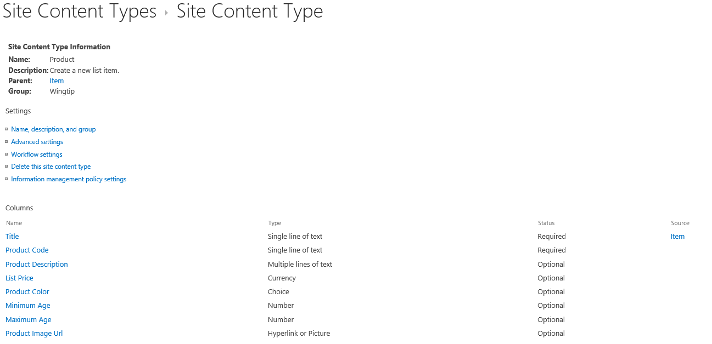
Example: The Product Content Type
This example shows a custom content type
Designed to track Wingtip products in a list

Slide 25
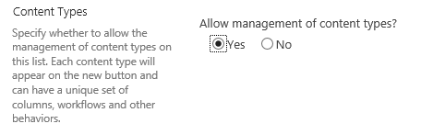
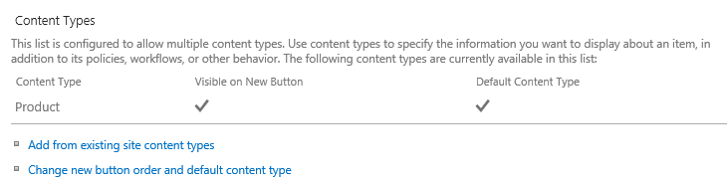
Lists and Content Types
List contains a collection of content types
Every list must contain at least one content type
Content types hidden on the List Settings page by default
Advanced Settings page for list provides option to show them
Content Types section allows for adding/removing content types

Slide 26
Agenda
SharePoint Site Fundamentals
Understanding Team Sites
Site Columns and Content Types
Understanding Publishing Sites
Navigation in a Publishing Site

Slide 27
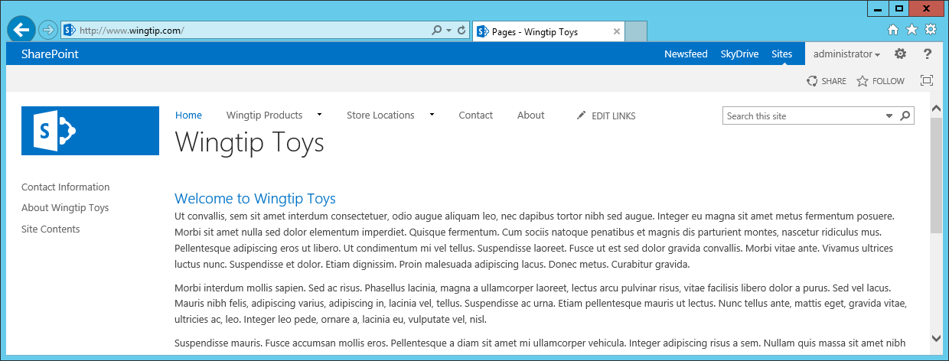
Publishing Sites
SharePoint 2013 supports WCM functionality with publishing sites
Requires hosting site collection to have publishing features activated
Often created using site template named Publishing Portal
Publishing sites can be used for public Internet-facing sites
Publishing sites provide features to collect and publish content
Publishing sites provide assistance with branding and friendly URLs
Site content created, edited and approved in terms of publishing pages

Slide 28
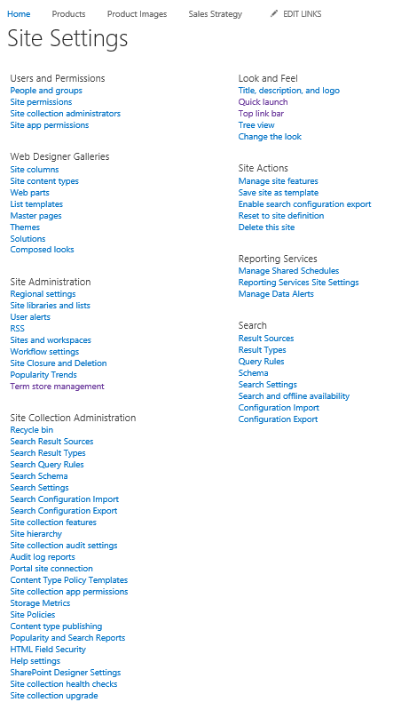
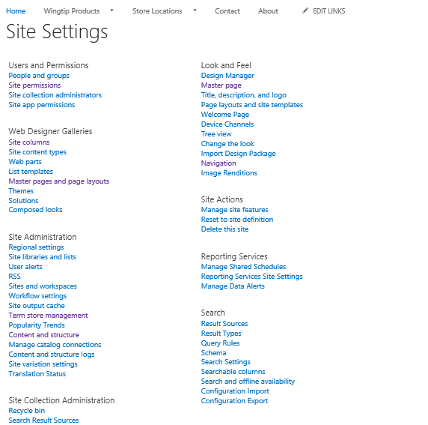
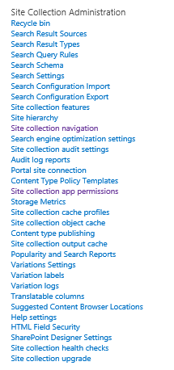
Which Site Settings Page Do You Like Better?
The Publishing features add a good deal of functionality
Site Settings page in Team Site
Site Settings page in Publishing Site

Slide 29
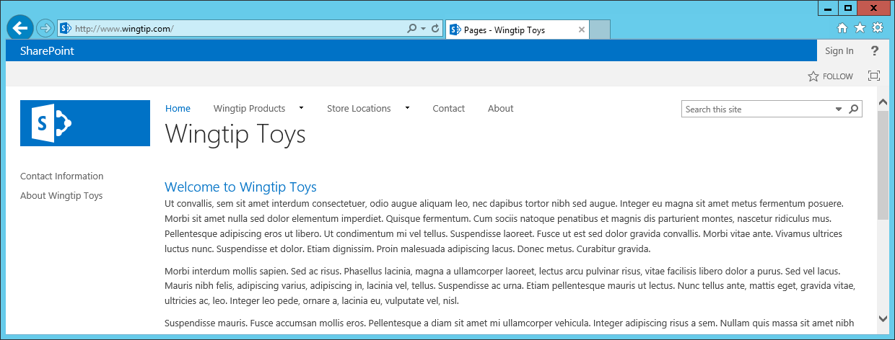
Security Trimming in Publishing Sites
Publishing sites has security trimming for visitors and anonymous access
Visitors do not see certain links such as Site Content and EDIT LINKS
Visitors do not see links to publishing pages until they have been published
Anonymous users do not see Suite bar links (Newsfeed, SkyDrive and Sites)
Anonymous users see the Sign in link instead of Welcome menu

Slide 30
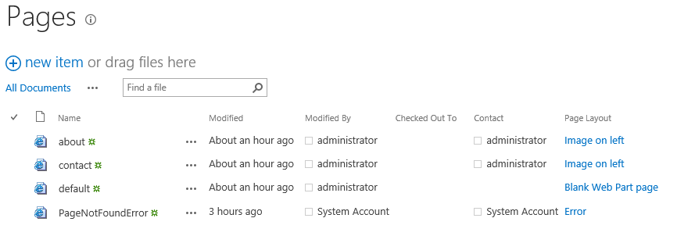
Publishing Pages and The Pages Library
Content added to publishing site using publishing pages
Every publishing site contains Pages Library
Publishing pages are always created in a Pages library
Pages library created with welcome page named default.aspx
You can add additional publishing pages to grow out site content

Slide 31
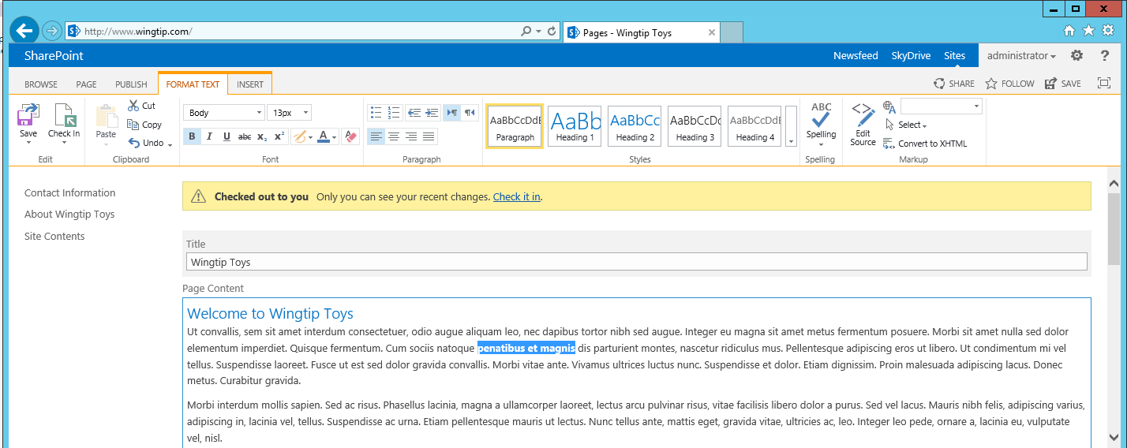
Editing an Existing Publishing Page
Experience is similar yet different from wiki page
Page content is split out into multiple site columns
Site column values edited using field controls
Publishing page has extra ribbon tabs such PAGE and PUBLISH

Slide 32
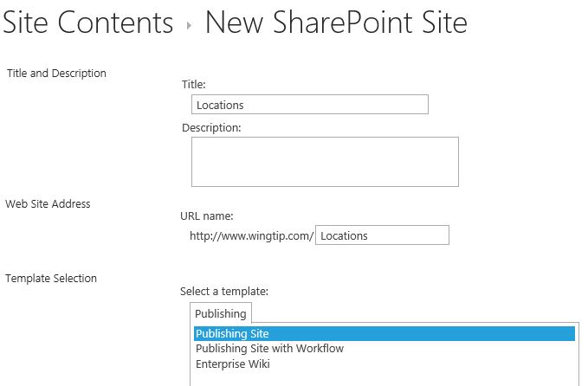
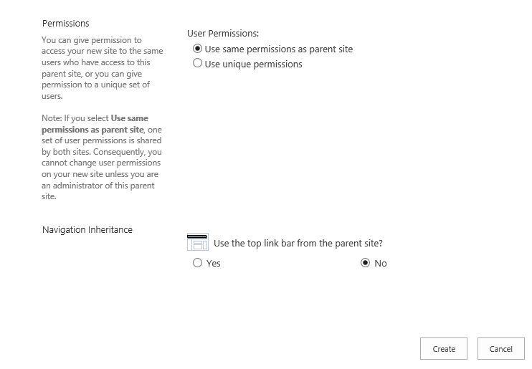
Adding Sites
You construct site hierarchy by adding subsites
Each site gets a welcome page (/Pages/default.aspx)
Secondary publishing pages added to site as needed
Subsites can be added under subsites
Subsite can inherit navigation and/or permissions
Notes:
When it is time to design the content for a new a publishing site collection, you construct site hierarchy by adding child sites. Each site that is added gets a landing page inside the Pages document library named default.aspx. By default, this landing page is configured as the home page for the new child site. Once you have created a new site, you then add extra publishing pages as needed.
Starting with SharePoint 2010, publishing sites support adding new publishing pages to folders created inside the Pages document library. By using folders efficiently, you can scale a single publishing site to contain 100s or even 1000s of pages. However, it should be noted that some of the stock functionality such a having SharePoint 2010 automatically provide navigational menus to publishing pages is only available to publishing pages at the root of the Pages document library.

Slide 33
Agenda
SharePoint Site Fundamentals
Understanding Team Sites
Site Columns and Content Types
Understanding Publishing Sites
Navigation in a Publishing Site

Slide 34
Publishing Site Hierarchy of Sites and Pages
Publishing site is a hierarchy of sites and pages
Provides structure for exposing page using URLs
\ (root site)
\Pages
\default.aspx
\contact.aspx
\about.aspx
\Locations (child site)
\Pages
\default.aspx
\tampa.aspx
\jacksonville.aspx
http://www.wingtiptoys.com/Pages/default.aspx
Top-site home page
\Products (child site)
\Pages
\default.aspx
\trainst.aspx
\planes.aspx
http://www.wingtiptoys.com/Pages/contact.aspx
Top-site secondary page
requests
http://www.wingtiptoys.com/Locations/Pages/Tampa.aspx
Locations site secondary page
\Trains (child site)
\Pages
\default.aspx
\train1.aspx
\train2.aspx
http://www.wingtiptoys.com/Products/Pages/defaulkt.aspx
Products site home page
http://www.wingtiptoys.com/Products/Trains/Pages/train1.aspx
Products child site secondary page
\Planes (child site)
\Pages
\default.aspx
\plane1.aspx
\plane2.aspx
Notes:
When you design the hierarchy of sites and pages, you are also committing to the structure which determines the URL to each page. The slide above shows a hierarchy of sites where different types of products have been factored out into their own child sites such as Trains and Planes. This adds the product category into the URL of each product pages and provides a better way to take advantage of the out-of-the-box support for navigation.

Slide 35
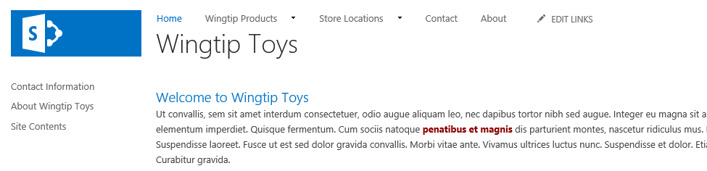
Navigation in a Publishing Site
Navigation in Publishing sites is different than Team sites
Enabling publishing features switches out navigation providers
Top Link Bar and Quick Launch continue to work the same
You can configure navigation using two different options
Structural navigation (carried over from SharePoint 2007 and SharePoint 2010)
Managed Navigation (new in SharePoint 2013)

Slide 36
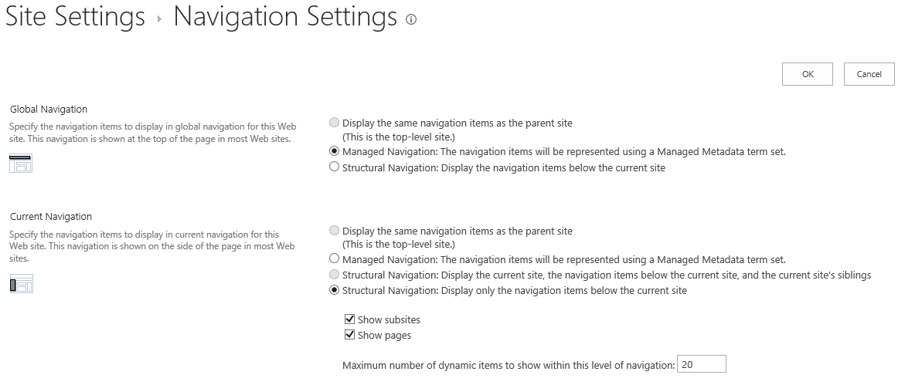
Site Navigation Settings
Global Navigation configured separately from Current Navigation
Global Navigation can used Structural Navigation or Managed Navigation
Current Navigation can used Structural Navigation or Managed Navigation
Subsites can inherit navigation from parent site

Slide 37
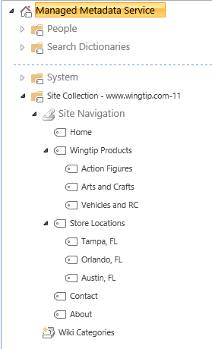
Managed Navigation
Managed navigation based on termset
Termsets managed by Managed Metadata Service
Termset can be created to store a hierarchy of terms
Site Navigation termset created atomically in new publishing site

Slide 38
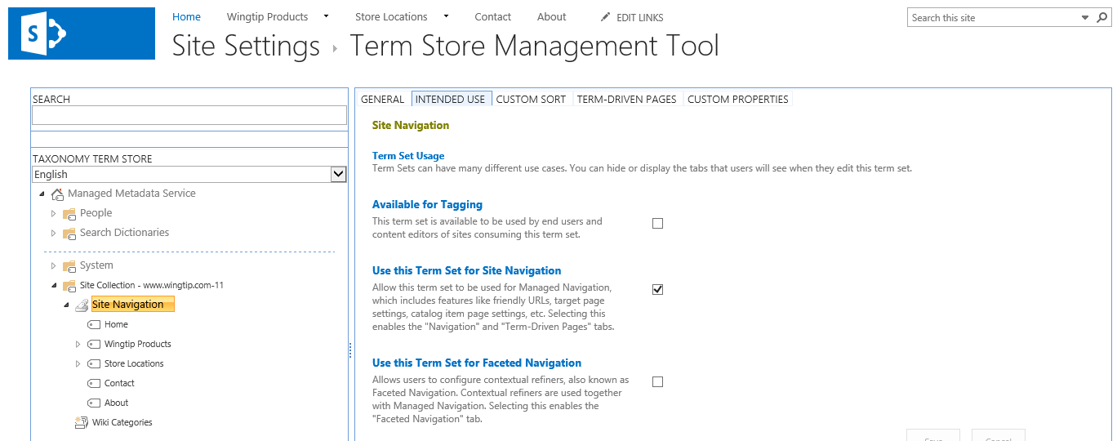
The Site Navigation Termset
Site Navigation termset provides navigation terms
Navigation terms can be added as pages are created
Navigation terms can be created and configured manually

Slide 39
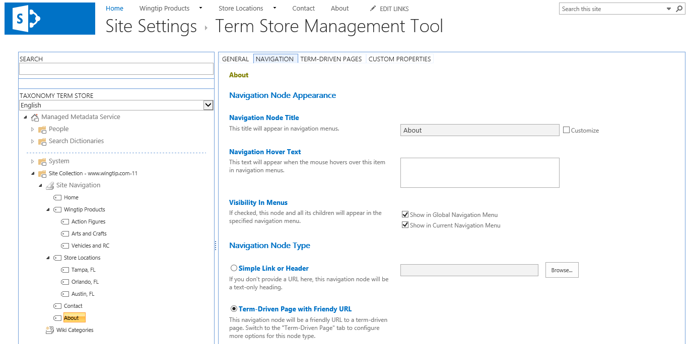
Understanding Navigation Terms
Navigation terms link to publishing pages
Can be configured to show in Global Navigation
Can be configured to show in Current Navigation
Links are added as Simple Links or Friendly URL links

Slide 40
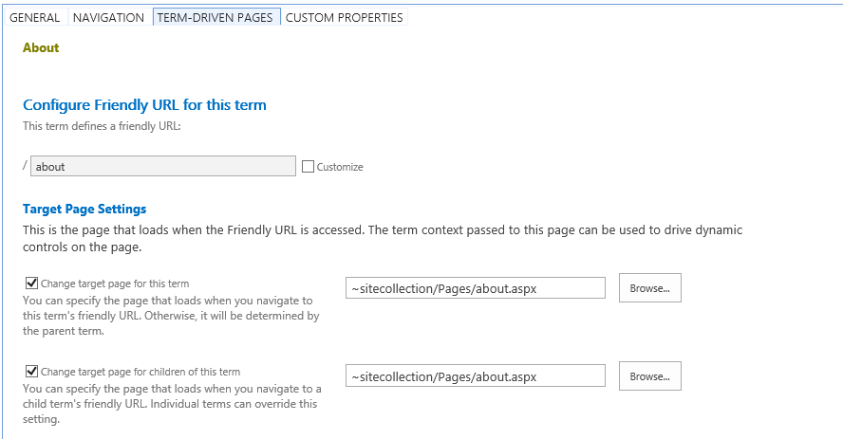
Configuring Friendly URLs
Navigation Term can be configured with friendly URLs
Incoming requested targeting friendly URL routed to target page
Supported with Managed Navigation but not with Structural Navigation
Examples of friendly URLs
http://www.wingtip.com/
http://www.wingtip.com/about
http://www.wingtip.com/contact
http://www.wingtip.com/store-locations
http://www.wingtip.com/store-locations/tampa
http://www.wingtip.com/store-locations/orlando
http://www.wingtip.com/store-locations/austin
http://www.wingtip.com/wingtip-products
http://www.wingtip.com/wingtip-products/action-figures
http://www.wingtip.com/wingtip-products/arts-and-crafts
http://www.wingtip.com/wingtip-products/vehicles-and-rc

Slide 41
Summary
SharePoint Site Fundamentals
Understanding Team Sites
Site Columns and Content Types
Understanding Publishing Sites
Navigation in a Publishing Site

