Slide 1
Web Parts and XSLT
Notes:
This module covers the use of web parts, and styling them using CSS and XSLT. First, the module presents an overview of web parts available in SharePoint 2013 out of the box. The module will emphasize web parts commonly used in publishing sites which include the Table of Content Web Part, the Summary Links Web Part and the ever-popular Content Query Web Part. The modules then moves on to discuss how to style these web parts using XSLT which will involve a quick primer on the XSLT language and simple ways to use it along with CSS to customize the look of content displayed using web parts such as the Content By Query Web Part.

Slide 2
Agenda
Overview of Web Parts in SharePoint 2013
The Table of Content Web Part
The Summary Links Web Part
The Content Query Web Part
Customizing Web Part Display using XSLT
Notes:
Publishing sites support the use of Web parts for both designers and authors to augment the functionality of web pages. In this module we will look at several web parts and then learn how to change the data fields and look of a Content Query Web part.

Slide 3
Web Parts
Building blocks of functionality
Some can be connected to build mash-ups
User configurable options
May be used in Collaboration and Publishing
Enables users to build functionality
Notes:
Web parts provide discrete bits of functionality that empower authors to add content and function to pages. As a designer you still control certain aspects of the placement and arrangement of the Web parts. Web parts can often bridge the gap between tightly controlled page layouts and the need for development by enhancing page functionality.

Slide 4
Types of Web Parts
List/Library/App Web Parts
Functional Web Parts
Content Roll Up
Media
Scripting
Active Web Parts
Filters
Forms
Notes:
There are different Web parts available depending on the version of SharePoint that you are using and the Features deployed to the Web Application, Site Collection and Site. Web parts can be divided up by those that are associated with lists and libraries, parts that add functionality to a page and web parts that interact with other web parts. By combining the web parts and connecting them on pages you can create active and dynamic web pages for your users.

Slide 5
Web Part Zones
Web Parts can be placed in Zones
Web Parts can be placed in Page Content
Web Part Zones can be configured
Notes:
Web part zones are added to Page Layouts by designers where they want Authors to have a bit of flexibility. The web part zone is a special <WebPartPages:WebPartZone … tag. Once added to the page, the zone can be configured to contain Web parts in a desired format, for example, horizontal or vertical alignment. It is the attributes of the zone that can constrain the page author to use the zone in a specific way.

Slide 6
Agenda
Overview of Web Parts in SharePoint 2013
Web Parts on Publishing Sites
The Summary Links Web Part
The Content Query Web Part
Customizing Web Part Display using XSLT
Notes:
Web parts can be used on Publishing Sites just as they can on team sites. Publishing sites support additional web parts that you may not see on standard Team sites. As a Publishing site creator, you should know what the Publishing site dependant web parts are and how they can be used to enhance the publishing site for navigation, rollup and filtering.

Slide 7
Web Parts vs. Field Controls
 | Field Controls | Web Parts
Content Storage | In a field (column) in the page’s underlying SPListItem | Within the Web Part data of the page
Personalization | No | Yes
Versioning | Versioning tied to page with complete history | Versioning tied to page without history
Who has ultimate control? | Page designer / developer | Page designer (in placement of Web Part zones); content owner in managing of zone’s contents (add/edit Web Parts within Web Part zone)
When to use? | Specific types of content must appear in specified places of a page; structured formatting / branding | Structure of content on page (in part of a page) isn’t important; let content owners have full control
Notes:
Web parts do not behave the same as the fields of the content type associated with the Page Layout. The primary difference has to do with Versioning and Control. If you seek to have your authors tightly controlled then you may want to avoid the use of Web parts. Web parts offer flexibility that some organizations want to avoid. On the other hand, Web parts can serve as an important stop-gap measure in the event a publishing page is too rigid for an author to use. This trade-off is an important decision point for Designers.
Web parts are stored and versioned differently than Field Controls. If an author changes a pages content in Field Controls the new version of the page and content are part of the page version history, an important feature for controlled authoring. Changes made to Web parts are not stored in the page version history and cannot be rolled back. Thus you must decide how the content for the page is to be managed on the pages under your control.

Slide 8
Zone Attributes
<WebPartPages:WebPartZone Title= "Top Zone" orientation="Horizontal"
Web Part 1
Web Part 2
Web Part 3
Notes:
As a designer you control the formatting of the Web part zone and other attributes. For example if you want the web parts to be laid out in a Horizontal orientation, you have to specify that on the web part zone. The Zone control supports additional attributes, like Title, that are reflected in how the zone is displayed to the author and what control an author will have in the resulting Page Layout.

Slide 9
Zone Attributes
<WebPartPages:WebPartZone Title= "Top Zone" orientation="Vertical"
Web Part 1
Web Part 2
Notes:
The designer has the control over the Web part Zone, not the Author. The Author can only use the page as it was configured by the Designer. This is part of the controlled publishing system supported by SharePoint 2013. In this slide the attribute orientation is set to Vertical to enforce a stacking of the web parts visually.

Slide 10
Zone Attributes
Other Web Part Zone Attributes
AllowLayoutChange - Allow users to add, remove, resize & move
AllowPersonalization - Allow users to change his/her settings
AllowCustomization - Allow users to change shared settings
Notes:
Additional zone attributes are available that provide additional control over the Web part zone.

Slide 11
Finally
Web Parts can be included in Master Page
Web Parts can be included in Page Layouts
Web Parts can exits outside of a Zone
This limits Author interaction
These Web parts are called “Static”
Web part must be fully configured by the designer
Notes:
Web parts can be added to a page in a “static” mode rather than letting the Author make the changes. In this technique the web part is not added to a Zone but added directly to the Master Page or Page Layout and then configured by the designer. In this way the Author has no control over the Web part. This advanced technique requires the designer to understand the consequences and the limitations. The Web part has to be correctly configured for a broad use case since the Author will be unable to change the configuration.

Slide 12
Agenda
Overview of Web Parts in SharePoint 2013
Web Parts on Publishing Sites
The Summary Links Web Part
The Content Query Web Part
Customizing Web Part Display using XSLT
Notes:
The Summary Links Web part was created to enable Authors to configure links from a page to additional meaningful content. The web part allows Authors the freedom to create Section Headers and links that are styled in a consistent visual design. In this section we will learn about the Summary Links and how it is used on a publishing site.

Slide 13
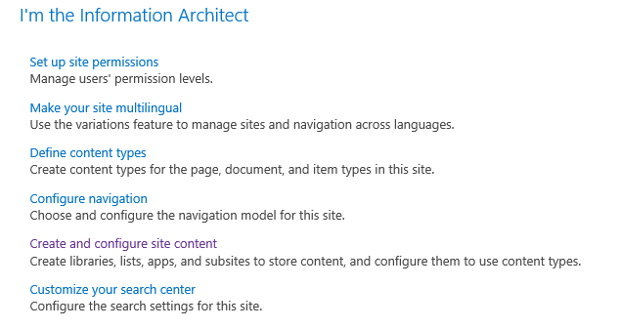
Summary Links Web Part
Easy Entry of Relevant Links
Static Links to any content
Easy for Authors to Manage
Groups
Styles
Notes:
The Summary Links Web part is preconfigured on the standard Publishing site. It can be used to prompt Authors to action or simply left empty and ready for the author to fill in (or remove), as the author desires. Since the web part contains both links and headings it is important to consider the CSS styling of the links and headings in your design.

Slide 14
Agenda
Overview of Web Parts in SharePoint 2013
Web Parts on Publishing Sites
The Summary Links Web Part
The Content Query Web Part
Customizing Web Part Display using XSLT
Notes:
The Content By Query (or CBQ or Content Query) Web part provides the ability to “rollup” content from a Site Collection into a summary view of the content. It has many features that support repurposing content from one library into other locations on the site. Most often this web part is used to aggregate content like “Top News Headlines” and “Features”, but it can be used for so many different uses it has become a very popular Web part.

Slide 15
Content Rollup or Aggregation
Present Aggregated information on page
Enable Authors to create content in one place and syndicate it to the rest of the web site
Recent News
“Hot Topics”
Departmental Summaries
“Hub Pages”
Notes:
The Web part enables the Author to construct a query based on several attributes like Content Type, Location and other advanced query rules. The power of the web part is how it can be easily configured by an author. The author then chooses from a “style” that can employ one of the out of the box styles, or much more commonly, a style created by a designer and developer for specific purposes.

Slide 16
Content Query
Web part executes query for content types
Configured for a Site Collection
Display managed with XSLT
Default fields use the Rollup Image
Notes:
The Content Query Web part is constrained to querying for content from the current site collection. The presentation of the results of the query are controlled with XSL markup. The XSL is generally stored in a library on the site. When properly configured a Designer will make the necessary design changes so that the Author simply chooses from a list of available styles. The web part works in conjunction with several out of the box fields, like the roll up image field, to present thumbnails of the content pages found by the query. This process can easily be changed by the designer.

Slide 17
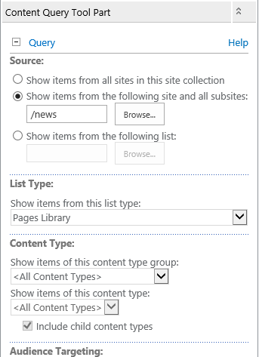
Configuring CBQ Web Part
Query
Site Collection
Site
List/Library
List Type
Content Type
Additional Configuration
Notes:
The configuration of the content query is performed in the tool part associated with the Web part. Filters can be set to show only specific content from a single location or the query can pull content from the entire site collection. In this way a “News Rollup” can be created from all sites that use the Article Content Type, or only from a specific library. Additional configuration includes how the content is displayed and what fields from the Content Type are displayed in the resulting Web part.

Slide 18
The Content Query Web Part
Notes:
In this demo you add and configure a Content Query Web part.

Slide 19
Agenda
Overview of Web Parts in SharePoint 2013
Web Parts on Publishing Sites
The Summary Links Web Part
The Content Query Web Part
Customizing Web Part Display using XSLT
Notes:
It is very common to create several custom rendering templates for your content query Web part. It is the job of the Designer to create the look and feel and if they are skilled in XSL, the actual implementation. If not, the designer would work with a developer to create the associated XSL to implement the design.

Slide 20
Content Query Group Styles
Group Styles
Default
Large Text
Small Text
Banded
Centered
Separator
Whitespace
Notes:
The out of the box Publishing Site employs several standard styles for the Content Query Web Part. It is a common practice to begin with an out of the box template and then alter it to implement your custom design in SharePoint 2013. The process involves editing a text file in the team site that is specifically designed for this purpose. The Group Styles template controls the Wrapper around the items returned in the query.

Slide 21
Content Query Item Styles
Image on left
Title and description
Title only
Title with background
Bulleted title
Image in right
…and more
Notes:
The Item Styles control how each item in a query are styled in the result. There are many samples in an out of the box implementation, yet usually they still fall short of the demands of a professional web site. So the designer must envision how the results should look and then implement the new styles (with the help of a developer if necessary). It is important to create meaningful sample content to get through the testing phase.

Slide 22
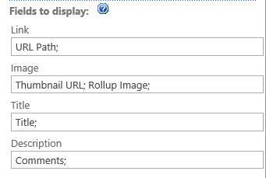
Use Custom Fields
Used to map custom fields
Field “slot” must exist in template
Add new fields to the XSL and Map in Web Part
Notes:
Custom fields from your custom content types must be “mapped” to the placeholder fields contained in the XSL templates employed by the web part. The web part is very “smart” about picking up these fields and provide a location (or slot) for the page author to “plug in” the field names. Often this task is beyond the ability of the Author and is left for a designer to perform.

Slide 23
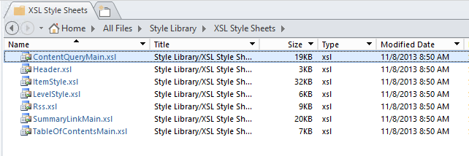
Create Custom Styles
Styles are maintained in XSL file
<root>/Style Library/XSL Style Sheets
Edit the appropriate file for your needs
Add new styles rather than change existing style
Notes:
The files in the XSL Style Sheets folder contain the XSL needed for rendering the UI for the Content Query Web part. The files should be checked out and published in order for any errors to be caught and possibly rolled back if necessary. It is best to only add new styles and not change the existing styles. The next page lists the purpose of each file.

Slide 24
Which File?
XSL Style Sheet | Purpose | Corresponding Web Part
ContentQueryMain.xsl | "Application" XSL style sheet | Content Query
Header.xsl | Group headers for Content Query and Summary Links, title headers for Table of Contents | Content Query, Summary Links, Table of Contents
ItemStyle.xsl | Content Query and Summary Link item styles | Content Query, Summary Links
LevelStyle.xsl | Table of Contents level styles, which includes the site and its pages | Table of Contents
SummaryLinkMain.xsl | "Application" XSL for Summary Links | Summary Links
TableOfContentsMain.xsl | "Application" XSL for Table of Contents | Table of Contents
Notes:
This table enumerates the various XSL files and their purpose. Depending on the demands of your design and the needs of your project you may find that you need to edit every XSL file in the site. That is what they are there for! Just be sure that you are using version control to manage the revisions so that you can recover from any breaking changes that may occur.

Slide 25
Create a CBQ Item Style
Notes:
Demonstrate editing the ItemStyle XSL sheet.

Slide 26
Summary
Overview of Web Parts in SharePoint 2013
Web Parts on Publishing Sites
The Summary Links Web Part
The Content Query Web Part
Customizing Web Part Display using XSLT
Notes:
Web parts enable you, as a designer, the ability to empower your authors to create flexible web experiences. You can also employ Web parts without your Author’s interaction in a static manner. The most popular We part on a Publishing site is the Content Query web part. Using XSL you can create aggregated roll ups of content that look exactly the way you want.

