Slide 1
Designing Reports in Power BI Desktop using Bookmarks and Drillthrough

Slide 2
Agenda
New Features for Report Design
Creating Page Navigation Bookmarks
Using Bookmarks to Capture Data Settings
Using Bookmarks to Hide and Show Visuals
Implementing Drillthrough

Slide 3
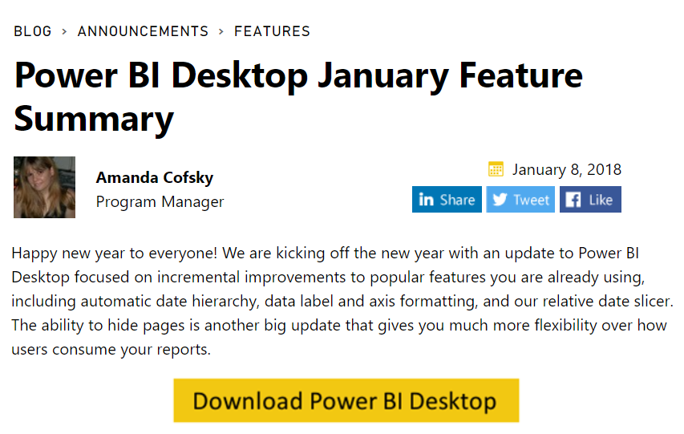
Thanks…

Slide 4
The Stream of New Reporting Features
Added in Sept 2017
Drillthrough features
Added in October 2017
Bookmarks and Bookmark Linking
Selection Pane to Hide/Show Visuals
Visual Spotlighting
Added in November 2017
Visual Ordering Control and Lock Objects
Added in December 2017
Cross-highlighting support for bookmarks, Field Pane, Q&A
Added in January 2018
Hide & Show report page tabs

Slide 5
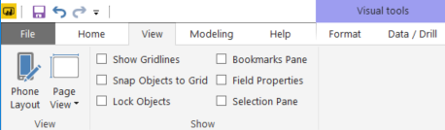
It's Not Your Father's Power BI Desktop
Lock Objects mode used to prevent accidental moving
Bookmarks Pane used to create and manage bookmarks
Field Properties used to add field description
Selection Pane used to select, order, hide & show visuals

Slide 6
Lock Objects Mode

Slide 7
Field Pane

Slide 8
Selection Pane

Slide 9
Bookmarks Pane

Slide 10
What are Bookmarks
Snapshot of recorded settings
The current page
Filters
Slicers
Sort order
Drill location
Visibility (of an object, using the Selection pane)
The focus or Spotlight modes of any visible object
Foundation for Story telling
Reports only – bookmarks not supported in dashboards

Slide 11
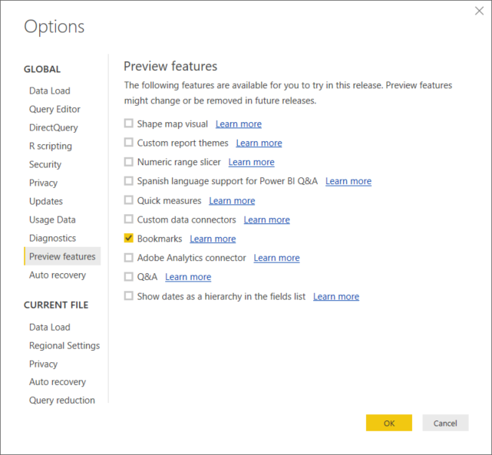

Slide 12
New Custom Visuals for 2018
Custom visuals shipped in Q4 of 2017
Text Filter
Image Grid
Table Heatmap
Card Browser
Image Timeline
Power KPI Matrix
PowerApps
HTML viewer

Slide 13
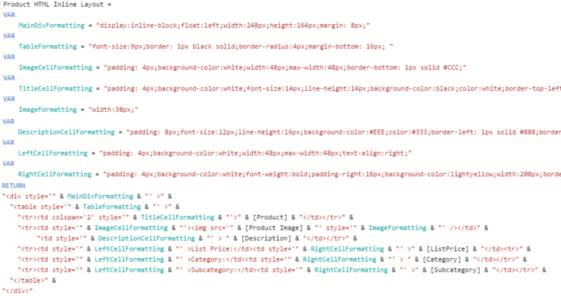
HTML Viewer Control
Allows you to create a per-item HTML template
HTML template created with calculated column & DAX

Slide 15
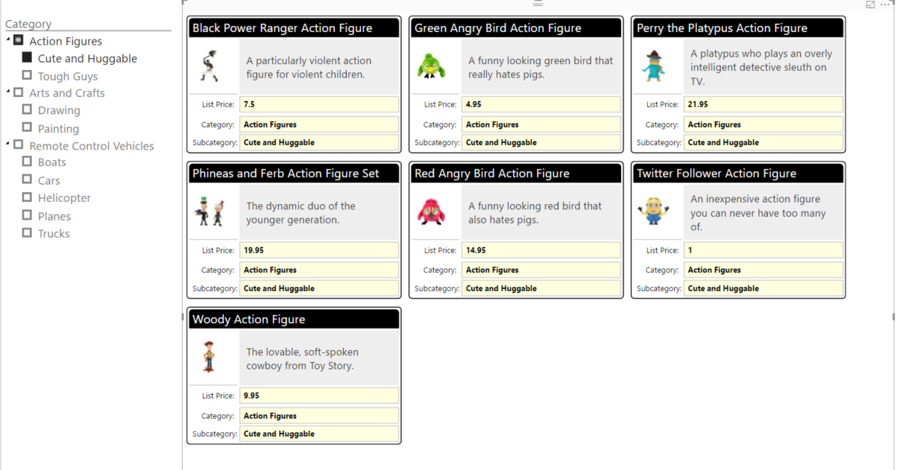
demo

Slide 16
Bookmarks as a Slide Show

Slide 17
Agenda
New Features for Report Design
Creating Page Navigation Bookmarks
Using Bookmarks to Capture Data Settings
Using Bookmarks to Hide and Show Visuals
Implementing Drillthrough

Slide 18
Agenda
New Features for Report Design
Creating Page Navigation Bookmarks
Using Bookmarks to Capture Data Settings
Using Bookmarks to Hide and Show Visuals
Implementing Drillthrough

Slide 19
Bookmark Types
Data
Filtering, slicers
Visual
Hide/show and spotlighting

Slide 20
Creating Buttons to Link to Bookmarks
Bookmarks for shapes and images

Slide 21
Agenda
New Features for Report Design
Creating Page Navigation Bookmarks
Using Bookmarks to Capture Data Settings
Using Bookmarks to Hide and Show Visuals
Implementing Drillthrough

Slide 22
Agenda
New Features for Report Design
Creating Page Navigation Bookmarks
Using Bookmarks to Capture Data Settings
Using Bookmarks to Hide and Show Visuals
Implementing Drillthrough

Slide 23
Summary
New Features for Report Design
Creating Page Navigation Bookmarks
Using Bookmarks to Capture Data Settings
Using Bookmarks to Hide and Show Visuals
Implementing Drillthrough

