Slide 1
Designing Reports in Power BI Desktop using Bookmarks and Drillthrough

Slide 2
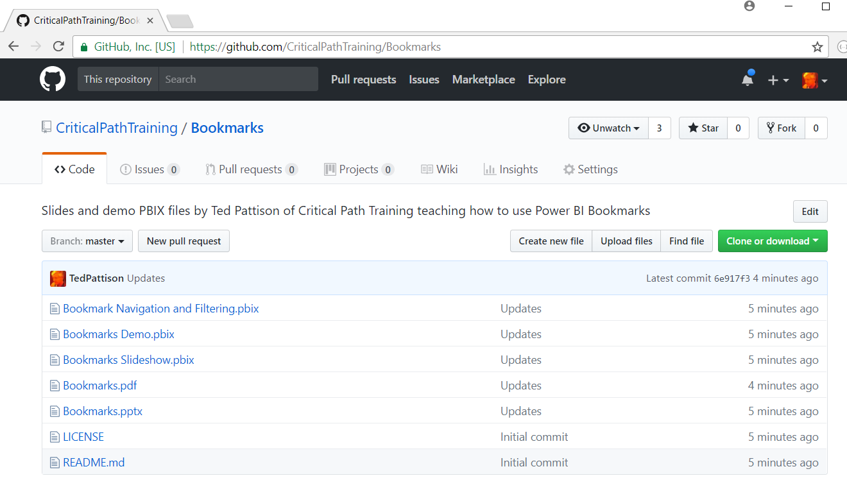
Download Slides & PBIX Files from GitHub
https://github.com/CriticalPathTraining/Bookmarks

Slide 3

Critical Path Training https://www.CriticalPathTrainig.com
PBI365: Power BI Certification Bootcamp – 4 Days
Audience is Business Users, Analysts and Data Professionals
PBD365: Power BI Developer Bootcamp – 4 Days
Audience is Professional Developers

Slide 4
Agenda
New Features for Report Design
Creating Page Navigation Bookmarks
Using Bookmarks to Capture Data Settings
Using Bookmarks to Hide and Show Visuals
Implementing Drillthrough

Slide 5
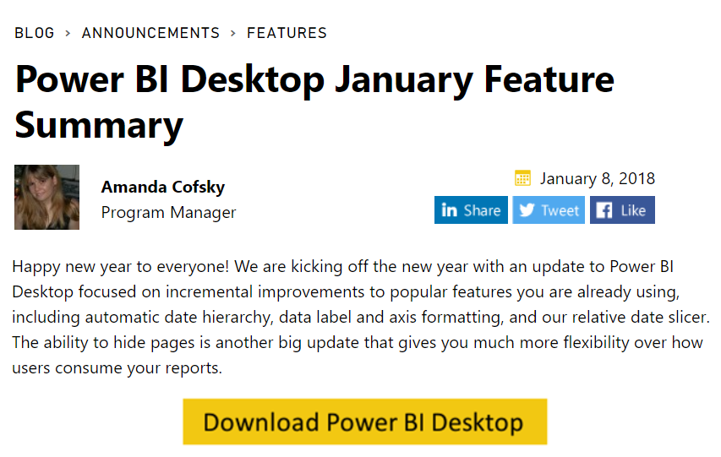
Thanks…

Slide 6
The Stream of New Reporting Features
Added in Sept 2017
Drillthrough features
Added in October 2017
Bookmarks and Bookmark Linking
Selection Pane to Hide/Show Visuals
Visual Spotlighting
Added in November 2017
Visual Ordering Control and Lock Objects
Added in December 2017
Cross-highlighting support for bookmarks, Field Pane, Q&A
Added in January 2018
Hide & Show report page tabs

Slide 7
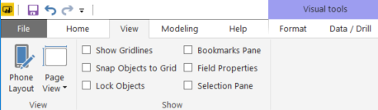
It's Not Your Father's Power BI Desktop
Lock Objects mode used to prevent accidental moving
Bookmarks Pane used to create and manage bookmarks
Field Properties used to add field description
Selection Pane used to select, order, hide & show visuals

Slide 8
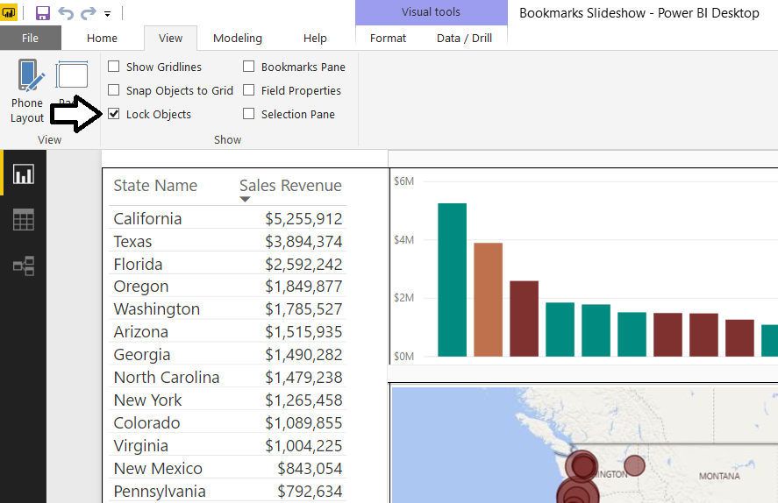
Lock Objects Mode
Prevents accident movement of report objects
Locks Objects setting is not saved at project level

Slide 9
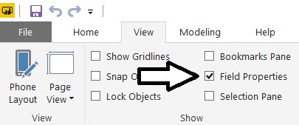
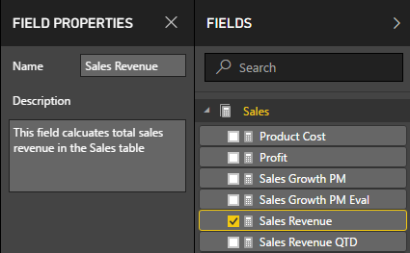
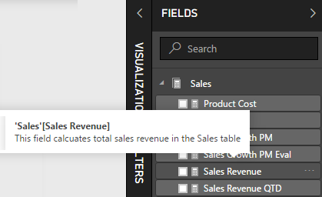
Field Proprties Pane
Allows data model author to add field description
Data model consumer can see description as tooltip in fields list

Slide 10
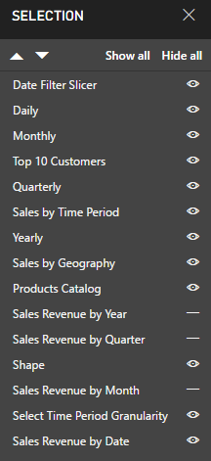
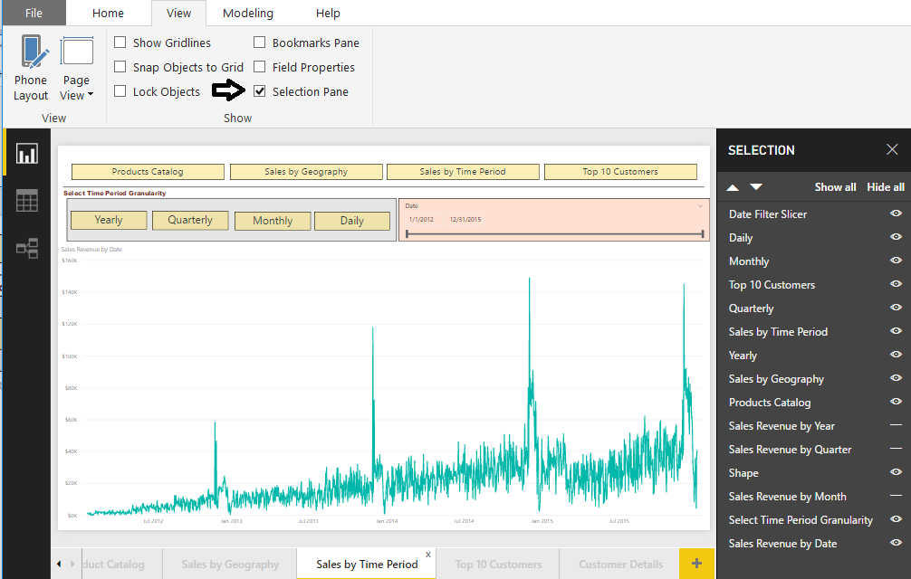
Selection Pane
Provides control over object on a page
You can control whether visual is visible or hidden
You can change ordering to control what is on top

Slide 11
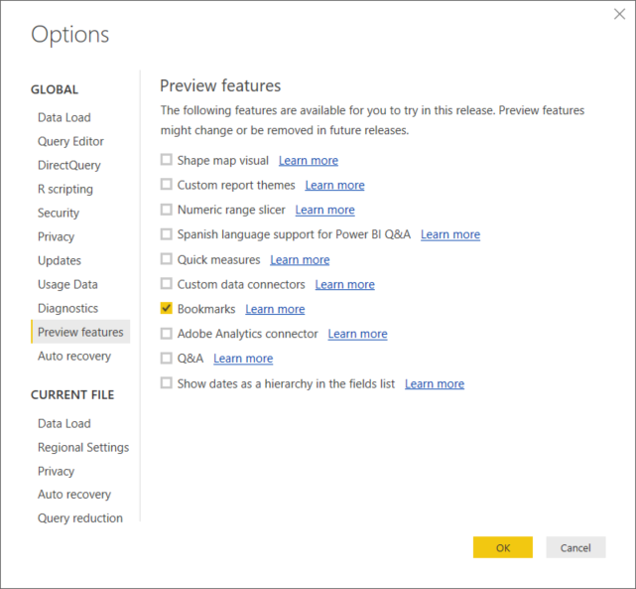
Bookmarks are still a Preview Feature
Preview features must be enabled in Power BI Desktop

Slide 12
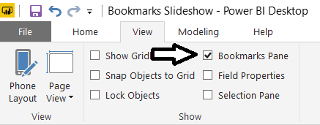
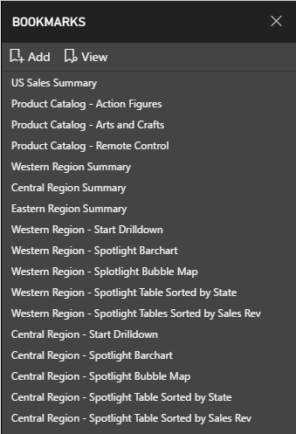
Bookmarks Pane
Provide ability to create and manage bookmarks

Slide 13
What are Bookmarks
Snapshot of recorded settings which can include…
Current page
Filters
Slicers
Visual sort order
Drill location
Visibility
Spotlighting
Foundation for Story telling
For reports only – bookmarks not supported in dashboards

Slide 14
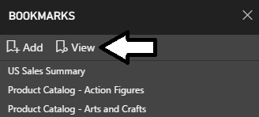
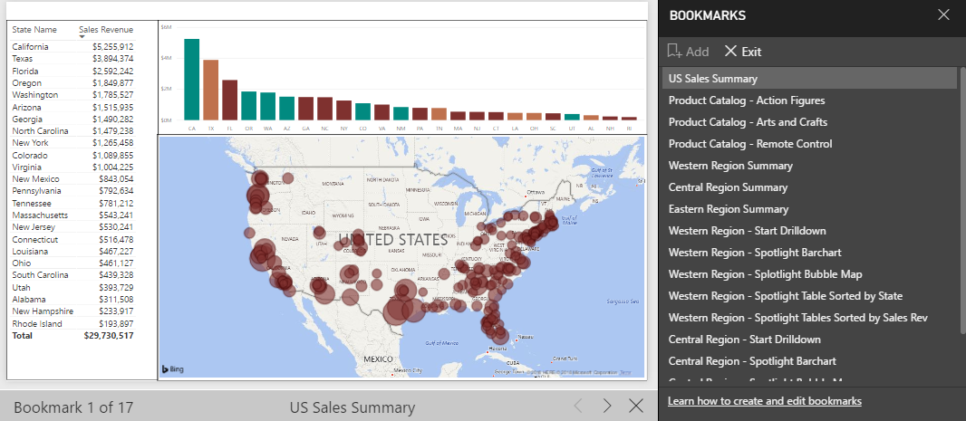
Bookmarks as a Slide Show
Bookmarks can be viewed as slide show
Start slide show by clicking View button
Consumer can step through one bookmark at a time

Slide 15
Viewing Bookmarks as a Slide Show

Slide 16
New Custom Visuals for 2018
Custom visuals shipped in Q4 of 2017
Text Filter
Image Grid
Table Heatmap
Card Browser
Image Timeline
Power KPI Matrix
PowerApps
HTML viewer

Slide 17
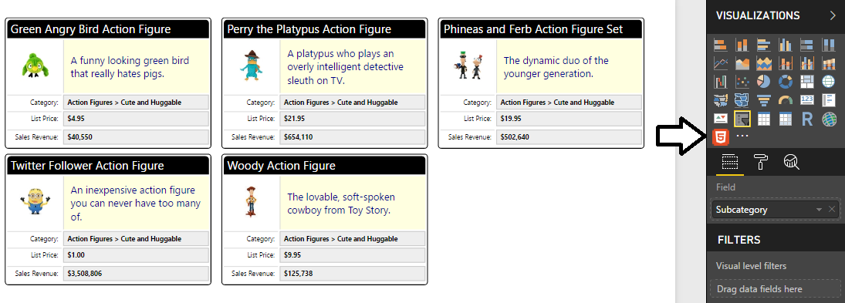
HTML Viewer Control
Allows you to create a per-item HTML template
HTML template created with calculated column using DAX

Slide 18
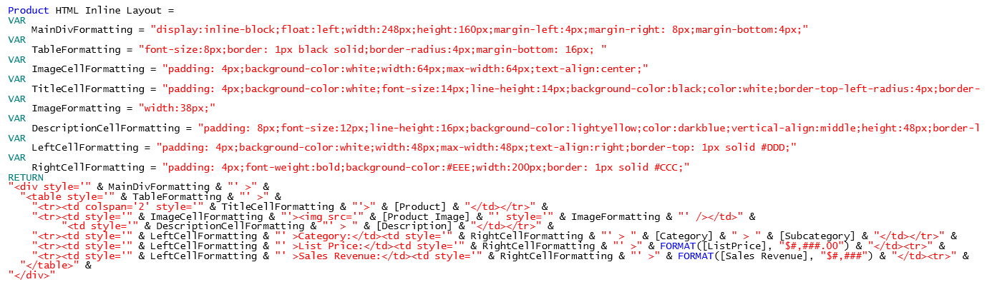
Oh my….
Nothing like parsing together HTML using DAX
It might be a good time to check out DAX Studio
http://daxstudio.org/

Slide 19
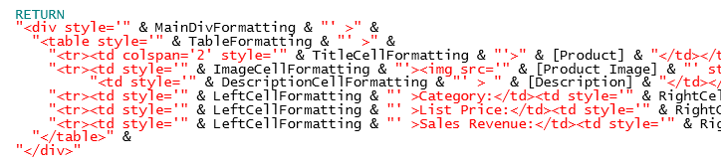
Into the weeds….
CSS Styles maintained in DAX variables
Measure returns a complete HTML element
Number, Currency & Date formatting accomplished using DAX

Slide 20
Agenda
New Features for Report Design
Creating Page Navigation Bookmarks
Using Bookmarks to Capture Data Settings
Using Bookmarks to Hide and Show Visuals
Implementing Drillthrough

Slide 21

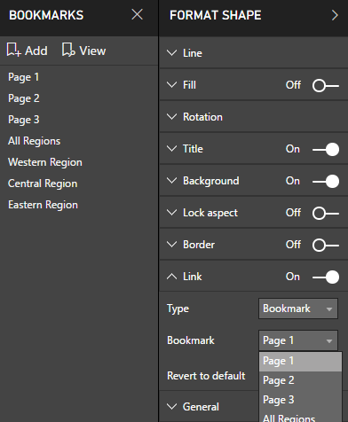
Creating Buttons to Link to Bookmarks
Shares and images can link to bookmarks
Acts as a button to navigate to bookmark
Button responds to click when in read view
Button requires CONTROL + click when in edit view

Slide 22
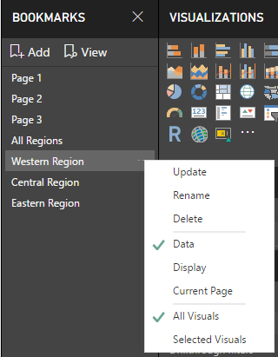
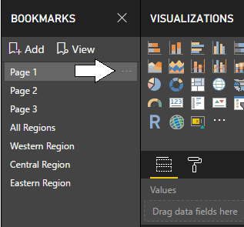
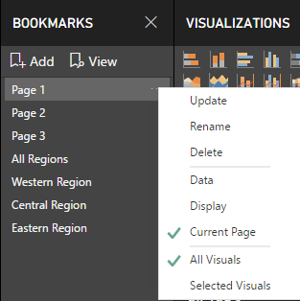
Bookmarks Types
Bookmarks can capture or ignore certain types of data
Data (filtering and slicers)
Display (visible or hidden)
Current Page (page navigation)

Slide 23
Using Bookmarks to Capture Data Settings

Slide 24
Using Bookmarks to Hide and Show Visuals

Slide 25
Implementing Drillthrough

Slide 26
Summary
New Features for Report Design
Creating Page Navigation Bookmarks
Using Bookmarks to Capture Data Settings
Using Bookmarks to Hide and Show Visuals
Implementing Drillthrough

Slide 27
Critical Path Training https://www.CriticalPathTrainig.com
PBI365: Power BI Certification Bootcamp – 4 Days
Audience is Business Users, Analysts and Data Professionals
Provides hands-on introduction to the Power BI platform
Focuses on build solutions using Power BI Desktop
Query design, data modeling and report and dashboard design
Apps and App Workspaces
Learn about “import” vs “connect to” with Excel workbooks
PBD365: Power BI Developer Bootcamp – 4 Days
Audience is Professional Developers
Teaches developing custom visuals with TypeScript and D3
Teaches R programming and integrating R with Power BI
Teaches programming with the Power BI APIs
Teaches developing with Power BI Embedded

