Slide 1
Developing with Power BI Embedding
Notes:
This module introduces students to the essential concepts and fundamental architecture involved with Power BI embedding. Students will learn about the types of Power BI resources that can be embedded on a custom web page. The module explains the differences between first-party embedding with the user-owns-data model versus third-party embedding with the app-owns-data model. Students will learn about creating dedicated capacities with Power BI Premium in Office 365 and with the Power BI Embedded Service in Microsoft Azure. The module concludes with a discussion of how to set up a development environment for Power BI embedding by creating an Office 365 trial tenant and installing the required developer software.

Slide 2
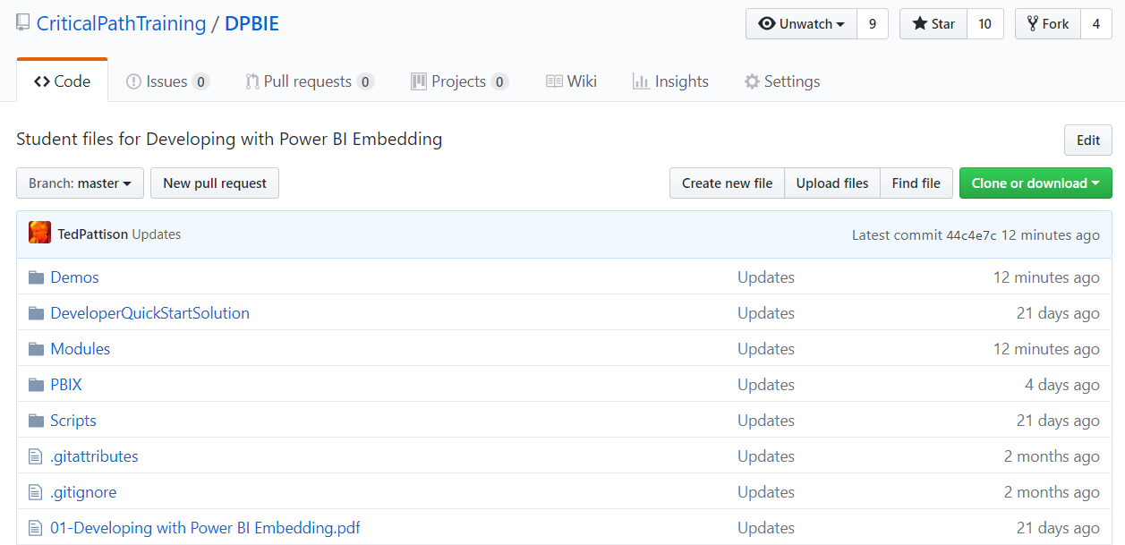
GitHub Repository for this Workshop
https://github.com/CriticalPathTraining/DPBIE

Slide 3
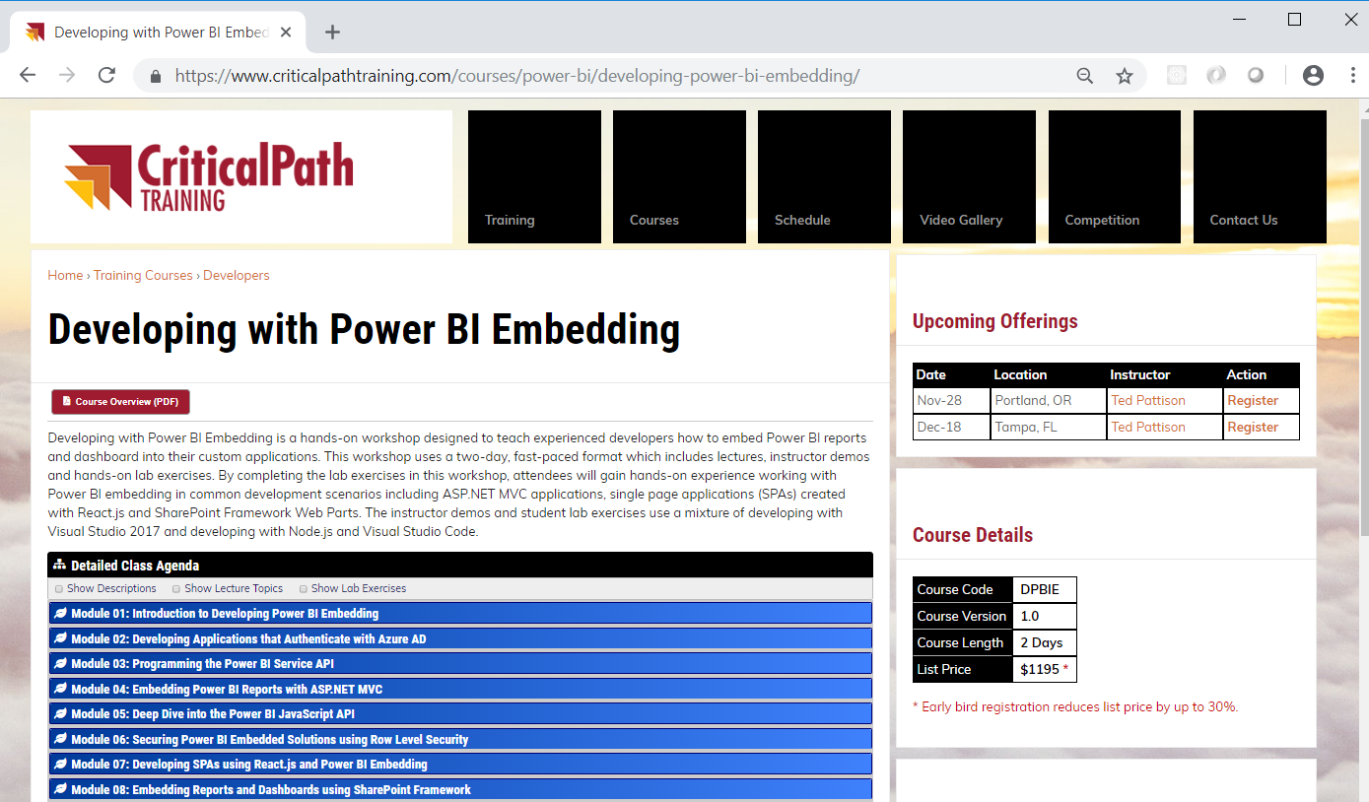
Developing with Power BI Embedding Workshop

Slide 4
Agenda
Power BI Embedding Fundamentals
Authentication with Azure AD
Programming the Power BI Service API
Programming the Power BI JavaScript API

Slide 5
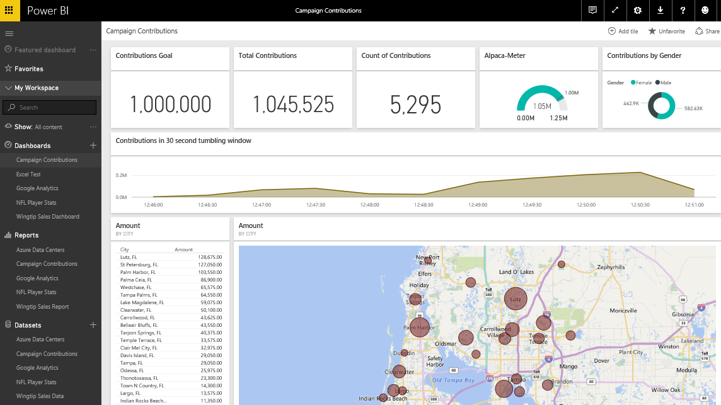
The Power BI Service – Who Is It For?
Provides SaaS service used by web and mobile users
Power BI portal accessible to browsers at https://app.powerbi.com
Power BI mobile accessible to users on mobile phones & devices
Provides PaaS service used by software developers
Power BI Service API accessible at https://api.powerbi.com
Notes:
You can think of the Power BI service as the heart and sole of the Power BI platform. Subscribed users access the Power BI service using any modern browser through its primary URL which is https://app.powerbi.com. Once a user has been authenticated against the common endpoint of https://app.powerbi.com, the users is then connected to the Azure data center which hosts the user’s Power BI workspaces.
Using the browser, a Power BI subscriber can view dashboard and interactive reports. The browser-based experience of the Power BI service also provides support to import datasets and to create reports and dashboards.

Slide 6
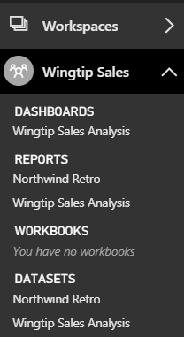
Central Power BI Concepts
Workspace
Secure container for publishing content
Every licensed user gets a personal workspace
App workspaces created for custom solutions
Dashboard
Consolidated view into reports and datasets
Custom solution entry point for mobile users
Report
Collection of pages with tables & visualizations
Provides interactive control of filtering
Dataset
Data model containing one or more tables
Can be very simple or very complex
Notes:
You can think of a workspace as a container that holds three different kinds of assets; dashboards, reports and datasets. Every dashboard, report and dataset created in Power BI must be created within the scope of a specific workspace. A workspace also provides a user context because the current workspace always determines which set of dashboards, reports and datasets are visible to the user.
Every Power BI subscriber has a personal workspace which is named My Workspace. An organization can also create group workspaces which make it possible to achieve team-based authoring and staged deployment of custom solutions. The course will go into greater detail on working with group workspaces later in module 7 when discussing how to deploy dashboards.
A dashboard typically serves as the top-level entry point into a custom data analytics solution. In Power BI, a dashboard is created as a consolidated view on top of reports and datasets. Dashboard are also important to Power BI mobile users because there display is often optimized for mobiles devices such as iPhones, Android phones and Windows 10 phone.
A report is a collection of pages that is associated with exactly one underlying dataset. Each page in a report serves as a canvas on which you can add tables, matrices and other types of visualizations. While dashboards are designed to provide a high-level overview, reports are the opposite because they are used to drill down into the lower-level details. Reports also provide much more interactive filtering control for custom solutions in which the user must be given the ability to drill down into further levels of detail.
A dataset is a collection of one of more tables that defines a data model. A simple dataset can contain a single table with three columns and ten rows. However, a dataset often contains multiple tables which has relationships between them. In the upcoming lab exercises in this course, you will design a dataset using all the different query and data modeling features of Power BI Desktop.

Slide 7
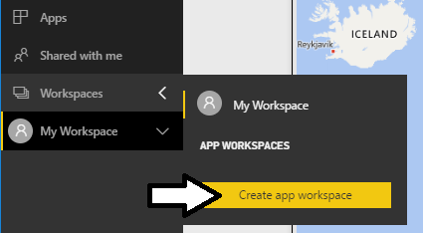
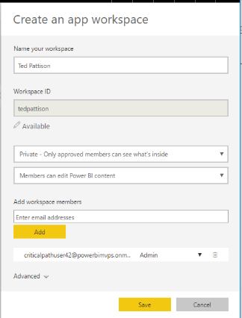
Creating App Workspaces
Power BI content published in app workspaces
Power BI Pro license required to author content in app workspace
Datasets & reports created by publishing PBIX project files
Dashboards must be created by hand

Slide 8
Power BI Embedding – The Big Picture
User launches your app using a browser
App authenticates with Azure Active Directory and obtains access token
App uses access token to call to Power BI Service API
App retrieves data for embedded resource and passes it to browser.
Client-side code uses Power BI JavaScript API to create embedded resource
Embedded resource session created between browser and Power BI service
5
Power BI Service
Browser
iFrame
6
4
4
3
1
Your App
2
Azure AD

Slide 9
First Party Embedding vs Third Party Embedding
First Party Embedding
Known as User-Owns-Data Model
All users require a Power BI license
Useful in corporate environments
App authenticates as current user
Your code runs with user’s permissions
User’s access token passed to browser
Third Party Embedding
Known as App-Owns-Data Model
No users require Power BI license
Useful for commercial applications
App authenticates with master user account
Your code runs with admin permissions
Embed token passed to browser
First Party Embedding for use within Organization
Third Party Embedding for use by ISVs
Browser
Power BI Service
Browser
Power BI Service
iFrame
iFrame
Azure AD
Access Token
for the current user
Power BI
Embed Token
for specific report

Slide 10
Embeddable Resources
Reports
Dashboards
Dashboard Tiles
New Reports
Q&A Experience
Visuals in custom layout

Slide 11
Agenda
Power BI Embedding Fundamentals
Authentication with Azure AD
Programming the Power BI Service API
Programming the Power BI JavaScript API

Slide 12
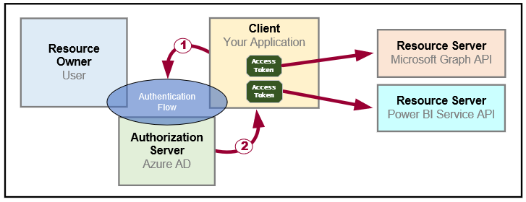
OAuth 2.0 Fundamentals
Client application calls to resource server on behalf of a user
Client implements authentication flow to acquire access token
Access token contains permission grants for client to call resource server
Client passes access token when calling to resource server
Resource server inspects access token to ensure client has permissions

Slide 13
OAuth 2.0 Client Registration
Client must be registered with authorization server
Authorization server tracks each client with unique Client ID
Client should be registered with one or more Reply URLs
Reply URL should be fixed endpoint on Internet
Reply URL used to transmit security tokens to clients
Client registration tracks permissions and other attributes

Slide 14
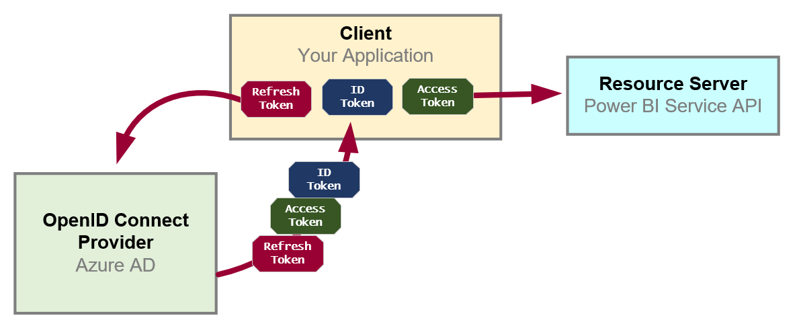
OpenID Connect Extends OAuth 2.0
OAuth 2.0 has shortcomings with authentication & identity
It does not provide client with means to validate access tokens
Lack of validation makes client vulnerable to token forgery attacks
Open ID Connect is standard which extends OAuth 2.0
OpenID Connect provider passes ID token in addition to OAuth 2.0 tokens
OpenID Connect provider provides client with keys for token validation

Slide 15
Authentication Flows
User Password Credential Flow (public client)
Used in Native clients to obtain access code
Requires passing user name and password across network
Authorization Code Flow (confidential client)
Client first obtains authorization code then access token
Access token acquired in server-to-server call
Access token never passes through browser or client device
Implicit Flow (public client)
Used in SPAs built with JavaScript and AngularJS
Application obtains access token w/o acquiring authorization code
Client Credentials Flow (confidential client)
Authentication based on SSL certificate with public-private key pair
Used to obtain access token when using app-only permissions

Slide 16
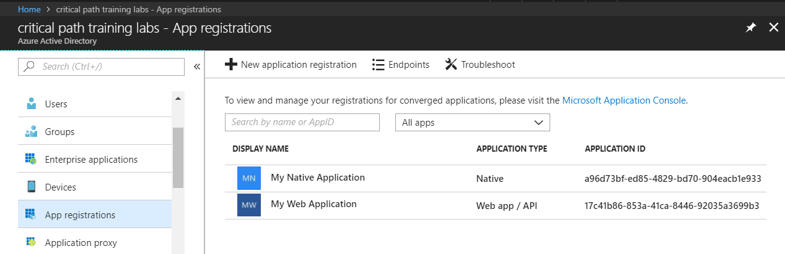
Azure AD Applications
Creating applications required for AAU authentication
Applications are as Native application or Web Applications
Application identified using GUID known as application ID
Application ID often referred to as client ID or app ID

Slide 17
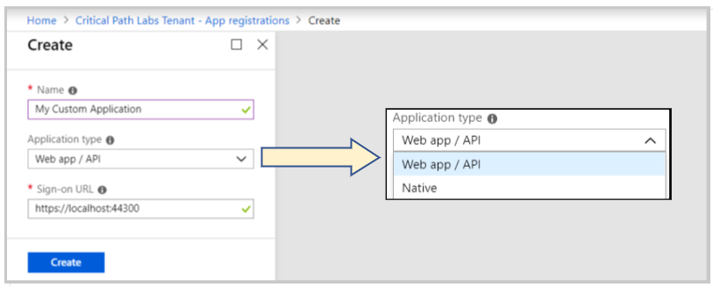
Application Types
Azure AD Application Types
Native clients
Web app / API client

Slide 18
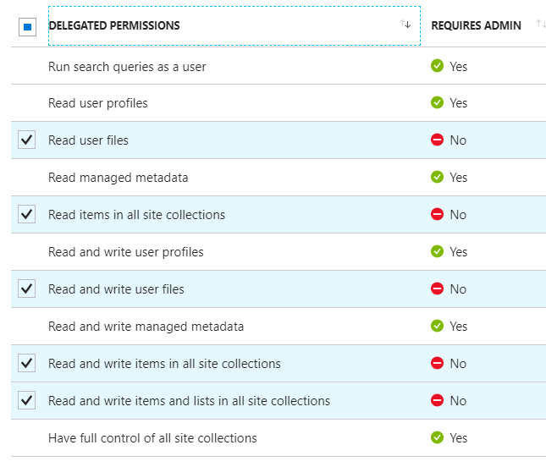
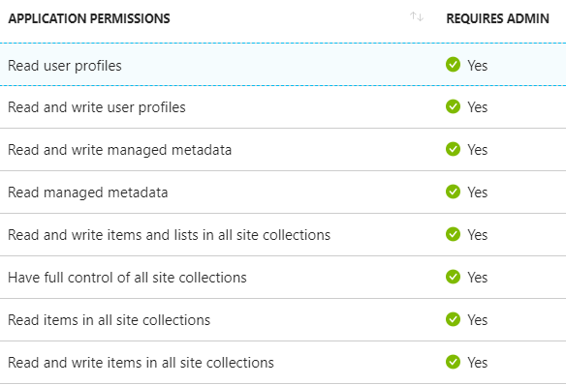
Delegated Permissions vs Application Permissions
Permissions categorized into two basic types
Delegated permissions are (app + user) permissions
Application permissions are app-only permissions (far more powerful)
Not all application types and APIs support application permissions
Power BI Service API does not yet support application permissions
Example permissions for Office 365 SharePoint Online
Some delegated permissions requires administrative permissions

Slide 19
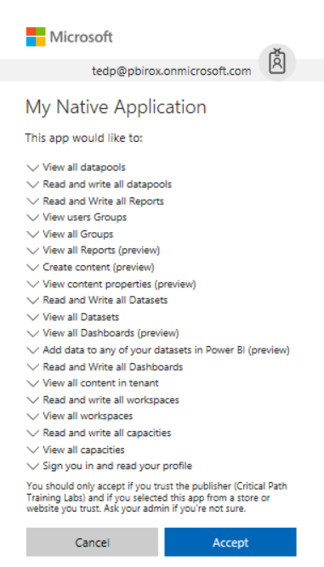
Interactive Consent for Delegated Permissions
Users must consent to delegated permissions
User prompted during first log in
User must click Accept
Only occurs once for each user

Slide 20
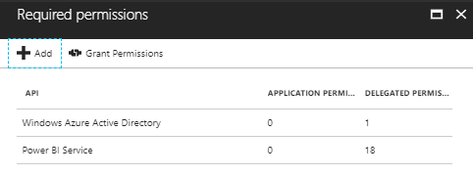
Granting Delegated Permissions
It can be helpful to Grant Permissions in Azure portal
Prevents the need for interactive granting of application by user
Might be required when authenticating in non-interactive fashion

Slide 21
AAD Security Principals
Azure AD creates service principal for application
Service principle created once per tenant
Service principle used to track permission grants
AAD creates service principal on demand when first needed
You can create service principal in PowerShell script
Host Tenant
Tenant 2
Tenant 3
Application
Application ID
Service Principal
Object ID
Service Principal
Object ID
Service Principal
Object ID
Permission Grants
User1
User2
Permission Grants
User1
User2
Permission Grants
User1
User2

Slide 22
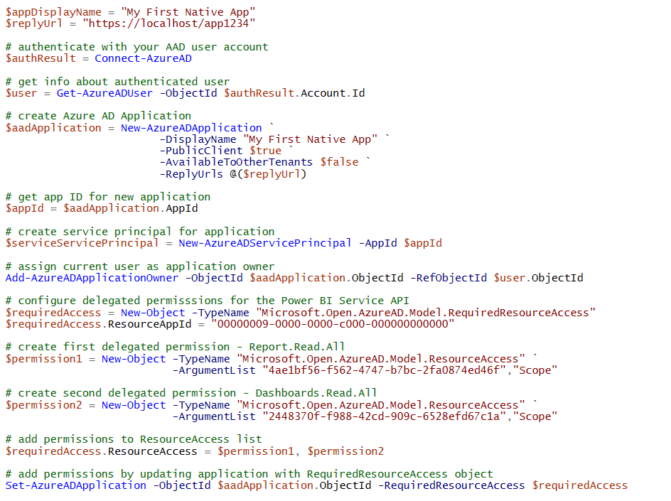
Creating AAD Applications with PowerShell

Slide 23
Agenda
Power BI Embedding Fundamentals
Authentication with Azure AD
Programming the Power BI Service API
Programming the Power BI JavaScript API

Slide 24
What Is the Power BI Service API?
What is the Power BI Service API?
API built on OAuth2, OpenID Connect, REST and ODATA
API secured by Azure Active Directory (AAD)
API to program with workspaces, datasets, reports & dashboards
API also often called “Power BI REST API”
What can you do with the Power BI Service API?
Publish PBIX project files
Update connection details and datasource credentials
Create workspaces and clone content across workspaces
Embed Power BI reports and dashboards tiles in web pages
Create streaming datasets in order to build real-time dashboards

Slide 25
Authenticating with Azure AD
User must be authenticated against Azure AD
User authentication used to obtain access token
Can be accomplished with the Azure AD Authentication Library
Access token pass to Power BI Service API in call REST calls
Azure Active Directory
Custom App
Access Token
Access Token
Power BI Service

Slide 26
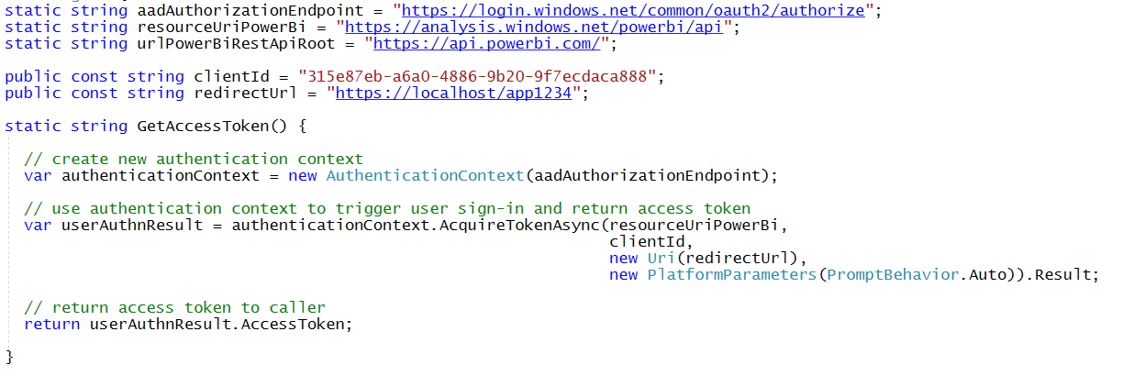
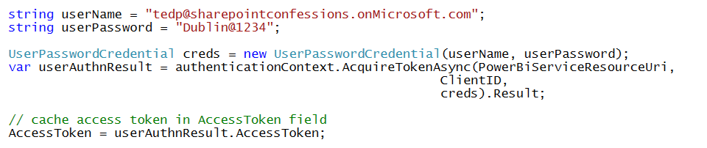
Access Token Acquisition (Native Client)
With interactive login
With User Password Credential flow (non-interactive)

Slide 27
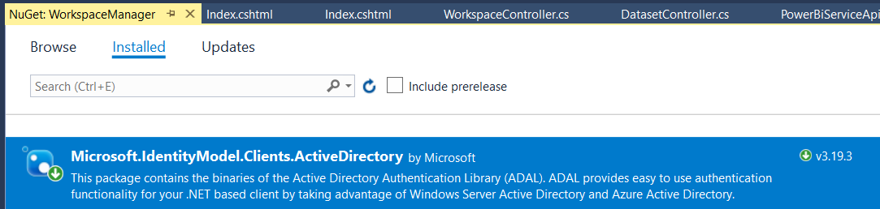
ADAL for .NET
Active Directory Authentication Library for .NET
Used in Native Clients and in Web Clients
Handles authentication flow behind the scenes
Provides caching for access tokens and refresh tokens
ADAL .NET installs as a NuGet Package
Package name is Microsoft.IdentityModel.Clients.ActiveDirectory

Slide 28
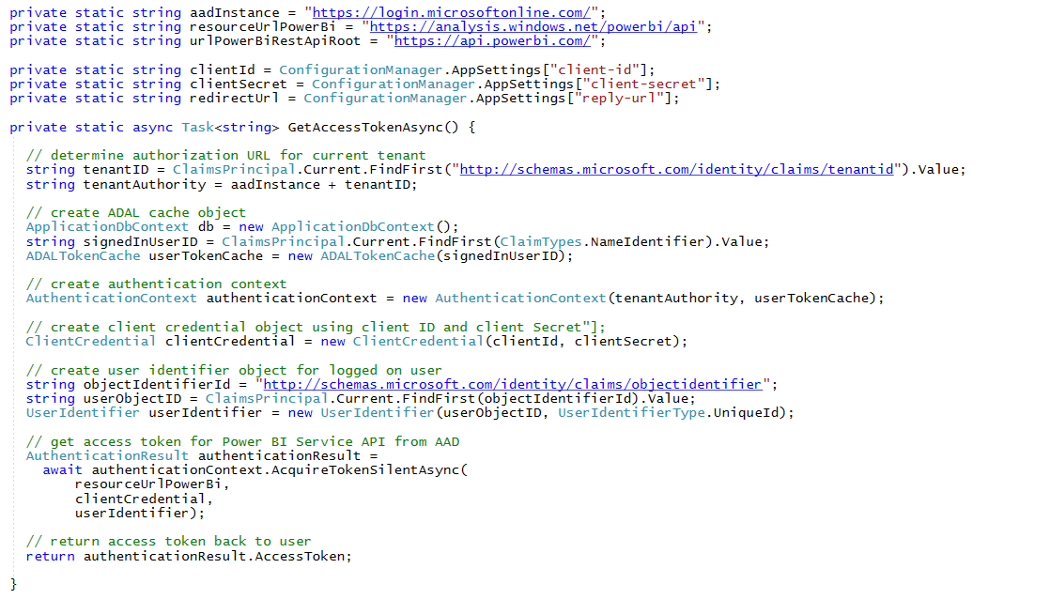
Access Token Acquisition (web app)

Slide 29
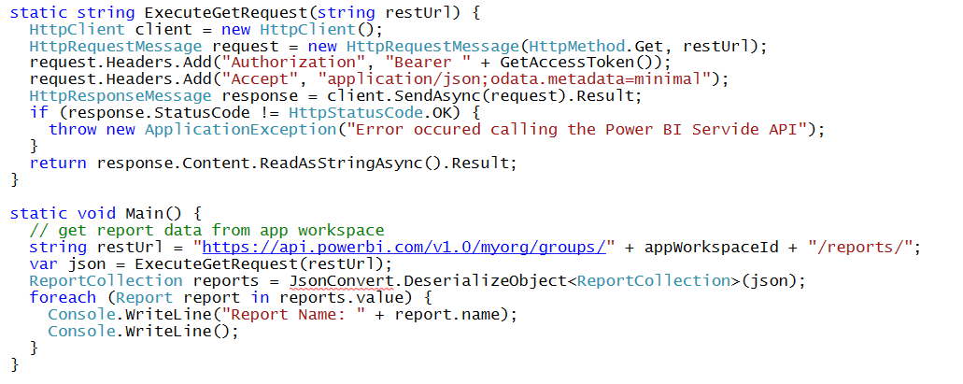
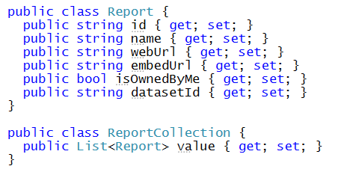
REST Calls to the Power BI Service API

Slide 30
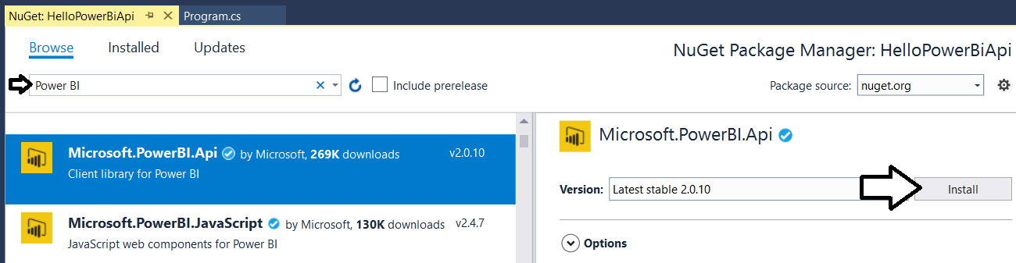
Power BI Service SDK
Added as a NuGet package

Slide 31
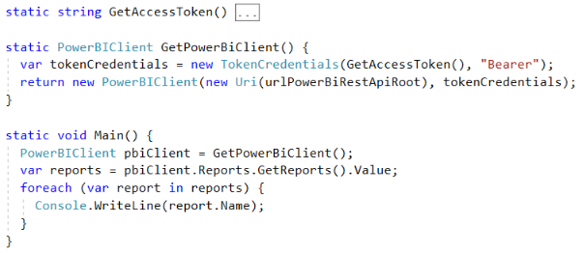
Initializing an Instance of PowerBIClient
PowerBIClient object serves as top-level object
Used to execute calls against Power BI Service
Initialized with function to retrieve AAD access token

Slide 32
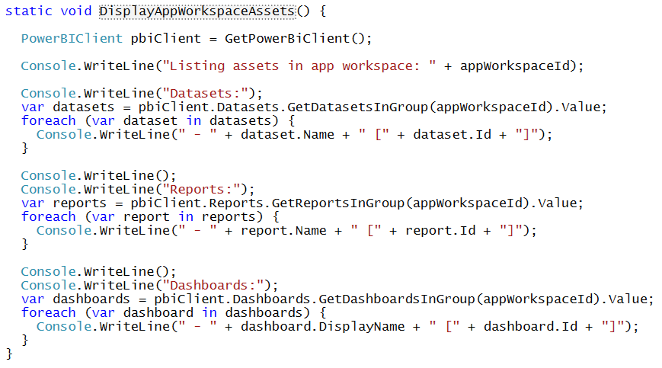
Enumerating Collections with PowerBiClient

Slide 33
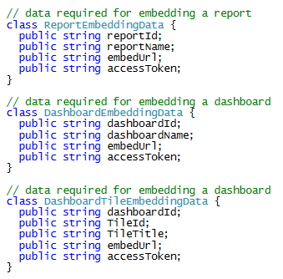
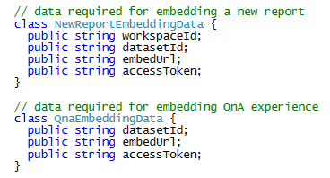
Report and Dataset Info

Slide 34
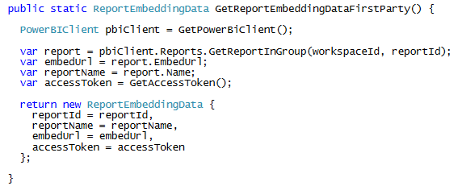
Data for First Party Report Embedding

Slide 35
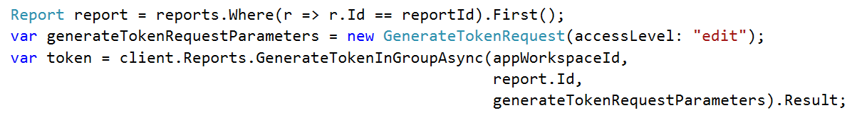
Embed Tokens
You can embed reports using master user AAD token, but…
You might want embed resource using more restricted tokens
You might want stay within the bounds of Power BI licensing terms
You generate embed tokens with the Power BI Service API
Each embed token created for one specific resource
Embed token provides restrictions on whether user can view or edit
Embed token can only be generated in dedicated capacity (semi-enforced)
Embed token can be generated to support row-level security (RLS)

Slide 36
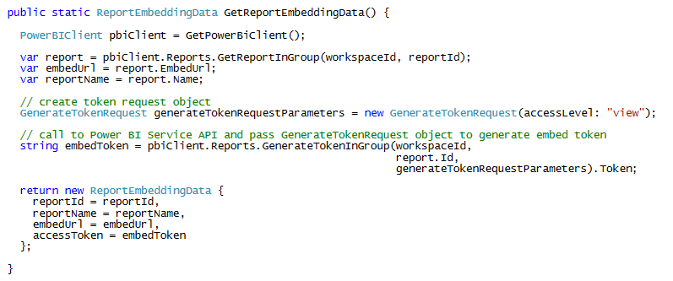
Data for Third Party Report Embedding

Slide 37
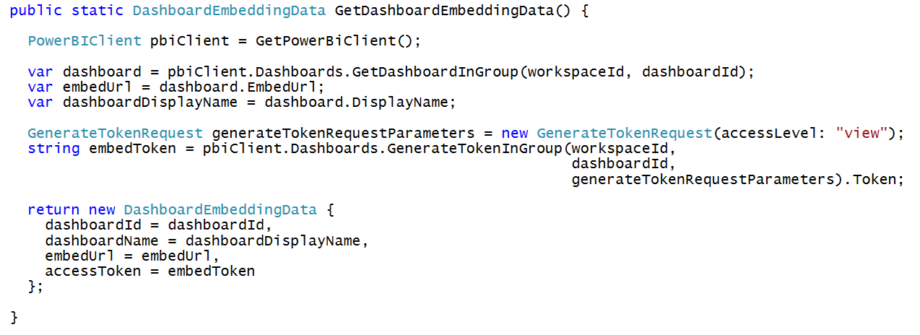
Getting the Data for Dashboard Embedding

Slide 38
Agenda
Power BI Embedding Fundamentals
Authentication with Azure AD
Programming the Power BI Service API
Programming the Power BI JavaScript API

Slide 39
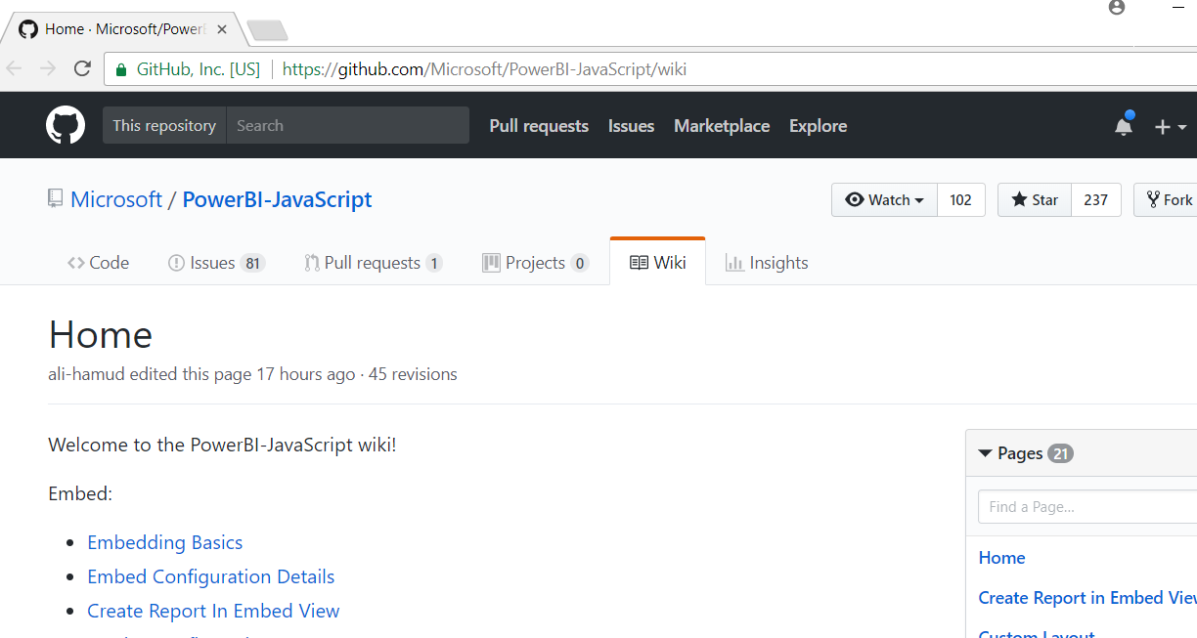
Power BI JavaScript API (powerbi.js)
Power BI JavaScript API used to embed resources in browser
GitHub repo at https://github.com/Microsoft/PowerBI-JavaScript/wiki
GitHub repository contains code, docs, wiki and issues list

Slide 40
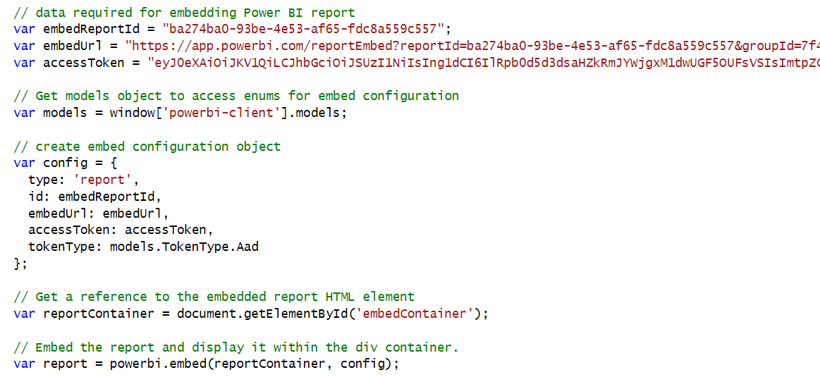
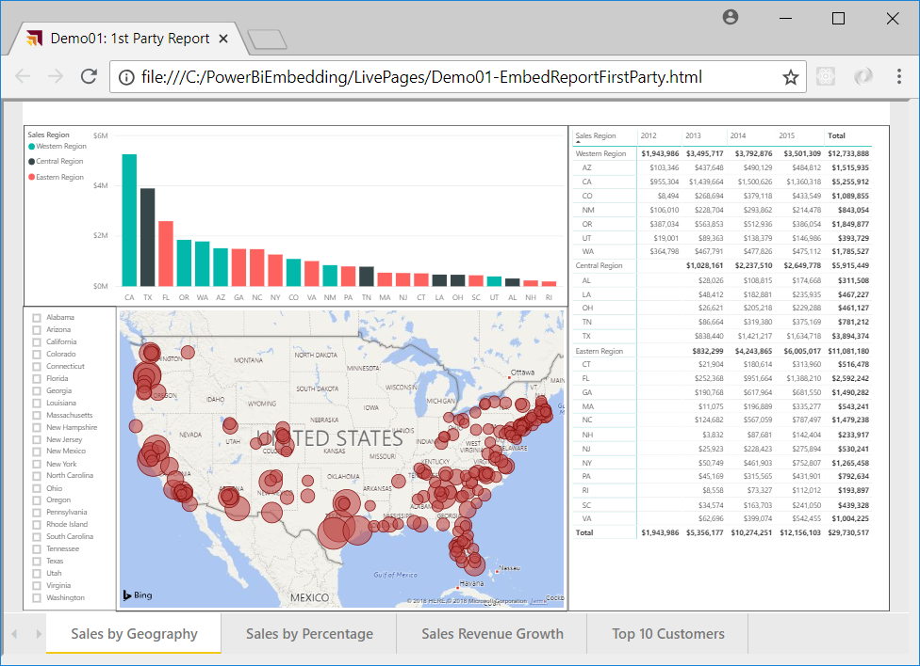
Hello World with Power BI Embedding
powerbi.js library provides powerbi as top-level service object
You call powerbi.embed and pass configuration object with access token
models object available to supply configuration settings
configuration object sets tokenType to either TokenType.Embed or TokenType.Aad
First party embedding

Slide 41
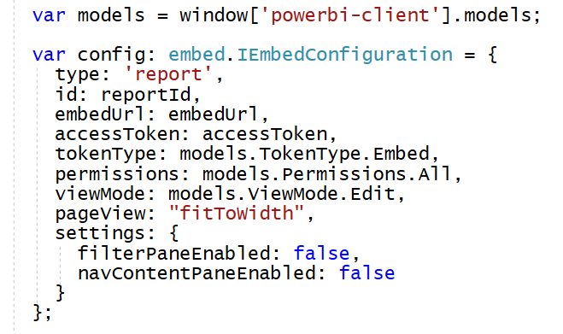
Embedded Report Configuration Options
permissions determines what permissions are given to user on resource
viewMode determines when report opens in read-only view or edit view
pageView determines how reports scales to fit embed container element
Read: Allows view report only.
ReadWrite: Allows view, Edit and Save report.
Copy: Allows Save a copy of a report using Save As.
Create: Allows creating a new report.
All: Allows everything.
View - Opens report in View mode.
Edit - Opens report in Edit mode.
fitToWidth: Fit to width of host HTML element.
oneColumn: Opens in single column.
actualSize: Actual size as designed in report

Slide 42
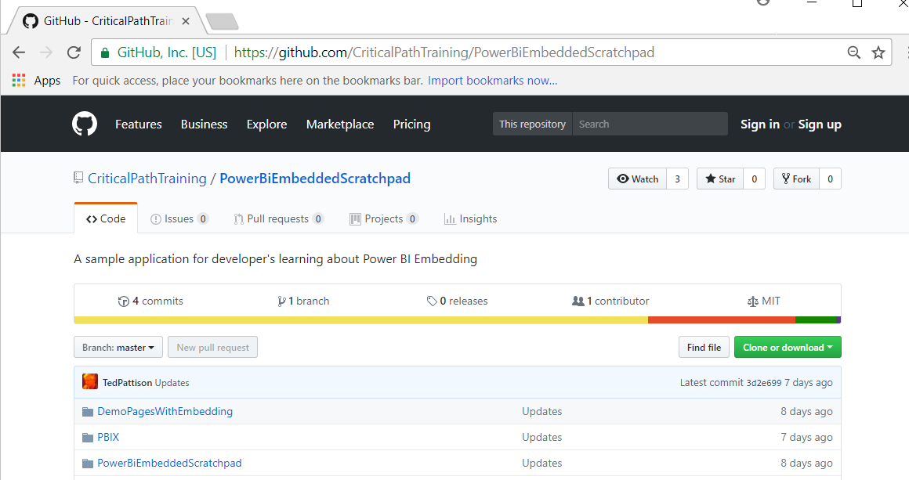
PowerBiEmbeddedScratchpad Sample
https://github.com/CriticalPathTraining/PowerBiEmbeddedScratchpad

Slide 43
The Power BI Embedded Scratchpad App

Slide 44
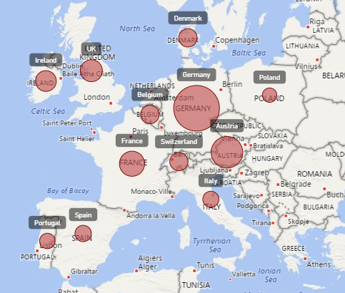
Report Embedding Architecture
Embedding involves creating an iFrame on the page
PBIJS transparently creates iFrame and sets source to Power BI Service
The iFrame and hosting page originate from different DNS domains
Your HTML and CSS
https://app1.mydomain.com
Web Hosting Server
Your
JavaScript
iFrame
Embedding Data
https://wabi-us-east2-redirect.analysis.windows.net/
powerbi.js
Power BI Service

Slide 45
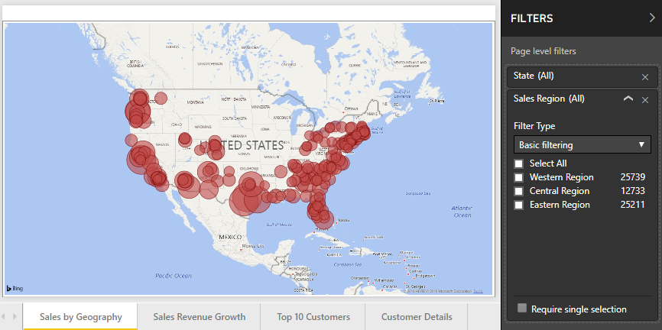
Post Message Communications Flow
4 extra libraries used communicate with report in iFrame
window-post-message-proxy (WPMP)
http-post-message (HPM)
powerbi-router (PBIR)
powerbi-models (PBIM)
iFrame
Your
JavaScript
service
report
HPM
PBIR
WPMP
WPMP
PBIR
HPM

Slide 46
A Promise-based Programming Model
Design of PBIJS simulates HTTP protocol
Creates more intuitive programming model for developers
Programming based on asynchronous requests and promises
Embedded objects programmed using actions and events
Actions
report.fullscreen
report
report.switchMode
report.setFilters
Your
JavaScript
report.getPages
Events
report.loaded
report.pageChanged
report.commandTriggered

Slide 47
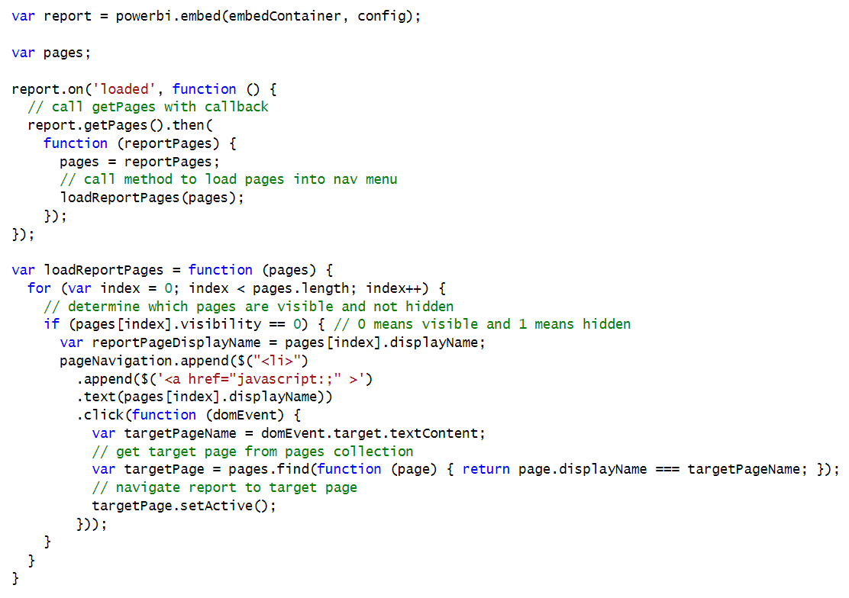
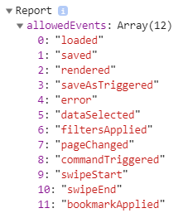
Handling Report Events

Slide 48
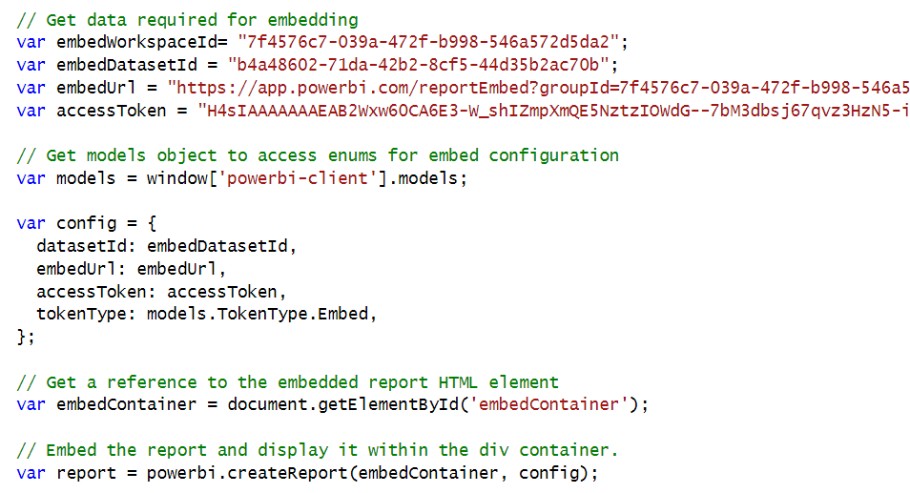
Embedding a New Report

Slide 49
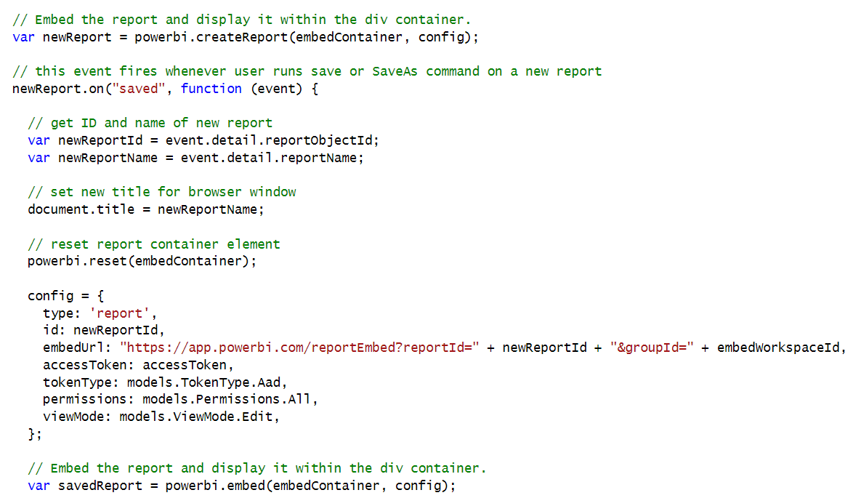
New Report with SaveAs Redirect

Slide 50
Summary
Power BI Embedding Fundamentals
Authentication with Azure AD
Programming the Power BI Service API
Programming the Power BI JavaScript API

