Slide 1
Power BI Embedding Nov Update Agenda
Power BI Embedding Fundamentals
Developer Assistance through PowerShell
Azure AD Authentication
Developing SPAs with Power BI Embedding

Slide 2
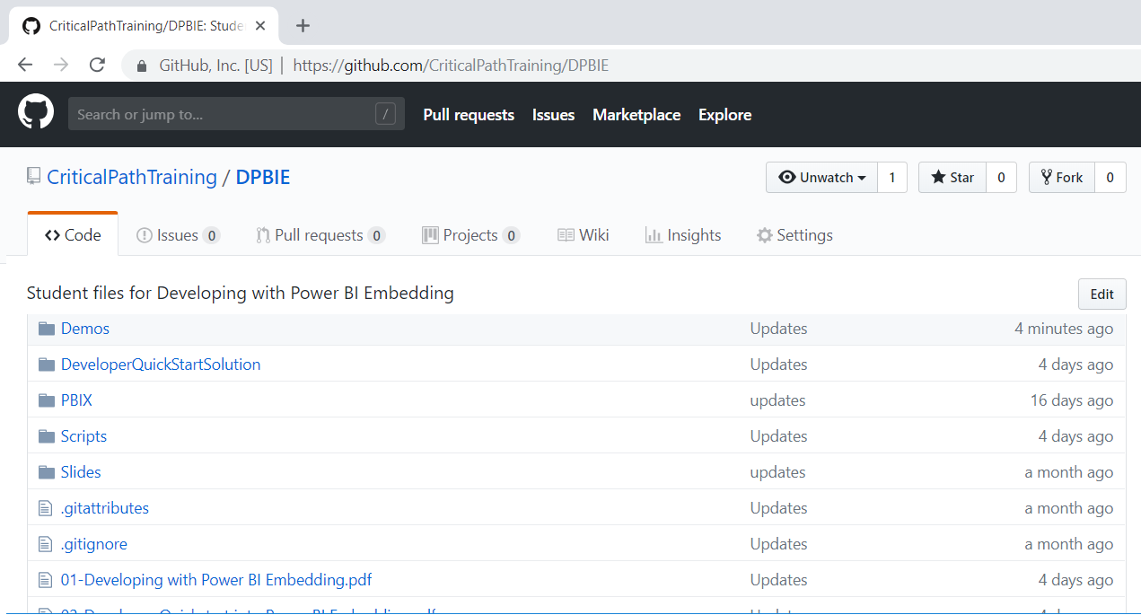
Code and Slides for this Session
https://github.com/CriticalPathTraining/DPBIE

Slide 3
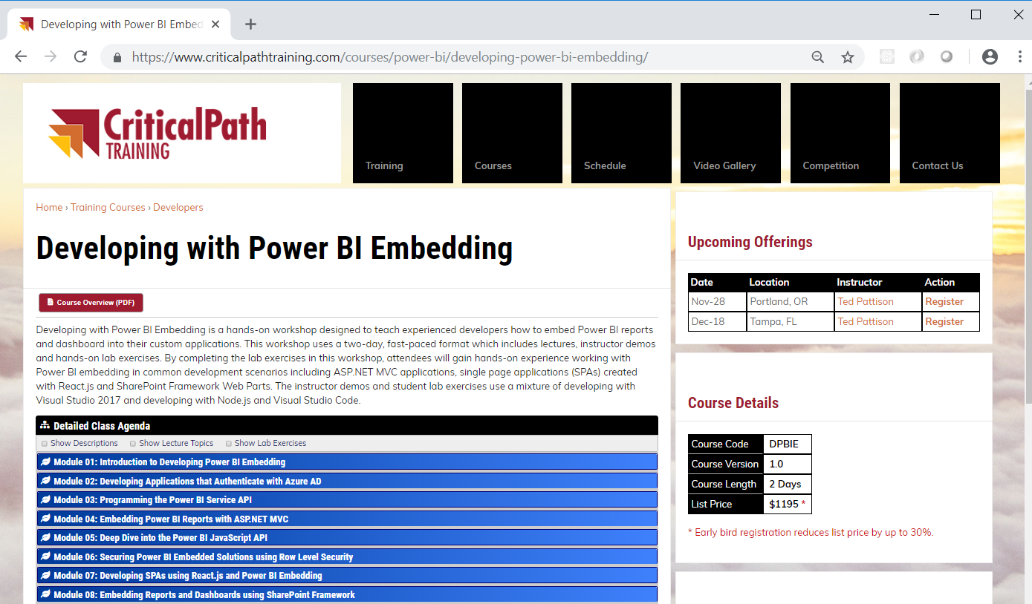
Developing with Power BI Embedding Workshop

Slide 4
Power BI Embedding – The Big Picture
User launches your app using a browser
App authenticates with Azure Active Directory and obtains access token
App uses access token to call to Power BI Service API
App retrieves data for embedded resource and passes it to browser.
Client-side code uses Power BI JavaScript API to create embedded resource
Embedded resource session created between browser and Power BI service
5
Power BI Service
Browser
iFrame
6
4
4
3
1
Your App
2
Azure AD

Slide 5
First Party Embedding versus Third Party Embedding
First Party Embedding
Known as User-Owns-Data Model
All users require a Power BI license
Useful in corporate environments
App authenticates as current user
Your code runs with user’s permissions
User’s access token passed to browser
Third Party Embedding
Known as App-Owns-Data Model
No users require Power BI license
Useful for commercial applications
App authenticates with master user account
Your code runs with admin permissions
Embed token passed to browser
First Party Embedding for use within Organization
Third Party Embedding for use by ISVs
Browser
Power BI Service
Browser
Power BI Service
iFrame
iFrame
Azure AD Access Token
for the current user
Power BI Embed Token
for one specific report

Slide 6
Embeddable Resources
Reports
Dashboards
Dashboard Tiles
New Reports
Q&A Experience
Visuals in custom layout

Slide 7
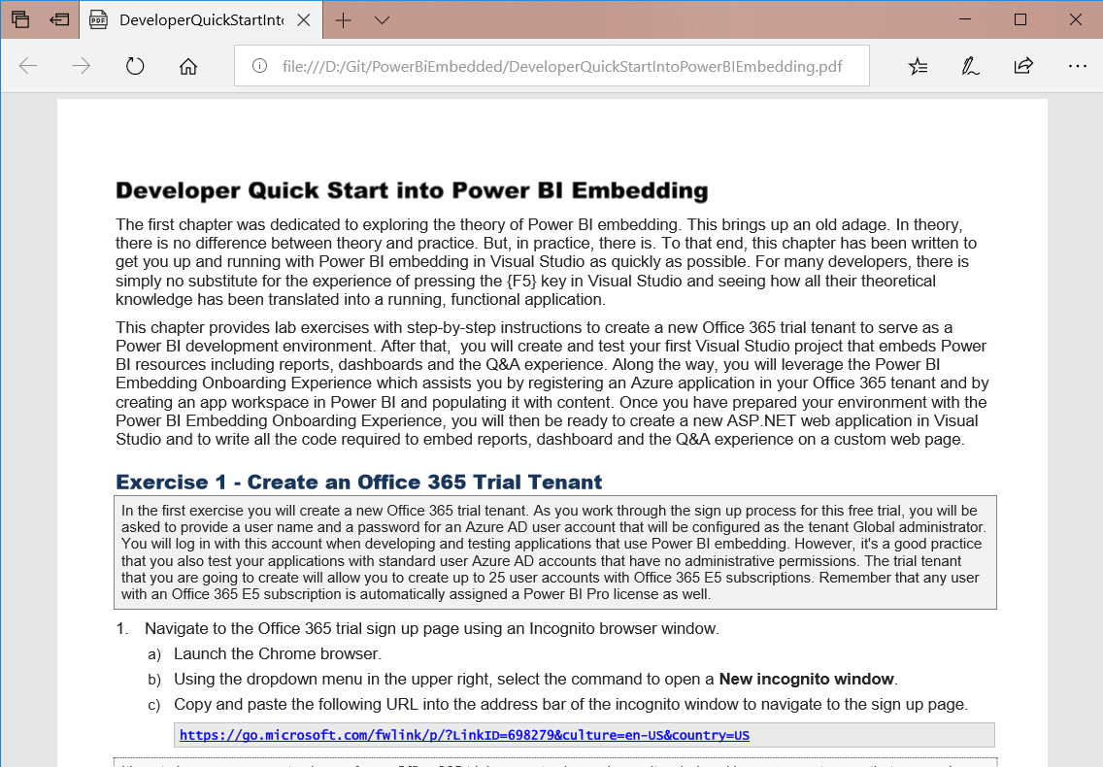
Developer Quick Start into Power BI Embedding
On-line lab exercises to get up and running
https://github.com/CriticalPathTraining/PowerBiEmbedded/raw/master/DeveloperQuickStartIntoPowerBIEmbedding.pdf

Slide 8
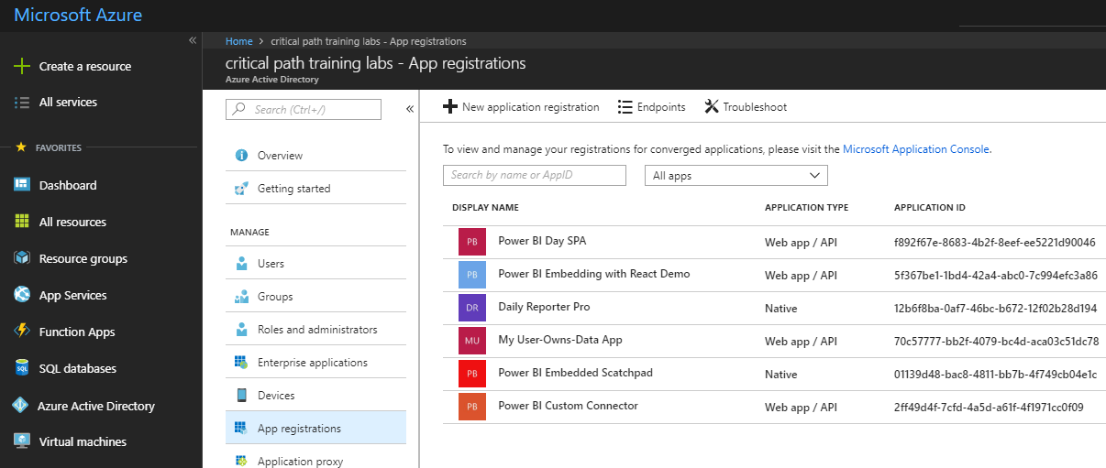
Understanding Authentication with Azure AD
Requirements of calling the Power BI Service API
App must be registered with Azure AD with Application ID (aka Client ID)
App must be created with app type of as Web app / API or Native
App registration must be configured with required permissions
App must implement authentication flow to authenticate user and obtain access token

Slide 9
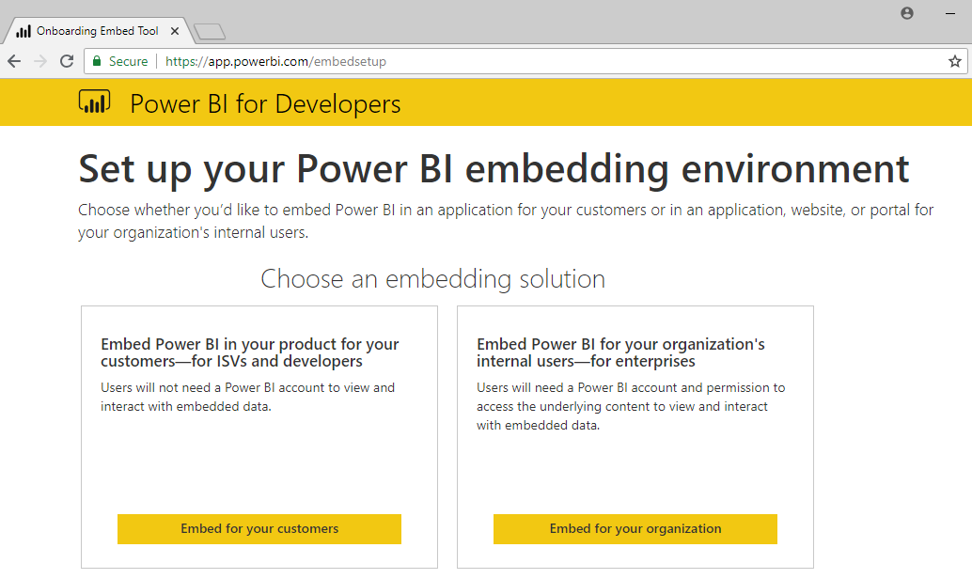
Power BI Embedding Onboarding Experience Tool https://app.powerbi.com/embedsetup
Third Party Embedding
First Party Embedding

Slide 10
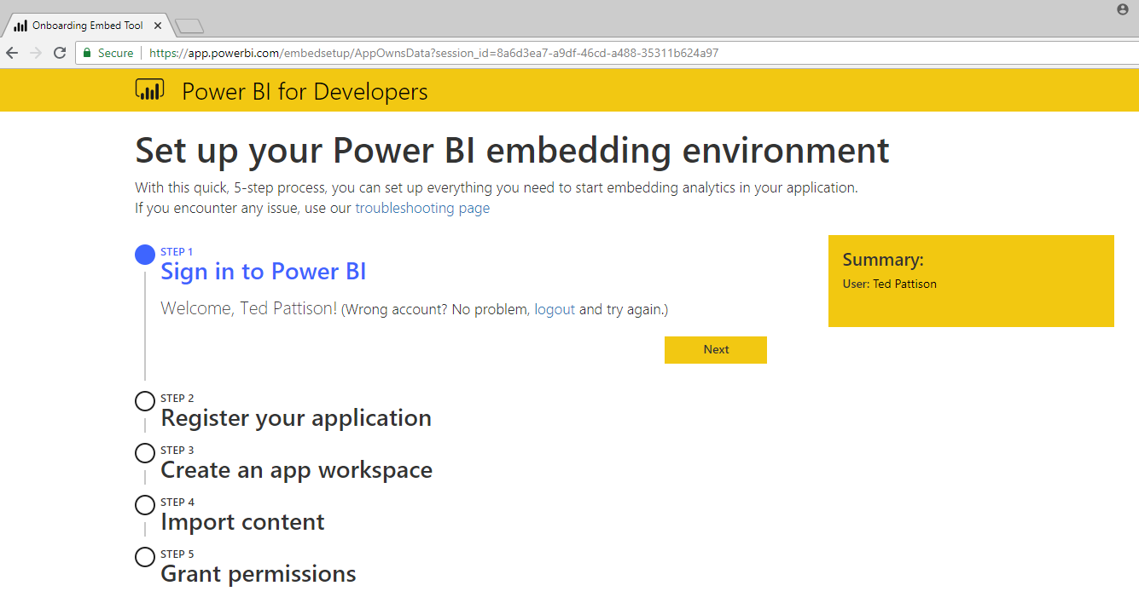
App-Owns-Data Experience – Step 1

Slide 11
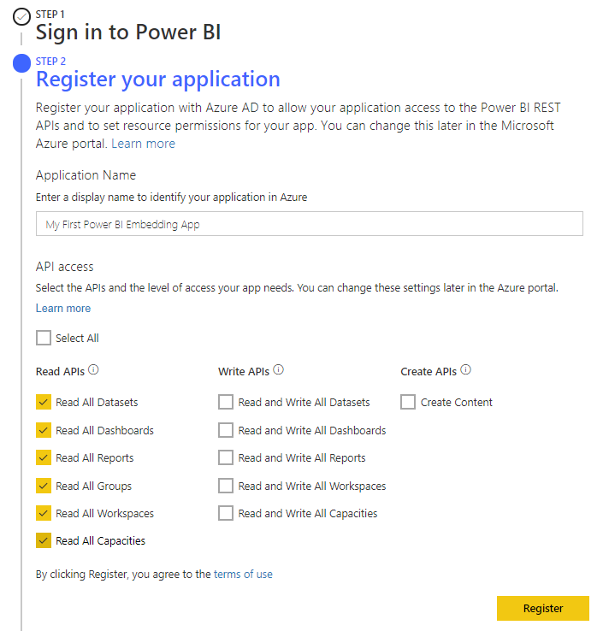
App-Owns-Data Experience – Step 2

Slide 12
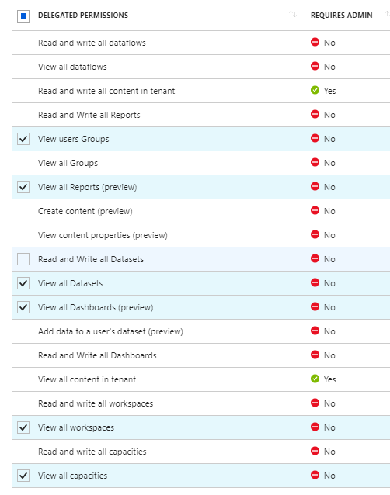
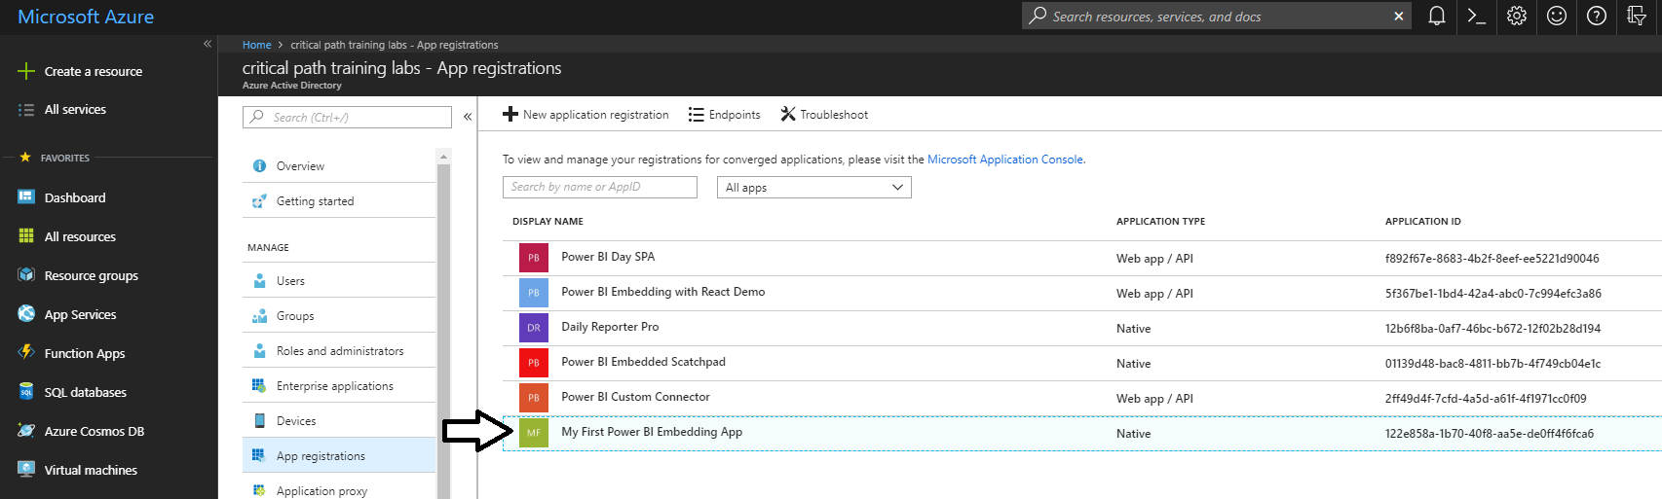
What Just Happened?
The Onboarding Tool created a new Azure AD App
Configured as a Native app as opposed to a Web app / API

Slide 13
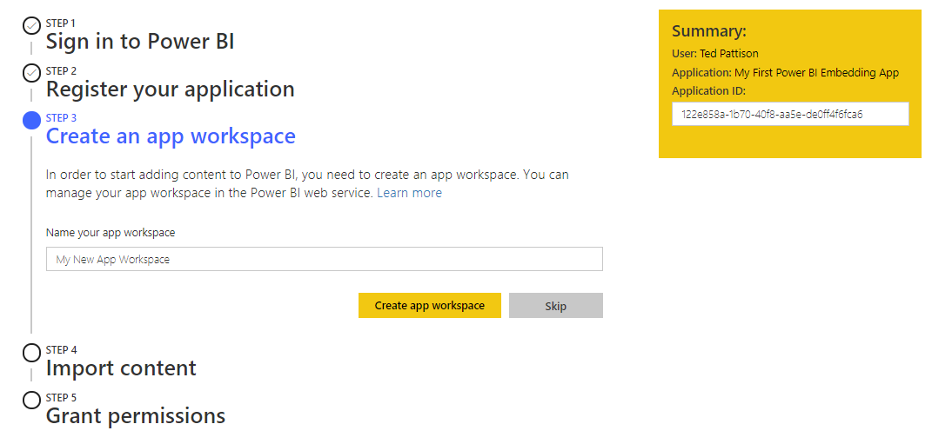
App-Owns-Data Experience – Step 3

Slide 14
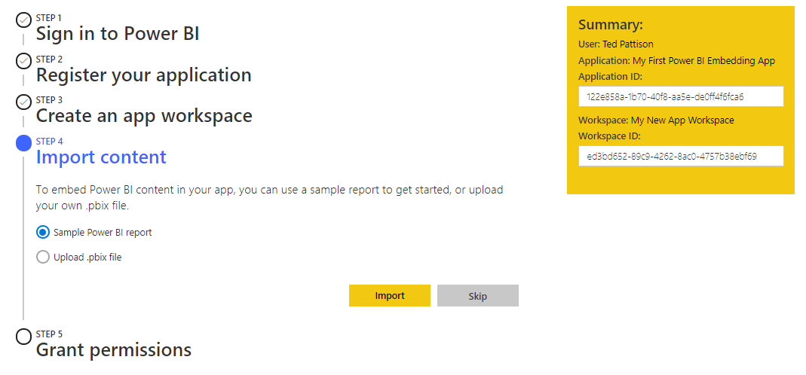
App-Owns-Data Experience – Step 4

Slide 15
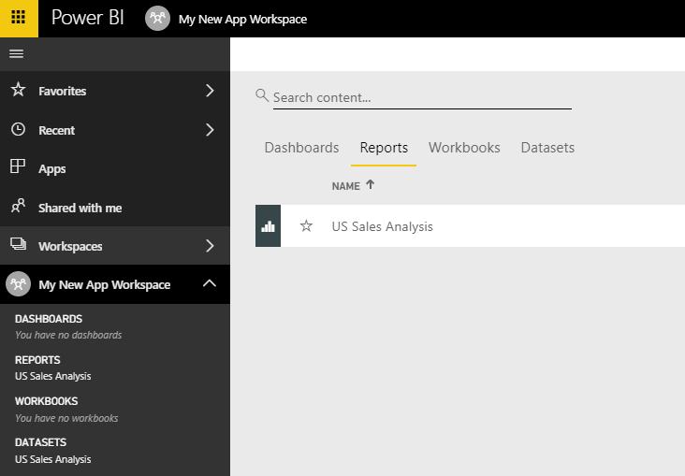
What Just Happened?
The Onboarding Tool created a new Power BI App Workspace
It also uploaded a PBIX file so there is already one dataset and one report
New app workspace is not automatically associated with a dedicated capacity

Slide 16
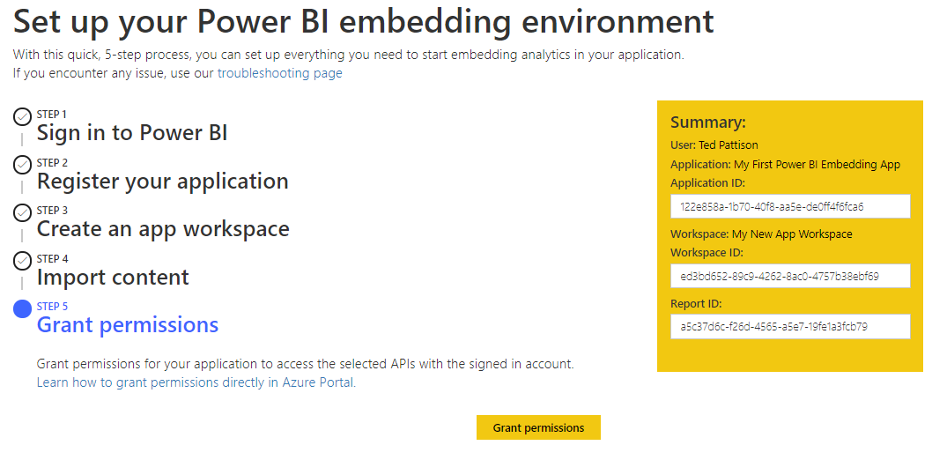
App-Owns-Data Experience – Step 5

Slide 17
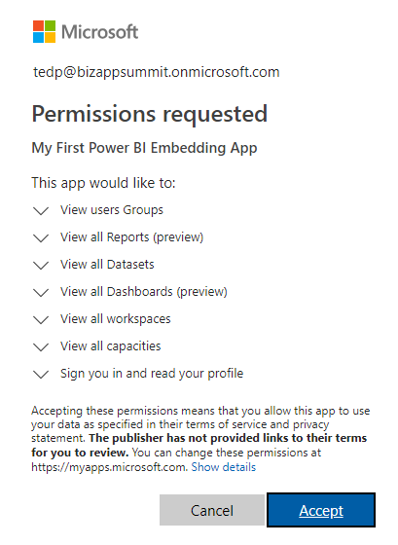
Granting Permissions to the App
Users must consent to the permissions requested by an app

Slide 18
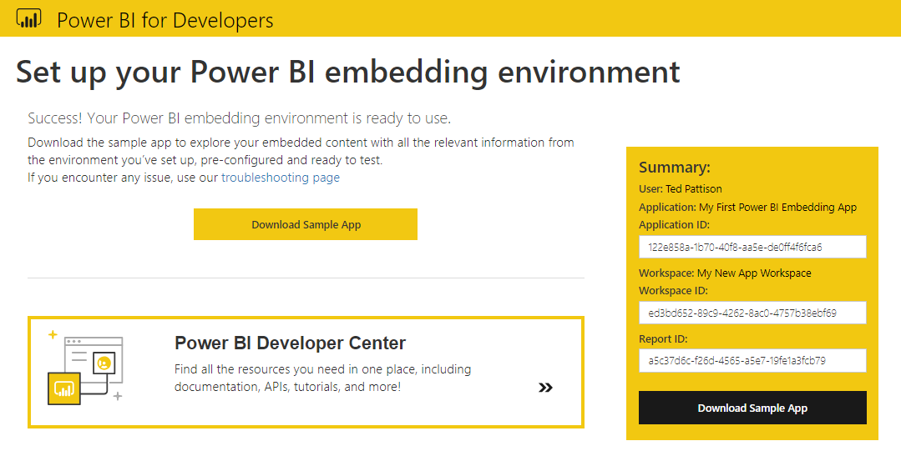
All Great Experiences Must Come to an End

Slide 19
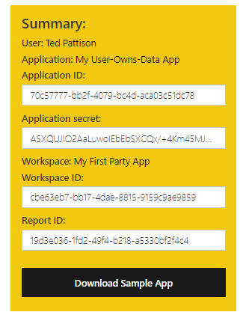
User-Owns-Data Onboarding Experience
Users-Owns-Data Experience is similar to App-Owns-Data experience
Users-Owns-Data Experience allows you to create app a Native or Web app / API
App create as Web app / API must be created with valid Reply URL
Process configures Azure app with a secret key known as Application secret
Application secret allows app to authenticate with AAD using authorization code grant flow

Slide 20
OAuth 2.0 and Authentication
OAuth 2.0 was designed for authorization
Creation of access token requires authentication
Authorization server passes access token to client
Client passes access token when calling resource services
Access token serves as app credentials for authorization
Access token not intended for user authentication
Access token not designed to carry user identity data
OAuth 2.0 doesn't require validation of access token
Naïve OAuth 2.0 implementations subject to attack

Slide 21
Open ID Connect
Resource service 1
User agent
End user working in browser
Client (Relying Party)
Your Custom Application
Resource service 2
Authentication Flow
Resource service 3
Id tokens
Open ID Provider
FaceBook, Google,
Twitter, GitHub
Azure Active Directory

Slide 22
Azure AD Authentication Flows
User Credentials Flow (public client)
Used in Native clients to obtain access code
Requires passing user name and password
Authorization Code Grant Flow (confidential client)
Client first obtains authorization code then access token
Server-side application code never sees user’s password
Implicit Grant Flow (public client)
Used in SPAs built with JavaScript and AngularJS
Application obtains access token w/o acquiring authorization code
Client Credentials Grant Flow (confidential client)
Authentication based on SSL certificate with public-private key pair
Used to obtain access token when using app-only permissions

