Slide 1
Developing with the SharePoint Framework
Notes:
In August of 2016, Microsoft released its first “developer preview” of the SharePoint Framework (SPFx). This module provides an introduction to SPFx and explains why this new client-side framework represents the future of the SharePoint development platform. Students will learn how to set up an SPFx development environment by installing Node.js and cross-platform developer utilities such as Gulp, Yeoman and Visual Studio Code. Students learn how to leverage the SPFx templates provided by Microsoft to create a new SPFx project as well as how to implement a client-side web part with an interactive user experience using the React.js JavaScript library. The module explains how to use the SharePoint Workbench to run and debug SPFx projects both locally and in the SharePoint Online environment. The module concludes with a discussion of how SPFx projects are deployed with the assistance of a content delivery network (CDN).

Slide 2
Agenda
Overview the SharePoint Framework (SPFx)
Setting up an SPFx Development Environment
Creating Projects using the SPFx Templates
Deploying SPFx Projects using an Azure CDN

Slide 3
Evolution of the SharePoint Platform
Farm Solutions
Server-side DLLs and XML Definitions
Sandboxed Solutions
SharePoint Apps Add-ins
iFrames used to add in security dimension
complexity of 2 domains (app web vs host web)
JavaScript Injection
Scripting can be disabled
No formal deployment model
SharePoint Framework (SPFx)

Slide 4
What is SPFx?
Development model based on pages and web parts
Based on client-side development with JavaScript or TypeScript
Code runs with authenticated identity of current user
Easy access to SharePoint and Office 365 content and data
Developer tools designed to support cross-platform development
Great support for targeting mobile devices
SharePoint Page
Client-side Web Part 1
Client-side Web Part 2
JavaScript
TypeScript
Knockout
React
SharePoint REST API
Microsoft Graph API

Slide 5
How Does SPFx Work?
No more iFrames
Code runs the context of the current page
Code runs with identity and permissions of user
Uses open browser connections for current user
Supports lifecycle events
render, load, serialize, deserialize, etc.
Use whatever JavaScript framework you want
React, Handlebars, Knockout, Angular1, Angular2, D3

Slide 6
Cross-platform Toolchain
Node.js
Node Package Manager (npm)
TypeScript
Yeoman
Webpack
Gulp
git

Slide 7
Moving from JavaScript to TypeScript
TypeScript is part of your future
Resistance is futile
Primary language for SharePoint client-side web parts
Typed superset of JavaScript
Compiles to plain JavaScript
SPFx development tools built using TypeScript
Classes, modules, and interfaces
Module loading support
Helps developers build robust client-side web parts.

Slide 8
Agenda
Overview the SharePoint Framework (SPFx)
Setting up an SPFx Development Environment
Creating Projects using the SPFx Templates
Deploying SPFx Projects using an Azure CDN

Slide 9
Install the SPFx Developer Toolchain
Install Node.JS
Version 5.0 recommended - 4.0+ minimum
Installs Node Package Manage (npm)
Install Visual Studio Code
Better environment for Development with Node.js
Install Local self-signed certificate

Slide 10
Working with npm
Windows Build Tools (Visual C++ Build Tools 2015)
npm install -g --production windows-build-tools
Install Gulp
npm install -g gulp
Install Yeoman
npm install -g yo
Install Yeoman Template for SPFx
npm install -g @microsoft/generator-sharepoint

Slide 11
Agenda
Overview the SharePoint Framework (SPFx)
Setting up an SPFx Development Environment
Creating Projects using the SPFx Templates
Debugging with the SharePoint Workbench
Developing SPFx Web Parts using React.js
Deploying SPFx Projects using an Azure CDN

Slide 12
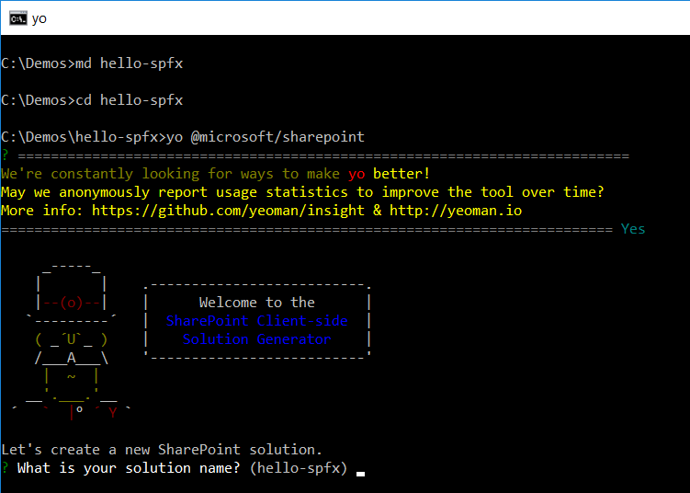
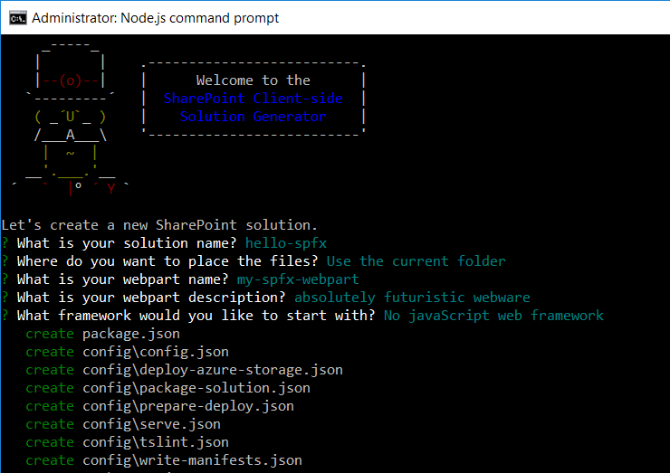
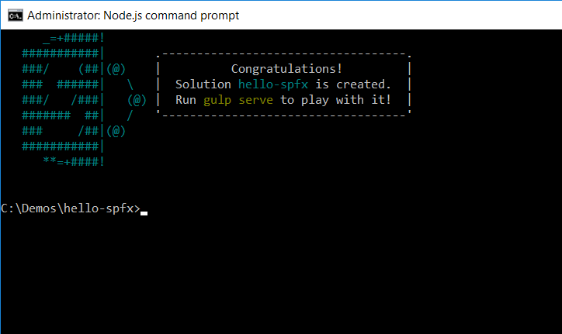
Using the SPFx Yeoman Template
SPFx projects created with Yeoman template
yo @microsoft/sharepoint
Takes 8-10 minutes to complete
Create a directory with over 200MB of source files

Slide 13
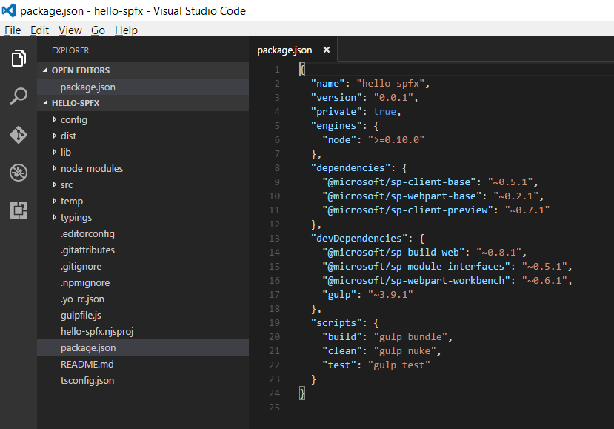
Package.json

Slide 14
Gulp as a Task Runner
Gulp serves as a Task Runner
Compiles TypeScript files to JavaScript
Compiles SASS files to CSS
Bundles and minifies JavaScript and CSS files
Create a self-signed certificate
gulp trust-dev-cert
Start up the project for testing & debugging
gulp serve

Slide 15
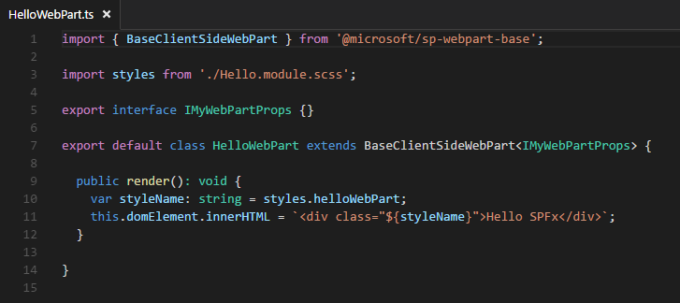
Developing a SPFx Web Part?
Create class that extends BaseClientSideWebPart
Override render() for minimal “hello world” functionality
Base class provides access to page context

Slide 16
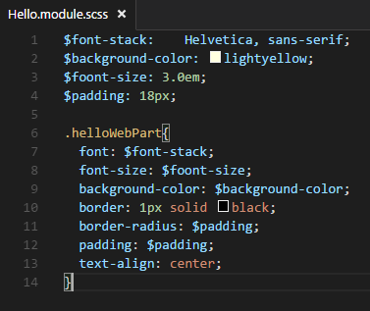
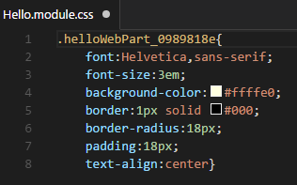
Working with SASS and .SCSS Files
Sass: Syntactically Awesome Style Sheets
Compiles .scss files into .css files
Allows build process to use variables and nesting
SASS

Slide 17
Hello World with SPFx

Slide 18
Adding a JavaScript Library (D3.js)
Adding package for D3.js library
npm install d3 –save
Add typings file to Intellisence and type checking
npm install @types/d3 --save-dev

Slide 19
Using D3 with SPFx

Slide 20
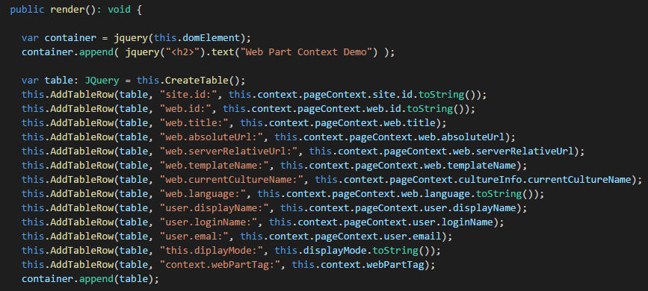
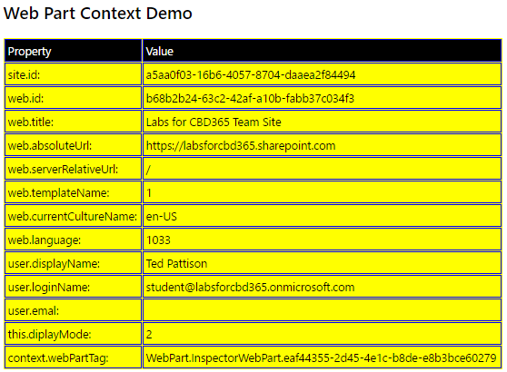
Web Part Context

Slide 21
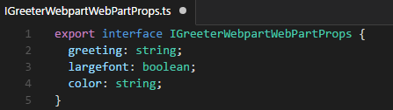
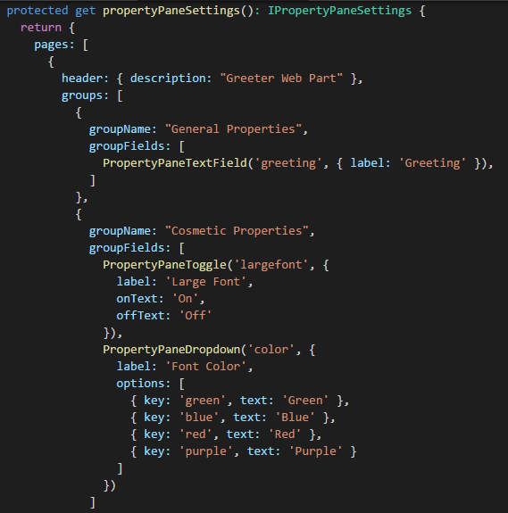
Web Part Properties
Define interface with properties
Add interface to web part class definition
Override panelPropertySettings()

Slide 22
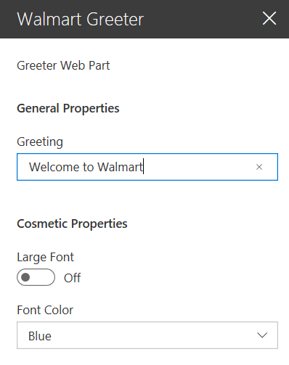
Property Panel Settings

Slide 23
Web Part Properties

Slide 24
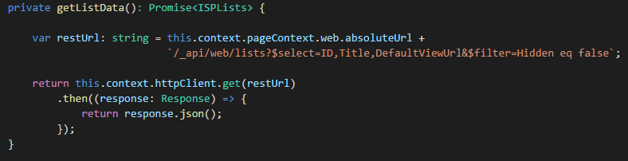
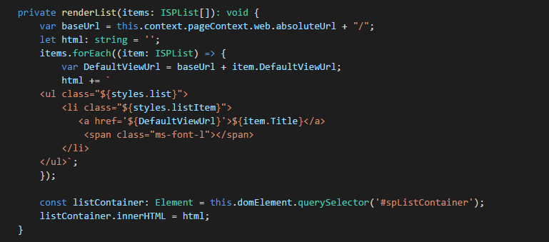
Calling the SharePoint REST API

Slide 25
Calling the SharePoint REST API

Slide 26
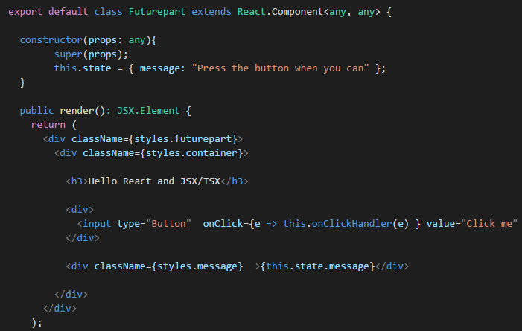
React and JSX

Slide 27
Creating Web Parts with React.js

Slide 28
Agenda
Overview the SharePoint Framework (SPFx)
Setting up an SPFx Development Environment
Creating Projects using the SPFx Templates
Deploying SPFx Projects using an Azure CDN

Slide 29
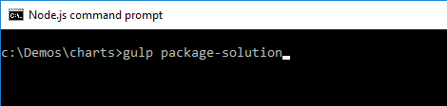
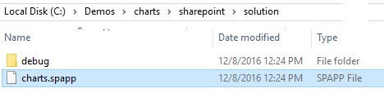
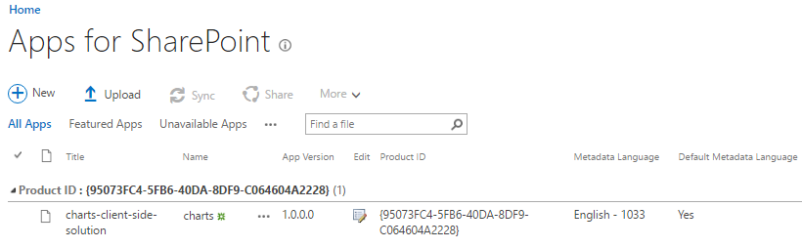
Building a Deployment Package

Slide 30
Deploying to Azure
Gulp commands to deploy to CDN
gulp --ship
gulp deploy-azure-storage
gulp bundle --ship
gulp package-solution --ship

Slide 31
Summary
Overview the SharePoint Framework (SPFx)
Setting up an SPFx Development Environment
Creating Projects using the SPFx Templates
Deploying SPFx Projects using an Azure CDN

