Slide 1
Getting Started with Node.js

Slide 2
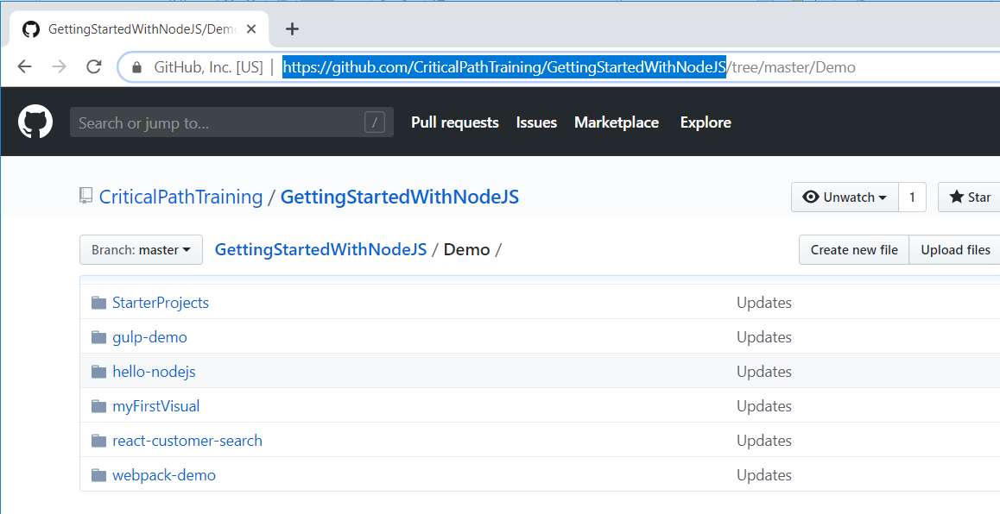
Download the Slides and Code
https://github.com/CriticalPathTraining/GettingStartedWithNodeJS

Slide 3
Agenda
Introduction to Node.JS and NPM
Automating Build Tasks using Gulp
Bundling Project Assets using Webpack
Developing with React.js, TypeScript and Webpack
Developing with SharePoint Framework
Developing Custom Visuals for Power BI

Slide 4

What is Node.js
Node.js was created to develop server-side applications in JavaScript
Node.js was initially created by Ryan Dahl in 2009
Built using Google's V8 JavaScript engine
Created to solve Apache HTTP Server's inability to deal with concurrency
Node.js offers single-threaded, non-blocking, asynchronously programming
JavaScript run-time environment based on Google V8 engine
JavaScript execution environment for web servers and development machines
It's free, cross-platform and open-source
Includes Node Package Manager (npm) and lots of available packages
What are the primary motivations for using Node.js
Server-side development with web applications and web services
Development environment with package management
Development with SharePoint Framework (SPX) of Power BI custom visuals

Slide 5
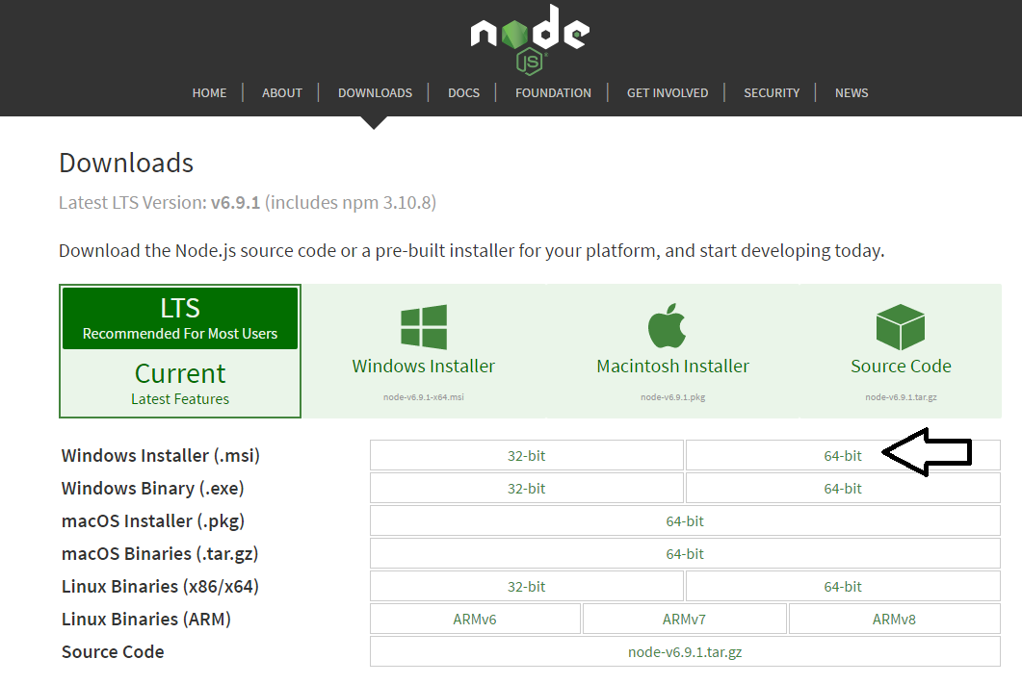
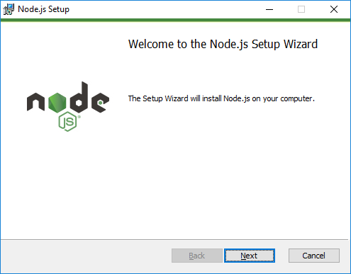
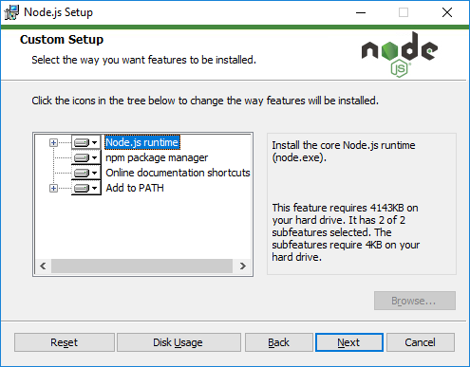
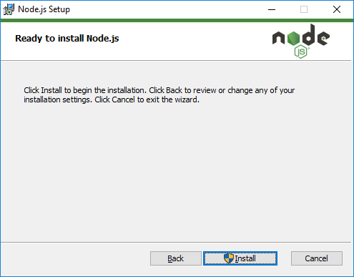
Installing node.js
https://nodejs.org/en/download/

Slide 6
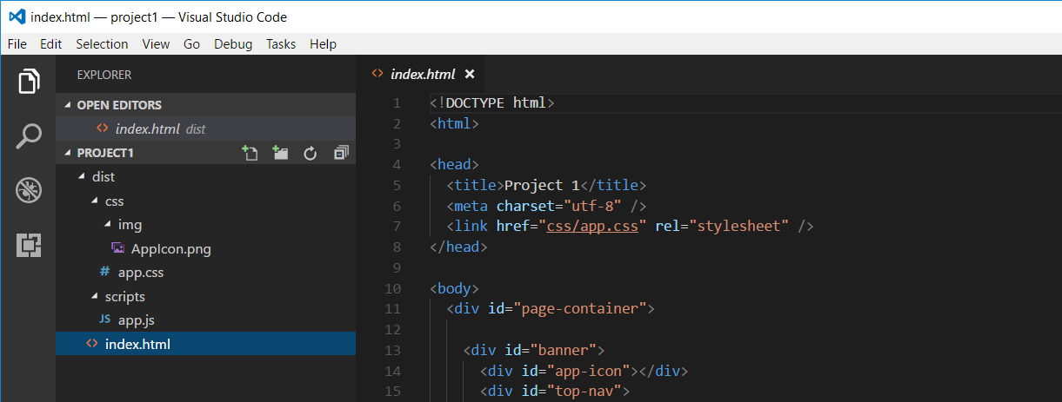
Developing with Visual Studio Code
Node.js is agnostic when it comes to developer IDE
There are many different IDEs that people use with Node.js
This course will be using Visual Studio Code
Visual Studio is not a good fit for Node.js development
Visual Studio solution & project files incompatible with Node.js

Slide 7
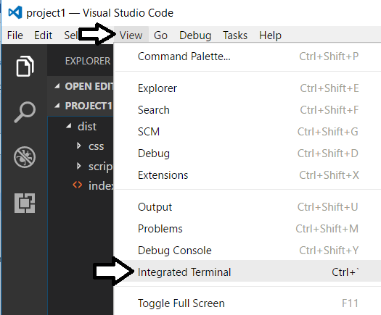
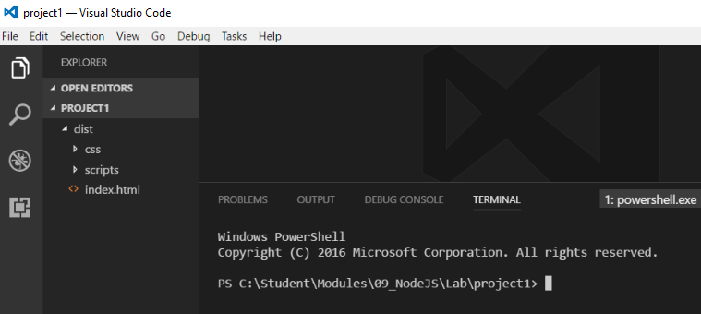
Integrated Terminal
Use the Integrated Terminal to execute npm command

Slide 8
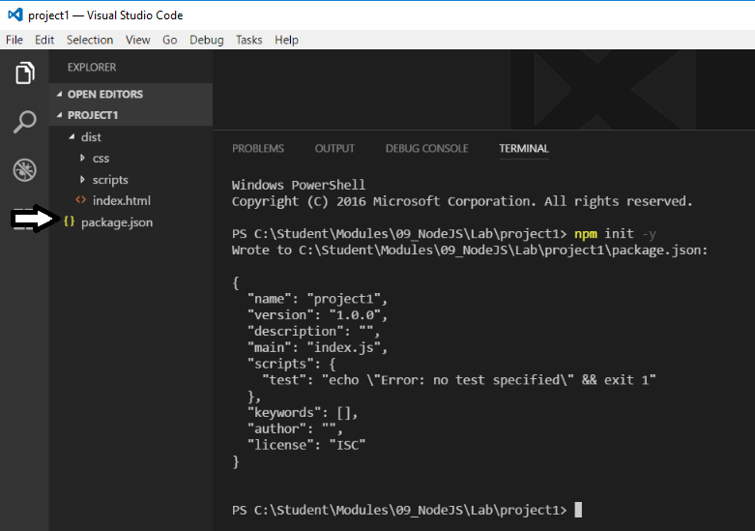
npm init
Node.js projects initialized with npm init command
This command created the package.json file

Slide 9
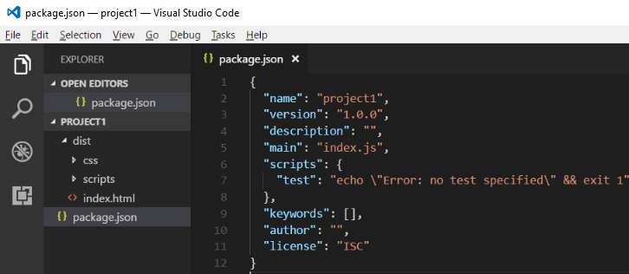
package.json
package.json serves as project manifest file
Tracks project name and version number
Tracks installed package dependencies

Slide 10
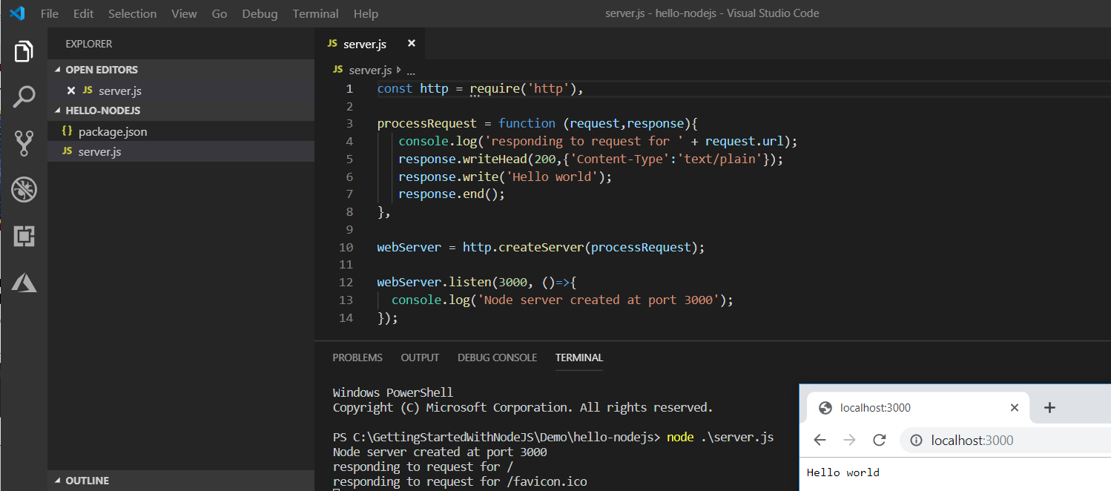
Hello Node.js

Slide 11
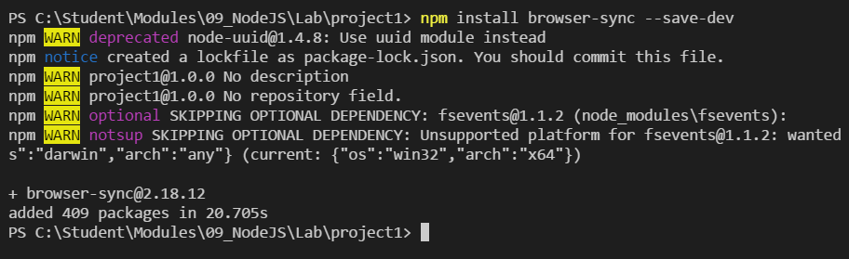

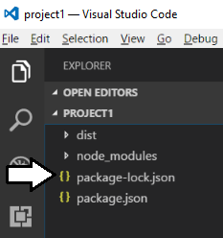
Installing Packages

Slide 12
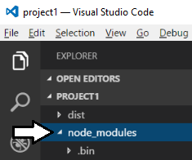
node_modules folder
Package files copied into node_modules folder
This folder often contain 100s of packages for a project
Contents of folder not saved into source control
Contents can be restored with npm install command

Slide 13
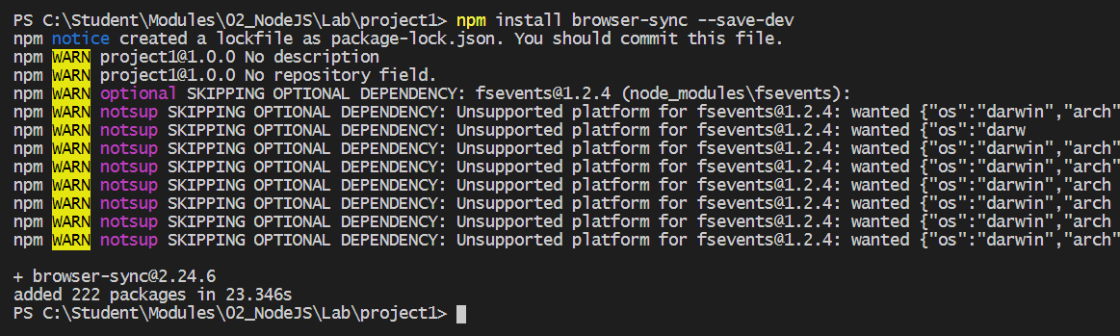
Configuring a Server-side Web Server
Node.js does not provide its own web server
Instead, you must install a npm package to provide web server
There are many different packages to choose from
Example packages which provide a web server for testing
http-server
express
Browser-sync (this is the one we will be using)

Slide 14
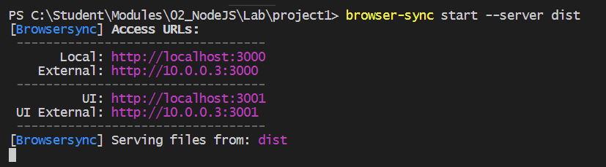
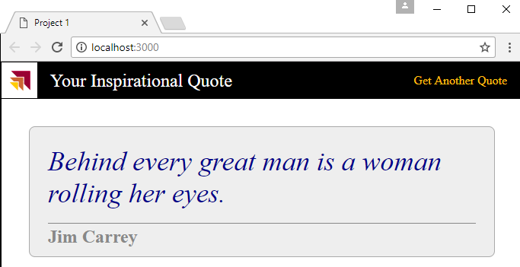
Using browser-sync to Serve Content
browser-sync start command used to start web server
--server parameters references root folder with index.html

Slide 15
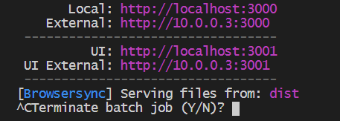
Stopping the Web Server Session
Type CTRL + C into console to interrupt session

Slide 16
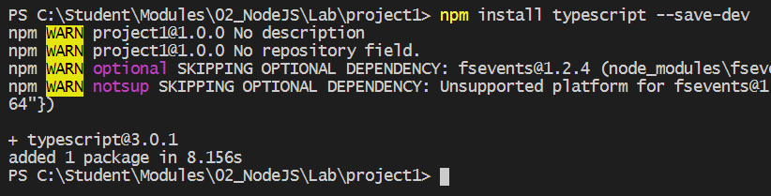
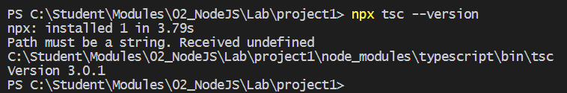
Installing the TypeScript Package
typescript package must be installed into project
Installed just like any other npm package
Take note of version number of typescript package
typescript version may vary from one project to another
Determine project-specific version using npx tsc --version

Slide 17
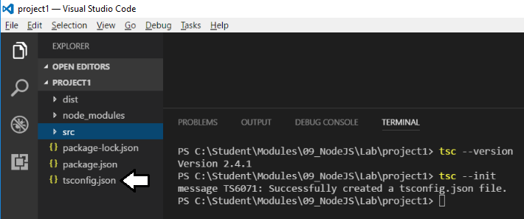
Generating tsconfig.json
Typescript compilation controlled using tsconfig.json file
Generated using tsc --init command

Slide 18
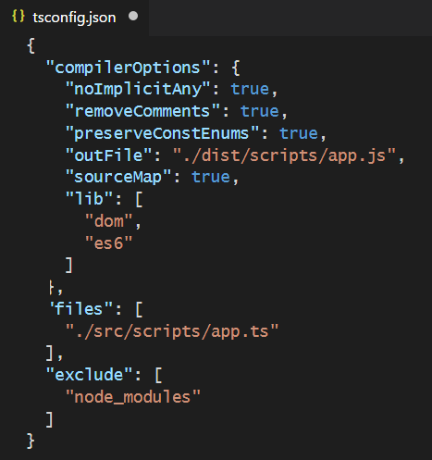
tsconfig.json
Example of a tsconfig.json file

Slide 19
Agenda
Introduction to Node.JS and NPM
Automating Build Tasks using Gulp
Bundling Project Assets using Webpack
Developing with React.js, TypeScript and Webpack
Developing with SharePoint Framework
Developing Custom Visuals for Power BI

Slide 20
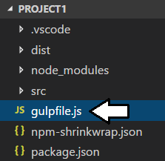
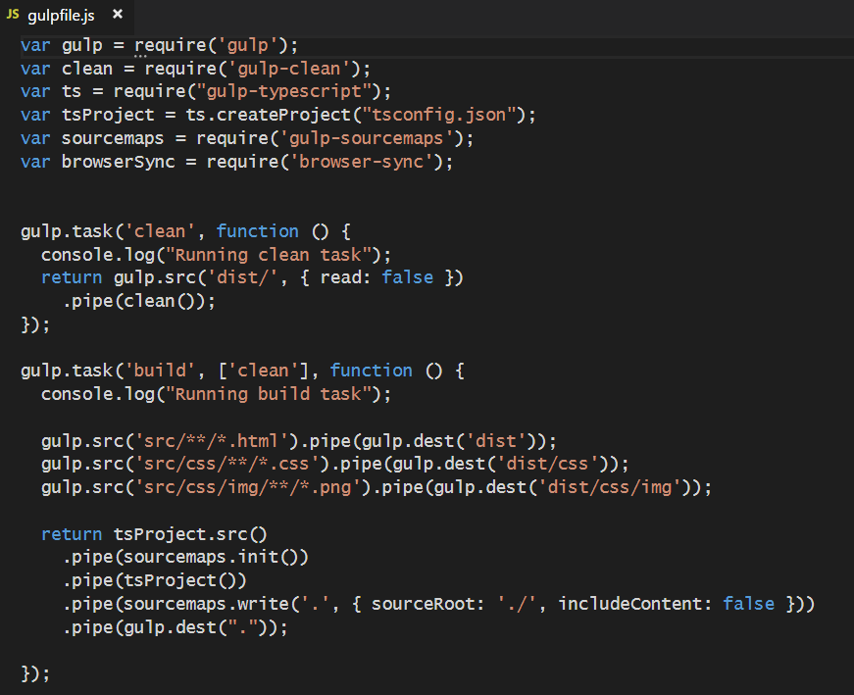
gulpfile.js
Gulp tasks are programmed inside gulpfile.js
Gulpfile.js must be added to root of project

Slide 21
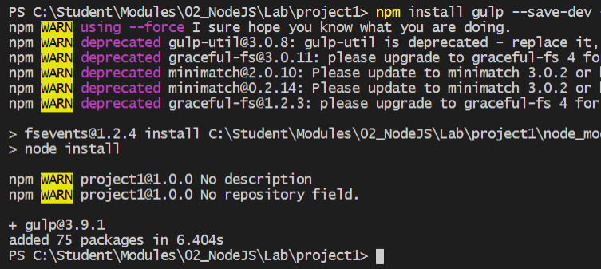
Gulp as a Task Runner
Gulp serves as a Task Runner
Compiles TypeScript files to JavaScript
Compiles SASS files to CSS
Bundles and minifies JavaScript and CSS files

Slide 22
Agenda
Introduction to Node.JS and NPM
Automating Build Tasks using Gulp
Bundling Project Assets using Webpack
Developing with React.js, TypeScript and Webpack
Developing with SharePoint Framework
Developing Custom Visuals for Power BI

Slide 23
WebPack
WebPack serves as a bundling utility
Bundles many js/ts files into a single file
Can handle dynamic module loading
Provides a dev server for testing and debugging
When using Webpack 4
Install packages for webpack and webpack-cli
npm install webpack webpack-cli --save-dev

Slide 24
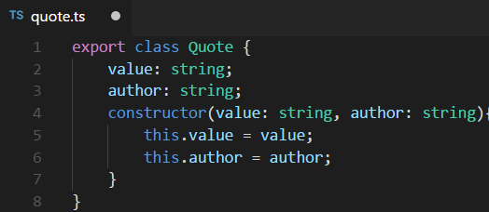
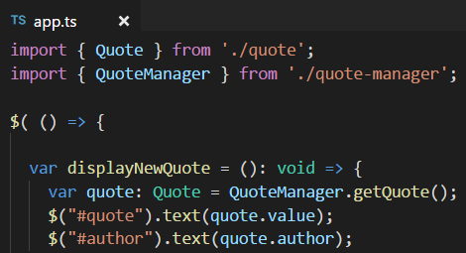
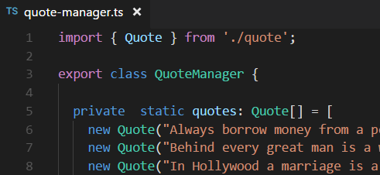
Dynamic Module Loading
Webpack controls dynamic module loading
Your project just references app.ts
Compiler dynamically determines other files to include

Slide 25
Webpack Loaders
Loaders do two things
Identify which file or files should be transformed
Transform files and ad them to dependency graph
Example loaders
awesome-typescript-loader
style-loader
css-loader
url-loader

Slide 26
Webpack Plugins
Webpack supports plugins in addition to loaders
commonly used to perform actions and custom functionality
Plugins act upon compilations or chunks of your bundled modules
Examples Plugins
clean-webpack-plugin
copy-webpack-plugin
html-webpack-plugin

Slide 27
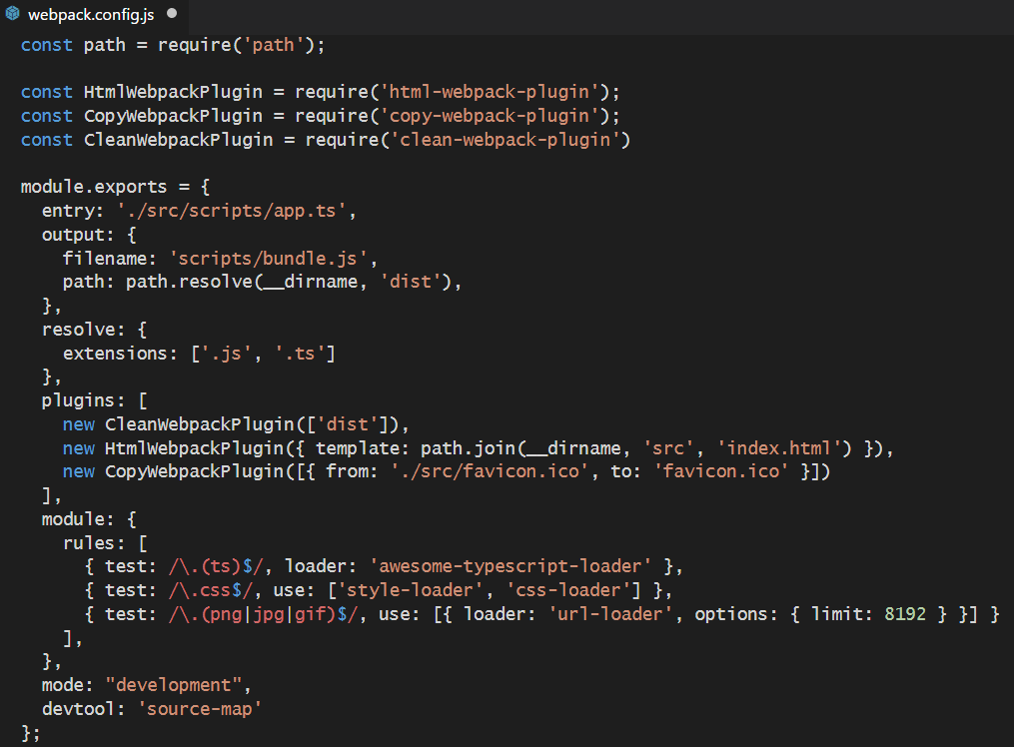
webpack.config.js
Build process controlled through webpack.config.js

Slide 28
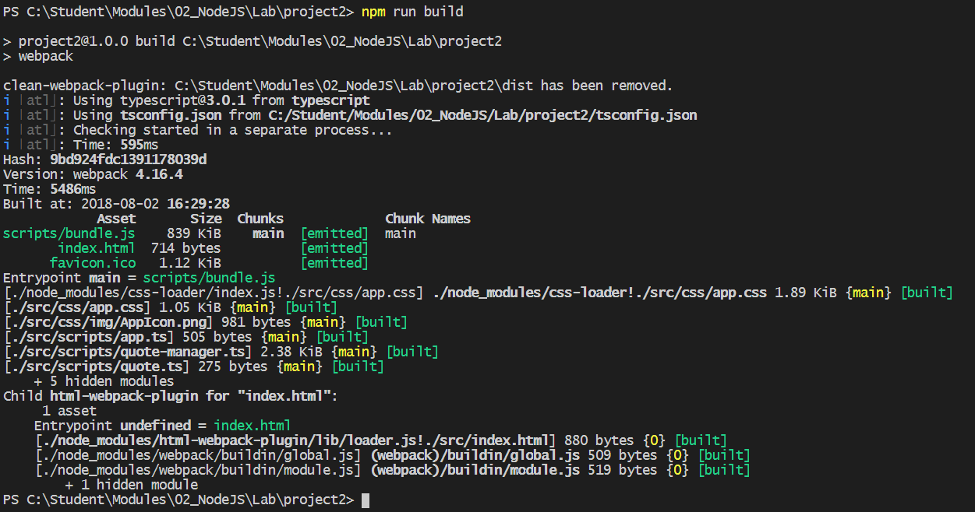
WebPack Builds
Running build process generates files for distribution

Slide 29
Webpack Dev Server
Webpack provides its own development server
Install the webpack dev server package
npm install webpack-dev-server --save-dev
Run your project using the webpack dev server CLI
webpack-dev-server --open

Slide 30
Agenda
Introduction to Node.JS and NPM
Automating Build Tasks using Gulp
Bundling Project Assets using Webpack
Developing with React.js, TypeScript and Webpack
Developing with SharePoint Framework
Developing Custom Visuals for Power BI

Slide 31
Introducing React
React is a library for building user interfaces
Not as all-encompassing as a framework like Angular
Focused on building HTML-based user experiences
Based on reusable component-based architecture
Components react to state changes by updating UI
React uses shadow DOM for efficient event handling
React was originally designed for Facebook
Also a good fit for building SPFx web parts

Slide 32
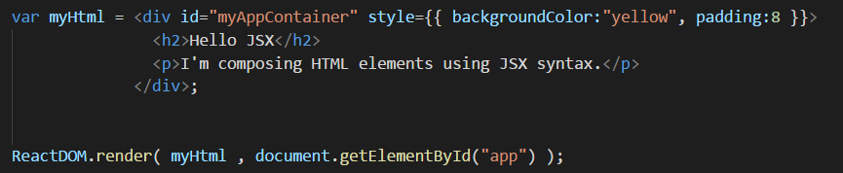
Understanding JSX (and TSX)
JSX provides better syntax for HTML composition
JSX allows extends JavaScript with XML-like syntax
JSX syntax must be transpiled into JavaScript code
JSX/TSX is separate from React library
JSX/TSX commonly used in React development
Babel compiler used to transpile JSX to JavaScript
TypeScript compiler used to transpile TSX to JavaScript

Slide 33
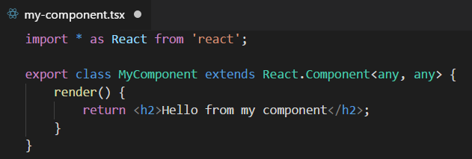
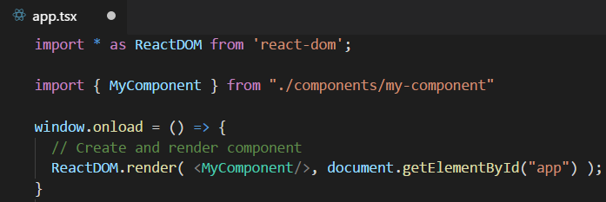
Defining React Components using TypeScript
Component is class extending React.Component
Component usually defined in its own tsx file
Component class must define render method
Component can be instantiated with JSX/TSX syntax

Slide 34
Component Properties and State
Component can contain properties and state
Properties are initialized by external components
Properties are read-only to hosting component
State is set internally by hosting component
Changing state triggers UI refresh by calling render
UI experience created by reacting to changes in state

Slide 35
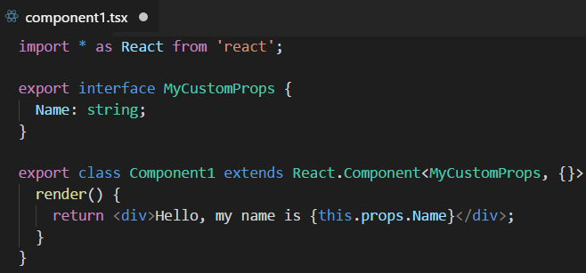
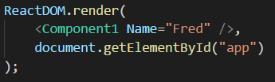
React Component Properties
Defining component with a property
Instantiating component with a property

Slide 36
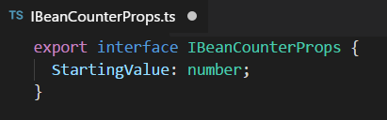
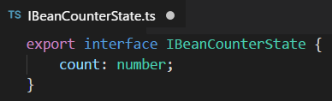
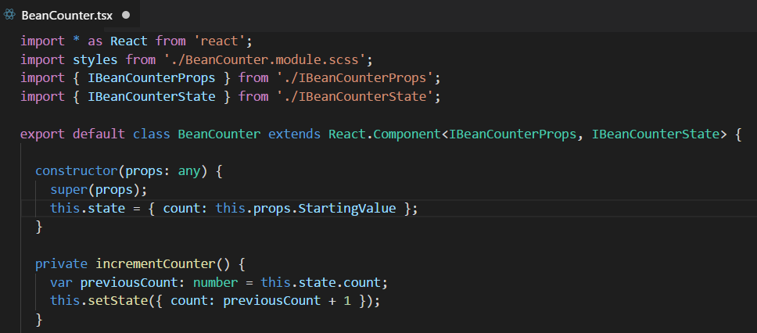
Stateful Component

Slide 37
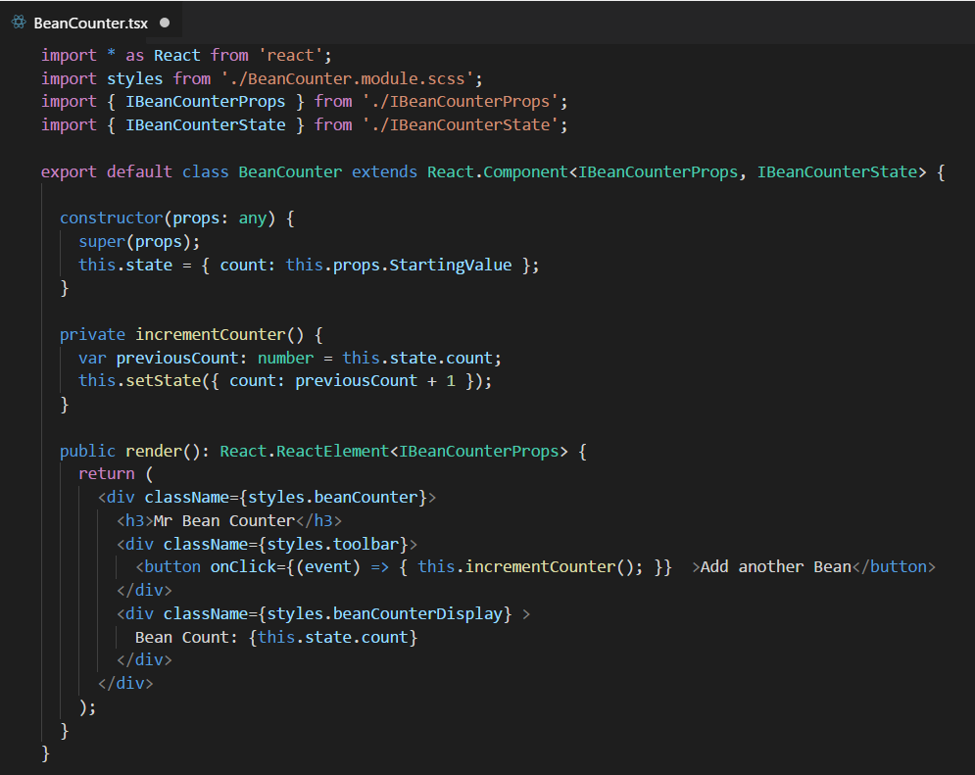
Stateful Component Rendering

Slide 38
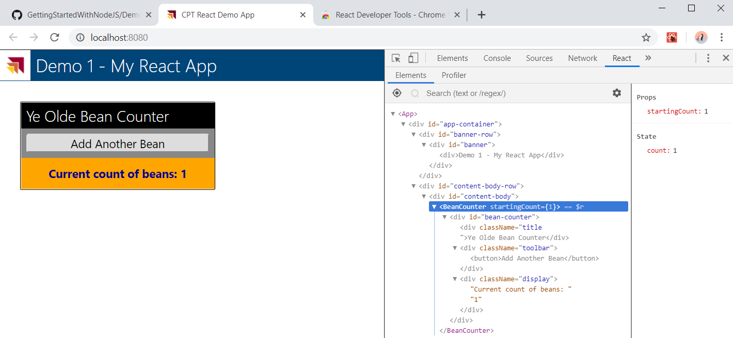
Chrome Developers Tools for React

Slide 39
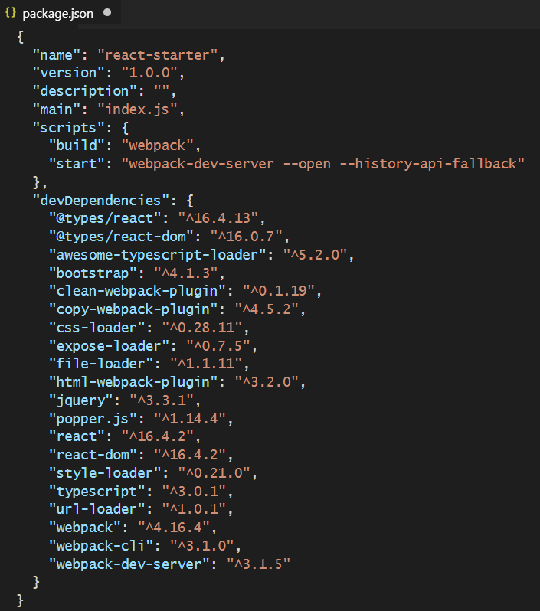
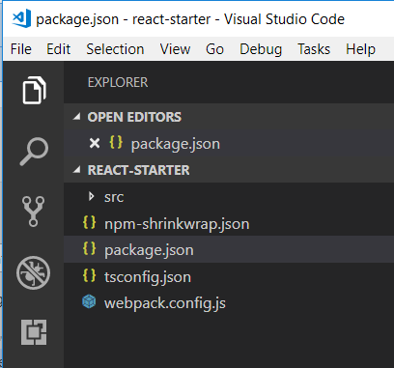
Starter Project - package.json

Slide 40
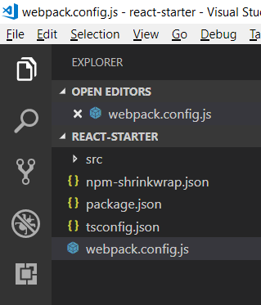
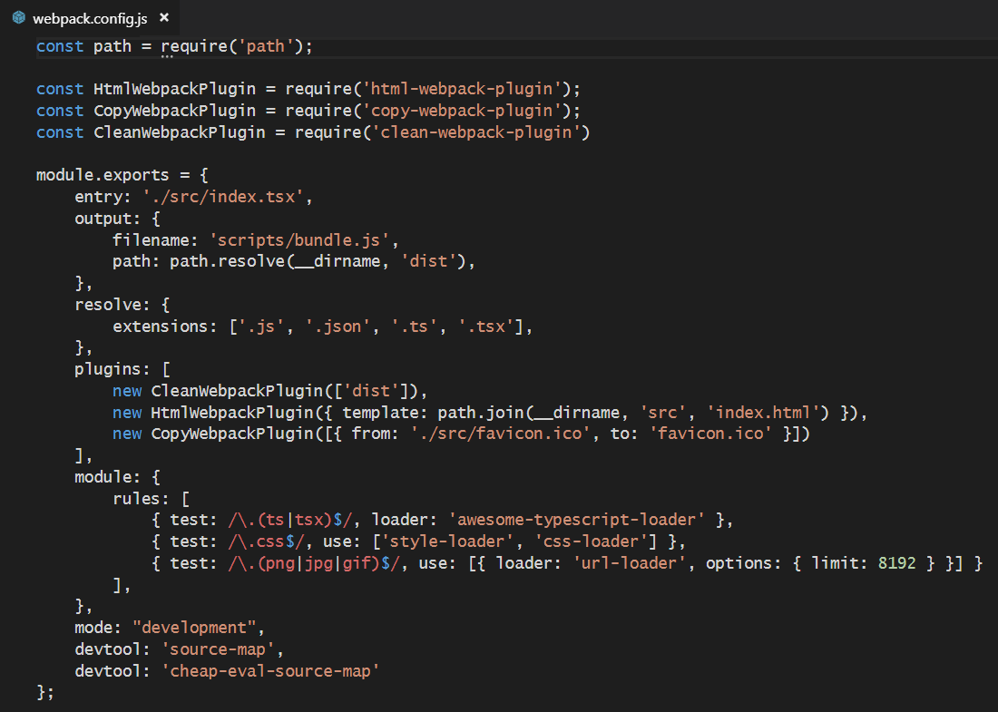
Starter Project - webpack.config.js

Slide 41
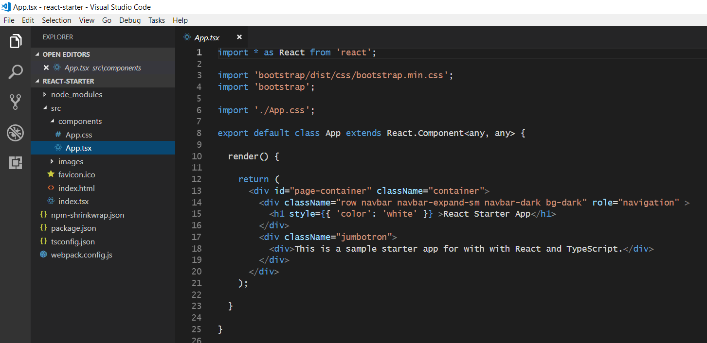
The Top-level App Component

Slide 42
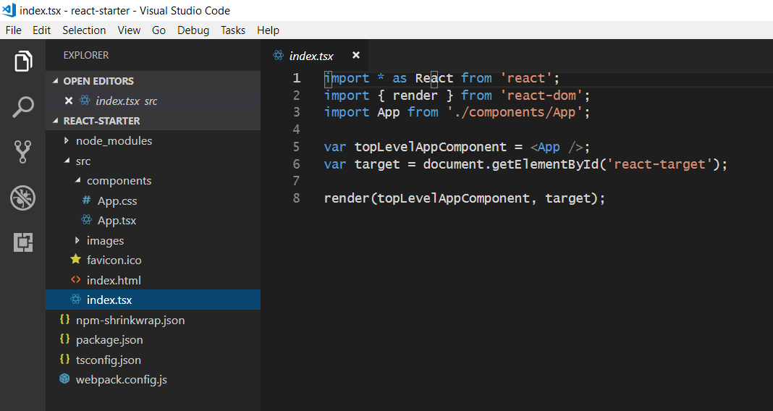
Bootstrapping the App Component

Slide 43
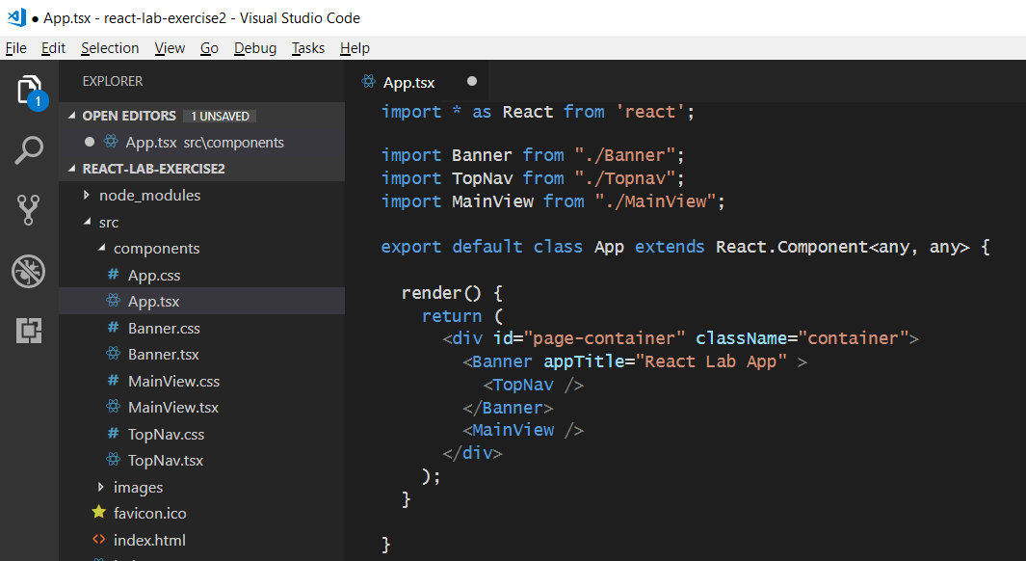
React Component Hierarchies
App
Banner
Topnav
MainView

Slide 44
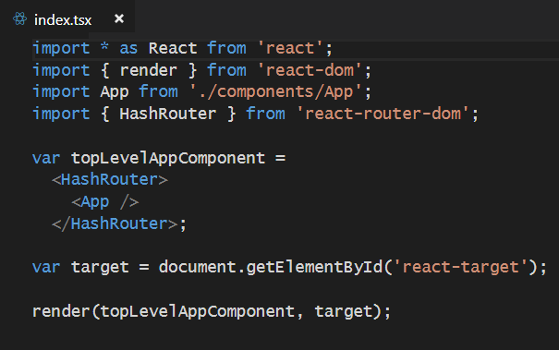
React Router
Used to create route map in single page application (SPA)
Installed as a pair of npm packages
npm install react-router @types/react-router --save-dev
npm install react-router-dom @types/react-router-dom --save-dev
Router must be added in as top-level component above App

Slide 45

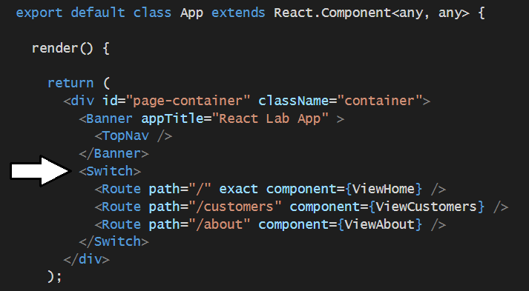
Using React Router
Import Route and Switch components
Create route map in HTML output

Slide 46
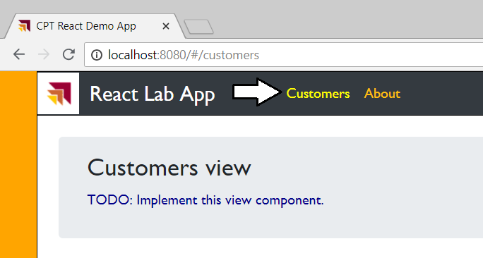

Creating Route Links

Slide 47
Component Lifecycle
componentWillUpdate
executed before component is rendered
componentDidUpdate
executed after component is rendered
componentWillMount
executed before node is added to the DOM
componentDidMount
executed after node is added to the DOM
componentWillUnmount
executed before node is removed from the DOM
shouldComponentUpdate(newProps, newState)
executed before component is updated

Slide 48


Calling a Web Service using the Fetch API

Slide 49
Agenda
Introduction to Node.JS and NPM
Automating Build Tasks using Gulp
Bundling Project Assets using Webpack
Developing with React.js, TypeScript and Webpack
Developing with SharePoint Framework
Developing Custom Visuals for Power BI

Slide 50
SharePoint Framework Component Types
SPFx allows you to create several styles of webparts
Standard Webparts
React Webparts
SPFx also provides several other Application Extensions
Application Customizer
Field Customizers
Command Sets
Modern SharePoint Page
Application Extension 1
Client-side Web Part 1
Client-side Web Part 2
Application Extension 2

Slide 51
Installing Packages for SPFx Development
Install Gulp (version 3)
Install Yeoman
Install Yeoman Template for SPFx
npm install -g gulp
npm install -g yo
npm install -g @microsoft/generator-sharepoint

Slide 52

Using the SPFx Yeoman Template
SPFx projects created with Yeoman template
Template provides wizard-like experience when creating new project
yo @microsoft/sharepoint

Slide 53

SharePoint Framework Project Structure
Project created as Node.js project

Slide 54

SharePoint Framework Adds Gulp Tasks
Run gulp --tasks to see SPFx gulp tasks added to project

Slide 55

Package.json
SPFx API Version Number

Slide 56
Agenda
Introduction to Node.JS and NPM
Automating Build Tasks using Gulp
Bundling Project Assets using Webpack
Developing with React.js, TypeScript and Webpack
Developing with SharePoint Framework
Developing Custom Visuals for Power BI

Slide 57

Getting Started with PBIVIZ
PBIVIZ.EXE is a command-line utility
You execute PBIVIZ commands from the NODE.JS command line

Slide 58

Installing the SSL Certificate
Installing certificate enables SSL through https://localhost
Installing certificate is a one time operation – not once per project
SSL certificate installed using pbiviz --install-cert command
Running --install-cert command starts Certificate Import Wizard

Slide 59


Creating a New Custom Visual Project
Creating a new project
pbiviz new <ProjectName>
Open the Project with Visual Studio Code
code .

Slide 60

The pbiviz.json File
Acts as top-level manifest file for custom visual project
External JS library files must be referenced in externalJS section

Slide 61
Summary
Introduction to Node.JS and NPM
Automating Build Tasks using Gulp
Bundling Project Assets using Webpack
Developing with React.js, TypeScript and Webpack
Developing with SharePoint Framework
Developing Custom Visuals for Power BI

