Slide 2
Hitchhikers Guide to the Power BI Service API
Ted Pattison
Power BI MVP

Slide 3
Agenda
Power BI Service API Overview
Authentication with Azure Active Directory
Developing with the Power BI SDK
Creating and Managing Workspaces
Working with Streaming Datasets

Slide 4
What Is the Power BI Service API?
What is the Power BI Service API?
API built on OAuth2, OpenID Connect, REST and ODATA
API secured by Azure Active Directory (AAD)
API to program with workspaces, datasets, reports & dashboards
API also often called “Power BI REST API”
What can you do with the Power BI Service API?
Publish PBIX project files
Update connection details and datasource credentials
Create workspaces and clone content across workspaces
Embed Power BI reports and dashboards tiles in web pages
Create streaming datasets in order to build real-time dashboards

Slide 5
Getting Started
What you need to get started?
Visual Studio 2017 or Visual Studio 2015
Organizational account in an Azure AD tenancy
License for Power BI Pro
Access to Azure portal to create Azure AD applications
Azure subscription not required!
Azure portal used to create Azure AD application
Azure subscription helpful to create Azure resources

Slide 6

Demo Time
Hello World with
the Power BI Service API

Slide 7
Agenda
Power BI Service API Overview
Authentication with Azure Active Directory
Developing with the Power BI SDK
Creating and Managing Workspaces
Working with Streaming Datasets

Slide 8
Authenticating with Azure AD
User must be authenticated against Azure AD
User authentication used to obtain access token
Can be accomplished with the Azure AD Authentication Library
Access token pass to Power BI Service API in call REST calls
Azure Active Directory
Custom App
Access Token
Access Token
Power BI Service

Slide 9
OAuth2 and OpenID Connect
Power BI Service requires OAuth2-style authentication
Your application must implement an authentication flow
Authentication flow used to acquire an access token
Access token required whenever calling Power BI Service API
Resource service 1
User agent
End user working in browser
Client (Relying Party)
Your Custom Application
Resource service 2
Authentication Flow
Resource service 3
Access tokens
OpenID Connect
Provider
Azure Active Directory (AAD)
Id tokens

Slide 10
Client Application Registration
Application must be registered with Azure AD
Authorization server tracks each client with unique Client ID
Client should be registered with one or more Reply URLs
Reply URL should be fixed endpoint on Internet
Reply URL used to transmit security tokens to clients
Client registration tracks permissions and other attributes

Slide 11
Authentication Flows
Authorization Code Grant Flow (confidential client)
Client first obtains authorization code then access token
Server-side application code never sees user’s password
Implicit Grant Flow (public client)
Used in SPAs built with JavaScript and AngularJS
Application obtains access token w/o acquiring authorization code
User Credentials Flow (public client)
Used in Native clients to obtain access code
Requires passing user name and password
Client Credentials Grant Flow (confidential client)
Authentication based on SSL certificate with public-private key pair
Used to obtain access token when using app-only permissions

Slide 12
Azure Active Directory (AAD)
AAD plays role of an OpenID Connect Provider
Creates access tokens based on OAuth 2.0
Creates id tokens based on OpenID Connect 1.0
AAD provides authentication & authorization for…
Office 365, Dynamics 365 and SharePoint Online
Power BI Service API and Microsoft Graph API
Custom Web Applications and Web Services

Slide 13
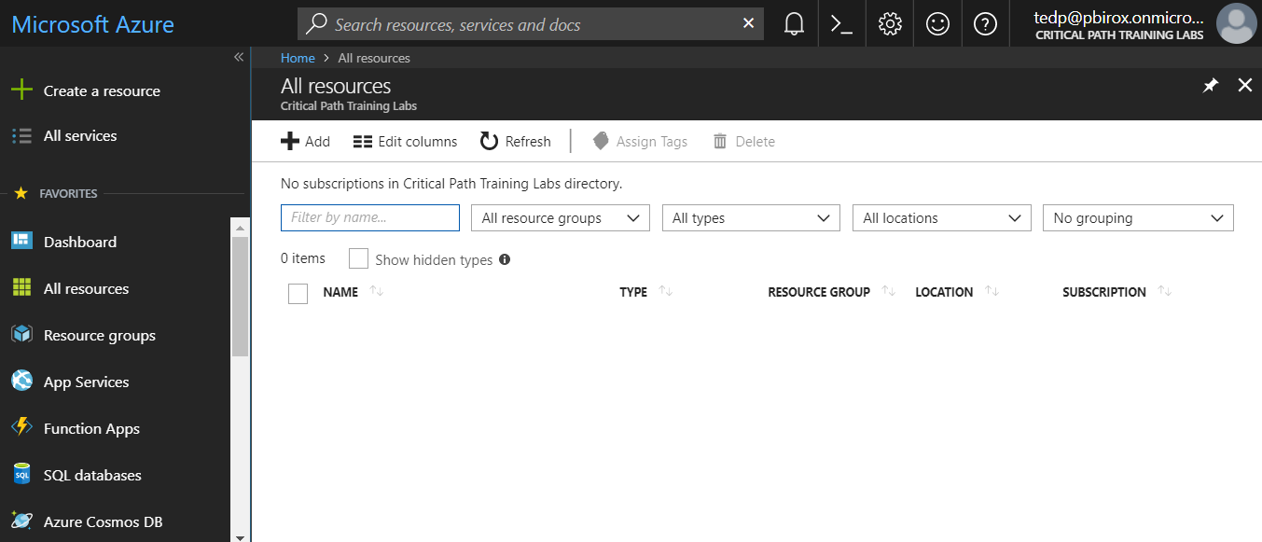
The Azure Portal
Azure portal allows to create application
Azure Portal accessible at https://portal.azure.com
Azure subscription required to create resources (e.g. Web Apps, VMs)
No Azure subscription required to manage users, groups and applications

Slide 14
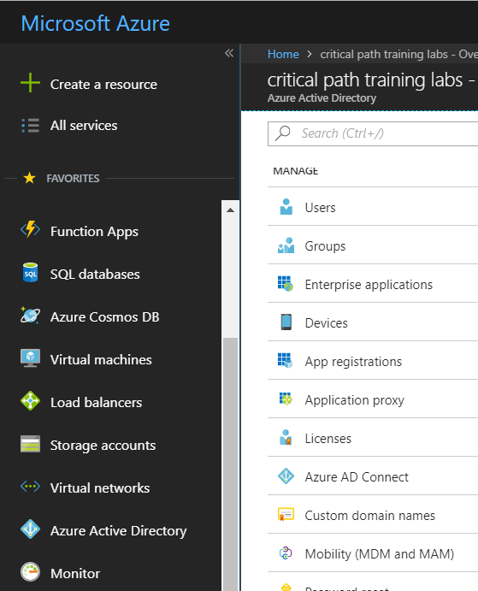
Azure Active Directory
Azure portal access to Access Azure Active Directory
Provides ability to configure users, groups and application

Slide 15
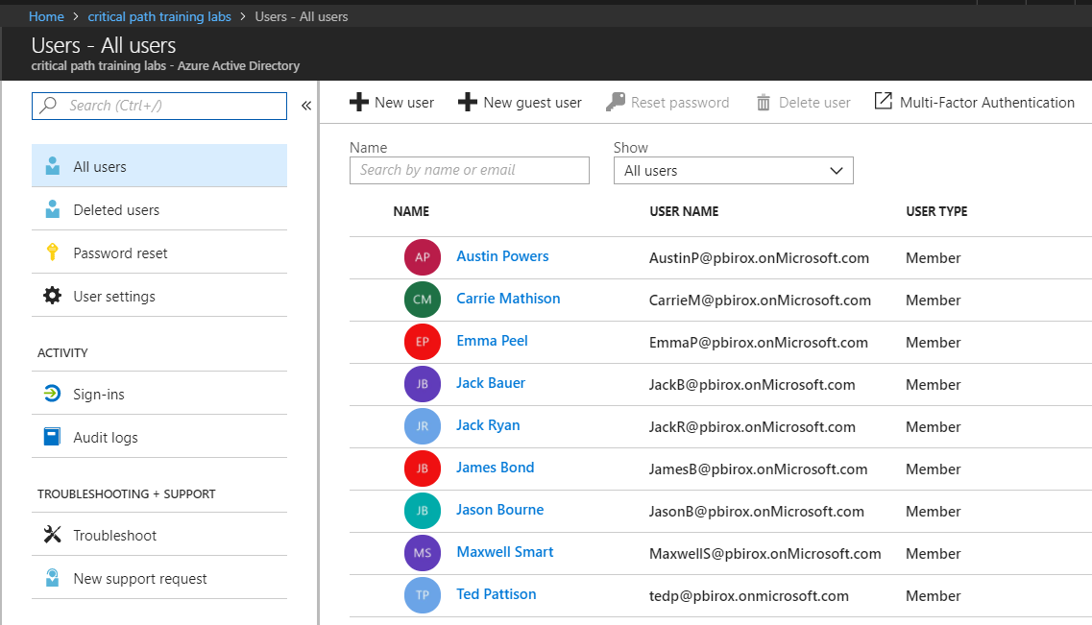
Managing Users and Groups
You can manage users and assign licenses
You can create groups and populate members

Slide 16
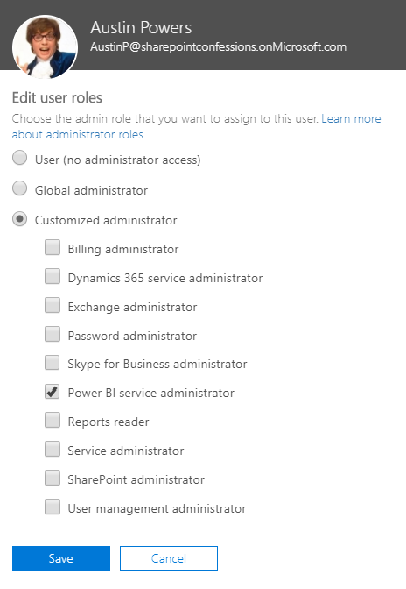
Power BI Administrator
Azure AD provides role of Power BI Service administrator
Provides user with tenant-level administrative permissions

Slide 17
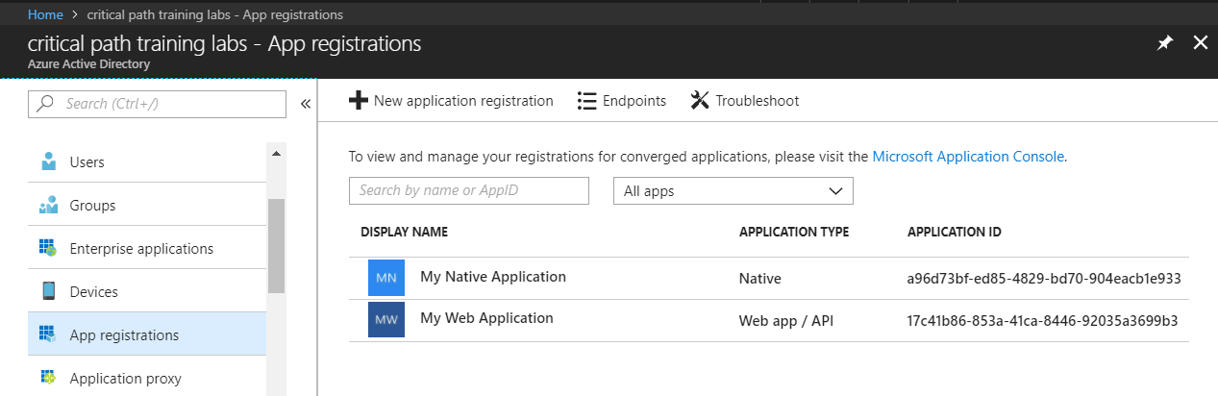
Azure AD Applications
Creating applications required for AAU authentication
Applications are as Native application or Web Applications
Application identified using GUID known as application ID
Application ID often referred to as client ID or app ID

Slide 18
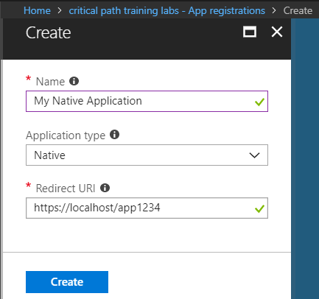
Creating a Native Application
Power BI supports Native applications
Can be used for desktop applications and Console applications
Used for third party embedding (known as App Owns Data model)
Application type should be configured as Native
Requires Redirect URI with unique string - not an actual URL

Slide 19
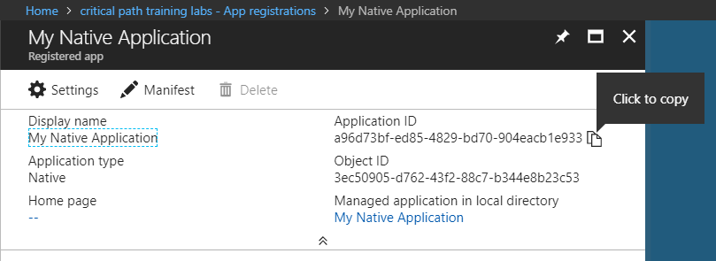
Copying the Application ID
Each new application created with Application ID
You cannot supply your own GUID for application ID
Azure AD will always create this GUID
You can copy the application IS from the azure portal

Slide 20
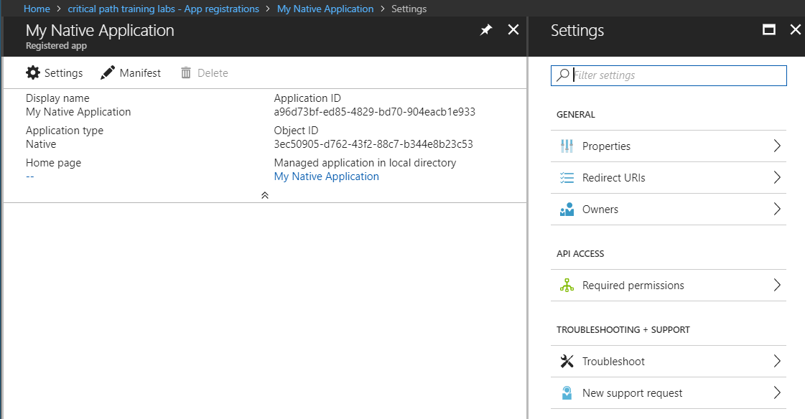
Native Application Settings
Properties
Redirect URLs
Owners
Required Permissions

Slide 21
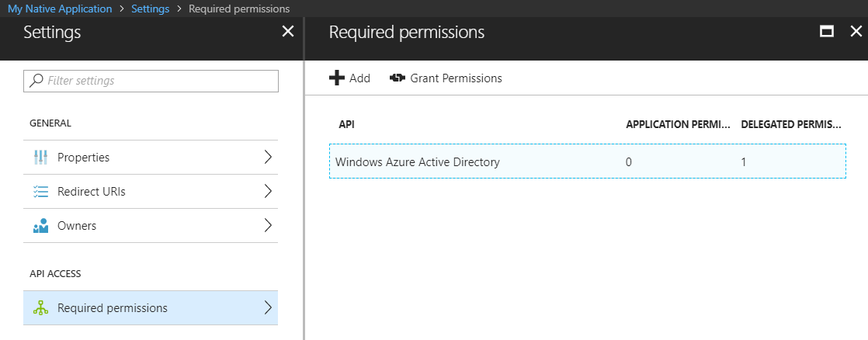
Configuring Required Permissions
Application configured with permissions
Default permissions allows user authentication – but that's it
To use APIs, you must assign permissions to the application

Slide 22
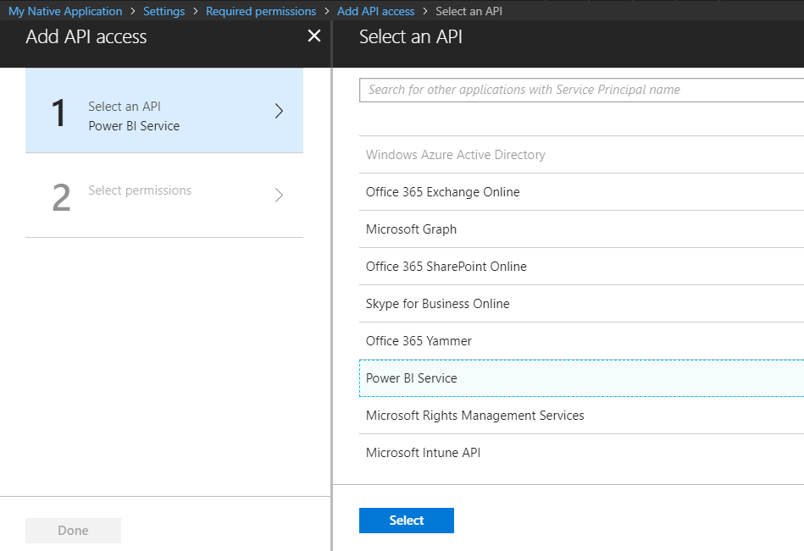
Choosing APIs
There are lots of APIs to choose from
Office 365 Exchange Online
Microsoft Graph
Office 365 SharePoint Online
Power BI Service

Slide 23
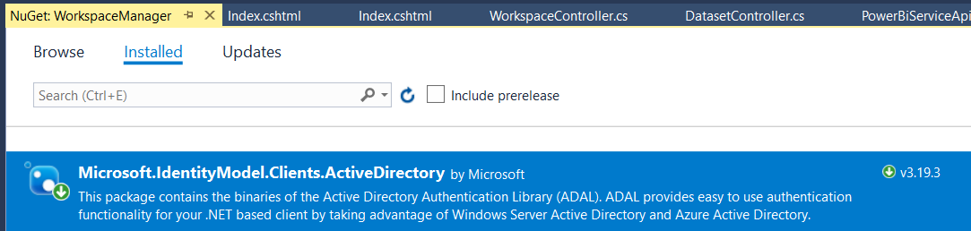
ADAL for .NET
Active Directory Authentication Library for .NET
Used in Native Clients and in Web Clients
Handles authentication flow behind the scenes
Provides caching for access tokens and refresh tokens
ADAL .NET installs as a NuGet Package
Package name is Microsoft.IdentityModel.Clients.ActiveDirectory

Slide 24
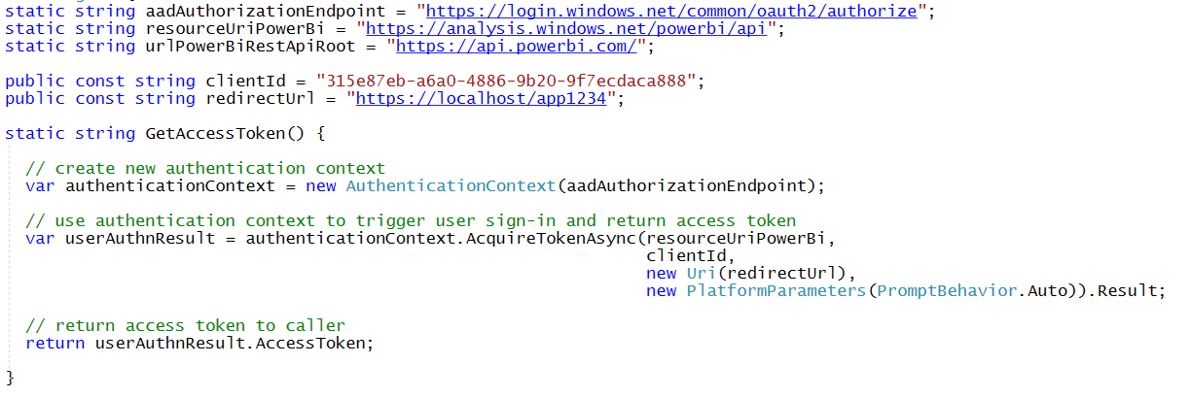
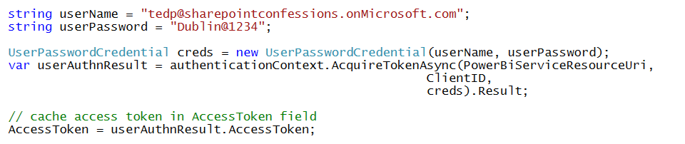
Access Token Acquisition (Native Client)
With interactive login
With Direct User Credentials (non-interactive)

Slide 25

Demo Time
Registering a Native Application with Azure AD

Slide 26
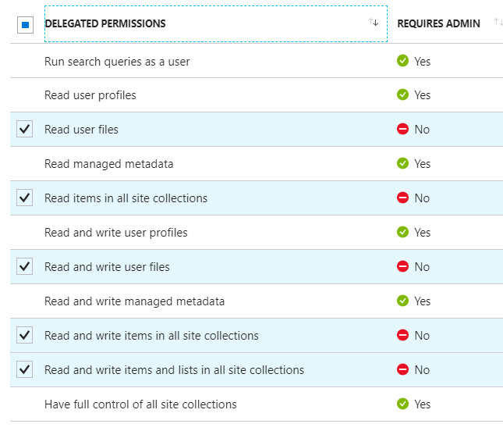
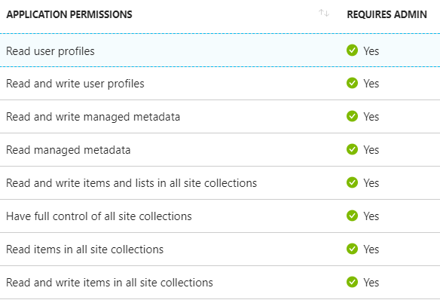
Delegated Permissions vs Application Permissions
Permissions categorized into two basic types
Delegated permissions are (app + user) permissions
Application permissions are app-only permissions (far more powerful)
Not all application types and APIs support application permissions
Power BI Service API does not yet support application permissions
Example permissions for Office 365 SharePoint Online
Note that some delegated permissions requires administrative permissions

Slide 27
Power BI Service API Permissions
View all datapools
Read and write all datapools
Read and Write all Reports
View users Groups
View all Groups
View all Reports (preview)
Create content (preview)
View content properties (preview)
Read and Write all Datasets
View all Datasets
View all Dashboards (preview)
Add data to a user's dataset (preview)
Read and Write all Dashboards
View all content in tenant (requires admin)
Read and write all workspaces
View all workspaces
Read and write all capacities
View all capacities

Slide 28
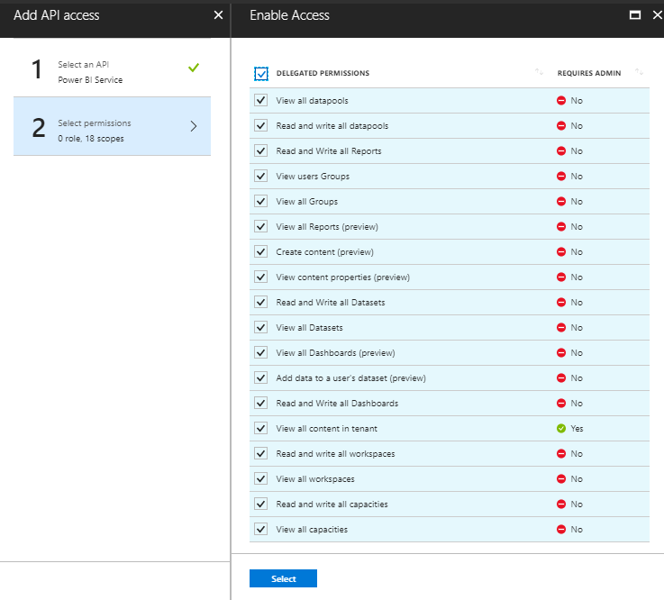
Power BI Service API Permissions
Do you really need permissions that Requires Admin
It makes it so that only Power BI administrators can use your app

Slide 29
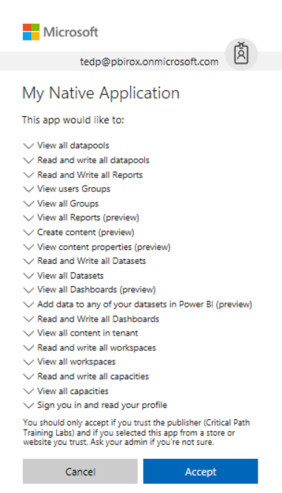
Interactive Consent for Delegated Permissions
Users must consent to delegated permissions
User prompted during first log in
User must click Accept
Only occurs once for each user

Slide 30
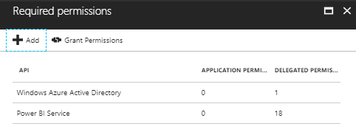
Granting Delegated Permissions
It can be helpful to Grant Permissions in Azure portal
Prevents the need for interactive granting of application by user
Might be required when authenticating in non-interactive fashion

Slide 31
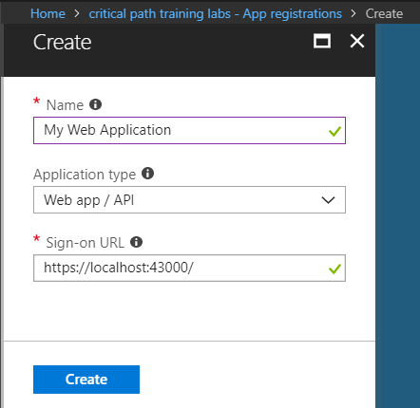
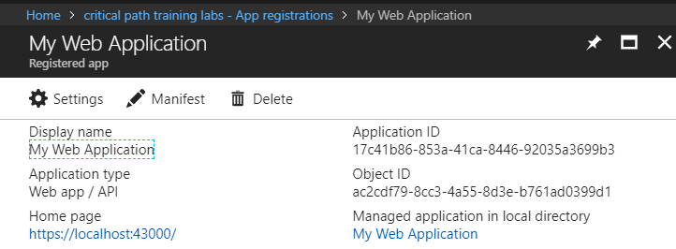
Creating Applications for Web Applications
Web applications more secure than native applications
Requires Redirect URI which improves security
Authentication can be used on client secret (application password)
Can use application permissions – Native applications cannot

Slide 32
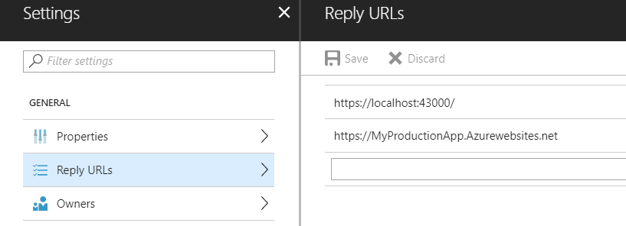
Reply URLs
Reply URLs required for web applications
Your application must be accessible through the reply URL
Provides extra security dimension not available to native apps
Application can be configured with multiple reply URLs for single
Application must pass Reply URL matching registered Reply URL

Slide 33
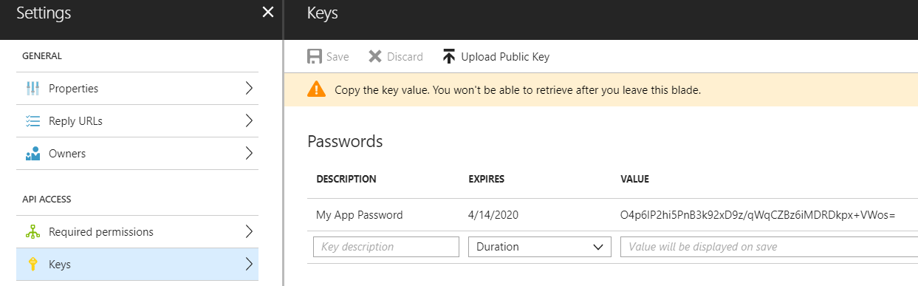
Creating Keys for Application Passwords
Web applications authenticate using keys
Key acts as application-level password
Application requires copy of key value

Slide 34
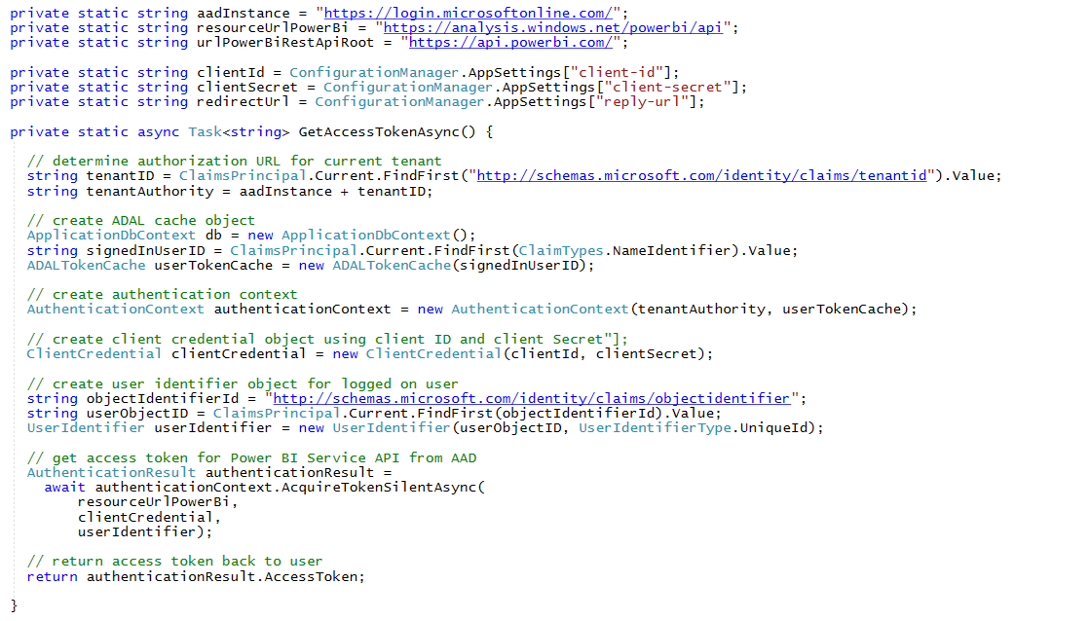
Access Token Acquisition (web app)

Slide 35

Demo Time
Registering a Web app / API application with Azure AD

Slide 36
Agenda
Power BI Service API Overview
Authentication with Azure Active Directory
Developing with the Power BI SDK
Creating and Managing Workspaces
Working with Streaming Datasets

Slide 37
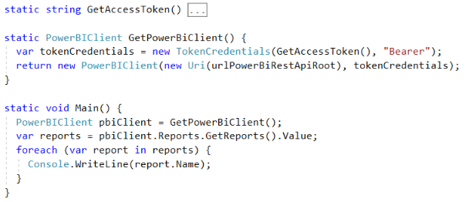
Initializing an Instance of PowerBIClient
PowerBIClient object serves as top-level object
Used to execute calls against Power BI Service
Initialized with function to retrieve AAD access token

Slide 38
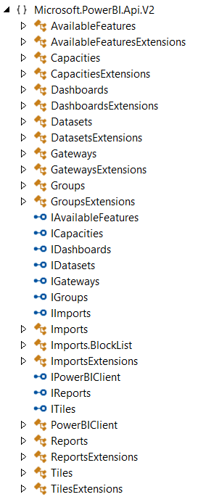
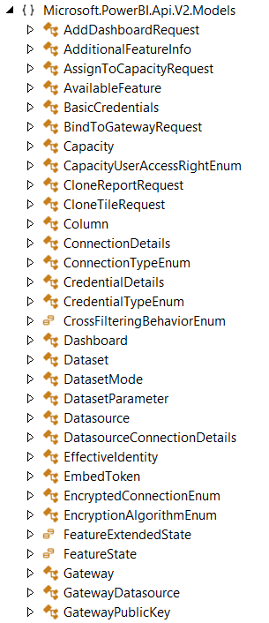
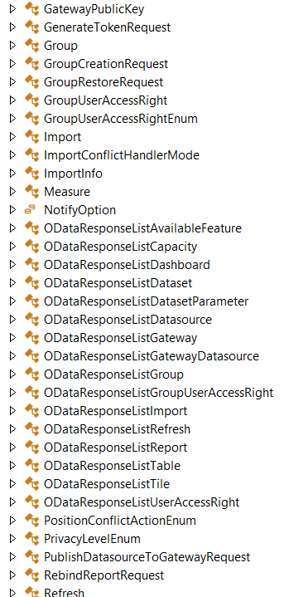
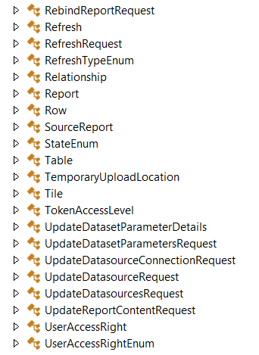
The Power BI Service API

Slide 39
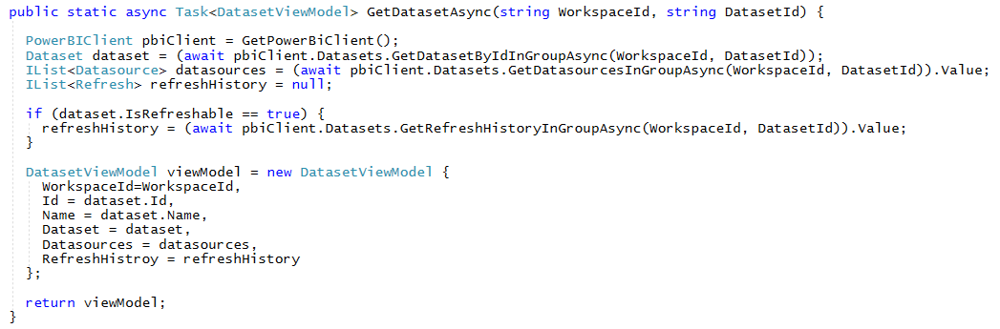

Implementing the GetDatasetsAsync Method

Slide 40
Agenda
Power BI Service API Overview
Authentication with Azure Active Directory
Developing with the Power BI SDK
Creating and Managing Workspaces
Working with Streaming Datasets

Slide 41
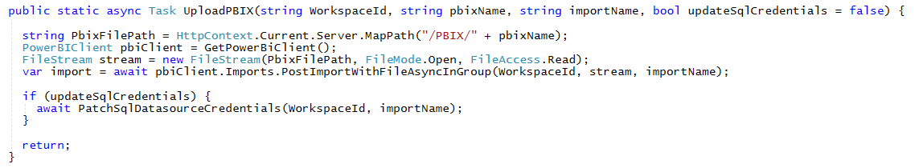
Importing a PBIX File

Slide 42
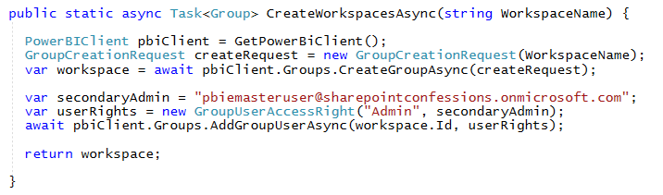
Creating Workspaces

Slide 43

Demo Time
Managing Power BI Content with the WorkspaceManager Application

Slide 44
Agenda
Power BI Service API Overview
Authentication with Azure Active Directory
Developing with the Power BI SDK
Creating and Managing Workspaces
Working with Streaming Datasets

Slide 45
Pull Datasets versus Real-time Datasets
Pull Datasets
Imported Datasets
DirectQuery Datasets
Live Connect Datasets
Real-time Datasets
Streaming Datasets
Push Datasets
Hybrid Datasets
Pull
Power BI
Service
Custom
Application
Power BI
Service API
Push
Power BI
Service

Slide 46
Streaming Datasets
Data stored in cloud-based cache – not persisted in DB
Restricted to single table - no rich data modeling
Not supported by standard Power BI report designer
Dashboard created using specialized streaming data tiles
No support for DAX, aggregation or filtering
Streaming Data Tiles

Slide 47
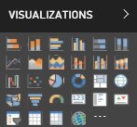
Push Datasets
Data stored in Azure SQL DB – not in cache
Supports multiple tables and table relationships
Supported by standard Power BI report designer
Supports DAX, measures, aggregation & filtering

Slide 48
Hybrid Datasets
Data stored in cloud-based cache AND in Azure SQL DB
Restricted to single table and no rich data modeling
Supported by streaming data tiles
Supported by Power BI report designer
Real-time Tiles

Slide 49
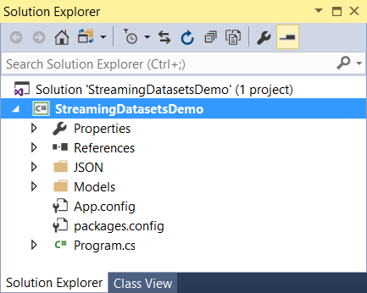
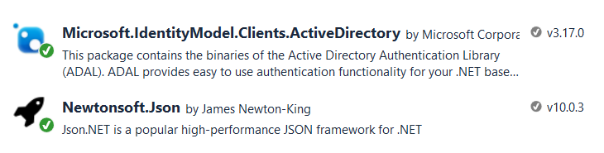
The StreamingDatasetsDemo Project
Console application project in Visual Studio 2017
Installed package for Azure AD Authentication library
Installed package to serialize .NET objects to JSON
Custom
Application
Power BI
Service API
Push
Power BI
Service

Slide 50
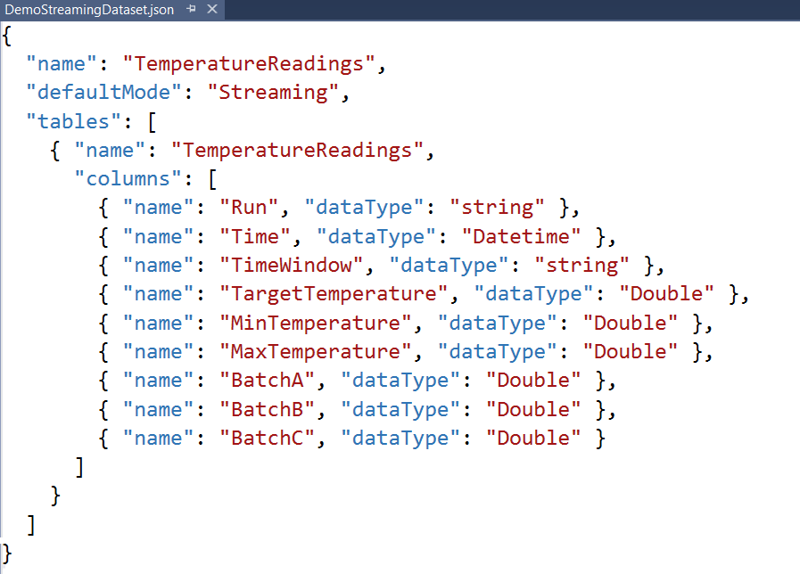
Creating a Streaming Dataset
Streaming dataset created using JSON schema definition
Streaming dataset limited to a single table
Columns defined using name and datatype
No support for any other column properties (e.g. formatting)

Slide 51
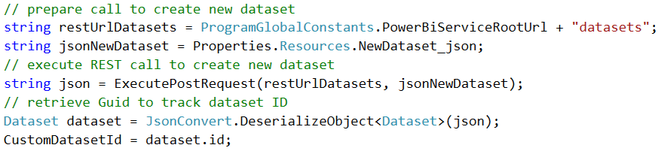
Creating a Custom Dataset
Dataset created by executing HTTP POST operation
One-time operation done as application begins running
1
2
3
Power BI Service
HTTP POST
My Streaming Dataset
Access Token
JSON
TemperatureReadings table

Slide 52
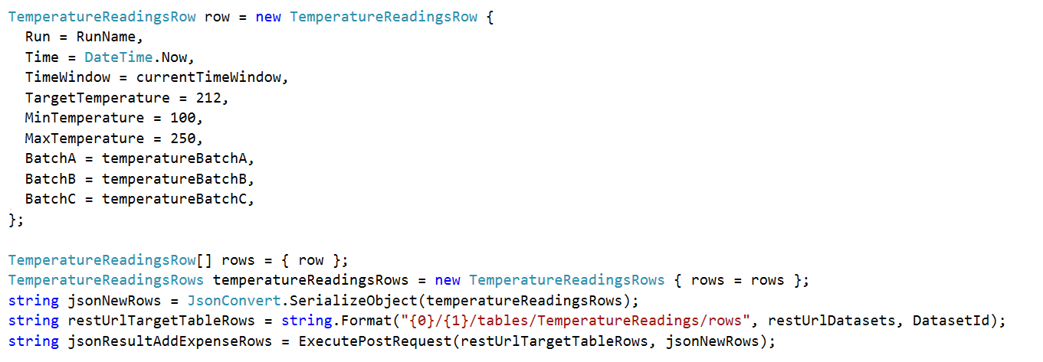
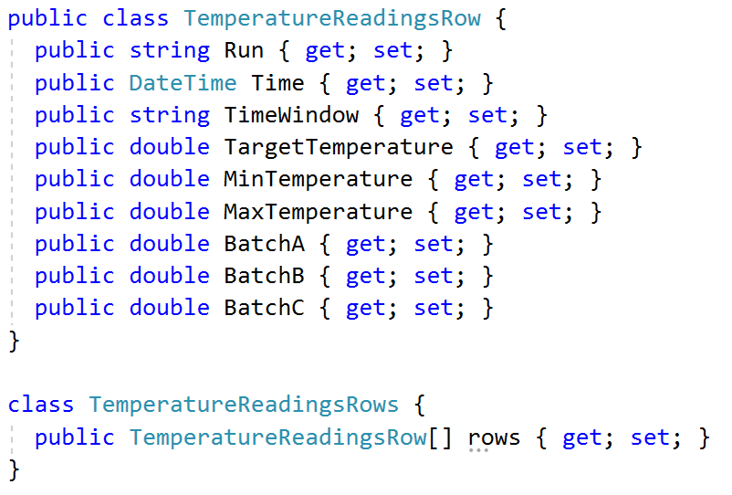
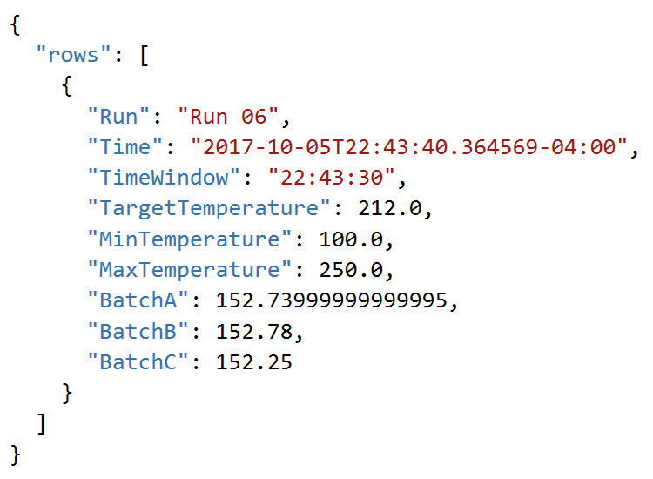
Adding Rows by Converting C# to JSON

Slide 53
Real-time Dataset Matrix
Feature | Streaming | Hybrid | Push
Updates in real-time | Yes | Yes | Yes
Smooth animations | Yes | Yes | No
Backed by Azure SQL DB | No | Yes | Yes
Report Designer Support | No | Yes | Yes
Allow Rich Data Modeling | No | No | Yes
Ingestion Rate | 5 request/sec 15KB/request |  | 1 request/second 16MB/request

Slide 54

Demo Time
Creating Real-time Datasets using the Power BI Service API

Slide 55
Summary
Power BI Service API Overview
Authentication with Azure Active Directory
Developing with the Power BI SDK
Creating and Managing Workspaces
Working with Streaming Datasets

Slide 56

Critical Path Training https://www.CriticalPathTrainig.com
PBI365: Power BI Certification Bootcamp – 3 Days
Audience is Business Users, Analysts and Data Professionals
Provides hands-on introduction to the Power BI platform
Focuses on build solutions using Power BI Desktop
Query design, data modeling and report and dashboard design
Deploying content using App Workspaces and Power BI Apps
Learn Power BI administration and Row Level Security (RLS)
PBD365: Power BI Developer Bootcamp – 4 Days
Audience is Professional Developers
Teaches developing custom visuals with TypeScript and D3
Teaches programming with the Power BI APIs
Teaches developing with Power BI Embedded
Teaches R programming and integrating R with Power BI

