Slide 1
Developing Applications with Power BI Embedded
Notes:
Introduction to Streaming Datasets - Creating a Streaming Dataset using PubNub - Creating a Real-time Dashboard - Integrating with Azure Streaming Analytics - Streaming Data using the Power BI REST API

Slide 2
Agenda
Power BI Embedded Overview
Working with PBIX Project Files
Provisioning Workspaces in Azure
Embedding Reports in a MVC Application
Configuring Datasets for DirectQuery Mode
Putting It All Together

Slide 3
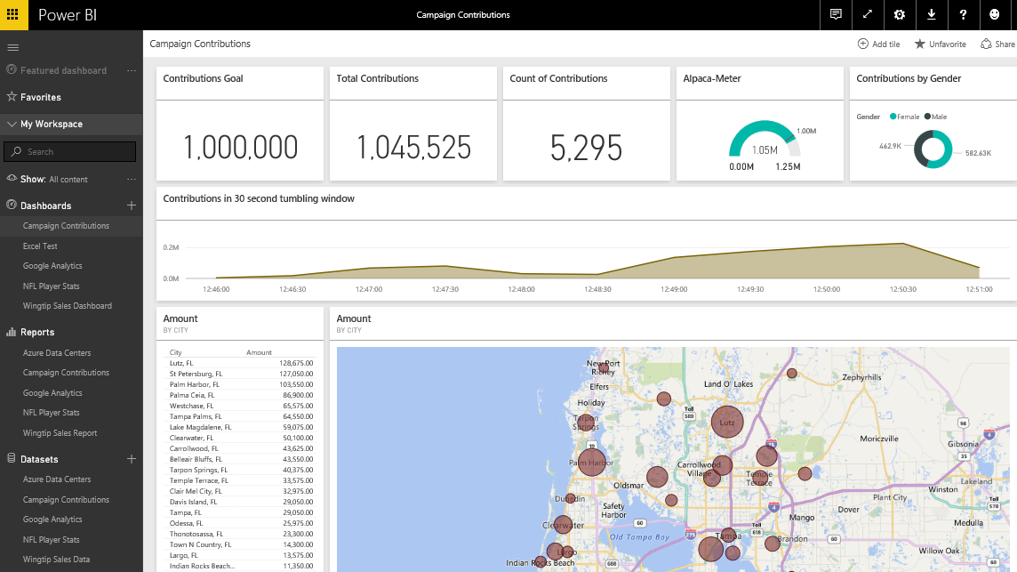
The Power BI Service at PowerBI.com
The Power BI service is accessible through browser
Provides cloud-based foundation for Power BI platform
Accessible through URL at https://app.powerbi.com
Users require Office 365 accounts and Power BI Licenses

Slide 4
What is Power BI Embedded?
Power BI Embedded is an Azure Service
PBI Embedded service can be provisioned on-demand
Service provisioned in terms of workspace collections
PBI Embedded service requires an Azure subscription
What is the core value of Power BI Embedded?
It eliminates need for Power BI license for each user
It eliminates need for Office 365 account for each user
It decouples user security from app security
It opens up PBI platform to commercial applications

Slide 5
PowerBI.com versus Power BI Embedded
PowerBI.com
-----------------------
Accessed via https://app.powerbi.com
Requires Office 365 accounts
Requires Power BI License
Custom development not required
Azure subscription not required
Power BI Embedded
-----------------------
Accessed via custom URL
No Office 365 accounts required
No Power BI user licenses required
Requires custom development
Requires Azure subscription

Slide 6
The Big Picture for Power BI Embedded
Create > Design > Test a PBIX project file on local PC
Done using Power BI Desktop
Note that Power BI Desktop only runs on Windows
Provision Azure resources for Power BI Embedded
Create a Power BI workspace collection
Create Power BI workspaces
Upload PBIX file to Power BI Embedded workspace
Use PowerShell, Power BI CLI or Azure REST API
Develop Web App with Embedded Power BI Reports
Most easily accomplished using ASP.NET MVC

Slide 7
Agenda
Power BI Embedded Overview
Working with PBIX Project Files
Provisioning Workspaces in Azure
Embedding Reports in a MVC Application
Configuring Datasets for DirectQuery Mode
Putting It All Together

Slide 8
Working with Power BI Desktop
Power BI Desktop used to design PBIX projects
Data Source and Query features for Data Discovery
Query features for ETL (extract-transform-load)
Data modeling features and DAX language
Report design features with a visual report designer
Tasks performed using Power BI Desktop
Data Discovery
ETL
Data Modeling
Design Reports

Slide 9
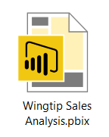
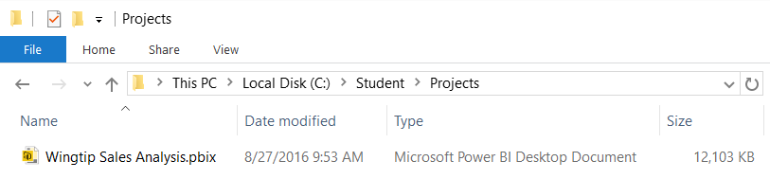
Projects and PBIX Files
Power BI Desktop projects saved using PBIX files
PBIX file contains data source definitions
PBIX file contains query definitions
PBIX file contains data imported from queries
PBIX file contains exactly one data model definition
PBIX file contains exactly one report
PBIX file never contains data source credentials

Slide 10
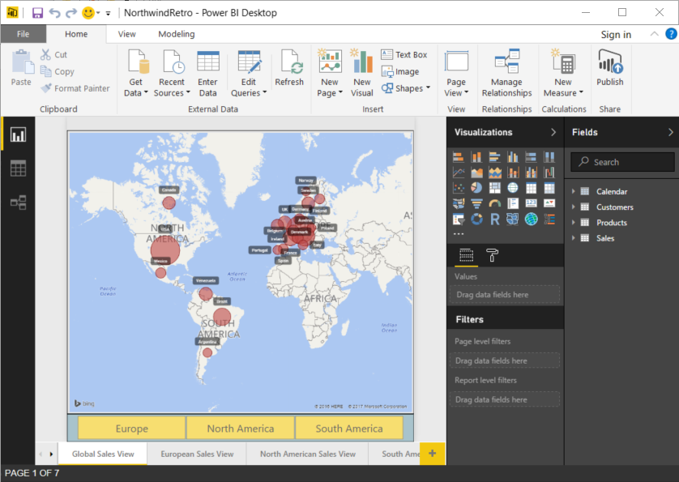
Demo: NorthwindRetro.pbix

Slide 11
Agenda
Power BI Embedded Overview
Working with PBIX Project Files
Provisioning Workspaces in Azure
Embedding Reports in a MVC Application
Configuring Datasets for DirectQuery Mode
Putting It All Together

Slide 12
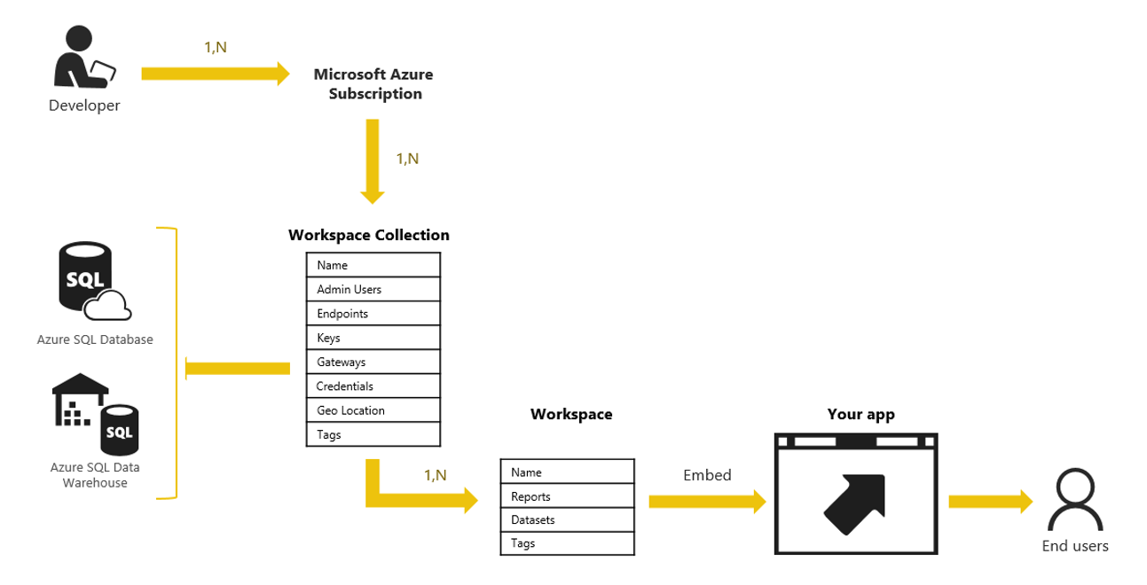
Power BI Embedded Service in Azure
Creating a Power BI workspace collection
Can be done by hand in Azure portal
Can be done with PowerShell and PowerBI-CLI utility
Can be done using C# and Azure ARM APIs
Workspace collection contains access keys

Slide 13
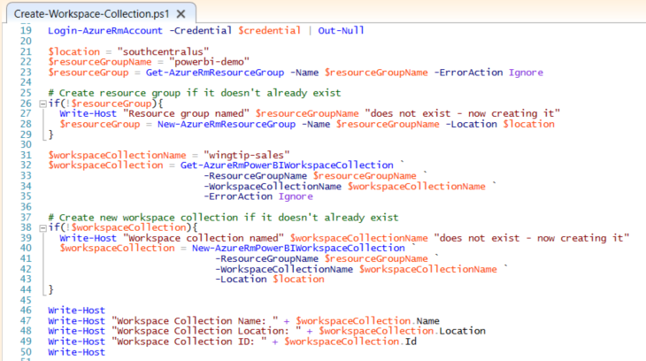
Create-Workspace-Collection.ps1

Slide 14
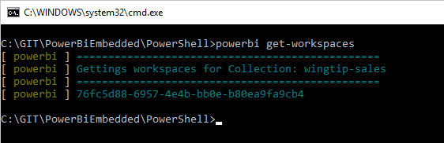
PowerBI-CLI
PowerBI-CLI is command-line utility for Power BI
Maintained at https://github.com/Microsoft/PowerBI-Cli
Installed using Node Package Manager
npm install powerbi-cli -g
Supported on Windows, Mac and Linux
Can be accessed using any command prompt
Can be automated using PowerShell script

Slide 15
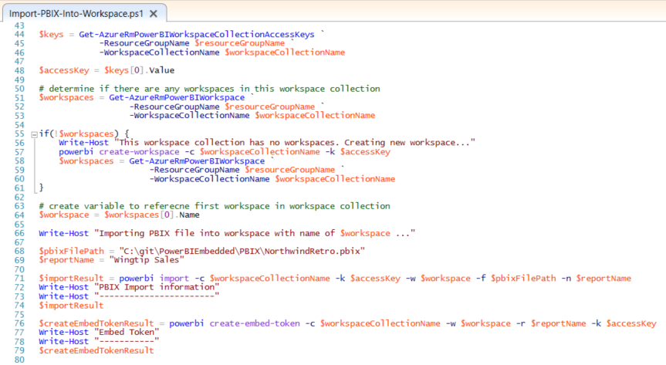
Import-PBIX-Into-Workspace.ps1

Slide 16
Agenda
Power BI Embedded Overview
Working with PBIX Project Files
Provisioning Workspaces in Azure
Embedding Reports in a MVC Application
Configuring Datasets for DirectQuery Mode
Putting It All Together

Slide 17
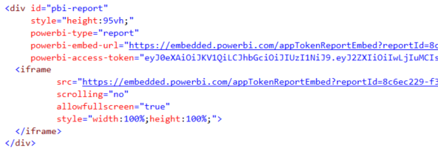
Embedding Internals
How are Power BI Reports Embedded?
It’s done using an iFrame
iFrame requires event to load embed token

Slide 18
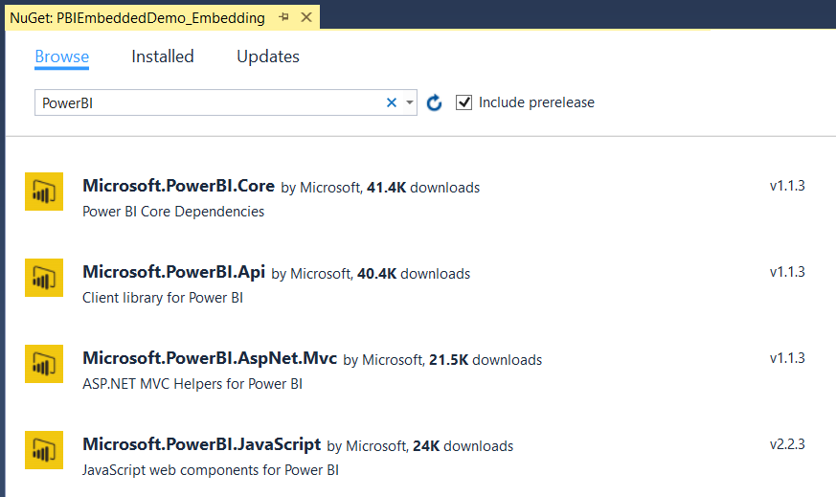
Creating an ASP.NET MVC Application
Add the following Nuget Packages

Slide 19
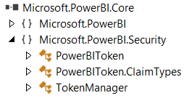

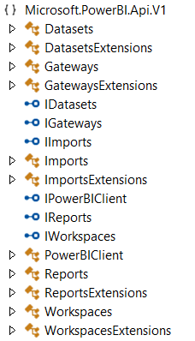
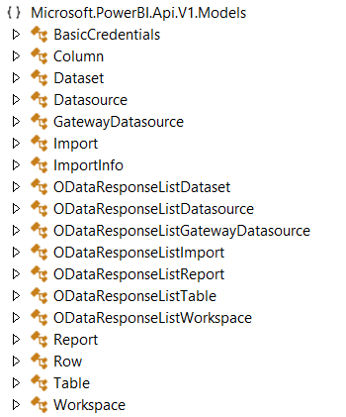
Power BI .NET APIs

Slide 20



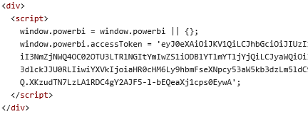

MVC Helper Classes

Slide 21
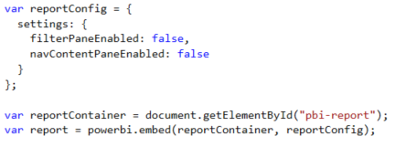
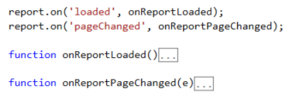
Power BI JavaScript API
Used to generate iFrame required for embedding
Call to powerbi.embed creates iFrame for embedding
API supports binding to report-level events

Slide 22
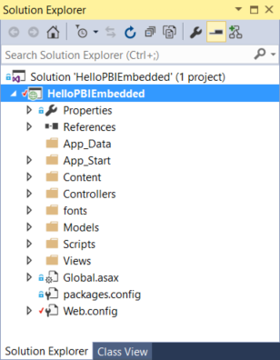
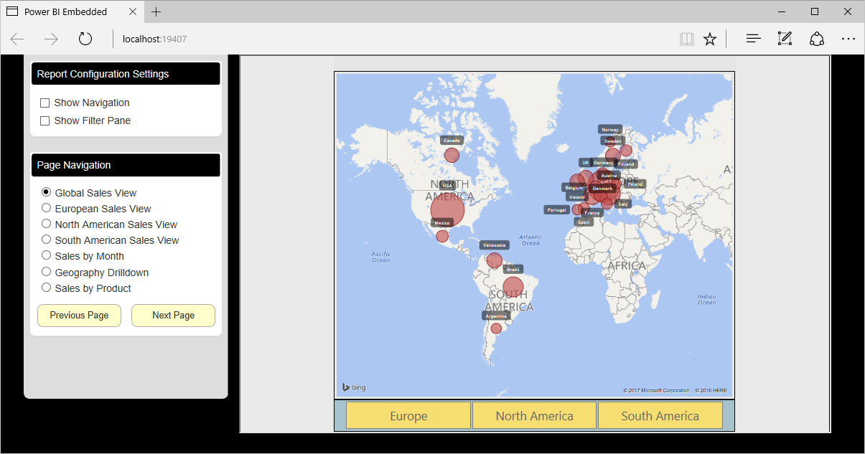
Demo: HelloPowerBIEmbedded.sln

Slide 23
Agenda
Power BI Embedded Overview
Working with PBIX Project Files
Provisioning Workspaces in Azure
Embedding Reports in a MVC Application
Configuring Datasets for DirectQuery Mode
Putting It All Together

Slide 24
Imported Datasets Versus DirectQuery
Imported Dataset
Data is imported into storage within Power BI cloud
Entire dataset loaded into memory when in use
Reports and Datasets query data in imported dataset
Dataset size is maxed out at 1GB
Dataset must be refreshed when source data changes
DirectQuery Dataset
No data is imported or cached in the Power BI cloud
Reports and Datasets query for data using live connection
No need to refresh data
No need to worry about 1GB dataset size limitation
Limitation are placed on features for querying and data modeling

Slide 25
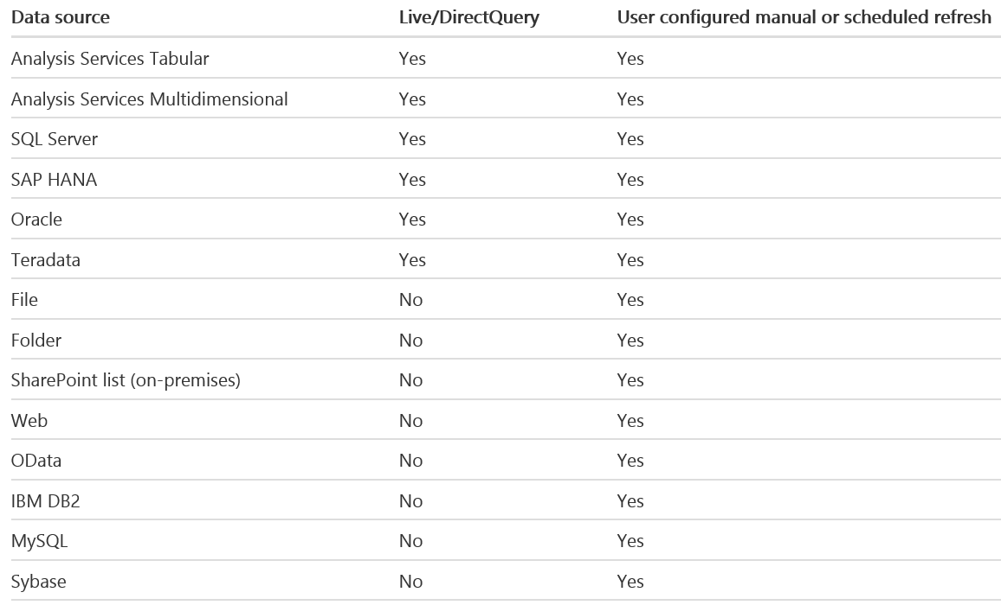
Supported Data Sources

Slide 26
Limitations of DirectQuery
DirectQuery imposes the following limitations
All tables must come from a single database
Many types of query steps are not supported
Relationship filtering limited to single direction
Time intelligence capabilities are not available
No special treatment of date columns
Calculated columns not allowed
By default, limitations placed on DAX in measures

Slide 27
Demo: WingtipSalesDirectQuery.pbix
Power BI Embedded does not support dataset refresh
Now way to refresh imported dataset – different than PowerBI.com
Requires delete and reimporting updated PBIX project
DirectQuery mode can be used to eliminate the refresh problem

Slide 28
Provisioning with C# and Azure REST APIs
Can be programmed in simple Console app
Use same Nuget packages as shown earlier
Dataset management is important
Credentials cannot be included in PBIX
Credentials must be configured after PBIX import
Terminology confusion
Remember that “Import” = “Dataset” = “Report”

Slide 29
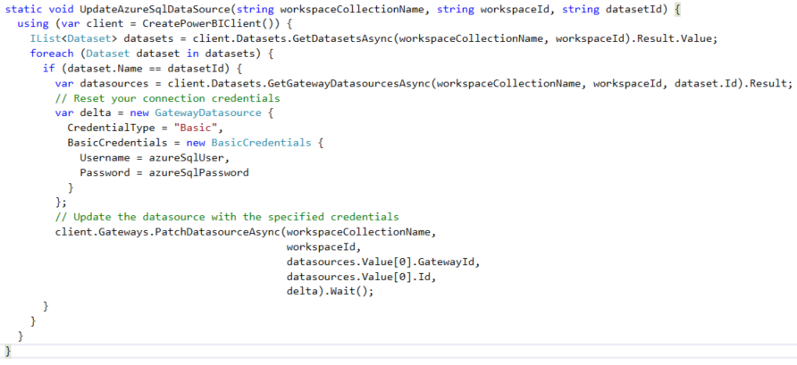
Configuring a Dataset for DirectConnect

Slide 30
Agenda
Power BI Embedded Overview
Working with PBIX Project Files
Provisioning Workspaces in Azure
Embedding Reports in a MVC Application
Configuring Datasets for DirectQuery Mode
Putting It All Together

Slide 31
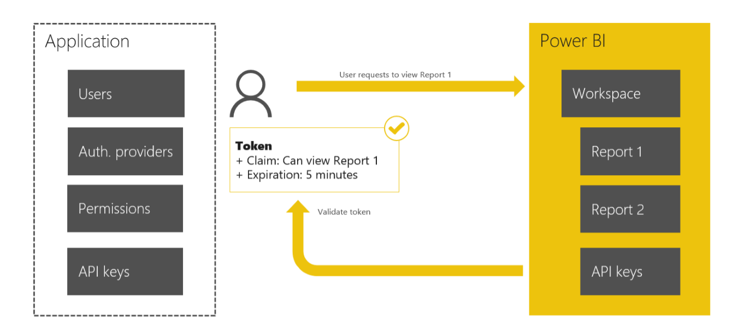
Security with Power BI Embedded
Power BI Embedded defers to your app…
to perform all the necessary user authentication
to provide an authorization scheme
PBI Embedded supports row-level security (RLS)

Slide 32
Summary
Power BI Embedded Overview
Working with PBIX Project Files
Provisioning Workspaces in Azure
Embedding Reports in a MVC Application
Configuring Datasets for DirectQuery Mode
Putting It All Together

