Slide 1
Developing with the Power BI REST API

Slide 2
Agenda
Getting Started with the Power BI REST API
Creating a Real-time Dashboard
Creating an SPA for Power BI using Angular.js
Embedding Reports and Dashboard Tiles

Slide 3
The Power BI REST API
What is Power BI?
Collection of cloud services & tools for building BI solutions
Power BI service available to licensed subscribers
Power BI model based on datasets, reports and dashboards
What is the Power BI REST API?
API built on OAuth2, OpenID Connect, REST and ODATA
Allows developers to program datasets, reports and dashboards
What can you do with the Power BI REST API?
Create and update datasets
Build real-time dashboards
Embed Power BI reports and dashboards tiles in web pages

Slide 4
Getting Started
What you need to get started?
Organizational account in an Office 365 tenancy
License for Power BI
Visual Studio 2017 and Visual Studio 2015
Azure subscription for application registration

Slide 5
What Operations Are Supported in v1.0?
Workspace Group Operations
Get Groups
Dataset Operations
Get Datasets
Create Dataset
Table Operations
Get Tables
Alter Table Schema
Table Row Operations
Add Rows
Delete Rows

Slide 6
What Operations are Supported in Beta?
Report Operations
Get Reports
Dashboard Operations
Get Dashboards
Get Dashboard Tiles
Import Operations
Create Import
Get Imports
Get Import by GUID
Get Import by File Path

Slide 7
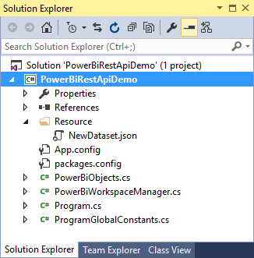
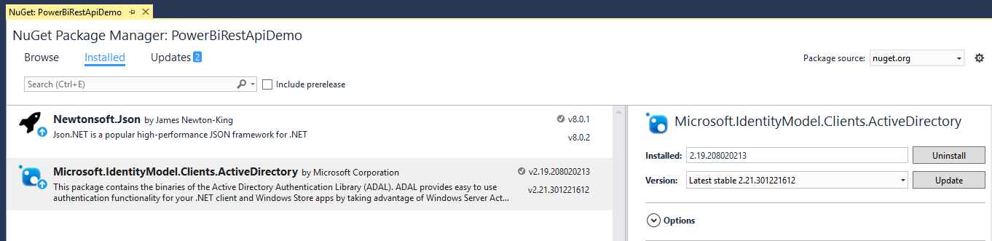
The PowerBiRestApiDemo Sample Project
Console application project in Visual Studio 2015
PowerBiRestApiDemo project contains two NuGet packages
Newtonsoft.Json used to convert JSON data to and from and C#
Azure ADAL used to get access tokens from Azure Active Directory

Slide 8
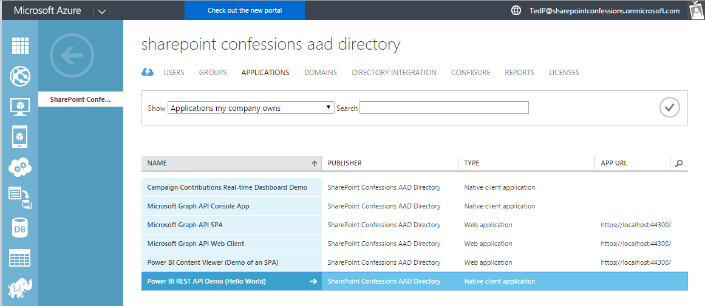
App Registration with an Azure Tenant
Application must be registered within an Office 365 tenant
Registration can be accomplished using Azure Management portal
Registration can be done using Power BI App Registration Page

Slide 9
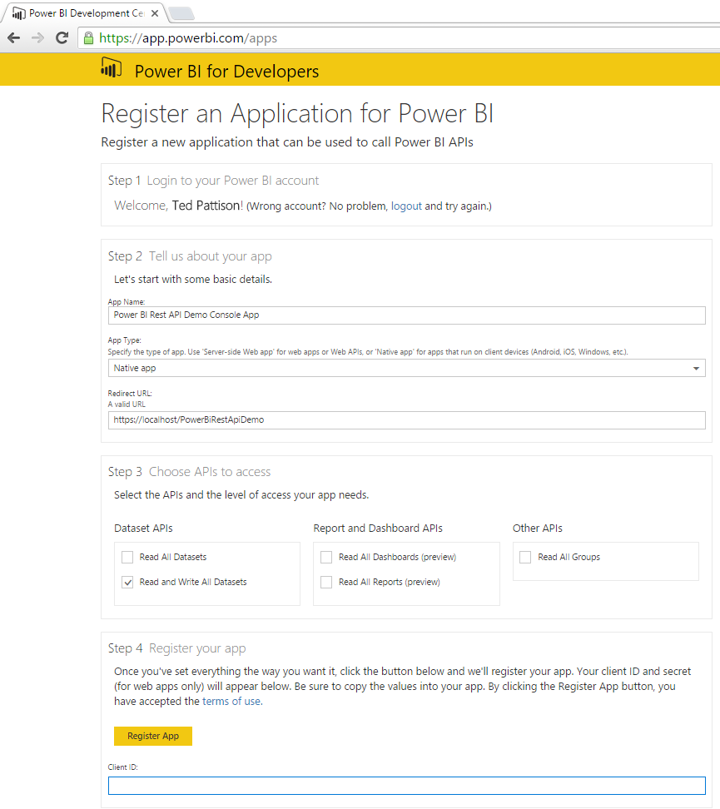
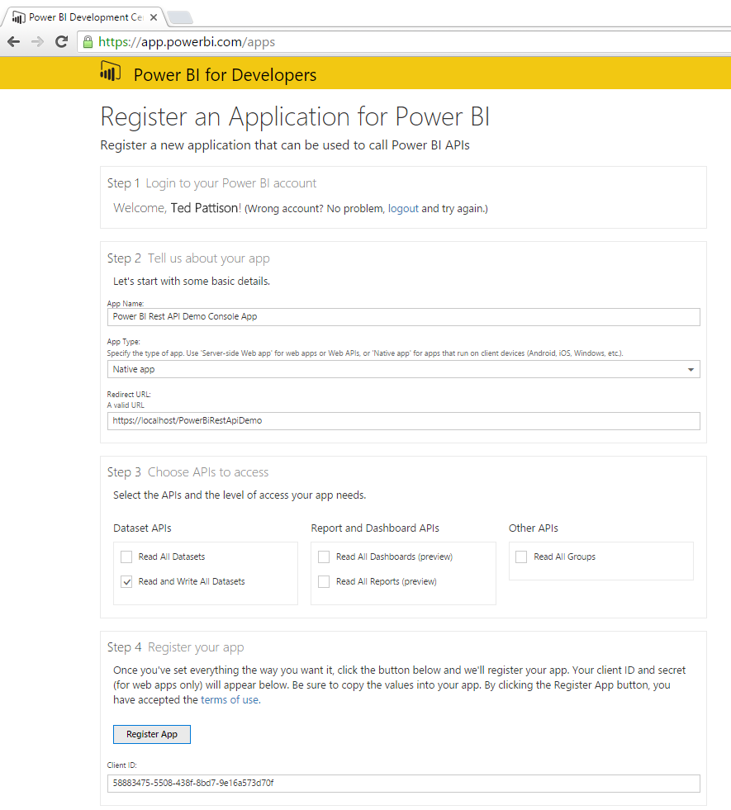
Power BI App Registration

Slide 10
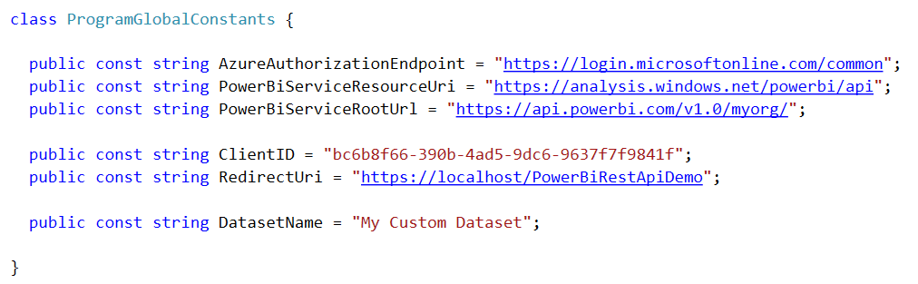
Important Application Constants
Power BI REST API requires Client ID and several URLs
These values are tracked as application constants

Slide 11
Authenticating with Azure AD
User must be authenticated against Azure AD
User authentication used to obtain access token
Can be accomplished with the Azure AD Authentication Library
Access token pass to Power BI REST API in call REST calls
Azure Active Directory
Custom App
Access Token
Access Token
Power BI Service

Slide 12
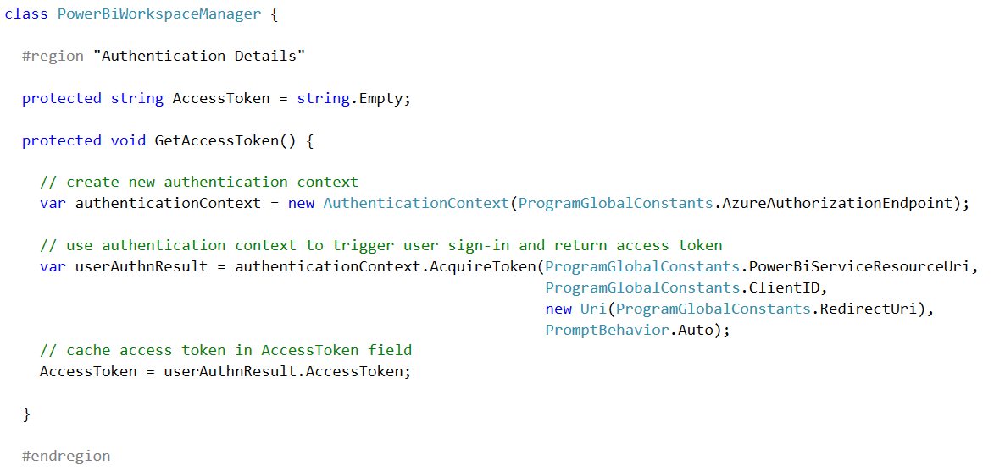
Using ADAL to Retrieve an Access Token
1
2
3

Slide 13
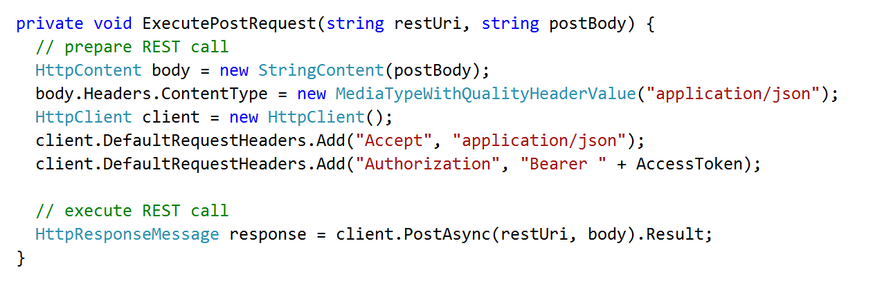
Executing Power BI REST API Calls
Generic helper methods designed to execute HTTP operations
1
2
Custom App
HTTP POST
Power BI Service
Access Token
JSON

Slide 14
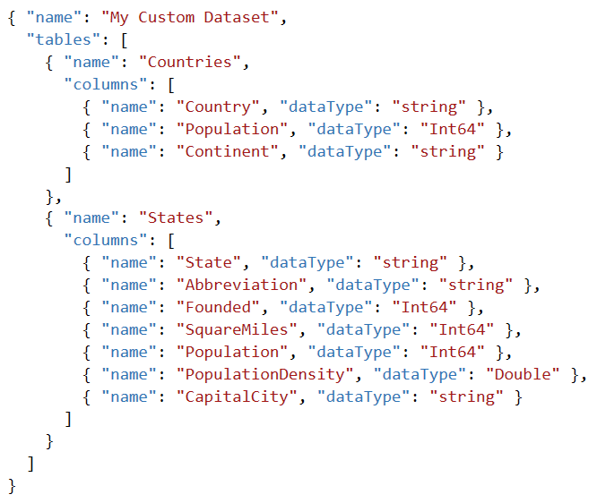
Using JSON to Create a Custom Dataset
Dataset created using JSON-formatted Table Schema

Slide 15
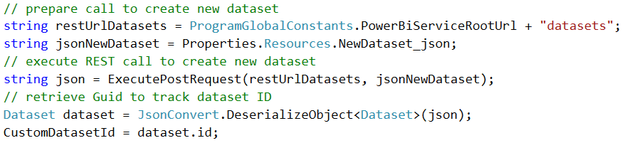
Creating a Custom Dataset
Dataset created by executing HTTP POST operation
One-time operation done as application begins running
1
2
3
Power BI Service
HTTP POST
My Custom Dataset
Access Token
JSON
Countries table
States table

Slide 16
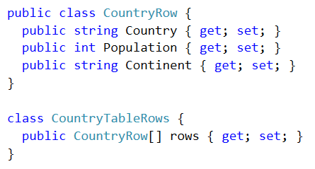
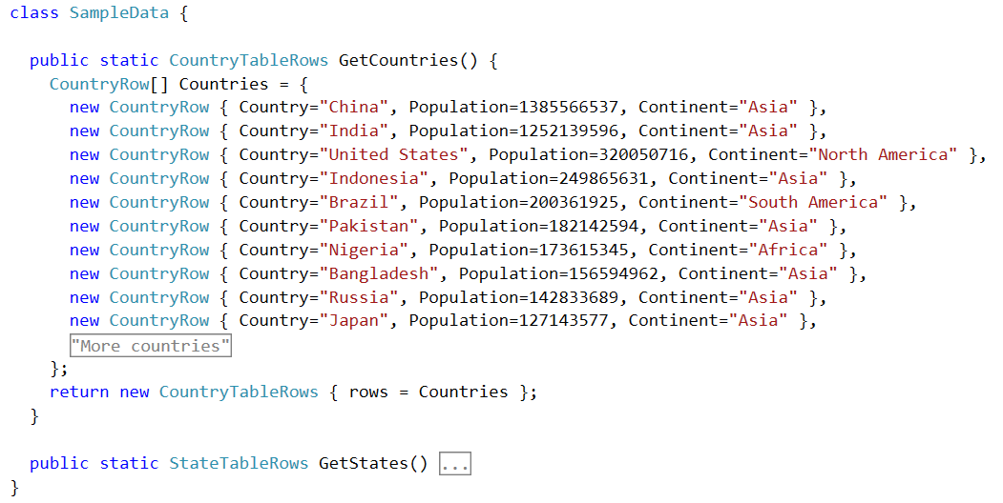
Designing C# Classes to Convert to JSON
C# class can be created to facilitate reading & writing JSON
Newtonsoft.Json package contains classes for performing conversions

Slide 17
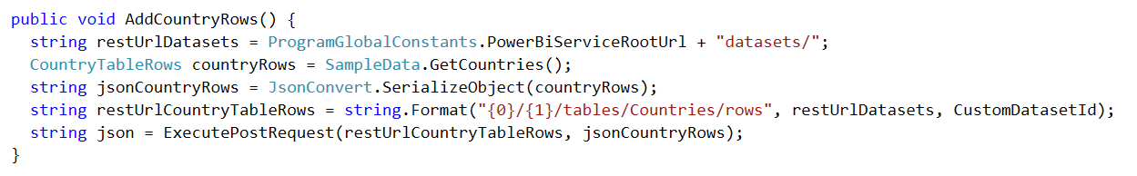
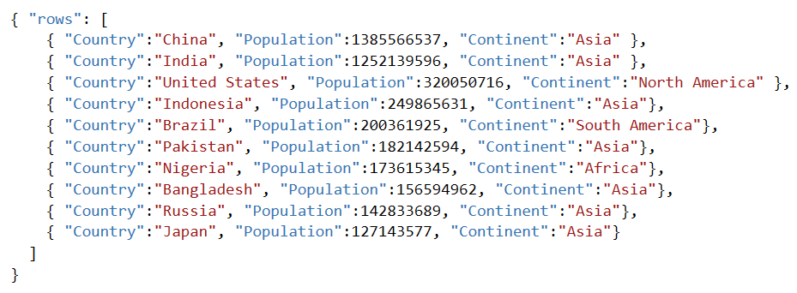
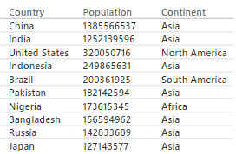
Adding Rows to a Table in a Dataset
Executing POST to add rows to Countries table
1
2
HTTP POST
Power BI Service
Access Token
JSON
Countries Table

Slide 18
Agenda
Getting Started with the Power BI REST API
Creating a Real-time Dashboard
Creating an SPA for Power BI using Angular.js
Embedding Reports and Dashboard Tiles

Slide 19
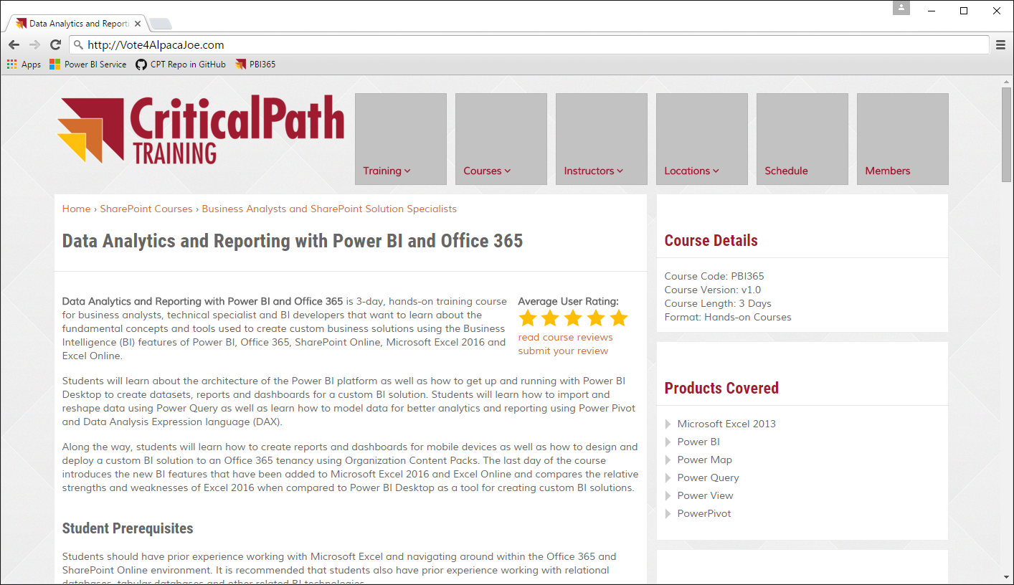

The Scenario Being Simulated
Contribution website accepts contributions from donors
Website calls web service to process credit card transaction
Website calls to Power BI REST API to create & update dataset
Vote for Joe
Vote for Joe
He’ll back an alpaca
Back an Alpaca
Donate
Related Links
Privacy Policy
Credit Card Authority
Contributions
Web Site
Power BI Service
Copyright 2016 – Alpaca Joe’s Super Pac to Get Back to the Facts When a Jackass Attacks an Alpaca - All Right Reserved

Slide 20
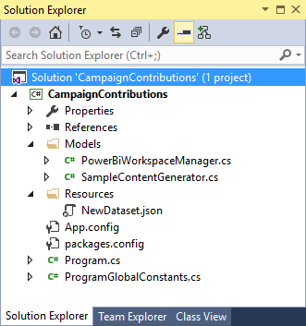
CampaignContributions Demo App
Console app similar to PowerBiRestApiDemo
Uses Newtonsoft.Json package to convert JSON data
Uses Azure ADAL.NET to get access tokens from Azure AD

Slide 21
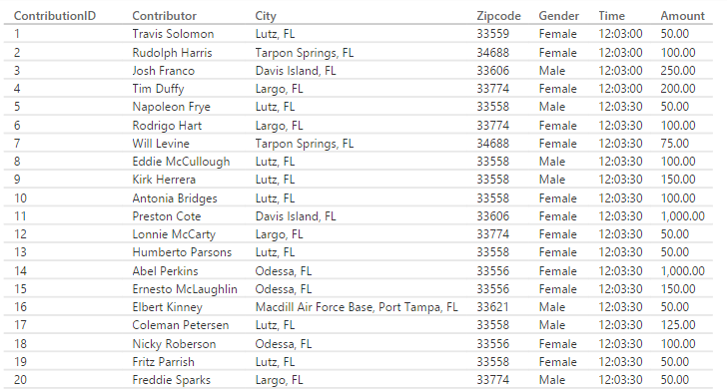
Contribution Row Data

Slide 22
Scaling a Real-time Dashboard
Low velocity data scenario
High velocity data scenario
My App
Power BI Service
HTTP
Data Sender
Data Sender
HTTP
Azure
Event Hub
Azure
Streaming Analytics
Power BI
Service
Data Sender
Data Sender
Data Sender

Slide 23
Agenda
Getting Started with the Power BI REST API
Creating a Real-time Dashboard
Creating an SPA for Power BI using Angular.js
Embedding Reports and Dashboard Tiles

Slide 24
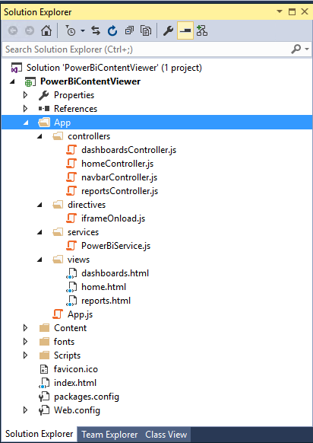
The PowerBiContentViewer Demo
Demonstrates SPA application
Built using client-side code (HTML, CSS and JavaScript)
SPA built using Angular-JS
Authentication using ADAL-JS

Slide 25
Understanding Implicit Grant Flow
Implicit Grant Flow
Used when client cannot keep secrets (public client)
Used with SPAs built using JavaScript and AngularJS
Less secure than Authentication Code Grant
How does it work?
Client authorizes user with AD authorization endpoint
AD returns access token directly to SPA in browser
Authentication flow does not involve authorization code

Slide 26
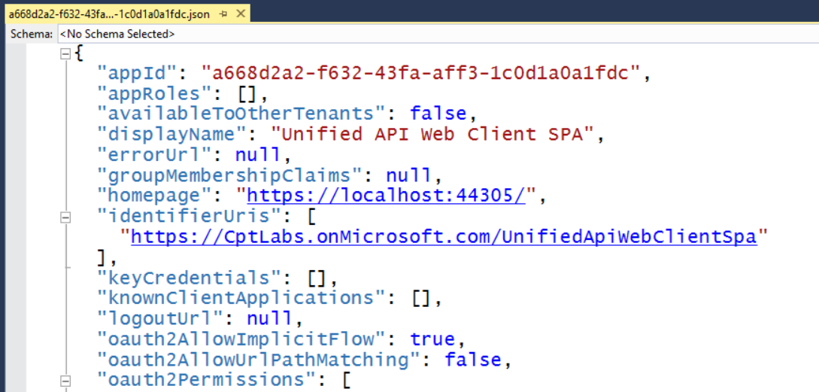
Configuring Implicit Flow in Azure AD
Requires configuring AD application in Azure AD
Download manifest from Azure AD
Update oauth2AllowImplicitFlow setting equal to true
Upload manifest to Azure AD to save changes

Slide 27
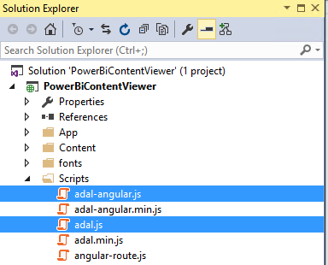
Downloading the ADAL-JS Library
Developing with ADAL-JS involves to two library files
adal.js – core ADAL-JS library
adal-angular.js –integration of ADAL-JS with AngularJS
Library files downloadable from GitHub Repository
https://github.com/AzureAD/azure-activedirectory-library-for-js

Slide 28
Initializing ADAL-JS Settings

Slide 29
Making Secure Calls to Custom Web Services
adal-angular.js adds interceptors to $http service
adal detects when calls are made to secure endpoints
adal acquires & caches access tokens behind scenes
adal attaches access token to Authorization header

Slide 30
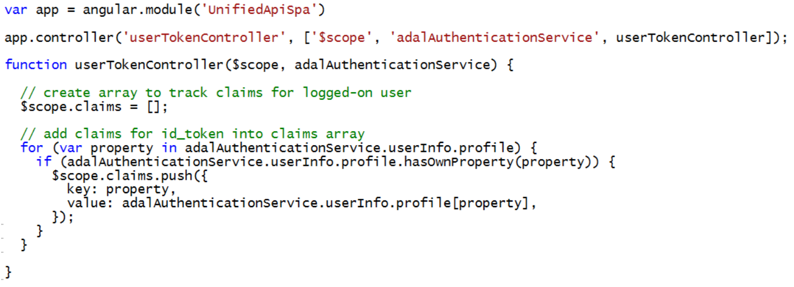
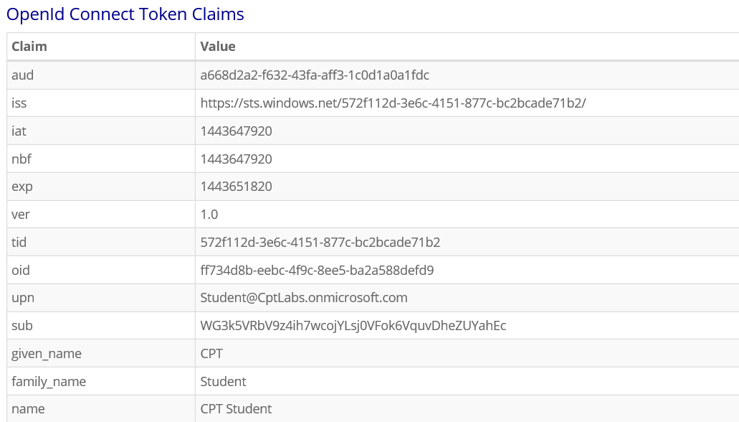
Inspecting Authenticated User Claims

Slide 31
Agenda
Getting Started with the Power BI REST API
Creating a Real-time Dashboard
Creating an SPA for Power BI using Angular.js
Embedding Reports and Dashboard Tiles

Slide 32
Embedding Power BI Reports

Slide 33
Summary
Getting Started with the Power BI REST API
Creating a Real-time Dashboard
Creating an SPA for Power BI using Angular.js
Embedding Reports and Dashboard Tiles

