Slide 1
Designing Queries with Power BI Desktop

Slide 2
Agenda
Deciding What To Measure
Understanding Queries in Power BI Desktop
Working with the Query Editor Window
Designing Advanced Combine Queries
Importing OLTP Data Into a Star Schema

Slide 3
Data Discovery
Data can live in a variety of sources
Files (e.g. CSV file, Excel workbook)
OLTP Databases
OLAP Databases
SharePoint Lists and Document Libraries
Azure-based services
Online services & SaaS applications
Notes:
Business Intelligence is all about analyzing data and surfacing insights. The first step is always figuring out what data you need and where to find it. The Power BI platform is very extensive in its ability to let you connect to and analyze just about any type of data.
This introduction slide lists the different formats of data you can work with when creating custom solutions for the Power BI platform. We will explore each of these data source types in greater detail a little later in this module. On the next few slides, we will discuss how to determine what you want to measure and why you should create grain statements before you begin designing queries. After that we will explore an OTP-style database named WingtipSalesDB that will be used in instructor demos and in student labs over the next few modules of this training course.

Slide 4
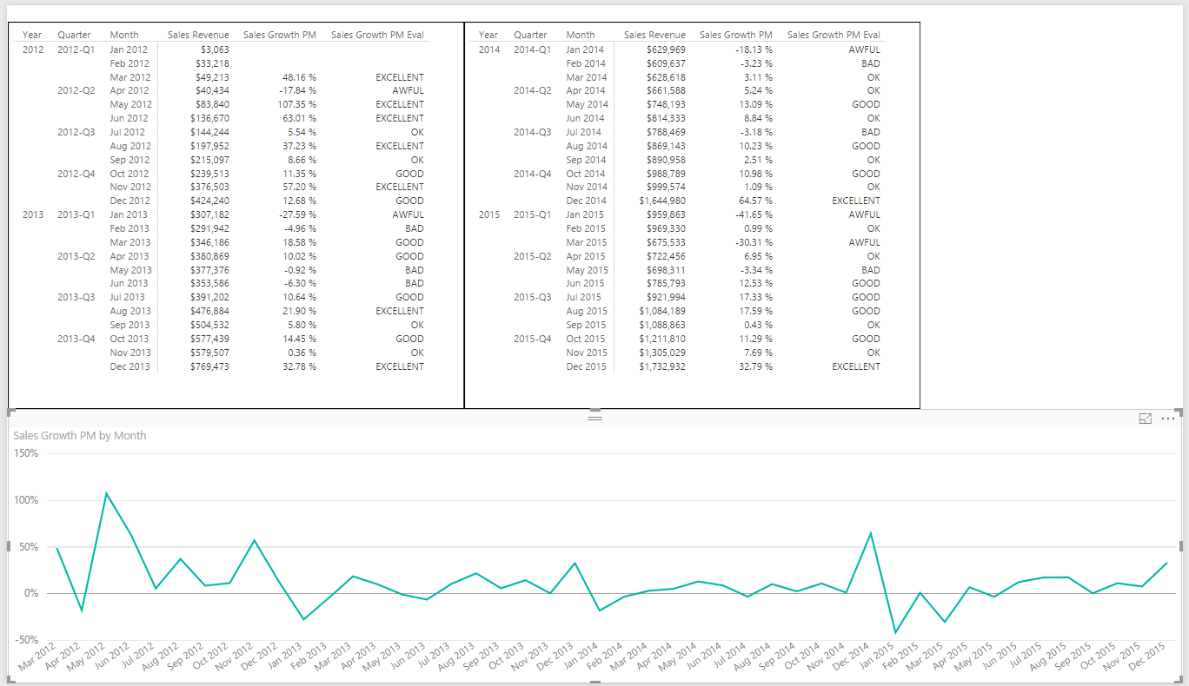
Deciding What To Measure
You Must Determine Measurable Objectives
Financial (revenue, expenses, profit margin, etc.)
Business processes efficiency
Customer Satisfaction Levels
Notes:
When you begin to create any type of custom solution with Power BI to monitor the health and report on business processes, it is important to take a step back in the initial design phase and clearly determine what you’re going to measure. This provides an opportunity to define what type of business analysis and visualizations your custom BI solution will need to provide. For example, one custom solution might just need to track sales revenue in order to calculate commission for sales people. Another custom solution with different requirements might need to analyze expenses and profit in addition to sales revenue. Determining high-level goals and capabilities is an important thing to do before getting into the nuts and bolts of beginning to extract and transform data.

Slide 5
Defining Grain Statements
Grain statements should be defined in initial design phase
Grain statements helps determine requirements for BI queries
Grain statements can be created & understood by business users
Example grain statements for BI project at Wingtip Toys
What was the total sales revenue over the last 4 years?
What was the sales revenue by year, quarter and month?
What was the sales revenue by region, state, city and zip code?
What was the sales revenue by category, subcategory and product?
What was the growth in sales revenue from month to month in 2013?
What was profit margin for each product by year, quarter and month?
Have their been any products with significantly decreasing profit margin?
Notes:
There’s a popular technique for determining what you need to measure and what data you will need to acquire to make those measurements. This technique involves authoring a set of grain statements. What's valuable about grain statements is that they can easily be written by business users with little or no technical experience. However, once you have clearly written a set of grain statements, technical people can use those grain statements to determine what data needs to be imported as well as what queries and reports need to be generated.
The slides above display examples of grain statements that might be used in a custom solution to analyze sales data. If you read through each of these grain statements, you should have a great head start in designing the queries you’ll need to import data into a new Power BI desktop project.

Slide 6
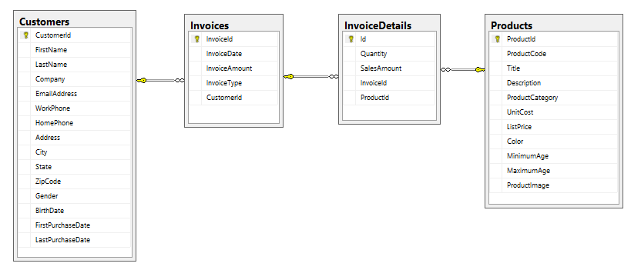
Sample OLTP Database: WingtipSalesDB
Online Transaction Processing (OLTP) System
Used for real-time data access and transaction-based data entry
Optimized for faster transactions (e.g. inserts, updates & deletes)
Tables normalized to reduce/eliminate redundancies
Table schemas can be hard for business users to understand
Notes:
Online Transaction Processing (OLTP) databases are used for databases that have high transaction rates. The data model of tables in this type of database is optimized to speed up transactions for operation such as inserting, updating and deleting records. Tables in an OLTP-style database are usually normalized to reduce or eliminate any redundancies.
Another noteworthy issue is that OLTP systems are often not designed to track historical data. For example, imagine a customer living in California makes a number of purchases over a 5 year period and then the customer moves to Florida. If you run a query to determine sales revenue by state, you will likely find that all the historic purchases for the customer are attributed to the new state Florida and not the state where the purchases were made which is California.
There are several common design issues you face when building BI projects on top of an OLTP database. First, they are not designed with data analysis as a primary objective. Therefore, you must often execute complex queries in a reporting solution which join tables together to properly analyze the data. Moreover, the execution of these complex queries might perform poorly since the indexing scheme configured for an OLTP database is typically optimized for greater transaction throughput instead of faster query performance. Also, the table schema for an OLTP-style database is often complicated and non-intuitive when access directly by the average business user.
Over the next few modules, you will take import the data from the WingtipSalesDB database and reshape it with querying and data modeling techniques to change the design from an OLTP design to an OLAP design that is much better suited for data analysis and reporting.

Slide 7
Agenda
Deciding What To Measure
Understanding Queries in Power BI Desktop
Working with the Query Editor Window
Designing Advanced Combine Queries
Importing OLTP Data Into a Star Schema

Slide 8

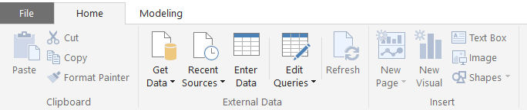
Getting Around in Power BI Desktop
What do you need to learn to use Power BI Desktop?
Query features for importing data
Design features for modeling data
Report designer for creating reports
Navigating between view modes
Report View
To access query features
Data View
Relationship View
Notes:
What do you need to learn to get up to speed on Power BI Desktop? There are three main areas to focus on at first which include creating queries, modeling data and designing reports. First, you must learn how to design queries which import data. The creation of queries is what allows you to create a base set of tables in the dataset for a Power BI Desktop project. Next, you must learn how to use the data modeling features so you can extend the project’s dataset to create a rich data model with things like calculated columns, measures and hierarchies. After that, you must learn how to use the report designer in Power BI Desktop to present the data analysis for your project using tables and visual images and to provide the user with interactive capabilities.
You will use Power BI Desktop’s main application window to model data and to design reports. The main application window provides a left navigation menu that allows you to switch back and forth between report view, data view and relationship view. When you need to create and design queries, you will do that in a separate Query Editor window which can be opened using one of the menu buttons in the ribbon of the main application window inside the External Data group on the Home tab.

Slide 9
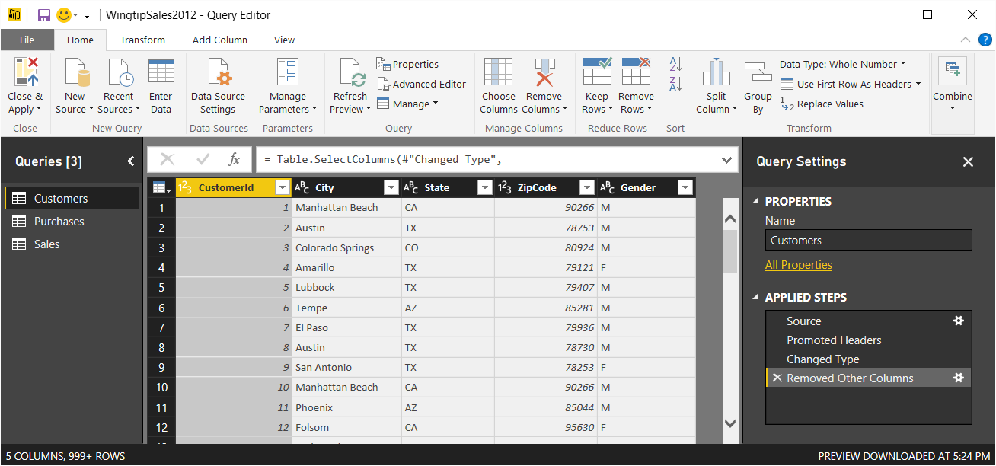
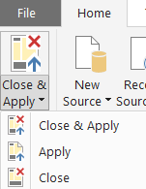
Query Editor Window
Power BI Desktop provides separate Query Editor window
Provides powerful features for designing queries
Displays list of all queries in project on the left
Displays Properties and Applied Steps for selected query on right
Preview of table generated by query output shown in the middle
Query can be executed using Apply or Close & Apply command
Notes:
In Power BI Desktop, do not design queries in the main application window. Instead, you edit queries using a separate Query Editor window. That means you must become comfortable moving back and forth between the main application window and the Query Editor window. You can open the Query Editor window using one of the menu buttons in the ribbon of the main application window inside the External Data group on the Home tab.
You design queries by executing commands on columns in the Query Editor window and working with the commands available in the ribbon. The Query Editor window displays a list of all queries in project on the left making it possible to select the query you want to work on. The Query Editor window displays the Properties section and the Applied Steps section for selected query on right. In the middle of the screen, the Query Editor window displays a preview of the table that will be generated by the query’s output.
When you are done designing queries, you often need to execute them to import data into your project to create a base set of tables. You can execute the queries you have been editing by running either the Apply command or the Close & Apply command from the Home tab in the ribbon. The difference between these commands is that the Apply command executes queries while leaving the Query Editor window open while the Close & Apply command execute the queries and then closes the Query Editor window.

Slide 10
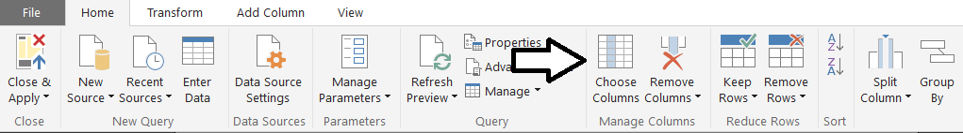
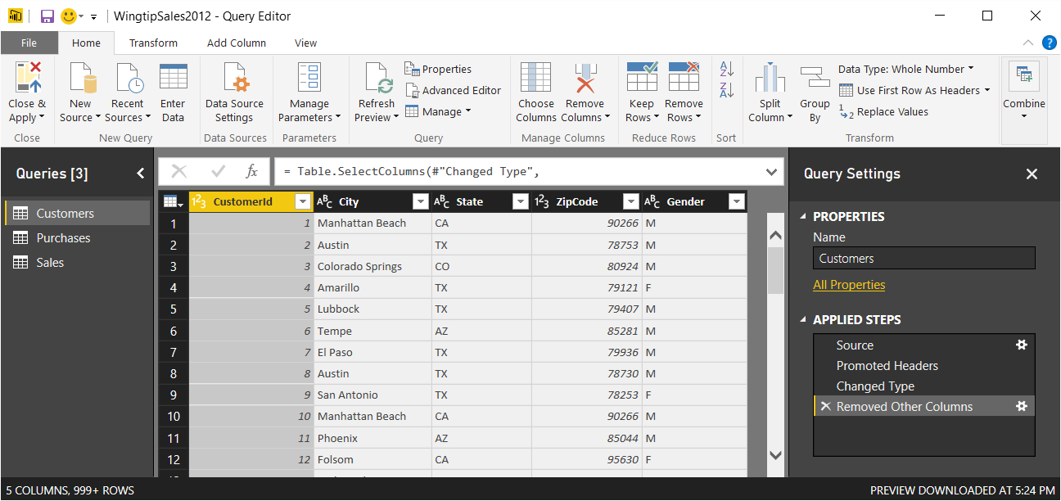
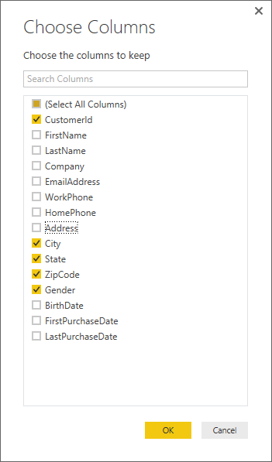
Queries Are Defined as Sequence of Steps
Here is an example of adding a query step
Click a column header then click Choose Column button in ribbon
Query definition is modified by adding new step
Notes:
As you begin to create and design queries in Power BI Desktop, it’s essential that you see that every query is defined as a sequence of query steps. As you work with the Query Editor window, you will typically add new steps to a query at the end after all the other steps that have already been added. However, as you start getting more comfortable with the Query Editor window you will find times when you will want to insert new steps in the middle of the Applied Steps list in front of pre-existing steps.
Each time you create a new query in Power BI Desktop, you are really creating a query definition that is stored and executed using code written in a special programming language named “M”. Internally, Power BI Desktop tracks each step you add to a query using a single line of M code. For example, adding the Choose Columns query step shown in the slide above results in the following M code.
Table.SelectColumns(#"Changed Type",{"CustomerId", "City", "State", "ZipCode", "Gender"})
The training course will not go into the details of M code in this module. Instead, this course will cover how each query is stored and executed as a batch of M code in greater detail in the next lecture in Module 3 which focuses on query design in Power BI Desktop.

Slide 11
Power BI Desktop is an ETL Tool
ETL process is essential part of any BI Project
Extract the data from wherever it lives
Transform the shape of the data for better analysis
Load the data into dataset for analysis and reporting
CSV
File
Power BI Desktop
Power BI Desktop Project (PBIX)
Dataset
Excel
Workbook
OLTP
Database
Notes:
Every custom BI solution works with some type of data. Some custom solutions require integrating data from multiple data sources into a single dataset for analysis. Early in the lifecycle of a Power BI desktop project, you must discover where the data you need lives and then you must decide how you are going to import it into a dataset that will eventually be used for data analysis and reporting. This is the project lifecycle phase that is often called the "ETL" phase because it involves extracting data, transforming data and then loading data.
Power BI Desktop is a self-service ETL tool for business users. It has the ability to extract data from a variety of data source. However, the real value of Power BI Desktop is that you can perform many types of transforms to better shape the data just before it's loaded.

Slide 12
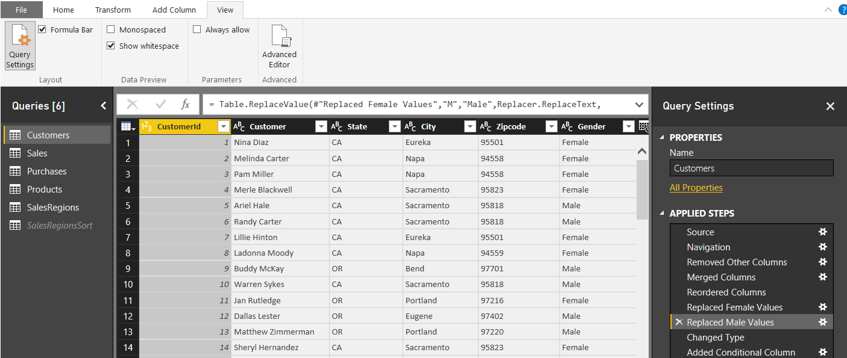
Query Steps
A query is created as a sequence of steps
Each step is a parameterized operation on the data
Each step has formula which can be viewed/edited in formula bar
Query starts with Source step to extract data from a data source
Additional steps added to perform transform operations on data
You can replay query operations one by one by clicking on steps
step formula bar
sequential list of steps for query
Notes:
As you learned in the previous module, every query in Power BI Desktop is defined as a sequence of steps. The Query Editor window displays the Applied Steps section for the query that is currently selected in the Queries list on the left. If you click on a step in the Applied Steps list, you can see how the step is defined behind the scenes using M code in the step formula bar. If the step formula bar is not currently visible in the Query Editor window, navigate to the View tab in the ribbon and check the Formula Bar checkbox in the Layout ribbon group. Once you check the Formula Bar checkbox, you should be able to see the M code that has been generated for the selected step in the Applied Steps list.
Most queries begin with the Source step which is used to extract the underlying data from a specific data source. After the Source step, other steps are added to clean up bad data and to perform transforms as required to reshape the data for analysis and reporting.
Note that you can use the Applied Steps list to debug the logic you have built into a query. You can do this by initially clicking on the first step in the Applied Steps list and then clicking on later steps one by one. When you do this, the Query Editor window will display what the query output looks like after each step. This provides you with the opportunity to see how the entire query will execute in a step by step fashion. If you right-click on a step in the Applied Steps list, you will see a set of menu commands to rename or delete the step as well as to move the step forwards or backwards in the sequence of steps. Some types of steps provide you with the an Edit Settings command which displays a custom dialog box to edit the steps settings. Other types of steps do not provide this capability.

Slide 13
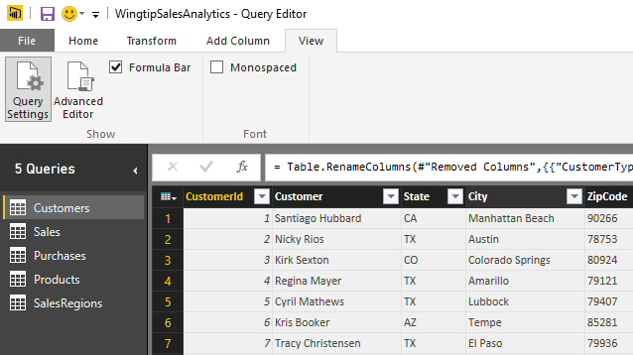
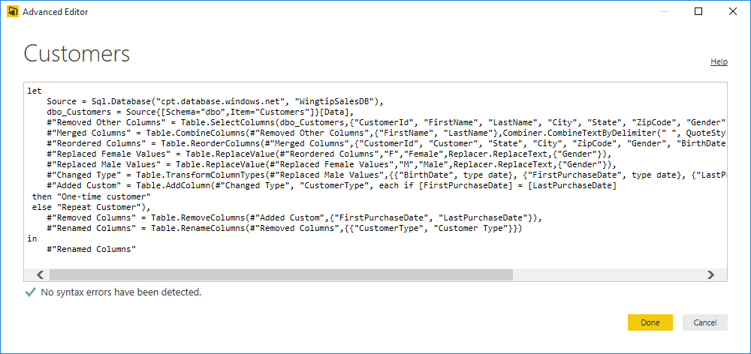
Advanced Editor
Power BI Desktop based on "M" functional language
Query in Power BI Desktop saved as set of M statements in code
Query Editor generates code in M behind the scenes
Advanced users can view & modify query code in Advanced Editor
Notes:
Behind the scenes, Power BI Desktop saves and executes each query you create using a batch of code written in a functional programming language known as M. Microsoft originally created the M programming language and an associated query execution engine for the Power Query add-in that was created for Microsoft Excel 2013 and Microsoft Excel 2010. Now that Microsoft has discontinued its use of “Power Query” as a technology brand name, they continue to use the M programming language to support the authoring and the execution of queries in Microsoft self-service BI products such as Microsoft Excel 2016 and Power BI Desktop. It’s important to note that the Power BI platform can also execute M code to run a query from within the Microsoft cloud when you have configured a dataset for manual refreshing or automated scheduled refreshing.
The user interface experience of Power BI Desktop goes to great lengths to hide M code from you while you are designing and debugging your queries in the Query Editor window. Some people using Power BI Desktop will like that all the M code is hidden out of sight by default. Other more technical users might like the fact that they can view the underling M code for a query and even make direct edits to the M code when it’s the best way to solve a problem.
The step formula bar displays one line of M code at a time. The step formula bar also allows you to make direct changes to the M code for whatever query step is currently selected. However, you can also view and modify the batch of M code for an entire query code using the Advanced Editor dialog. The Advanced Editor dialog can be opened using the Advanced Editor button in the View tab of the ribbon.

Slide 14
Understanding Query Input and Output
PBIX project is container for data sources and queries
Queries created and saved within scope of Power BI project
Queries can pull data from local files
Queries can pull data from external content sources
Queries main purpose is to load imported data into data model
PBIX Project
CSV
File
Data Source
query1
Data Source
query2
External Database
col1 | col2 | col3
bob | 23 | 45
mary | 43 | 74
col1 | col2 | col3
bob | 23 | 45
mary | 43 | 74
col1 | col2 | col3
bob | 23 | 45
mary | 43 | 74
Notes:
When working with Power BI Desktop, you will create and save queries within the scope of the current project. Each query must have at least one data source to use as its input. You can create a query from an external data source such as a CSV file, an Excel workbook, a SQL Server database, an Azure SQL database, a SharePoint list or an Online Service.
Remember that the main purpose of creating queries in Power BI desktop is to import external data to create a base set of tables in your project’s data model. Because of this, a new query is always configured to load its output into a new table generated in the data model for the current project. However, you don’t always want every query to generate an output table in the project’s data model. There are some scenarios in which you will create a query whose sole purpose is to be used as a input for another query. In cases such as these, you can disable a query’s Enable Load property so it does not generate a table in the data model of the current project. While a query with its Enable Load property disabled will not generate an output table, the query can still be used as input to other queries in cases where you want to merge columns or append rows from two different queries to combine content from multiple data sources.

Slide 15
Query Composition
Query can serve as source for other queries
Allows for creation of reusable base queries & query composition
Complexity can be hidden in base queries
Reference command creates new query based on another query
PBIX Project
Data Source
query1
External Database
col1 | col2 | col3
bob | 23 | 45
mary | 43 | 74
query2
query3
table1
table2
col1 | col2 | col3
bob | 23 | 45
mary | 43 | 74
sue | 32 | 47
fran | 41 | 55
col1 | col2 | col3
bob | 23 | 45
mary | 43 | 74
sue | 32 | 47
fran | 41 | 55
Notes:
When working with Power BI Desktop, you create and save queries within the scope of a PBIX project file. Each query must have at least one data source to use as its input. Most queries you create will be based on an external data source. However, you can also create a query which uses the output of another query as it’s data source. This is done by executing the Reference command on a query which creates a new query whose data source is the query on which you ran the Reference command.
By using the Reference command to create a query whose input is based on another query, you can take advantage of a design technique known as query composition. The key concept is that you can create reusable logic in one query and then share that logic across several other queries. That helps to reduce the redundant logic you need to maintain across the queries in the Power BI desktop project.

Slide 16
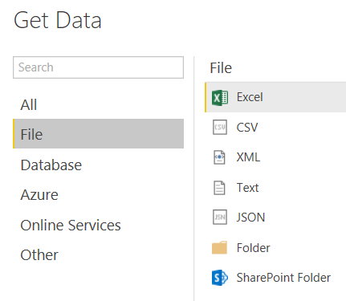
File-based Data Sources
Power BI Desktop supports common file types
Notes:
Power BI Desktop provides rich support for importing data from a wide array of file formats. You can import data from an Excel workbook which contains worksheets with named ranges and tables. You can also import data from a data model that has been created inside an Excel workbook.
It’s become an industry norm to download and make data available using text-based CSV files. If you have already completed the lab for the previous module on Power BI Desktop, then you have already worked through the steps of creating queries to import data from CSV files. You have to admit that the steps are pretty straightforward and easy to accomplish.
Power BI Desktop also supports other types of semi-structured data in common text file formats such as XML and JSON. You can create queries using the data source type of Text which allows you to leverage the data cleanup tools of the Query Editor window. This approach makes it possible to scrape data from non-structured text files when dealing with business documents such as invoices and expense receipts.
You can also use Power BI desktop to import data associated from the set of files in a folder in the local file system or a folder in a SharePoint site. This makes it possible to analyze the files and their metadata inside a specific folder in terms of the number and/or size of files by categories such as file extension, content type or date last modified.

Slide 17
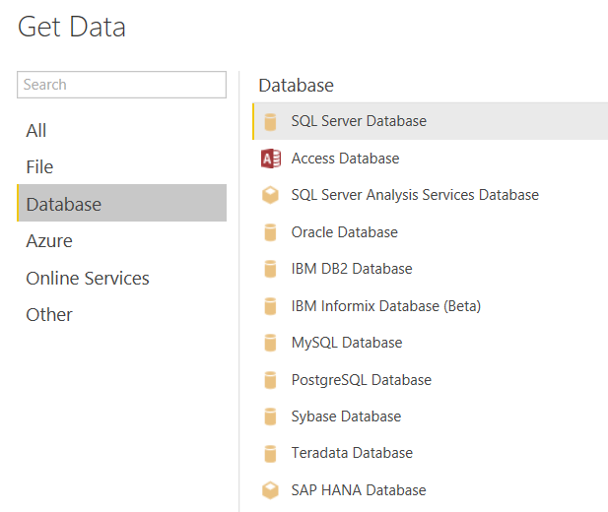
Supported Databases
Power BI Desktop supports many database systems
Notes:
Power BI Desktop supports connecting to all the industry most-popular database systems. What’s especially helpful when importing data from a database is that Power BI Desktop can read database metadata to ensure that table columns are imported with the correct data types and that table relationships defined in the database can be maintained after the data has been imported into the data model for a Power BI Desktop project.
From the list shown in the slide above, you can see that Power BI Desktop has native support to import data from Access databases as well as many popular database management systems for running OLTP-style databases including SQL Server databases, Oracle databases, DB2 databases, MySQL databases, PostgreSQL databases, Sybase databases and Teradata databases.
In addition to supporting OLTP-style databases, Power BI desktop also supports connecting to OLAP-style databases in SQL Server Analysis Services (SSAS). This includes both Tabular databases as well as class multidimensional databases which are based on multidimensional cubes and key performances indicators (KPIs).

Slide 18
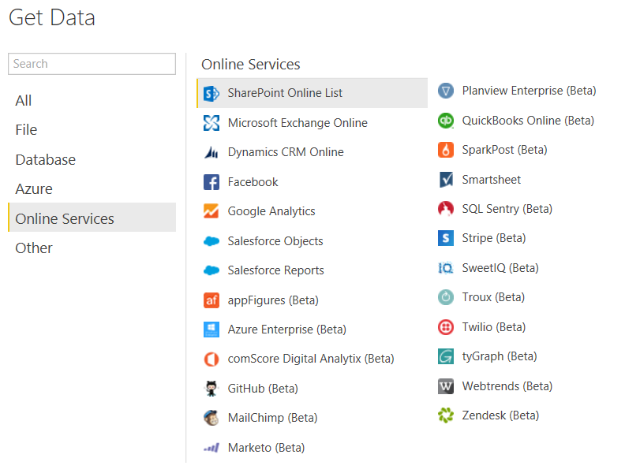
Online Service Data Sources
Power BI Desktop Supports Online Services
Includes popular Software-as-a-Service (SaaS) applications
Microsoft is working with 3rd vendors to expand this list
Notes:
Over the last decade, the software industry has witnessed the rise in popularity of Online Services based on the Software-as-a-Service (SaaS) application model. The success of commercial online services such as Salesforce, Dynamics CRM Online, QuickBooks, GitHub and Google Analytics has created pockets of essential business-related data in vendor-specific clouds. The ability to freely import, analyze and report on this cloud-based data provides businesses and organizations with a new opportunities to monitor and evaluate their business processes.
Consider a simple example. Image you work for a large company that uses Google Analytics to track website usage on its public website. If you don’t like the way that the Google Analytics web portal reports on the data they have recorded about your company’s website, you have another option. You can use Power BI Desktop to analyze the exact same data and present your visualizations and insights in a different way. You can start by importing the Google Analytics data from the cloud into a set of base tables and then layering on your own calculated columns and measures to enrich the data model. After that, you leverage the Power BI platform and it’s ability to create interactive reports and mobile-friendly dashboards. Once you have deployed this type of custom solution, you can then configure the Power BI service to synchronize the imported dataset with its cloud-based data source in the Google Analytics service several times over the course of a standard business day.
The list of Online Services shown in the slide above is a testament to Microsoft’s ongoing investment to integrate Power BI Desktop and the Power BI platform with a growing number of Online Services. You can import data from Microsoft services including SharePoint Online, Exchange Online and Active Directory. Microsoft has continued to invest in relationships with 3rd vendors which is helping to expand the list of services which you can use as a data source when building a custom solution for the Power BI platform.

Slide 19
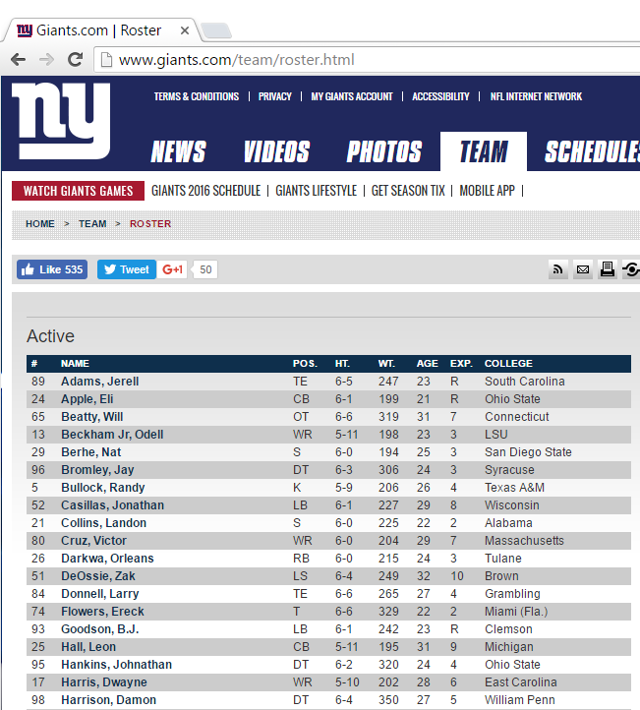
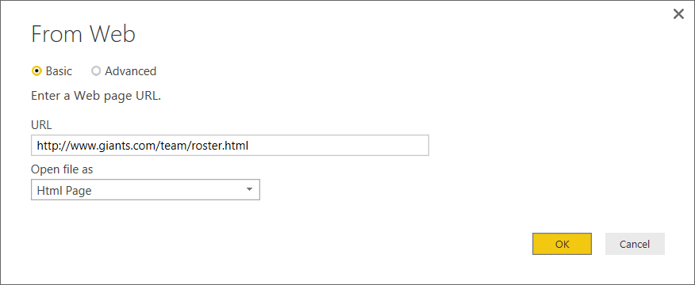
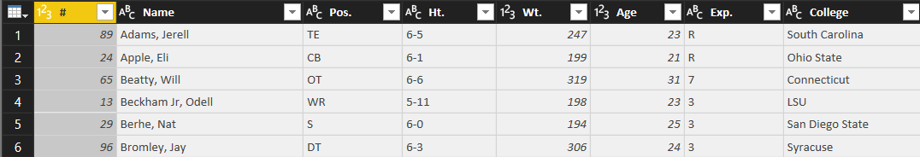
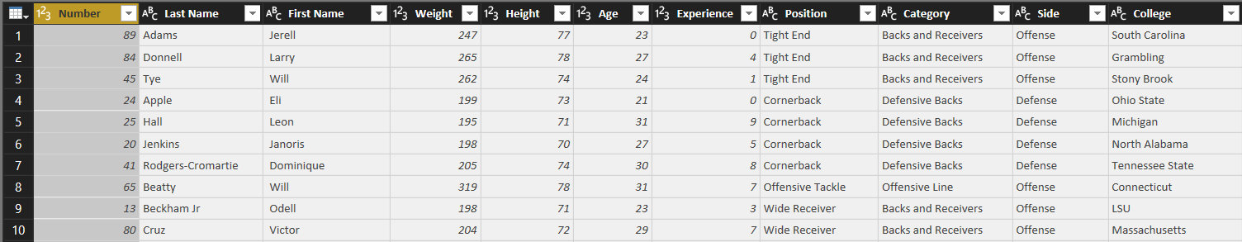
Working with Web Data Sources
Many public websites publish data using HTML tables
Power BI desktop can scrape data from tables in HTML pages
Query Input
Query Output
Notes:
There is a wealth of data that has been published by public websites on the Internet using HTML tables. Power BI Desktop makes it straightforward and relatively painless to extract data from tables in HTML pages and to clean up this data to condition it for insightful data analysis.
The National Football League (NFL) in the United States has 32 teams each of which hosts a public website with its roster of active players in an HTML table. For example, the HTML page with a table with the roster of active players on the New York Giants is accessible through the URL of http://www.giants.com/team/roster.html. Between this URL and the 31 URLs for the other teams, Power BI Desktop can extract and analyze data about every active player in the NFL.
Working with NFL active player data extracted from public websites provides a great way to learn about cleaning up data. The slide above shows the raw query input. When importing data into Power BI desktop, your query output can be designed to rename columns, to convert column values into numeric data types and to add extra categorization aspects to the data using lookup tables and merge queries.

Slide 20
Scraping Data from a Web Page

Slide 21
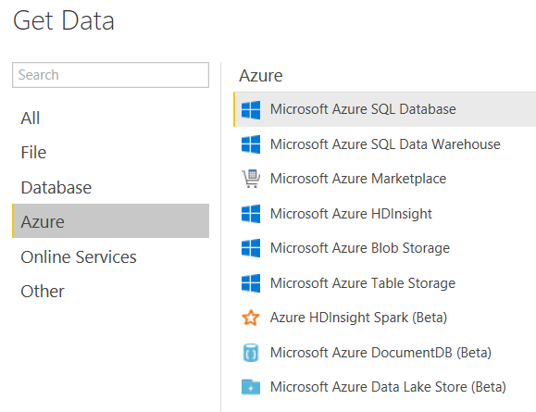
Azure Data Sources
Power BI Desktop supports many Azure data sources
Notes:
It’s clear that Microsoft is investing heavily in Microsoft Azure and Azure-based services to give its customers a cloud-based platform for building software solutions. Microsoft Azure provides several different ways to store data in the cloud including semi-structured data stored using tables, queues and blobs. Microsoft Azure also offers a cloud-based version of a SQL Server database. In fact, you will connect to an Azure SQL Server database as a data source in your next lab. That means you will get hands-on experience extracting data from the Microsoft Azure cloud in order to import customer and sales data for analysis and reporting.
Microsoft Azure HDInsight provides the means to capture large amounts of streaming data in a design process that the industry has gotten to know as “big data”. If your company is already using HDInsight, you can use Power BI Desktop to connect directly to its data or you can use an big data adapter such as Azure HDInsight Spark which provides an abstracted query layer on top of the data structures stored in an HDInsight dataset.
Microsoft Azure also provides the ability to design and populate a SQL Data Warehouse in the cloud. For companies that are taking this direction to build a cloud-based data warehouse, Power BI Desktop will be at the top of the list in in terms of effective data analytics and reporting tools to build on top of a SQL Data Warehouse.

Slide 22
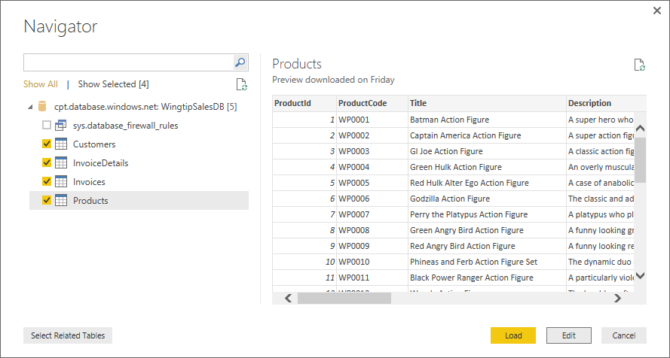
Selecting Tables from a SQL Database
Power BI Desktop provides Navigator dialog
Allows you to select tables
Navigator understands existing table relationships
Clicking Load will run query and import data
Clicking Edit will open queries in Query Editor window
Notes:
When connecting to a SQL Server database or a Azure SQL Server database, you will be prompted with the Navigator dialog which allows you to select which base tables you would like to import into your project. In your upcoming lab, you will extract data from an Azure SQL database named WingtipSalesDB. When you go through this lab, you will use the Navigator dialog to select the four tables from the database which includes Customers, Invoices, InvoiceDetails and Products. When you click the Edit button to dismiss the Navigator dialog, you will see that Power BI Desktop has actually created 4 new queries. There will be an separate query created for each table you selected in the Navigator dialog.
When Power BI Desktop inspects the schema of the tables in a SQL database, it has the ability to read metadata to determine which tables are connected through relationships. Power BI desktop can then use this knowledge to properly recreate the table relationships when importing sets of related tables into the data model for a specific project. The best part is that all this happens automatically behind the scenes and doesn’t require your attention.

Slide 23
Creating Queries to Import Data from an Azure SQL Database

Slide 24
Agenda
Deciding What To Measure
Understanding Queries in Power BI Desktop
Working with the Query Editor Window
Designing Advanced Combine Queries
Importing OLTP Data Into a Star Schema

Slide 25
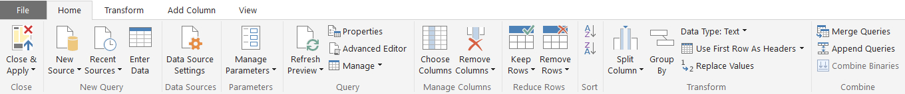
Query Editor Ribbon Tabs
Home tab
Transform tab
Add Column tab
View tab
Notes:
The screenshots in this slide shows the four different tabs available in the ribbon of the Query Editor window which include the Home tab, the Transform tab the Add Column tab and the View tab. Note that the button and other controls in these ribbon tabs are context-sensitive. That means which column or columns are currently selected will determine which ribbon commands are currently available. For example, some commands in the ribbon will be disabled when you do not have anything selected on which to run those commands.

Slide 26
Examples of Basic Power BI Desktop Steps
Rename column
Convert column type
Format column values
Reorder columns
Replace column values
Expanding related column
Merging columns
Splitting columns
Notes:
This slide above lists some of the more command operations that can be added as applied steps to a query when working within the Query Editor window. For example, you might want to rename a column so the column name in the query output is different than the name of the underlying column in the database from where you are importing it. You also might want to convert a column data type, format column values or reorder columns as they appear in the query output.
Some of the common operation listed in the slide above can be more complicated. For example, expanding related column allows your query to perform a logical join between two or more underlying tables. Merging columns allows you to combine the values from two columns into a single column and splitting columns make it possible to separate values from a single column into two or more columns.

Slide 27
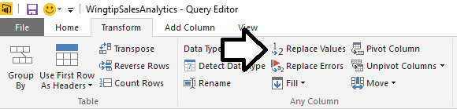
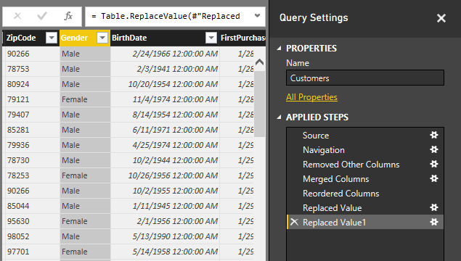
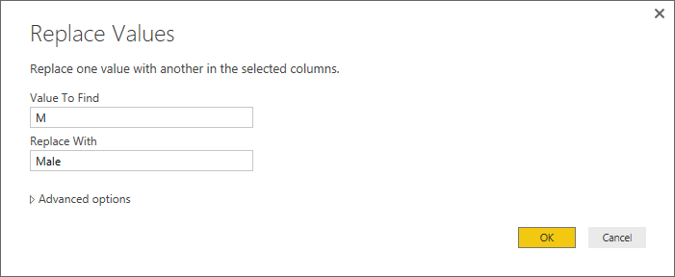
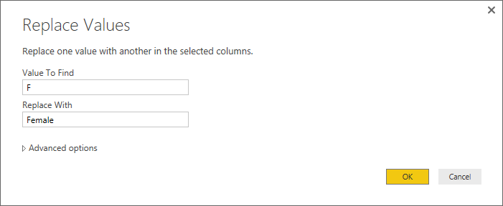
Replacing Values
Used to substitute values during import
Notes:
The operation for replacing values is often used to clean up data. Let’s look at an example. Imagine you have a database with a Customers table contains a Gender column and each row contains a value or either “M” or “F”. When you create reports on the Customers table, you want to show what percentage of customers are men as compared to women.
While you can display the underlying Gender values of “M” and “F” directly in a report, it might be more readable to your users to replace all “M” values with “Male” and all “F” values with “Female”.
The Replace Values operation makes this very easy to do as part of the transform that is run in the Customers table as the data is imported. Note that you will need two separate operations as one will find all “M” values and replace them with “Male” and the second will operation one will find all “F” values and replace them with “Female”.

Slide 28
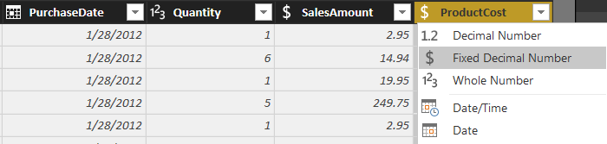
Converting Column Types
Transform data to make it more reliable
Convert date-time column to date column
Transform data to make it more efficient
Convert decimal to fixed decimal number for currency
Beware: Conversion can have destructive effect on data
Notes:
When creating queries in Power BI Desktop, it is a very common undertaking to convert column types as the data is imported into a Power BI Desktop project. For example, if you are creating a query to import database columns that contain currency values, you should explicitly convert these column values to a type of Fixed Decimal Number. When importing date values, it is also very common to convert from the Data/Time data type to a Date data type so that the imported date values have only a date component without a time offset.
Note that the Query Output window display the type of each column in the upper left-hand corner of the column header. This makes it easy to examine a query in the Query Editor window and quickly determine what data type Power BI desktop will use for each column in the query output. If you see that a column in the Query Editor window is not being imported using the most appropriate data type, you can click on the header for that column to drop down the column type menu as shown in the slide above where the ProductCost column is being configured to explicitly convert its values into the Fixed Decimal Number type.

Slide 29
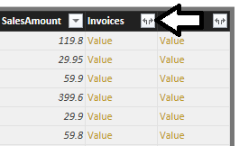
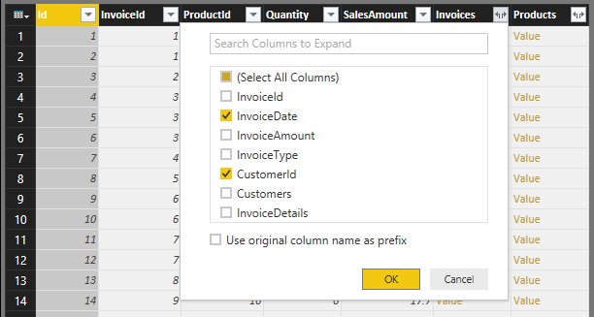
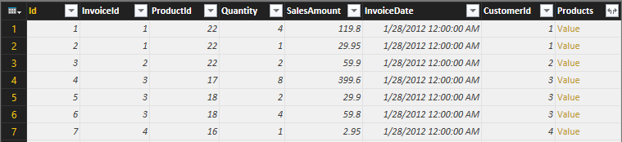
Expanding Related Columns
Used to pull data from related tables
Saves you from performing SQL joins or VLOOKUP
Notes:
When you are importing data from a database that has multiple tables, it is common to create a query whose output contains data from two or more tables. Consider the example with the database named WingtipSalesDB which has an InvoiceDetails table and an Invoices table.

Slide 30
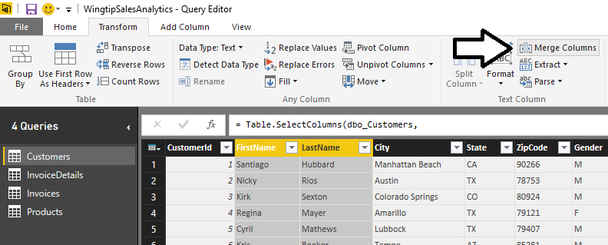
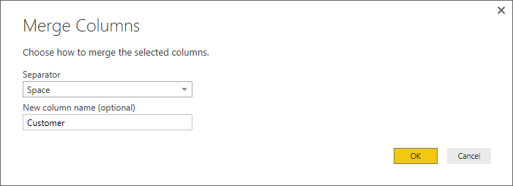
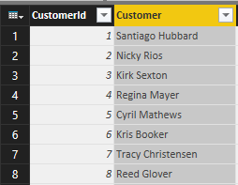
Merging Columns
Merge two columns into a single column

Slide 31
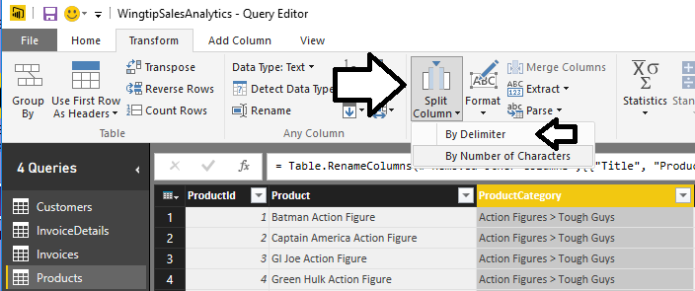
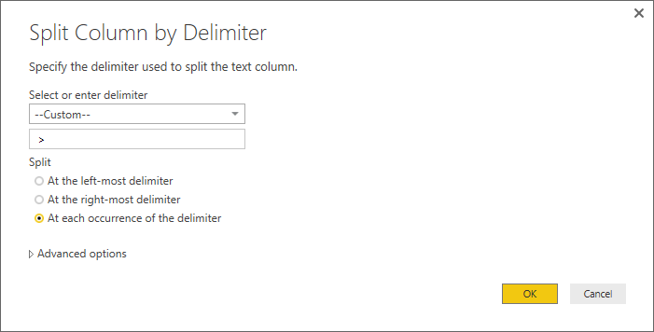
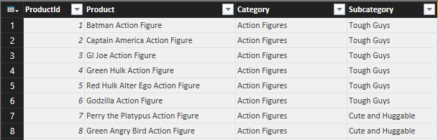
Splitting Columns
Split a single column up into two columns

Slide 32
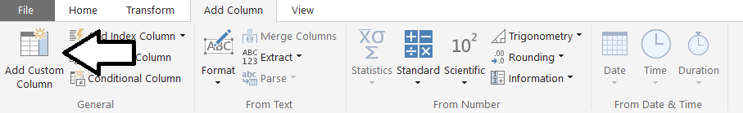
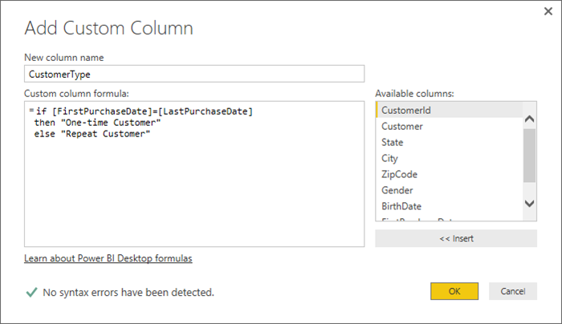
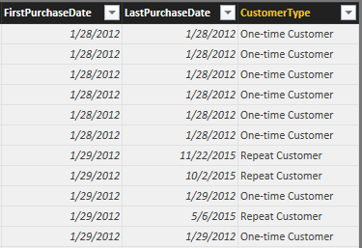
Adding a Custom Column
Custom column provide custom logic
Logic must be written in M programming language

Slide 33
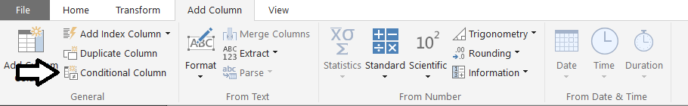
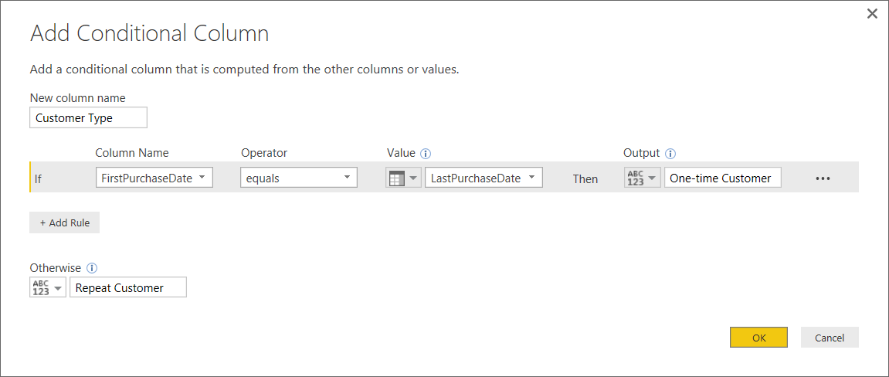
Adding a Conditional Column
Abstracts away need to write M code

Slide 34
Using Queries to Transform Data During the Load Process

Slide 35
Agenda
Deciding What To Measure
Understanding Queries in Power BI Desktop
Working with the Query Editor Window
Designing Advanced Combine Queries
Importing OLTP Data Into a Star Schema

Slide 36
Combining Queries
Query can be merged or appended with another query
Merge operation allows you combine columns from two tables
Append operation allows you to combine rows from two tables
Two queries are combined into single output for loading
Load settings of main query determines where output is loaded
Secondary query acts as source for main query
Secondary query be can created with connection-only load setting
Data Source
Data Source
Data Source
query2
Data Source
main query
query2
main query
query3
Data Source
query output
query4
Data Source
col1 | col2 | col3
bob | 23 | 45
Oft | 43 | 74
sue | 32 | 47
fran | 41 | 55
query output
Notes:
Power BI Desktop allows you to combine to queries. Combining queries means that you are combining two data sources into a single table as the queries output. Power BI Desktop supports two combine operations which are merge and append. A merge operation is used when you need to combine columns in from two tables into a single table. An append operation is used when you need to combine rows from two tables into a single table.
Consider that combining two queries produces a single output. Yet each of the queries involved has its own Power BI Desktop load setting. You configure the load setting of the main query to determine where to load the result of the merge/append operation. However, the secondary query which is only being used as the source in another query doesn't usually need to load its output anywhere in the workbook. When you are creating a query whose sole purpose is to be used as a source for a merge or append operation in another query, you can disable loading by configuring the load setting as a "connection-only" query.
What if you need to append together rows from more than one table? That's not a problem. A main query can include more than one append operation as shown in the diagram above on the right. This means a single query can append together rows from as many source tables as necessary.

Slide 37
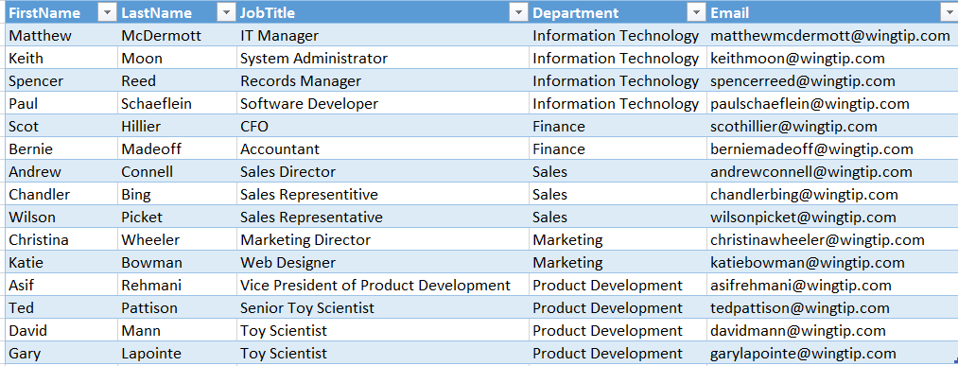
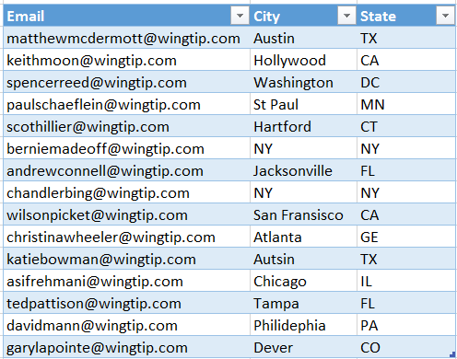
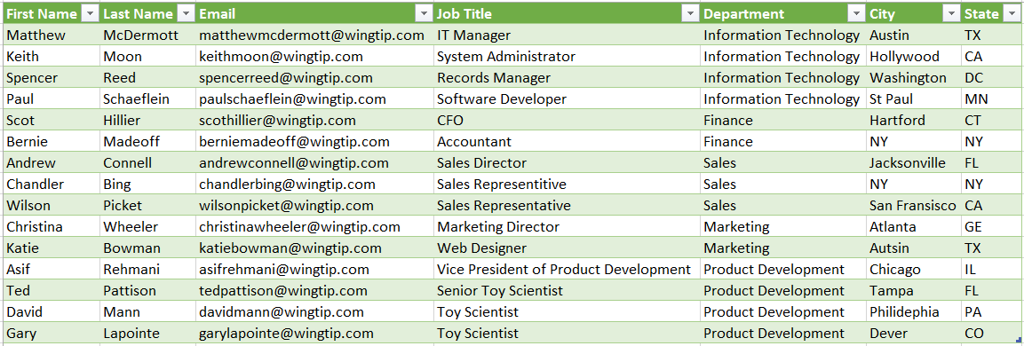
Merging Columns
Main Query Input
Merge Query Input
Join Column
Join Column
Query Output
Notes:
Merging columns is a transform operation that you can perform on two tables that have either a one-to-one relationship or a one-to-many relationship. When you merge columns from two tables together, must a select a key column in each of the tables to perform the equivalent of a database join operation.

Slide 38
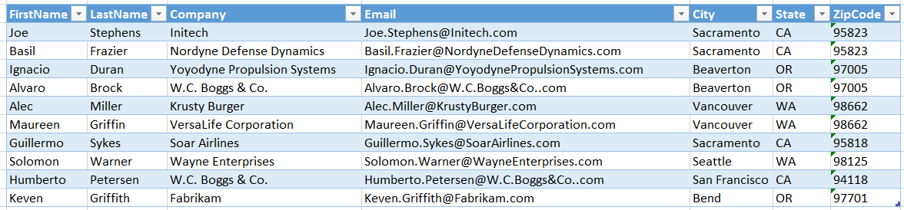
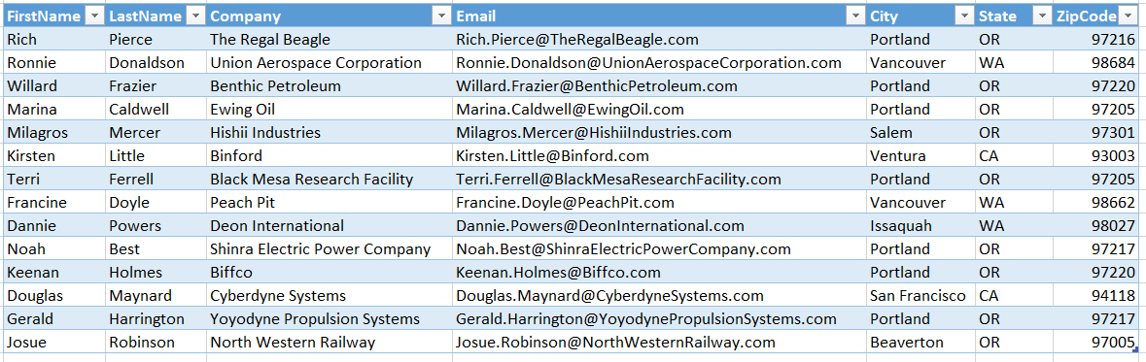
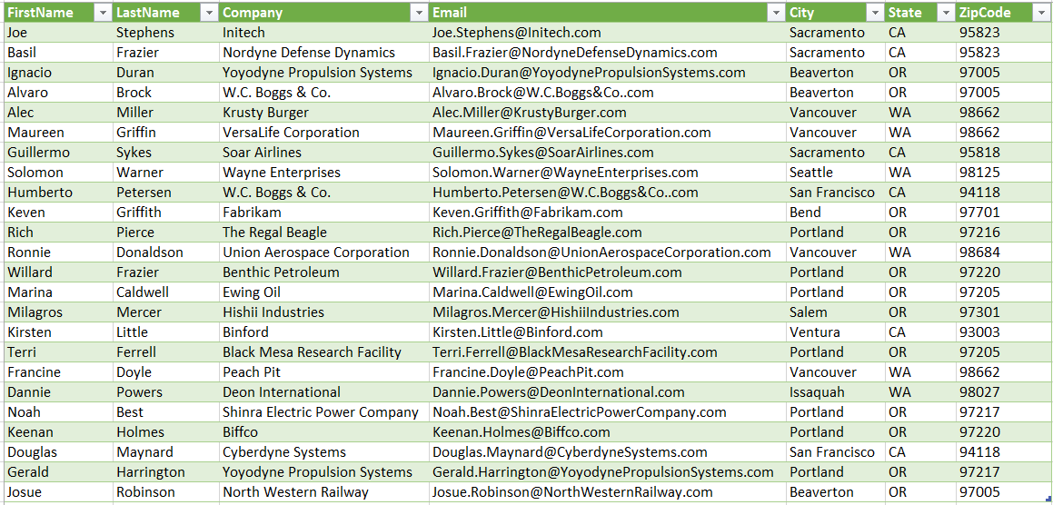
Appending Rows
Main Query Input
Append Query Input
Query Output
Notes:
Appending rows is a transform operation that combines the rows of two or more tables into a single output table. In general, you should ensure that all of the tables used in a append operation all have an identical set of columns with respect to column name and column datatype.
Consider an example. Imagine you append the rows from two tables. If the first table contains a column named Email that is not included in the second table, the Email column is included in the query output and all the rows added from the second table will have a blank value for the Email column.

Slide 39
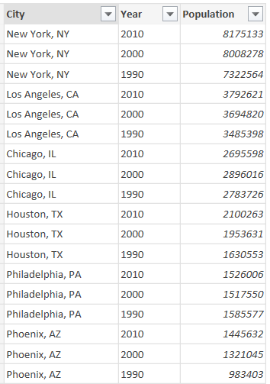
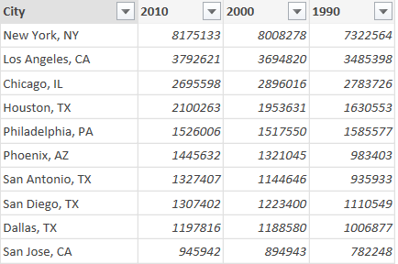
Pivoting Columns
Pivot column adds its values are new columns
Create table layout like PivotTable

Slide 40
Unpivoting Columns
Unpivot columns to collapse them into single column
Removes PivotTable layout
Can be useful to prepare data for charting and analysis

Slide 41
Agenda
Deciding What To Measure
Understanding Queries in Power BI Desktop
Working with the Query Editor Window
Designing Advanced Combine Queries
Importing OLTP Data Into a Star Schema

Slide 42
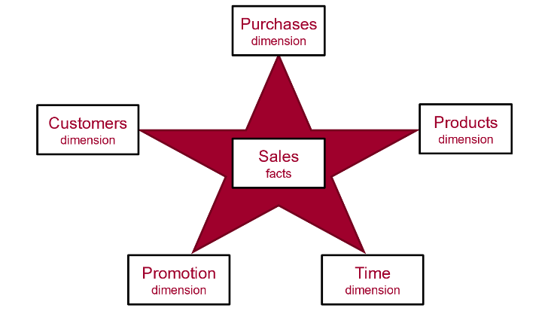
Data Modeling using a Star Schema
OLAP Modeling often based on Star Schema
Tables defined as fact tables or dimension tables
Fact tables related to dimension table using 1-to-many relationships

Slide 43
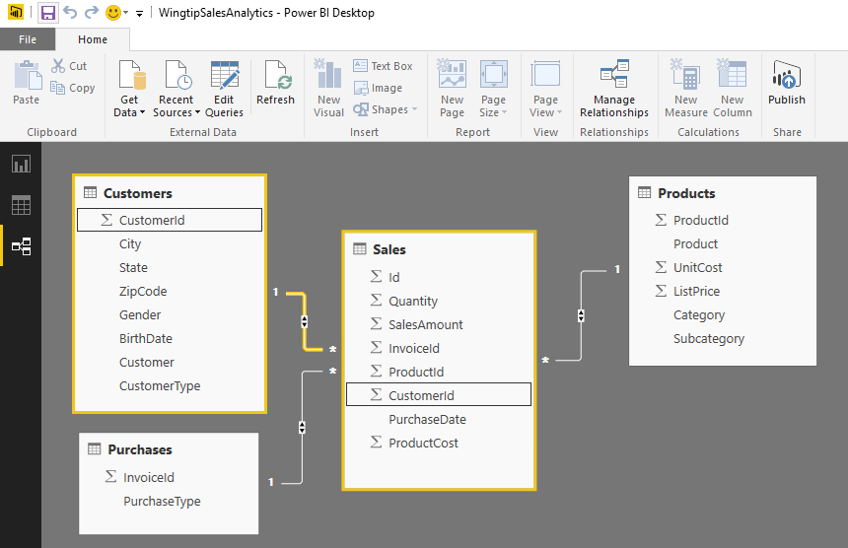
Designing Queries to Build a Star Schema
Converts OLTP Data Model to OLAP Data Model
Sales table is modeled as a OLAP Fact Table
Other tables are modeled as OLAP Dimension tables
Requires pulling CustomerId column into Sales table
All dimension tables should be directly related to fact table

Slide 44
Using Power BI Desktop to Import Data into a Star Schema

Slide 45
Summary
Deciding What To Measure
Understanding Queries in Power BI Desktop
Working with the Query Editor Window
Designing Advanced Combine Queries
Importing OLTP Data Into a Star Schema

