Slide 1
Data Modeling with Power BI Desktop
Notes:
While this course assumes students already have experience writing DAX code in Power BI Desktop, this module covers DAX at a more advanced level. The module discusses DAX coding conventions and guidelines for writing measures and calculated columns that are more readable and maintainable. The module also examines how DAX expressions are affected by the evaluation contexts well as using the CALCULATE function. Students will learn how to use DAX to create a dynamic Calendar Table and leverage the built-in time intelligence functions.

Slide 2
Agenda
Data Modeling with Power BI Desktop
Understanding the DAX Evaluation Context
Creating a Dynamic Calendar Table
Designing Interactive Reports
Understanding Row-level Security (RLS)
Publishing PBIX Projects to PowerBI.com

Slide 3
Data Modeling with Power BI Desktop
Steps to create a data model with Power Pivot
Create relationships between tables
Modify columns (rename, set formatting, convert type)
Create calculated columns
Create measures
Add column metadata
Create dimensional hierarchies
Add Calendar table(s)

Slide 4
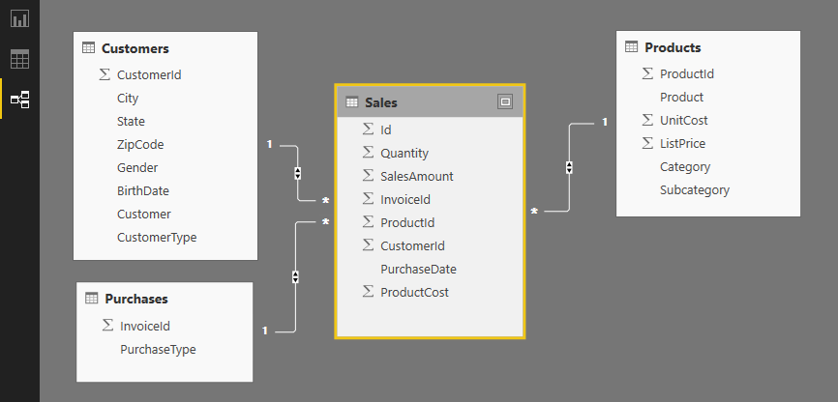
Table Relationships
Tables in data model associated with relationships
Relationships based on single columns
Tabular model supports [1-to-1] and [1-to-many] relationships
Relationships based on single column in each table

Slide 5
Calculated Columns vs Measures
Calculated Columns (aka Columns)
Evaluated based on context of a single row
Evaluated when data is loaded into memory
Measures
Evaluated at query time based on current filter context
Commonly used for aggregations (e.g. SUM, AVG, etc.)
Used more frequently than calculated columns
Column1 = <DAX expression>
Measure1 = <DAX expression>

Slide 6
When to Create Calculated Columns
Measures often better choice than calculate columns
Don't create calculated column when you need a measure
Prefer to create calculated columns only in specific scenarios
When should you create calculated columns?
To create headers for row labels or column labels
To place calculated results in a slicer for filtering
Define an expression strictly bound to current row
Categories text or numbers (e.g. customer age groups)

Slide 7
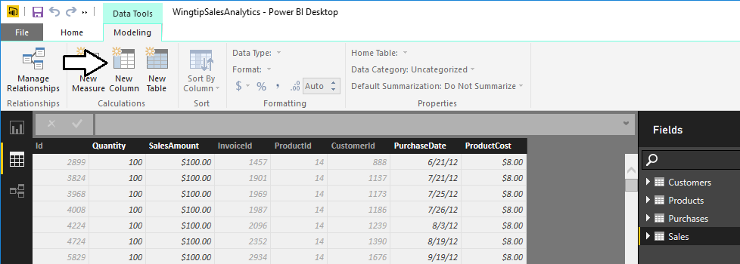
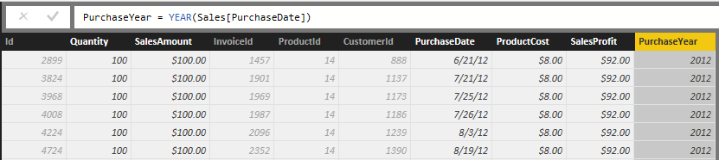
Creating Calculated Columns
Edited in formula bar of Power Pivot data view
Start with name and then equals (=) sign
Enter a valid DAX expression
Clicking on column adds it into expression

Slide 8
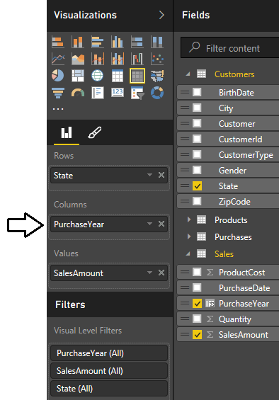
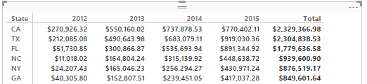
Calculated Column as a Column Label
Calculate column can serve as...
Row labels
Column labels

Slide 9
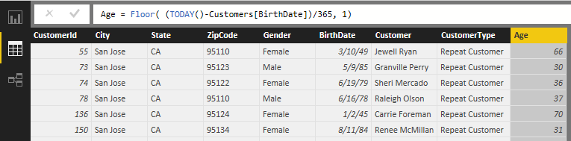
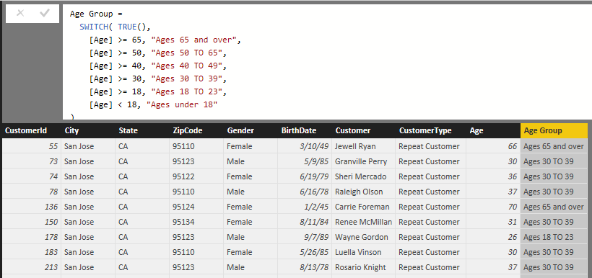
Calculated Column for Customer Age Group
Calculate customer age from birthdate
Calculate age groups using calculated column

Slide 10
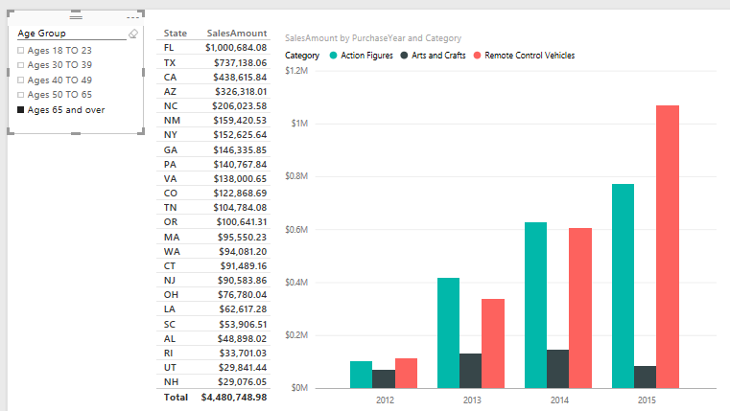
Calculated Column used in a Slicer
Calculated column can populate slicer values

Slide 11
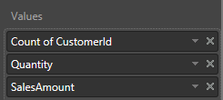
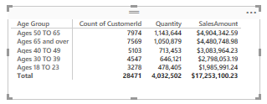
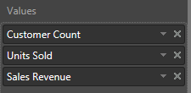
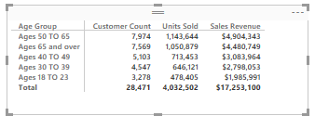
Benefits of Measures over Calculated Columns
Calculated columns can be aggregated in visual
However, aggregation details are stored in visual
Visual doesn't offer control over name and formatting
Measure defines name, aggregation and formatting
Work is done once and reused across many visuals
Makes data model more fool-proof for report designers

Slide 12
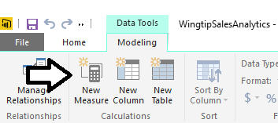
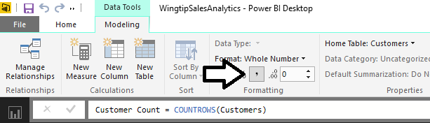
Creating Measures
Measures have advantage over calculated columns
They are evaluated based on the current evaluation context
Creating a measure with Power BI Desktop
Click New Measure button
Give measure a name and write DAX expressions
Configure formatting
1
3
2

Slide 13
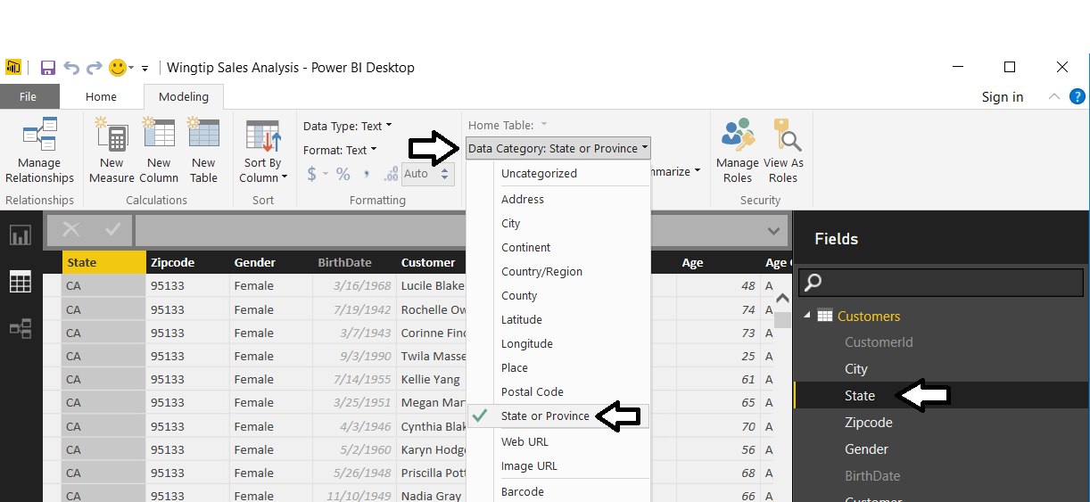
Geographic Field Metadata
Fields in data model have metadata properties
Metadata used by visuals and reporting tools
Used as hints to Bing Mapping service

Slide 14
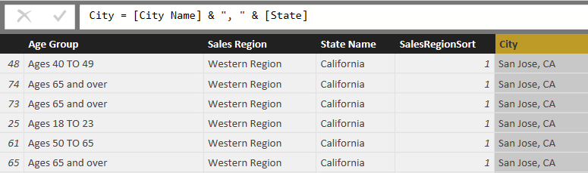
Eliminate Geographic Ambiguity
City name alone is ambiguous
"Athens" defaults to Greece not Georgia
Concatenate city name with state to disambiguate

Slide 15
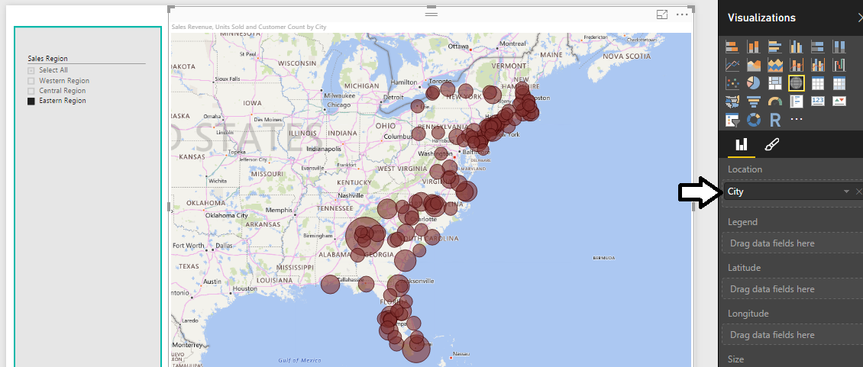
Using Map Visual with a Geographic Field
Map Visual shows distribution over geographic area
Visual automatically updates when filtered

Slide 16
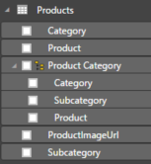
Dimensional Hierarchies
Hierarchy created from two or more columns
All columns in hierarchy must be from the same table
Defines parent-child relationship between columns
Provides path to navigate through data
Provides path to drill down into greater level of detail

Slide 17
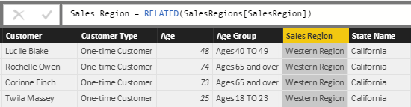
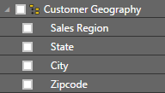
Pulling Columns for Hierarchy into Single Table
Sometimes hierarchy columns are spread across tables
Use RELATED function from DAX to pull columns into single table
Then create hierarchy in the table with all the columns

Slide 18
Agenda
Data Modeling with Power BI Desktop
Understanding the DAX Evaluation Context
Creating a Dynamic Calendar Table
Designing Interactive Reports
Understanding Row-level Security (RLS)
Publishing PBIX Projects to PowerBI.com

Slide 19
A Tale of Two Evaluation Contexts
Row Context
Context includes all columns in iteration of current row
Used to evaluate DAX expression in calculated column
Only available in measures with iterator function (e.g. SUMX)
Filter Context
Context includes filter(s) defining current set of rows
Used by default to evaluate DAX expressions in measures
Can be fully ignored or partially ignored using DAX code
Not used to evaluate DAX in calculated columns

Slide 20
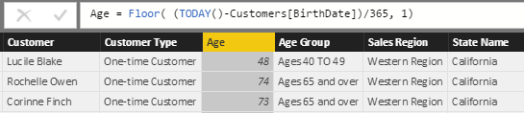
Understanding Row Context
Row context used to evaluate calculated columns

Slide 21

Understanding Iterators Like SUMX
Standard aggregation functions (e.g. SUM) have no row context
You can use SUM to sum values of a single column
You cannot use SUM to sum results of an expressions
Iterator functions (e.g. SUMX) iterate through rows in target table
First argument accepts expressions that evaluates to table of rows
Second argument accepts expression that is evaluated for each row

Slide 22
DAX Table Iterator Functions
The following DAX functions create row context
AVERAGEX
COUNTAX
COUNTX
MAXX
MINX
SUMX

Slide 23
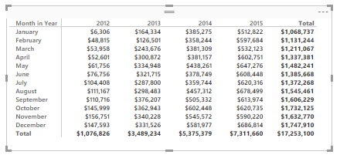
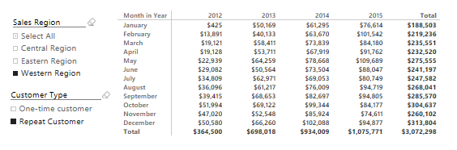
Understanding Filter Context
Visuals apply various filters in different evaluation contexts
Filter context also affected by slicers and other filters
Filters on this evaluation
[Year] = 2015
[Month in Year] = "October"
Filters on this evaluation
[Year] = 2015
[Month in Year] = "October"
[Sales Region] = "Western Region"
[Customer Type] = "Repeat Customer"

Slide 24
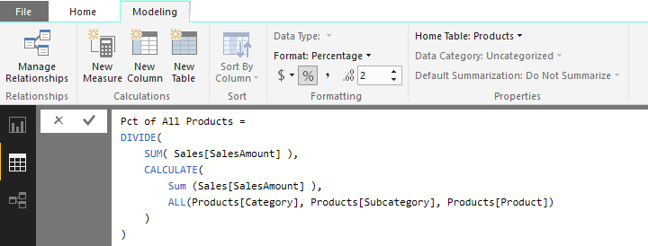
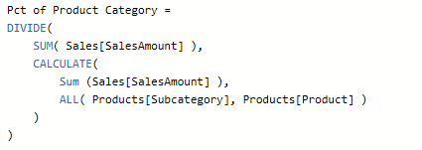
Using the CALCULATE Function
CALCULATE function provides greatest amount of control
First argument defines expression to evaluate
Second argument defines table on which to evaluate expression
You can evaluate expressions with or without current filter context

Slide 25
Agenda
Data Modeling with Power BI Desktop
Understanding the DAX Evaluation Context
Creating a Dynamic Calendar Table
Designing Interactive Reports
Understanding Row-level Security (RLS)
Publishing PBIX Projects to PowerBI.com

Slide 26
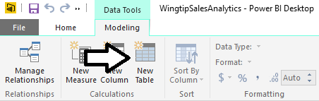
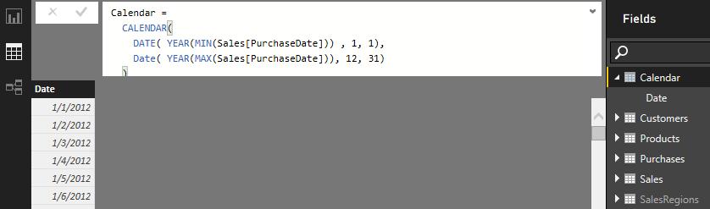
Creating Calendar Table as Calculated Table
Use New Table command in ribbon
Create calendar table using DAX CALENDAR function

Slide 27
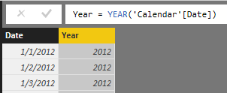
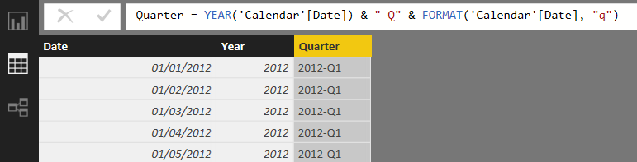
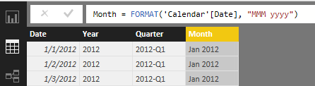
Adding Columns to Calendar Table
Creating the Year column
Creating the Quarter column
Creating the Month column

Slide 28
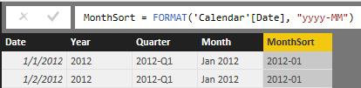
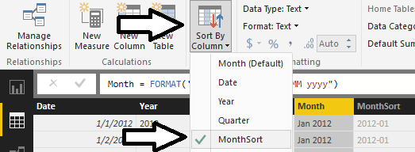
Configuring Sort Columns
Month column will not sort in desired fashion by default
For example, April will sort before January, February and March
Creating a sort column for the Month column
MonthSort sorts alphabetically & chronologically at same time
Configure Month column with MonthSort as sort column

Slide 29
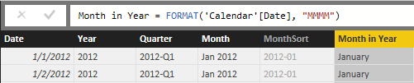
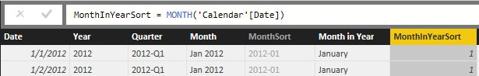
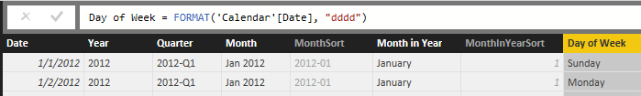
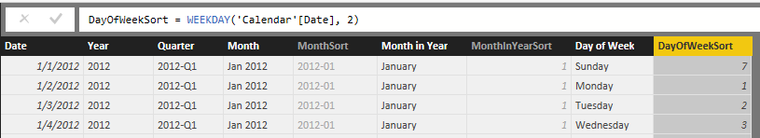
Columns for Month in Year and Day in week
Creating the Month in Year column
Creating the MonthInYearSort column
Creating the Day of Week column
Creating the DayOfWeekSort column

Slide 30
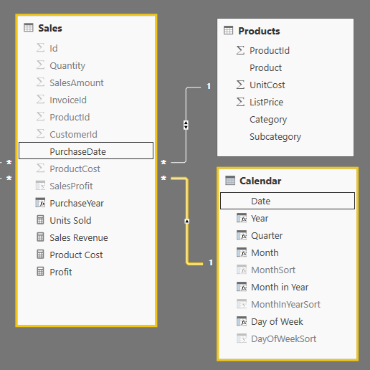
Integrating Calendar Table into Data Model
Calendar table needs relationship to one or more tables

Slide 31
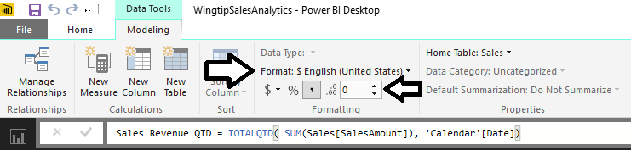
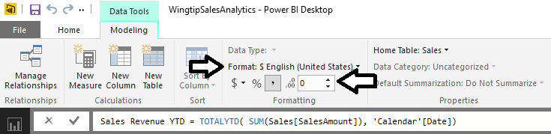
Calculated Fields for QTD and YTD Sales
TOTALQTD function calculates quarter-to-date totals
TOTALYTD function calculates year-to-date totals

Slide 32
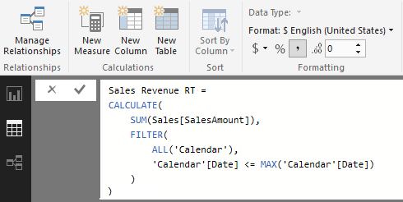
Creating Running Total using CALCULATE
Calculate a running total of sales revenue across years
This must be done using CALCULATE function

Slide 33
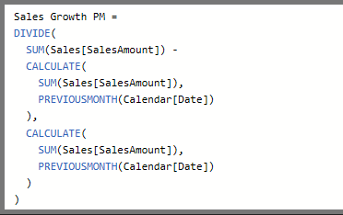
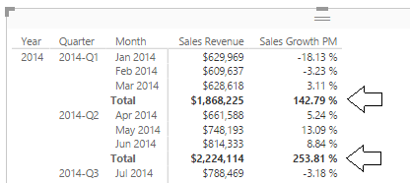
Sales Growth PM Measure - First Attempt
Create a measure named Sales Growth PM
Use measure in matrix evaluating month and quarter
Measure returns correct value when filtered by Month
Measure returns large, erroneous value when filtered by Quarter

Slide 34
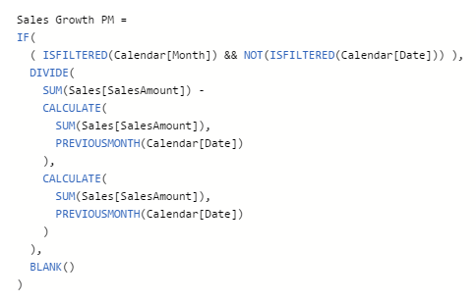
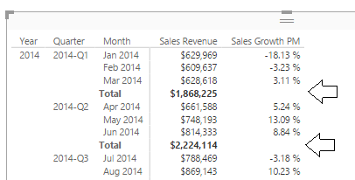
Using the ISFILTERED Function
ISFILTERED function used to determine when perform evaluation
Expression returns Blank value when evaluation context is invalid

Slide 35
Agenda
Data Modeling with Power BI Desktop
Understanding the DAX Evaluation Context
Creating a Dynamic Calendar Table
Designing Interactive Reports
Understanding Row-level Security (RLS)
Publishing PBIX Projects to PowerBI.com

Slide 36
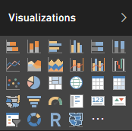
Built-in Visualization Types
Table and Matrix
Bar charts and Column charts
Pie charts and Doughnut chart
Line chart and Area chart
Scatter chart and Combo charts
Card and Multi-row Card
Treemap
Waterfall charts
Funnel charts
Gauge charts
Map and Filled Map
Slicer
R script visual
Shape map (in preview)

Slide 37
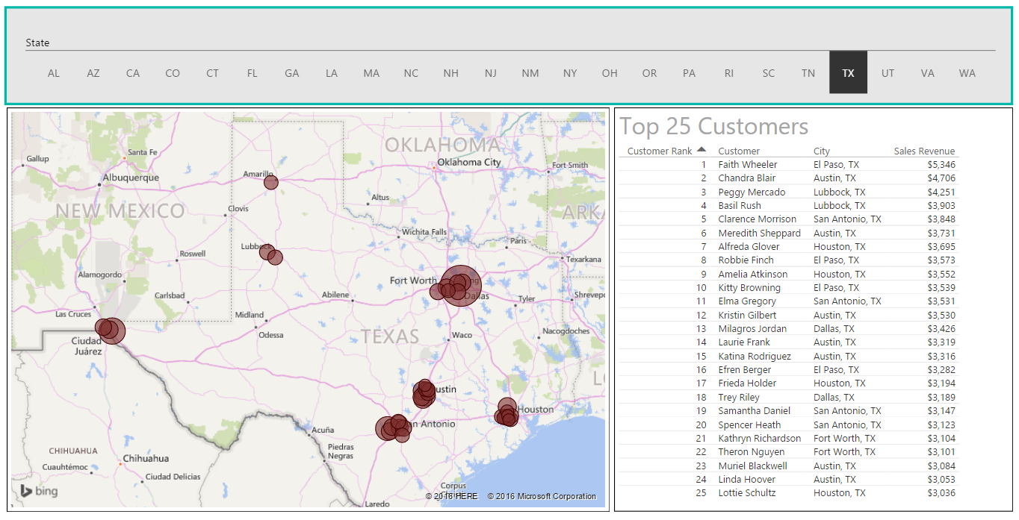
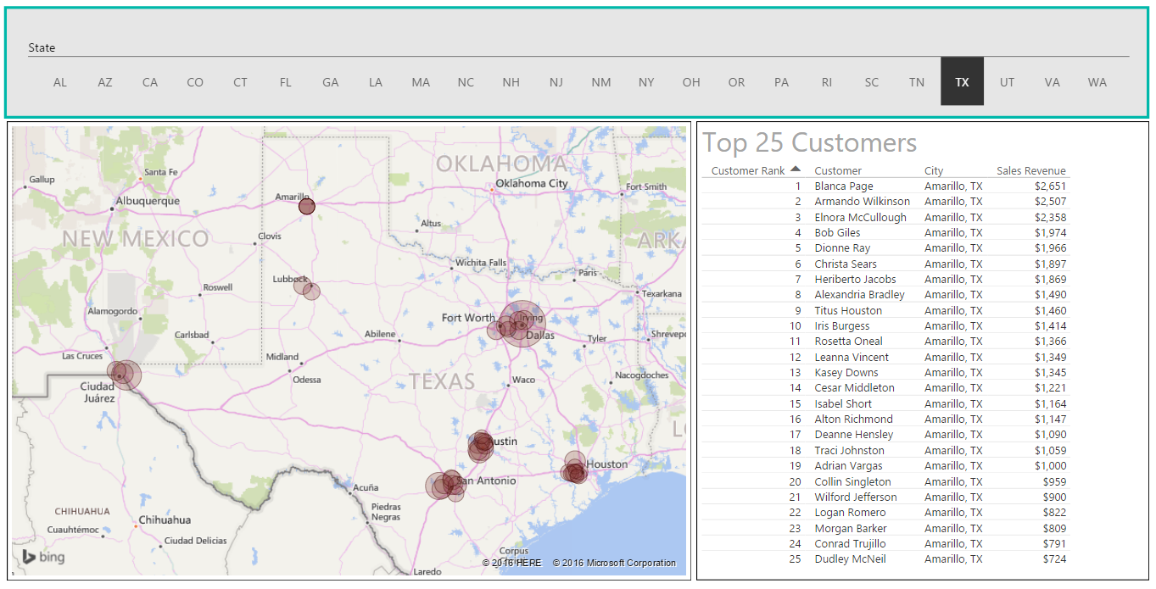
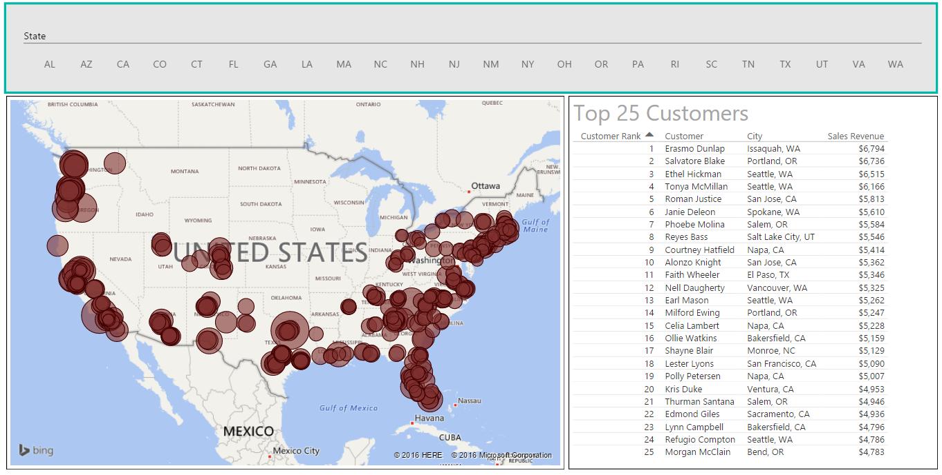
User Interaction with Slicers & Highlighting
Provides user with interactive filtering control
Click to filter
Click again to disable Highlight
Click to Highlight

Slide 38
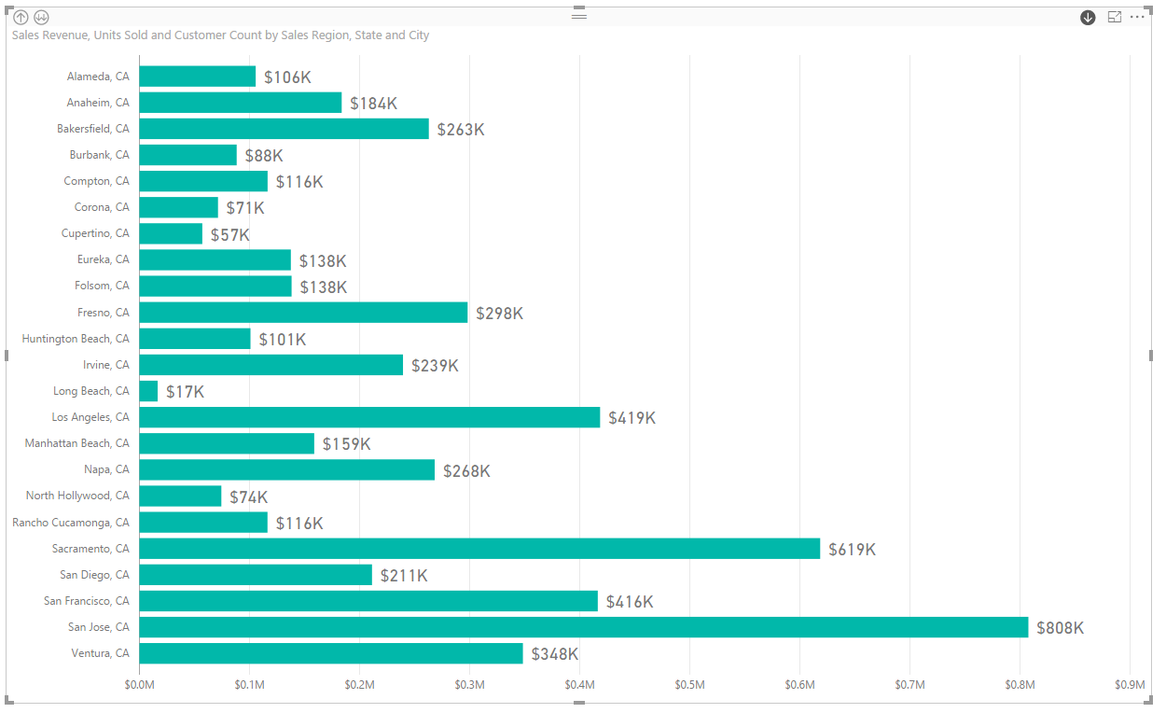
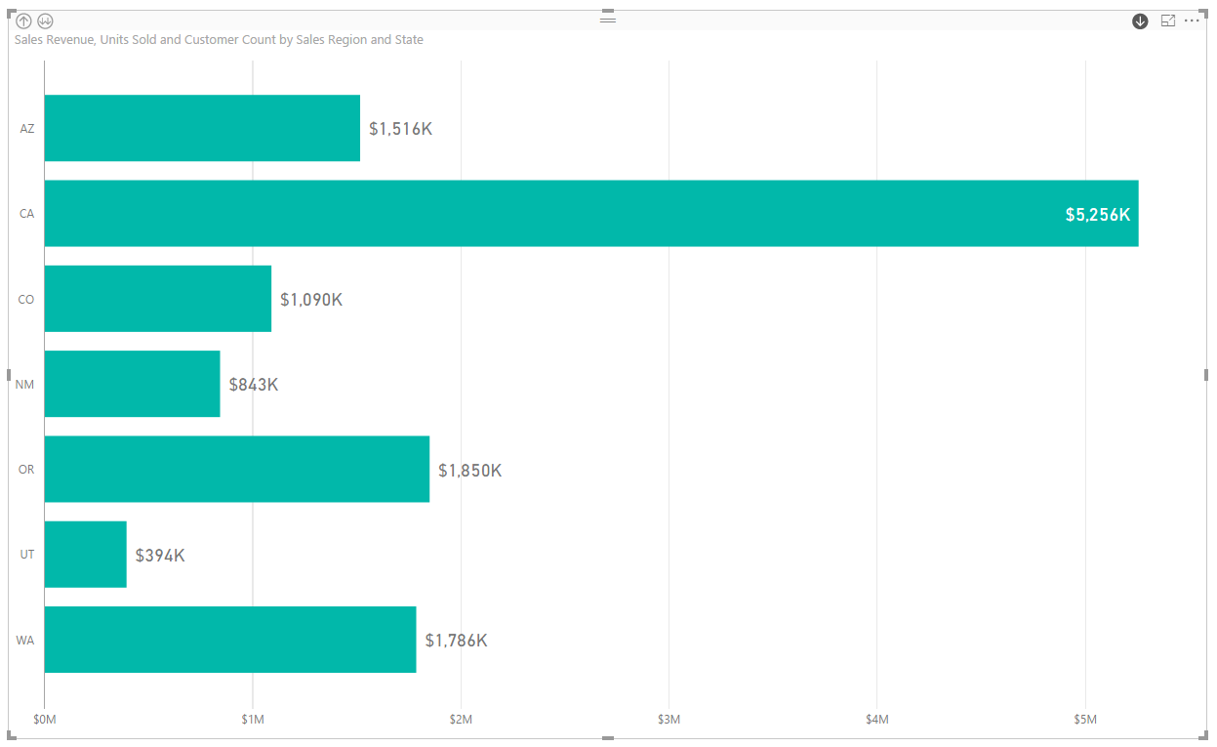


User Interaction using Drill Actions
Drill Actions supported when using hierarchies
You must enabled drilldown mode in visual

Slide 39
Agenda
Data Modeling with Power BI Desktop
Understanding the DAX Evaluation Context
Creating a Dynamic Calendar Table
Designing Interactive Reports
Understanding Row-level Security (RLS)
Publishing PBIX Projects to PowerBI.com

Slide 40

What Is Row-level Security (RLS)
Security features for restricting user access
Introduced into preview in February of 2016
RLS feature set changed in summer of 2016
Configuring RLS now requires Power BI Desktop
RLS requires all users to have Power BI Pro license
This course covers RLS in Module 6 and Module 7
Notes:
The Power BI platform is constantly changing. Since its release into General Availability (GA) in July of 2015, Microsoft has been very consistent about apply monthly updates to the Power BI service and Power BI Desktop. One challenge for any professional that works with the Power BI platform is keeping up to date with Microsoft’s monthly updates as they are applied. Things can change drastically from one day to the next.
In February of 2016, Microsoft held the Data Insights Summit conference in which they made several major announcements about new features that they were adding to the Power BI platform. One of the biggest announcements was the introduction of a new security feature known as Row-level Security (RLS).
The way in which you work with RLS has been changed significantly through its time in preview. When RLS was first introduced, you could configure it entirely through the browser. Then in the summer of 2016, the RLS feature set was changed in a manner that requires you to configure it using Power BI Desktop. The key point here is that you must anticipate change especially for features that are still in preview.

Slide 41
Agenda
Data Modeling with Power BI Desktop
Understanding the DAX Evaluation Context
Creating a Dynamic Calendar Table
Designing Interactive Reports
Understanding Row-level Security (RLS)
Publishing PBIX Projects to PowerBI.com

Slide 42



Publishing a Power BI Desktop Project
Power BI Desktop provides Publish command
Used to publish project to Power BI service
Requires logging into your Office 365 account
Published articles added to a specific workspace

Slide 43

Examining What's Been Published
What does project publishing add to workspace?
One dataset with same name as project
One report with same name as project

Slide 44

Dataset Configuration
You can configure Dataset after its been published
Configure data source credentials
Configure refresh schedule
Configure Row-level Security

Slide 45
Summary
Data Modeling with Power BI Desktop
Understanding the DAX Evaluation Context
Creating a Dynamic Calendar Table
Designing Interactive Reports
Understanding Row-level Security (RLS)
Publishing PBIX Projects to PowerBI.com

