Slide 1
Managing Power BI Gateways and On-premises Data
Notes:
The module begins by explaining the differences between imported datasets and datasets which are based on a live connection. Students will learn how to configure data source credentials in the Power BI service making it possible to refresh data manually on demand or in an automated and scheduled fashion. The module also discusses the role of gateways in the Power BI platform and explains what types of connections and scenarios require you to install and configure a Power BI gateway. Student will learn about the differences between the Personal Gateway and the On-premises Gateway and also learn how to configure on-premises data sources to support data refresh and DirectQuery Mode.

Slide 2
Agenda
Comparing Imported Datasets to Live Connect
Refreshing Data using Storing Credentials
Configuring a Dataset for Auto Refresh
Installing and Configuring Personal Gateway
Installing and Configuring On-premises Gateway
Designing Datasets using DirectQuery Mode

Slide 3
Imported Datasets Versus Live Connect
Imported Dataset
Data is imported into storage within Power BI service
Entire dataset loaded into memory when in use
Reports and Datasets query data in imported dataset
Dataset size is maxed out at 1GB
Dataset must be refreshed when source data changes
Dataset based on Live Connection
No data is imported or cached in the Power BI service
Reports and Datasets query data with live connection
No need to refresh data
No need to worry about 1GB dataset size limitation
Limitation are placed on features for querying and data modeling

Slide 4

Importing Data from Cloud Data Sources
Importing Datasets from Cloud Data Sources
Power BI Desktop saves data locally in PBIX file
PBIX file published to import dataset into Power BI Service
Microsoft Cloud
Power BI Service
Azure SQL Server
Your PC
Power BI Workspace
SQL Database
Power BI
Desktop
Power BI
Report
extract
publish
SharePoint Online
PBIX File
Power BI
Dataset
SharePoint List
Excel Workbook

Slide 5
Refreshing Data from Cloud Data Sources
Power BI Service Can Be Configured to Refresh Data
Power BI Desktop will never publish login credentials
You must configure data source credentials in Power BI service
Microsoft Cloud
Power BI Service
Azure SQL Server
Power BI Workspace
SQL Database
Power BI
Report
Refresh on demand
SharePoint Online
Power BI
Dataset
Scheduled Refresh
SharePoint List
Connection
Credentials
Excel Workbook

Slide 6
Importing Data from On-premises Data Sources
What If Your Data Sources Live Inside an AD Domain?
Exacting and Publishing Data with PBIDT remains the same
Refreshing Data Becomes More Complicated
Power BI Service Cannot Directly Connect to Data Sources
Private Network with Active Directory Domain
Power BI Service
Azure SQL Server
SQL Database
Your PC
Power BI Workspace
Power BI
Desktop
Power BI
Report
extract
publish
SharePoint Online
PBIX File
Power BI
Dataset
SharePoint List
Excel Workbook

Slide 7
What is a Power BI Gateway?
Gateway connects Power BI to data source
Runs on PC or server joined to domain
Extracts data and returns it to Power BI service
Private Network with Active Directory Domain
Power BI Service
On-prem SQL Server
SQL Database
Power BI Workspace
PC or Server
Azure Service Bus
Power BI
Report
extract
Power BI
Gateway
request
SharePoint On-Prem
refresh
Power BI
Dataset
SharePoint List
Excel Workbook

Slide 8
Power BI Gateway Types
Power BI Personal Gateway
Data transferred under identity of single user
Requires Power BI Pro and x64 bit Operating Systems
Can refresh data up to 8 times per day
Does not support DirectQuery mode
Power BI On-premises Gateway
Data transferred under identity of any user
Requires Power BI Pro and x64 bit Operating System
Adds support for DirectQuery mode

Slide 9
Agenda
Comparing Imported Datasets to Live Connect
Refreshing Data using Storing Credentials
Configuring a Dataset for Auto Refresh
Installing and Configuring Personal Gateway
Installing and Configuring On-premises Gateway
Designing Datasets using DirectQuery Mode

Slide 10
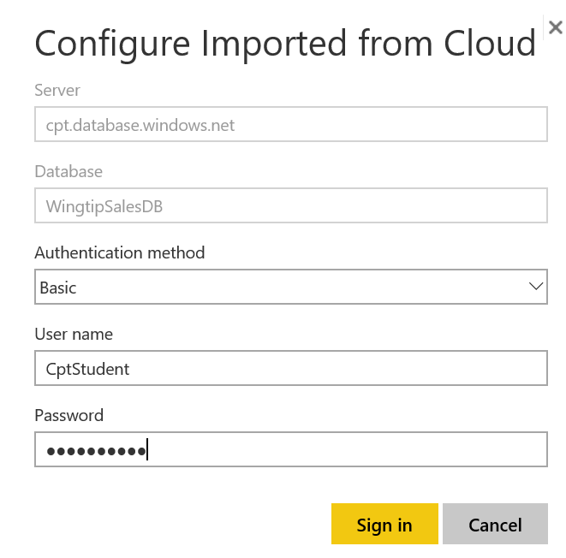
Configuring Credentials in the Cloud
Power BI Desktop never Publishes Credentials
PBIDT caches credentials locally for its own use
Connection credentials must be configured in cloud
Power BI stores credentials in encrypted format

Slide 11
Manual Refresh
Once you have configured credentials…
You can refresh on demand from Dataset flyout menu

Slide 12
Agenda
Comparing Imported Datasets to Live Connect
Refreshing Data using Storing Credentials
Configuring a Dataset for Auto Refresh
Installing and Configuring Personal Gateway
Installing and Configuring On-premises Gateway
Designing Datasets using DirectQuery Mode

Slide 13
Configuring Scheduled Refresh
Very easy to configure
Power BI Pro allows up to 8 refreshes per day
Power BI Standard allows one refresh per day

Slide 14
Agenda
Comparing Imported Datasets to Live Connect
Refreshing Data using Storing Credentials
Configuring a Dataset for Auto Refresh
Installing and Configuring Personal Gateway
Installing and Configuring On-premises Gateway
Designing Datasets using DirectQuery Mode

Slide 15
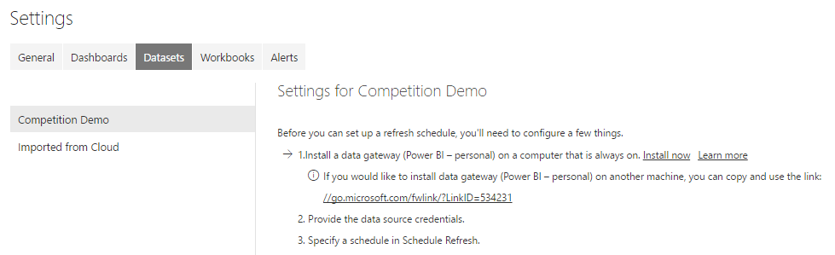
Data Refresh Might Require a Gateway
Power Service cannot connect directly to…
Local files on your PC
Files in your local network
Data sources in an Active Directory domain

Slide 16
Install Gateway As Service vs Application
Installing Personal Gateway with Admin Perms
Gateway runs as Windows service
Requires configuring Windows password for connecting
Refresh fails if password has expired
Installing Personal Gateway w/o Admin Perms
Gateway runs as standard Windows application
User must be logged into PC for refresh to occur
Gateway runs under identity of currently logged in user

Slide 17
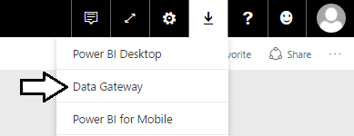
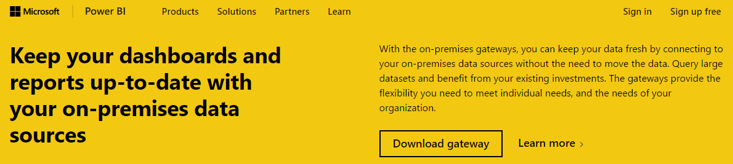
Downloading Power BI Gateway Install File
Select Data Gateway from Download menu
Click Download button on download page
Installation file for all gateways named PowerBIGatewayInstall.exe

Slide 18
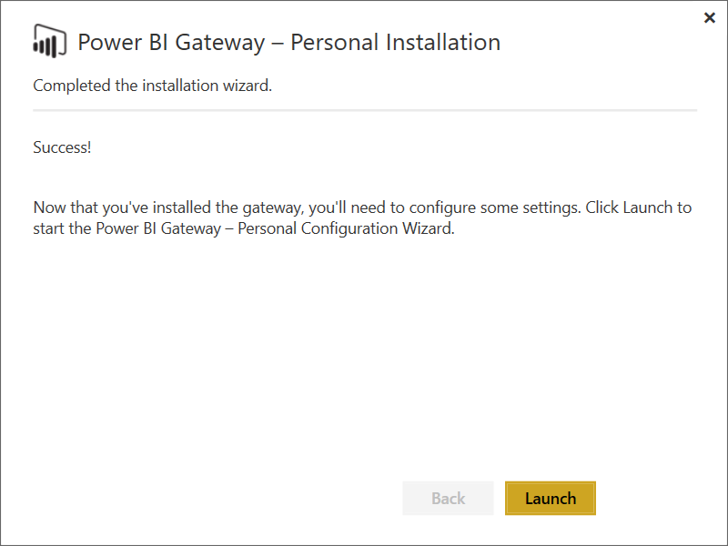
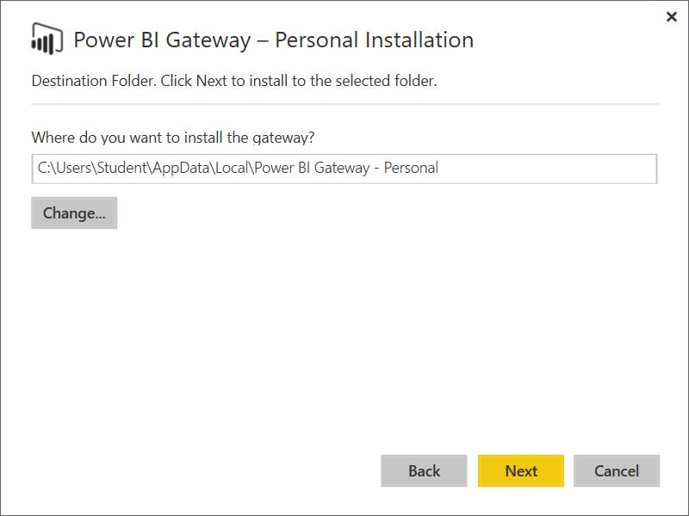
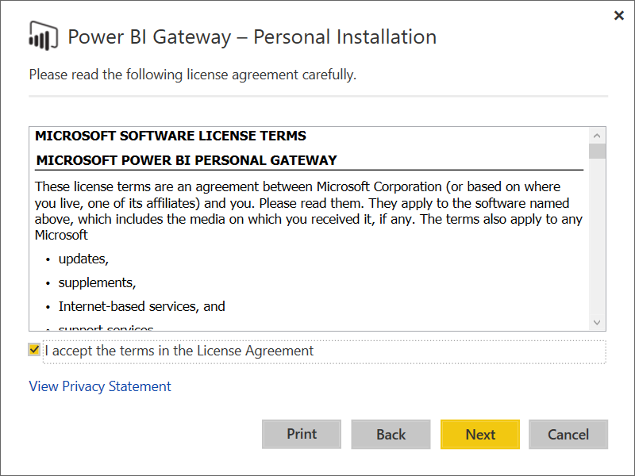
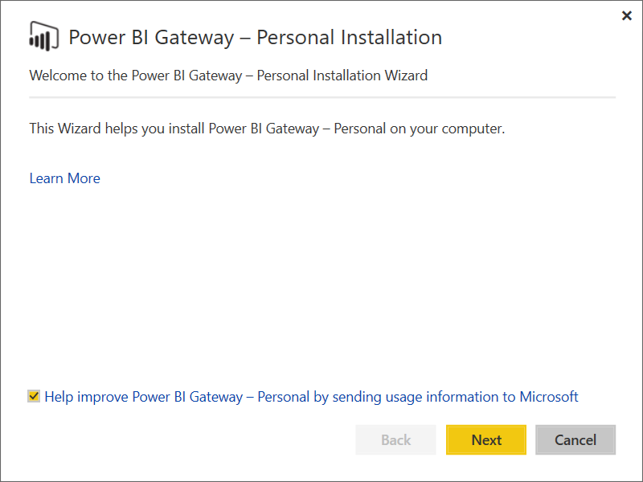
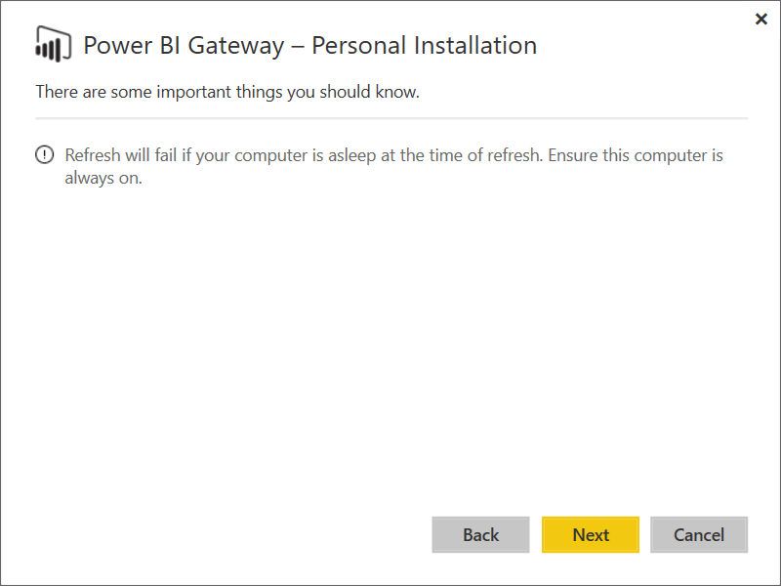
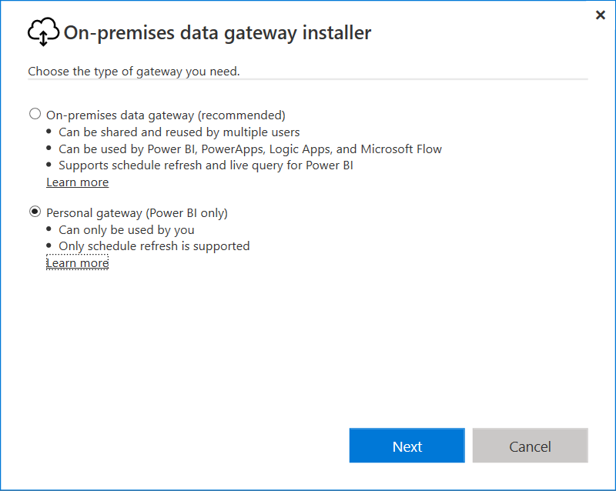
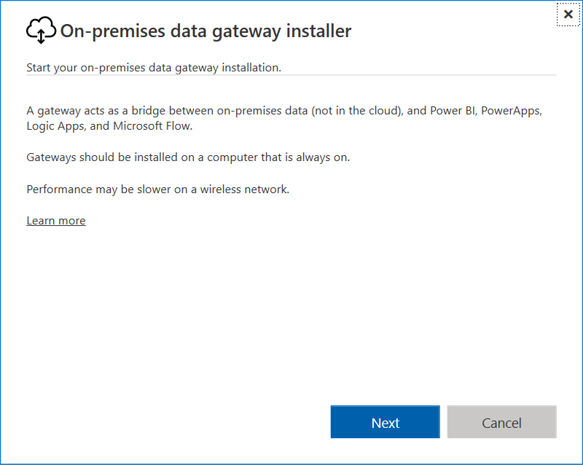
Personal Gateway Installation

Slide 19
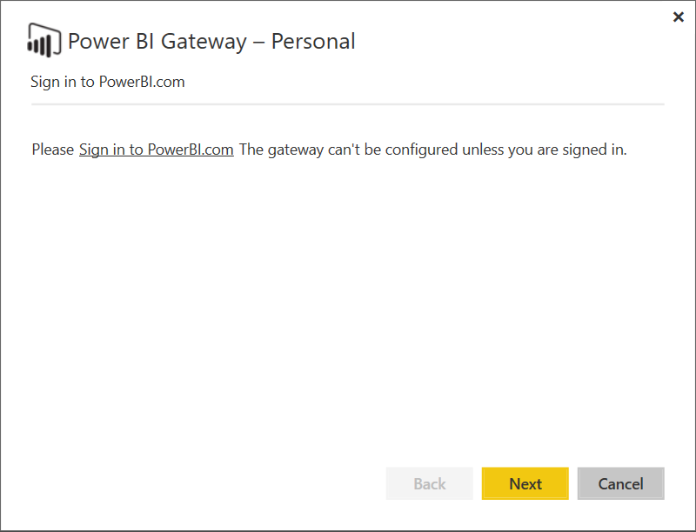
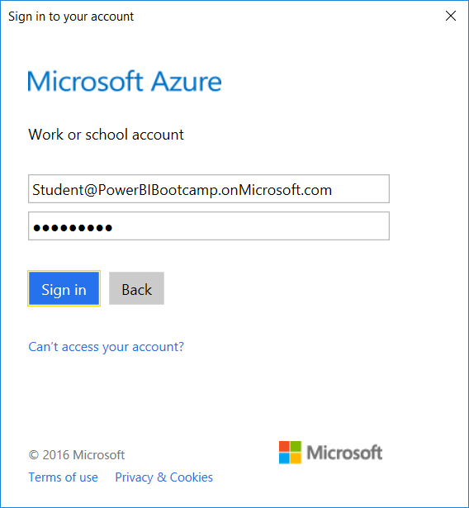
Personal Gateway Sign-in

Slide 20
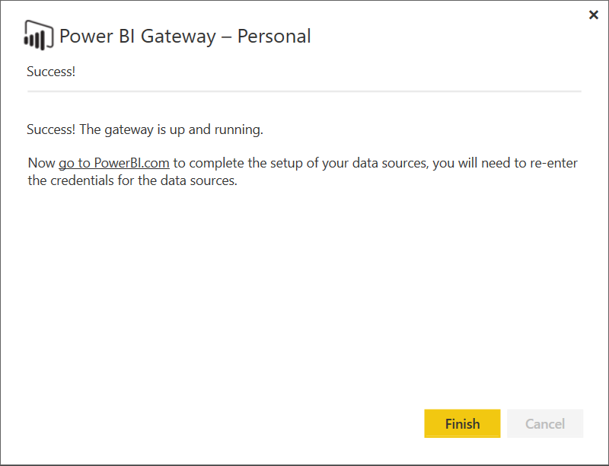
Personal Gateway Configuration

Slide 21
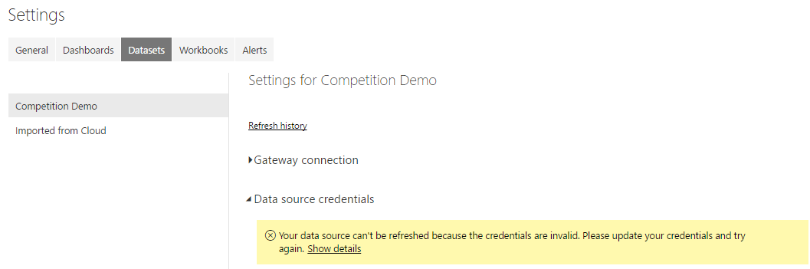
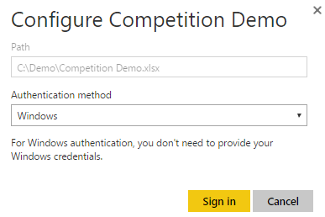
Configuring Data Source Through Gateway

Slide 22
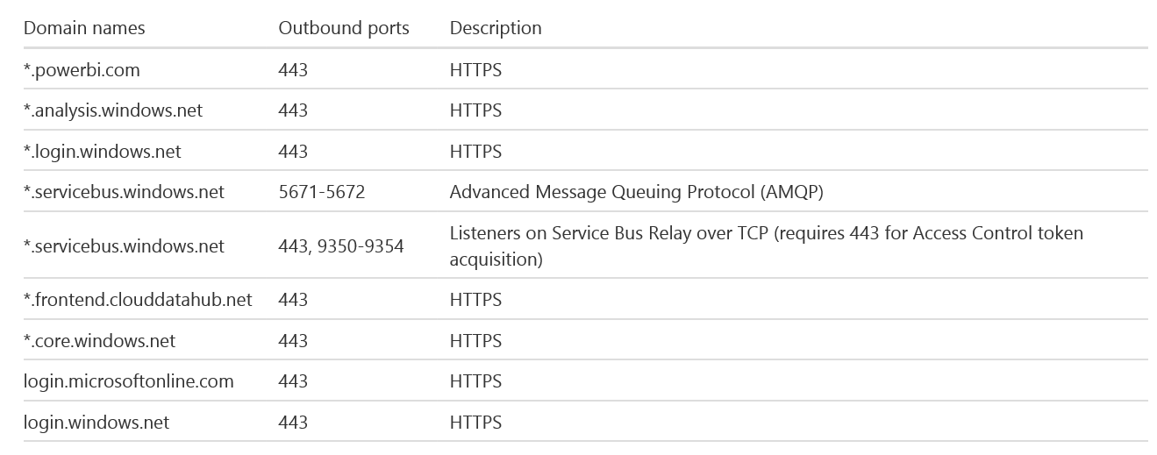
Outbound Ports – Personal Gateway
Gateway communicates through outbound ports
Gateway does not require inbound ports

Slide 23
Agenda
Comparing Imported Datasets to Live Connect
Refreshing Data using Storing Credentials
Configuring a Dataset for Auto Refresh
Installing and Configuring Personal Gateway
Installing and Configuring On-premises Gateway
Designing Datasets using DirectQuery Mode

Slide 24
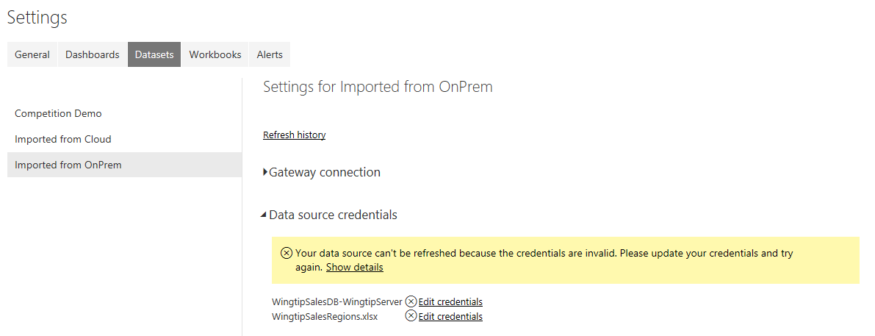
When to Use On-Premises Gateway
Common Motivation
Connecting to on-premises data sources for refersh

Slide 25
On-Premises Gateway
Enables IT to deploy & manage shared gateways
Each gateway can service large number of users
IT can install and manage multiple gateways
Eliminates need to for individual users to install personal gateways
Replaces several older Power BI Gateways
On-premises Gateway gives more control to IT
IT can centrally manage user access to underlying data sources
IT can monitor and gain visibility into gateway usage
Does On-Premises Gateway support High Availability?
Not yet as of Q3 of 2016
Microsoft working on plans to provide high availability architecture

Slide 26
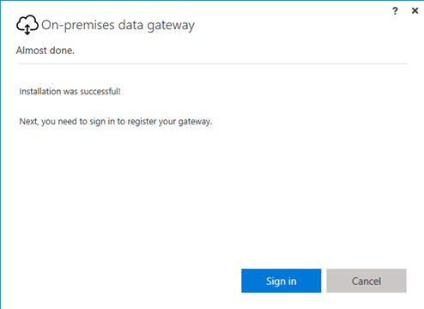
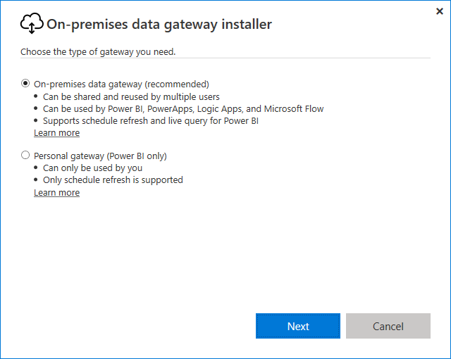
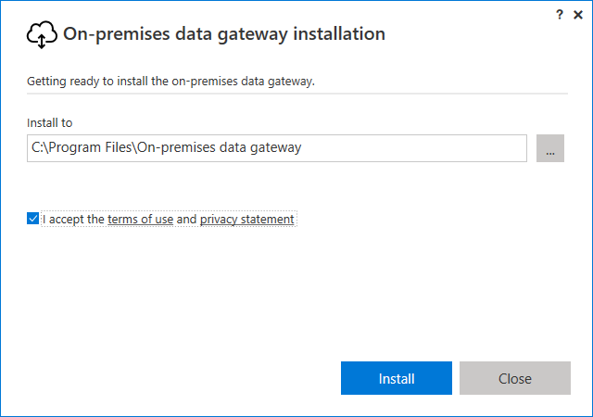
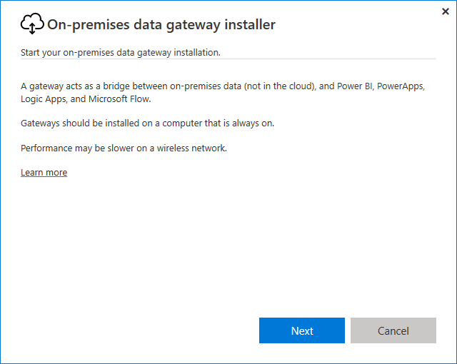
On-Premises Gateway Installation

Slide 27
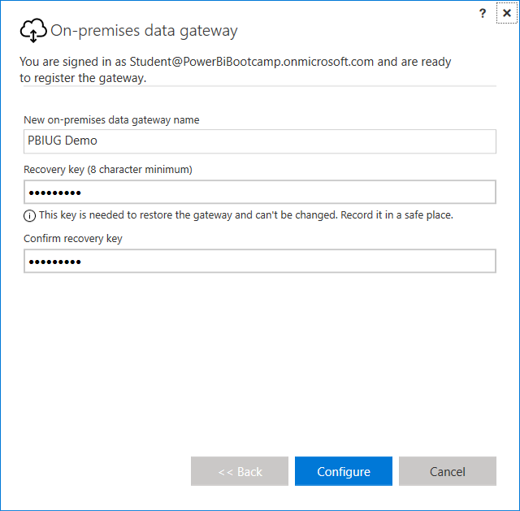
On-prem Gateway Names & Recovery Keys

Slide 28
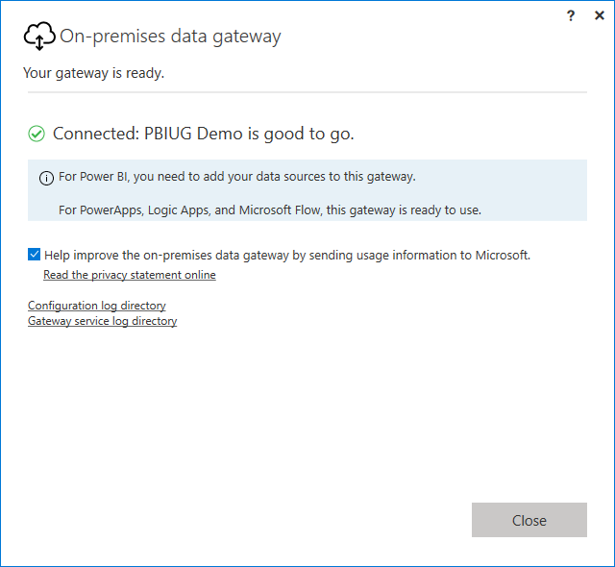
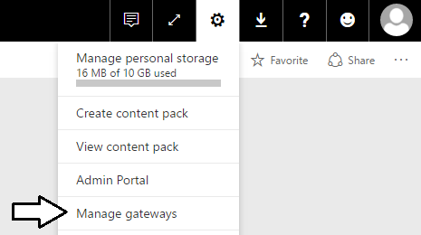
Getting the Gateway Up and Running

Slide 29
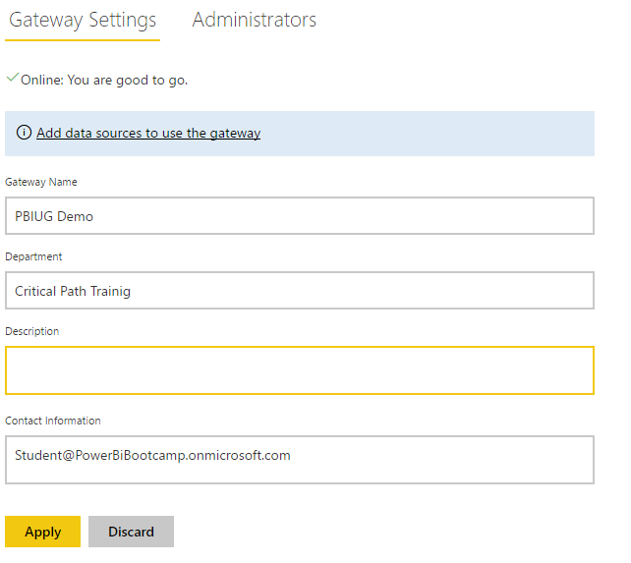
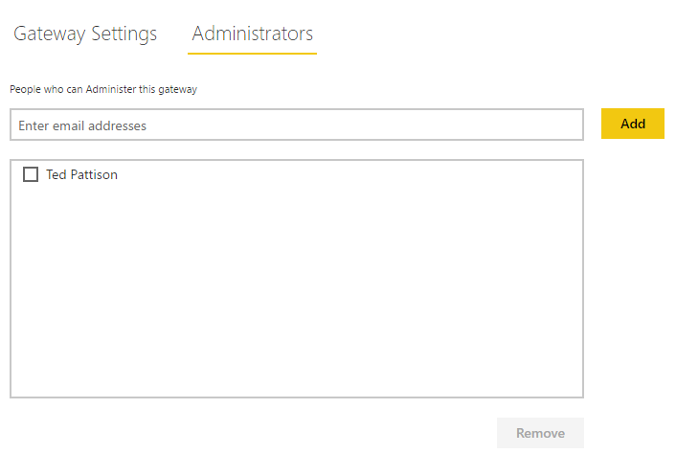
Configuring Gateway in Power BI Service

Slide 30
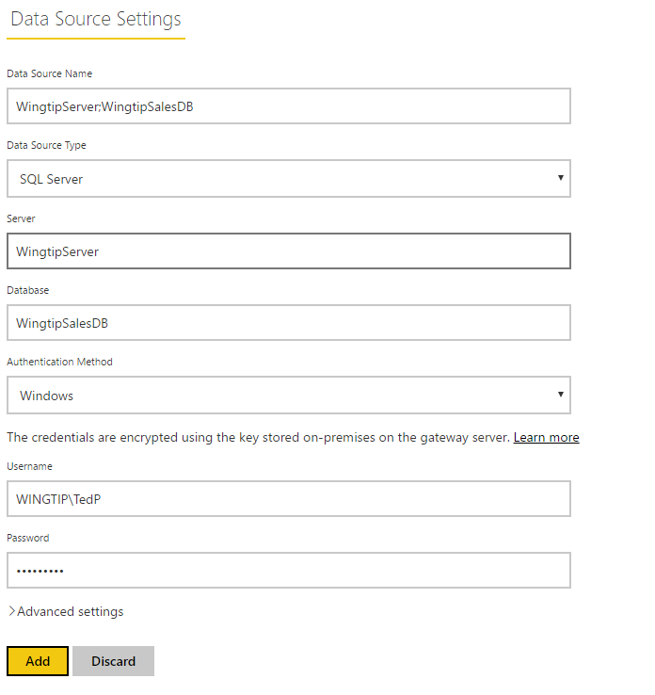
Configuring Data Sources in Gateway

Slide 31
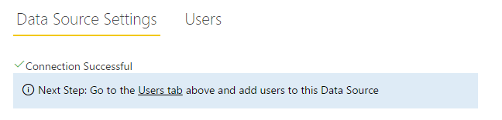
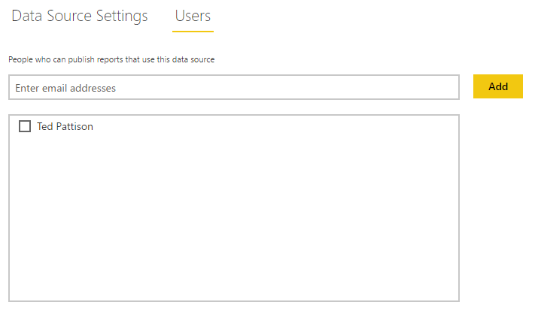
Configuring Users

Slide 32
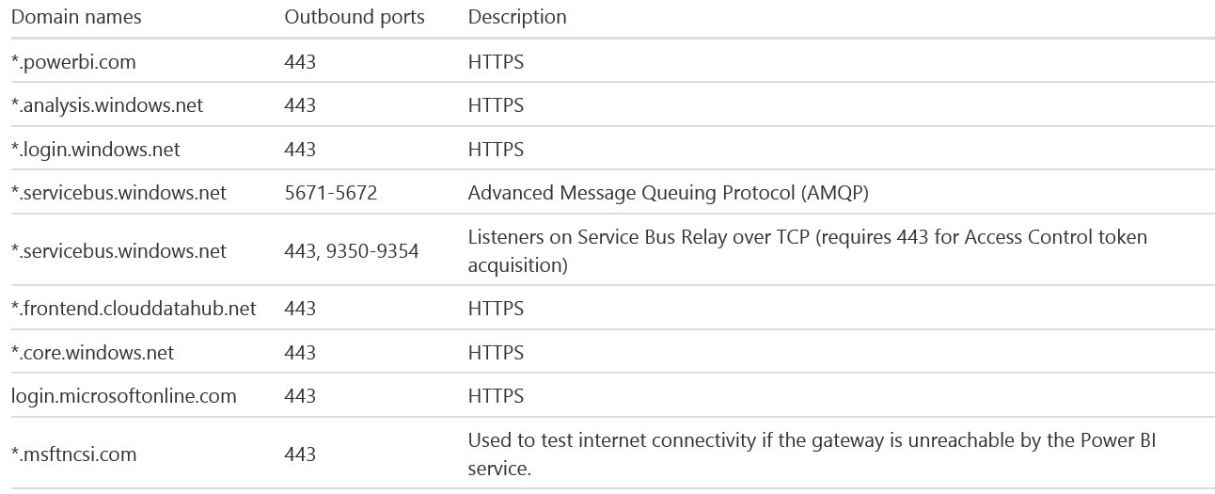
Outbound Ports – On-Premises Gateway
Gateway communicates through outbound ports
Gateway does not require inbound ports

Slide 33
On-premises Gateway with SSAS
On-premises Gateway adds functionality to SSAS
Sets EffectiveUserName property for Power BI user
EffecitveUserName is email of current user
Office 365 UPN should match a UPN within local AD
Associated Windows account added to SSAS roles
Allows for role-based security and row-level security
EffectiveUserName settings is in the format
UPN must be same in local AD and Azure AD

Slide 34
Agenda
Comparing Imported Datasets to Live Connect
Refreshing Data using Storing Credentials
Configuring a Dataset for Auto Refresh
Installing and Configuring Personal Gateway
Installing and Configuring On-premises Gateway
Designing Datasets using DirectQuery Mode

Slide 35
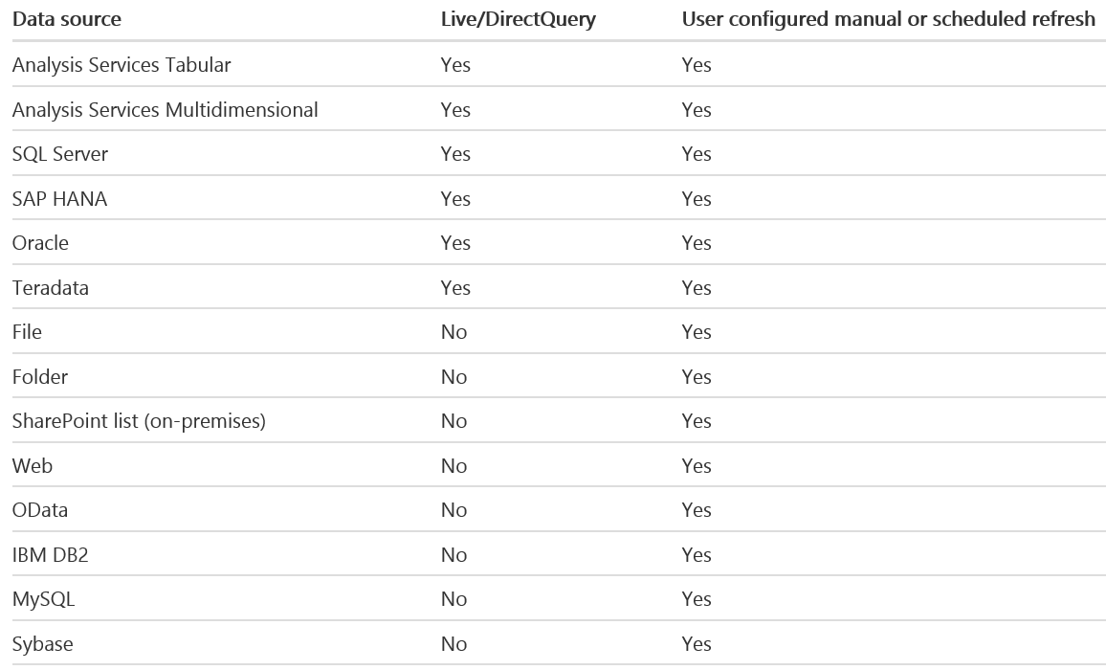
Supported Data Sources

Slide 36
Limitations of DirectQuery
DirectQuery imposes the following limitations
All tables must come from a single database
Many types of query steps are not supported
Relationship filtering limited to single direction
Time intelligence capabilities are not available
No special treatment of date columns
Calculated columns not allowed
By default, limitations placed on DAX in measures

Slide 37
Summary
Comparing Imported Datasets to Live Connect
Refreshing Data using Storing Credentials
Configuring a Dataset for Auto Refresh
Installing and Configuring Personal Gateway
Installing and Configuring On-premises Gateway
Designing Datasets using DirectQuery Mode

