Slide 1
Developing and Distributing Custom Visuals
Notes:
Understanding the Power BI Visuals API - Defining Visual Capabilities and Data Mappings - Creating Visuals Bound to Categorical Data - Extending a Visual with Custom Properties - Packaging and Deploying Custom Visuals

Slide 2
Agenda
Defining Visual Capabilities and Data Mappings
Creating Visuals Bound to Categorical Data
Extending a Visual with Custom Properties
Packaging and Deploying Custom Visuals

Slide 3
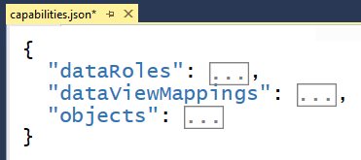
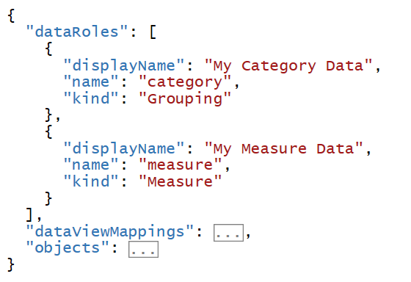
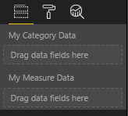
Visual Capabilities

Slide 4
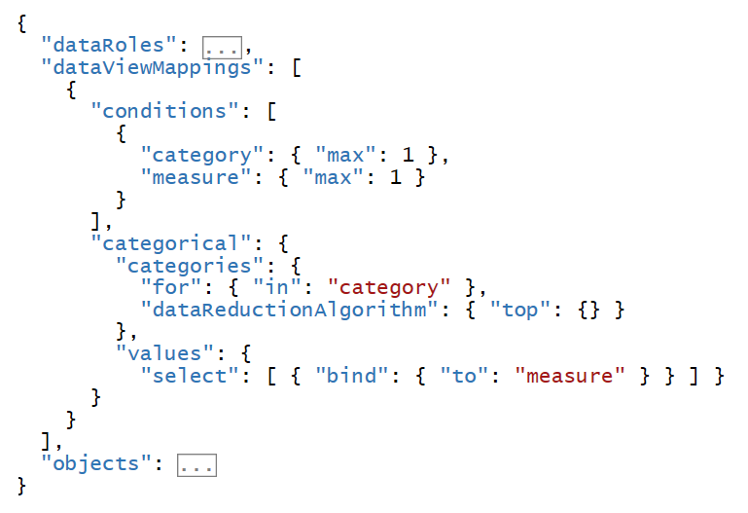
Data Mappings

Slide 5
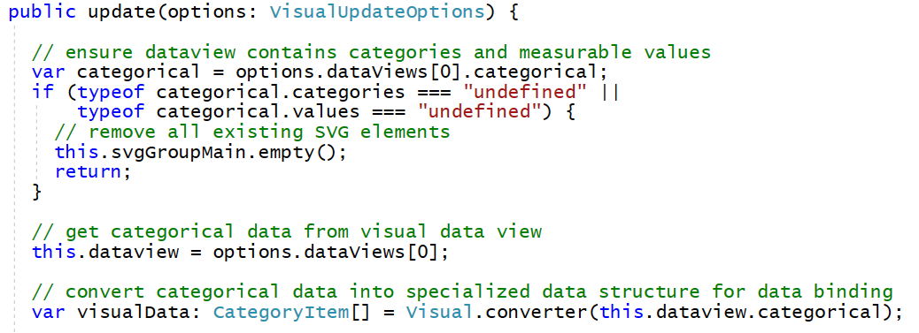
Binding Visuals to Categorical Data

Slide 6
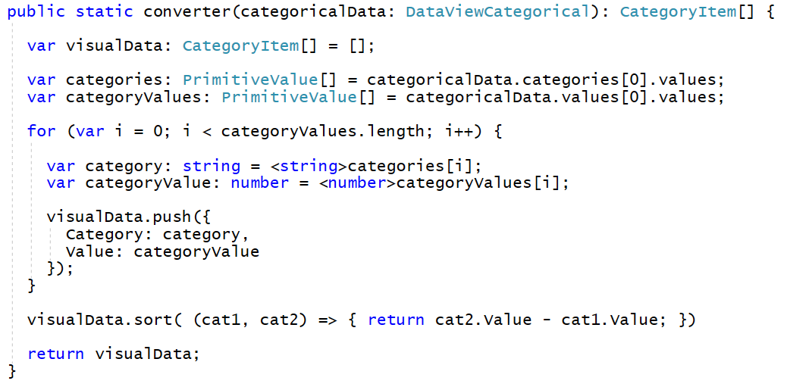
Creating a Converter Function

Slide 7
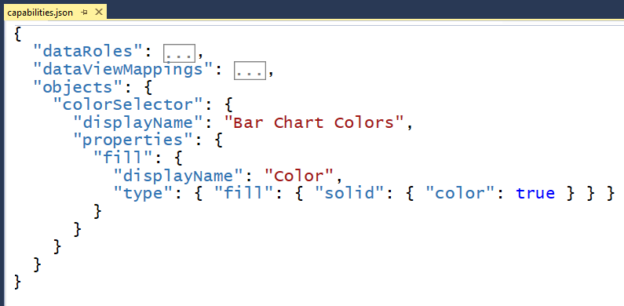
Extending Visuals with Custom Properties

Slide 8
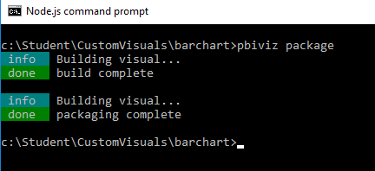
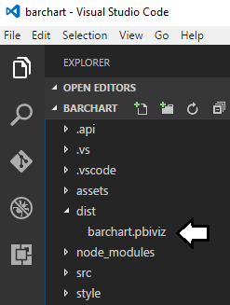
Packaging and Deploying Custom Visuals

