Slide 1
Programming with TypeScript and the D3 Library
Notes:
TypeScript Language Primer - Getting Started with the D3.js Library - Using Data Binding to Create a Bar Chart - Working with Scales and Axes - Creating Line Charts, Area Charts - Using D3 Layouts - Event Handling and Transitions

Slide 2
Agenda
TypeScript Language Primer
Getting Started with D3 and SVG Graphics
Creating Data-driven Visuals
Enhancing Visuals with Scales and Axes
Event Handling and Transitions
Using D3 Layouts

Slide 3
What is TypeScript?
A programming language which compiles into plain JavaScript
A superset of JavaScript that adds a strongly-typed dimension
It can be compiled into ECMAScript3, ECMAScript3 or ECMAScript 6
It runs in any browser, in any host and on any OS
product.ts
product.js
TypeScript
Compiler
Notes:
There is a getting started tutorial at https://www.typescriptlang.org/docs/tutorial.html .

Slide 4
Type Annotation
TypeScript allows you to annotate types
Provides basis for strongly-typed programming
Type annotations used by compiler for type checking
Type annotations are erased at the end of compile time

Slide 5
Assignment with let versus var
var does not recognize nor honor scope
let will recognize and honor scope

Slide 6
Parameter Arrays

Slide 7
Arrow Function Syntax
TypeScript supports arrow function syntax
Concise syntax to define anonymous functions
Can be used to retain this pointer in classes

Slide 8
Classes
TypeScript supports defining classes
Class defines type for object
Export keyword makes class created across files
Class can be passed as factory function
Default accessibility is public

Slide 9
Class Constructors
Constructor parameters become fields in class
Client-side code calls constructor using new operator

Slide 10
Interfaces
Interface defines a programming contract
Classes can implement interfaces
Client code can be decoupled from concrete classes

Slide 11
TypeScript Definition Files (d.ts)
What are TypeScript definition files
Typed definitions for 3rd party JavaScript libraries
DefinitelyTyped provides great community resource
Typed definition files have a d.ts extension

Slide 12

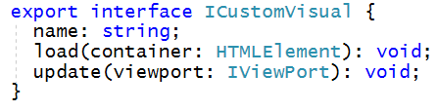
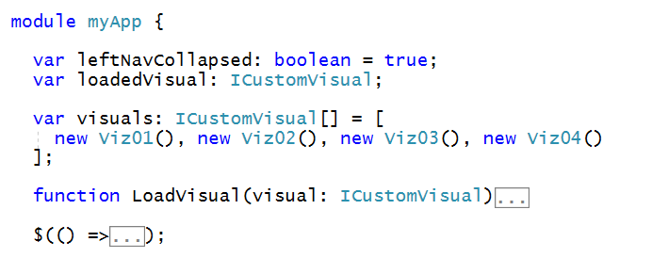
Interface-based Design
Interfaces define programming contracts
Application design can use interfaces instead of concrete classes

Slide 13
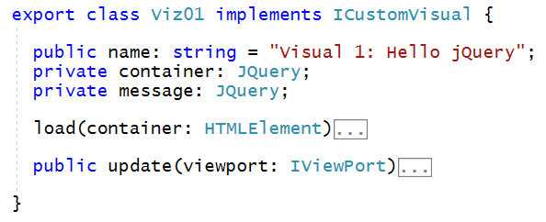
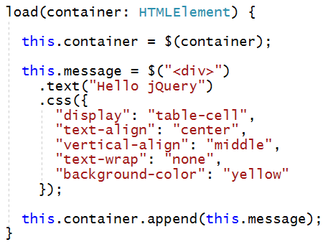
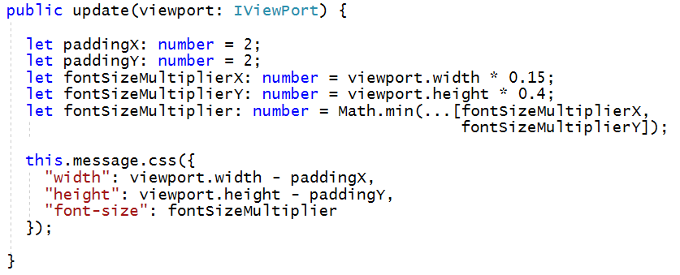
Sample Custom Visual using jQuery

Slide 14
Agenda
TypeScript Language Primer
Getting Started with D3 and SVG Graphics
Creating Data-driven Visuals
Enhancing Visuals with Scales and Axes
Event Handling and Transitions
Using D3 Layouts

Slide 15
The D3 Library
What does the D3 library do?
Loading data into the browser’s memory
Binding data to create new set of SVG elements
Adding and removing SVG elements as needed
Transforming SVG elements by setting properties
Transitioning SVG elements in response to user actions

Slide 16
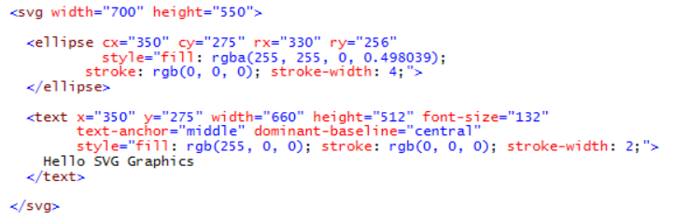
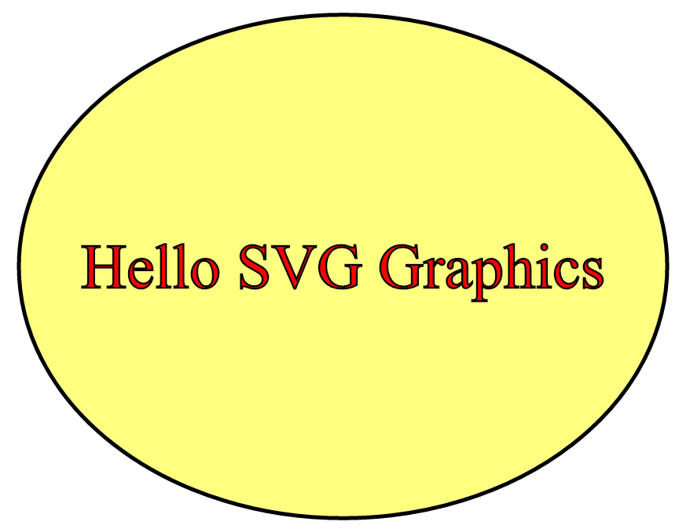
SVG Graphics
SVG = Scalable Vector Graphics
Specialized type of HTML element
More reliable and consistent than other HTML elements

Slide 17
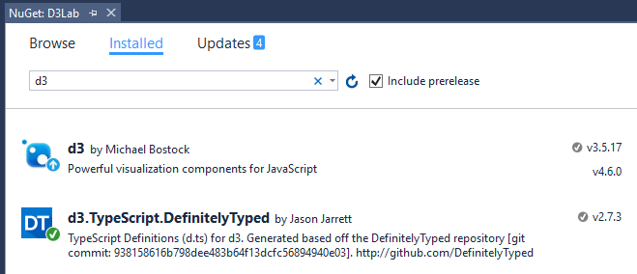
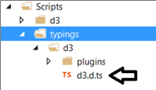
Adding d3 and d3 typings files

Slide 18
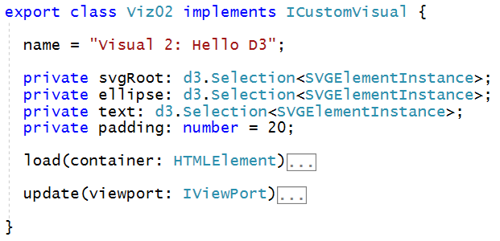
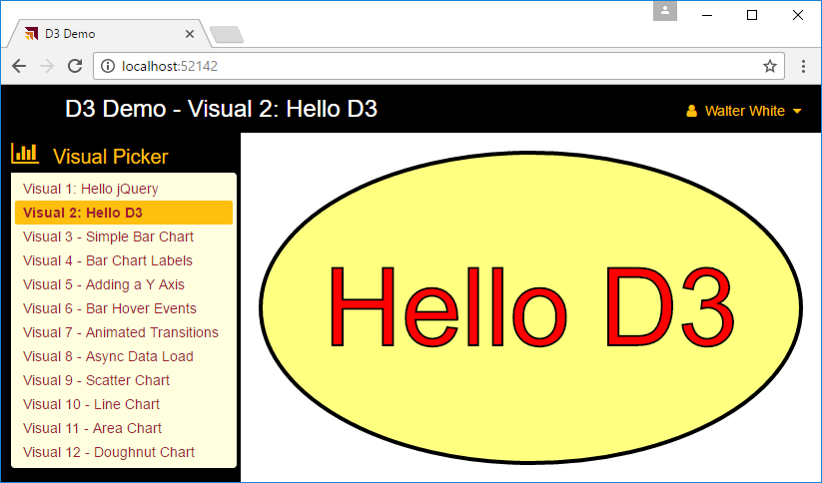
Designing a D3 Custom Visual

Slide 19
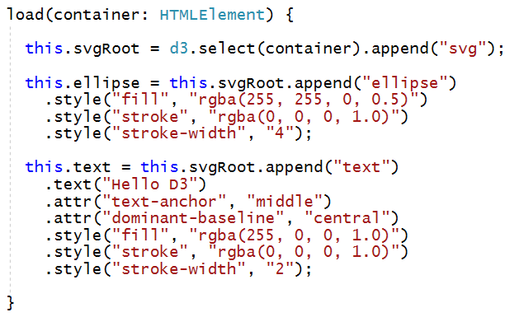
Implementing load

Slide 20
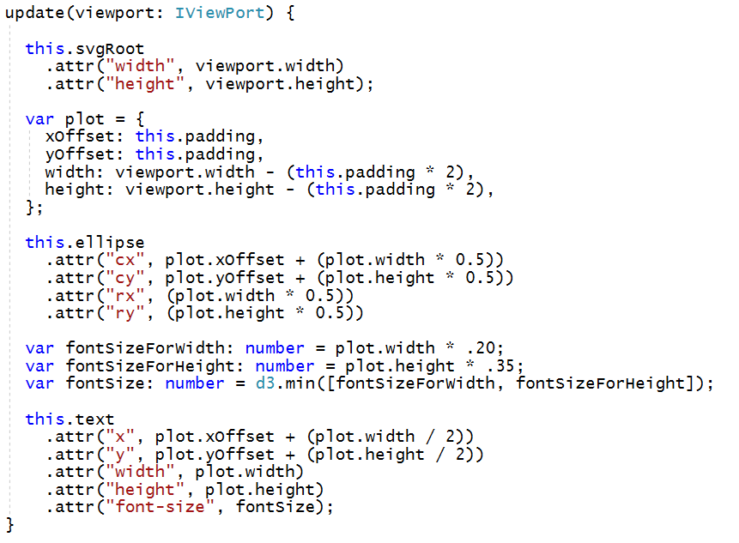
Implementing update

Slide 21
Agenda
TypeScript Language Primer
Getting Started with D3 and SVG Graphics
Creating Data-driven Visuals
Enhancing Visuals with Scales and Axes
Event Handling and Transitions
Using D3 Layouts

Slide 22
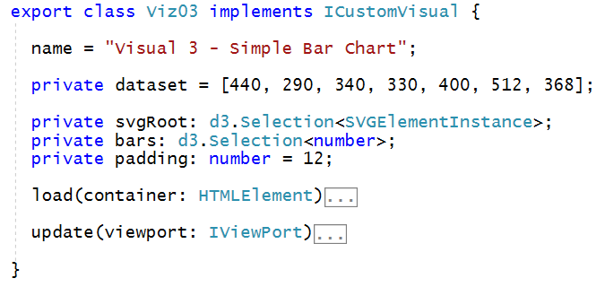
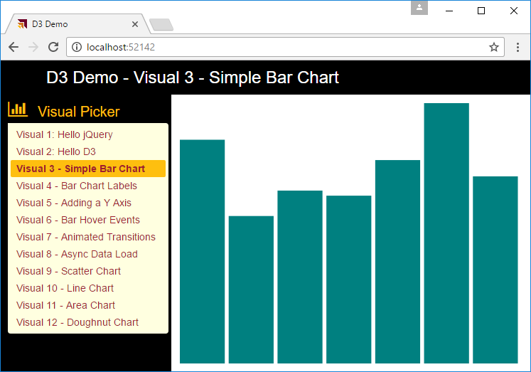
Designing a D3 Visual with a Bar Chart

Slide 23
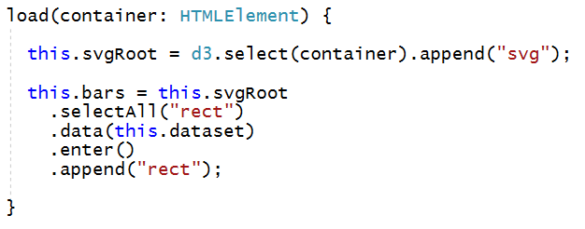
Implementing load

Slide 24
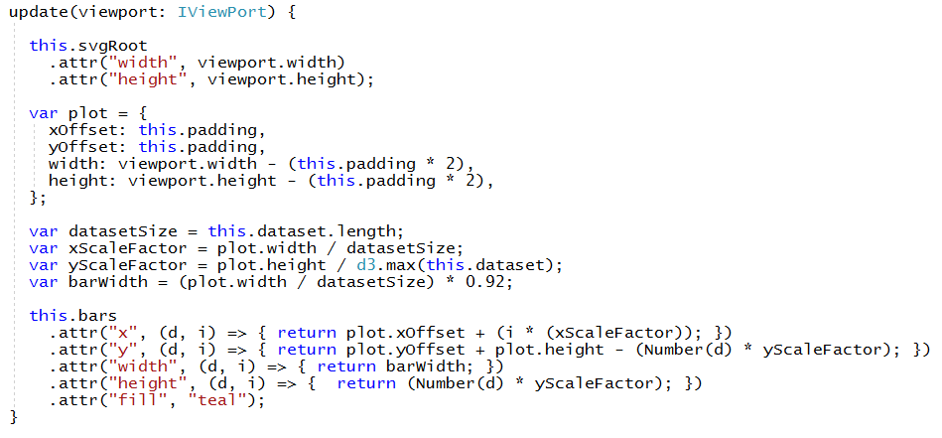
Implementing update

Slide 25
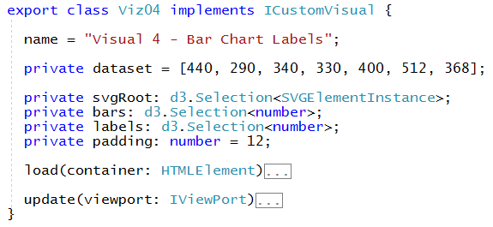
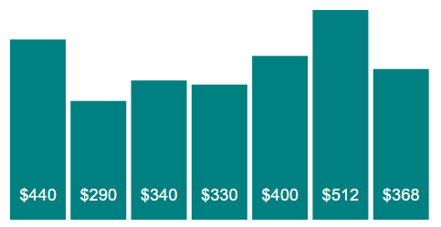
Adding Labels to the Bar Chart

Slide 26
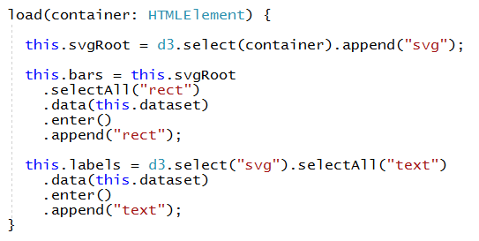
Implementing load

Slide 27
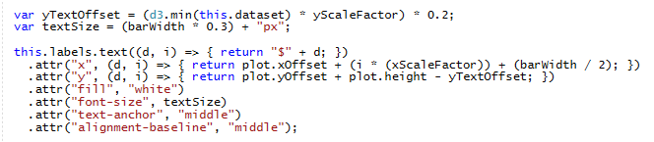
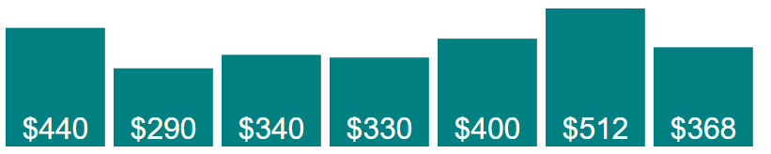
Generating Labels in update

Slide 28
Agenda
TypeScript Language Primer
Getting Started with D3 and SVG Graphics
Creating Data-driven Visuals
Enhancing Visuals with Scales and Axes
Event Handling and Transitions
Using D3 Layouts

Slide 29
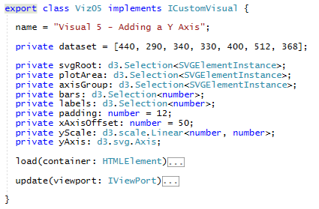
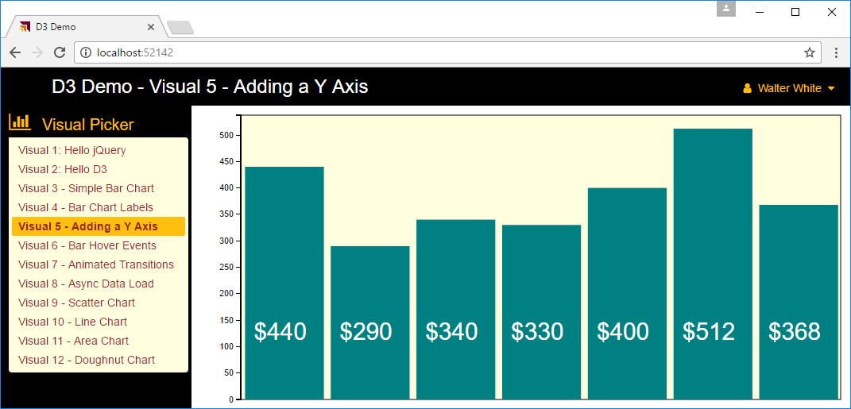
Adding a Scale and an Axis
Scale is a function that maps input domain to output range
Axis is a function used to generate the HTML elements of visual axis

Slide 30
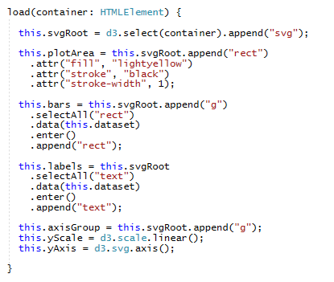
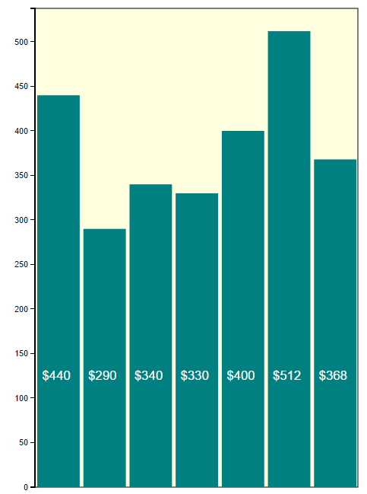
Implementing load

Slide 31
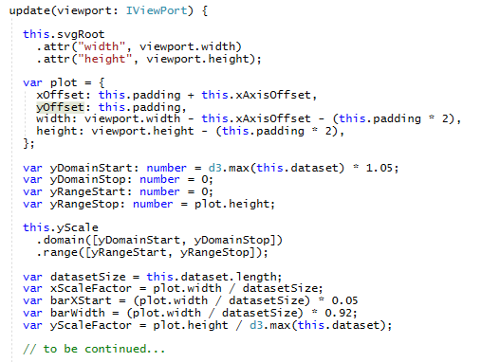
Implementing update (part 1)

Slide 32
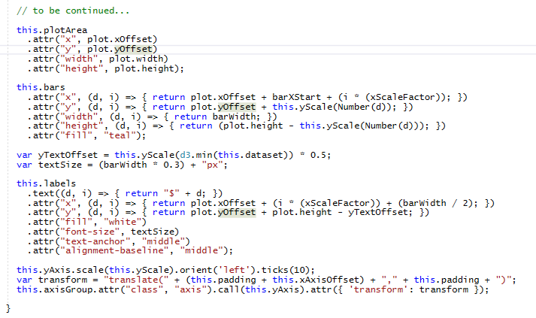
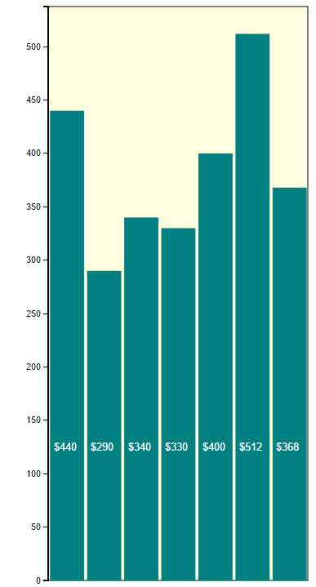
Implementing update (part 2)

Slide 33
Agenda
TypeScript Language Primer
Getting Started with D3 and SVG Graphics
Creating Data-driven Visuals
Enhancing Visuals with Scales and Axes
Event Handling and Transitions
Using D3 Layouts

Slide 34
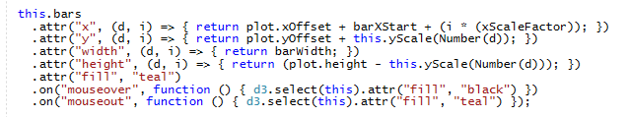
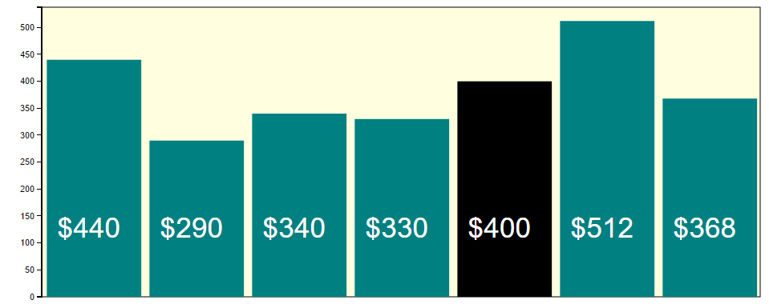
Adding Mouse Event Handlers
mouse

Slide 35
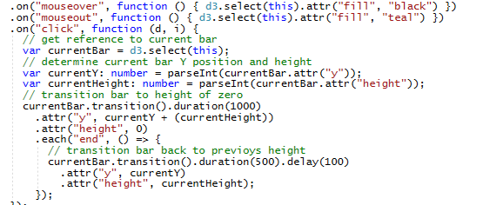
Programming D3 Animation

Slide 36
Agenda
TypeScript Language Primer
Getting Started with D3 and SVG Graphics
Creating Data-driven Visuals
Enhancing Visuals with Scales and Axes
Event Handling and Transitions
Using D3 Layouts

Slide 37
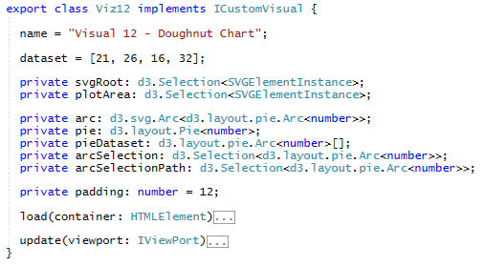
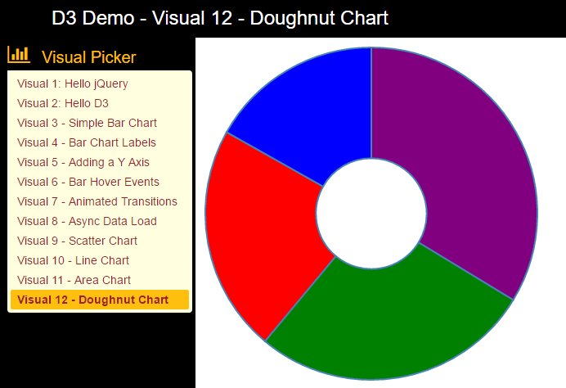
Using a D3 Layout

Slide 38
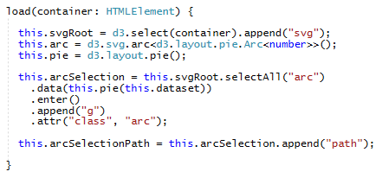
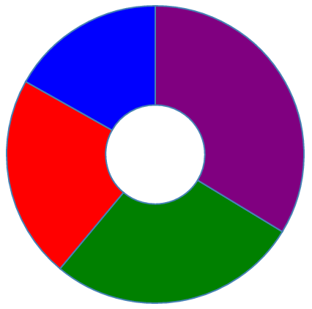
Implementing load

Slide 39
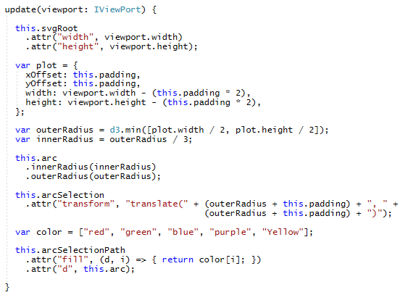
Implementing Update

Slide 40
Summary
TypeScript Language Primer
Getting Started with D3 and SVG Graphics
Creating Data-driven Visuals
Enhancing Visuals with Scales and Axes
Event Handling and Transitions
Using D3 Layouts

