Slide 1
Getting Started with the Power BI Developer Tools
Notes:
Custom Visuals in Power BI - Node.JS and the Cross-platform Toolchain - Creating Projects with the PBIVIZ CLI - Custom Visual Project Structure - Adding Typed Definition Files - Testing and Debugging a Custom Visual

Slide 2
Agenda
Custom Visuals in Power BI
Node.JS and the Cross-platform Toolchain
Creating Projects with the PBIVIZ CLI
Custom Visual Project Structure
Adding Typed Definition Files
Testing and Debugging a Custom Visual

Slide 3
Install the Power BI Developer Toolchain
Install Node.JS
Installs Node Package Manage (npm)
Install Power BI visuals CLI tool (pbiviz)
Install using Node Package Manager (npm)
Install Local self-signed certificate
Install using Power BI visuals CLI tool (pbiviz)
Install Visual Studio Code
Lightweight Alternative to Visual Studio for Node.js Development

Slide 4
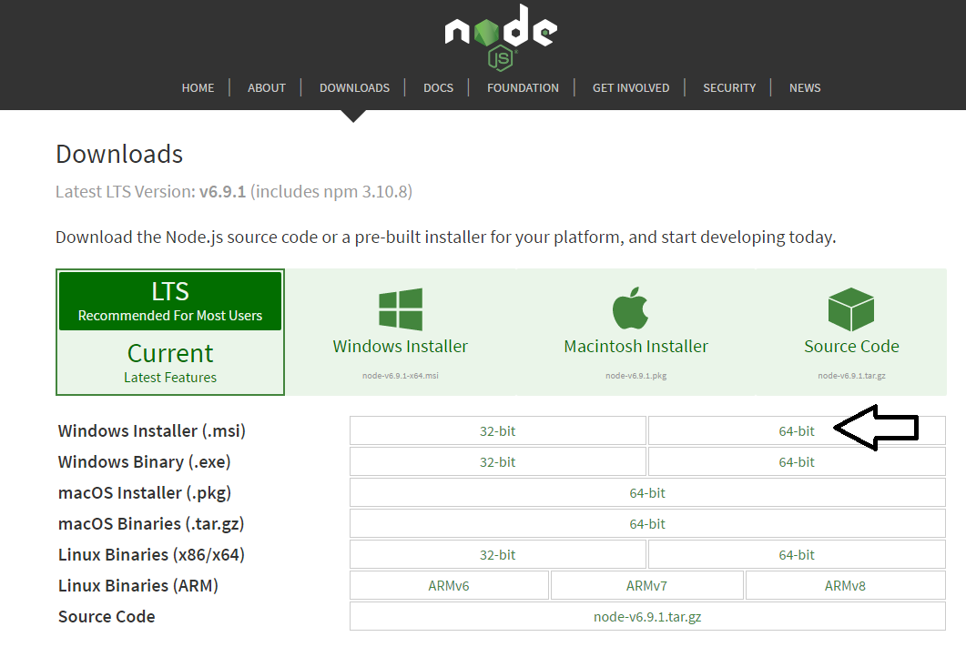
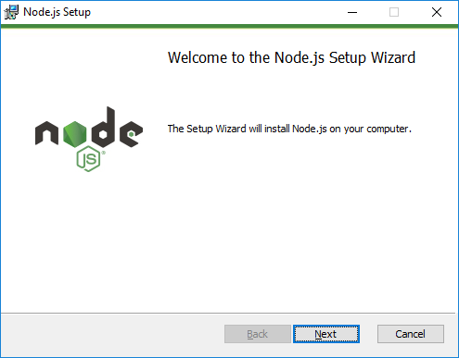
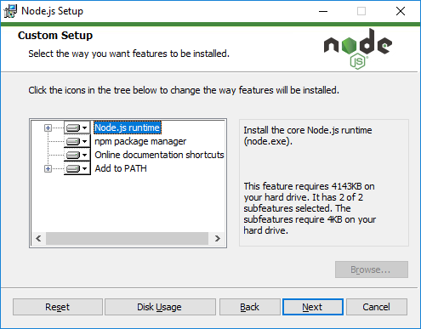
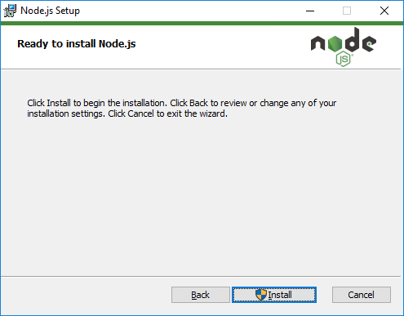
Installing node.js
https://nodejs.org/en/download/

Slide 5
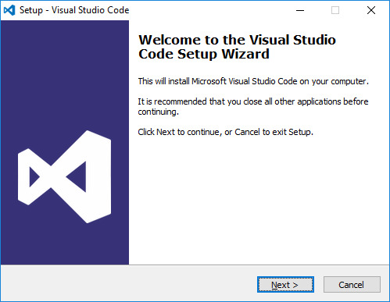
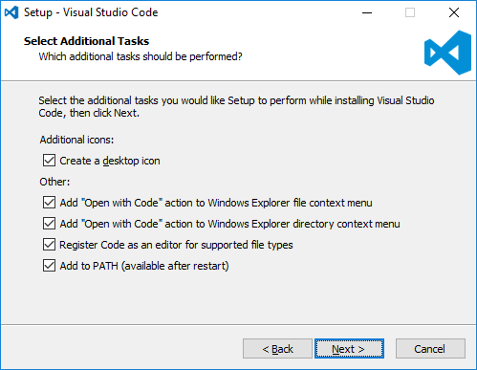
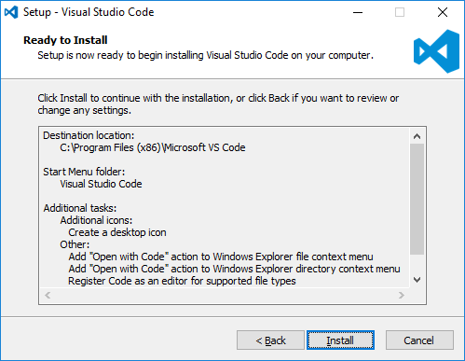
Install Visual Studio Code
http://code.visualstudio.com/

Slide 6
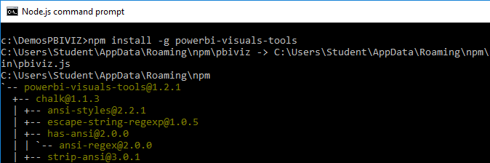
Power BI Visual CLI Tool (PBIVIZ)
What is the Power BI Custom Visual Tool?
Command-line utility for cross-platform dev
Use it with Visual Studio or Visual Studio Code
Requires that you first install node.js
Install by running command from node.js command prompt
npm install -g powerbi-visuals-tools

Slide 7
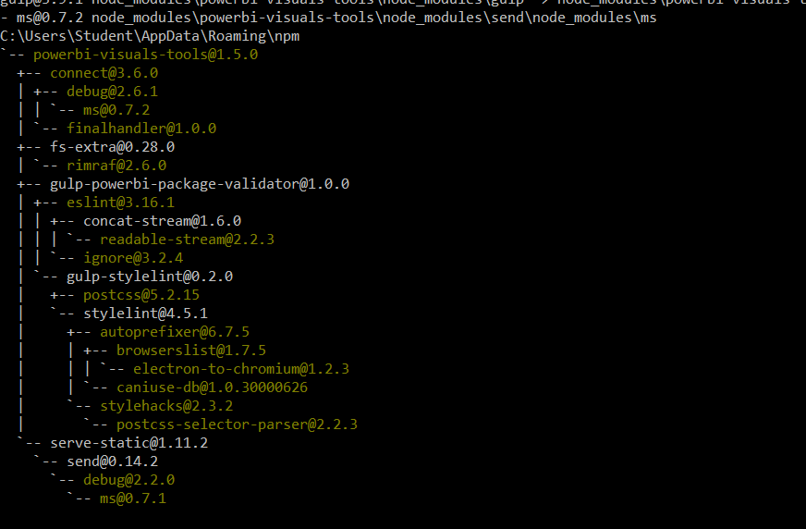
Power BI Visual Tool Dependencies

Slide 8
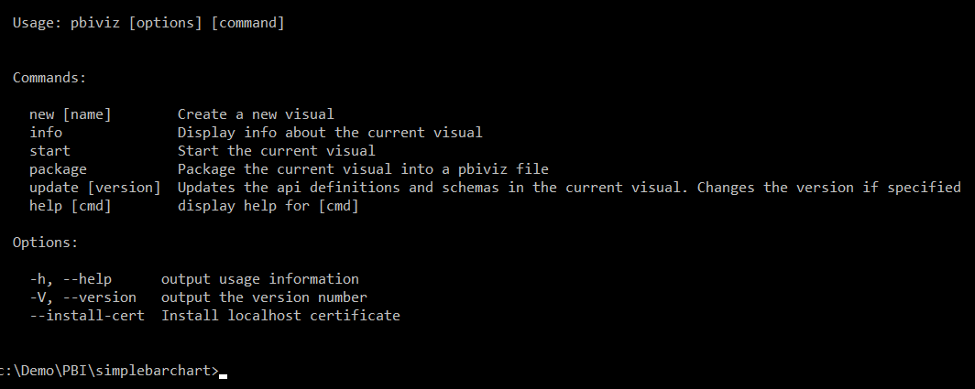
Getting Started with PBIVIZ

Slide 9
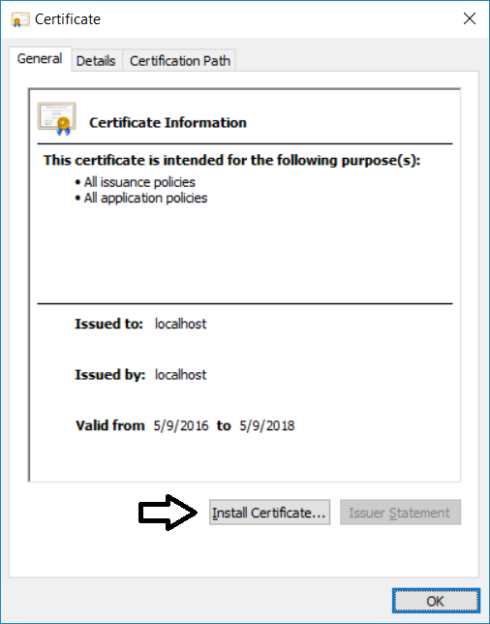
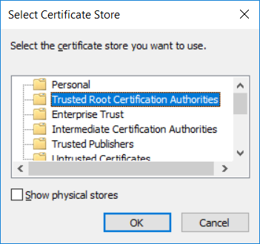

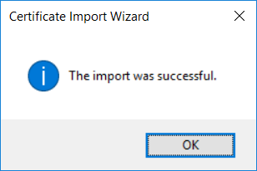
Installing the Developer Certificate
Debugging visuals inside PowerBI.com requires SSL
PBIVIZ leverages Node.js to provide debugging experience
Node.js acts as web service to serve project files through HTTP
Node.js debugging session uses http://localhost address
Installing certificate enables SSL through https://localhost
Installing certificate is a one time operation – not once per project

Slide 10
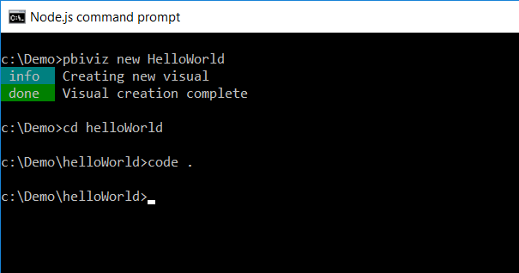
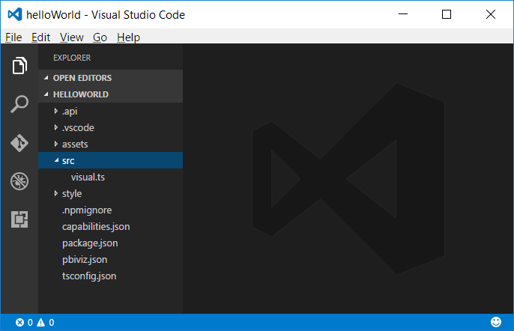
Creating a New Custom Visual Project
Creating a new project
pbiviz new <ProjectName>
Open the Project with Visual Studio Code
code .

Slide 11
Files in the new project
gitignore
tells git to ignore files that shouldn't be tracked in the repository
capabilities.json
used to define the capabilities of your visual learn more about visual capabilities
package.json
Used by npm to manage modules learn more about npm
pbiviz.json
Main configuration file for your visual
tsconfig.json
Typescript compiler settings learn more about tsconfig

Slide 12
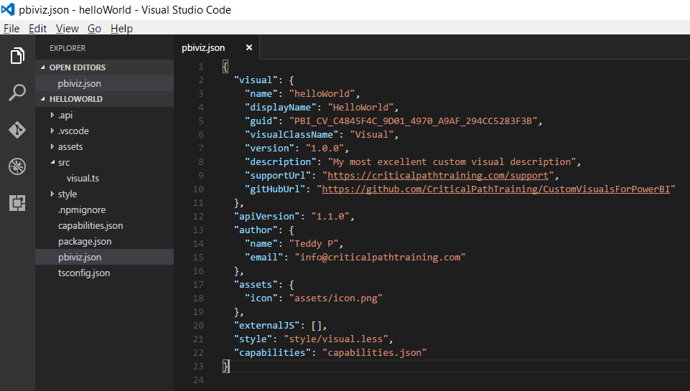
The pbiviz.json File

Slide 13
Folders in the new project
assets/
Used to store visual assets (icon, screenshots, etc)
dist/
when you run pbiviz package the pbiviz file will be generated here
src/
Typescript code for your visual goes here
style/
Less styles for your visual go here

Slide 14
Installing Typed Definitions for D3
Two choices for installing typed definitions files
Using the typings utility (the original way)
Using the npm utility (the new and better way)
Installing typed definitions files using typings utility
npm install typings –g
typings install --save --global dt~d3#0.0.0+20160907005744
Installing typed definitions files using typings utility
npm install @types/d3@3 --save-dev

Slide 15
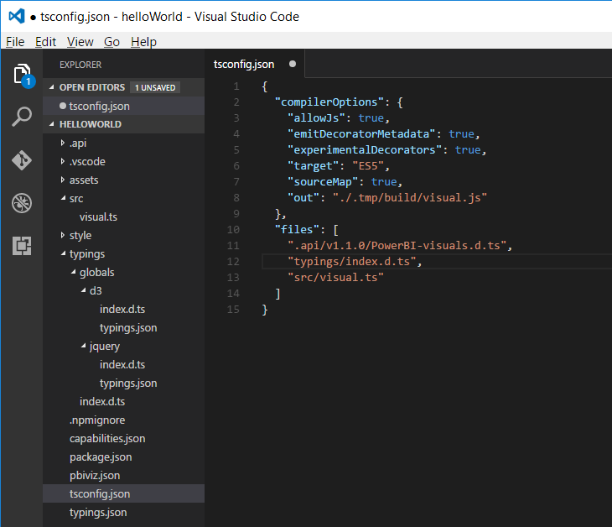
The tsconfig.json File
Used to add references to typings files
This is what enables Intellisense
Typings file reference

Slide 16
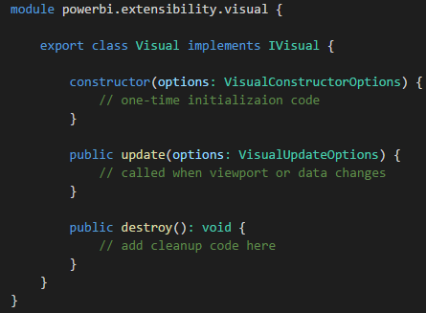
Developing a Custom Visual?
Create a class that implements IVisual
Class wrapped in module with namespace to APIs
You code can program again PBI APIs types

Slide 17
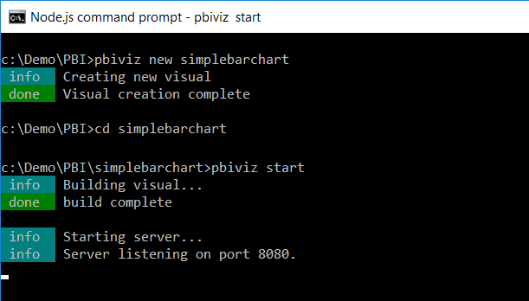
Running a Custom Visual Project

Slide 18
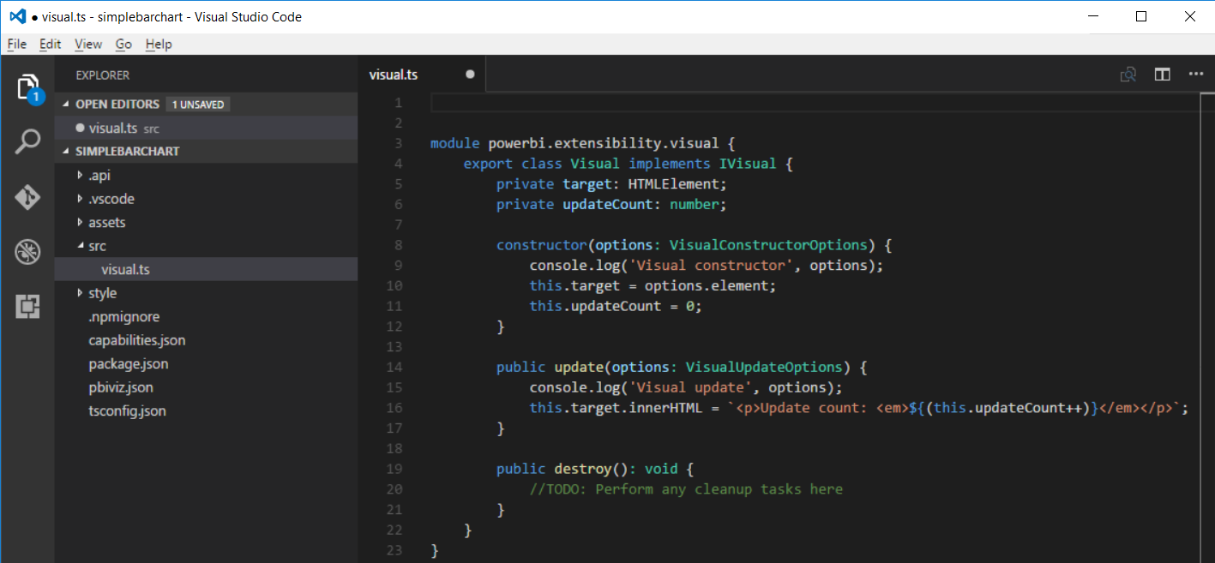
Developing with Visual Studio Code

Slide 19
Summary
Custom Visuals in Power BI
Node.JS and the Cross-platform Toolchain
Creating Projects with the PBIVIZ CLI
Custom Visual Project Structure
Adding Typed Definition Files
Testing and Debugging a Custom Visual

