Slide 2
Developing with Power BI Embedding and the SharePoint Framework
Ted Pattison
Power BI MVP

Slide 3
Agenda
Power BI Embedding Fundamentals
Implementing Embedding in SPFX Web Parts

Slide 4
Power BI Embedding – The Big Picture
User launches your app using a browser
App authenticates with Azure Active Directory and obtains access token
App uses access token to call to Power BI Service API
App retrieves data for embedded resource and passes it to browser.
Client-side code uses Power BI JavaScript API to create embedded resource
Embedded resource session created between browser and Power BI service
5
Power BI Service
Browser
iFrame
6
4
4
3
1
Your App
2
Azure AD

Slide 5
First Party Embedding versus Third Party Embedding
First Party Embedding
Known as User-Owns-Data Model
All users require a Power BI license
Useful in corporate environments
App authenticates as current user
Your code runs with user’s permissions
User’s access token passed to browser
Third Party Embedding
Known as App-Owns-Data Model
No users require Power BI license
Useful for commercial applications
App authenticates with master user account
Your code runs with admin permissions
Embed token passed to browser
First Party Embedding for use within Organization
Third Party Embedding for use by ISVs
Browser
Power BI Service
Browser
Power BI Service
iFrame
iFrame
Azure AD Access Token
for the current user
Power BI Embed Token
for one specific report

Slide 6
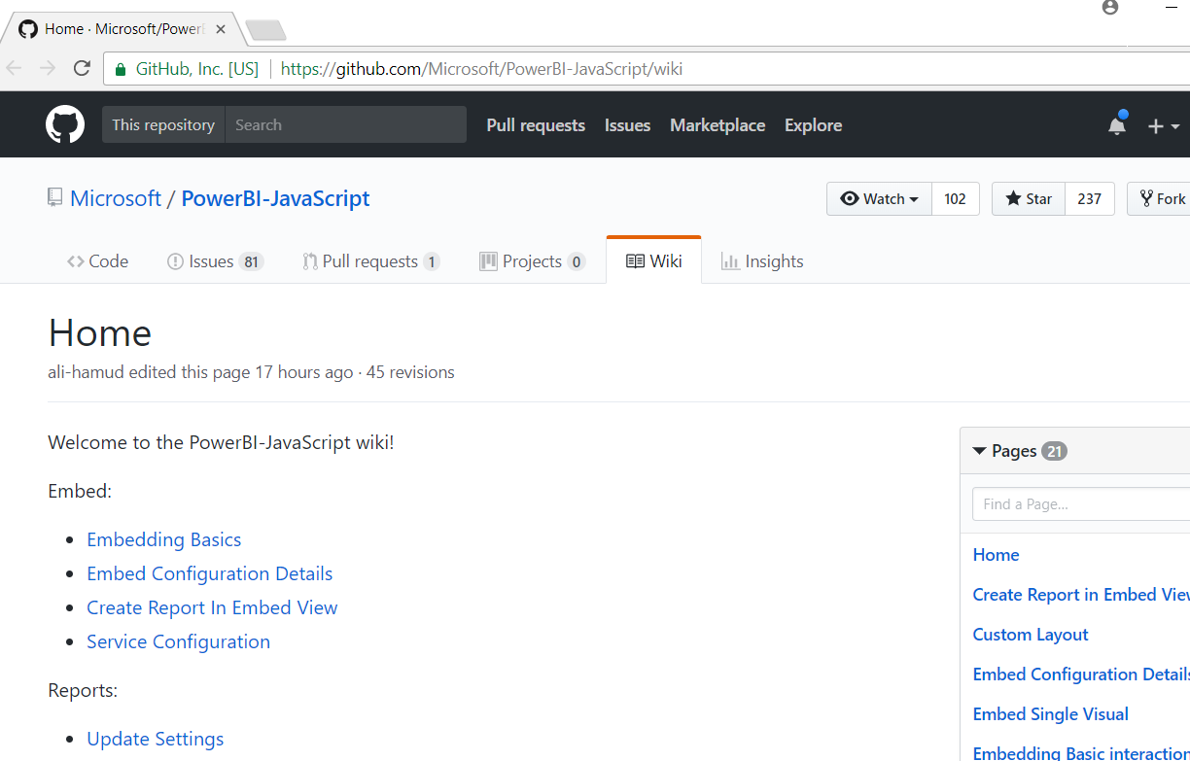
Power BI JavaScript API (PBIJS)
https://github.com/Microsoft/PowerBI-JavaScript/wiki

Slide 7
Embeddable Resources
Reports
Dashboards
Dashboard Tiles
Q & A Experience
Visual *
* really just a trick you do when embedding a report

Slide 8
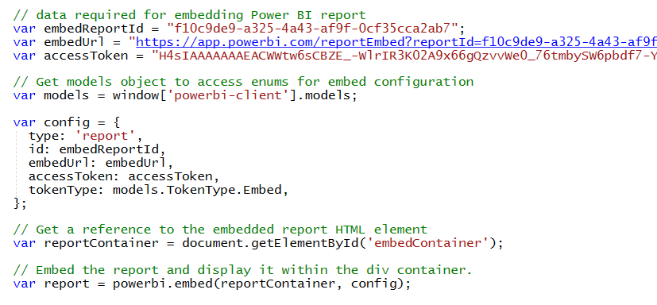
Hello World with Power BI Embedding
PBIJS library provides powerbi as top-level service object
You create configuration and then call powerbi.embed to embed a report
You must pass access token as part of the configuration

Slide 9
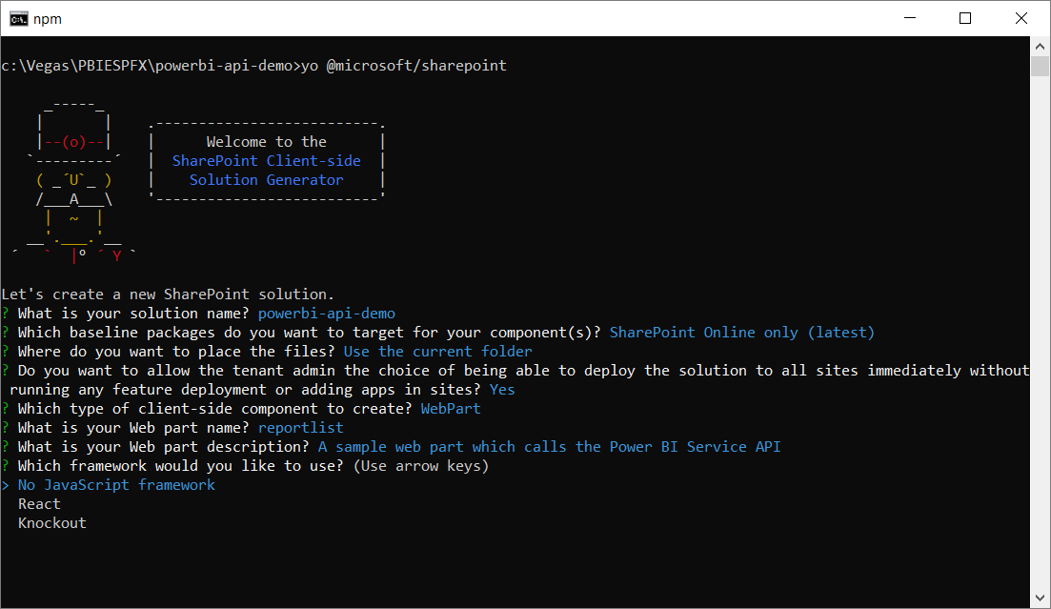
Create a New SPFX Web Part Project

Slide 10
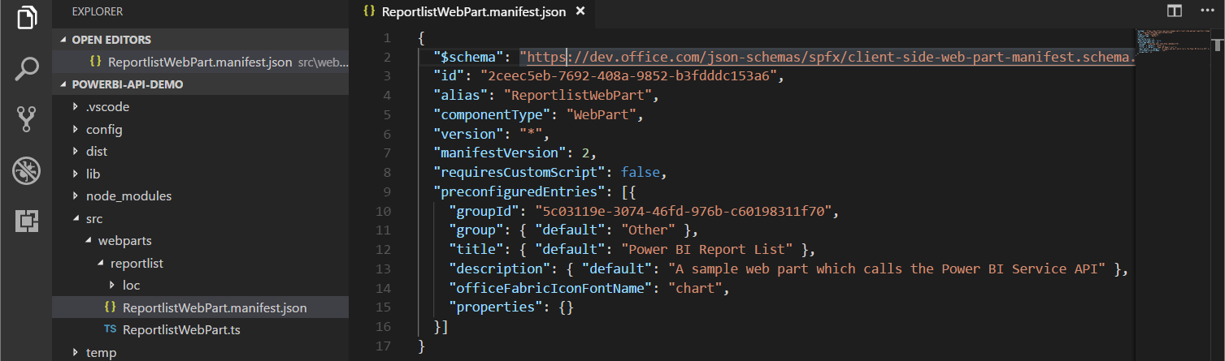
Updating the Web Part Manifest

Slide 11
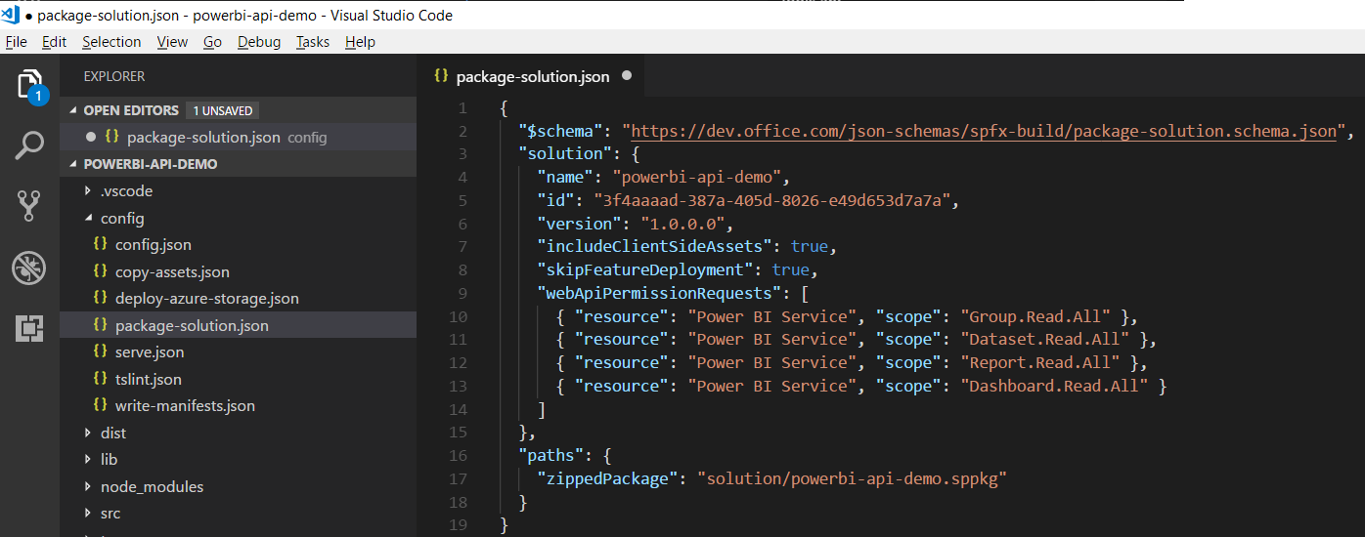
Configuring Web API Permissions

Slide 12
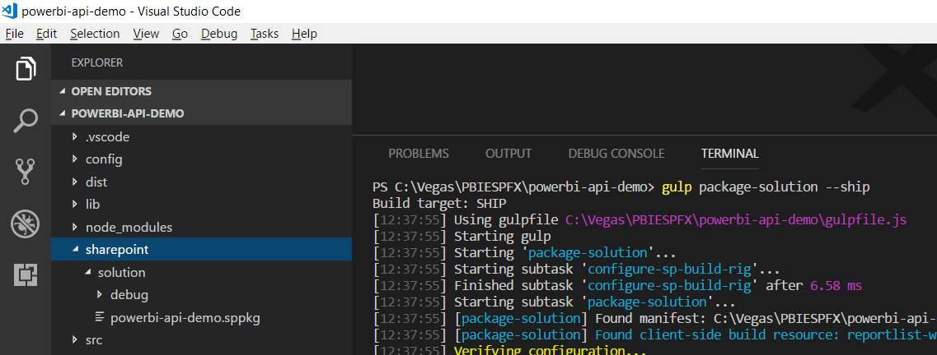
Packaging Your SPFX Solution

Slide 13
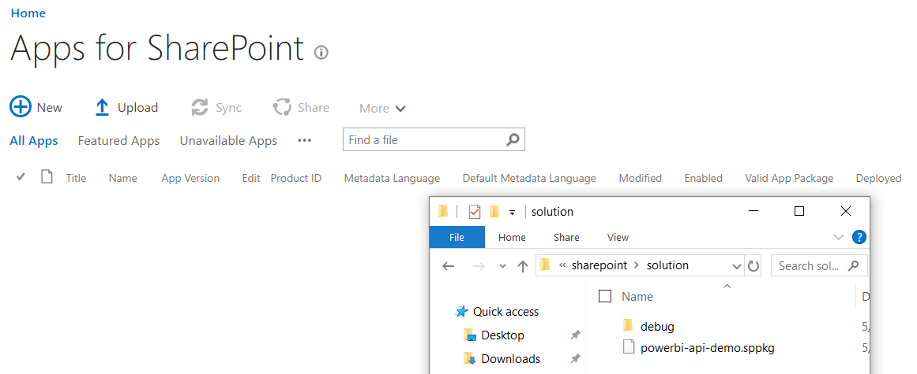
Deploy the Web Part to the App Gallery

Slide 14
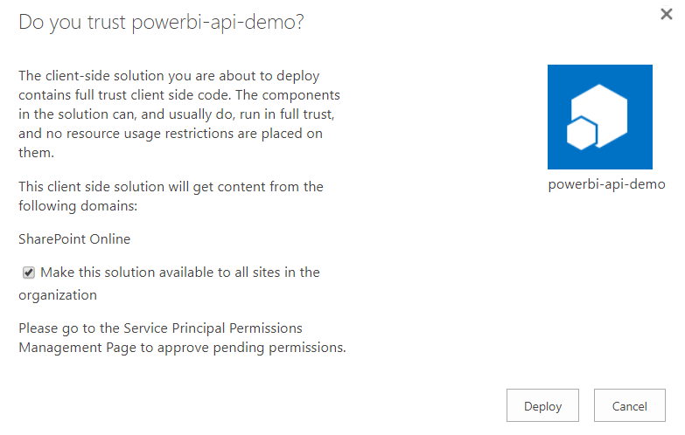
Configuring Trust

Slide 15
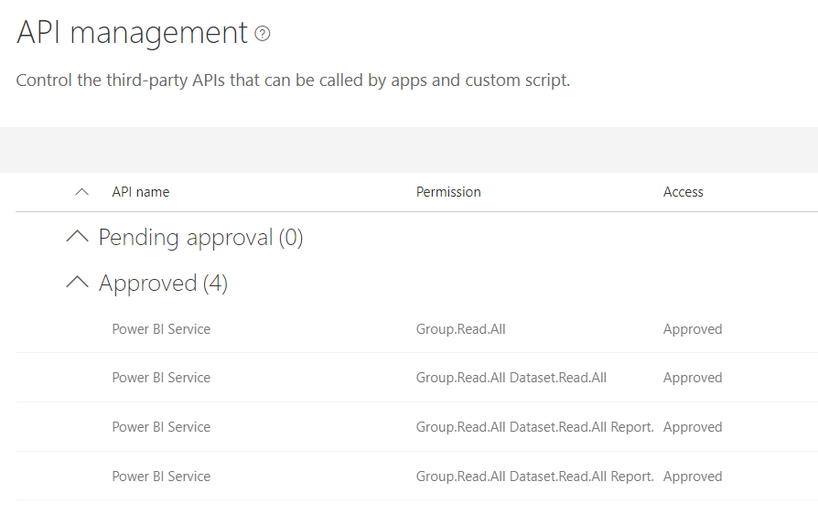
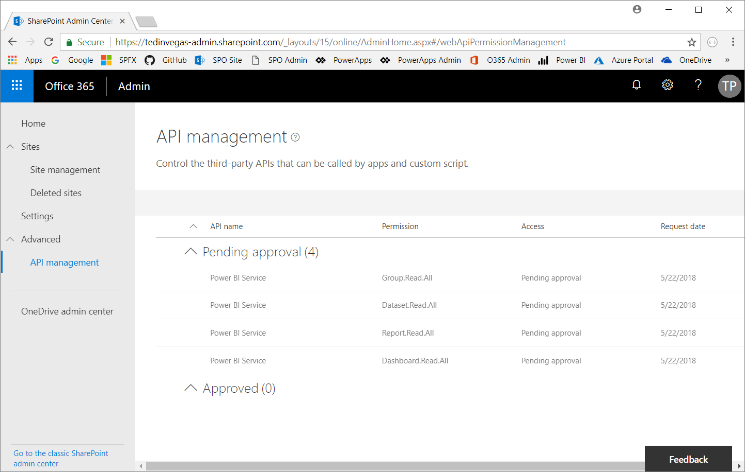
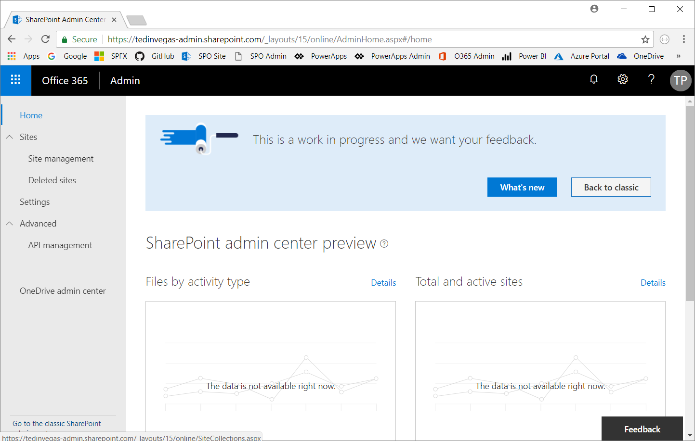
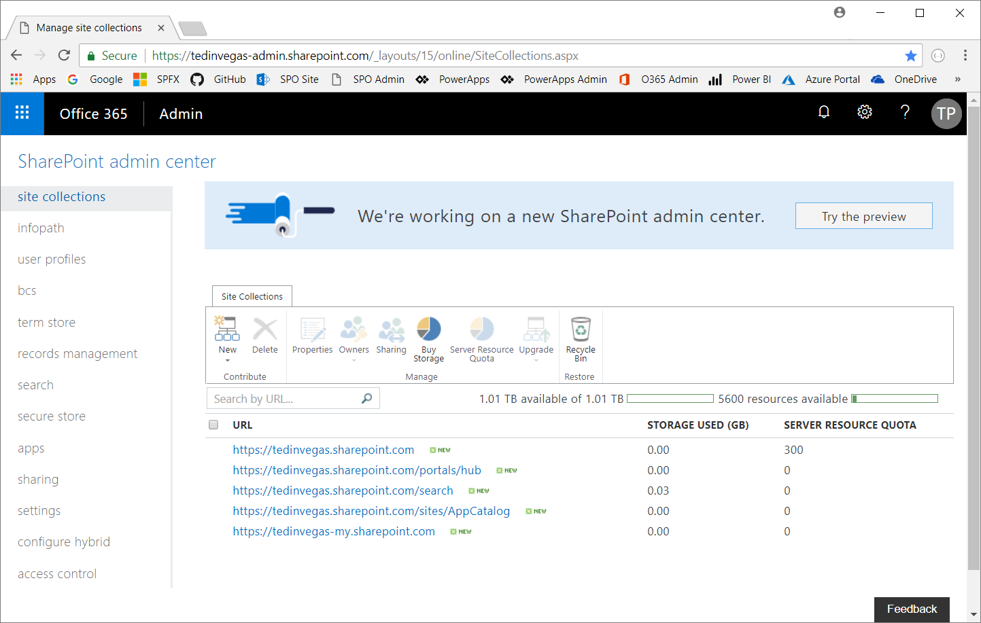
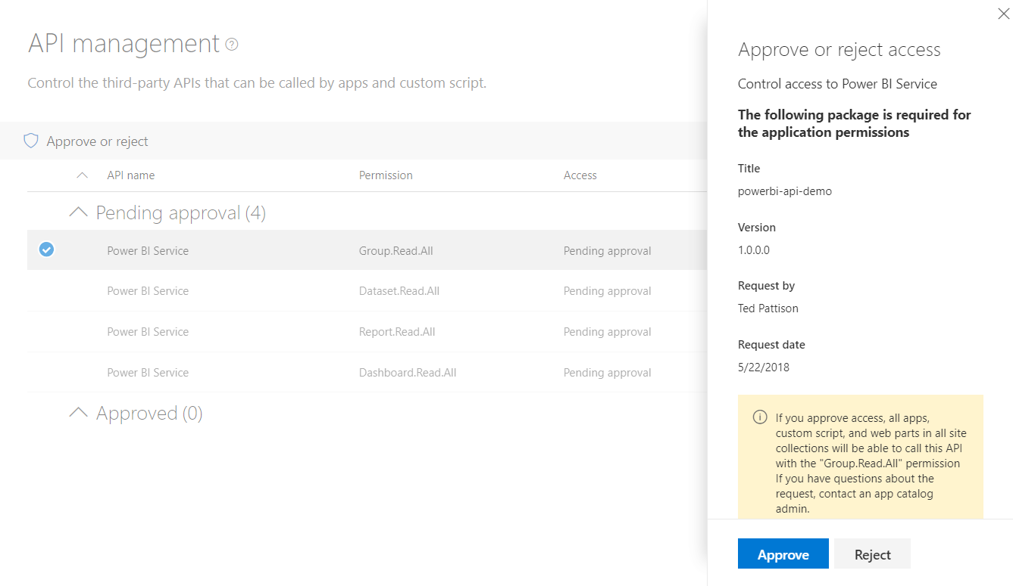
Granting Web API Permissions

Slide 16
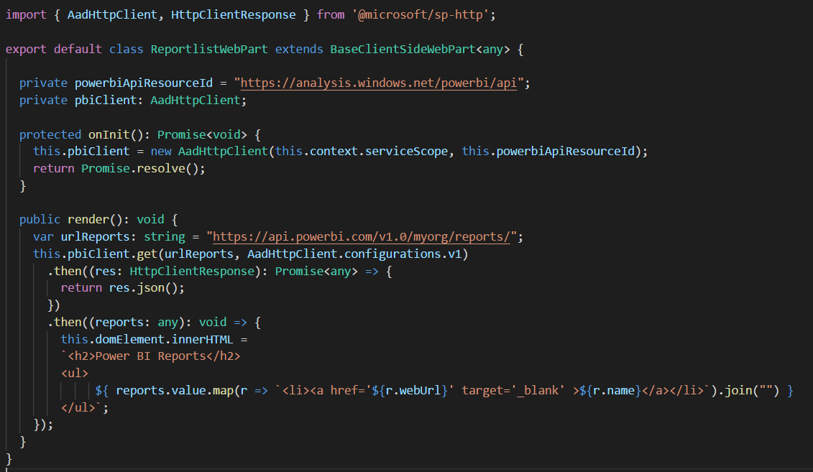
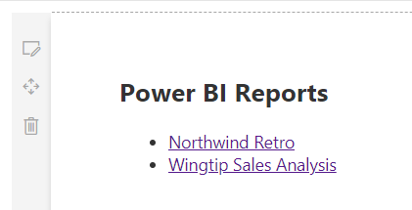
Calling the Power BI Service API with AadHttpClient

Slide 17
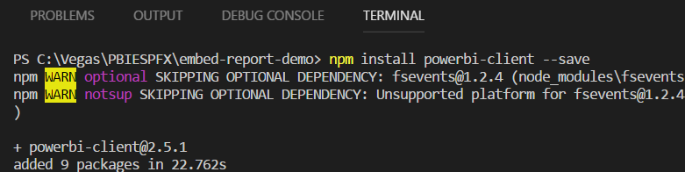
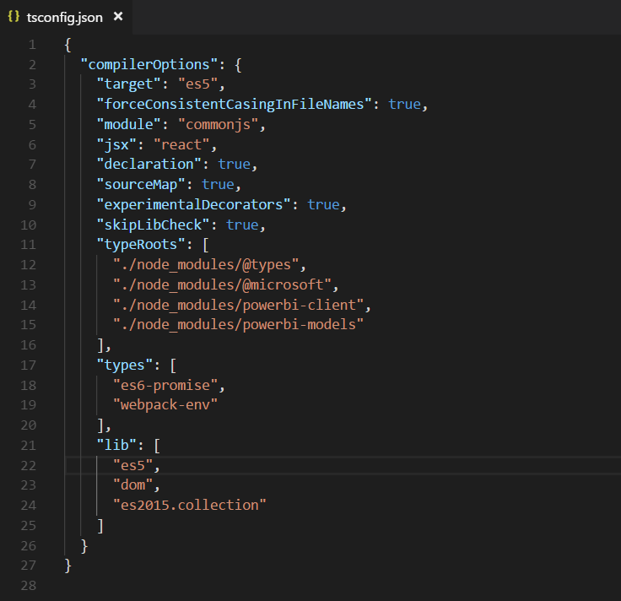
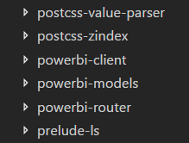
npm install powerbi-client –save-dev

Slide 18
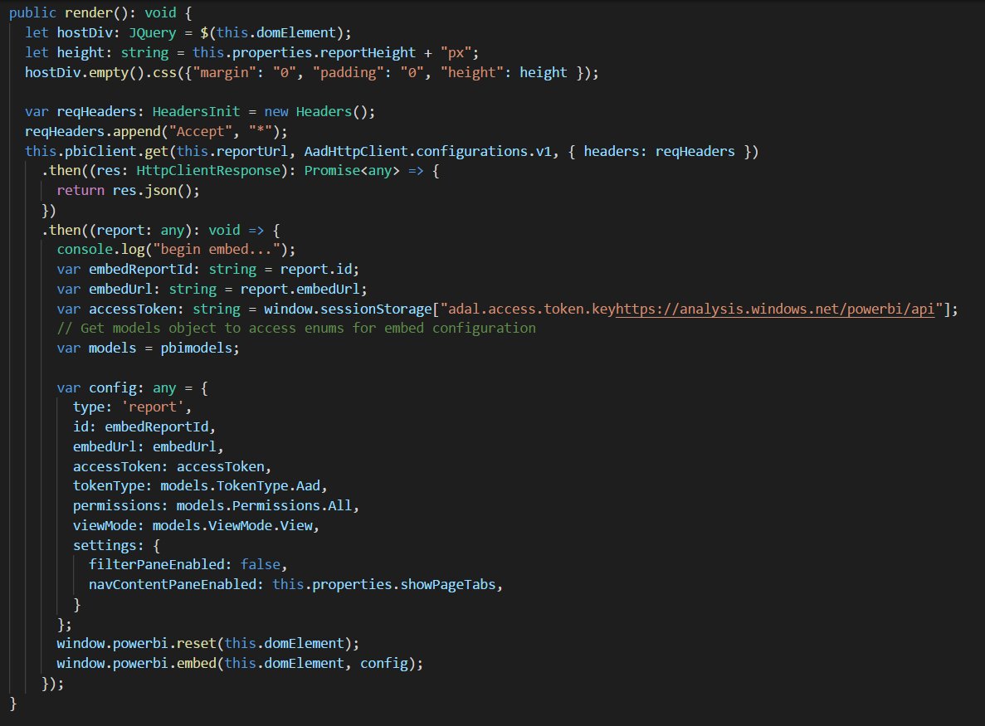

Slide 19
Agenda
Power BI Embedding Fundamentals
Implementing Embedding in SPFX Web Parts

