Slide 1
Getting Started with the PowerApps Component Framework

Slide 2
Agenda
PowerApps Component Framework Overview
Setting up for PCF Development
Creating and Debugging a PCF Project
Testing Components in a PowerApps Environment
Learning from the PCF Samples Projects

Slide 3
What is PCF?
PowerApps component framework
Create components for model-driven apps
Create components for canvas apps
Custom components packaged in PowerApps solution
Solution can be installed in different environments
Getting Started…
https://docs.microsoft.com/en-us/powerapps/developer/component-framework

Slide 4
PowerApps Component Framework APIs
PowerApps Component Framework APIs
component lifecycle management
contextual data and metadata access
seamless server access via Web API
utility and data formatting methods,
device features like camera, location and microphone
UI elements (e.g. dialogs, lookups, full page rendering)

Slide 5
Agenda
PowerApps Component Framework Overview
Setting up for PCF Development
Creating and Debugging a PCF Project
Testing Components in a PowerApps Environment
Learning from the PCF Samples Projects

Slide 6
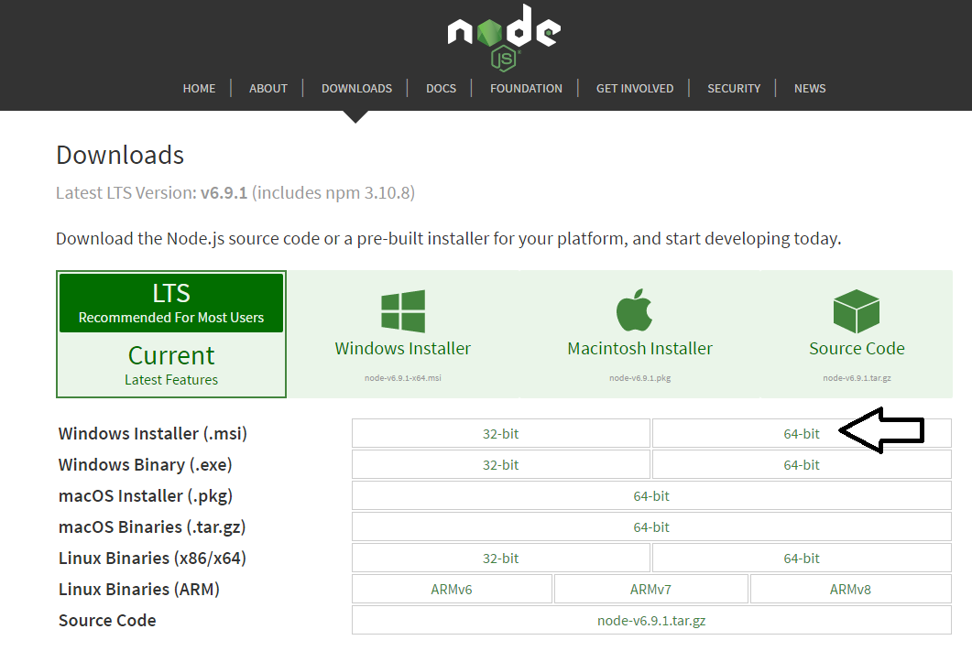
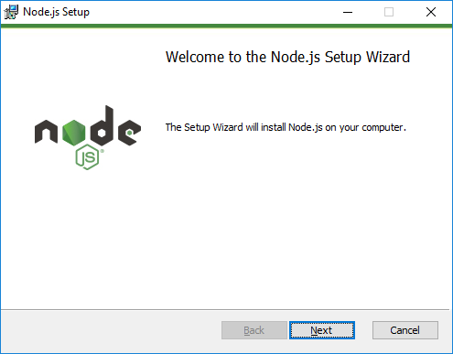
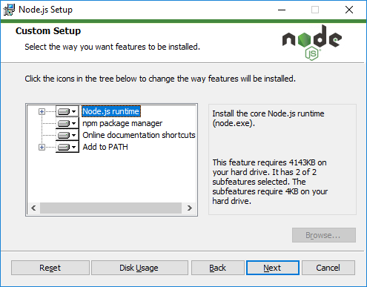
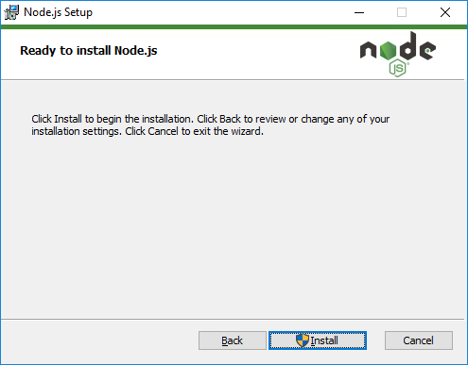
Installing node.js
https://nodejs.org/en/download/

Slide 7
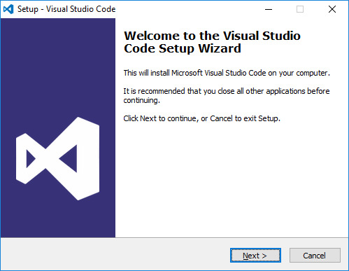
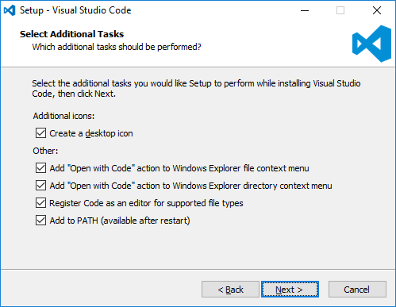
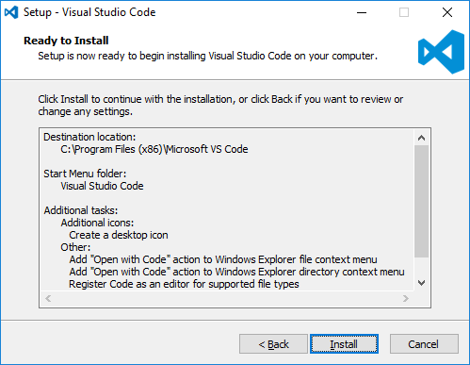
Install Visual Studio Code
http://code.visualstudio.com/

Slide 8
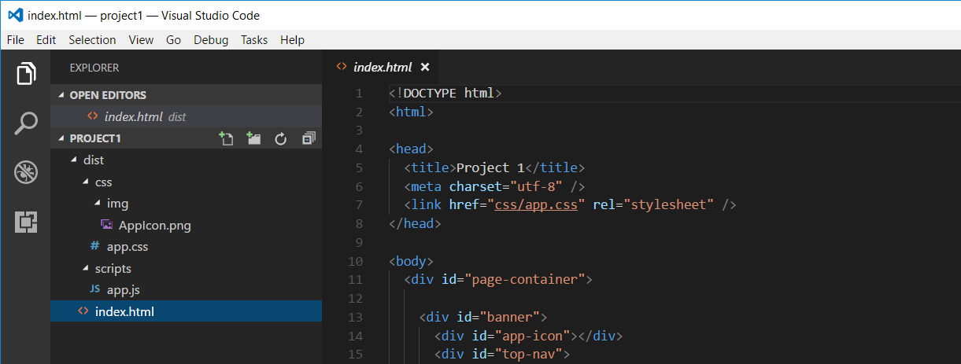
Developing with Visual Studio Code
Node.js is agnostic when it comes to developer IDE
There are many different IDEs that people use with Node.js
This course will be using Visual Studio Code
Visual Studio is not a good fit for Node.js development
Visual Studio solution & project files incompatible with Node.js

Slide 9
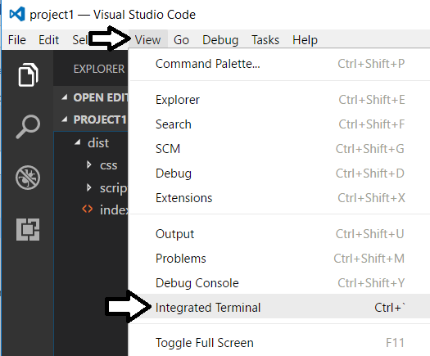
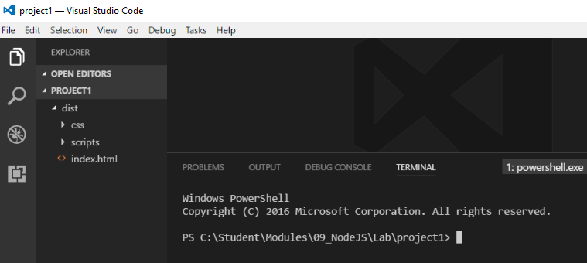
Integrated Terminal
Use the Integrated Terminal to execute npm command

Slide 10
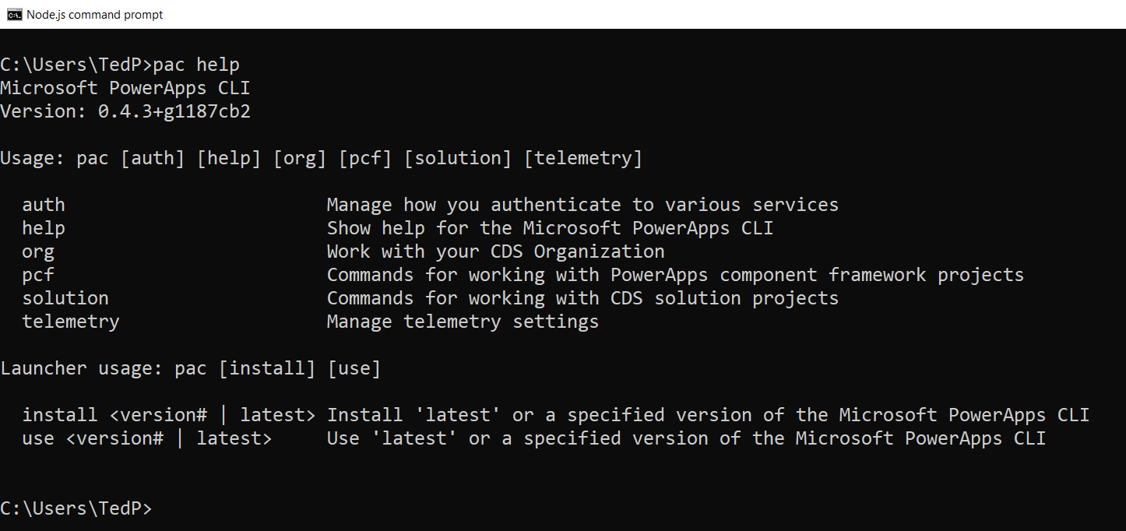
Microsoft PowerApps CLI
PowerApps CLI is command-line tool
Download MSI install file from https://aka.ms/PowerAppsCLI
Used to create, debug, build and deploy components
Requires Node.JS and .NET Framework 4.6.2 Developer Pack.
Preview of PowerApps CLI currently only supports Windows 10

Slide 11
Agenda
PowerApps Component Framework Overview
Setting up for PCF Development
Creating and Debugging a PCF Project
Testing Components in a PowerApps Environment
Learning from the PCF Samples Projects

Slide 12
PCF Components 101
Developing a PowerApps component with PCF
Create the component manifest
Write component implementation in TypeScript
Add component resources (if needed)

Slide 13
Component Manifest
Component Manifest
Includes namespace and name of component
Component type (e.g. field or data-set)
Component properties
Resource files used by component
TypeScript function with component entry point

Slide 14
Component Implementation in TypeSscript
Create a class in TypeScript
Inherit from base class in PCF API
Override lifecycle methods
init (Required)
updateView (Required)
getOutputs (Optional)
destroy (Required)

Slide 15
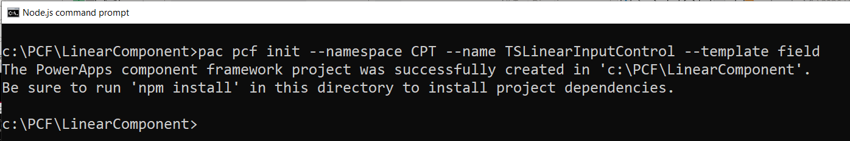
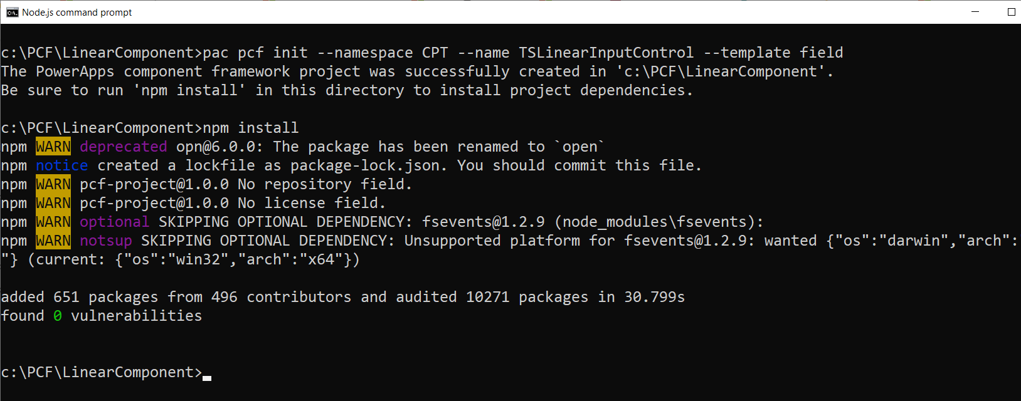
Running pac pcf init
xx

Slide 16
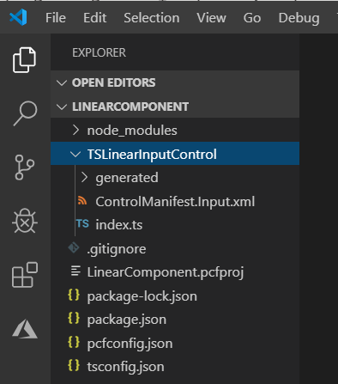
New Project
Component manifest
Component implementation

Slide 17
Agenda
PowerApps Component Framework Overview
Setting up for PCF Development
Creating and Debugging a PCF Project
Testing Components in a PowerApps Environment
Learning from the PCF Samples Projects

Slide 18
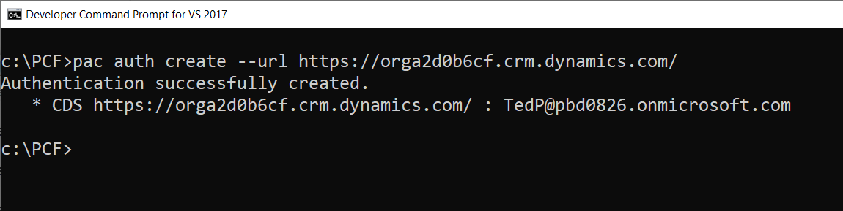
pac auth create --url

Slide 19
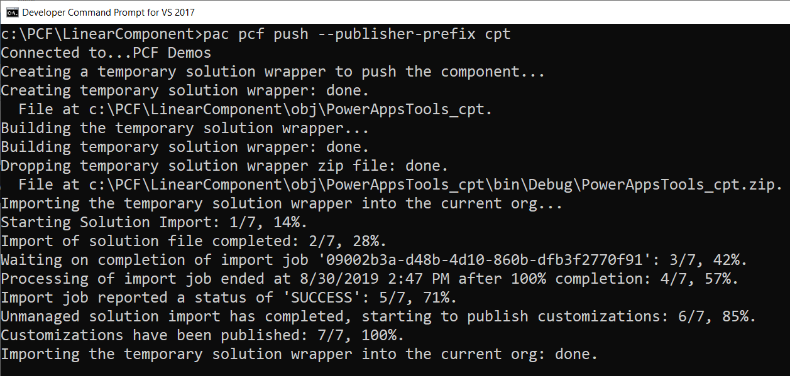
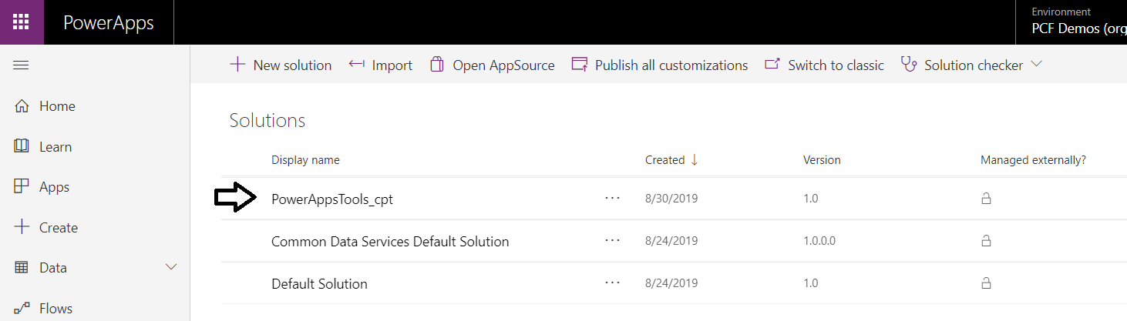
pac pcf push

Slide 20
Agenda
PowerApps Component Framework Overview
Setting up for PCF Development
Creating and Debugging a PCF Project
Testing Components in a PowerApps Environment
Learning from the PCF Samples Projects

Slide 21
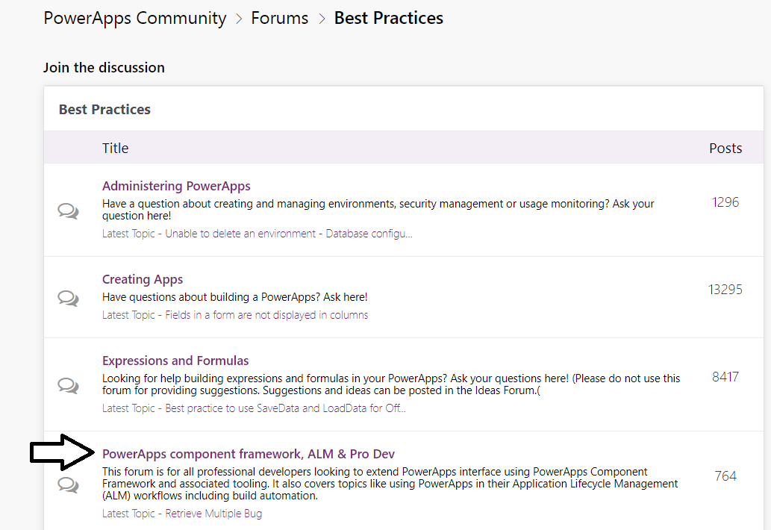
PowerApps Component Framework Forum
https://powerusers.microsoft.com/t5/PowerApps-Community

Slide 22
Summary
PowerApps Component Framework Overview
Setting up for PCF Development
Creating and Debugging a PCF Project
Testing Components in a PowerApps Environment
Learning from the PCF Samples Projects

