Slide 1
Developing in Power BI with Streaming Datasets and Real-time Dashboards

Slide 2
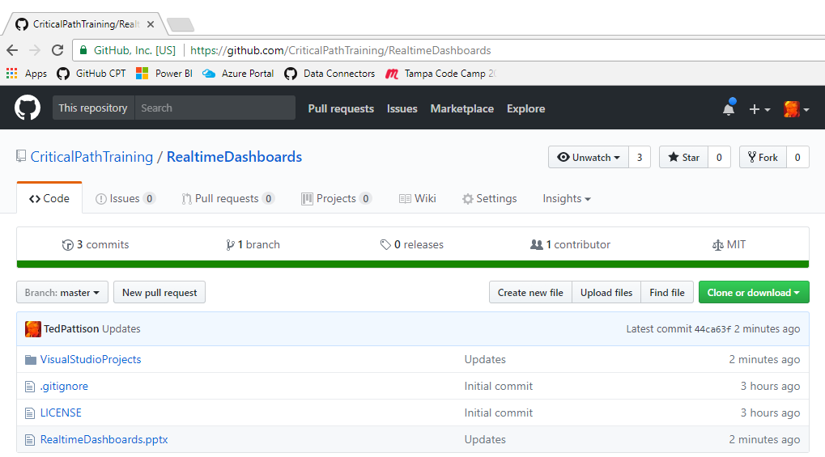
Code and Slides for this Session
https://github.com/CriticalPathTraining/RealtimeDashboards

Slide 3

Critical Path Training https://www.CriticalPathTrainig.com
PBI365: Power BI Boot Camp – 4 Days
Audience is Business Users, Analysts and Data Professionals
Provides hands-on introduction to the Power BI platform
Focuses on build solutions using Power BI Desktop
Query design, data modeling and report and dashboard design
Apps and App Workspaces
PBD365: Power BI Developer Boot Camp – 4 Days
Audience is Professional Developers
Teaches developing custom visuals with TypeScript and D3
Teaches programming with the Power BI APIs
Teaches developing with Power BI Embedded
Teaches R programming and integrating R with Power BI
Teaches how to develop custom connector using M

Slide 4
Agenda
Introduction to Real-time Datasets
Creating a Streaming Dataset with the API
Designing Dashboards with Streaming Data Tiles
Creating a Push Dataset with Real-time Data
Integrating Azure Streaming Analytics Jobs

Slide 5
Pull Datasets versus Real-time Datasets
Pull Datasets
Imported Datasets
DirectQuery Datasets
Live Connect Datasets
Real-time Datasets
Streaming Datasets
Push Datasets
Hybrid Datasets
Pull
Power BI
Service
Custom
Application
Power BI
Service API
Push
Power BI
Service

Slide 6
Streaming Datasets
Data stored in cloud-based cache – not persisted in DB
Restricted to single table - no rich data modeling
Not supported by standard Power BI report designer
Dashboard created using specialized streaming data tiles
No support for DAX, aggregation or filtering
Streaming Data Tiles

Slide 7
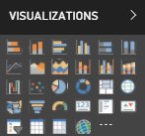
Push Datasets
Data stored in Azure SQL DB – not in cache
Supports multiple tables and table relationships
Supported by standard Power BI report designer
Supports DAX, measures, aggregation & filtering

Slide 8
Hybrid Datasets
Data stored in cloud-based cache AND in Azure SQL DB
Restricted to single table and no rich data modeling
Supported by streaming data tiles
Supported by Power BI report designer
Real-time Tiles

Slide 9
Creating a Hybrid Dataset by Hand

Slide 10
Agenda
Introduction to Real-time Datasets
Creating a Streaming Dataset with the API
Designing Dashboards with Streaming Data Tiles
Creating a Push Dataset with Real-time Data
Integrating Azure Streaming Analytics Jobs

Slide 11


Real-time Scenario Being Simulated
Heisenberg labs processes chemicals
Required to monitor temperatures during processing
Temperature must be monitored on per-second basis
Send alerts if temperature exceeds preset threshold

Slide 12
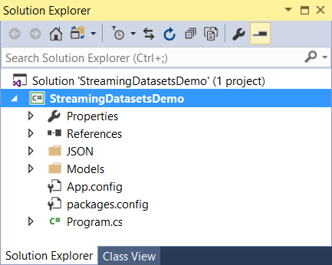
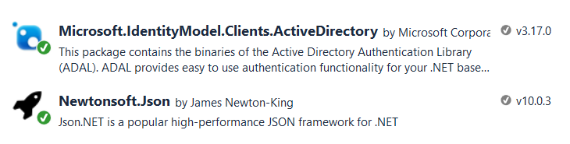
The StreamingDatasetsDemo Project
Console application project in Visual Studio 2017
Installed package for Azure AD Authentication library
Installed package to serialize .NET objects to JSON
Custom
Application
Power BI
Service API
Push
Power BI
Service

Slide 13
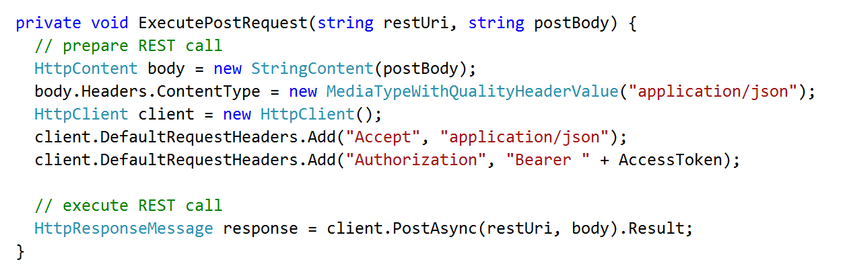
Executing Power BI Service API Calls
Generic helper methods designed to execute HTTP operations
1
2
Custom App
HTTP POST
Power BI Service
Access Token
JSON

Slide 14
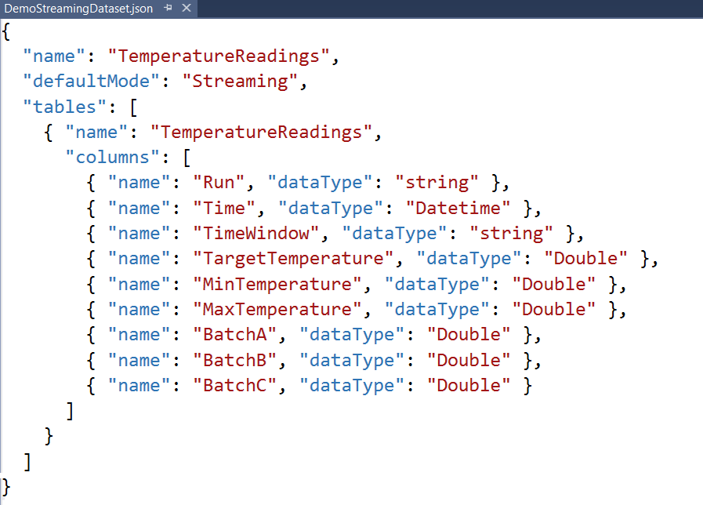
Creating a Streaming Dataset
Streaming dataset created using JSON schema definition
Streaming dataset limited to a single table
Columns defined using name and datatype
No support for any other column properties (e.g. formatting)

Slide 15
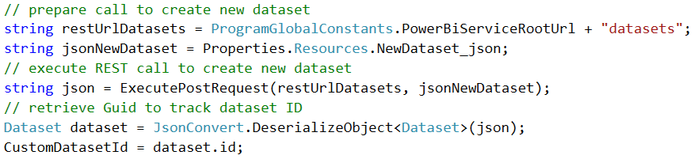
Creating a Custom Dataset
Dataset created by executing HTTP POST operation
One-time operation done as application begins running
1
2
3
Power BI Service
HTTP POST
My Streaming Dataset
Access Token
JSON
TemperatureReadings table

Slide 16
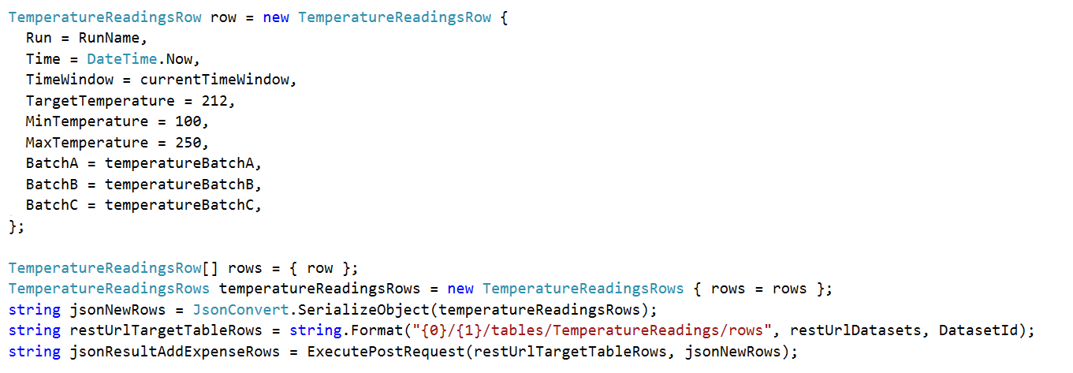
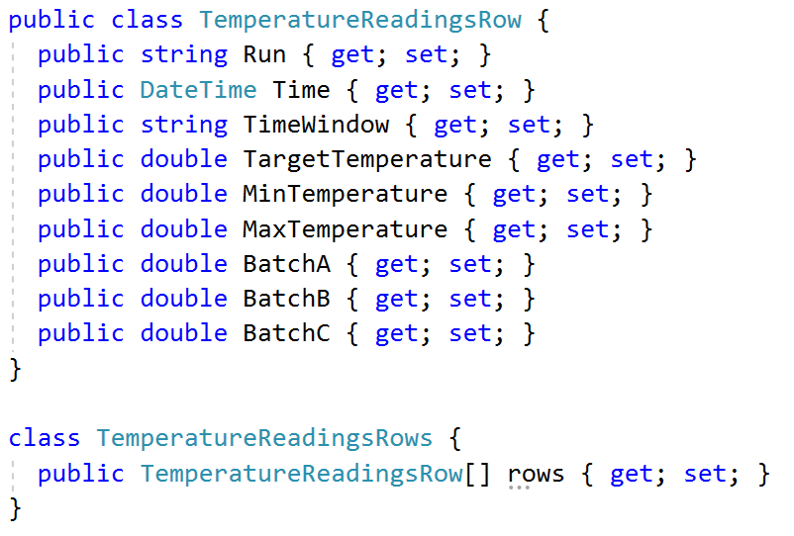
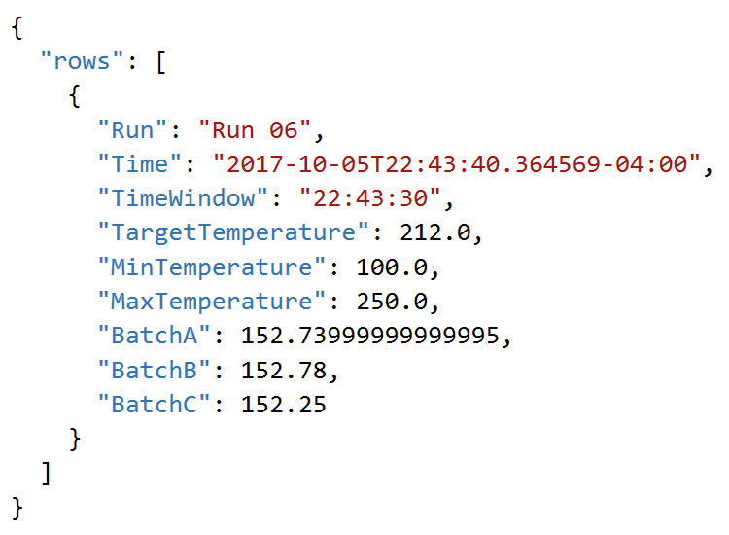
Adding Rows by Converting C# to JSON

Slide 17
Creating a Streaming Dataset using the Power BI Service API

Slide 18
Agenda
Introduction to Real-time Datasets
Creating a Streaming Dataset with the API
Designing Dashboards with Streaming Data Tiles
Creating a Push Dataset with Real-time Data
Integrating Azure Streaming Analytics Jobs

Slide 19
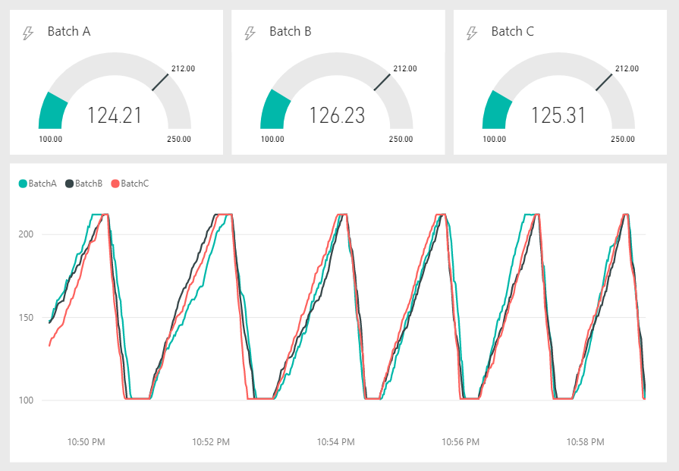
Streaming Data Tiles
Streaming Data surfaced using Streaming Data Tiles
Used to surface data values from streaming dataset cache
Optimized to provide smooth animations for real-time data
Available set of streaming titles as of today
Card
Gauge
Line chart
Cluster Bar Chart
Cluster Column Chart

Slide 20
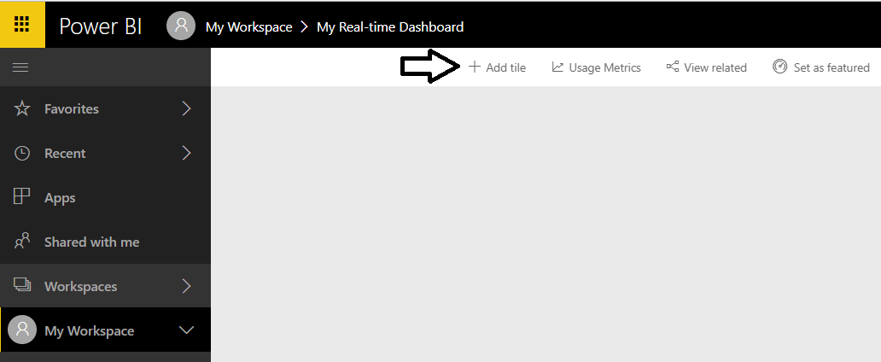
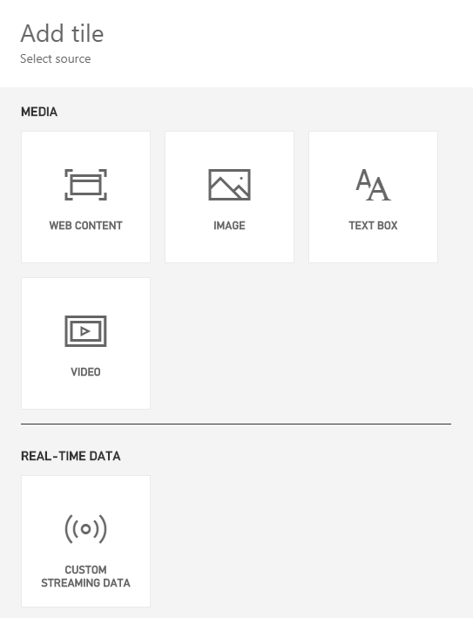
Creating Dashboards with Streaming Datasets
You cannot use the Power BI report designer
Instead, you add real-time data tiles directly to a dashboard
Real-time data tiles different from standard set of Power BI visuals

Slide 21
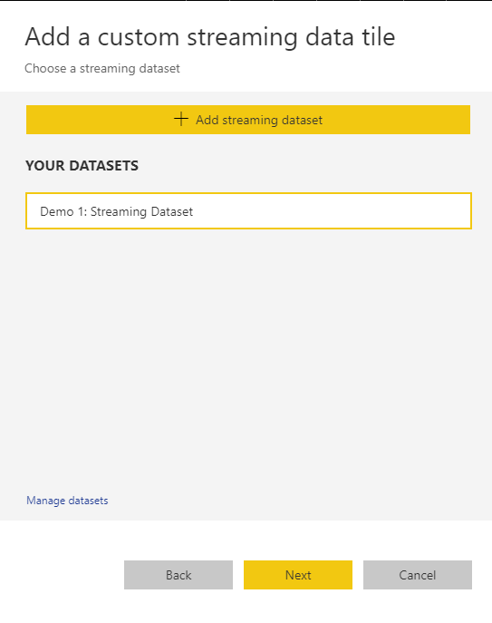
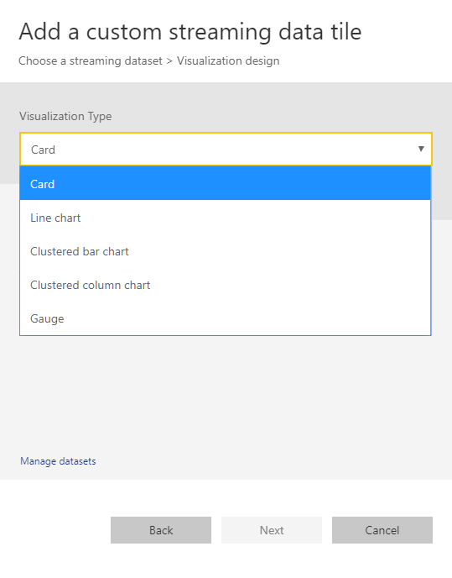
Creating a New Streaming Data Tile
When creating a streaming data tile…
Select dataset that is a streaming dataset or a hybrid dataset
Choose the type of data streaming tile

Slide 22
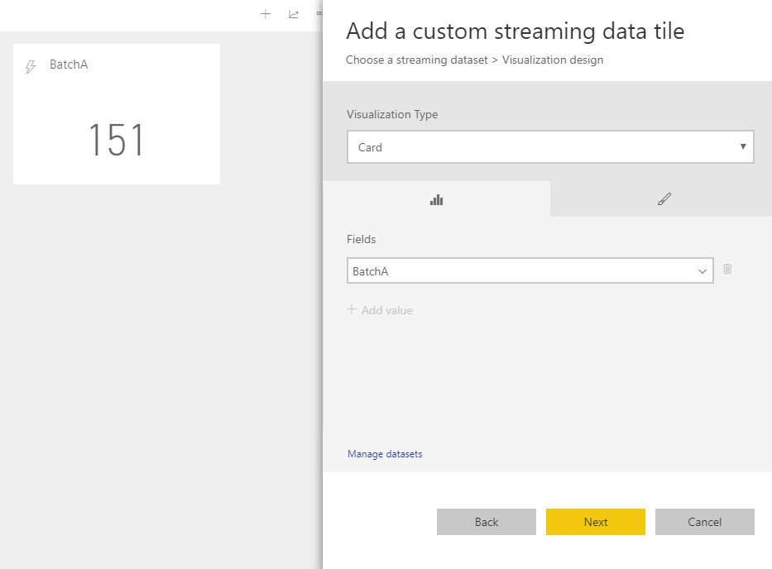
Real-time Data Tile Field Pane

Slide 23
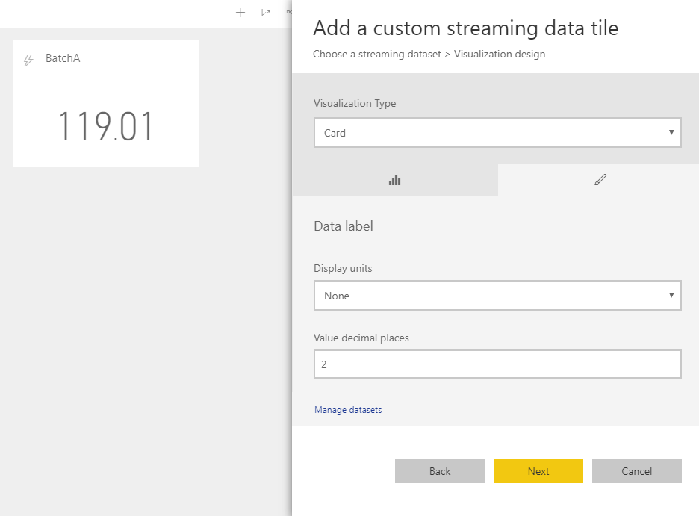
Real-time Data Tile Format Pane

Slide 24
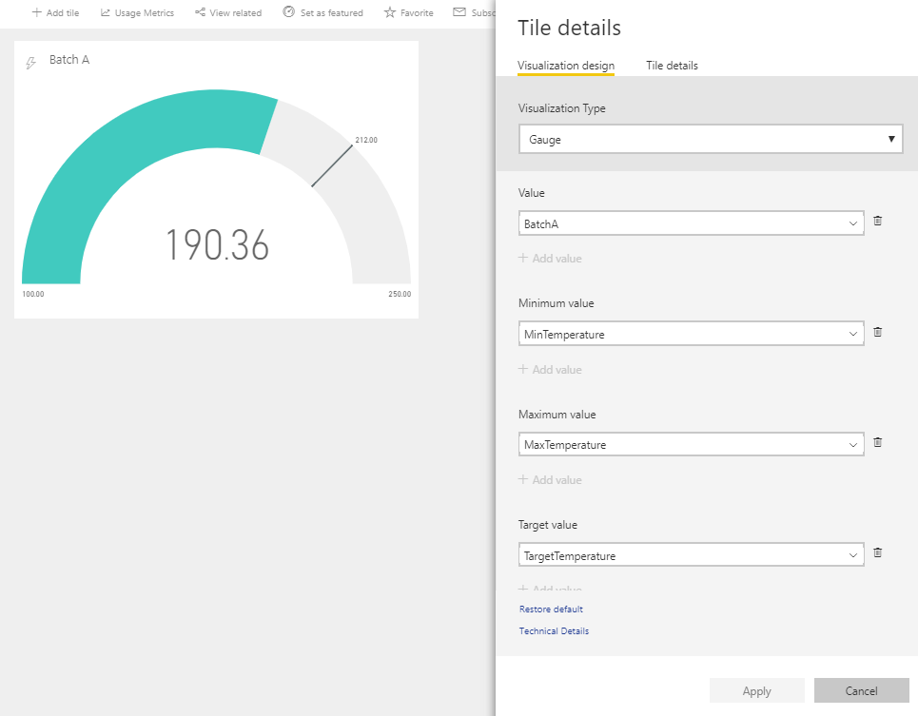
Streaming Gauge Tile

Slide 25
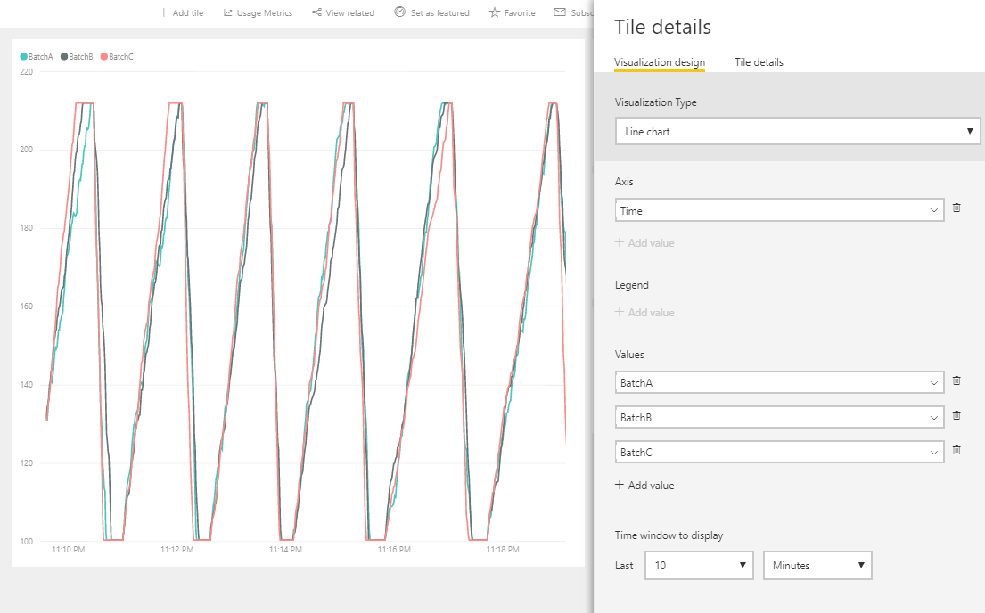
Streaming Line Chart Tile

Slide 26
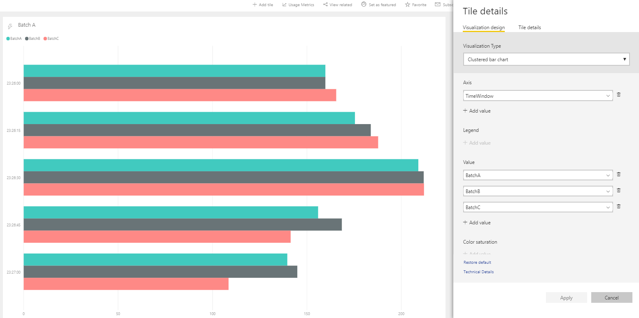
Streaming Clustered Bar Chart Tile

Slide 27
Agenda
Introduction to Real-time Datasets
Creating a Streaming Dataset with the API
Designing Dashboards with Streaming Data Tiles
Creating a Push Dataset with Real-time Data
Integrating Azure Streaming Analytics Jobs

Slide 28
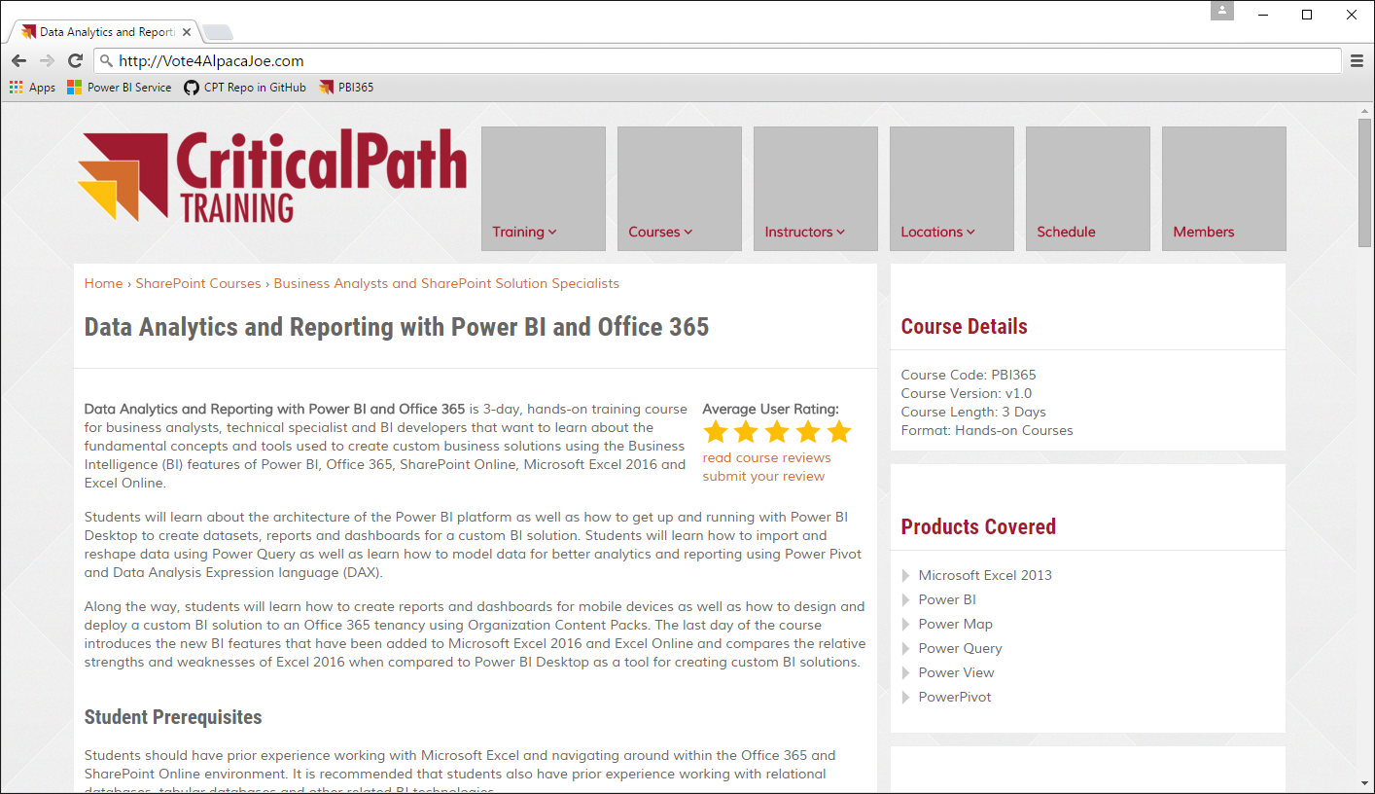

Real-time Scenario Being Simulated
Contribution website accepts contributions from donors
Website calls web service to process credit card transaction
Website calls to Power BI REST API to create & update dataset
Vote for Joe
Vote for Joe
He’ll back an alpaca
Back an Alpaca
Donate
Related Links
Privacy Policy
Credit Card Authority
Contributions
Web Site
Power BI Service
Copyright 2016 – Alpaca Joe’s Super Pac to Get Back to the Facts When a Jackass Attacks an Alpaca - All Right Reserved

Slide 29
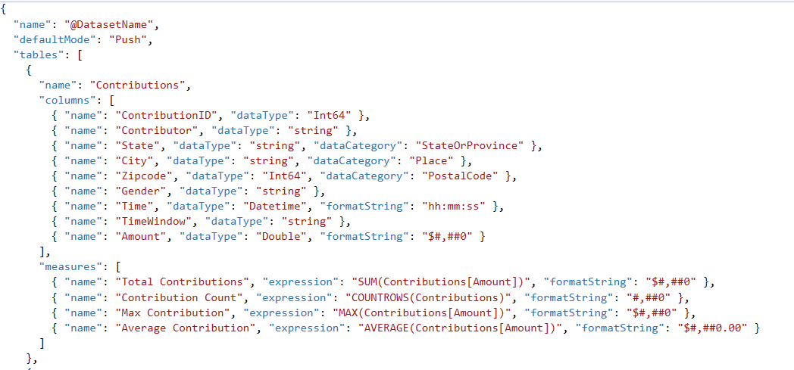
Creating a Push Dataset
Push dataset created using JSON schema definition
Push dataset can contain multiple tables and table relationships
Tables can contains measures as well as columns
Columns & measures can be defined with formatString & dataCategory

Slide 30
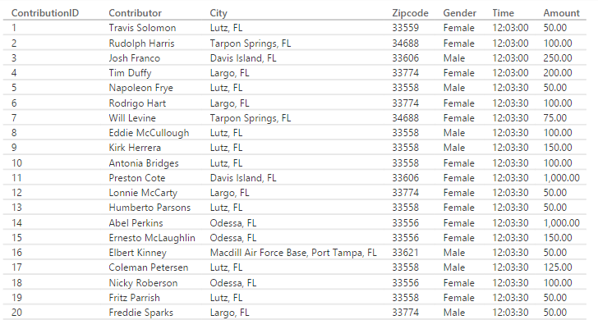
Creating a Tumbling Time Window

Slide 31
Designing a Real-time Dashboard using a Push Dataset

Slide 32
Real-time Dataset Matrix
Feature | Streaming | Hybrid | Push
Updates in real-time | Yes | Yes | Yes
Smooth animations | Yes | Yes | No
Backed by Azure SQL DB | No | Yes | Yes
Report Designer Support | No | Yes | Yes
Allow Rich Data Modeling | No | No | Yes
Ingestion Rate | 5 request/sec 15KB/request |  | 1 request/second 16MB/request

Slide 33
Agenda
Introduction to Real-time Datasets
Creating a Streaming Dataset with the API
Designing Dashboards with Streaming Data Tiles
Creating a Push Dataset with Real-time Data
Integrating Azure Streaming Analytics Jobs

Slide 34
Scaling a Real-time Dashboard
Low velocity data scenario
High velocity data scenario
My App
Power BI Service
HTTP
Data Sender
Data Sender
HTTP
Azure
Event Hub
Azure
Streaming Analytics
Power BI
Service
Data Sender
Data Sender
Data Sender

Slide 35
The StreamingDatasetsDemo Project
Console application project in Visual Studio 2017
Installed package for Azure AD Authentication library
Installed package to serialize .NET objects to JSON
Custom
Application
Power BI
Service API
Push
Power BI
Service

Slide 36
Creating Streaming Datasets using Azure Streaming Analytics Jobs

Slide 37
Summary
Introduction to Real-time Datasets
Creating a Streaming Dataset with the API
Designing Dashboards with Streaming Data Tiles
Creating a Push Dataset with Real-time Data
Integrating Azure Streaming Analytics Jobs

Slide 38
Critical Path Training https://www.CriticalPathTrainig.com
PBI365: Power BI Boot Camp – 4 Days
Audience is Business Users, Analysts and Data Professionals
Provides hands-on introduction to the Power BI platform
Focuses on build solutions using Power BI Desktop
Query design, data modeling and report and dashboard design
Apps and App Workspaces
PBD365: Power BI Developer Boot Camp – 4 Days
Audience is Professional Developers
Teaches developing custom visuals with TypeScript and D3
Teaches programming with the Power BI APIs
Teaches developing with Power BI Embedded
Teaches R programming and integrating R with Power BI
Teaches how to develop custom connector using M

