Slide 1
TASK-07
PRODUCT - SMART HYDROPHONIC
GARDENING SYSTEM

Slide 2
Smart Hydroponic Gardening System
A Smart hydroponic gardening system is an advanced, technology- driven method of growing plants in a nutrient- rich solution rather than soil . It integrtes sensors , automation , and data analysis to optimize palnt growth , reduce resources , and increase yeilds .

Slide 3
AUTOMATION
PUMP CONTROL
LIGHT
CONTROL
DATA
ANALYSIS
DATA LOGGING
ALERTS
HYDROPONIC
SYSTEM
NFT
DWC
SENSORS
HUMIDITY
LIGHT

Slide 4
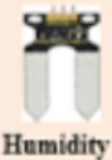

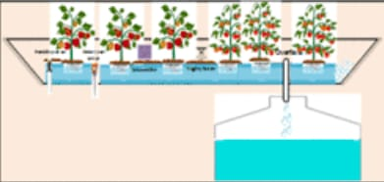




Data Acquisition
(collect water & humidity data from sensors)
Sensors
Desired settings
(desired minimum and maximum water and humidity level for efficient plant production)
Optimization
(compute optimal water & humidity level based on settings )
Hydroponic system
Power source
Fuzzy Logic Control (compute optimal working level & operational duration for actuators)
Actuators
constraints

Slide 5
THANK
YOU
TEAM CRITICAL THINKERS
T.RISHIKA
K.VAISHNAVI
V.MANASWANI DEVI
V.TEJAWINI
Y.AVANTHIKA

