Slide 1
TASK-08
IT in METRO RAIL

Slide 2
Metro Rail Systems
Metro rail systems are high-capacity urban rail systems that are designed to improve urban transport efficiency. They are also known as subways or underground railways.

Slide 3
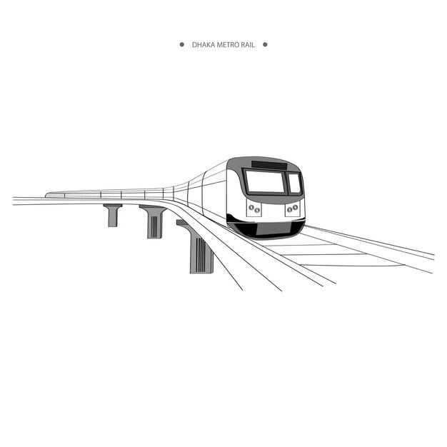
Metro Rail Systems
Metro Rail in India
India has 17 operational metro systems in 17 cities, with Delhi metro being the largest. India’s metro network is the third longest in the world ,behind China and USA.

Slide 4
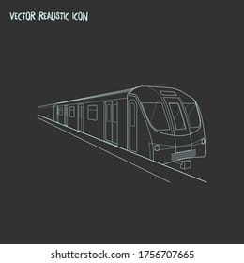
Metro Rail Impacts on Cities
Metro systems can lead to urban expansion, densification, end commercial suburbanization. They can also increase housing prices, end people may choose to live closer to a metro station.

Slide 5

Benefits of Metro Rail
Benefits of Metro Rail
Metro rails are known for facilitating people’s safe, quick ,and easy movement. They can help connect hard- to- reach places with the rest of the city, which dissipates congestion.
Metro can also be a more economical option then taxes.

Slide 6
THANK YOU
TEAM CRITICAL THINKERS
T.RISHIKA
K.VAISHNAVI
V.MANASWANI DEVI
V.TEJASWINI
Y.AVANTHIKA

