Slide 1
TASK-11
Unique Characteristic Of Design Thinking

Slide 2
Brainstorming Kits:
Brainstorming kits are versatile tools designed to facilitate creative thinking and collaboration in teams. Here’s a deeper look at their features and benefits:
Components of Brainstorming Kits
Idea Cards: Cards with prompts or questions that inspire creativity and spark new ideas. They can focus on specific challenges or broader themes.
Sticky Notes: Essential for jotting down ideas, organizing thoughts, and visualizing concepts. They allow for easy rearrangement during discussions.
Markers and Pens: Tools for writing and sketching ideas, making it easy to illustrate concepts or annotate notes.

Slide 3
.
Templates: Pre-designed worksheets or frameworks for specific brainstorming methods, such as mind mapping or SWOT analysis.
Instruction Guides: Step-by-step instructions on various brainstorming techniques (like SCAMPER, brainwriting, or round-robin), helping teams utilize the kit effectively.
Timer: To keep sessions focused and efficient, encouraging quick thinking and minimizing overthinking.
Digital Tools: Some kits include access to online platforms or apps that facilitate virtual brainstorming, allowing remote teams to collaborate seamlessl

Slide 4
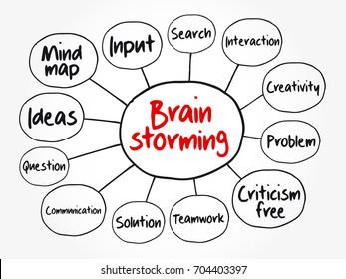
EMPATHY PROCESS FLOWCHART:-

Slide 5
THANK YOU
TEAM CRITICAL THINKERS
T.RISHIKA
K.VAISHNAVI
V.MANASWANI DEVI
V.TEJASWINI
Y.AVANTHIKA

