Slide 1
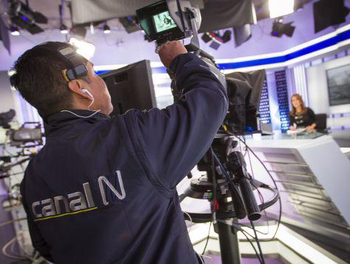
Media, Power, and the Subversion or Restoration of Democracy in Latin America
We explore how television shaped political reality and determined democratic outcomes across Latin America from the 1970s through the 1990s.
In one case, television was corrupted and silenced to maintain a façade of democracy; in the other, it became the channel through which democracy reawakened.

Slide 2
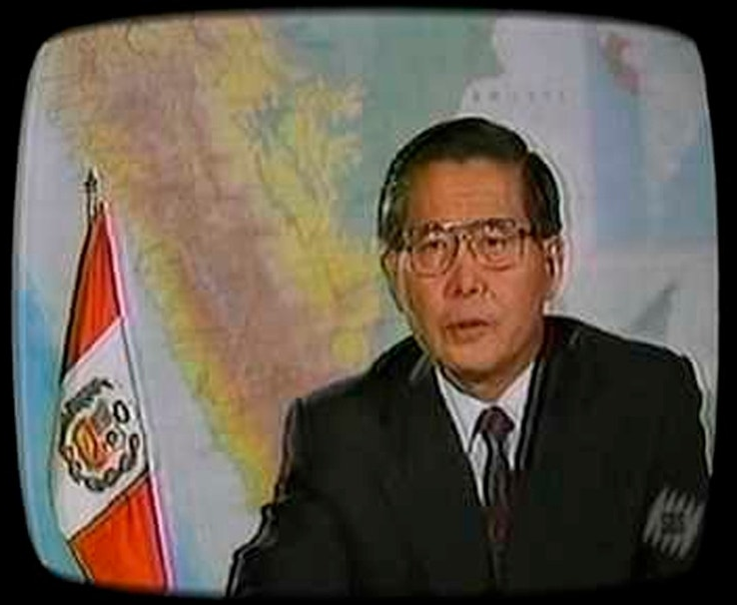
Setting the Stage: Television and the Politics of Visibility
From the 1970s through the democratic wave of the 1990s, mass media became the most powerful tool for shaping political reality in Latin America. Radio and print had long mediated the public sphere, but television transformed the scale and immediacy of communication. It could reach millions simultaneously, transmit emotion as well as information, and—crucially—link rulers to citizens without the mediation of parties or institutions.
Authoritarian rulers quickly understood that whoever controlled television could control the narrative of legitimacy. Likewise, democratic reformers learned that even limited access to the airwaves could erode the walls of fear and censorship. The cases of Peru under Alberto Fujimori and Vladimiro Montesinos, and Chile under Augusto Pinochet, illustrate two sides of this same coin.
Understanding how these media dynamics unfolded allows us to see why the control—or liberation—of television often determines whether democratic institutions endure or collapse.

Slide 3
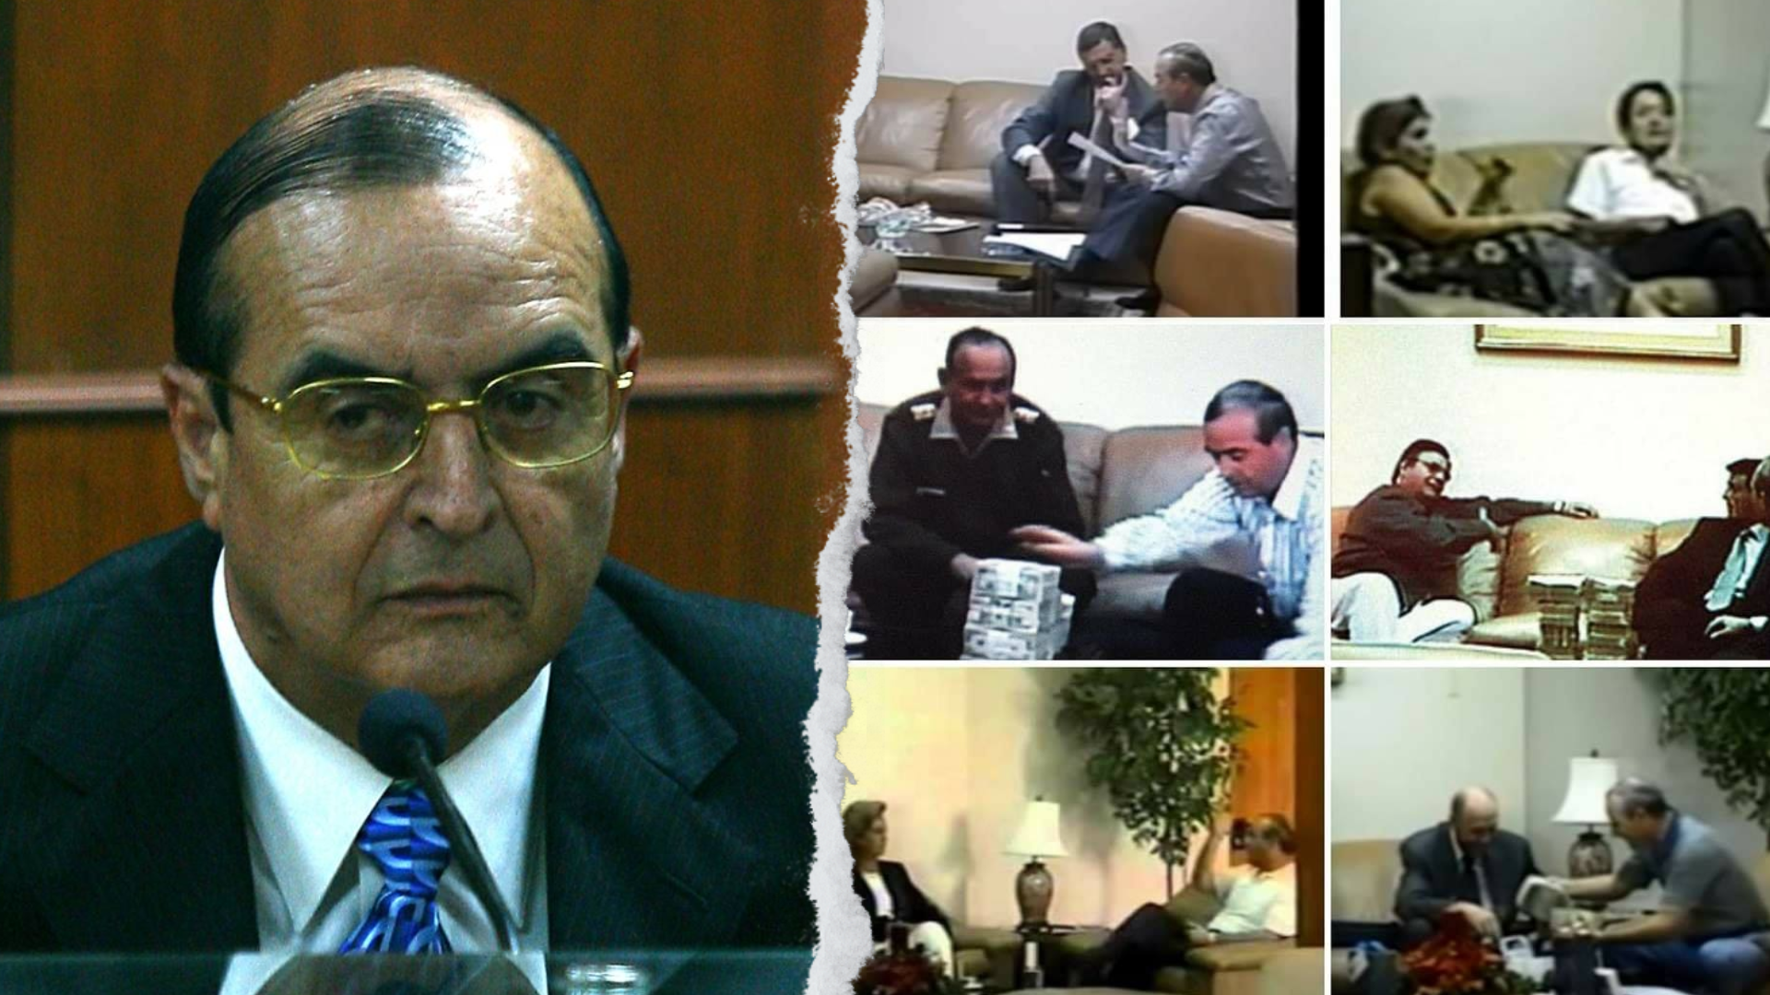

Slide 4
The Peruvian Case: Montesinos and the Market for Corruption
01
02
Power Behind the Throne
Lies, Videotapes, and the Price of Compliance
When Fujimori came to power in 1990, Peru was a nation in disarray: hyperinflation, insurgency, and discredited political parties. Into this vacuum stepped Vladimiro Montesinos, a disgraced ex-officer who became the de facto architect of government as head of the National Intelligence Service (SIN). Montesinos grasped a fundamental truth about modern authoritarianism: it is not always imposed by force, but by buying the appearance of consent.
Montesinos's genius and eventual downfall lay in his obsession with documentation. He demanded written receipts for bribes and filmed his transactions—the now infamous vladivideos. By analyzing these tapes, McMillan and Zoido revealed a the political economy of corruption: television was the most expensive institution to capture. A single TV channel cost Montesinos more than all opposition politicians combined, confirming that media, not parliament, was the regime's real check on power.
03
04
Mechanisms of Control
Collapse Through Exposure
Montesinos created a system of perpetual dependency. Monthly payments ensured loyalty, while videotaped evidence served as blackmail. Violence was used sparingly; the true coercion was psychological and informational. Through these networks, he merged executive, legislative, and judicial powers under the veneer of legality—an echo of Madison's warning that such accumulation is the "very definition of tyranny."
In 2000, a single videotape showing Montesinos bribing a congressman for $15,000 triggered the regime's implosion. Fujimori fled to Japan; Montesinos was arrested and tried. The downfall revealed a paradox of informational control: the same medium used to suppress truth became the instrument of exposure.

Slide 5


Slide 6
The Chilean Case: Television and the Democratic Defeat of Pinochet
Context and the 1988 Plebiscite
1
Chile's seventeen-year dictatorship sought to blend repression with constitutionalism. The 1980 constitution scheduled a plebiscite in 1988 to determine whether General Augusto Pinochet would rule for another eight years. Confident of victory, the regime permitted opposition access to television for fifteen minutes per night during the campaign. That space—the franja del No—became a turning point in Latin American political communication.
2
The Campaign of Joy
The opposition's broadcast offered humor, music, and hope under the slogan "Chile, la alegría ya viene" (Chile, joy is coming). In contrast to the regime's fear-based messages, the franja portrayed ordinary Chileans envisioning a democratic future. It personalized politics, showing not ideology but everyday life. For millions, it was their first glimpse of dissent not framed as chaos or subversion.
Measuring Television's Impact
3
Using survey and voting data, González and Prem (2018) find that greater access to television increased opposition votes by about two percentage points per standard deviation of exposure, even after controlling for prior political leanings and socioeconomic variables. Crucially, radio exposure had no similar effect, showing that it was not media penetration per se, but the visual, emotional impact of television that moved voters.
4
Television as a Public Sphere
The franja temporarily shattered the regime's information monopoly. It created a shared national conversation, blending political argument with cultural performance. The campaign's success reflected not only its message but its capacity to unify a fragmented opposition, showing that cooperation, not polarization, could defeat authoritarianism.

Slide 7
10-13%
2%
15
Voter Persuasion
Vote Increase
Minutes Per Night
Estimated percentage of exposed viewers who switched to the "No" option after watching the opposition broadcasts.
Percentage point increase in opposition votes per standard deviation of television exposure.
Daily airtime granted to the opposition during the campaign period—enough to change history.

Slide 8
Comparative Reflections: Two Media Regimes, Two Logics of Power
Peru: Television as Weapon
Chile: Television as Liberation
Television was the pillar of authoritarian stability
Montesinos recognized that capturing it was more efficient than censoring it
By bribing broadcasters, he neutralized public scrutiny and fabricated consensus
The regime's strength lay in secrecy, transaction, and control of narrative
Used television to suppress pluralism and monopolize information flows
Television became the catalyst of democratic awakening
The Franja del No bypassed fear and reframed the meaning of citizenship
Opposition used it to re-humanize politics and create shared conversation
A carefully controlled institutional opening allowed citizens to reclaim sovereignty
Demonstrated that even partial media liberalization can trigger democratic change
The Dual Nature of Media Power
Executive Dominance Destroys Accountability
Television can be a weapon of manipulation or a stage for liberation, depending on who holds the microphone and what message is broadcast. Both cases expose the fragility of institutional checks in presidential systems when information flows are monopolized.
In Peru, the executive's covert dominance over other branches destroyed accountability through bribery and information control. In Chile, Pinochet's constitution codified executive dominance, but a moment of communicative pluralism allowed democratic forces to prevail.

Slide 9



Institutions, Media, and the Logic of Authoritarian Durability
Executive Predominance and Institutional Capture
Media as Informational Infrastructure
Legitimacy and Resilience
These cases embody the perils of unchecked presidentialism. Montesinos's network blurred constitutional boundaries, while Pinochet's constitution codified executive dominance. Both neutralized the legislature and judiciary—one through bribery, the other through design. The readings confirm patterns we've seen in executive–legislative relations throughout the course.
Mass media operates as a fourth branch of government. When independent, it sustains vertical accountability; when captured, it consolidates executive rule. Montesinos paid most to neutralize television precisely because it was the only institution capable of influencing public opinion outside his control. The Chilean experience shows that even partial media liberalization can trigger democratic change once citizens encounter alternative narratives.
From the perspective of the "legitimacy and resilience" framework, Peru's regime depended on performance legitimacy—economic recovery and security—reinforced by propaganda. Chile's depended on institutional legitimacy, claiming constitutional order and stability. Both were undone when informational legitimacy collapsed: when citizens stopped believing the official story.
Democracy depends not just on formal institutions, but on the informational infrastructure that allows citizens to hold power accountable. When that infrastructure is captured or corrupted, even constitutional democracies can become authoritarian facades.

Slide 10
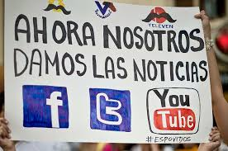
From Television to Social Media
Television Era
Social Media Era
Concentrated communication in few powerful channels. Unified the public sphere. Control meant capturing broadcasters.
Infinite channels of communication. Risks fragmenting publics into echo chambers. Control means algorithmic manipulation.
The difference lies not in the technology itself but in who controls the flow of messages
Democracy depends on transparency, credible information, and institutions capable of resisting capture—whatever the medium through which power communicates. The lessons from Peru and Chile remain vital: whether through television broadcasts or viral tweets, the battle for democracy is ultimately a battle for the narratives that shape how citizens understand their world and their power within it.
Notes:
Like the franja del No, viral campaigns can pierce censorship and coordinate collective action—witness movements such as #NiUnaMenos or protests in defense of democracy across the region. Yet, echoing Montesinos's logic, digital platforms can also fragment publics, spread disinformation, and algorithmically target individuals with personalized propaganda.
Key Takeaway: Television once unified the public sphere; social media risks dividing it into isolated echo chambers. Yet the fundamental principle remains unchanged: democratic survival requires citizens to share a common informational space where truth can challenge power.

