Slide 1
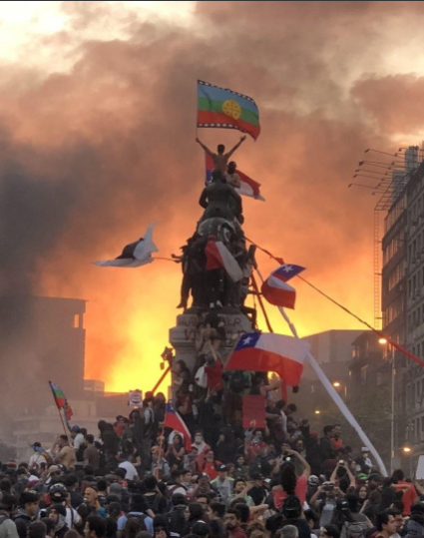
The Health of Democracy in Latin America
Samuel Huntington's concept of democratization "waves" provides the framework for understanding one of the most remarkable political transformations in modern history. Latin America's experience during the Third Wave of democratization (1974-1990s) represents the most comprehensive regional shift from authoritarian rule to democratic governance ever witnessed.
This transformation began in Southern Europe but found its most dramatic expression across Latin America, where nearly an entire continent embraced democratic institutions within two decades. Unlike previous waves that proved fragile and reversible, the Third Wave created lasting change that continues to shape the region today.

Slide 2
The Three Waves of Democratization
First Wave (1828-1926)
1
Elite-dominated experiments in Argentina, Chile, Uruguay, and Costa Rica. These early democratic forms were fragile and exclusive, restricted to narrow segments of society and vulnerable to economic and political pressures.
2
Second Wave (1943-1962)
Post-World War II democratic openings created hope for sustained democratization. However, by the late 1960s and 1970s, military coups established bureaucratic-authoritarian regimes across the Southern Cone.
Third Wave (1978-1992)
3
The collapse of military rule began in the Southern Cone and extended through Central America. By 1990, almost all of Latin America had democratic or semi-democratic governments, with only Cuba remaining fully authoritarian.
This Third Wave was unprecedented in its scope, duration, and resilience. For the first time in history, Latin America became predominantly democratic, producing a generation that grew up with regular voting as the norm.

Slide 3
Testing Democratic Theories in Latin America
Classical theories of democratization, built primarily from European experiences, face significant challenges when applied to Latin America's democratic transitions and survival.
Modernization Theory
Class-Based Theories
Economic Performance
Prediction: Economic development fosters democracy through education, middle class growth, and complex economies.
Prediction: Democracy requires strong working and middle classes with weakened landed elites.
Prediction: Deep economic crises should cause democratic breakdowns.
Latin American Reality: The 1980s "lost decade" of debt crisis and hyperinflation did not lead to democratic collapse.
Latin American Reality: Authoritarian coalitions often included both elites and middle class segments, while democracy survived in unexpected contexts.
Latin American Reality: The most developed societies (Argentina, Chile, Uruguay) suffered military breakdowns in the 1960s-70s, while poorer democracies like Costa Rica endured.
These traditional explanations cannot account for democracy's survival and spread in Latin America after 1978. Instead, regional dynamics, elite choices, and international context emerge as key drivers of democratization.

Slide 4
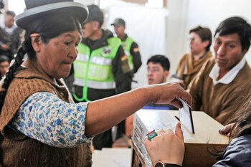

The Persistence of Democratic Paradox
Frances Hagopian's Central Paradox
Hagopian's 2005 analysis reveals a striking contradiction at the heart of Latin American democracy: remarkable institutional durability coupled with persistent citizen disaffection.
Durability Evidence
Militaries have retreated to barracks
Civilian elites remain committed to elections
Only Peru's 1992 autogolpe represents clear reversal
Democratic institutions have survived massive crises
Disaffection Indicators
Only 50% said democracy always preferable (2003)
Many would accept authoritarianism for economic solutions
The conditions that foster transitions are not the same as those that consolidate healthy democracy. This creates the risk of formal survival but substantive hollowing out.
Rise of "doubting democrats" across the region

Slide 5




Forces Behind Democratic Transitions
If modernization and economic growth cannot explain the Third Wave, what factors drove Latin America's democratic transitions?
International Support
Value Changes
U.S. foreign policy shifted toward democracy promotion, particularly in Central America. The OAS and Mercosur conditioned membership on democratic rule, while international condemnation deterred coups in Guatemala (1993) and Paraguay (1996).
Catholic Church reforms through Vatican II and liberation theology emphasized human rights and democracy. The Latin American left, radicalized in the 1960s, learned through exile and repression to embrace elections as the only viable path forward.
End of Communism
Elite Strategies
The collapse of the Soviet bloc diminished fears of "communist takeovers" and reduced ideological polarization, creating space for democratic competition without existential stakes.
Institutional innovations like Mexico's Federal Electoral Institute, Chile's binomial electoral law promoting coalitions, and Brazil's constitutional provisions balancing executive power and governability.

Slide 6
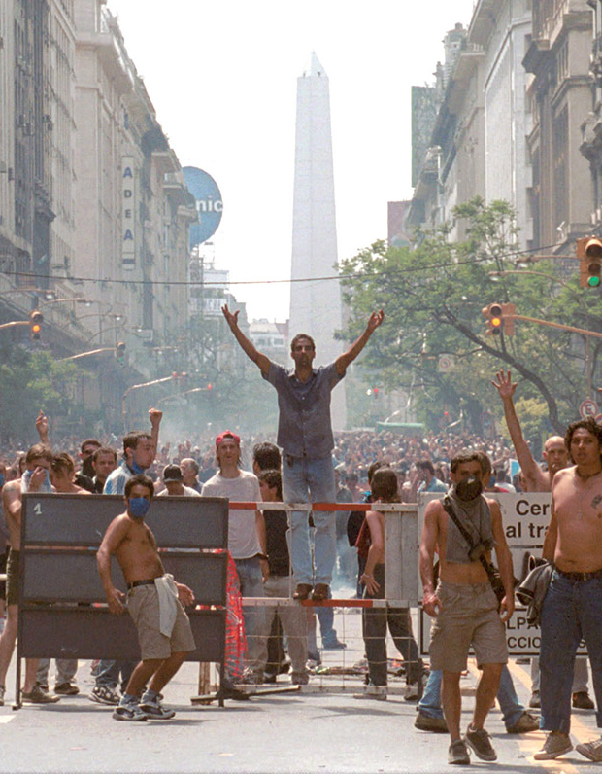



The Participation Dilemma
Despite regime stability, citizen skepticism has grown, creating a fundamental tension about the appropriate level of democratic participation.
Rising Disaffection
Indicators include rising abstention, electoral volatility, outsider candidates, and protests that toppled presidents in Ecuador (2000), Argentina (2001), and Bolivia (2003).
The Participation Debate
High participation may deepen democracy but risks populism and destabilizing protests. Low participation preserves stability but leaves elites unchecked and citizens alienated.
Party Systems Matter
When parties are strong and representative (Chile), they mediate demands and sustain trust. When weak or fragmented (Venezuela, Ecuador), anti-system leaders emerge.
"Democracy cannot thrive without parties and institutions capable of channeling participation." - Frances Hagopian

Slide 7
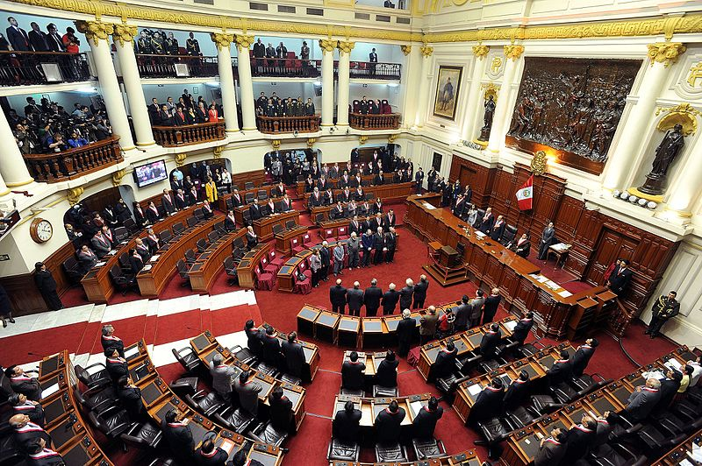



The Low-Level Equilibrium Trap
Expectations vs. Performance
A critical mismatch exists between citizen expectations and government performance. With expanded suffrage bringing previously excluded groups into the democratic process, citizens expect more from democracy: jobs, safety, transparency, and responsive governance.
Yet governments consistently underdeliver, creating what Hagopian identifies as an "uneasy low equilibrium" rather than democratic collapse.
Poor Performance
Governments fail to deliver expected services and security
Lowered Expectations
Citizens adjust downward their demands on democracy
Shallow Survival
Democracy persists but remains weak and hollow
This equilibrium allows democracy to persist in poor, unequal societies, but at the cost of citizen disillusionment and weak democratic legitimacy. The system survives but fails to thrive.

Slide 8



Challenges to Democratic Governance
Economic Security
Public Security
Corruption
Persistent unemployment, poverty, and recurrent economic crises erode citizen confidence in democratic governance. Argentina's 2001 collapse exemplifies how economic failure undermines democratic legitimacy despite institutional survival.
High crime rates and weak state enforcement capabilities create daily insecurity for citizens. When governments cannot provide basic safety, democratic institutions lose credibility and citizens may support authoritarian alternatives.
Scandals, whether real or perceived, make citizens doubt the integrity of democratic institutions. Corruption undermines the fundamental democratic promise of accountable governance and equal treatment under law.
These three domains consistently undermine democratic quality across Latin America, creating a regional pattern of "democracy without quality" that persists from Hagopian's 2005 analysis to the present day.
Risks of Heightened Participation
Populist channel: Charismatic leaders bypass institutions, claiming to embody "the people" (Fujimori, Chávez)
Fiscal channel: Popular demands for redistribution exceed state capacity, creating unsustainable debt
Extra-institutional channel: Protests, assemblies, or vigilante justice replace institutional mediation

Slide 9



The Future of Latin American Democracy
Hagopian's analysis reveals that vibrant civil society alone cannot sustain democratic quality—political parties remain essential for channeling citizen demands and building sustainable coalitions.
Strong Parties Build Democracy
Weak Parties Enable Outsiders
Institutional Innovation Matters
Countries with robust party systems (Chile, Uruguay) successfully channel demands, build coalitions, and sustain accountability, creating positive feedback loops for democratic legitimacy.
Where parties have decayed or fragmented (Venezuela), outsider politicians dominate, institutions erode, and democracy becomes vulnerable to authoritarian capture.
Electoral reforms, legislative strengthening, and innovative representation mechanisms can bolster democratic quality when designed thoughtfully and implemented consistently.
The enduring lesson from Latin America's democratic experience is that transition does not equal consolidation. While modernization and economic performance theories fail to explain democratic endurance, the real challenge lies in how citizens perceive democracy: their expectations, trust, and sense of representation.
Unless governments deliver security, fairness, and responsiveness, democracy will survive in form but weaken in substance, remaining trapped in the paradox of durable but disillusioned democracies.

