Slide 1
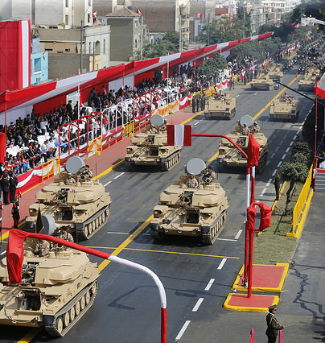
Civil-Military Relations in Latin America
We explore the transformation of civil–military relations in Latin America, with a special focus on the Southern Cone.
We examine how authoritarian legacies, democratic transitions, and institutional reforms have shaped the relationship between soldiers, politicians, and society. Theoretical frameworks and case studies help us gain insight into how militaries moved from rulers to subordinates, why civilian control is essential for democratic consolidation, and what challenges remain in building stable, democratic defense institutions.

Slide 2
Setting the Stage: Why Civil-Military Relations Matter
Cold War Era (1960s-1980s)
1
Military-led authoritarian regimes dominated Latin America. Generals became governors, military zones replaced civilian districts, and thousands faced imprisonment, torture, or death in the name of national security doctrine.
2
End of Cold War (1980s-1990s)
Democratic transitions began across the region, but military retreat was incomplete. Officers sought to preserve privileges and veto power over fragile democratic institutions.
Contemporary Period (2000s-Present)
3
Coups became rare, military obedience more common. However, "no coup" doesn't mean "no problem"—many democracies struggle with unfinished institutional reforms.
The central challenge remains: for democracies to consolidate, militaries must evolve from political actors into compliant instruments of elected civilian authority. This transformation requires deliberate reform, political leadership, and sustained public engagement—none of which occur automatically.

Slide 3
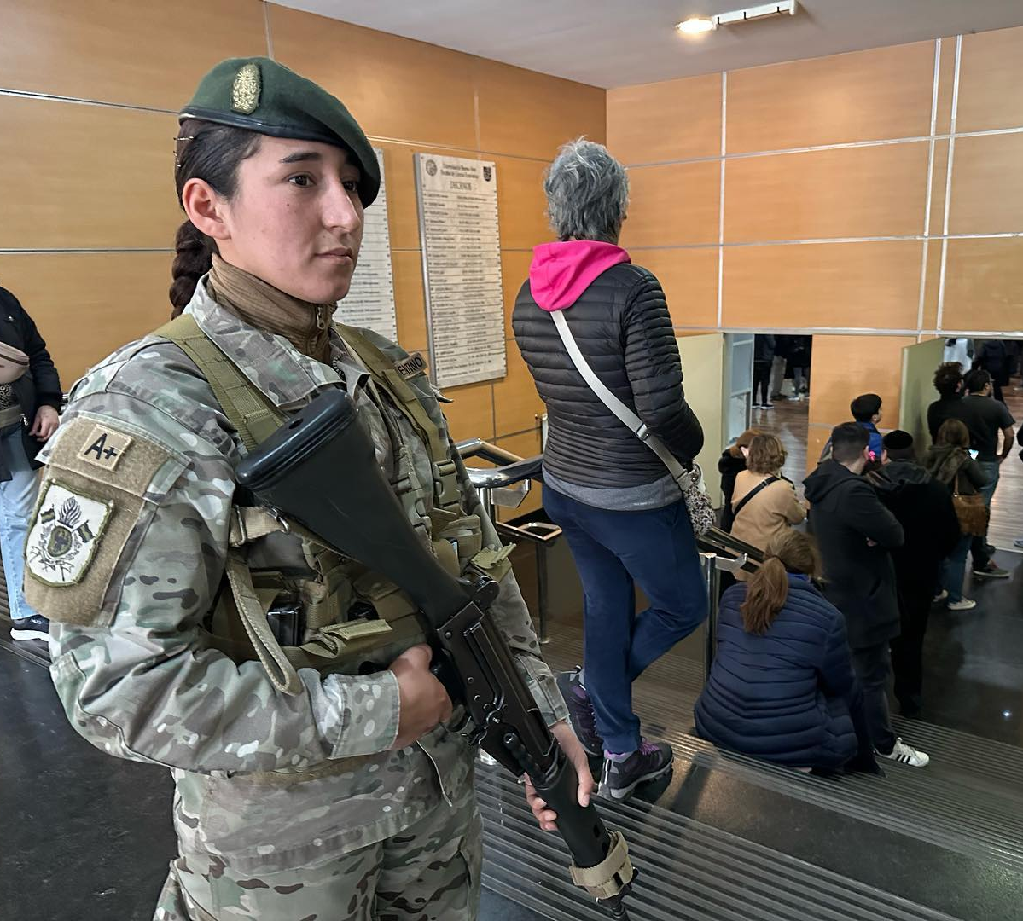
Understanding Democratization and Military Reform
Democracy as Interlocking Subsystems
Democracy functions as a collection of subsystems—what Philippe Schmitter termed "partial regimes." These include electoral systems, civil liberties, accountability mechanisms, and crucially, civil-military relations. Each subsystem evolves at its own pace, sometimes creating dangerous imbalances.
Because militaries hold coercive power, their behavior affects democratic survival and quality more than many other subsystems. A military can stall democratization, reverse it entirely, or provide crucial stability when properly subordinated to civilian authority.

Slide 4

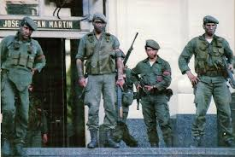



Phases of Democratic Development
Authoritarian Phase
Armed forces rule directly through military governments and juntas.
Transition Phase
Shift begins through liberalization, negotiations, or regime collapse. Militaries often shape transition rules.
Consolidating Phase
Elections held, governments gain policy authority—crossing the "first threshold." Military threats persist.
Consolidated Democracy
The "second threshold"—military poses no threat, democratic reversals become unthinkable.
The Three L's of Democratic Consolidation: Loyalty (no actor seeks authoritarian restoration), Legitimacy (public accepts democracy as only legitimate governance), and Legality (conflicts resolved through democratic institutions).

Slide 5






The Triangular Relationship: Soldiers, Politicians, and Society
Traditional analyses focused narrowly on politician-military interactions, but this misses the complete picture. Civil-military relations should be understood as a triangle connecting three crucial actors:
Politicians
Elected officials and policymakers who must balance competing priorities while asserting civilian control over defense matters.
Soldiers
The military institution with its corporate interests, hierarchical structure, and professional concerns. Officers seek autonomy, resources, and respect for their mission.
Society
Citizens, civil organizations, and public opinion that shape democratic expectations and accountability mechanisms.
Healthy democracy requires alignment among all three vertices. Discord—when politicians neglect defense, militaries resist subordination, or societies remain apathetic—produces dangerous instability. As sociologist Morris Janowitz argued, armies often mirror their societies' values and tolerances.
"Public indifference—the 'no coup, no problem' mentality—undermines crucial incentives for meaningful civil-military reform."

Slide 6
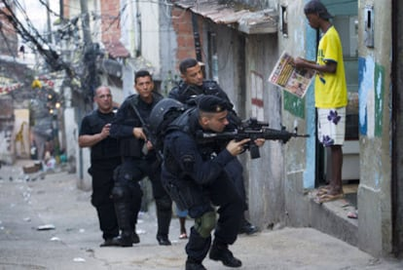
Civil-Military Relations in the Southern Cone and Brazil
The Southern Cone (Argentina, Chile, Uruguay, Brazil) provides exceptional insight into civil-military dynamics due to shared historical experiences and unique regional characteristics that shaped their democratic transitions.
Common Authoritarian Legacy
Systematic Repression
Economic Integration
All endured prolonged direct military rule where officers held ultimate political authority. Unlike Spain's transition, Latin American militaries expected to negotiate their exit terms and preserve institutional interests.
Their regimes employed state terror—torture, disappearances, and mass violations—leaving deep societal scars and creating powerful moral demands for accountability and justice.
Better-off economically than most of Latin America, with substantial middle classes. MERCOSUR integration in the 1990s fostered cooperation and transformed historic rivalries.
The Peace Dividend and Military Role Redefinition
Diplomatic rapprochement eliminated existential threats between these historically rival states. Argentina-Brazil-Chile cooperation replaced centuries of competition and arms races.
This created a fundamental dilemma: with no external enemies, what legitimate roles should armed forces play in democracies at peace?
The challenge became preventing military reversion to internal security roles that historically justified domestic repression and political intervention.

Slide 7

Argentina: A Case Study in Reform Dynamics
Argentina's civil-military trajectory offers perhaps the most dramatic transformation story in Latin America, illustrating both the possibilities and pitfalls of democratic reform.
Dictatorship Collapse (1976-1983)
1
The military regime collapsed spectacularly after catastrophic economic mismanagement, systematic human rights abuses, and humiliating defeat in the Falklands/Malvinas War. The armed forces left power completely discredited.
2
Alfonsín Era (1983-1989)
President Raúl Alfonsín pursued aggressive human rights trials and institutional reforms. His 1988 Defense Law separated internal security (police) from external defense (military)—a crucial boundary. However, military rebellions forced concessions including amnesty laws.
Menem Period (1989-1999)
3
Carlos Menem adopted pardons and reconciliation, combined with neoliberal budget cuts. He maintained firm control by crushing rebellions but neglected deeper structural defense reforms.
4
Kirchner Governments (2003-2015)
Néstor and Cristina Kirchner reignited human rights trials, purged resistant officers, and strengthened civilian Defense Ministry capabilities. They professionalized the military through sometimes confrontational relationships.
Argentina demonstrates how strong civilian leverage after dictatorship collapse enables bold policies, but shifting political priorities over successive governments produces uneven, incomplete progress.

Slide 8
Key Lessons for Democratic Consolidation
1
Civil-Military Relations Are Central to Democratization
Without genuine civilian supremacy over armed forces, democracy cannot fully consolidate. Military subordination is not optional—it's essential for democratic survival.
2
Transitions Remain Fragile
Militaries often retain significant influence after leaving direct power. Early reform windows are crucial but limited—delay enables military resistance and institutional entrenchment.
3
Context Shapes Possibilities
Subregional factors matter enormously. The Southern Cone's shared histories, economic integration, and peace dividend created unique reform opportunities unavailable elsewhere in Latin America.
4
Reform Requires Political Will
Democratic civilian control demands both institutional frameworks and sustained political leadership. Laws alone prove insufficient if presidents, ministers, and legislatures fail to assert authority consistently.
5
Society Must Engage
Without public demand for reform, defense issues become marginalized. Military institutions risk drifting back into anti-democratic roles when citizens and civil society remain indifferent to civil-military balance.

