Slide 1
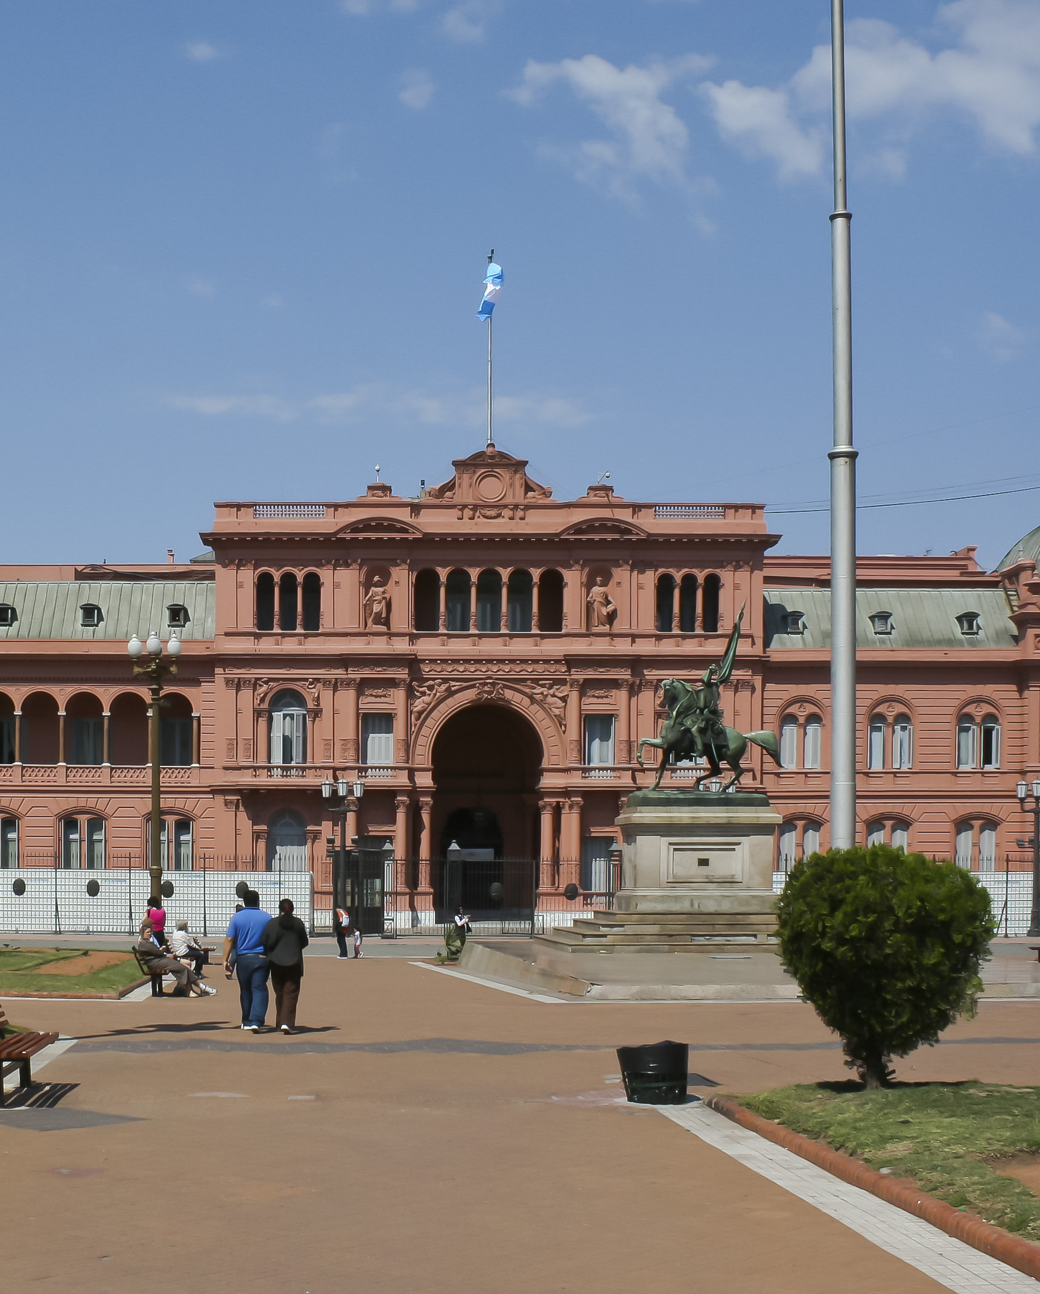
Presidents in Latin America: Power, Peril and Democratic Governance
Presidential democracies in Latin America balance extraordinary executive authority with persistent risks of instability and gridlock. Their success depends less on regime type than on how constitutions distribute power and how party systems channel it. This framework explains how electoral rules, fragmentation, and discipline shape presidents’ ability to govern and remain accountable. It highlights the fine line between effective leadership and the perils of executive dominance in fragile democracies.

Slide 2

The presidentialism question during the Third Wave
The classic claim is that presidentialism is inherently brittle: dual democratic legitimacy (separately elected branches) plus fixed terms generate zero-sum conflict and inflexibility.
Shugart & Mainwaring argue this is too sweeping.
Scholars confounds regime type with region and history: most presidential democracies were in Latin America (military legacies, high inequality), while most parliamentary democracies were in Europe or British Commonwealth contexts (state capacity, rule-of-law traditions). So differences in durability may reflect background conditions as much as constitutional form.
Both regime types have seen breakdowns at different historical moments (e.g., interwar parliamentary collapses in Europe vs. presidential breakdowns in South America in the 1960s–70s).
The question, then, is not "which system is universally superior?" but which institutional configurations within presidentialism support stable, accountable governance.

Slide 3

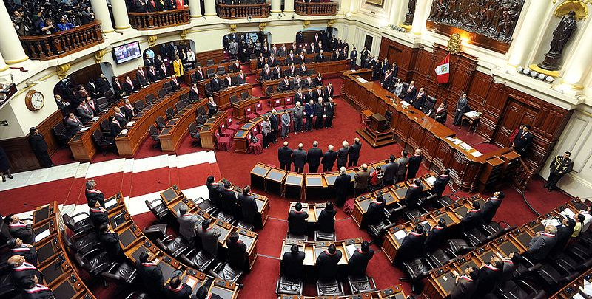
Defining presidentialism
Separate origin
Separate survival
The chief executive is popularly elected (directly or via an electoral college that transparently aggregates the popular vote).
Fixed terms for executive and legislature; neither can routinely dismiss the other (impeachment is exceptional and judicialized).
Parliamentarism instead makes the cabinet collectively responsible to parliament (no fixed executive tenure) and often allows early dissolution of the legislature. However, presidentialism is not one thing—it's a family of systems sharing separate origin and survival but varying widely in powers and party-system environments.

Slide 4
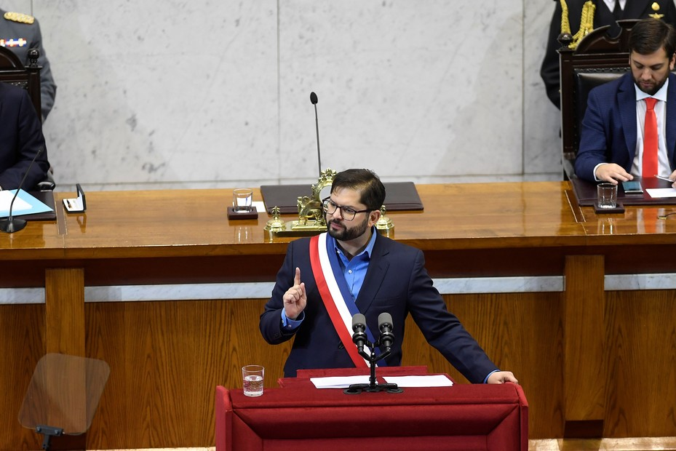
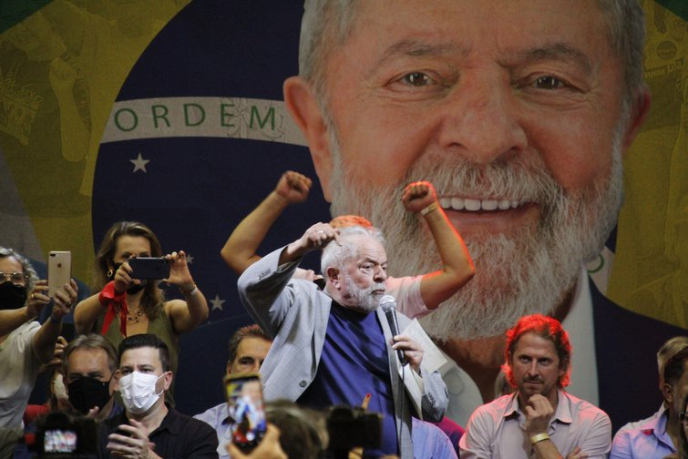
Constitutional and partisan powers of presidents
Constitutional powers (textual)
Partisan powers (political)
Veto (and override thresholds), partial/line-item vetoes, decree or urgency powers, budget initiation, agenda-setting, appointment/removal powers. These determine how much a president can shape policy independent of the legislature.
The president’s party or coalition seat share and coalitional position in the legislature, plus the cohesion/discipline of those allies.
Examples: presidents in post-Pinochet Chile and Colombia enjoy substantial agenda and veto tools, whereas Costa Rica and Venezuela give comparatively modest formal tools; Mexico (under the PRI) illustrates high partisan power; Brazil shows strong formal tools but weak partisan anchors.
The interaction of these two dimensions—text and parties—determines governing capacity far more than either alone.

Slide 5

Party systems and the consequences
Majority presidentialism
Minority presidentialism
President's party/coalition ≥ 50% seats. Executive–legislative bargaining is smoother, but an overly disciplined single-party majority risks eroding checks and balances.
President's party well below half—often <⅓. Presidents must assemble ad-hoc or brittle coalitions to pass ordinary policy and budgets; because terms are fixed, the opposition can defect without "bringing down the government," creating incentives for immobilism or governing by decree.
Coalitions in presidential regimes are often pre-electoral and non-binding post-election, unlike the binding cabinet coalitions of parliamentarism. Hence, fragmentation + weak discipline is the danger zone, not "presidentialism" per se. This is why we care about avoiding the scenario of a president facing a multiparty legislature in which their own party is a small minority: it magnifies veto players, raises transaction costs, and tempts executives toward extra-legislative tools.
Core variables: president's party seat share; coalition status; coalition bindingness; cabinet participation vs. legislative loyalty; use of veto/decree as substitutes for lawmaking.

Slide 6




Fragmentation, discipline, and ideological proximity
Fragmentation
Discipline
Ideological proximity
Use the effective number of parties (N) to capture how many "relevant" parties exist, weighting by size. Empirically, when N ≲ 3–3.5, presidents are likelier to find stable legislative support or at least reliable veto-sustaining minorities; as N rises, minority presidentialism becomes the norm and coalitions become fragile.
Party cohesion (internal vote unity) lowers bargaining costs and makes executive-legislative relations predictable. Very low discipline (e.g., personalistic/open-list systems) forces presidents into retail bargaining with individual legislators.
Even with few parties, polarization can block coalitions; with many parties, ideological proximity can still make deals feasible. Distance on the policy spectrum conditions whether a president can bridge from a large plurality to a working majority.
In practice, fragmentation, discipline, and proximity interact: high N + low discipline + high polarization is the worst triad; moderate N + moderate discipline + moderate proximity is the most governable.

Slide 7
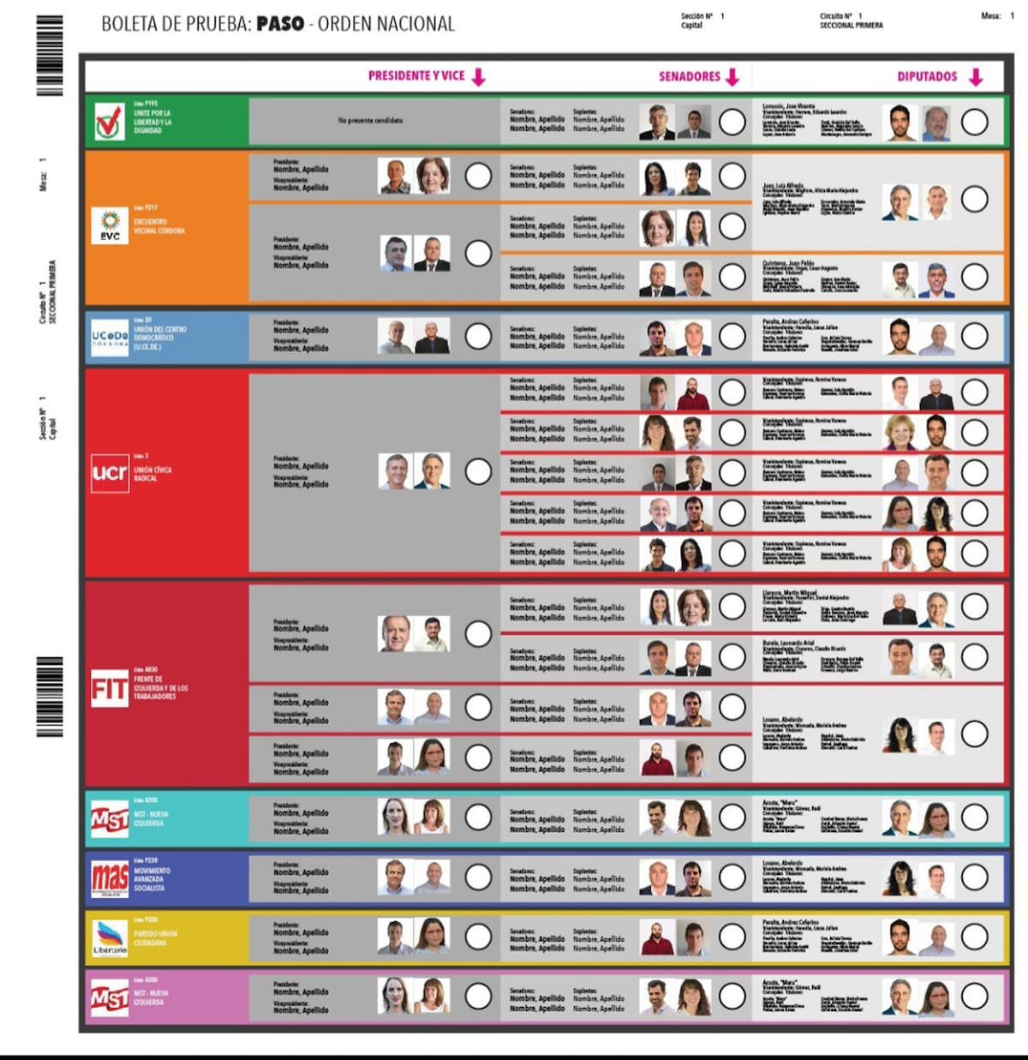
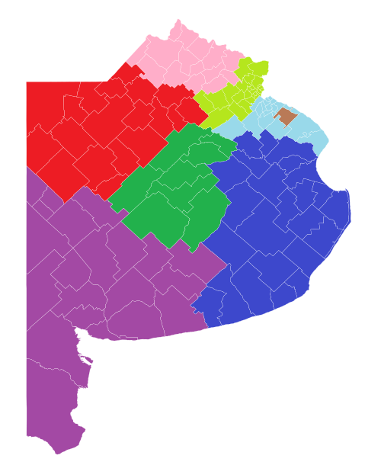
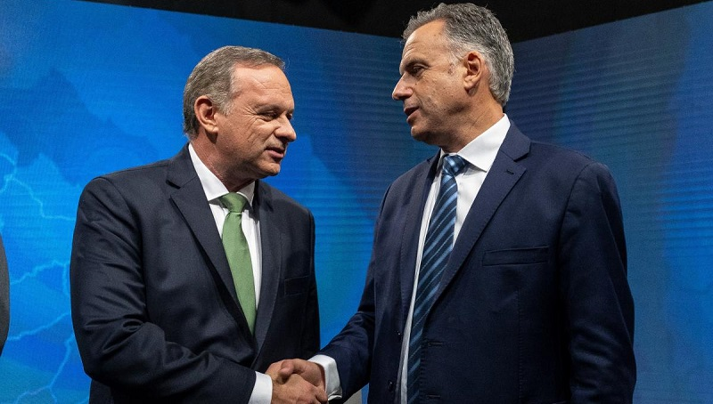

Electoral rules and the number of parties
District magnitude (M)
Presidential rule
Electoral cycle
Higher M with bigger PR districts and national lists, lowers thresholds and lets small parties win seats. This leads to higher Number of parties.
Smaller M, especially single-member districts raises thresholds and lowers the Number of parties.
Plurality tends to focus the contest into two big blocs; runoff reduces coordination pressures, allowing multiple first-round entrants to survive.
Concurrent presidential–legislative elections transmit the presidential cleavage into congressional voting (coattails) with fewer, larger blocs.
Non-concurrent breaks that linkage and more parties survive.
Core levers: district magnitude; legal/effective thresholds; list type; presidential plurality vs. runoff; election timing; malapportionment; party-entry barriers.

Slide 8





Institutional determinants of party discipline
Ballot structure & list type
Nomination & finance control
Open-list PR lets voters reward individuals within the same party list, fostering personal vote-seeking and intra-party competition , and leads to weaker discipline. Closed-list PR ties careers to party leaders' ranking and leads to stronger discipline.
Centralized control over candidate placement, list order, and money increases leaders' leverage to enforce roll-call unity; decentralized primaries or free-agent fundraising weakens it.
Career ladders & reelection rules
Committee & agenda rules
When re-nomination and advancement depend on party loyalty (or national leadership approval), members comply; where individual reputations and constituency service dominate, members defect.
Parties that can allocate committee posts and control floor access can reward loyalty and sanction defection, building cohesion over time.
Coalitional presidentialism tools. Targeted appointments, budget amendments, and sub-national transfers can purchase short-term unity, but without institutionalized party control they rarely produce durable cohesion.
Bottom line: electoral engineering and internal party statutes manufacture discipline (or not), which then conditions presidential governance.
Core variables: open vs. closed lists; centralization of nominations/finance; reelection/re-nomination dependence; internal rules for posts; executive patronage reach.

Slide 9

The interaction of constitutional and partisan powers
Strong-text / Strong-party
Strong-text / Weak-party
Presidents possess robust veto/decree/agenda tools and command a cohesive majority or near-majority. Expect fast lawmaking, programmatic coherence, and—if oversight is weak—risk of delegative tendencies or dominance.
Presidents hold powerful formal tools but lack reliable seats and cohesion. Expect standoffs, heavy reliance on decrees or urgency procedures, frequent bargaining crises, and judicialized conflict over the limits of decree/urgency powers.
Weak-text / Strong-party
Weak-text / Weak-party
Presidents with modest formal tools but cohesive legislative backing govern effectively via party channels: party leadership, agenda control in the chamber, budget bargaining. The presidency "borrows" strength from the party.
The paralysis corner: few formal levers and no stable bloc. Expect immobilism, budget delays, policy drift, temptation toward extra-institutional shortcuts, and heightened regime stress.
Do not ask "Is this a strong presidency?" in the abstract. Ask "Strong where?" (constitutional vs. partisan) and "What compensatory moves follow?" (decree reliance, patronage for votes, coalition pacts, or party-led governance).
Core variables: composite "textual power" index (veto type, decree scope, budget prerogatives) × partisan power (seat share, coalition durability, discipline).

