Slide 1
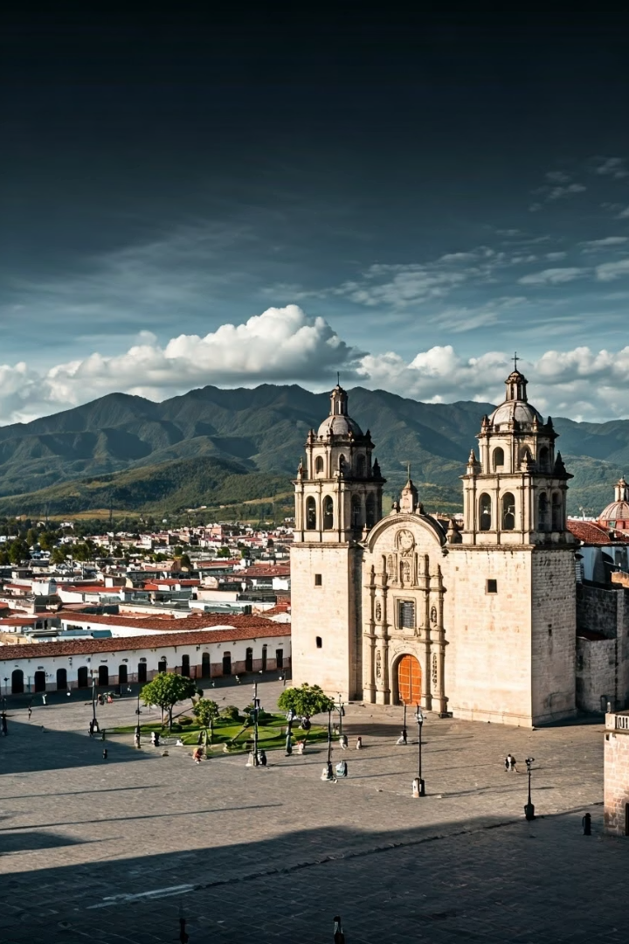
Colonial Crucible
Latin American societies during the colonial period (roughly 1500–1800) were profoundly shaped by Iberian colonization. Rather than a straightforward imposition of Spanish and Portuguese rule, colonization created a cultural, social, and economic crucible where Indigenous, African, and European elements fused in complex and unequal ways.
This fusion occurred through economic systems centered on resource extraction, religious and patriarchal hegemony, and processes of transculturation that produced uniquely Latin American cultural forms. The resulting colonial society was characterized by rigid hierarchies yet remarkable diversity across regions.

Slide 2
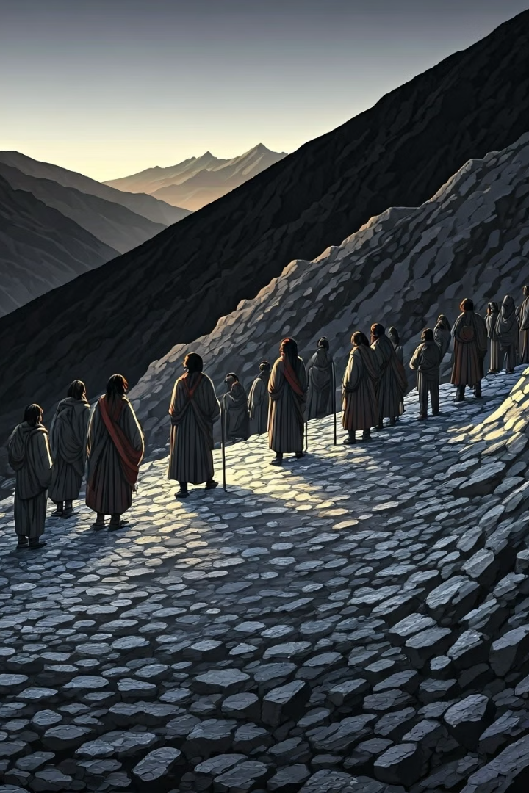



Silver and Sugar: The Colonial Economic Backbone
Silver Mining in Spanish America
Royal Revenue
The "royal fifth" (el quinto real), a 20% tax on all mining production, became the Spanish Crown's main revenue stream, funding imperial ambitions.
Major mines like Zacatecas in Mexico and Potosí in Peru became massive enterprises requiring Indigenous labor. These operations reshaped local economies and created support industries in agriculture, textiles, and transport.
Brazilian Sugar Plantations
Brazil centered its economy on sugar plantations in the Northeast, where vast estates (engenhos) owned by senhores de engenho were worked by enslaved Africans brought from Africa.

Slide 3








Colonial Urban Centers of Power
Religious Authority
Cathedrals dominated city centers
Political Administration
Viceroys and councils governed
Educational Institutions
Universities trained colonial elites
Economic Activity
Markets and trade networks
The wealthiest colonial centers formed around mining zones—Mexico City, Lima, and later Bogotá and Buenos Aires. These cities served as administrative centers with rigid colonial order, where European urban planning principles were imposed on the New World landscape.
Though dominated by White elites, these urban centers became crucibles of cultural exchange, home to Mestizos, Blacks, and Indigenous migrants who collectively shaped Latin American popular culture despite social stratification.

Slide 4
Hegemony: Rule Through Consent
The Catholic Church
Patriarchal Order
The Church played a central hegemonic role, blending spiritual authority with political legitimacy. It controlled time through religious calendars, education through mission schools, and everyday rituals through sacraments.
Patriarchy served as another pillar of hegemony. Fathers ruled over households just as kings ruled over colonies, creating parallel structures of authority.
Honor was defined differently for men and women, reinforcing strict gender roles and sexual double standards that maintained social control.
Its authority was presented as divinely ordained, making resistance seem not just illegal but sinful.
Hegemony explains how Iberian colonial control lasted for centuries without constant military enforcement. It represents rule by consent, where those at the bottom accept a social order that disadvantages them as "natural" or "just."

Slide 5





Resistance Within the System
Sor Juana Inés de la Cruz
This brilliant nun challenged gender norms through her writing but was ultimately silenced for exceeding the limits of what women were expected to be.
Syncretic Religious Practices
Indigenous and African peoples maintained their spiritual traditions by hiding them within Catholic practices, creating unique blended religions.
Inquisition Cases
Records show how women, Indigenous people, and African slaves resisted through religion, magic, and everyday acts of disobedience.
Tupac Amaru II Rebellion
By the late colonial period, cross-class and cross-caste rebellions emerged, such as that led by Tupac Amaru II in Peru.

Slide 6








Transculturation: Creating Something New
European Elements
Indigenous Contributions
Catholic religion, language, governance
Foods, medicinal knowledge, artistic motifs
Latin American Fusion
African Influences
Unique cultural expressions emerge
Music, spiritual practices, agricultural techniques
Transculturation, a concept coined by Cuban scholar Fernando Ortiz, refers to the mutual, though unequal, exchange of cultural traits among Europeans, Indigenous peoples, and Africans. This process produced uniquely Latin American forms—blended religions, music, foodways, and languages.
A classic example is the Virgin of Guadalupe, which melded Indigenous and Catholic religious traditions to create a powerful symbol that resonated across cultural boundaries.

Slide 7





The Colonial Caste System
Peninsulares
Spanish/Portuguese-born whites
Criollos
American-born whites
Mestizos/Mulatos
Mixed European-Indigenous/African
Indigenous/Africans
Lowest legal status
The caste system attempted to impose racial order through a complex hierarchy with Spaniards at the top, followed by various mixed categories (mestizo, mulatto, morisco), and Indigenous and African people at the bottom. Caste paintings illustrated these categories, though everyday life often blurred these rigid distinctions.
Despite its rigidity, the system could be negotiated. Wealth, clothing, and behavior could "whiten" a person socially or even legally through mechanisms like gracias al sacar, which allowed individuals to purchase a higher racial status.

Slide 8
Rural Life and Cultural Persistence
Haciendas
Indigenous Communities
Quilombos
Large agricultural estates that produced for local consumption and export. These self-contained communities often developed their own social dynamics, allowing for more racial mixing among the working population.
Many Indigenous groups maintained communal lands (ejidos) and traditional governance structures, especially in remote areas. These communities preserved languages, agricultural practices, and spiritual traditions despite colonial pressures.
In Brazil, escaped enslaved Africans established independent communities called quilombos. The most famous, Palmares, was led by Zumbi, who has become an enduring Afro-Brazilian hero for his resistance to Portuguese rule.
While cities enforced colonial order, the countryside allowed for more Indigenous and African cultural retention. Distance from administrative centers created spaces where alternative social arrangements could develop, though still within the broader colonial economic system.

Slide 9

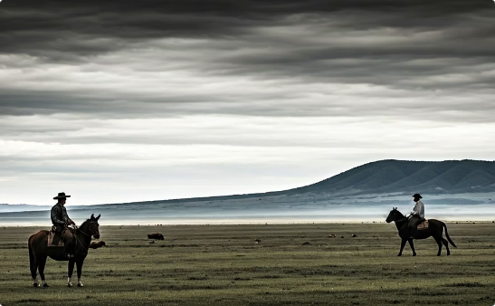
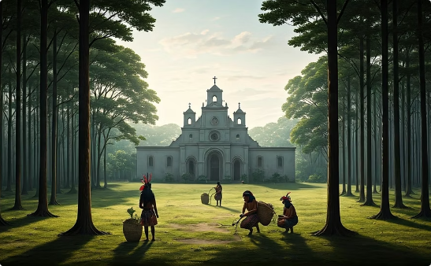
Regional Diversity: The Fringes of Empire
Brazilian Bandeirantes
Río de la Plata
Paraguay
From São Paulo, these frontier explorers expanded settlement into Brazil's interior, driven by gold prospecting and slave hunting. Their exploits led to the destruction of quilombos but also opened up new territories for settlement.
This southern region lacked valuable export commodities until late in the colonial period. It developed a distinctive ranching culture with gauchos (cowboys) and a more fluid social structure than mining or plantation regions.
Under Jesuit influence until their expulsion in 1767, this region developed unique bilingual culture (Spanish/Guaraní) and economic patterns centered on yerba mate production rather than precious metals or sugar.

Slide 10





Late Colonial Reforms and Rising Tensions
Bourbon and Pombaline Reforms
By the mid-1700s, Spain and Portugal initiated reforms seeking to rationalize colonial governance and extract more profit through increased taxes, royal monopolies, and restrictions on local production.
Colonial Discontent
These reforms angered Indigenous peoples, mixed-race artisans, and creole elites, who began to feel increasingly alienated from imperial governance despite their loyalty to the crown.
Early Rebellions
New cross-class and cross-caste rebellions emerged, such as that of Tupac Amaru II in Peru, foreshadowing the independence movements to come.
Eve of Independence
By 1800, despite three centuries of domination, Latin America had become something new: a fusion of peoples, cultures, and contradictions—united under hegemony, yet filled with tensions ready to erupt.

