Slide 1
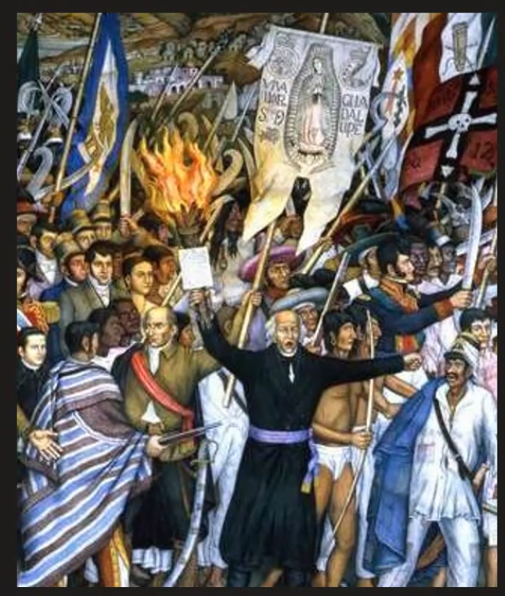
Latin American Independence: From Colonial Stability to Revolutionary Change
Before 1800, colonial Latin America experienced remarkable stability under Spanish and Portuguese rule for over 300 years. This stability was maintained through law, force, cultural hegemony, and a rigid social hierarchy that benefited Creoles (American-born whites).
However, this centuries-old order was dramatically disrupted not by internal revolution but by external events—particularly Napoleon's invasion of the Iberian Peninsula. This crisis of legitimacy would ultimately trigger the independence movements that would transform the political landscape of Latin America forever.

Slide 2

The Napoleonic Catalyst
1
1807
Napoleon invades Portugal; Portuguese royal family flees to Brazil, making Rio de Janeiro the temporary capital of the Portuguese empire
2
1808
Napoleon invades Spain, removes King Ferdinand VII, and installs his brother Joseph Bonaparte as king
3
1810-1815
Initial independence movements emerge across Spanish America in response to the legitimacy crisis
4
1824
Battle of Ayacucho marks the decisive end of Spanish power in South America
Napoleon's invasions of Portugal and Spain created an unprecedented political vacuum in Latin America. With the legitimate monarchs displaced, colonial authorities faced a crisis of legitimacy that opened the door for Creole elites to question who held authority in the absence of the crown.

Slide 3
Creole Response and Cabildos Abiertos
Political Opportunity
Limited Goals
Strategic Positioning
Creole elites used cabildos abiertos (open town councils) to claim power while maintaining nominal loyalty to the deposed King Ferdinand VII
Most Creoles sought political independence from Spain but were reluctant to dismantle the colonial social order or caste system
These assemblies, though framed as loyalist, laid the groundwork for independence movements across Spanish America
The cabildos abiertos became crucial vehicles for Creole political ambitions. In cities like Buenos Aires and Caracas, these gatherings allowed elites to express continued loyalty to the Spanish crown while simultaneously asserting their own political autonomy. This strategic positioning reflected the Creoles' frustration with Peninsular (Spanish-born) dominance while preserving their privileged position in the colonial hierarchy.

Slide 4




Mexico's Radical Beginning
Father Miguel Hidalgo (1810)
Rallied Indigenous and Mestizo peasants under the Virgin of Guadalupe banner; rebellion became violent and lost Creole support
Hidalgo's Execution (1811)
Captured and executed after initial successes, but the revolutionary spark continued
Father José María Morelos (1811-1815)
Offered more focused agenda: end slavery, abolish caste system, eliminate Indigenous tribute
Morelos' Defeat (1815)
Without elite backing, his disciplined insurgency was ultimately defeated and he was executed
Mexico's independence movement began with a radical popular uprising led by Father Miguel Hidalgo, whose call to arms mobilized the masses but alarmed Creole elites. His successor, Father José María Morelos, advanced a more structured but equally radical agenda that directly challenged colonial social hierarchies. Both leaders were executed, but their movements represented a more socially revolutionary approach than seen elsewhere in Latin America.

Slide 5



Revolutionary Rhetoric: Uniting Diverse Populations
Nativism
Popular Sovereignty
Inclusive Discourse
Leaders promoted a unifying identity of "Americanos" that encompassed all American-born people against foreign Peninsular elites, regardless of racial background
The revolutionary concept that legitimate political authority arises from the people themselves became a powerful mobilizing idea
Unlike the U.S. revolution, Latin American independence movements at least rhetorically included racially diverse populations in their nationalist discourse
To expand support beyond the Creole elite, revolutionary leaders adopted powerful ideological strategies. By emphasizing nativism and popular sovereignty, they created a framework that could unite diverse populations against Spanish rule. This inclusive rhetoric distinguished Latin American independence movements from the more racially exclusive American Revolution, even if the social reality often fell short of the revolutionary promise.

Slide 6






Regional Paths to Independence
Brazil
Unique path: Portuguese royal court relocated to Rio (1807); Prince Pedro declared independence (1822) and became Emperor Pedro I
Peru
Creole elites remained cautious and loyal to Spain longer, haunted by memories of the Tupac Amaru II uprising of the 1780s
Río de la Plata
Early independence (1816); region's economic orientation toward Atlantic trade fueled separatist sentiment
Independence unfolded differently across regions. In Peru, fear of Indigenous uprisings made Creoles hesitant to break with Spain. Brazil's unique path involved the Portuguese royal family's presence and a relatively peaceful transition to an independent monarchy that preserved existing hierarchies, including slavery. The Río de la Plata region (modern Argentina, Uruguay) moved early toward independence, driven by economic interests tied to Atlantic trade.

Slide 7
The Liberation Campaigns
Battle of Ayacucho (1824)
José de San Martín's Southern Campaign
The final decisive battle crushed Spanish power in South America, effectively ending the wars of independence
Simón Bolívar's Northern Campaign
The Argentine general led forces across the Andes into Chile and Peru, meeting with Bolívar in Guayaquil (1822) before ceding leadership to him
The Venezuelan Creole led forces through the Andes, securing decisive victories at Boyacá (1819) and Carabobo (1821), liberating Colombia, Venezuela, Ecuador, and later Bolivia
Two major military campaigns finally secured independence for most of Spanish South America. Simón Bolívar's bold northern campaign and José de San Martín's southern advance converged in their goal of liberating the continent. Their historic meeting in Guayaquil in 1822 marked a turning point, with San Martín stepping aside and Bolívar continuing the campaign that would culminate in the decisive victory at Ayacucho in 1824.

Slide 8








Outcomes and Contradictions
Political Independence
Most of Latin America gained independence by 1825
Social Continuity
Colonial hierarchies largely preserved
Persistent Inequality
Slavery and informal caste systems continued
Creole Dominance
New nations ruled by American-born white elites
By 1825, most of Latin America had achieved independence, with the notable exceptions of Cuba and Puerto Rico, which remained Spanish colonies. However, independence did not lead to radical social transformation. The caste system persisted informally, slavery remained legal in many countries (especially Brazil), and the new republics and empires were dominated by Creole elites who had little interest in dismantling existing social hierarchies.

