Slide 1
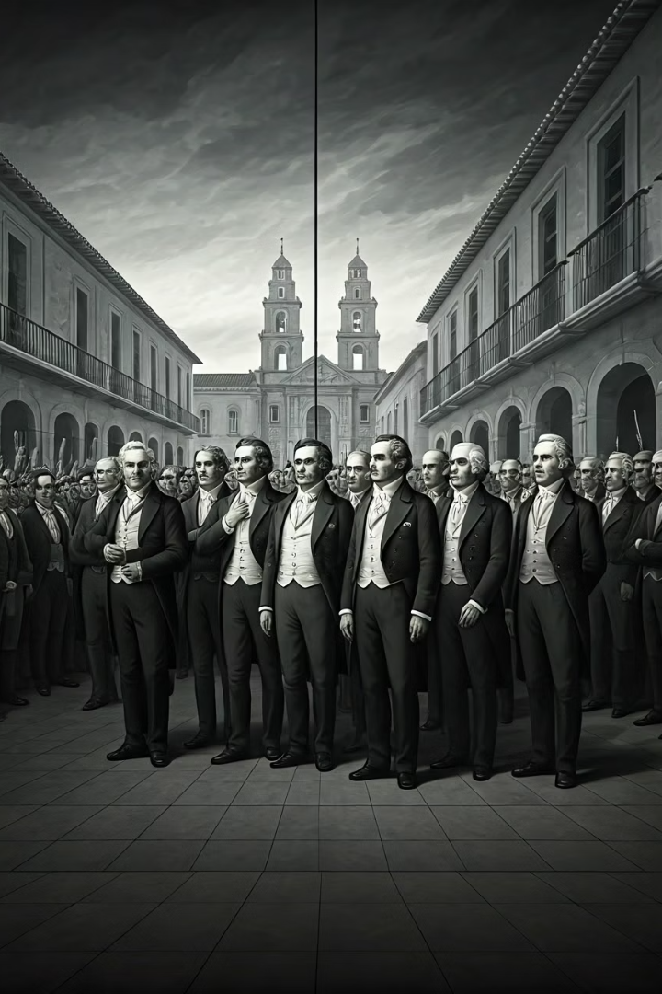
Liberal Dreams, Harsh Realities: Latin America After Independence
After independence, Latin America embraced liberal ideals—liberty, equality, popular sovereignty. These became the rhetorical backbone of new constitutions. But the transition from colony to liberal republic was much rockier than anticipated.
The first generation of liberal leaders, mostly upper-class Creoles, lacked the institutional and economic foundations needed to implement liberalism. The result was instability, not transformation. Political violence, corruption, and disillusionment quickly set in.
Despite removing caste labels from censuses and parish records, social hierarchies remained deeply entrenched. Slavery continued in Brazil and Cuba, and Indigenous and mixed-race people were excluded from real citizenship and power.

Slide 2
Liberalism vs. Conservatism: Competing Visions
The ideological clash between liberals and conservatives dominated the political landscape after independence. While liberals advocated for separation of church and state, public education, and civil liberties, conservatives defended Catholicism as the official religion, traditional hierarchies, and elite rule.
Though liberalism was officially dominant in many new republics, conservatives often resonated more with the rural masses, who remained deeply attached to traditional religious and social structures. This created a fundamental tension in governance.
A major issue was that liberal ideals were imported from Europe and didn't fit easily into the hierarchical, land-based societies of Latin America, creating a disconnect between constitutional ideals and social realities.
Liberal Vision
Conservative Vision
Separation of church and state
Catholicism as official religion
Public education systems
Traditional social hierarchies
Civil liberties and equality
Elite political control
Free trade and markets
Protection of established interests

Slide 3




The Rise of Caudillos: Personalism Over Institutions
In the absence of strong institutions, personalism and patronage filled the vacuum. Political leaders operated through networks of loyalty rather than ideology, giving rise to the caudillo—a charismatic strongman who ruled through a combination of personal charisma, landownership, military power, and patron-client relationships.
These leaders weren't merely warlords—they embodied the crisis of post-independence governance where constitutions were weak and military charisma ruled. Their power demonstrated how liberal institutions failed to take root in societies still structured around personal relationships.
Juan Manuel de Rosas (Argentina)
Antonio López de Santa Anna (Mexico)
Used violence, mass propaganda, and symbolism (mandatory red ribbons) to maintain control
Switched sides often, ruled repeatedly, and cultivated patriotic mythologies
José Antonio Páez (Venezuela)
Rafael Carrera (Guatemala)
A llanero war hero turned conservative national figure
Protected Indigenous land and the Catholic Church; crushed liberal efforts

Slide 4




Brazil's Monarchical Exception
Unlike Spanish America, Brazil retained its monarchy under Pedro I and later Pedro II. Though Pedro I claimed to be a liberal, he was authoritarian in practice, creating tension between constitutional promises and imperial reality.
During the regency period (1831–40), Brazil experienced significant unrest as liberals briefly took power but soon lost control. This led to Pedro II's early enthronement and a return to conservative stability that would last for decades.
Brazil's unique path avoided the fragmentation seen elsewhere in Latin America. By maintaining centralized imperial authority and continuing slavery and monarchy, Brazil paradoxically achieved stability while delaying the social transformations liberalism promised.
1822
1824
1831-40
1840
Pedro I declares independence from Portugal and becomes Emperor
First Brazilian Constitution establishes constitutional monarchy
Regency period with liberal reforms and regional revolts
Pedro II enthroned early to restore stability

Slide 5
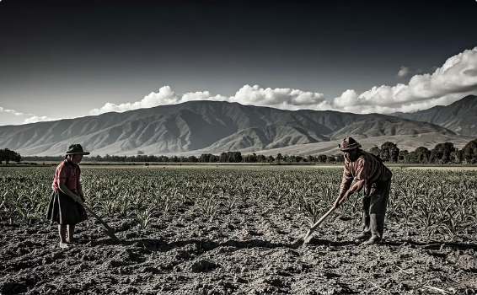
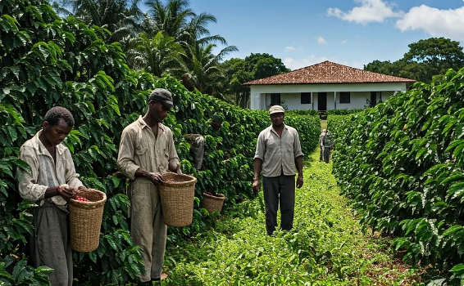
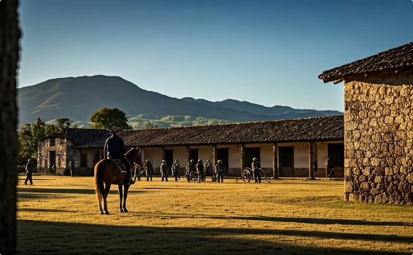
Everyday Life: Continuity Amid Political Change
Despite the dramatic political upheavals following independence, most people's daily lives changed very little. The grand liberal rhetoric rarely translated to meaningful change for ordinary citizens, especially those in rural areas far from centers of power.
Indigenous communities remained autonomous in many regions, while peons and sharecroppers continued working on haciendas under conditions similar to colonial times. Slavery persisted in Brazil and Cuba, and subsistence agriculture dominated the economy for most families.
Meanwhile, landowners gained new power as liberal policies dismantled merchant guilds and opened export opportunities. This often strengthened rather than weakened traditional hierarchies, contradicting liberal promises of equality.
Indigenous Subsistence
Persistent Slavery
Hacienda System
Indigenous communities continued traditional farming practices largely unchanged from colonial times.
Slavery continued in Brazil and Cuba despite independence movements' rhetoric of freedom.
Large estates remained the dominant economic and social structure in rural areas.

Slide 6








Forging National Identities Through Culture
Transculturation continued to shape emerging national identities as newly independent nations sought to define themselves. Folk traditions like the jarabe in Mexico and bambuco in Colombia gained prestige as symbols of national character, distinct from European influences.
The literary genre of costumbrismo emerged, depicting everyday customs to define national identity. These works celebrated local traditions while often romanticizing rural life and indigenous heritage, even as actual indigenous peoples remained marginalized.
Nativist imagery—especially anti-Spanish or anti-Portuguese rhetoric—remained politically potent in nation-building narratives, though increasingly disconnected from meaningful social reform that might have benefited the populations being celebrated.
Literature
Music & Dance
Costumbrismo works depicting local customs and character
Folk traditions elevated to national symbols
Public Celebrations
Visual Arts
Festivals and ceremonies reinforcing national myths
Paintings celebrating local landscapes and people

Slide 7








Economic Dependency and Foreign Influence
Latin America remained economically and culturally dependent on Europe and the U.S. despite political independence. British, French, and U.S. traders simply replaced Spanish monopolies, creating new forms of economic subordination through trade and finance.
When debts weren't paid, foreign powers employed gunboat diplomacy, using military threats to protect their economic interests. The Monroe Doctrine asserted U.S. interest in the region but had limited practical effect in this early period beyond rhetorical claims.
The Guano Boom in Peru exemplified these dynamics. This seabird fertilizer exported to Europe brought temporary prosperity, but benefits stayed coastal, deepening regional inequality while reinforcing export dependency.
Foreign Powers
Britain, France, United States
Economic Control
Trade, loans, investment
Export Economies
Raw materials, agricultural products
Local Populations
Limited benefits, continued poverty

Slide 8
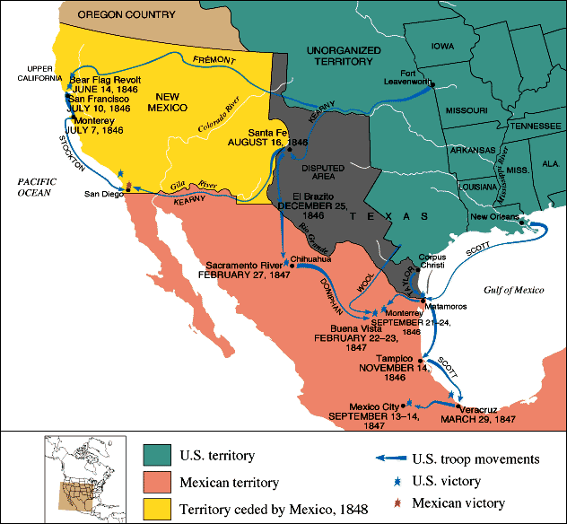
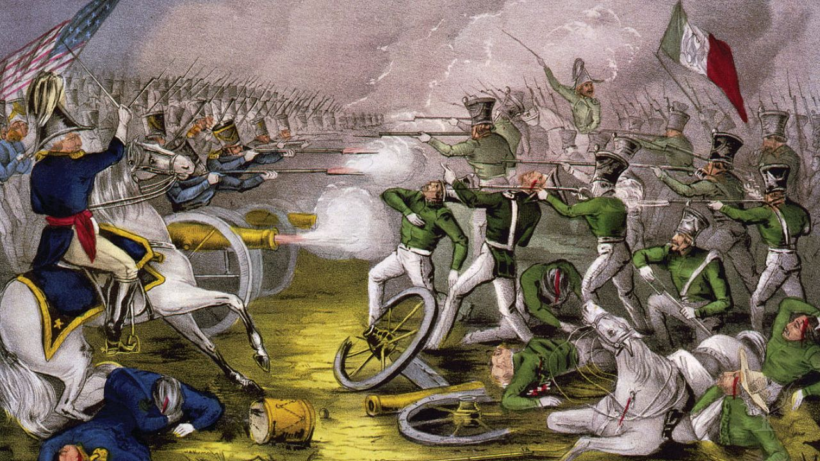
The U.S.–Mexico War: Territory and Identity
The U.S.–Mexico War (1846–1848) represented a pivotal moment in hemispheric relations. Sparked by disputes over Texas and driven by U.S. expansionist ideology of Manifest Destiny, the conflict resulted in the loss of half of Mexico's territory—including California, New Mexico, and Texas.
This traumatic event profoundly shaped Mexican national identity and soured Mexican views of the United States. It introduced a love-hate dynamic in hemispheric relations that would persist for generations, combining admiration for U.S. power with resentment of its imperialism.
For the United States, the victory reinforced beliefs in national superiority, while for Mexico, the defeat prompted
soul-searching about national weakness and the need for reform.

Slide 9
Gender and Cultural Hierarchies
Women were largely excluded from public life in post-independence Latin America, prominent only through their relationships to powerful men. Notable exceptions like Encarnación Ezcurra, Manuela Rosas, and Camila O'Gorman gained influence through family connections rather than independent political standing.
Cultural hegemony ensured European norms remained dominant throughout society. Writing, education, and political participation were restricted to elites who defined themselves through European standards of fashion, speech, and culture. Honor and respectability became crucial markers of social status.
Though the formal caste system declined after independence, class and racial inequalities persisted, now framed in more subtle terms of "civilization" versus "barbarism" rather than explicit racial categories.
Elite Women
Indigenous Women
Afro-Latin Women
Gained limited influence through family connections to powerful men, maintained social networks, and upheld European cultural standards in domestic spheres.
Faced double marginalization based on gender and ethnicity, maintained traditional roles in communities while navigating increasing economic pressures.
Continued to face slavery in some regions, worked as domestic servants or in markets elsewhere, developed economic strategies for survival and possible manumission.

Slide 10



Conclusion: The Unfulfilled Promise
By 1850, liberal hopes had largely failed across Latin America. The region was marked by political instability, conservative dominance, economic stagnation and dependency, and persistent social inequality despite the rhetoric of republican equality.
The emergence of national identities represented one achievement, though these often existed amid continuity with colonial patterns rather than true transformation. The gap between constitutional ideals and social realities remained vast, with power concentrated in the hands of landowners and military leaders.
Yet the seeds of future change were planted during this period. Liberalism would return—stronger, better adapted, and more ambitious in the decades to follow, building on both the failures and limited successes of this first generation of independence.
Political Independence
Achieved but with unstable results
Constitutional Governance
Established but frequently violated
Social Equality
Promised but largely unrealized

