Slide 1
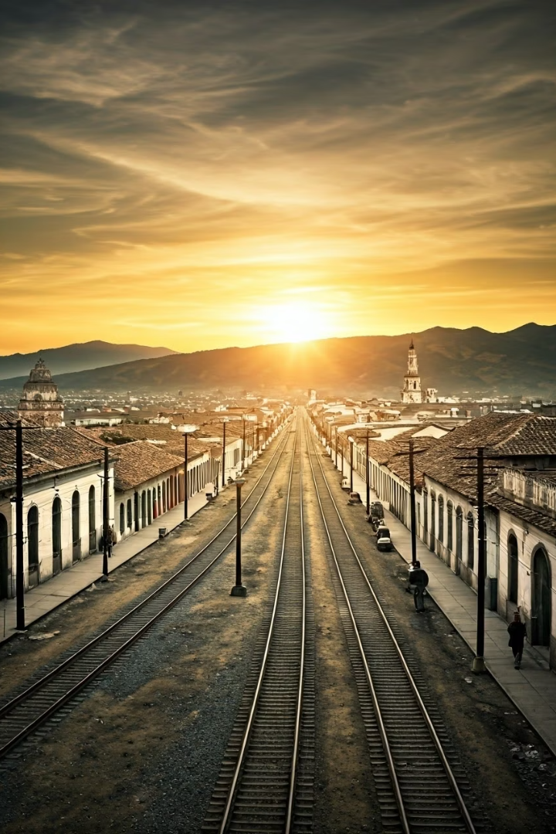
Progress and Liberalism in Latin America (1850-1889)
The mid-19th century marked a pivotal era in Latin American history, as liberal ideologies resurged against conservative dominance. This period, spanning from 1850 to 1889, witnessed transformative changes across the region as nations embraced the concept of "Progress" with a capital P.
Fueled by the Industrial Revolution in Europe and the United States, Latin American liberals championed technological modernization, export economies, and secular governance. However, this liberal resurgence contained contradictions, particularly in its treatment of women, indigenous peoples, and racial minorities.
This presentation explores how liberalism reshaped Latin American societies through transportation revolutions, anti-clerical reforms, nationalist movements, and scientific ideologies—revealing both the triumphs and limitations of the liberal project.

Slide 2
The Liberal Resurgence
Conservative Dominance
Liberal Frustrations
Industrial Catalyst
By 1850, conservatism dominated Latin America, promising order and tradition after decades of post-independence instability. Conservative regimes established patronage systems that primarily benefited elites and maintained close ties with the Church.
Liberalism resurged in the mid-19th century, fueled by frustrations with the unequal distribution of benefits under conservative patronage. Those excluded from power increasingly embraced liberal ideals of progress, secularism, and economic modernization.
The Industrial Revolution provided new markets, capital investments, and demand for Latin American exports like coffee, sugar, and hides. This economic shift strengthened liberal arguments that modernization was the path to prosperity and national development.
The concept of "Progress" became hegemonic during this period, invoking technological modernization as an inevitable destiny. Liberals positioned themselves as forward-thinking modernizers against what they characterized as backward-looking conservatives, creating a powerful political narrative that would reshape the region.

Slide 3



The Transportation and Communications Revolution
Steamships
Steamships revolutionized maritime trade by replacing wind-dependent sailing vessels. This reduced travel time between Latin America and European markets, enabling more reliable and frequent commercial exchanges.
Railroads
Railway networks opened interior lands for export agriculture, connecting previously isolated regions to global markets. Foreign investors, particularly British companies, funded extensive rail projects that transformed economic geography.
Telegraph
Telegraph lines connected Latin America to Europe, with Brazil being linked by 1874. This allowed for real-time market information and diplomatic correspondence, tightening Latin America's integration into global systems.
These technological innovations became powerful symbols of modernity and progress, allowing liberal parties to position themselves as champions of the future. However, the export-oriented infrastructure left inland areas increasingly dependent on volatile global markets, creating new vulnerabilities even as it generated wealth.

Slide 4






Anti-Clerical Liberalism in Mexico
Juárez Law (1855)
Attacked military and ecclesiastical fueros
Lerdo Law (1856)
Forced sale of Church and Indigenous lands
Church Power
Land ownership, banking, and tithes
Nowhere was the Church more powerful than in Mexico, where it owned vast tracts of land, acted as the primary banking institution, and collected mandatory tithes from the population. Mexican liberals viewed this ecclesiastical power as a direct affront to Progress and national development.
The liberal Reform Laws directly challenged traditional Church privileges. The Juárez Law attacked the fueros (legal privileges) that allowed clergy and military to be tried in special courts rather than civil ones. The Lerdo Law forced the sale of Church properties and, controversially, Indigenous communal lands as well.
These anti-clerical measures drew sharp battle lines between liberals and conservatives, setting the stage for a bitter civil war that would reshape Mexican society and politics for generations.

Slide 5




Civil War, Intervention, and Nationalism in Mexico
Civil War (1858-61)
French Intervention (1862-67)
Nationalist Resistance
Conservative Collapse
Liberals under Benito Juárez battled conservatives in the Reform War, establishing liberal control of the government.
Juárez led the nationalist resistance; with U.S. support after their Civil War, French forces withdrew.
Maximilian's execution in 1867 discredited conservatives, cementing liberal dominance in Mexico.
Napoleon III invaded Mexico and installed Maximilian of Habsburg as emperor, supported by Mexican conservatives.
Benito Juárez exemplified the powerful synthesis of liberalism and nationalism that emerged during this period. An indigenous Zapotec who rose to become president, Juárez became a potent symbol of republican virtue and national sovereignty. His victory against European intervention demonstrated that Latin American nations could successfully defend their independence.
The fall of Maximilian's empire in 1867 represented a watershed moment that permanently altered Mexico's political landscape, discrediting conservatism and foreign intervention while elevating liberal nationalism as the dominant political ideology.

Slide 6
Liberal Trends Across Latin America
Colombia
Chile
Central America
Liberal resurgence under President Tomás Cipriano de Mosquera implemented anticlerical reforms and expelled the Jesuit order. These measures mirrored Mexican reforms but encountered fierce resistance from conservative regions.
After decades of conservative stability, Chile experienced a liberal shift under President Manuel Montt. Chilean liberals promoted modernization through railroad construction, expanded education, and gradual secularization of institutions.
Liberalism spread throughout Central America after 1850, with the notable exception of Nicaragua. There, the U.S. mercenary William Walker's failed presidency and attempt to reintroduce slavery discredited liberals for decades.
While liberalism spread across Latin America, it took different forms depending on local conditions and leadership. In some regions, liberal reforms were implemented gradually and pragmatically, while in others they triggered violent conflict with conservative forces, particularly the Church and landed elites.
The case of William Walker in Nicaragua demonstrated how liberal rhetoric could be co-opted to justify foreign intervention and exploitation. His brief, disastrous presidency—which included attempts to reintroduce slavery—tainted Nicaraguan liberalism and highlighted the complexities of ideological conflicts in the region.

Slide 7








Limits of Liberalism: Women and Race
Limited Opportunities
Literary Exceptions
Progress had restricted benefits for women who faced minimal educational opportunities, domestic expectations, and few public roles despite liberal rhetoric of universal advancement.
Female writers like Juana Manuela Gorriti, Clorinda Matto de Turner, and Gertrudis Gómez de Avellaneda created significant literary works despite societal constraints.
Racial Exclusion
Social Critique
Despite promises of universal progress, liberalism frequently excluded racial minorities from its vision, maintaining hierarchies that benefited white and mestizo elites.
Their writing boldly tackled controversial issues including slavery, patriarchy, and Indigenous rights, often challenging the liberal establishment's blind spots.
The contradictions within liberal ideology became particularly evident in its treatment of women and racial minorities. While espousing universal principles of freedom and progress, liberal governments and thinkers often reinforced traditional gender roles and racial hierarchies that limited opportunities for large segments of society.
Female writers of this period played a crucial role in exposing these contradictions. Through their novels, essays, and poetry, figures like Gorriti and Matto de Turner challenged not only conservative traditions but also the limitations of liberal reforms that failed to address fundamental inequalities based on gender and race.

Slide 8




Argentine Models of Progress
Liberal Visionaries
European Immigration
Intellectuals like Juan Bautista Alberdi, Bartolomé Mitre, and Domingo Faustino Sarmiento developed comprehensive visions of Argentine modernization based on European models and liberal principles.
Following Alberdi's slogan "Gobernar es poblar" ("To govern is to populate"), Argentina actively encouraged European immigration, transforming the country's demographic makeup and cultural orientation.
Educational Expansion
Urban Transformation
Sarmiento, as president from 1868 to 1874, dramatically expanded public education, importing U.S. teaching models and establishing normal schools to train a new generation of educators.
Buenos Aires underwent rapid development to resemble European capitals like Milan and Paris rather than other Latin American cities, reflecting Argentina's aspirations to European standards of modernity.
Argentina represented perhaps the most ambitious application of liberal modernization theories in Latin America. Its leaders explicitly modeled their development strategies on European and North American examples, pursuing a transformation that extended beyond economics to encompass demographics, education, and urban design.
The visible results of these policies—European-style boulevards, grand public buildings, expanded educational institutions—created a powerful image of progress that reinforced liberal claims about the path to national development. However, these transformations primarily benefited urban centers and certain social classes, creating new forms of inequality.

Slide 9



Scientific Racism and Racial Hierarchies
European Theories
Scientific racism imported from Europe
Elite Adoption
Embraced by liberal intellectuals
Racial Hierarchies
Race mixing viewed as degenerative
In a profound contradiction, many of the same liberal thinkers who championed progress and modernization also embraced scientific racism, viewing racial diversity as an obstacle to national development. These theories, imported from Europe, classified humanity into a hierarchy with Europeans at the top and indigenous and African peoples at the bottom.
Domingo Sarmiento, while promoting universal education, simultaneously described gauchos (mixed-race rural workers) as barbaric and expendable in his influential work Facundo: Civilization and Barbarism. This work established a powerful dichotomy between European-style "civilization" and American "barbarism" that would influence generations of Latin American thinkers.
This embrace of scientific racism represents what scholars have called the "darker side of liberalism"—the way liberal ideologies paradoxically advanced elitist and racist ideologies even as they promoted modernity, education, and technological advancement. These racial theories provided intellectual justification for policies that marginalized indigenous and Afro-Latin American populations.

Slide 10
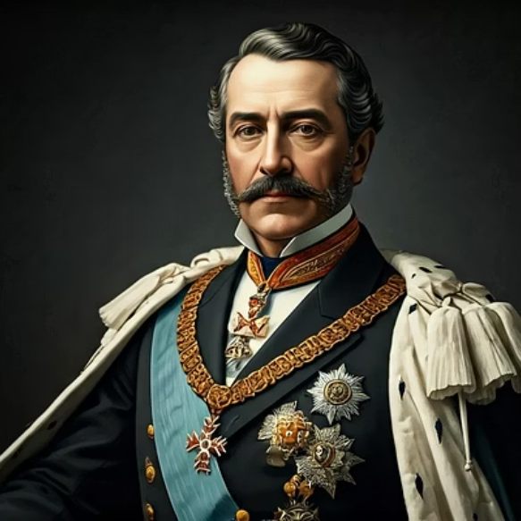

Liberalism in Brazil and the Fall of Monarchy
Brazil presented a unique case in Latin America as a stable constitutional monarchy where Emperor Pedro II, himself a philosophical liberal, gradually implemented progressive reforms. However, Brazil's continued reliance on slavery presented a fundamental contradiction with liberal principles of individual freedom and progress.
The catastrophic Triple Alliance War (1865-70) against Paraguay catalyzed profound changes in Brazilian society. The conflict fueled abolitionist sentiments as Black soldiers fought for the empire, while also triggering republican activism among military officers exposed to different political systems. The gradual abolition of slavery through the "Free Birth" law (1871) and finally the "Golden Law" (1888) undermined the economic and social foundations of the monarchy.
When the Brazilian Republic was declared in 1889, Emperor Pedro II stepped down peacefully rather than resist with force. This relatively bloodless transition marked the final triumph of liberalism as a political ideology across Latin America, though its implementation would continue to reflect contradictions regarding gender, race, and class inclusion for decades to come.

