Slide 1
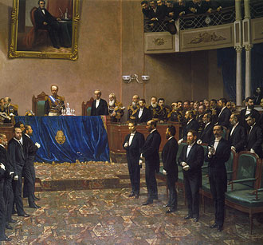
Neocolonialism in Latin America: Structure Without Sovereignty
Between 1880 and 1930, Latin America entered its "neocolonial" period—a time of deep economic, cultural, and political dependence on foreign powers, especially Britain and the United States. While politically independent, Latin American nations remained subordinated in global affairs.
Foreign investment shaped economies, cities, and governments throughout the region. Hierarchies of race and class remained largely unchanged from colonial times. Social elites emulated European culture and depended heavily on export markets, creating a system where independence existed on paper but not in practice.

Slide 2
The Great Export Boom
Latin American economies exploded with growth through commodity exports during this period—but the benefits flowed almost exclusively to elites. Each country specialized: coffee in Brazil, nitrates in Chile, sugar in Cuba, and wheat in Argentina.
Infrastructure like railroads was built specifically to serve exports, not internal development. The scale was impressive: Argentina's wheat exports multiplied 1,000-fold, while Brazil produced two-thirds of the world's coffee. Yet the vast majority of the population remained poor, landless, and disenfranchised.
Coffee (Brazil)
Nitrates (Chile)
Sugar (Cuba)
Wheat (Argentina)
Dominated global markets, creating vast wealth for plantation owners while workers lived in poverty.
Mining operations controlled by foreign companies, with minimal benefits for Chilean workers.
Created a dependent economy vulnerable to price fluctuations and U.S. control.
Exports multiplied 1,000-fold, enriching landowners while rural workers gained little.

Slide 3




Dispossession and Agrarian Capitalism
Economic modernization devastated traditional rural life across Latin America. In Mexico, railroad expansion displaced Indigenous communities, resulting in only 3% of the population owning land by 1910. This concentration of land ownership created extreme inequality.
Governments enforced vagrancy laws that forced rural laborers into underpaid work on large estates. In El Salvador and Guatemala, Indigenous people were systematically pushed onto coffee plantations, creating a captive workforce. Rural majorities couldn't influence politics due to literacy and income voting requirements.
Railroad Expansion
Displaced Indigenous communities and facilitated land grabs by elites and foreign companies
Vagrancy Laws
Criminalized unemployment, forcing rural people into exploitative labor arrangements
Plantation Economy
Indigenous communities forced to work on coffee and other export crop plantations
Political Exclusion
Literacy and property requirements prevented rural majority from voting

Slide 4






Industrial Monocultures and Foreign Control
Certain industries became completely dominated by foreign corporations, creating economic enclaves with little connection to national development. Sugar refineries controlled local economies, while mining operations were mostly owned by British and American companies.
The rubber boom temporarily created enormous wealth before collapsing, leaving devastated Amazonian communities in its wake. Perhaps most notorious was the United Fruit Company, which established "banana republics" across Central America, controlling not just agriculture but often governments themselves.
Foreign Corporate Control
Direct ownership of production and infrastructure
Political Influence
Manipulation of local governments through bribes and threats
Military Intervention
U.S. military support when corporate interests threatened

Slide 5

Urban Growth and Cultural Modernity
While most Latin Americans remained rural, cities like Buenos Aires and Mexico City modernized rapidly during the neocolonial period. Buenos Aires transformed dramatically, growing from 100,000 residents in 1852 to 2 million by 1930, becoming a showcase of European-style "progress."
Wealthy elites lived European lifestyles, consuming imported goods and constructing Paris-style boulevards and architecture. Education expanded, though slowly and unevenly, with elite sons typically studying law and politics to maintain their families' influence in government and business.
1.9M
95%
Population Growth
Hollywood Dominance
Buenos Aires growth from 1852-1930
Percentage of films shown in Latin America from U.S. by 1920
3%
Land Ownership
Percentage of Mexicans who owned land by 1910

Slide 6








Managed Elections and Oligarchic Rule
Democracy in neocolonial Latin America was largely superficial. Elections were systematically manipulated by landowners and elites who disqualified opposition votes and controlled outcomes. Most citizens couldn't vote due to property and literacy requirements, effectively excluding the majority from political participation.
Governance typically took the form of oligarchies (rule by a few elites) or dictatorships (rule by a single strongman). Elites embraced "order and progress" over democratic participation, using positivist philosophy to justify authoritarian governance as scientifically necessary for development.
Elite Agreements
Managed Elections
Powerful families and interests determine candidates
Voting restricted to literate property owners
Economic Control
Oligarchic Rule
Policies favor foreign investment and exports
Elected officials serve elite interests

Slide 7
Porfirio Díaz and the Porfiriato
Porfirio Díaz's 35-year rule in Mexico (1876–1911) epitomized neocolonial dictatorship. His regime welcomed foreign investment, built extensive railroads, and modernized cities while brutally suppressing opposition and indigenous communities. His scientific advisors, known as the Científicos, guided policy based on positivist ideology.
Under Díaz, Indigenous people were systematically pushed out of cities and even forcibly removed during national celebrations to present a "modern" image to foreign visitors. He created the rurales, a rural police force, to secure countryside areas for investors and suppress peasant resistance.
Foreign Investment
Científicos
Rurales
Díaz welcomed British and American capital, giving generous concessions for railroads, mining, and oil extraction with minimal taxation or regulation.
His positivist advisors promoted "scientific" governance, prioritizing economic development over democracy and justifying racial hierarchies.
Rural police force that violently suppressed peasant uprisings and labor movements, ensuring stability for foreign investors.

Slide 8
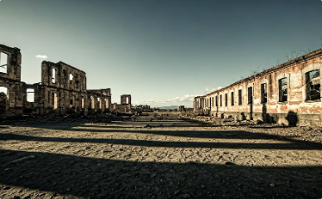

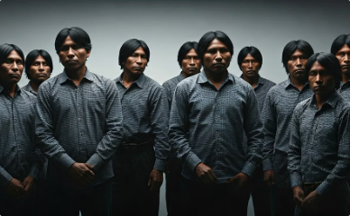
Resistance and New Voices
Despite overwhelming elite control, resistance movements emerged across Latin America. In Brazil, the holy city of Canudos resisted the republic until the army annihilated it in 1897, an event that inspired Euclides da Cunha's famous work The Backlands—exploring the tension between "civilization" and "barbarism."
New ideas, including feminism, emerged where outside influence was strongest. Pioneering feminists like Paulina Luisi in Uruguay and Bertha Lutz in Brazil led early women's rights movements, inspired by U.S. and European suffragists but adapting these ideas to Latin American contexts.
Canudos Resistance
Rural religious community that resisted government forces until its destruction in 1897, symbolizing the conflict between traditional ways of life and modernization.
Feminist Movements
Early feminist leaders like Bertha Lutz organized for women's suffrage and education rights, adapting international feminist ideas to Latin American contexts.
Indigenous Resistance
Throughout the region, indigenous communities organized to protect their lands and cultures from encroachment by expanding export economies.

Slide 9




U.S. Hegemony and the 1898 War
U.S. power gradually overtook Britain's influence in Latin America, beginning dramatically with the Spanish-American War of 1898. This conflict resulted in the United States seizing Cuba, Puerto Rico, and the Philippines, establishing its imperial presence in the region.
The Platt Amendment effectively made Cuba a U.S. protectorate, while Roosevelt's Corollary to the Monroe Doctrine provided justification for repeated U.S. military interventions across the Caribbean and Central America. These policies established U.S. hegemony that would last throughout the 20th century.
Spanish-American War (1898)
U.S. defeated Spain and seized Cuba, Puerto Rico, and the Philippines
Platt Amendment (1901)
Limited Cuban sovereignty and gave U.S. right to intervene militarily
Roosevelt Corollary (1904)
Claimed U.S. right to exercise "international police power" in Latin America
Military Interventions
U.S. forces occupied numerous countries including Nicaragua, Haiti, and Dominican Republic

Slide 10



Cultural Dependence and the End of an Era
Neocolonialism wasn't just economic—it profoundly shaped Latin American culture and identity. Cities adopted European fashion, architecture, and entertainment, while U.S. cinema dominated screens. By 1920, an astonishing 95% of movies shown in Latin America came from Hollywood, spreading American cultural influence.
Writers like Rubén Darío, José Martí, and José Enrique Rodó warned against uncritical acceptance of foreign influence, especially from the United States. However, the entire neocolonial system collapsed with the Great Depression in 1929, as demand for exports plummeted and capital flows stopped. This economic catastrophe shattered the legitimacy of oligarchies and dictatorships, setting the stage for nationalist movements to rise across the region.
Economic Collapse
Great Depression devastated export economies
Political Upheaval
Oligarchies and dictatorships lost legitimacy
Nationalist Movements
New political forces emerged across the region

