Slide 1
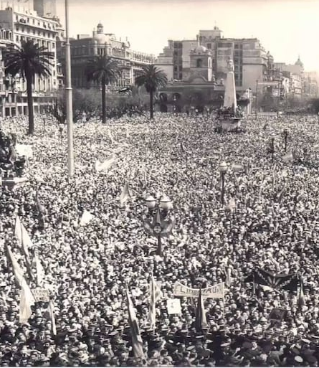
Latin American Nationalism: A New Political Identity
After 1929, a new wave of nationalism swept across Latin America, combining traditional nativist sentiments with a strong economic agenda. This movement was largely driven by middle-class, urban citizens of mixed heritage or recent immigrant descent—groups previously excluded from neocolonial elite circles.
These new nationalists directly challenged the cultural and economic dominance of Europe and the United States. They advocated for psychological independence and promoted pride in racial and cultural mixing, creating a broadly appealing platform centered on inclusion, anti-imperialism, and industrial development.
This nationalist movement ultimately provided Latin America with a shared political identity that had been missing since the fragmented independence processes of the early 19th century.

Slide 2
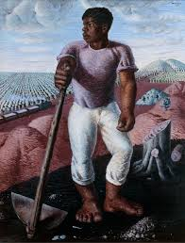
Cultural Nationalism and the Celebration of Racial Identity
Latin American nationalism embraced mestizaje (race mixing), rejecting previous elite aspirations to "whiten" the population. This cultural shift represented a decisive break from the "scientific racism" that had dominated neocolonial ideologies.
Leading artists and intellectuals like Nicolás Guillén, Alejo Carpentier, and Miguel Ángel Asturias played crucial roles in elevating Indigenous and African cultural themes in their work. Guillén's poem "Ballad of the Two Grandfathers" and Portinari's painting "The Coffee Grower" exemplified this movement, both celebrating racial hybridity as national strength.
This cultural nationalism represented a profound reimagining of national identity, one that celebrated rather than suppressed the diverse racial heritage of Latin American populations.

Slide 3
The Mexican Revolution: Blueprint for Revolutionary Nationalism
The Mexican Revolution began in 1910 as an uprising against Porfirio Díaz's 34-year dictatorship. It was led by diverse figures with different agendas: Madero, Zapata, Pancho Villa, and later the Constitutionalists.
The revolution culminated in the 1917 Constitution, which established groundbreaking nationalist principles through Article 27 (nationalizing subsoil rights including oil) and Article 123 (establishing labor rights), while limiting foreign and Church power.
1910
1917
Revolution begins against Porfirio Díaz
Revolutionary Constitution established
1
2
3
4
1911-1916
1920s-1930s
Multiple revolutionary factions fight for control
Post-revolution governments build nationalist legitimacy
Post-revolutionary governments used education, land reform, and culture to build nationalist legitimacy. José Vasconcelos and artists like Diego Rivera and Frida Kahlo became central figures in this cultural nationalist movement, creating works that celebrated Mexico's indigenous heritage and revolutionary spirit.

Slide 4
Nationalist Governments Across Latin America
Nationalist movements took different forms across Latin America, with several countries establishing governments focused on national development and sovereignty.
Uruguay (Batllismo)
Argentina (Radicals)
Peru (APRA)
Under José Batlle y Ordóñez, Uruguay became the hemisphere's first welfare state. His government implemented tariffs to protect local industry, expanded public ownership, and promoted secularism.
Hipólito Yrigoyen won power through elections, symbolizing the rise of mass politics. However, despite nationalist rhetoric, foreign capital largely remained dominant in the Argentine economy.
Founded by Victor Raúl Haya de la Torre, the APRA movement blended indigenismo with anti-imperialism. It emphasized "Indo-America" and grassroots mobilization, though it faced significant repression from authorities.
These nationalist governments represented different approaches to addressing similar challenges: reducing foreign economic dominance, expanding political participation, and creating more inclusive national identities.

Slide 5
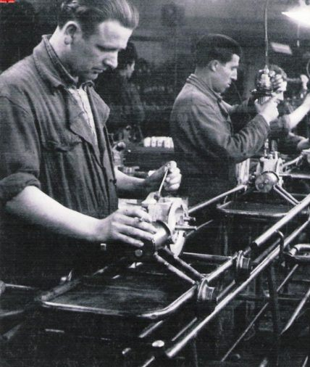
Import Substitution Industrialization: Economic Nationalism
Import Substitution Industrialization (ISI) emerged during World War I and expanded dramatically during the Great Depression. As international trade collapsed, Latin American nations—especially Brazil, Mexico, and Argentina—filled the vacuum by developing domestic industries.
ISI promoted government activism through labor laws, nationalized utilities, price controls, and state-owned enterprises. While light industry (food, textiles) grew substantially, heavy industry required major investments, particularly in steel production.
However, ISI's benefits were unevenly distributed. Urban, industrializing areas—especially capital cities and coastal hubs—saw the greatest gains. Middle-class workers, bureaucrats, and skilled laborers in these areas often enjoyed rising wages, job protections, and political inclusion through populist coalitions .In contrast, rural regions and smaller countries experienced far fewer benefits.

Slide 6
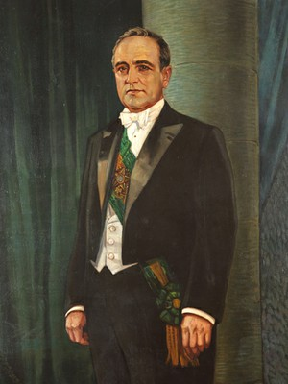



Brazil Under Vargas: The New State
Getúlio Vargas rose to power in 1930 in Brazil's "Revolution of the Ballot Box." Initially ruling as a constitutional president, he later established a dictatorship (1937-1945) under the Estado Novo (New State).
Industrialization
Labor Relations
Cultural Nationalism
Created national banks and established Brazil's first steel company
Introduced protections but banned strikes and established corporatist unions
Embraced Afro-Brazilian culture, supported samba, and backed Gilberto Freyre's racial theories
Under Vargas, cultural nationalism flourished through the works of composer Villa-Lobos, writer Oswald de Andrade, and novelist Jorge Amado. His government's policies combined authoritarian control with populist appeals and economic nationalism, creating a model that would influence Latin American politics for decades.

Slide 7






Lázaro Cárdenas: Mexico's Transformational Nationalist
As president from 1934 to 1940, Lázaro Cárdenas implemented some of Latin America's most ambitious nationalist policies. He redistributed over 45 million acres of land to peasant communities, fundamentally transforming Mexico's rural landscape.
Cárdenas actively supported labor strikes and, in his most dramatic move, nationalized Mexico's oil industry in 1938, creating PEMEX. This bold action rallied unprecedented national unity and demonstrated Mexico's economic sovereignty, receiving support even from former adversaries like the Catholic Church.
Oil Nationalization
Created PEMEX in 1938
Land Reform
Redistributed 45 million acres
Labor Support
Backed workers' rights and unions
Cárdenas symbolized grassroots nationalism with his visible commitment to the countryside and working class. His policies created a model of economic nationalism that would influence Mexico and Latin America for generations.

Slide 8
U.S.–Latin America Relations: The Good Neighbor Policy
Franklin D. Roosevelt's Good Neighbor Policy marked a significant shift in U.S. relations with Latin America, officially ending direct military interventions. This policy relied instead on symbolic diplomacy and cultural exchanges, exemplified by works like Disney's Three Caballeros and the popularization of performers like Carmen Miranda.
Cultural Diplomacy
Diplomatic Engagement
Cultural Exchange
Disney's Three Caballeros represented U.S. efforts to build cultural connections with Latin America during World War II.
Roosevelt's administration emphasized formal diplomatic relations rather than military intervention.
Brazilian performer Carmen Miranda became a cultural ambassador, though often presenting stereotypical images.
The policy allowed nationalism to flourish in larger nations with substantial economic leverage. However, the U.S. simultaneously supported dictators like Trujillo in the Dominican Republic and Somoza in Nicaragua, revealing the limits of this "neighborly" approach.

Slide 9




The Uneven Effects of Latin American Nationalism
While nationalist movements brought significant urban improvements and expanded the middle class across Latin America, their benefits were unevenly distributed. Rural areas often remained excluded from progress, shantytowns grew rapidly around major cities, and racism persisted despite inclusive nationalist rhetoric.
The success of nationalist reforms varied dramatically by country. In nations like Guatemala, El Salvador, and Nicaragua, powerful neocolonial elites and U.S. influence effectively suppressed nationalist movements, preventing the kinds of reforms seen in Mexico and Brazil.
Urban Growth
Industrial Development
Cities expanded rapidly but unevenly, with modern centers alongside growing slums
Manufacturing increased but remained concentrated in few regions
Persistent Inequality
Rural Exclusion
Social hierarchies remained despite nationalist rhetoric of inclusion
Countryside often left behind in nationalist modernization projects

Slide 10



Populist Nationalism: A Distinctive Political Style
Leaders like Gaitán (Colombia), Haya de la Torre (Peru), Velasco Ibarra (Ecuador), Cárdenas (Mexico), and Vargas (Brazil) pioneered a distinctive political approach combining mass politics with direct appeals to the poor and working classes.
This populist nationalism typically blended leftist rhetoric with paternalist leadership, creating movements that transcended traditional ideological boundaries. These leaders mobilized previously excluded groups while maintaining centralized authority, establishing political movements that would endure for generations.
Mass Communication
Direct appeals to the people through radio and rallies
Labor Mobilization
Organization of workers into state-affiliated unions
Nationalist Symbolism
Use of patriotic imagery and anti-imperial rhetoric
The populist nationalist model created a distinctive Latin American political tradition that would influence the region throughout the 20th century and beyond, establishing patterns of leadership and mass mobilization that continue to shape politics today.

